Slide 1

TDIS Production Schedule and Logistics
Antonio PERILLO MARCONE
EN-STI-TCD
TDIS Production Readiness Review – 08/03/2018

Slide 2
Main Steps

Slide 3
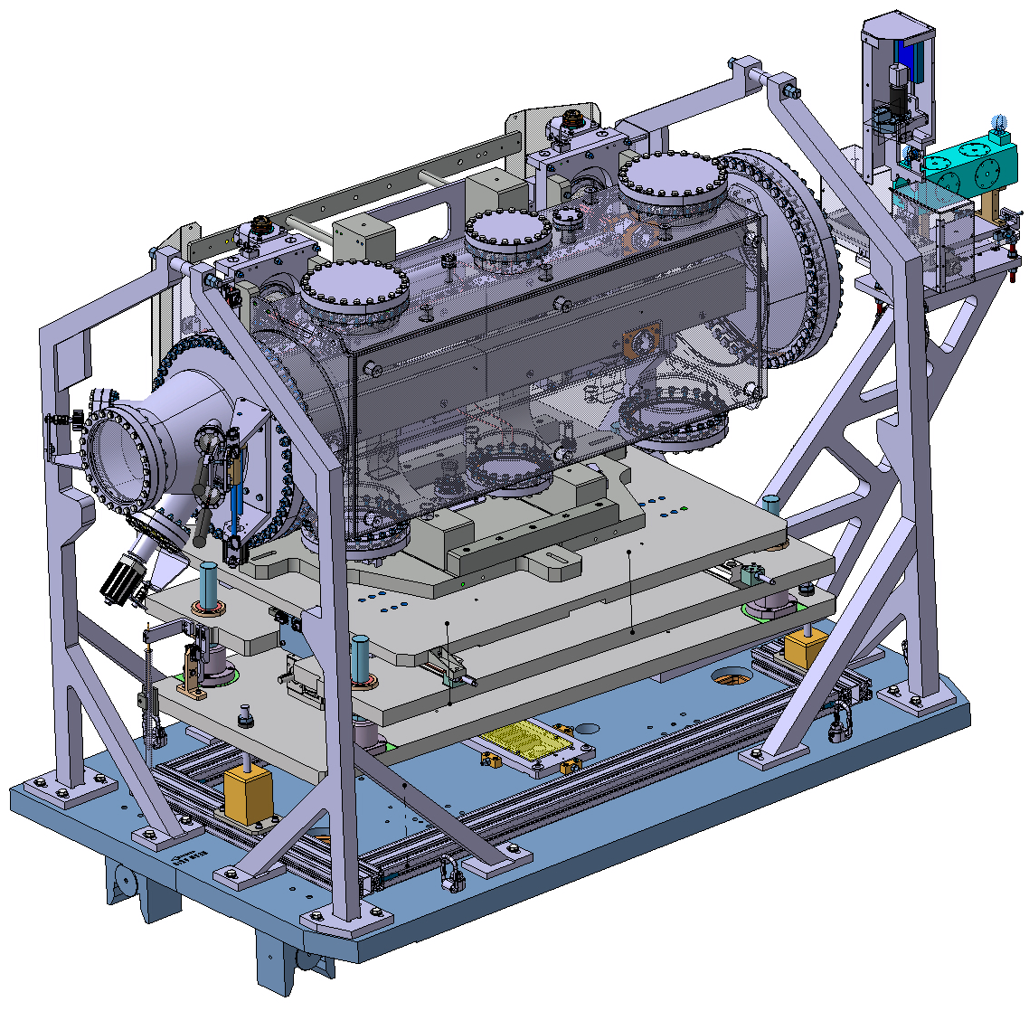
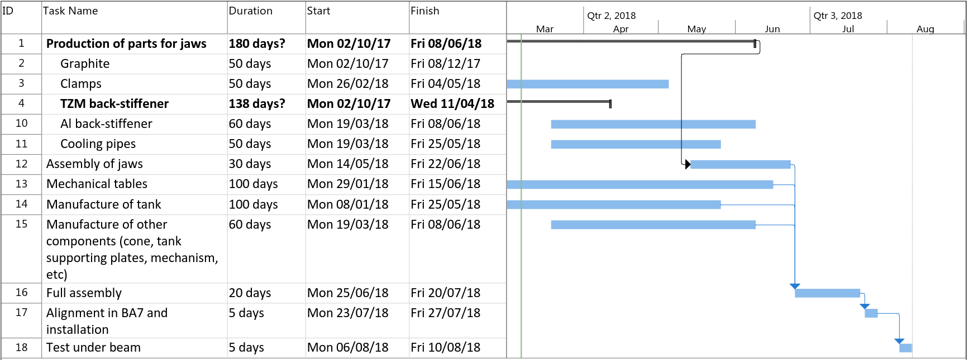
HiRadMat Preparation
Assembly May – July 2018
Requirements:
A marble for assembly of jaws
Crane (> 1t)
>50 m²
Teams involved
EN-STI
EN-SMM
EN-MME
TE-VSC
EN-HE
EN-EA

Slide 4
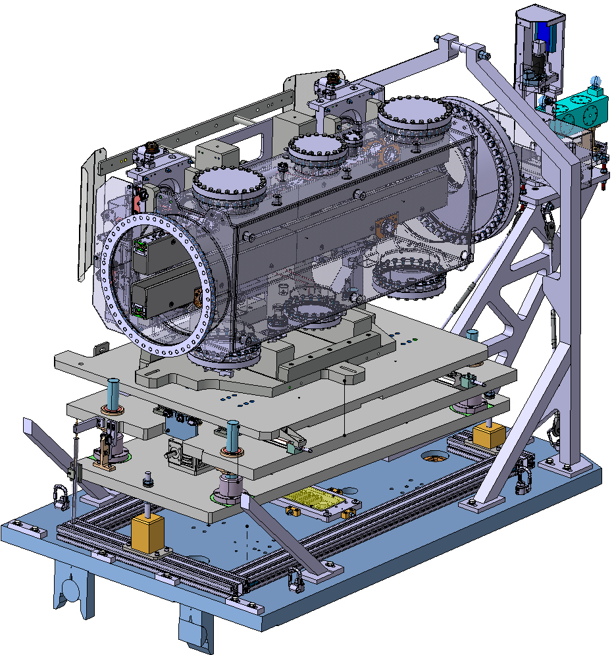
HiRadMat Goals
HRMT45 necessary to:
Test one full module of TDIS under beam impact (pre-prototype)
Validate integral jaw robustness for large impact parameters
Confirm that TZM back-stiffener (baseline) withstands loads
Test AW-2219 back-stiffener (back-up option)
Back-stiffener responsible for straightness of the jaw -> vital for TDIS performance!

Slide 5
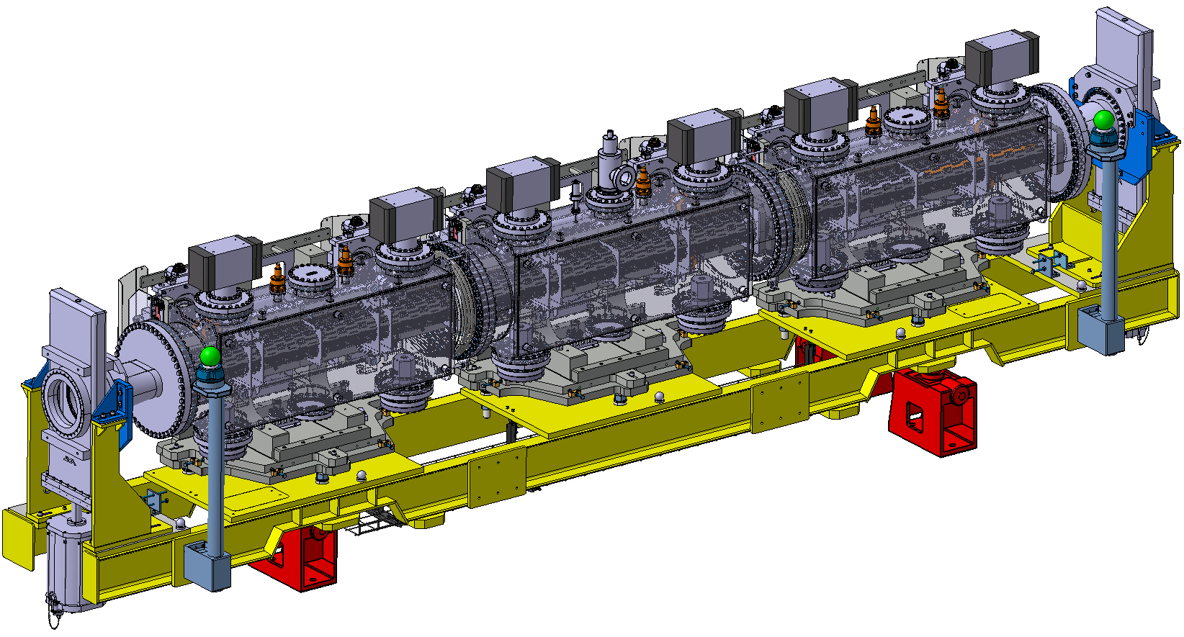
Prototype TDIS assembly

Slide 6
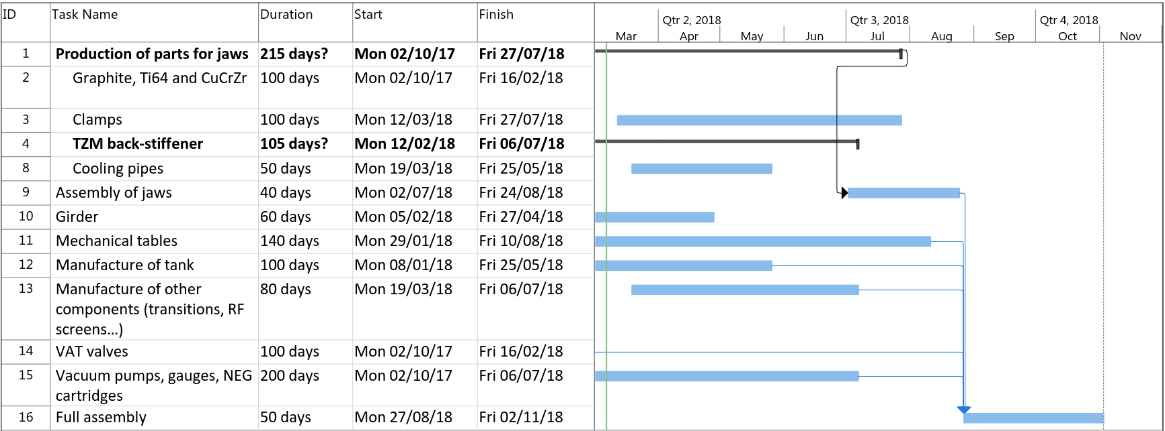
Prototype TDIS assembly
Assembly July – Oct 2018
Requirements:
Clean room
  A marble for assembly of jaws
  Crane (> 3t)
  >100 m²
Teams involved
EN-STI
EN-SMM
EN-MME
TE-VSC
EN-HE

Slide 7
Tests on prototype TDIS
Test | Location | Time | Resources
Straightness of jaw | Clean room | Jul-Aug 2018 (After jaw assembly, before insertion in tank) | EN-STI EN-MME EN-SMM
Alignment of modules | Clean room / metrology lab | Sep-Oct 2018 | EN-STI EN-MME EN-SMM
Jaw positioning | Clean room | Sep-Oct 2018 | EN-STI EN-SMM
Impedance measurements | Clean room | Nov 2018 | EN-STI EN-ABP
Vacuum tests (RGA, bake-out) | 867-R-P49* | Dec 2018 – Feb 2019 | TE-VSC
Storage (further tests?) | 867-R-P49* | 2019 – 2020
* Not fully suited, should not be used for non-radioactive equipment

Slide 8
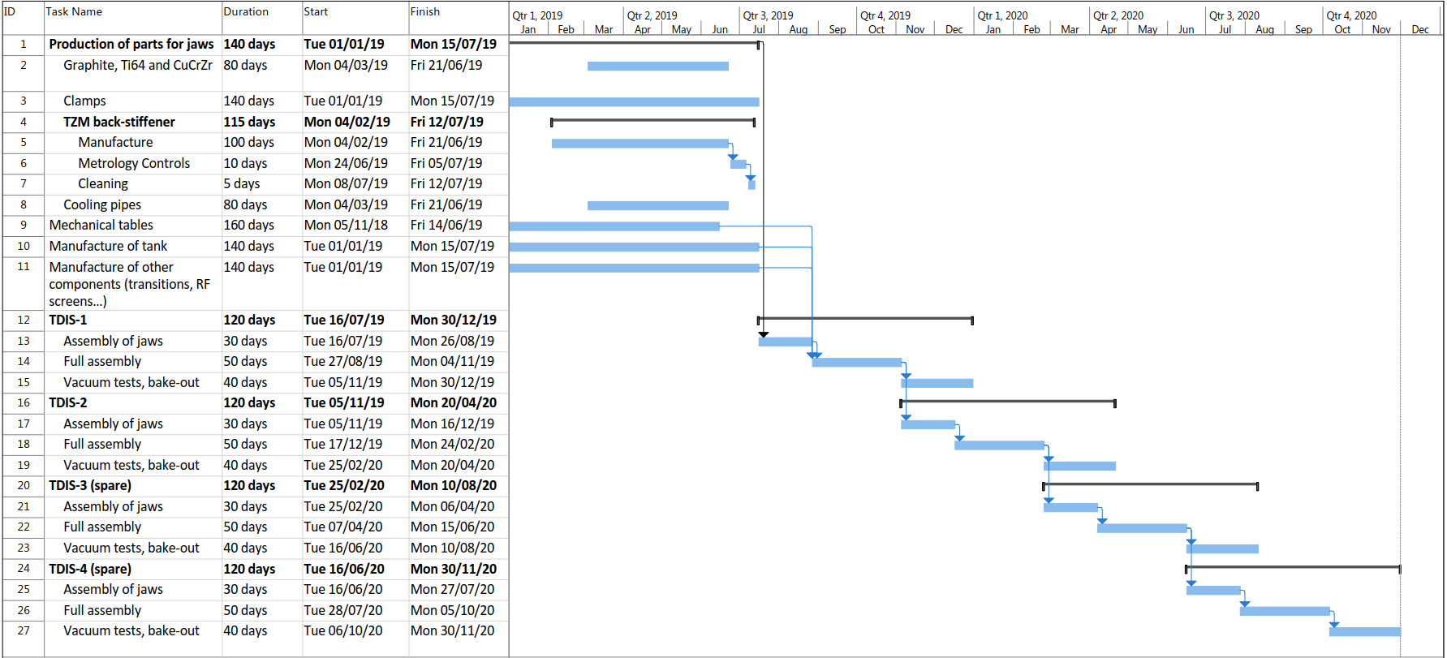
TDIS assembly
Assembly period

Slide 9
TDIS assembly
Assembly July 2019 – Dec 2020
Requirements:
Clean room
  A marble for assembly of jaws
  Crane (> 3t)
  >100 m²
Space for vacuum conditioning and temporary storage
  Power supply for bake-out
  Crane (> 3t)
  >100 m²
Teams involved
EN-STI
EN-SMM
EN-MME
TE-VSC
EN-HE
To date, assembly space not available.

Slide 10
Infrastructure Requirements
Activity | Features | Time Required | Possible Options
Temporary storage of components and assembled TDIS | Secure Adapted to large, heavy equipment Lifting means > 100 m² | Mar 2018 – Dec 2020 | b.927 to be freed so that EN-STI workshop moves out of 867, and the existing area could be used for assembly.
Clean Assembly | “Clean” environment A marble for assembly of jaws Crane (> 3t) > 100 m² | May 2018 – Dec 2020 | Modular “containers” to produce a clean environment. To be installed in b. 867 after moving the STI workshop.
External operations (tanks closed) Vacuum conditioning | Power supply for bake-out Crane (> 3t) > 100 m² | Oct 2018 – Dec 2020 | b. 867 after moving STI workshop.

Slide 11
Conclusions
Production for HRMT and prototype under way
Tight schedule for HRMT but feasible
Prototype to be assembled and tested from mid 2018
Final devices will be ready for installation as required (May-June 2020)
Significant resource investment from different groups
Appropriate assembly and storage space required as of 2018

Slide 12
Thank you

