Slide 1


Introduction to the Meeting
Wolfgang Lohmann, BTU, DESY and RWTH
FCAL workshop Krakow, May 2018

Slide 2
Mission of FCAL
R&D for technologies to measure the luminosity at e+e- colliders
Develop concepts for luminometers installed in different detector designs
Optimise the performance of luminometers using Monte Carlo techniques
Construction of prototypes of major components
mechanics
sensors
FE electronics
Readout
alignment
Performance studies in test-beams- proof of priciple

Slide 3
Linear e⁺e⁻ Collider
Currently discussions to prepare the European Strategy
In Germany several workshops happened. A summary was given beginning of May. Major statements (not for public yet)
Full exploitation of the LHC (including HL LHC)
Full support for BELLEII
An e+e- collider with at least 500 GeV is of highest priority in the future
About ILC: wait for the recommendation of the MEXT committee. Hitoshi may inform us about the latest news.
About CLIC: Konrad will inform us.
We should be prepared for both projects

Slide 4
Circular e⁺e⁻ collider
There are new circular collider projects coming up:
CEPC Project in China (Ivanka will report)
FCC at CERN (talk in Belgrade by Mogens Dam)
Questions we may ask:
Which are the requirements there?
Are there interesting technological developments?
Can we use synergies ?
Will new people join us?

Slide 5
Possible engagement at LHC
Luminosity, beam optimisation, radiation monitoring
will play an important role at HL-LHC
Systems should be independent on power/readout of the detectors
On-line bunch-by-bunch luminosity with high precision in short time slots
At least two independent luminosity systems per experiment
Technologies we developed may be applied for these purpose. For students it might be interesting to appply the acquired expertise in a running experiment
Paul and Witold will tell us more details about plans at ATLAS and CMS

Slide 6
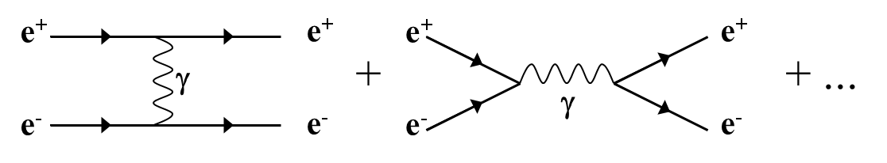
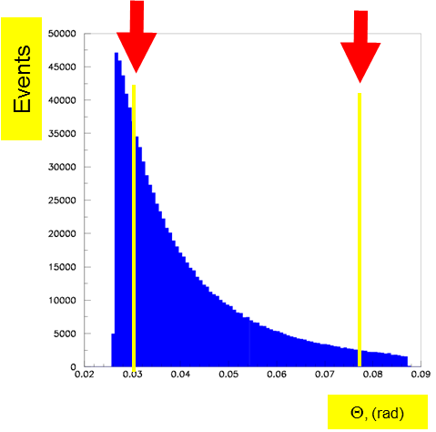
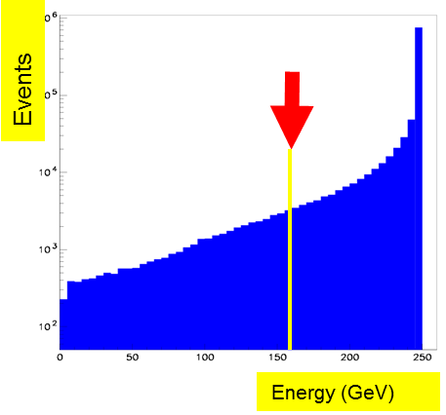
Bhabha Scattering
Bhabha scattering at low polar angles is used as a gauge process
e⁺e⁻ e⁺e⁻ (γ)
L = N / σ
Count Bhabha events
From theory

Slide 7
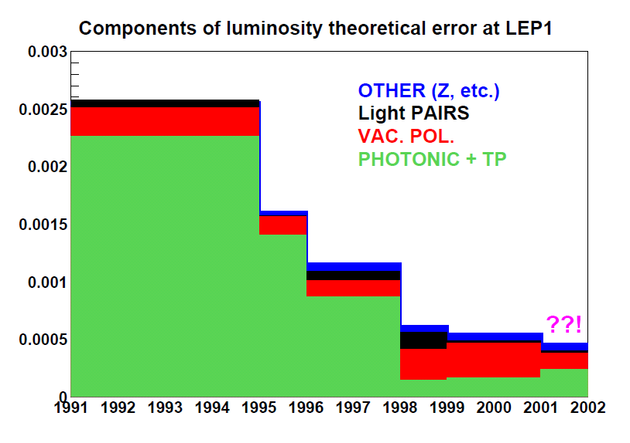
Bhabha Scattering
Theory uncertainties in the Bhabha cross section at LEP1 (S. JADACH, FCAL workshop Cracow 2006):
There is a lack of MC generators optimized for higher energies. Activities e.g. in JINR and University of Minsk may be interesting for us for application

Slide 8
FCAL specific issues
Major Topic: detector prototype for beam tests
(2019/20)
Sensors (available, but to be qualified)
Absorber planes (available, but need mechanical integration)
Detector plane (technology under developement)
ASICs (to be produced)
DAQ with FPGA in preparation
Laser alignment?

Slide 9
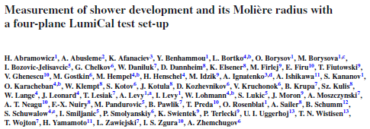
FCAL specific issues
Publications
  Presence on conferences was very good.
  Future topics?
  One publication in
  „The European
  Physical
  Journal C“
  New paper on irradiation studies
Never finished topics
  Calibration and alignment with muons (MC to be done)
  CLIC timing, FE, readout, background → impact on performance
  BeamCal/LumiCal performce in the new ILD software

Slide 10
FCAL specific issues
67 authors

Slide 11
FCAL specific issues

Slide 12
FCAL funding
Europe
  National funding Agencies
  AIDA 2020 (2020)
  current JINR-BMBF program ends 2017, new application written, pending
Chile
  Angel got a grant
US ???
Japan ???
Particularly difficult in some eastern Europe institutions
Effort needed!!!!

Slide 13
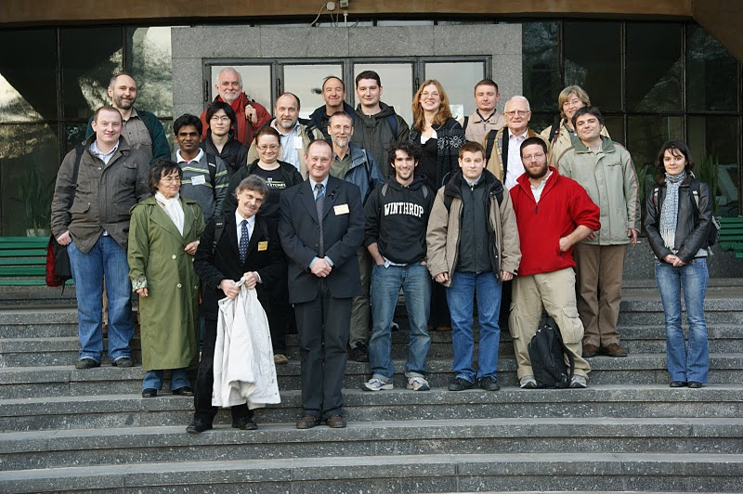
Tribute to Leszek

