Slide 1
Toward a new Treatment Planning Approach accounting for in-vivo proton range verification
Ludwig-Maximilians-Universität, München
Liheng Tian

Slide 2
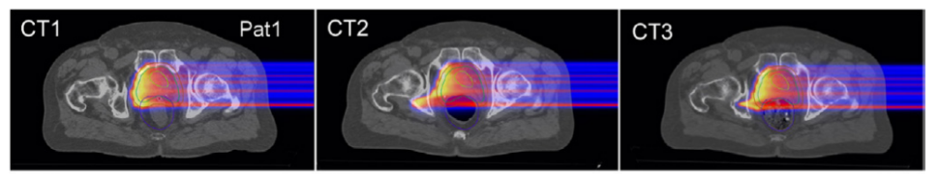
Introduction
Proton range uncertainties
CT number conversion
Anatomical changes
Patient set up
…

Slide 3

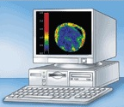
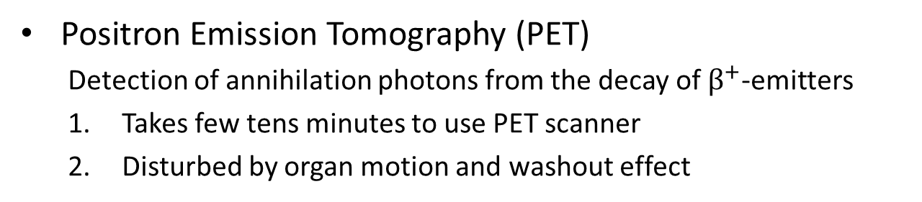


Introduction
In-vivo proton range verification
Positron Emission Tomography (PET)
  Detection of annihilation photons from the decay of $β^{+}$-emitters
  Takes few tens minutes to use PET scanner
  Disturbed by organ motion and washout effect
$$β^{+}$$
Beam path
Detector
Detector
γ
γ
$$e^{−}$$
Correlator

Slide 4
Introduction
In-vivo proton range verification
Prompt Gamma (PG) Imaging
  Monitor the Prompt Gamma emitted by nuclear de-excitation of nuclei in the beam path
  Fast (within nanoseconds)
  Better PG-dose signal comfirmation
  Higher gamma production rates
  Clinical experiment shows that the retrieval precision of 2mm can be achieved
Beam path
Prompt gamma
Detector

Slide 5
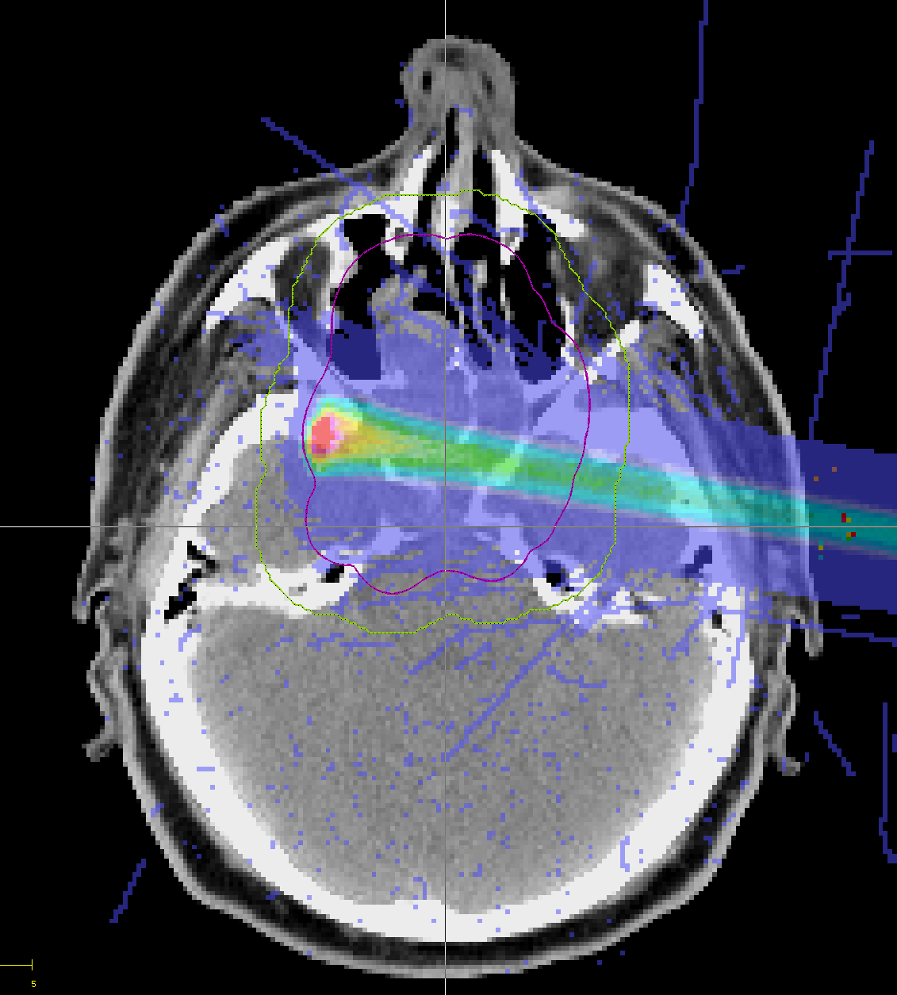
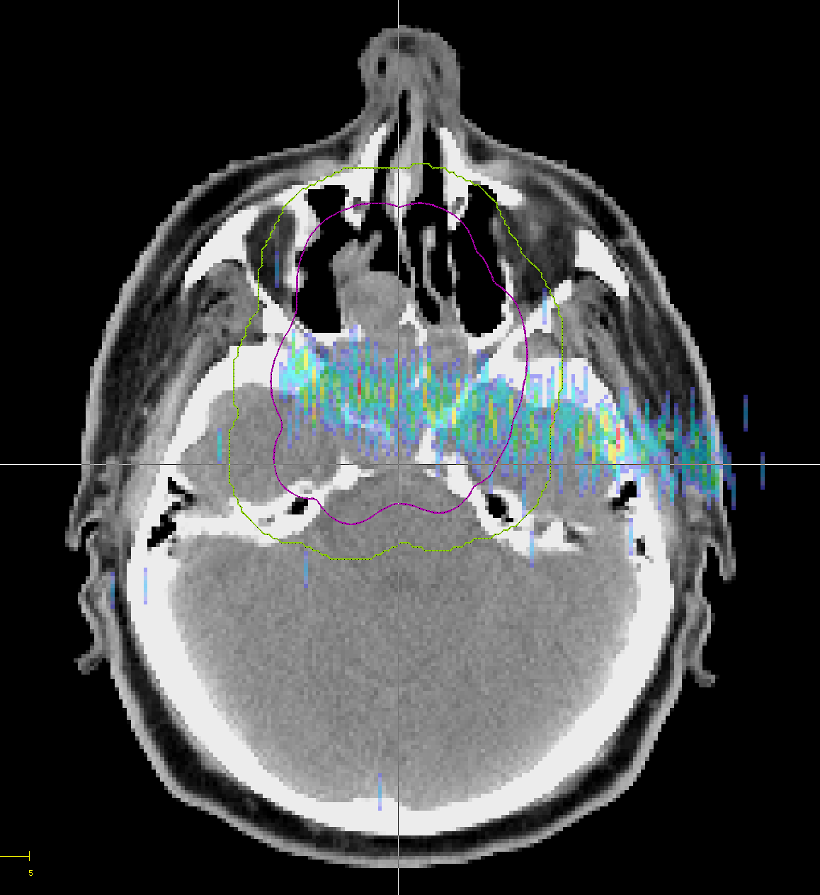
Introduction
Dose delivery
PG emission

Slide 6
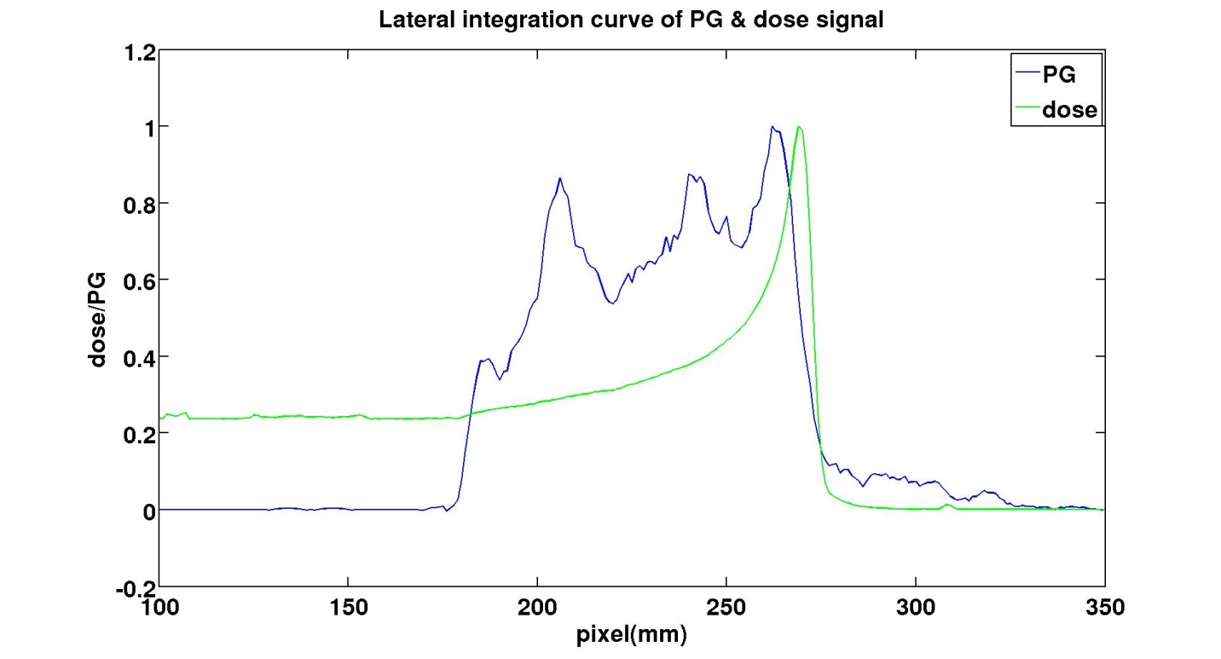


Introduction
Ideal PG & dose profile
Fall-off region
Lateral integration of PG & dose signal
c: Fall-off position
1/b : Fall-off slope
$$F\left(x\right)=a+\left(1−a\right)erf⁡[b(x−c)]$$
$$F\left(x\right)=a+\left(1−a\right)erf⁡[b(x−c)]$$

Slide 7
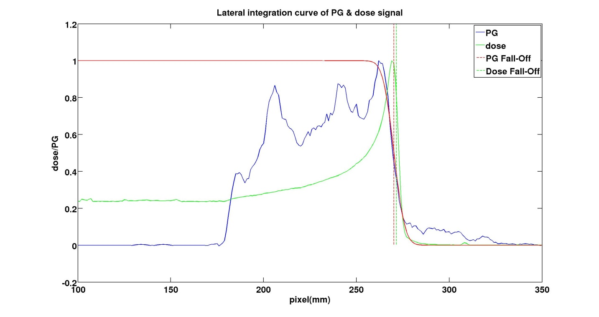

Introduction
Ideal PG & dose profile
$$dR=−1.30 mm$$
Lateral integration of PG & dose signal
Distance between PG and dose fall-off position:
dose: distal 80% dose fall off
PG : fitting function

Slide 8
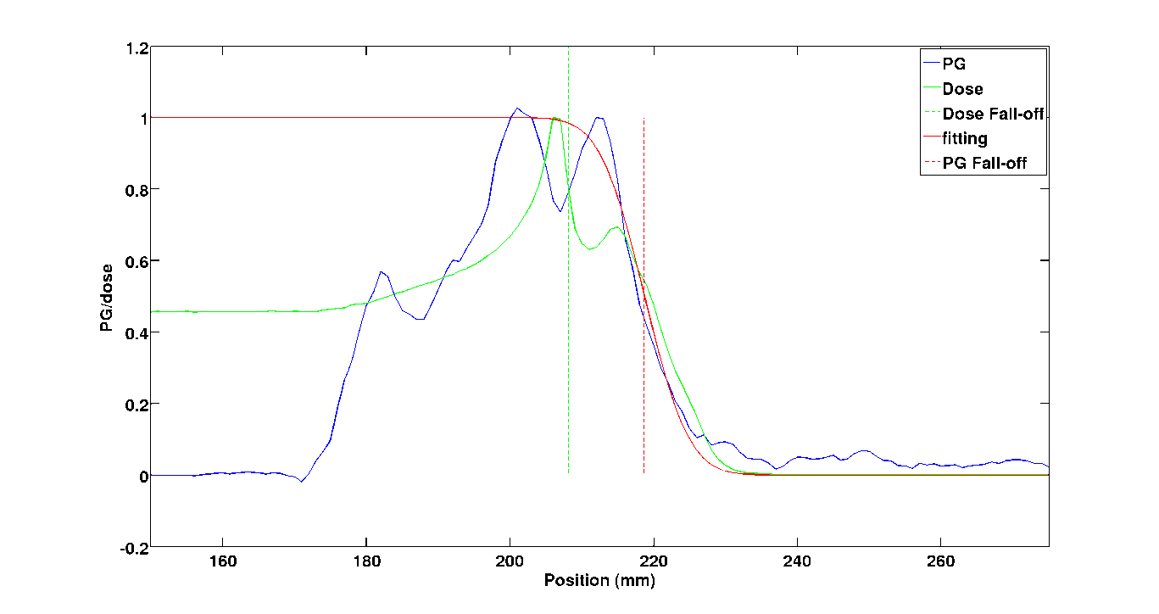

Introduction
However, the correlation between PG and dose signal is not always good
$$dR=−8.6 mm$$
Lateral integration of PG & dose signal

Slide 9
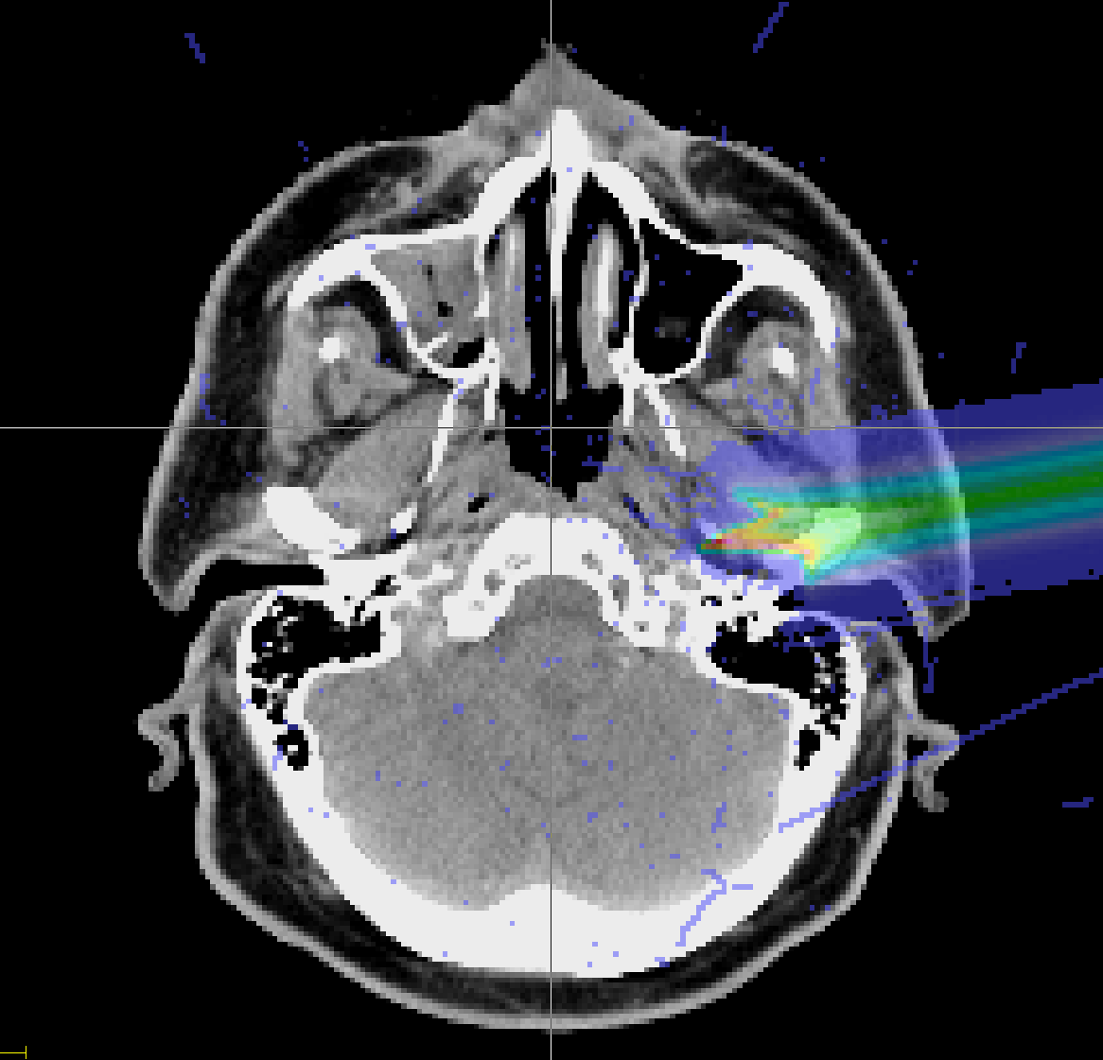
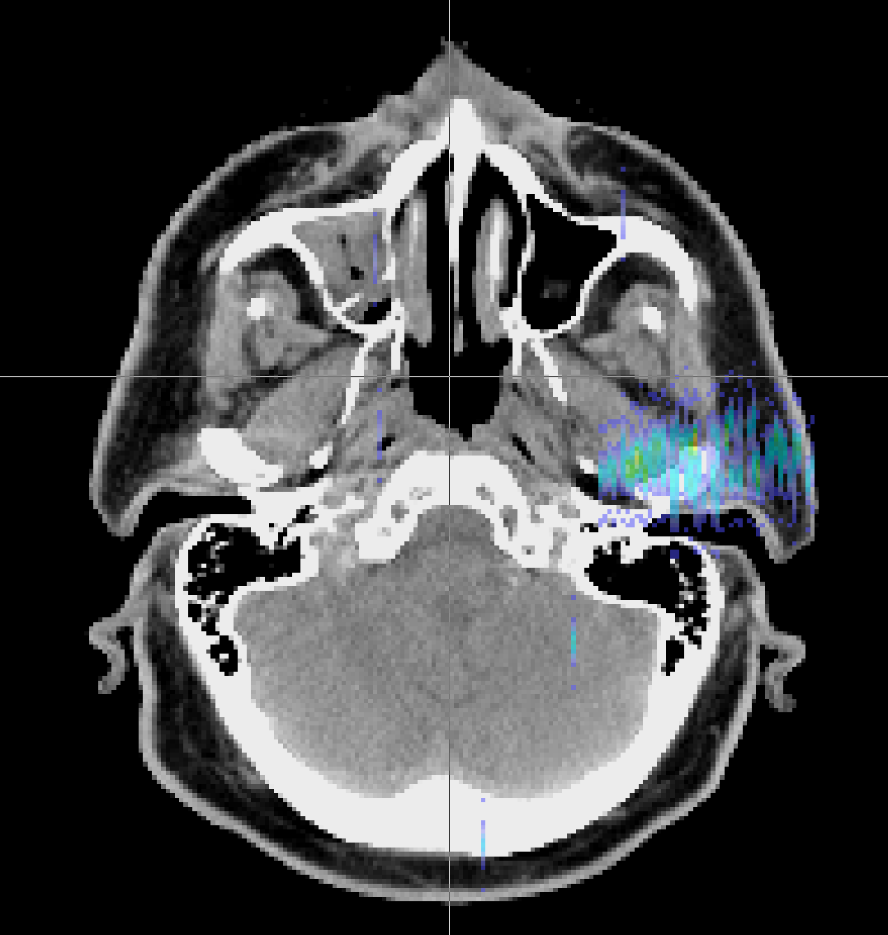
Introduction
Reason
  Tissue inhomogeneity (bone/air in beam path)
Dose delivery
PG emission

Slide 10
Introduction
The PG-dose correlation of individual pencil beam (called subPB in the following) is not considered in current treatment planning system (TPS)

Slide 11
Goal
Goal of my study:
  Optimize current TPS system, accounting for in-vivo proton range verification to enable a reliable treatment monitoring

Slide 12
Method
Quantify and identify the degree of ‘PG-dose correlation’ for each subPBs
Criteria:
Distance between the Fall-off positions of PG & dose profile (dR)
Slope of the PG signal Fall-off region (1/b)
Fitting quality (Sum of squared errors, SSE)

Slide 13
Method
Example:
Ideal case:

Slide 14
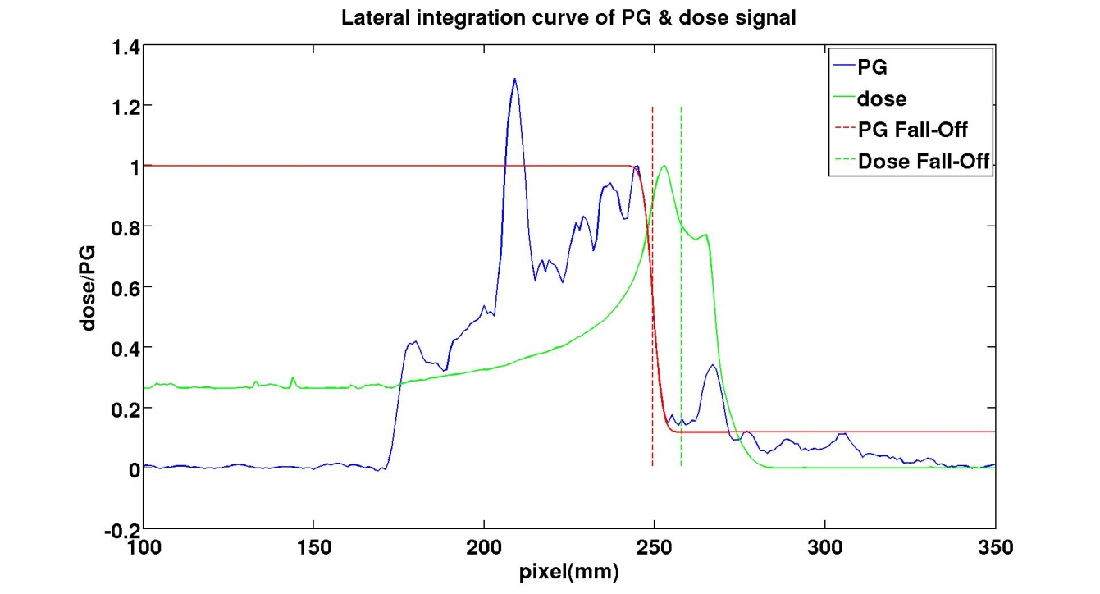
Method
Example:
Poor correlation case 1:
dR
Large dR relates to poor correlation directly
A secondary peak, relating to an air cavity, leads to high SSE value

Slide 15
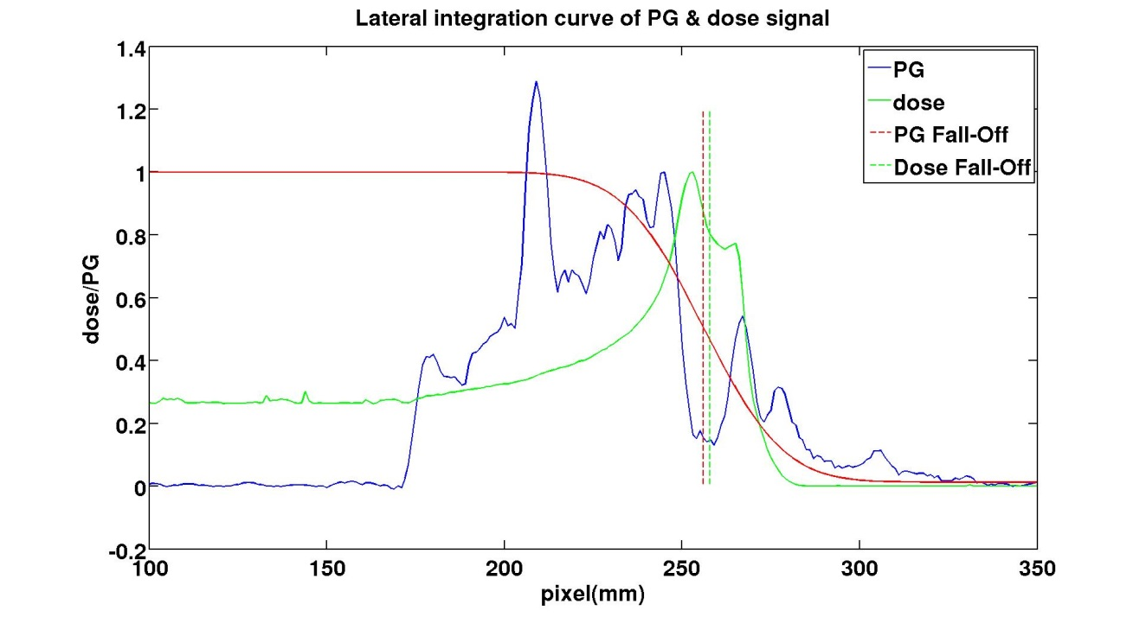
Method
Example:
Poor correlation case 2:
A shallow slope related also to an air cavity, causing the failure of fitting

Slide 16
Method
Quantify and identify the degree of ‘PG-dose correlation’ for each subPBs
Improve the initial treatment plan while maintaining the quality of plan

Slide 17
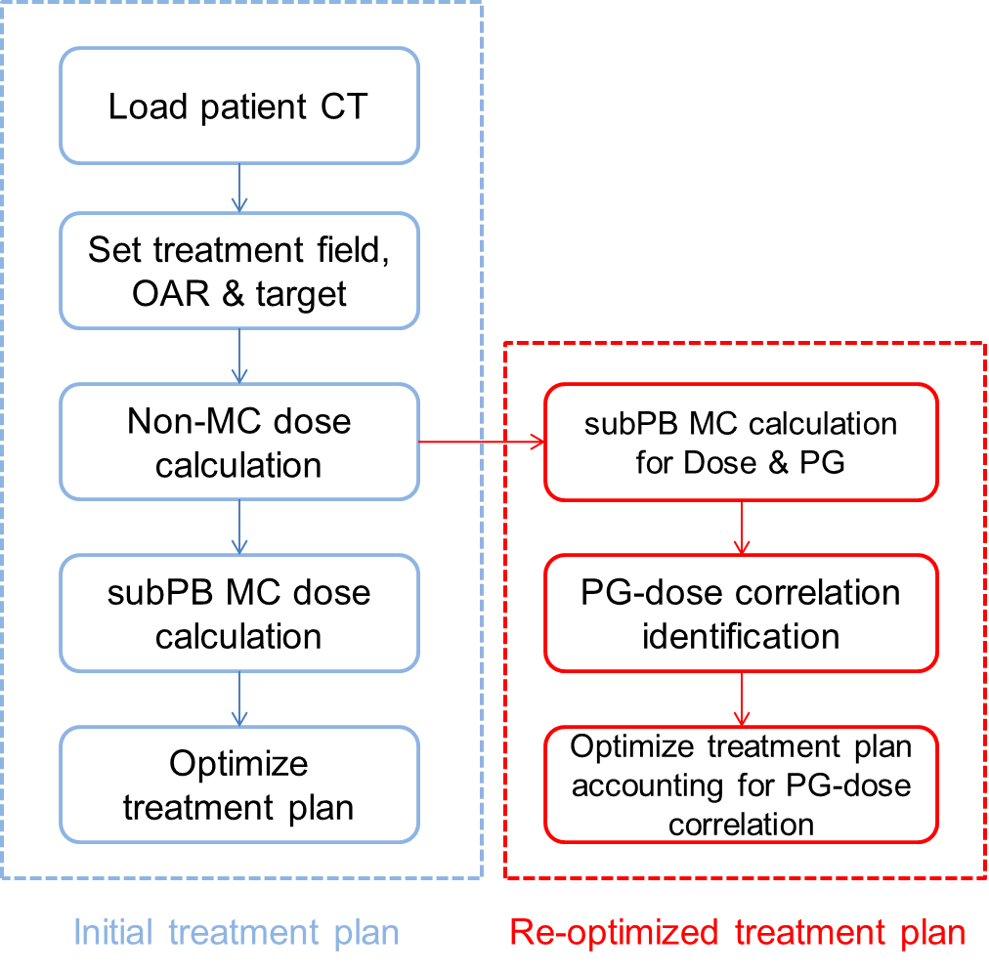
General workflow of CERR TPS and our improved TPS:

Slide 18
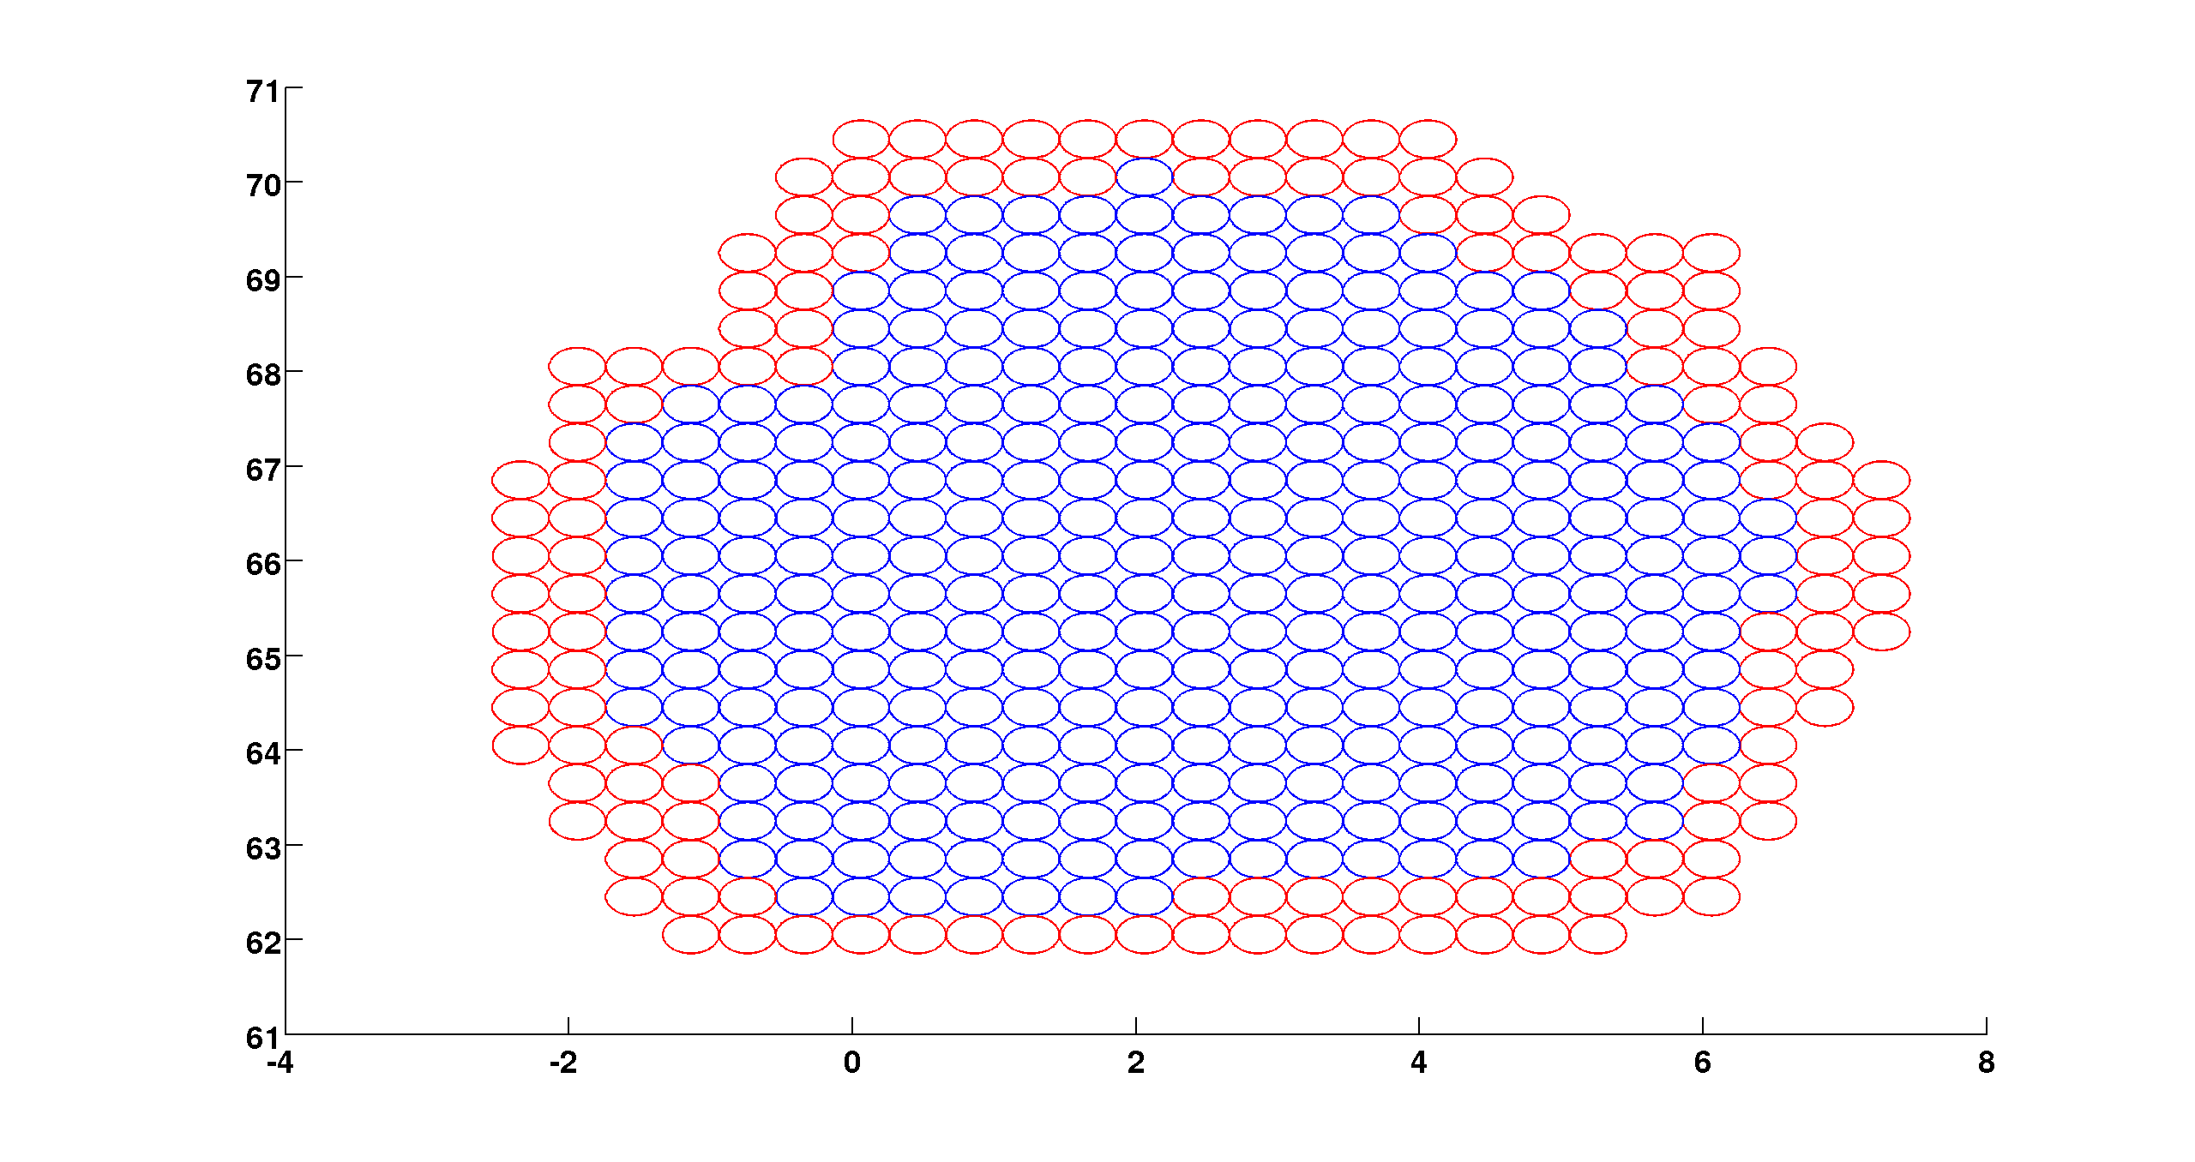
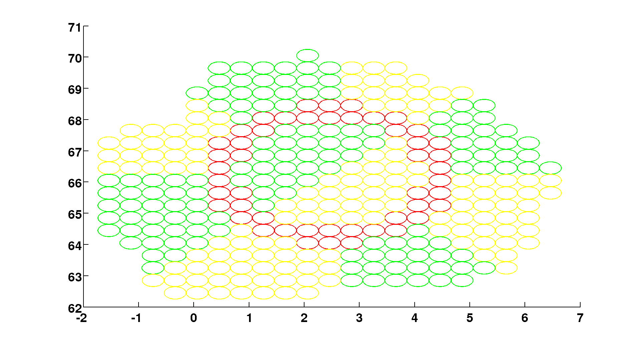
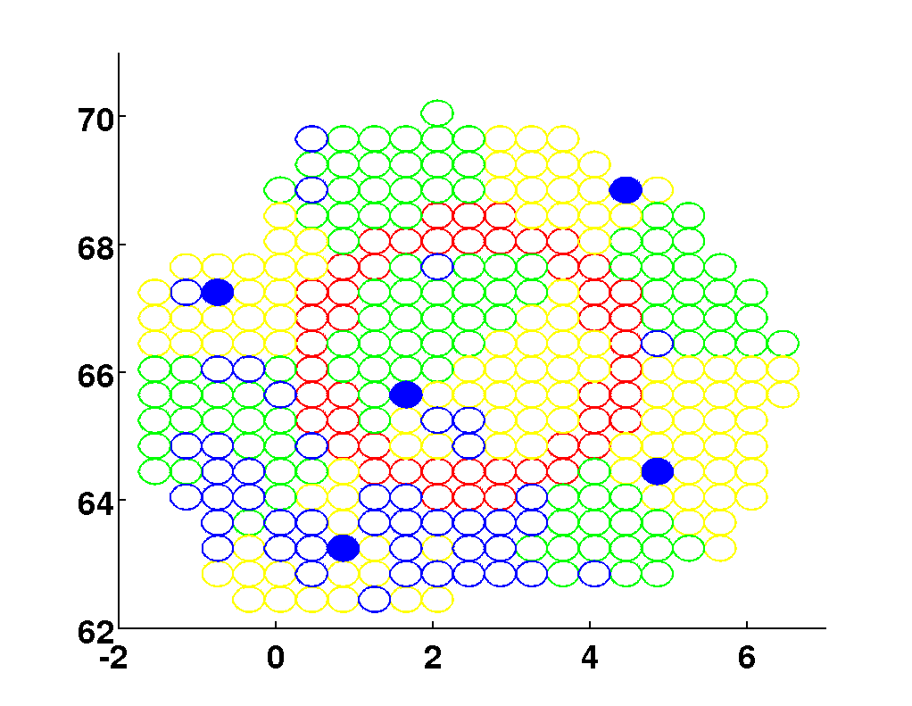
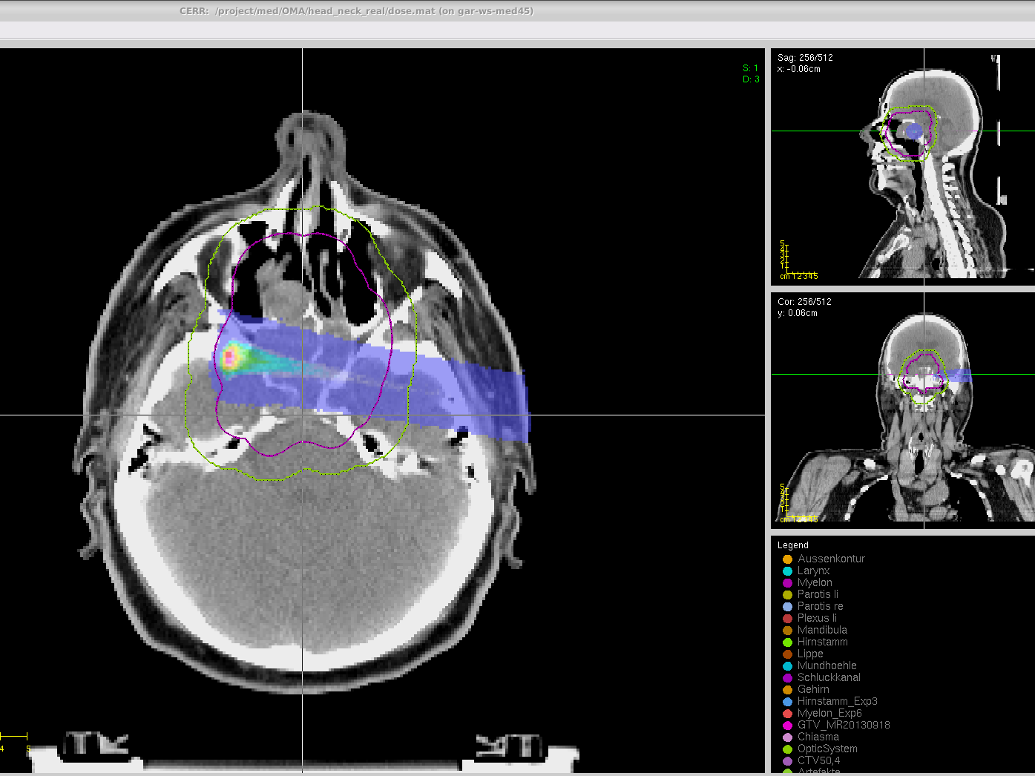
Method
Boost few subPBs which have the best PG-dose correlation
A
B
C
D

Slide 19
Result
Dose delivery
PG-dose correlation

Slide 20
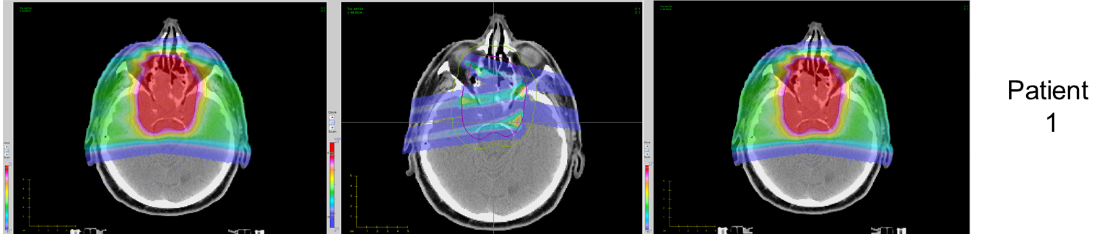
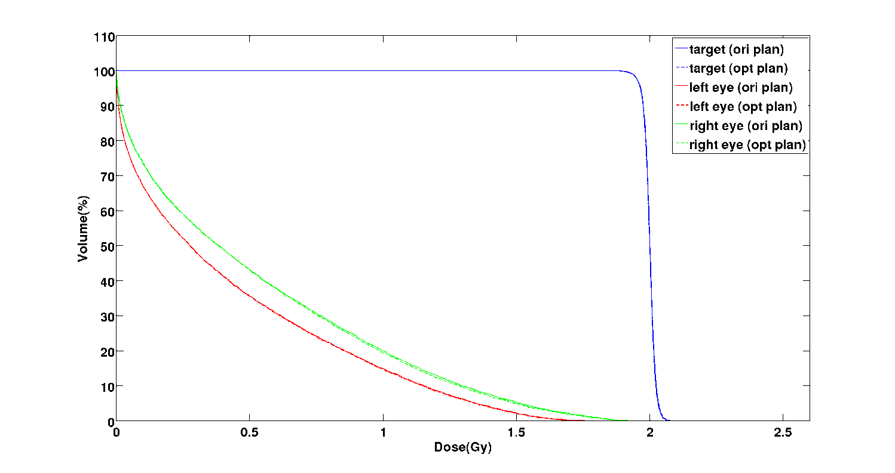
Dose delivery

Slide 21
Result
Dose delivery
PG-dose correlation

Slide 22
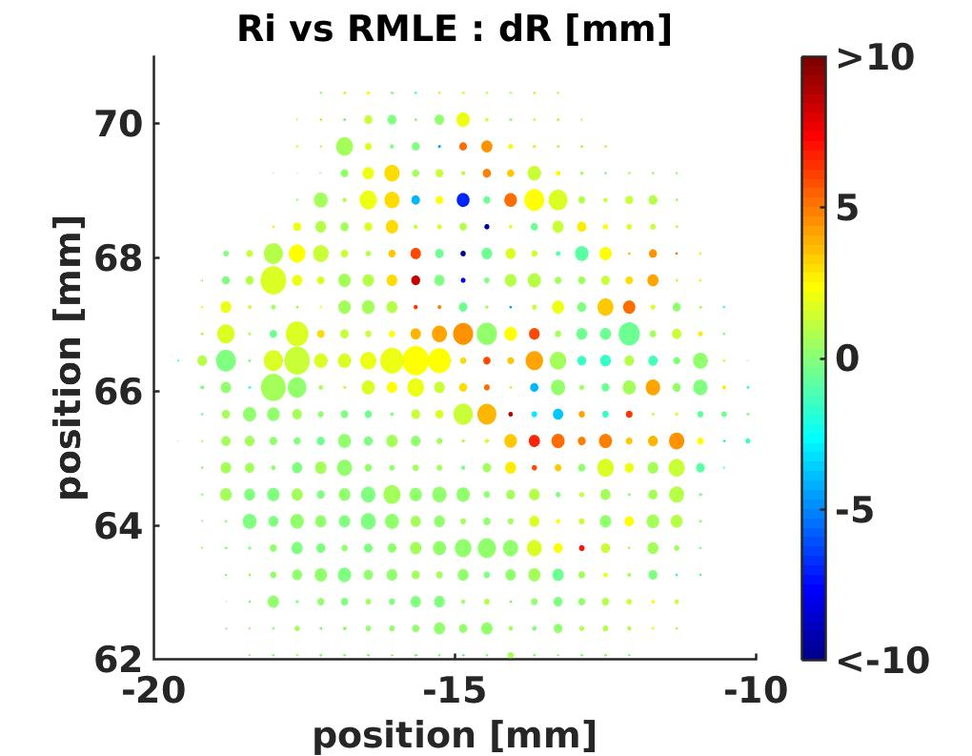
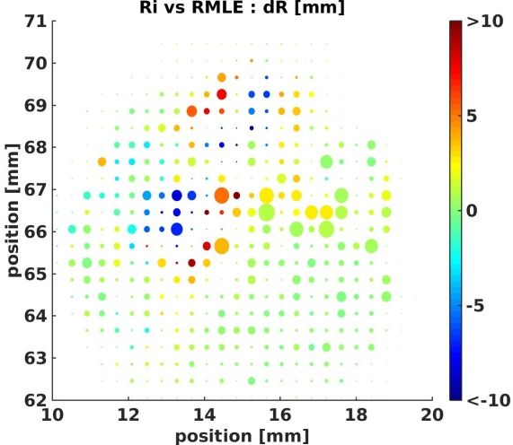
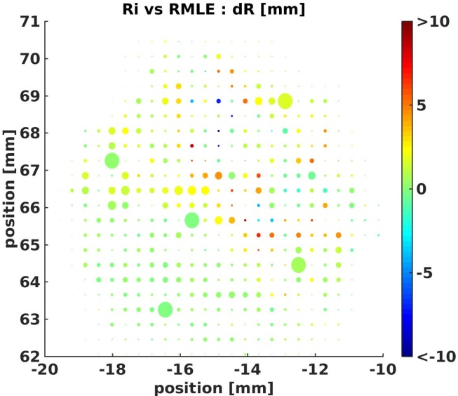
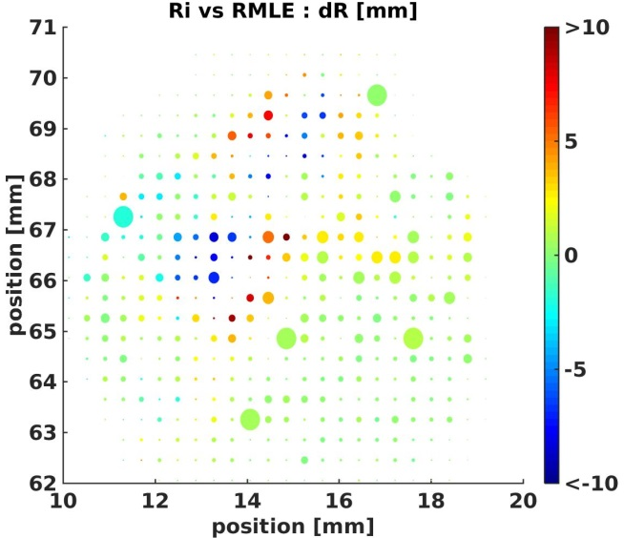
PG-dose correlation
Beam’s eye:
The color shows the PG-dose correlation and
The spot radius is linearly proportional to the proton number

Slide 23
Result
Currently, our new approach is able to:
Quantify and identify spot-by-spot PG dose correlation automatically in a MC treatment planning process
Provide the user with candidate subPBs which have reliable PG-dose correlation
Optimize a treatment plan which is comparable to the initial treatment plan in terms of dose distribution. Besides, few high-intensity subPBs in the new plan could provide reliable in-vivo proton range verification

Slide 24
Future work
MC treatment plan is time-consuming, especially when more protons are needed to generate enough PG emission
Detection devices signal is different from PG emission
Robustness of PG-dose correlation considering anatomical change and different uncertainties
Combine state-of-the-art CBCT, DECT

Slide 25
Conclusion
Though different issues are still needed to be addressed, with the results of this project, the treatment planning process in proton therapy could be improved, by integrating the PG-based in-vivo monitoring of the beam range
This novel approach could lead to a safer and more controllable proton treatment in the future

Slide 26
Thank you!

