Slide 1

Light ion therapy software for data exchange
Carlos Afonso
Horizon2020 Marie Skłodowska-Curie Grant Agreement No 675265

Slide 2
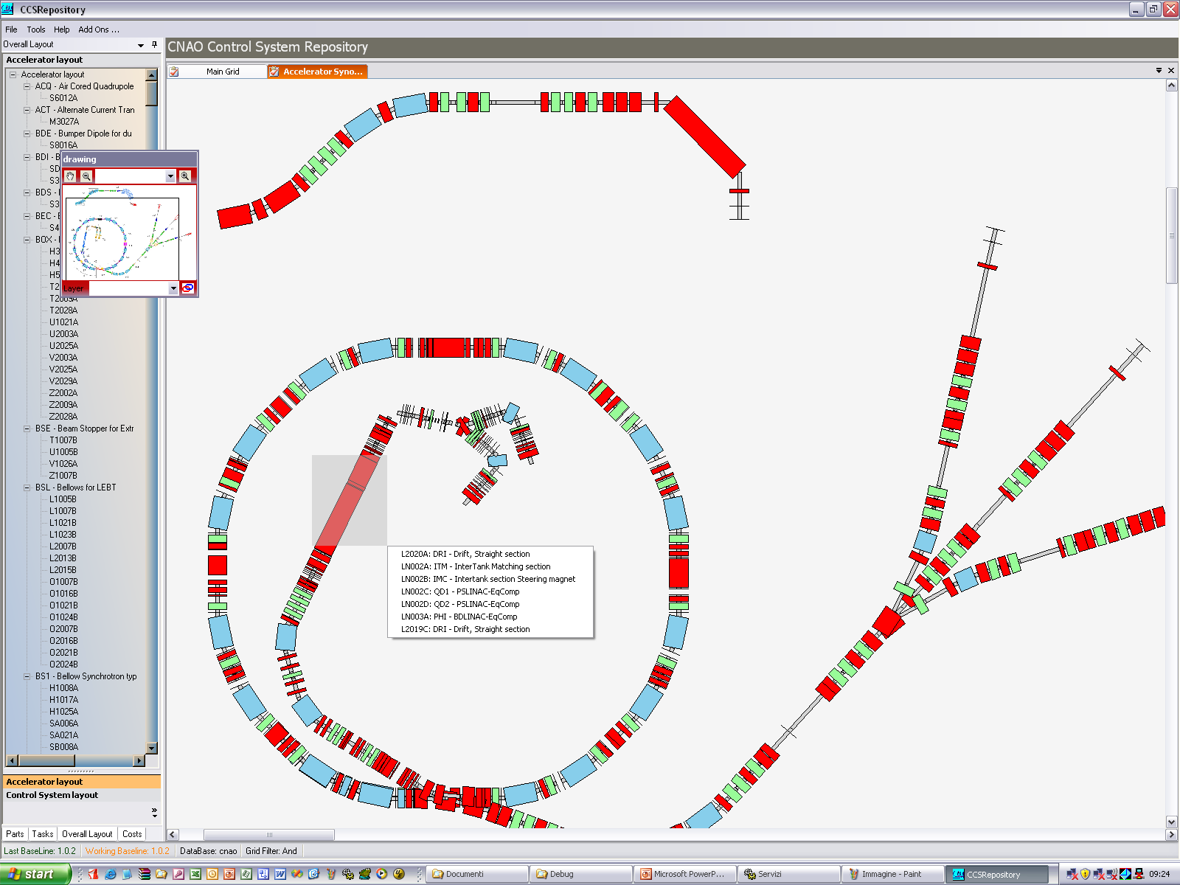
Accelerator control system
Developing a medical accelerators require expertise in many areas
The accelerator’s control system is the software that controls and monitors the accelerator

Slide 3
The Accelerator as a Complex Medical Device
Dose Delivery
System
Treatment Delivery
System
Patient Safety
System
OIS
TCL
QA
PIS
PPS
PVS
OTS
Control System
Accelerator Complex

Slide 4
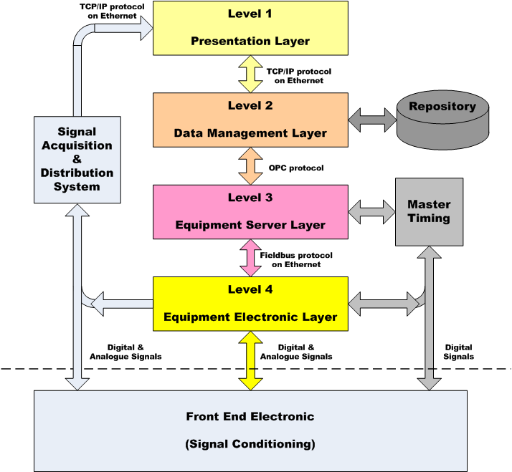
Control System Conceptual Model
Several application scopes
Several protocols: OPC(s), TPC/IP, analogue signals
Several languages: LabView, WinCC, C#, proprietary component languages

Slide 5
Applications and support services
Applications and support services
Data management and processing services
Specialized end user monitoring applications
Initial system configuration
Currently more than sixty software applications

Slide 6
Project objectives
Environment for creation of future projects
Adapting several existing modules to be compatible with newer development environments
Addition of mobile devices to the control system
Ensure compatibility, and allow slow phase out of current environment applications
A framework to standardize data access, security requirements, and presentation
Development of flagship applications using this new framework

Slide 7
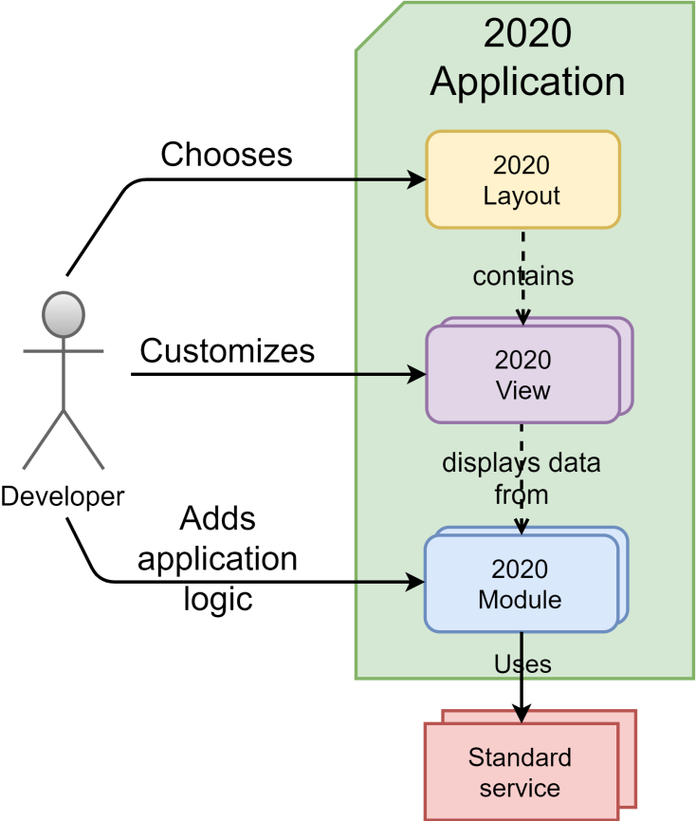
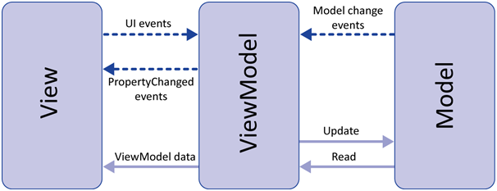
Framework for developing applications
Framework defines how control system’s applications function
Provides the developer with a base application layout, and standardized access to services

Slide 8
Model-View-ViewModel
MVVM is an architectural pattern
    Separation of presentation level logic (view) from the business logic (model) of an application
    One way dependencies
    If required, a new view can be developed without changing the model

Slide 9
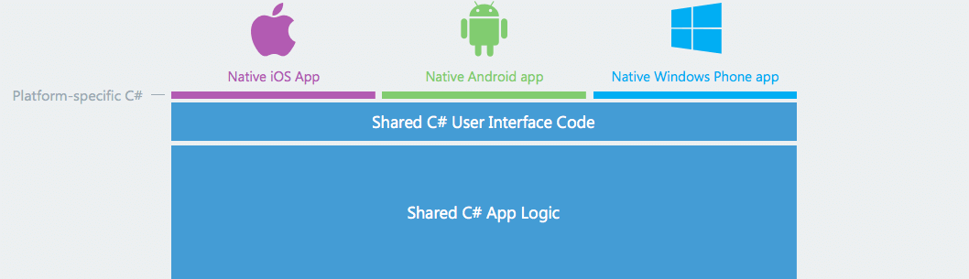
Addition of mobile devices and applications
Objectives:
  Monitoring of control system equipment
  Creation of applications to aid the medical doctor, in tasks such as obtaining patient information and ongoing treatment status
Challenges:
  Security
  Maintainability

Slide 10
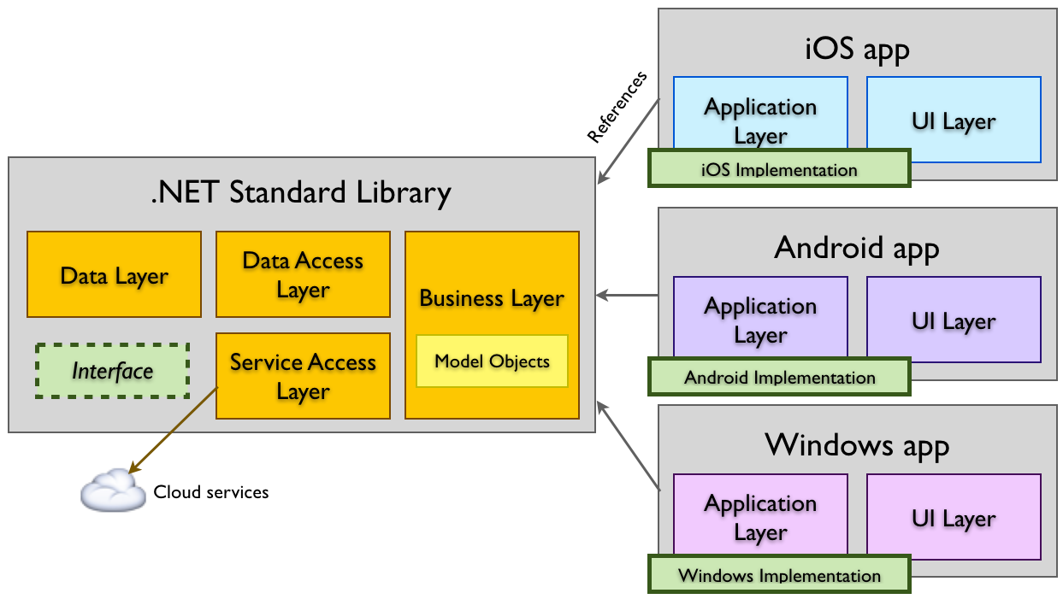
Xamarin
Xamarin is a multiplatform development environment based in C#
Applications can still use native functionality
In SCL, every platform dependent project depends on a common multiplatform library

Slide 11
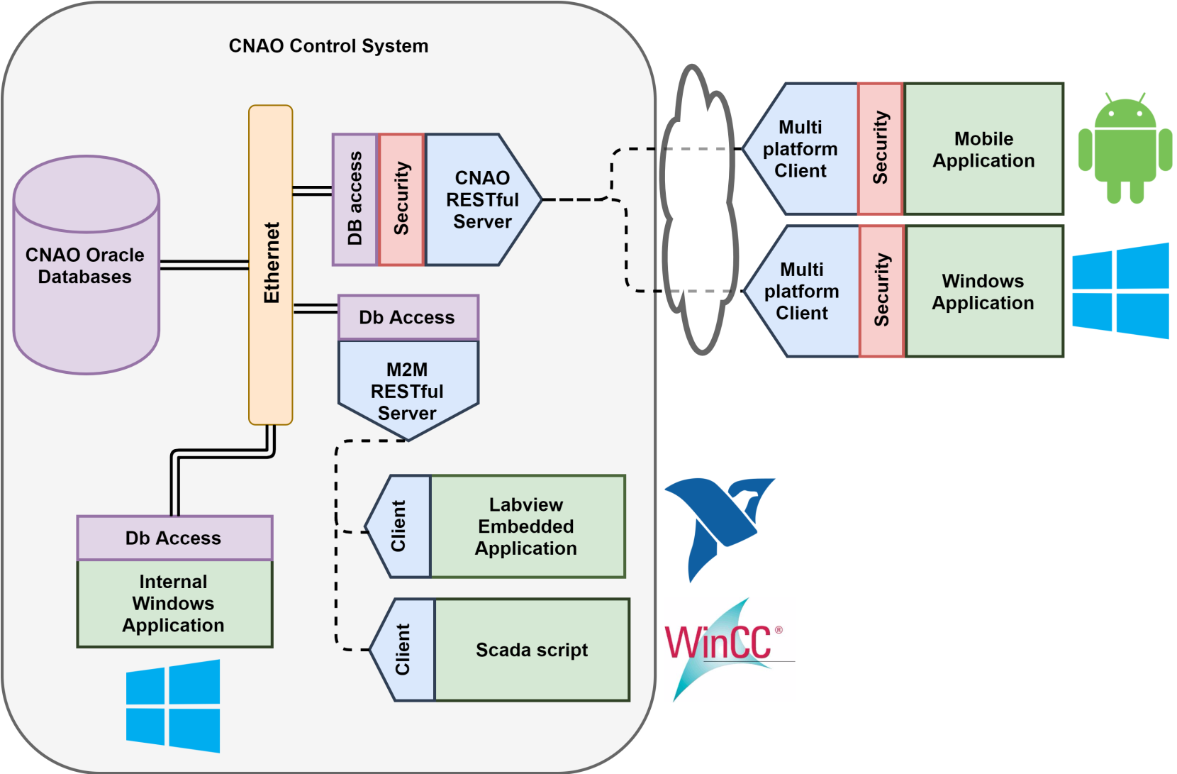
Relational data access library Service

Slide 12
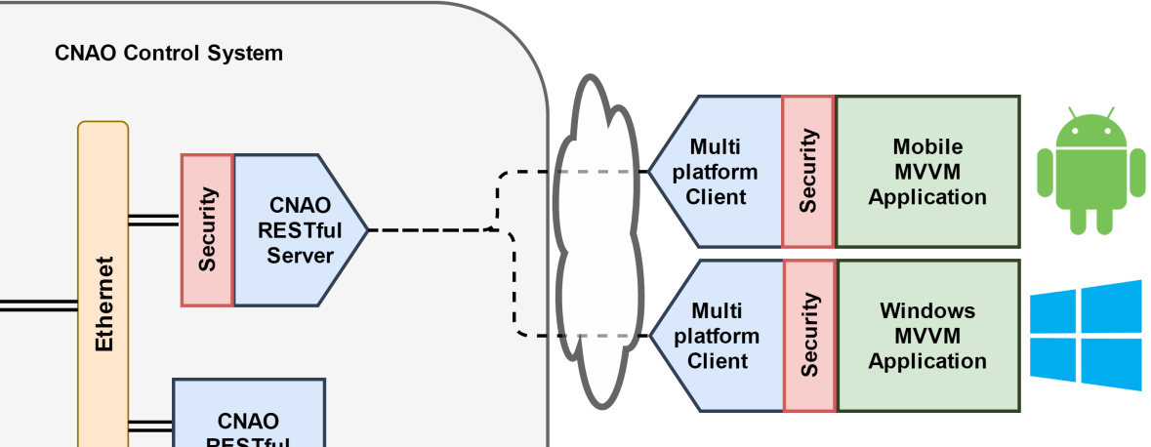
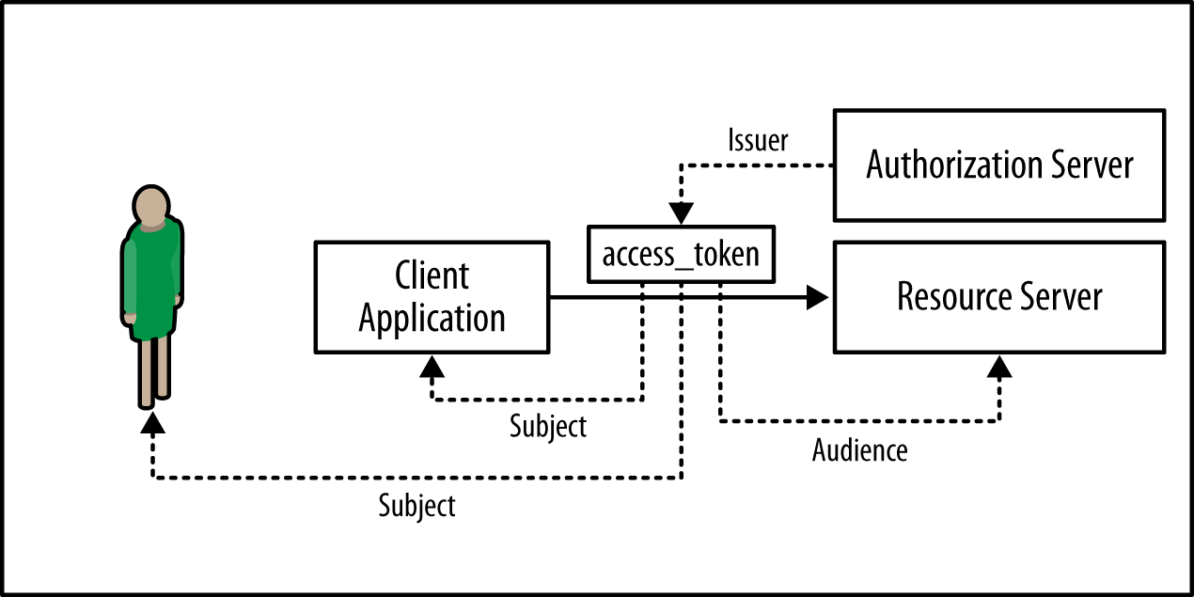
Security requirements service
Open Id Connect standard for security
Applications request tokens, use tokens to access resources (and more)
Glen Brock et al. 2014
https://www.safaribooksonline.com/library/view/designing-evolvable-web/9781449337919/ch16.html
User

Slide 13
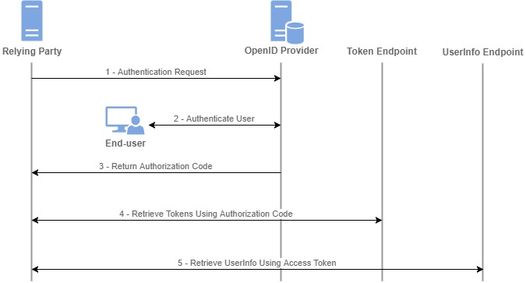
Open Id Connect – Authorization code flow
https://rograce.github.io/openid-connect-documentation/explore_auth_code_flow.html
Beware of facility requirements
Tokens may be refreshed
In order to add one, or a hundred, resource servers, just change the OpenID provider’s configuration
Authorization and authentication are different concepts

Slide 14
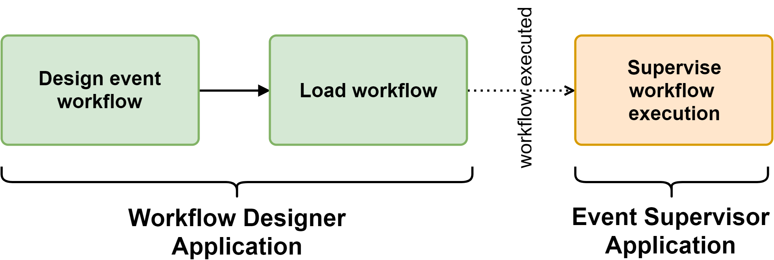
Flagship application - Timing system
Client application to manage the timing system:
  Creation of new configurations
  Selection of configurations
Monitoring events present in the system

Slide 15
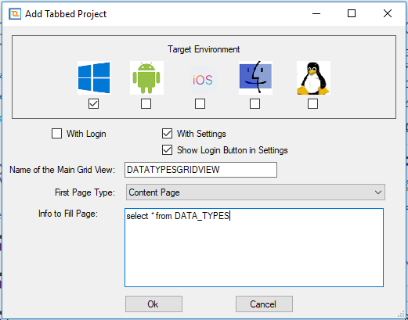
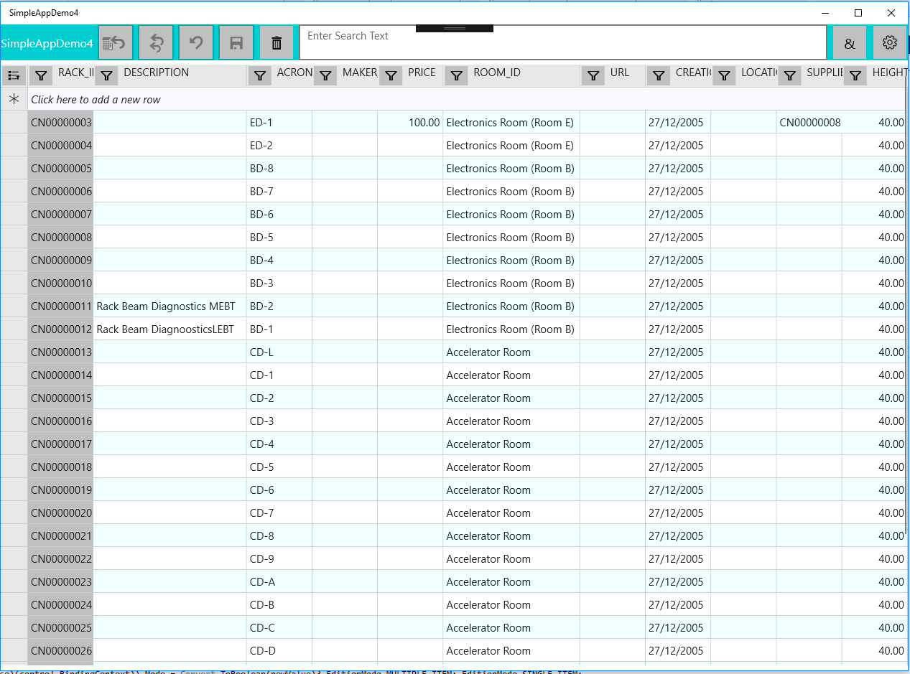
Project creation – First example
Tools to provide customized project templates and class generation

Slide 16
Impact of project
Modernization of software environment
Standard communication reduces software fault vectors and improves maintainability
Framework2020:
  delegates many implementation details away from final developer
  Reduces software development time

Slide 17
Light ion therapy software for data exchange
Carlos Afonso
Horizon2020 Marie Skłodowska-Curie Grant Agreement No 675265

