Slide 1
ROOT Documentation
Olivier Couet (CERN EP-SFT)

Slide 2
Overview
Overview of the ROOT main sources of documentation.
Reference Guide
User’s Guide
Primer and/or Mini ROOT guide
Tutorials
Web Site
Man pages and command usage
This presentation gives the status of each of them and how they can evolve in the future.

Slide 3
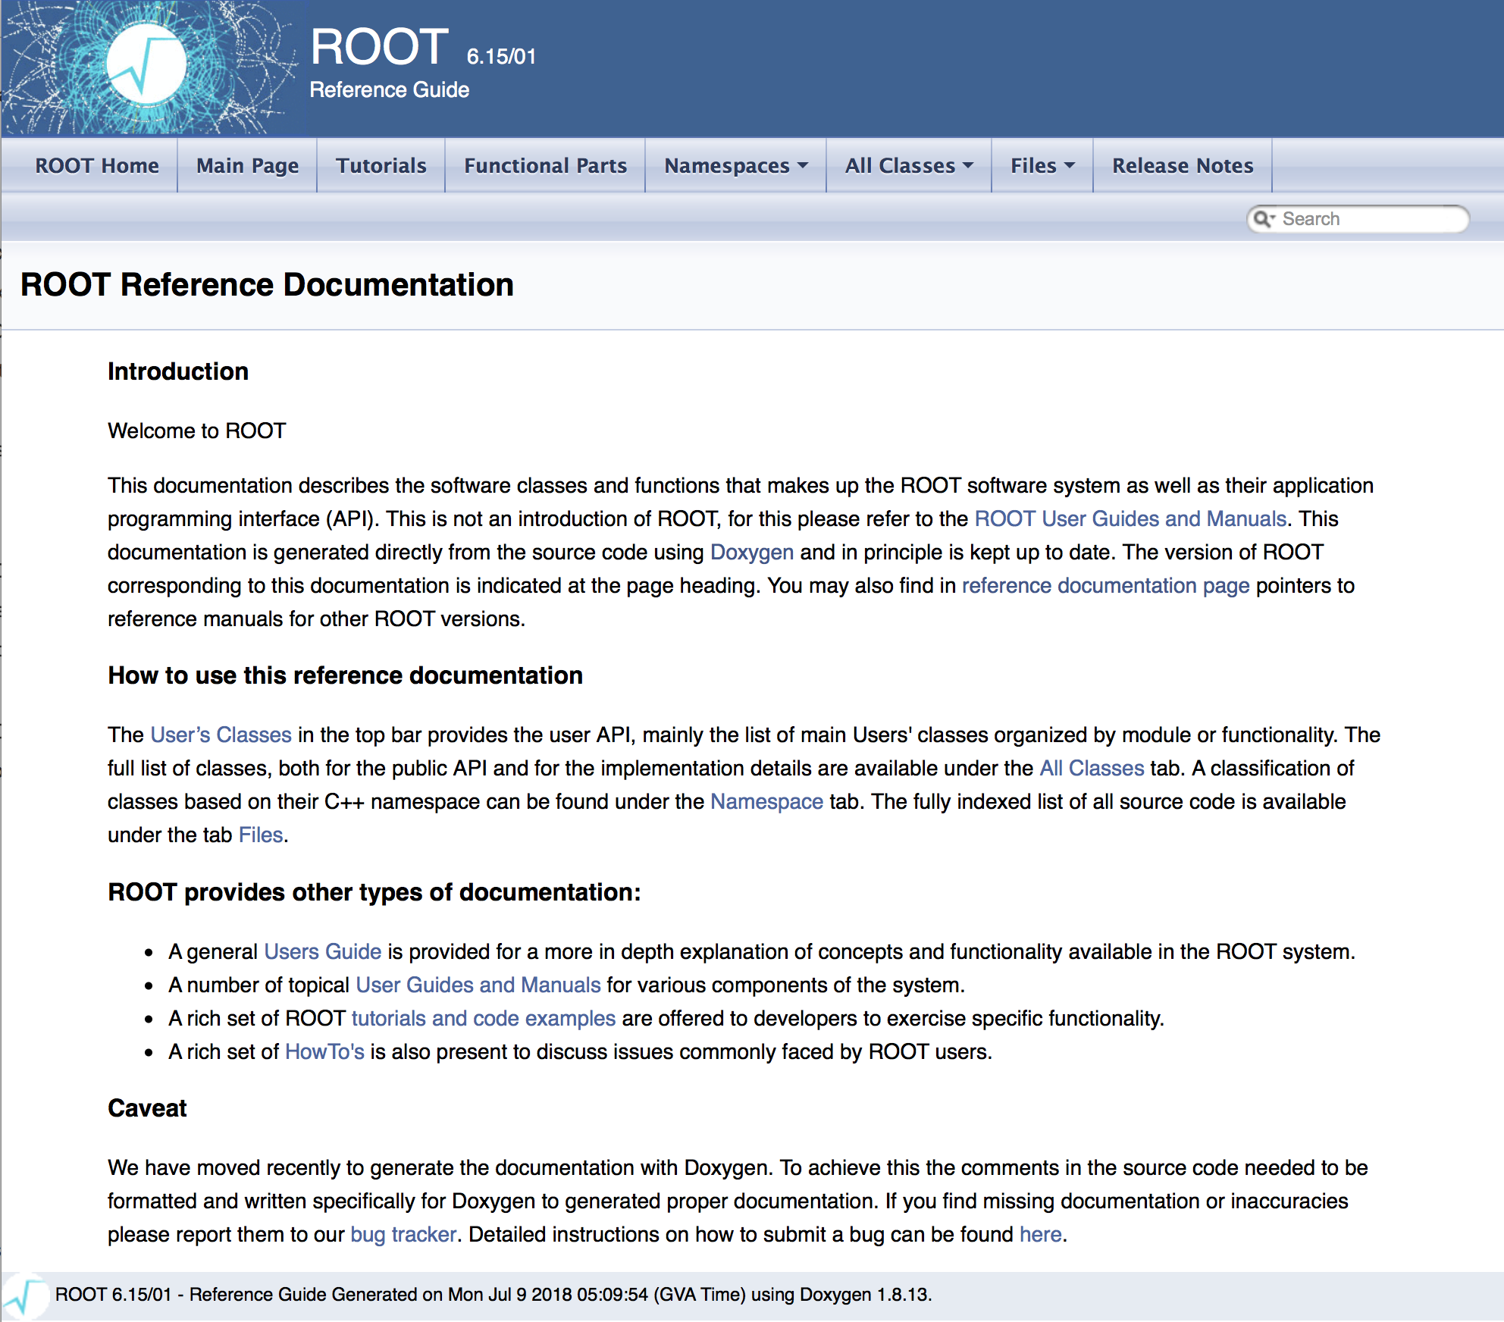
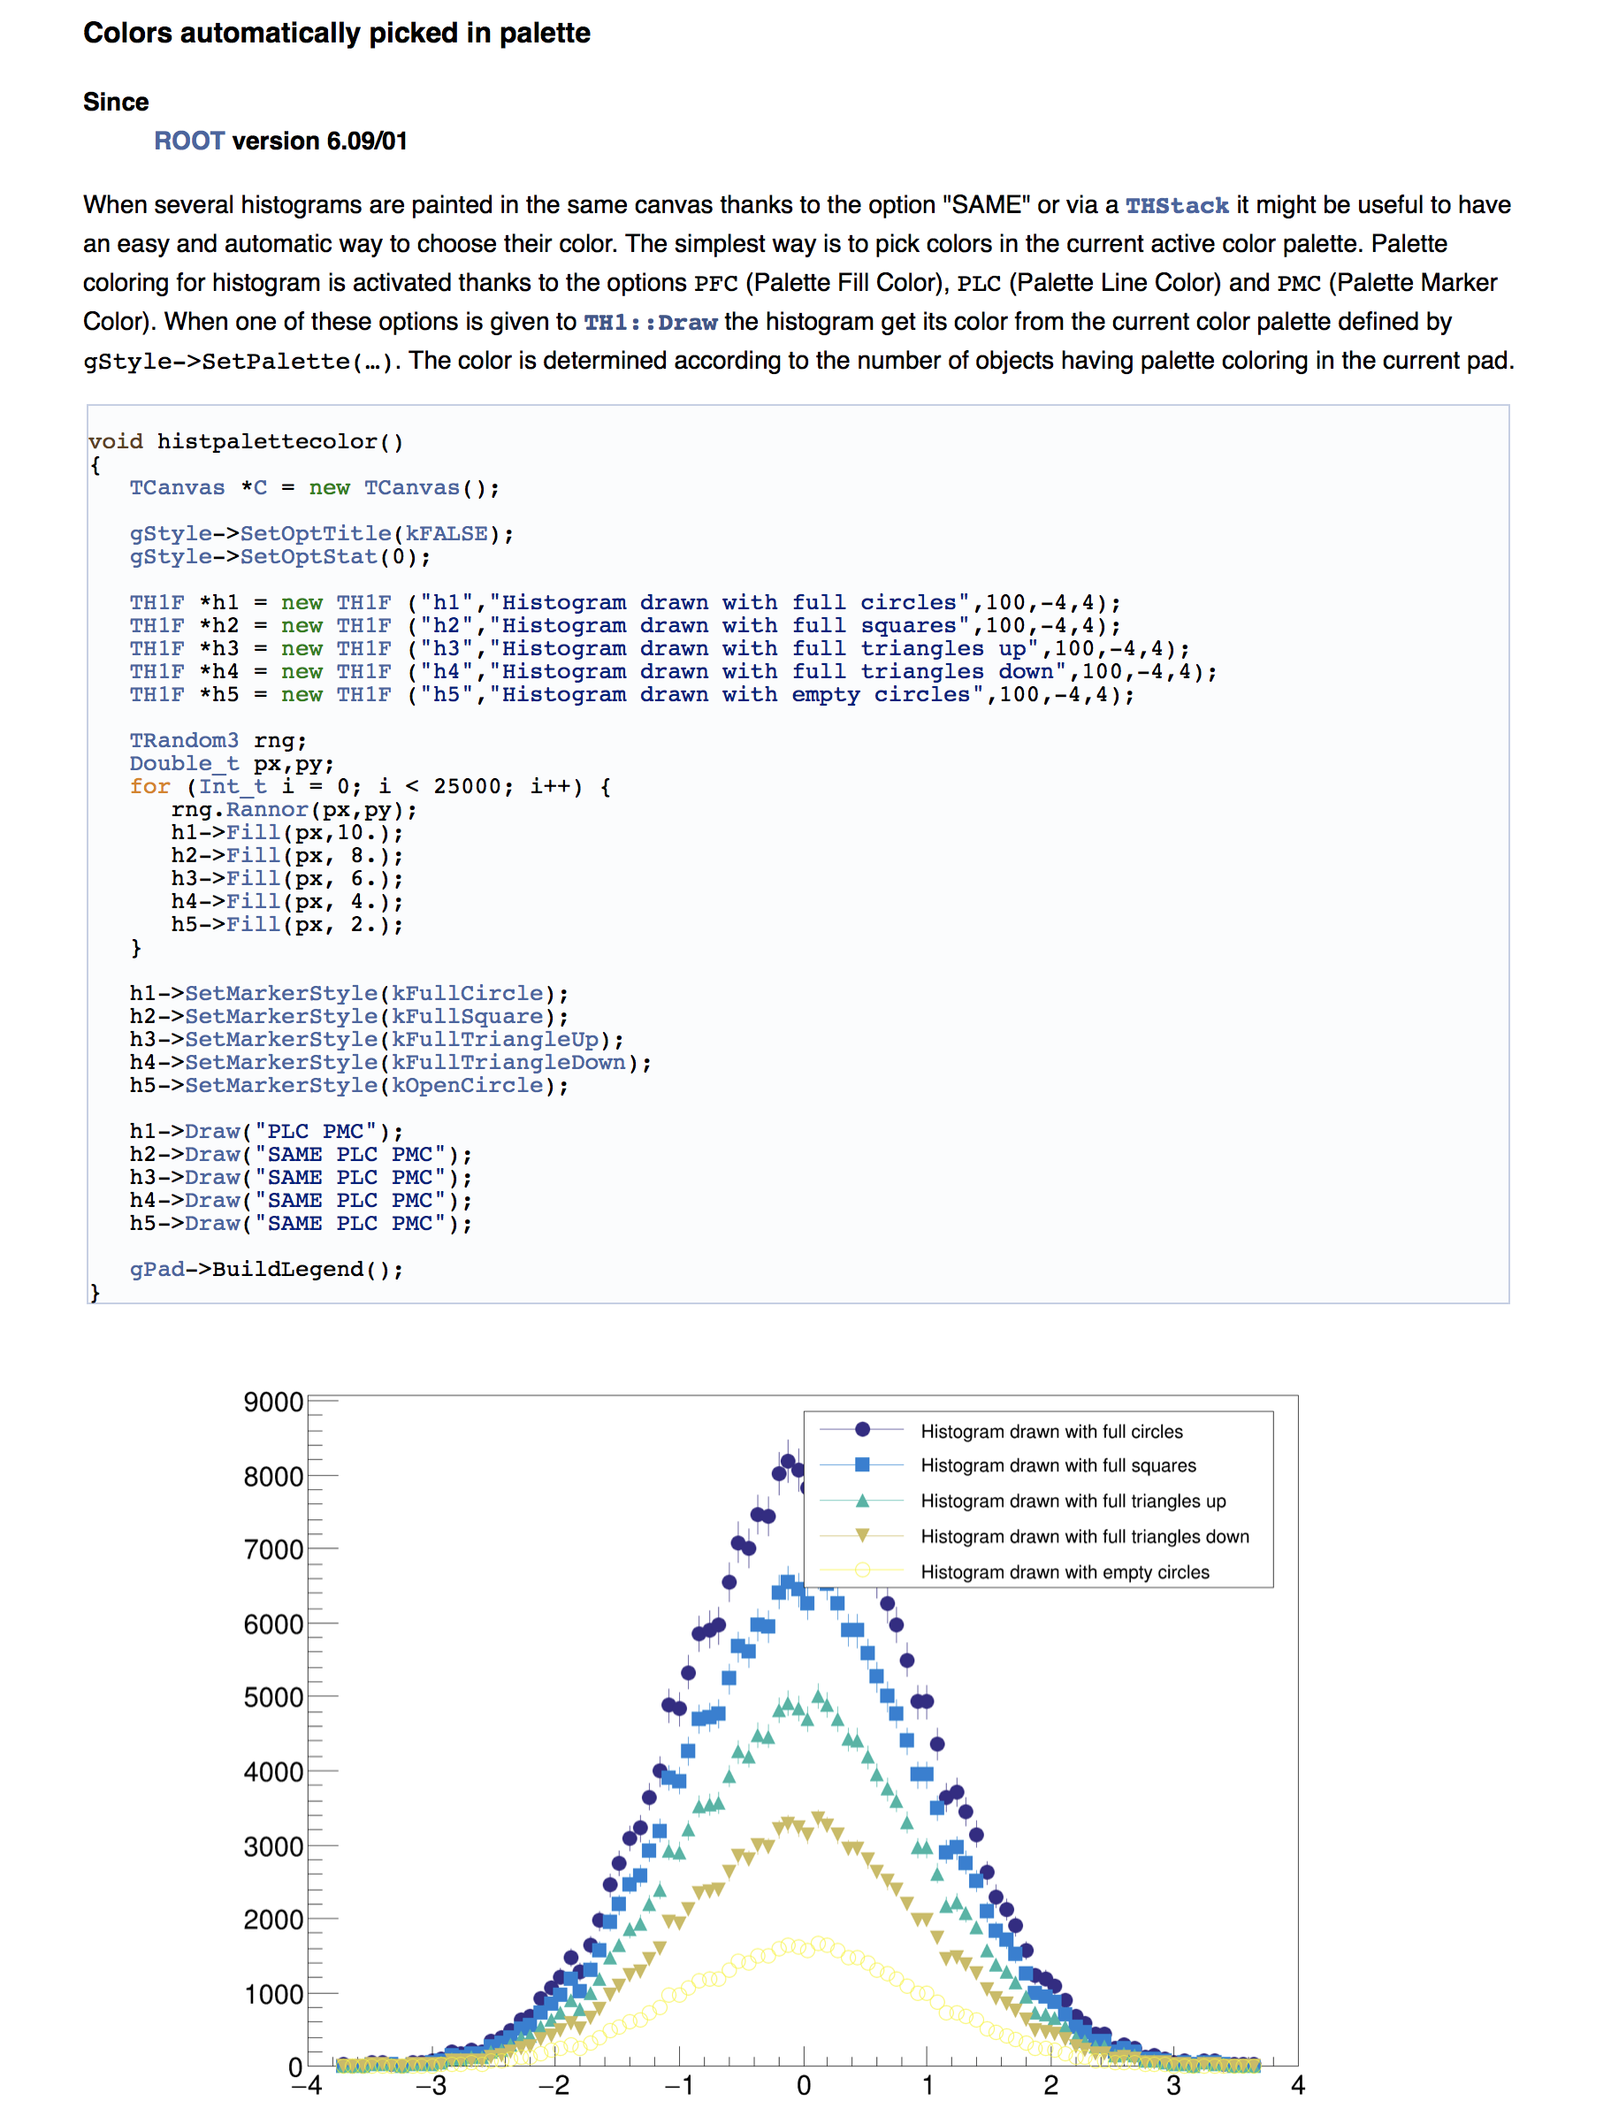
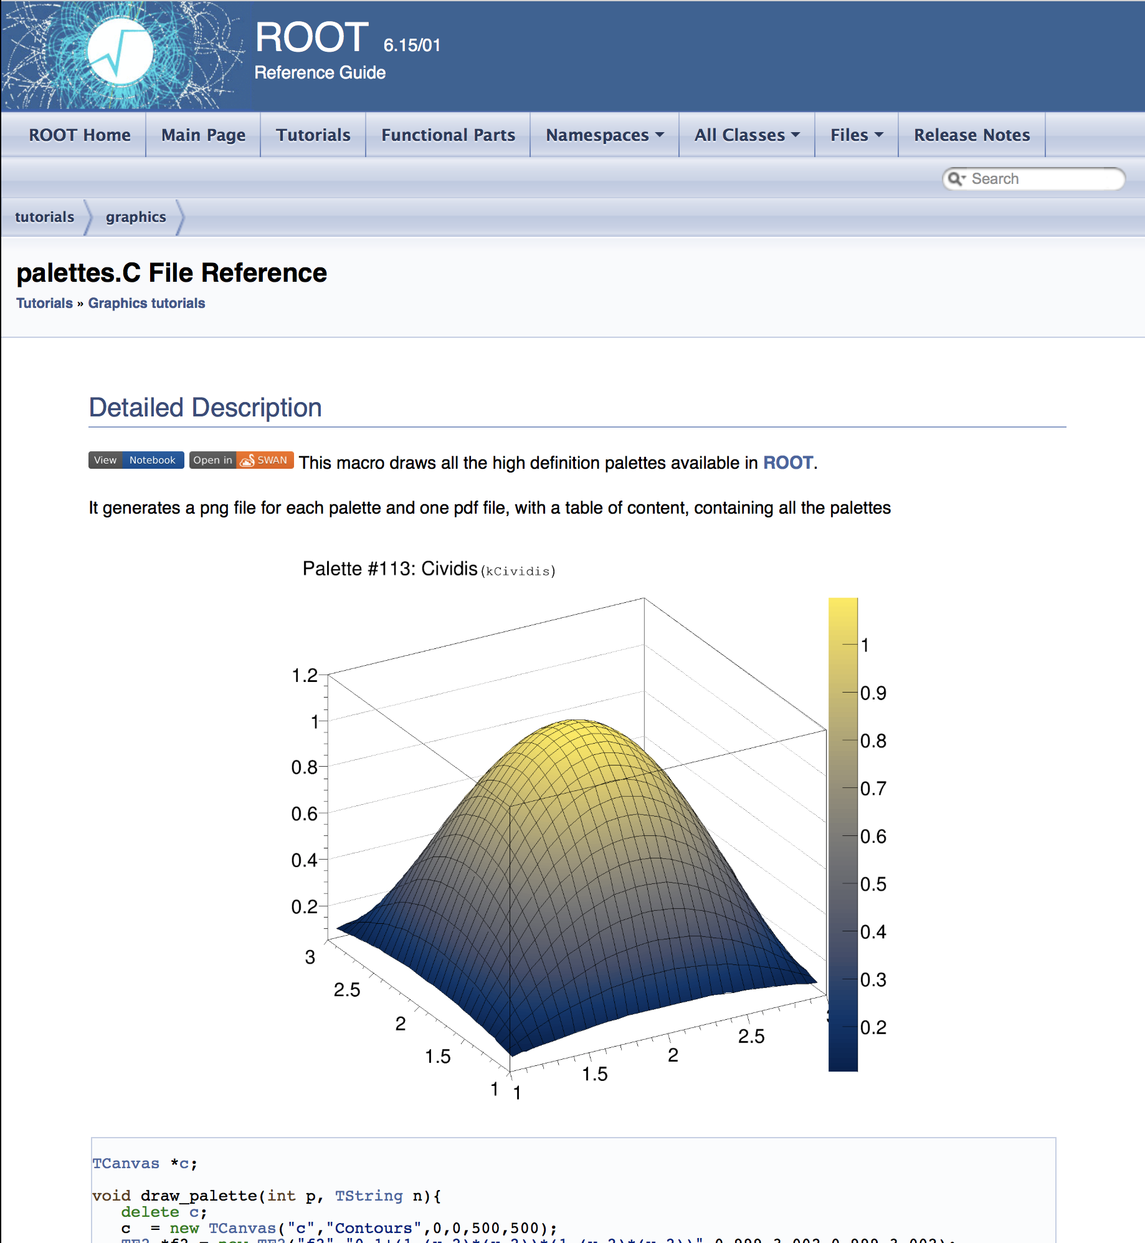
Reference Guide
The most up to date doc. Automatically generated from the code.
In doxygen format (THtml-> doxygen)
Customized for ROOT thanks to the « doxygen filter »
              Macro execution (high definition pictures)
          Provide ROOT specific diagram (like the libaries used by a class).
    Generate tutorials’ reference pages (SWAN)
Follow the evolution of Doxygen (Doxypress)
Convert the tutorials list into a gallery

Slide 4
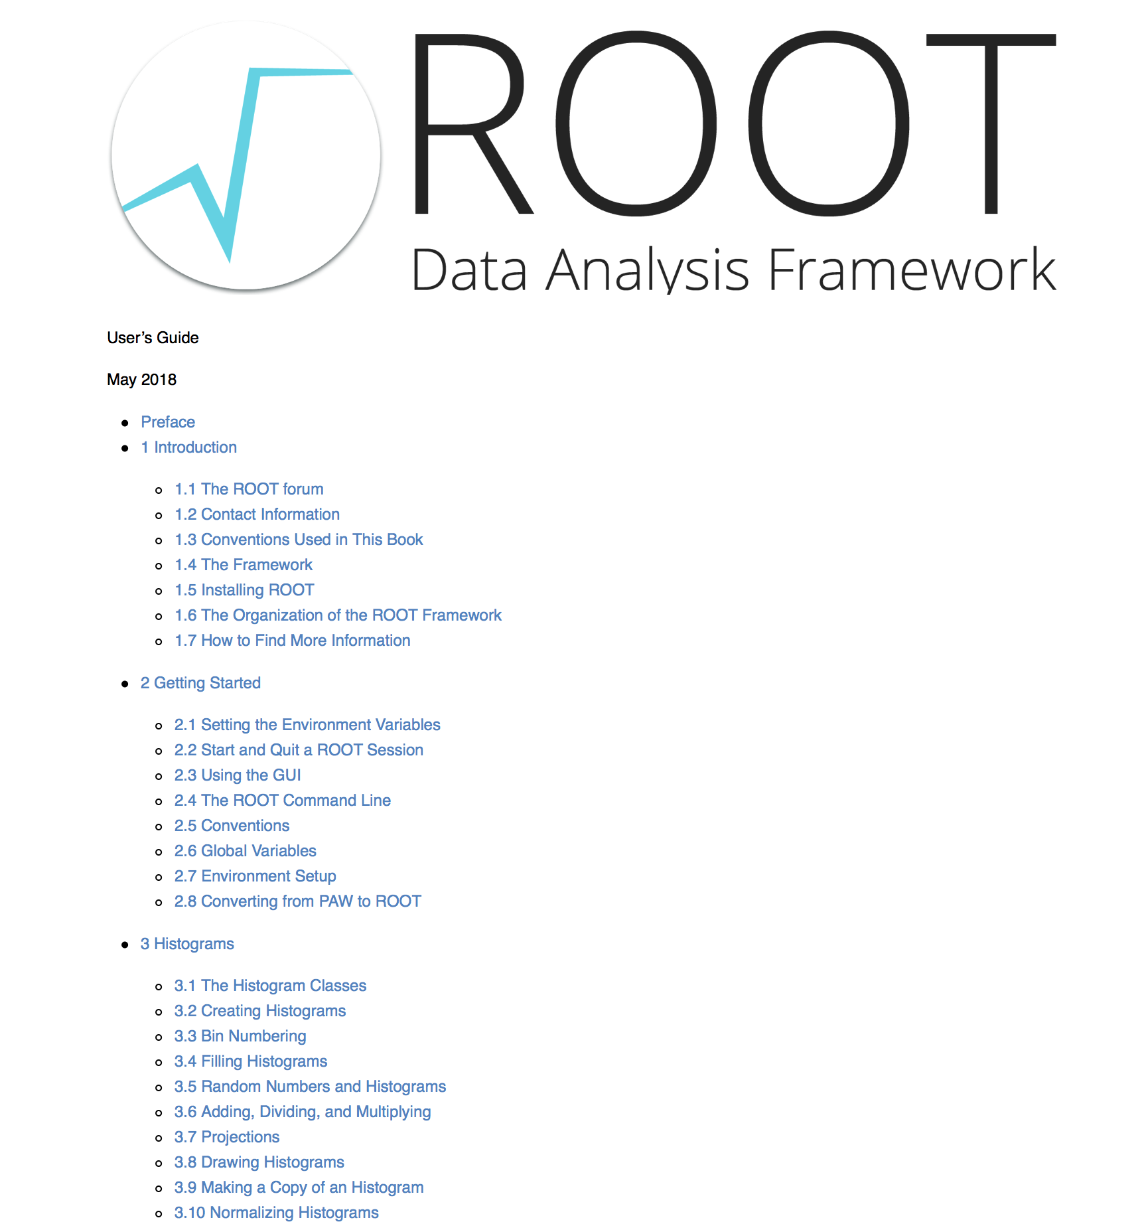
User’s Guide
In markdown (after word, docbook …)
pandoc -> allows to generate several output format (pdf, html, ebook, latex …)
One chapter (markdown file) per package
Despite the fact the editing is now very easy (markdown file in GitHub), it has not been updated for a while (four years ago). A big refresh is needed.
Needs an update.
      Make it simpler ?
      Is it used ? Should we keep it ?

Slide 5
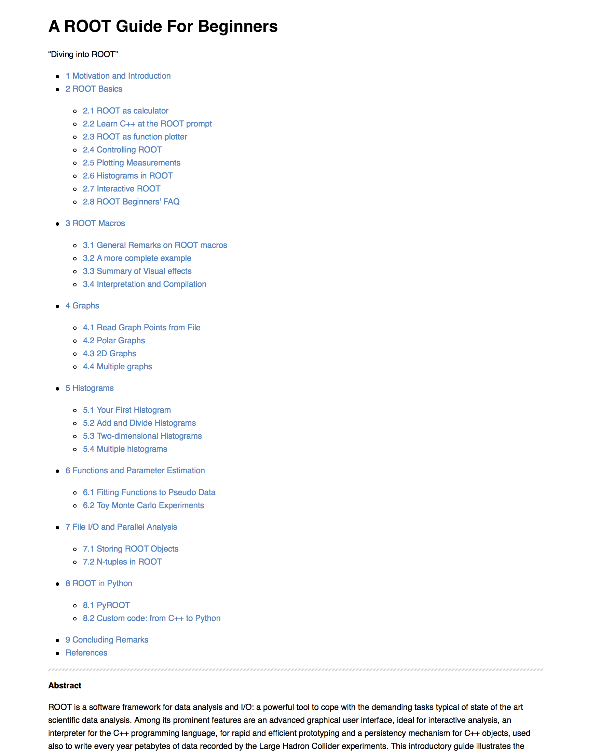
Mini ROOT guide
ROOT primer
In markdown format
Used as tutorial materiel (CERN summer students)
Has a SWAN version
Up to date: revised every year for the CERN summer students tutorials.
Could coupled more closely to the reference guide examples
Very useful for beginners (more used than the User’s guide)

Slide 6
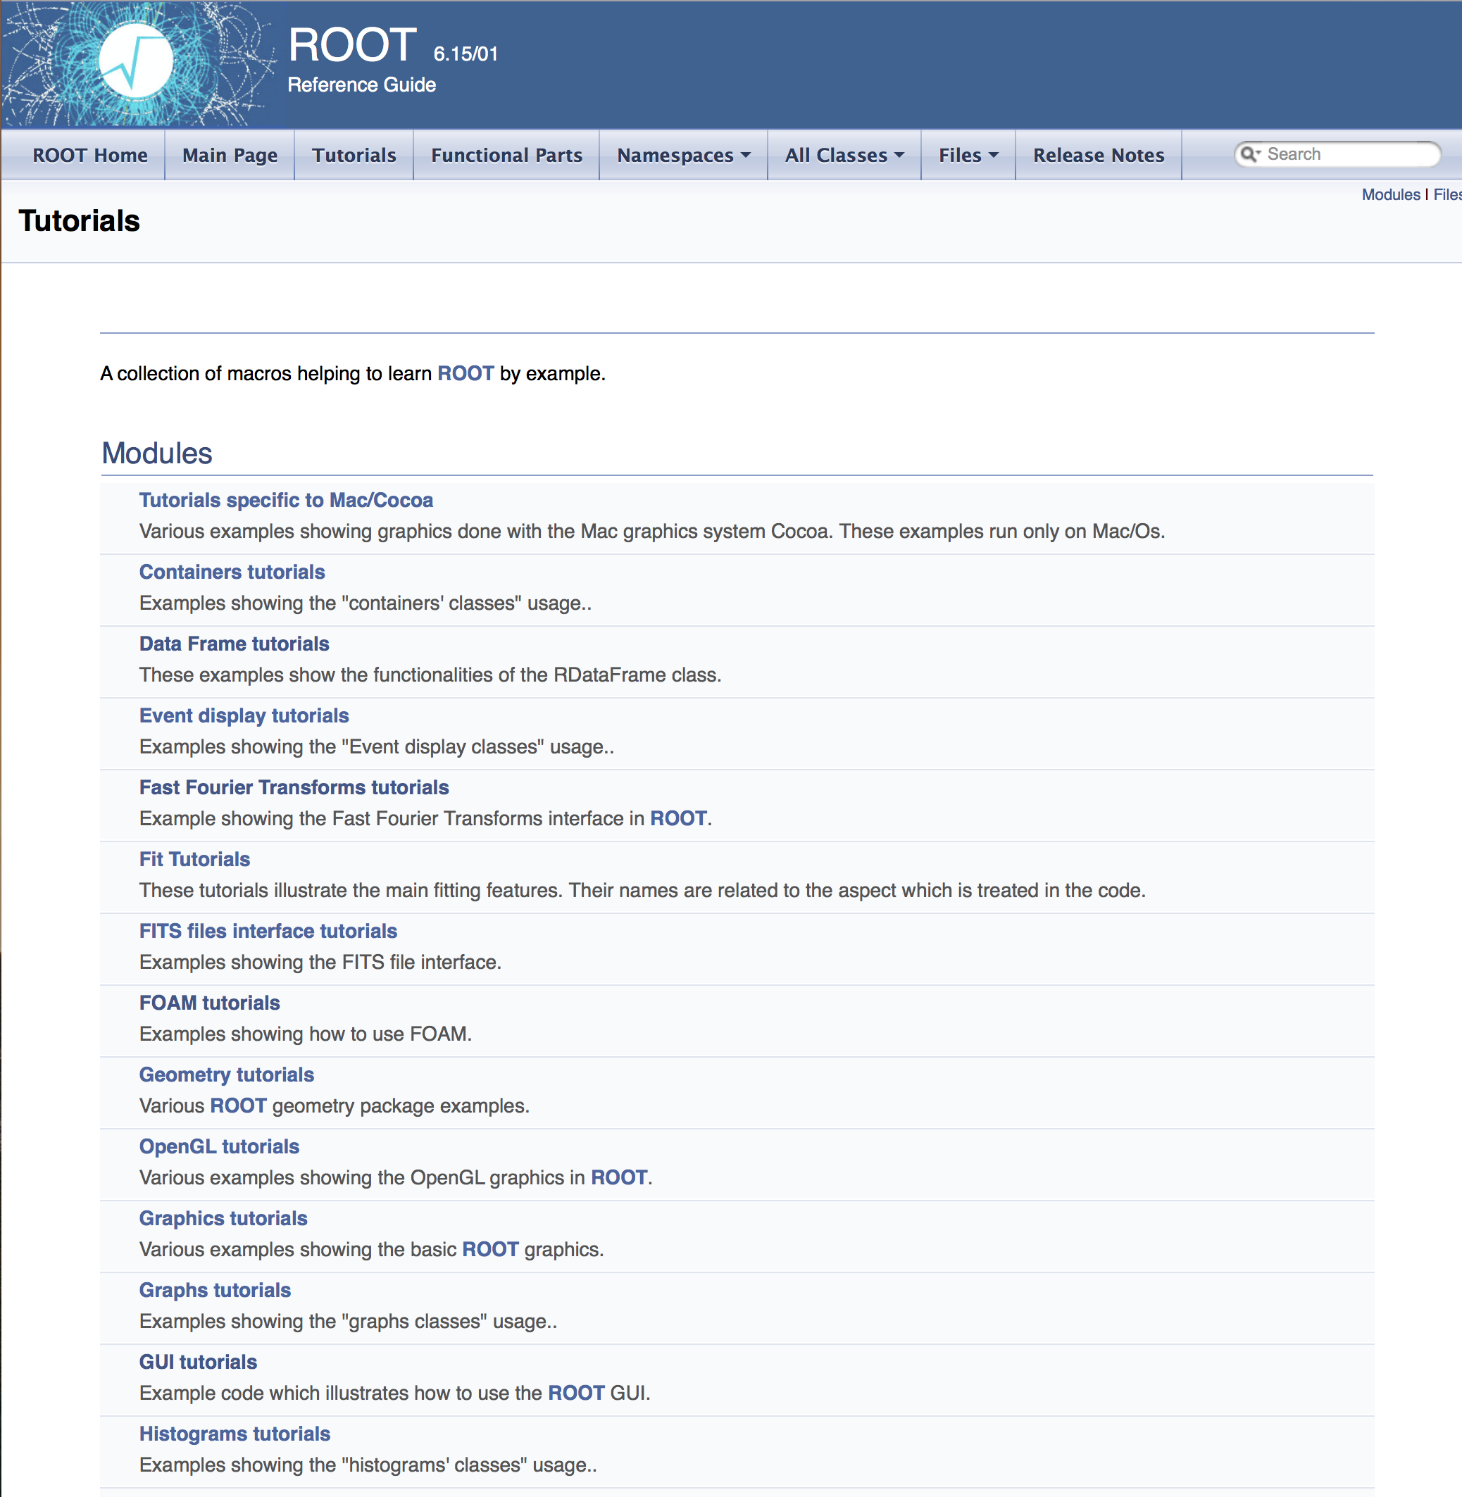
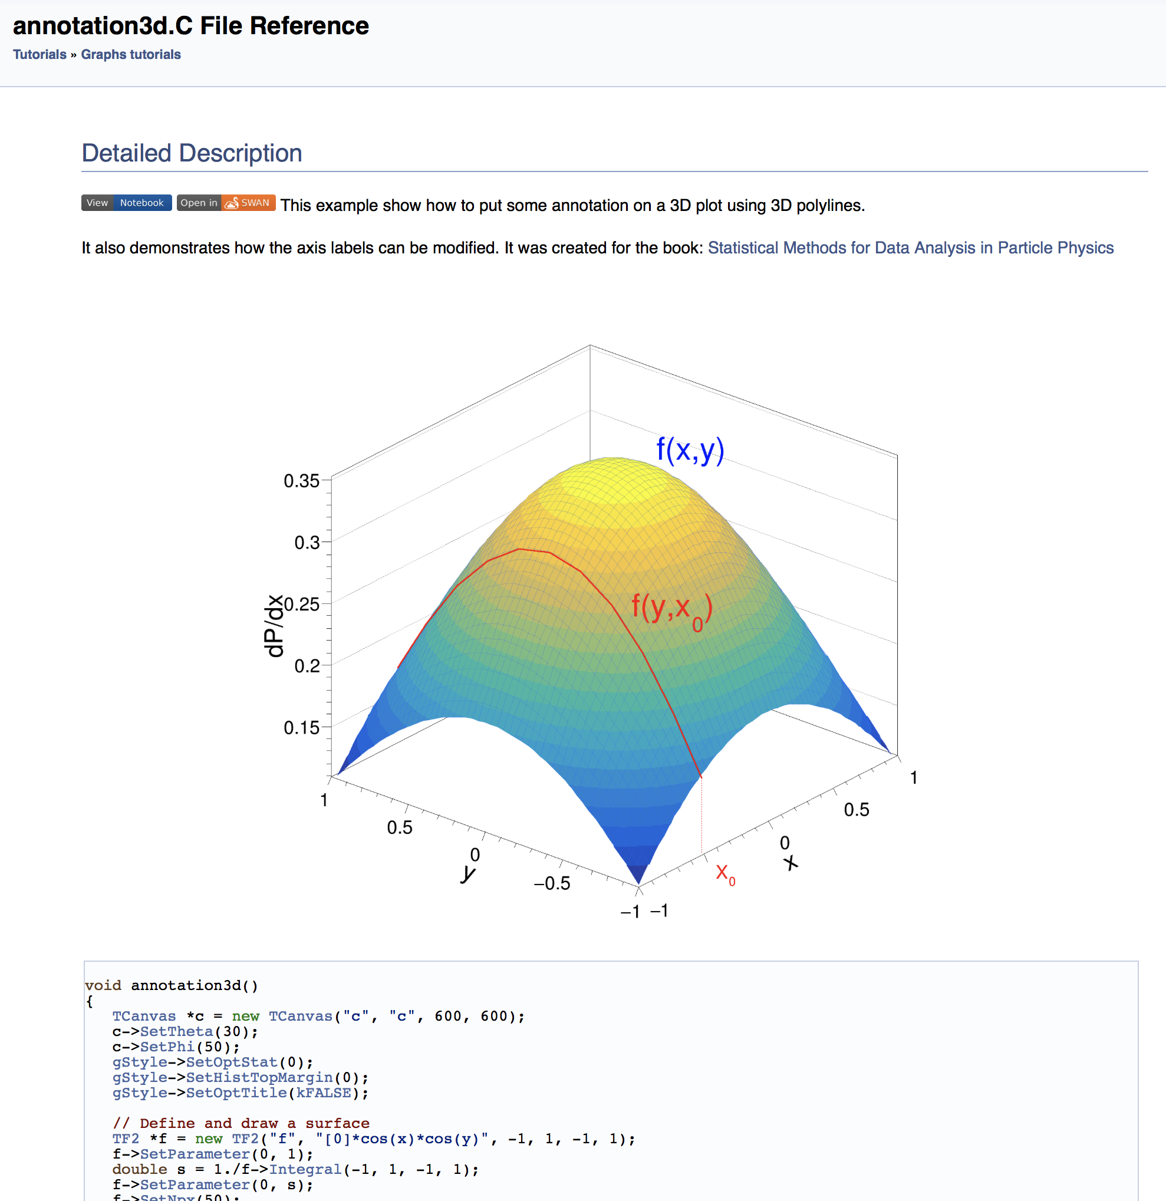
Tutorials
Part of the reference guide. The doxygen filter generates one web page per tutorial.
Jupiter/SWAN notebooks are also generated by the filter.
All the tutorials are in C++. Some have their python version also. This needs to be generalized.
Need to be presented as a Gallery

Slide 7
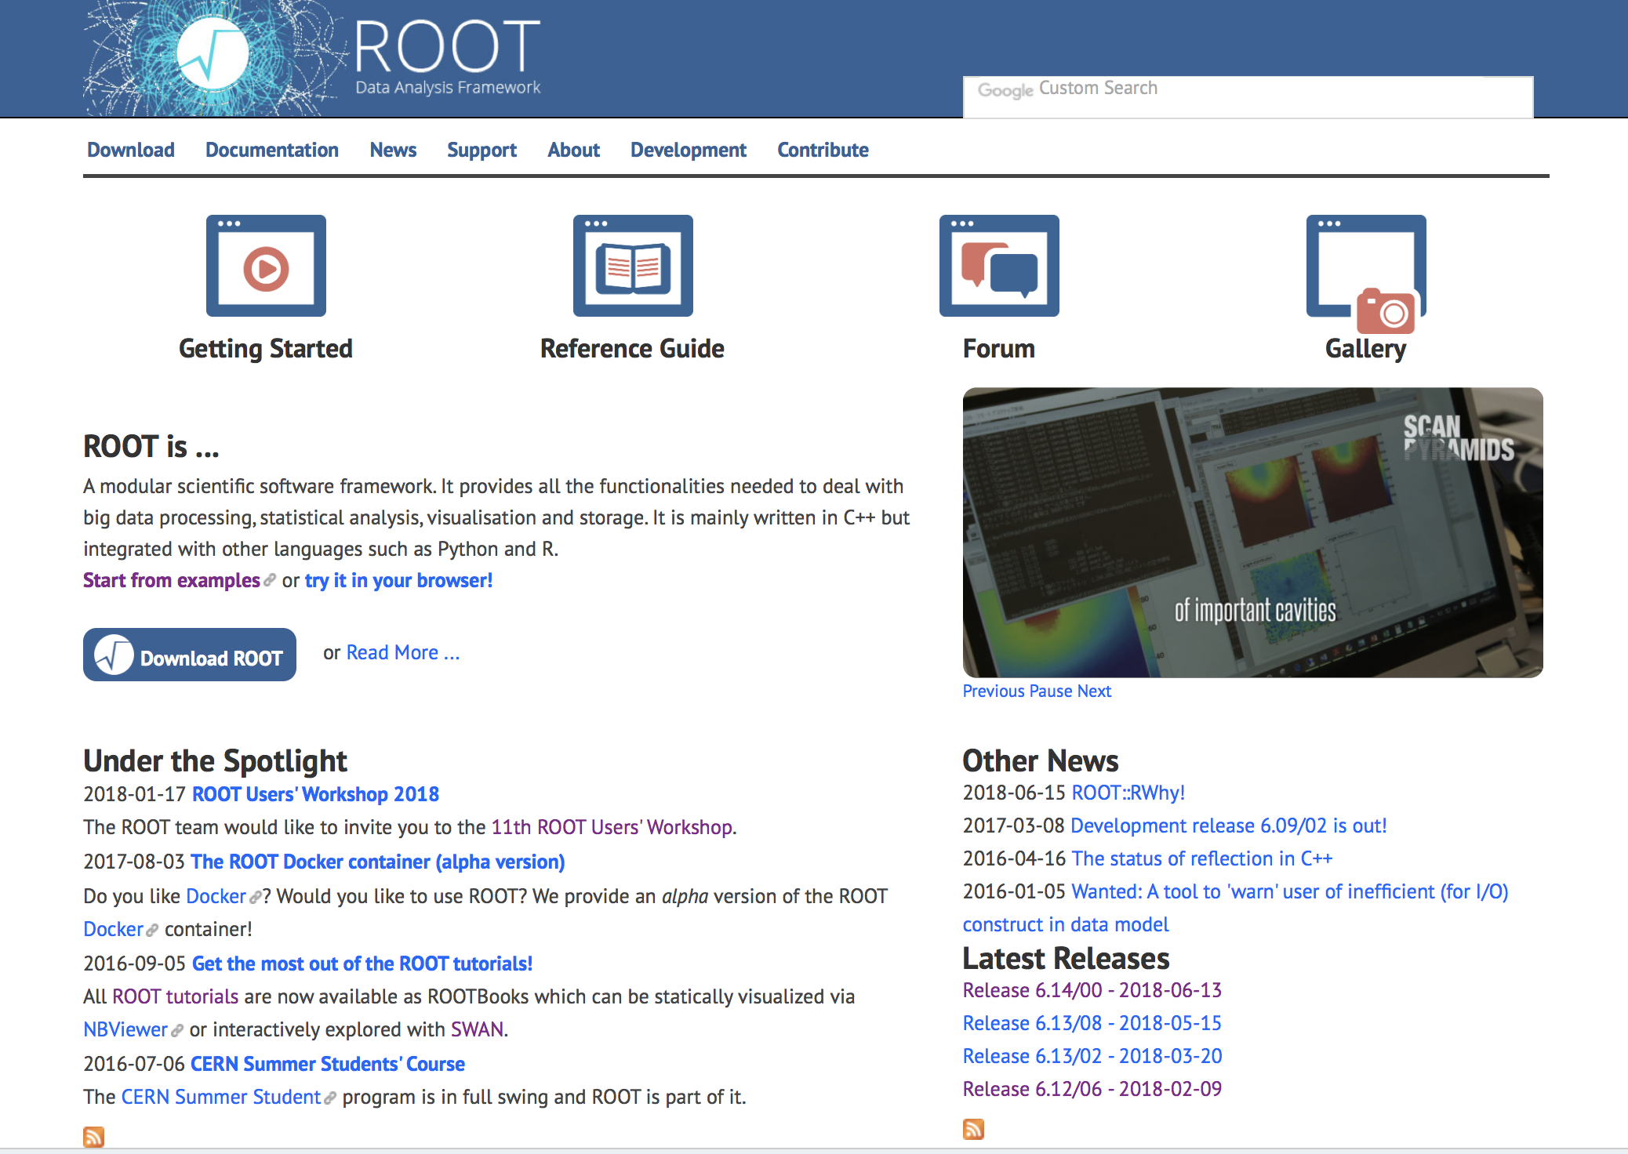
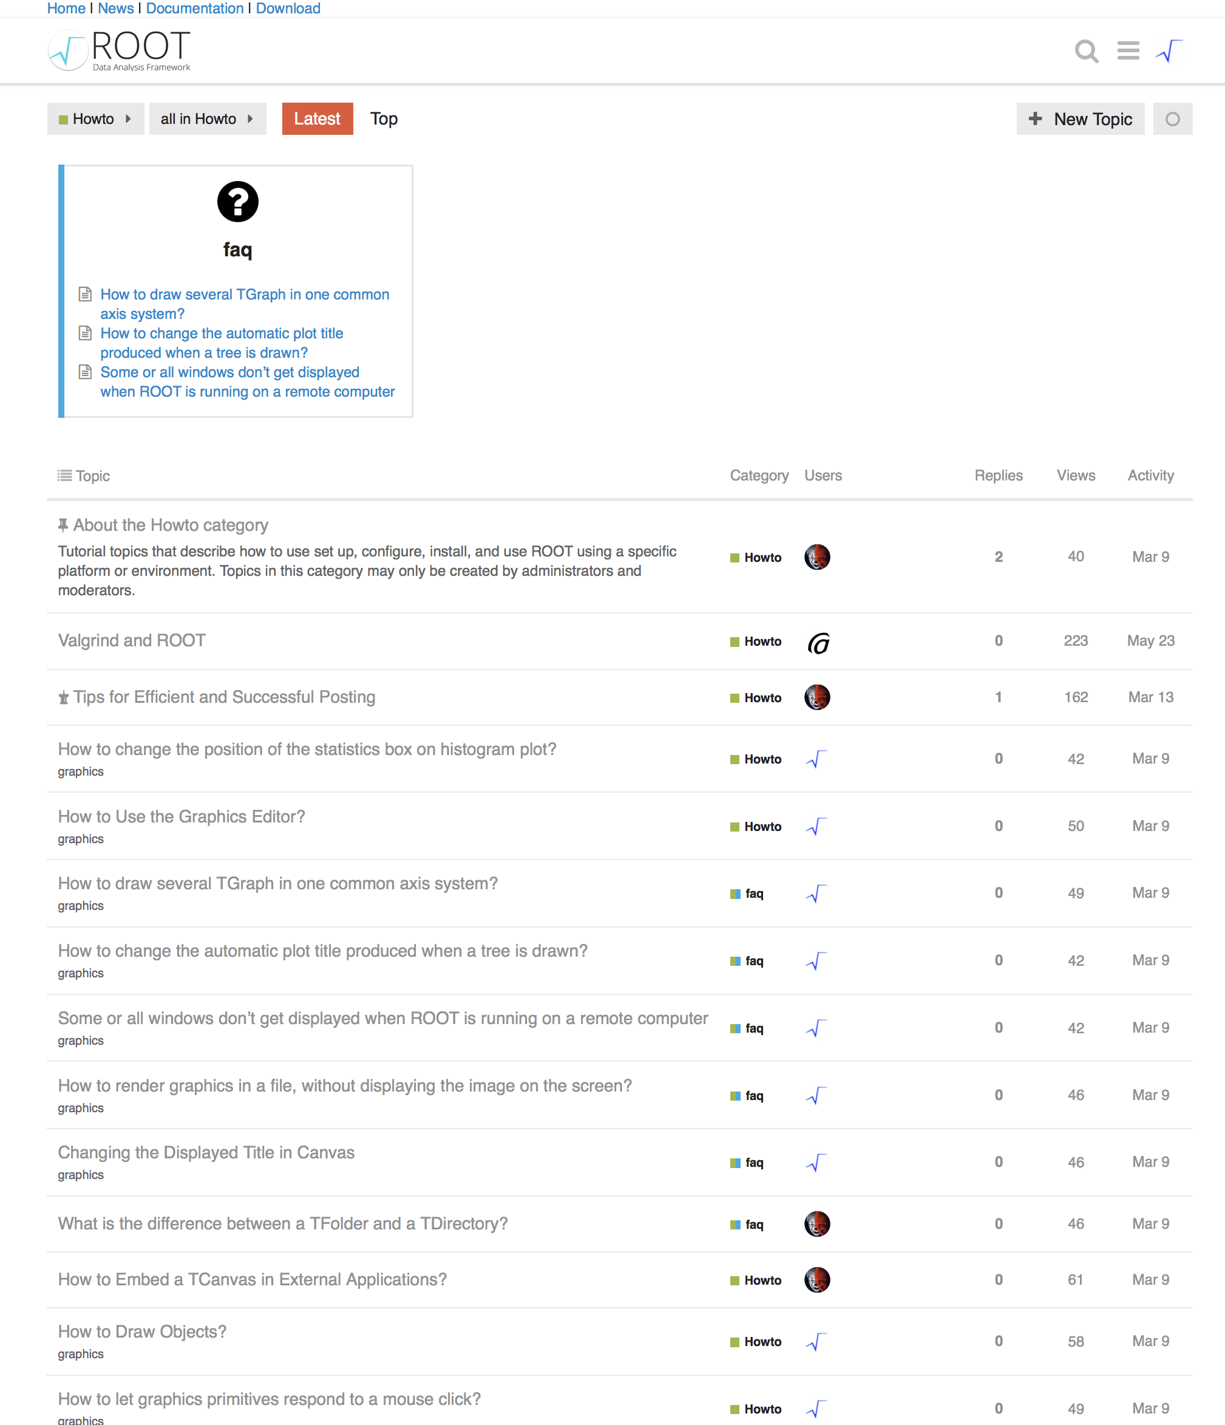
Web Site
Entry point for all the manuals/doc listed before
Entry point for the forum which is also a huge source of information (discourse).
FAQs and HowTo’s are now in the forum (need update)

Slide 8
Man pages and command usage
$ man root
…
$ root --help
Man pages and commands usage were described in several, not synchronized, places.
There was no consistency check between the options implemented and the options description.
Since this summer, these two points are now addressed thanks to a python tool using the module “argparse”. This work was done by Elie Khairallah, summer student 2018.

Slide 9
Summary
Documentation type | Status | Tools | Future work
Reference Guide | Update daily. Most accurate documentation. | doxygen | The primary source of documention. Constant « polishing »
User’s Guide | Kind of frozen | Markdown / pandoc | Something should be done: Update or removed.
Primer | Used by all ROOT beginners (summers students) to start with ROOT | Mardown / Pandoc/ Notebooks | More and more oriented toward notebook/SWAN
Tutorials | Closely linked to the reference guide. | doxygen | Need a gallery – make sure they are all « pythonized ».
Web site | Link to all documentions - Faq and Howto’s in the forum. | Drupal / Discourse
Man pages | Now synchronised with commands’ usage. | Python script (argparse)

