Slide 1




GANDALPH @ CRIS
FNPMLS
S. Rothe on behalf of
CRIS collaboration
ISCC 2018

Slide 2
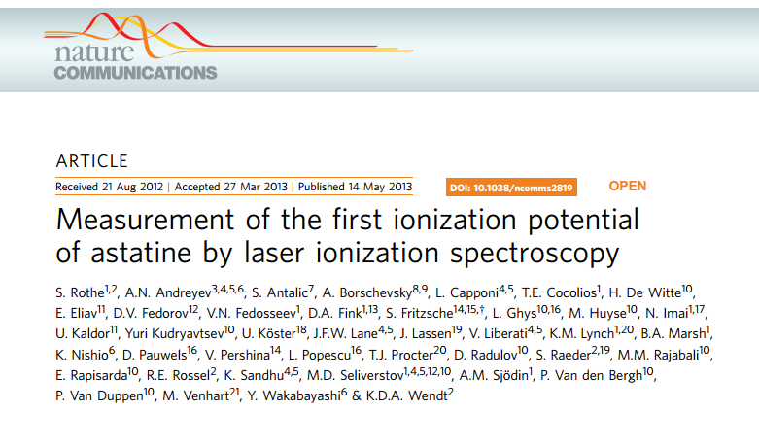
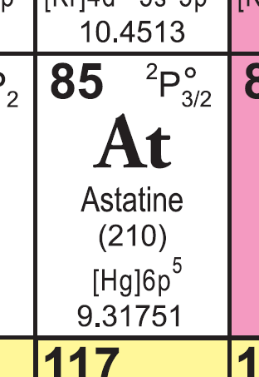
The ionization potential of astatine
IP (At) = 9.31751(8) eV

Slide 3
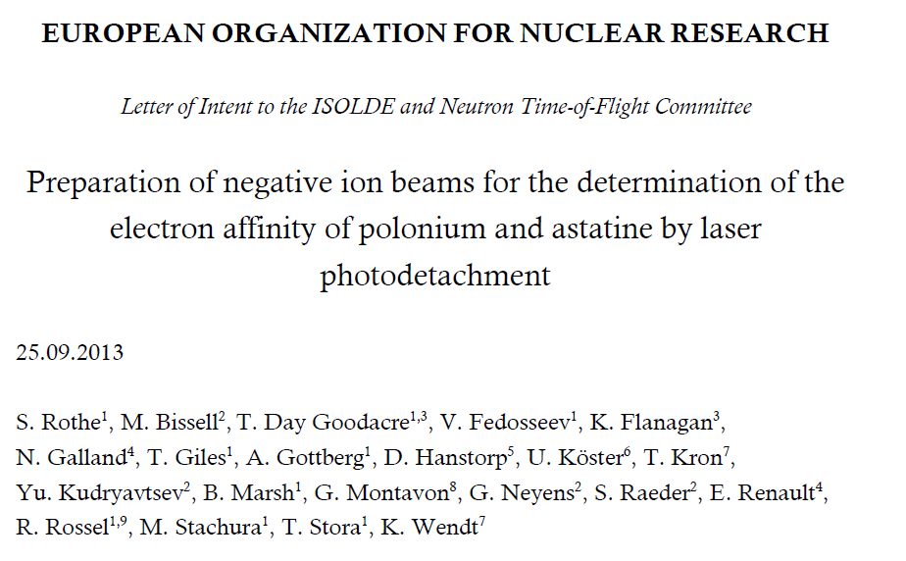
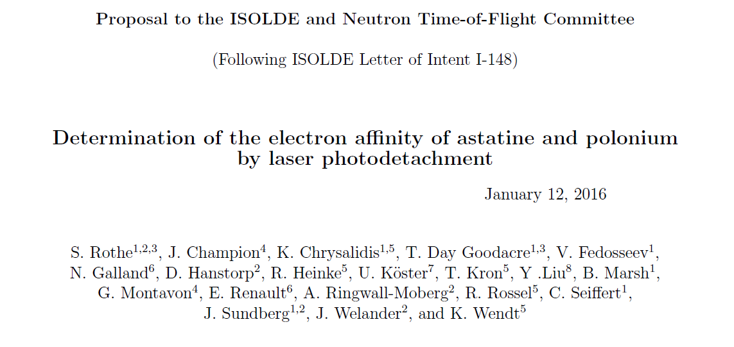
The electron affinity of astatine
Letter of Intent INTC-I-148
2013
Proposal INTC-P-462
No experimental value for EA(At) yet
Scattering of all theoretical predictions and extrapolations ~1 eV
2016

Slide 4
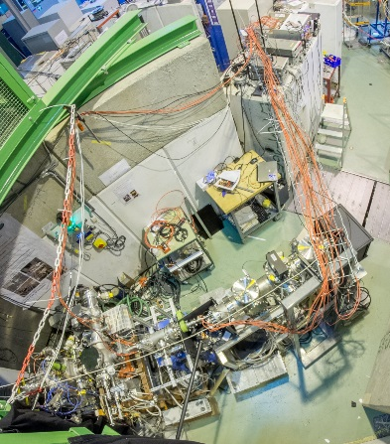
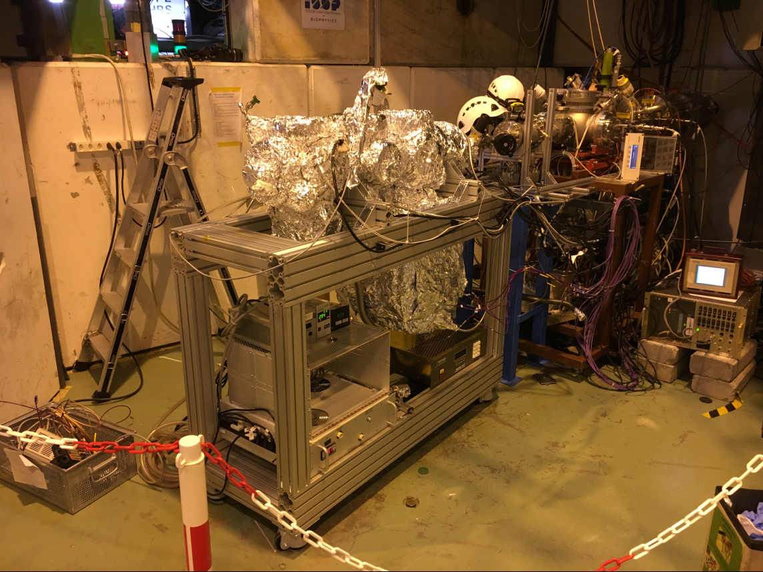
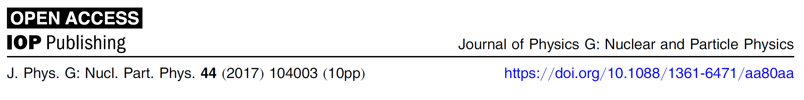
GANDALPH @ GLM
2016
Laser photodetachment of radioactive 128I-
Successful stable iodine detachment
2015

Slide 5
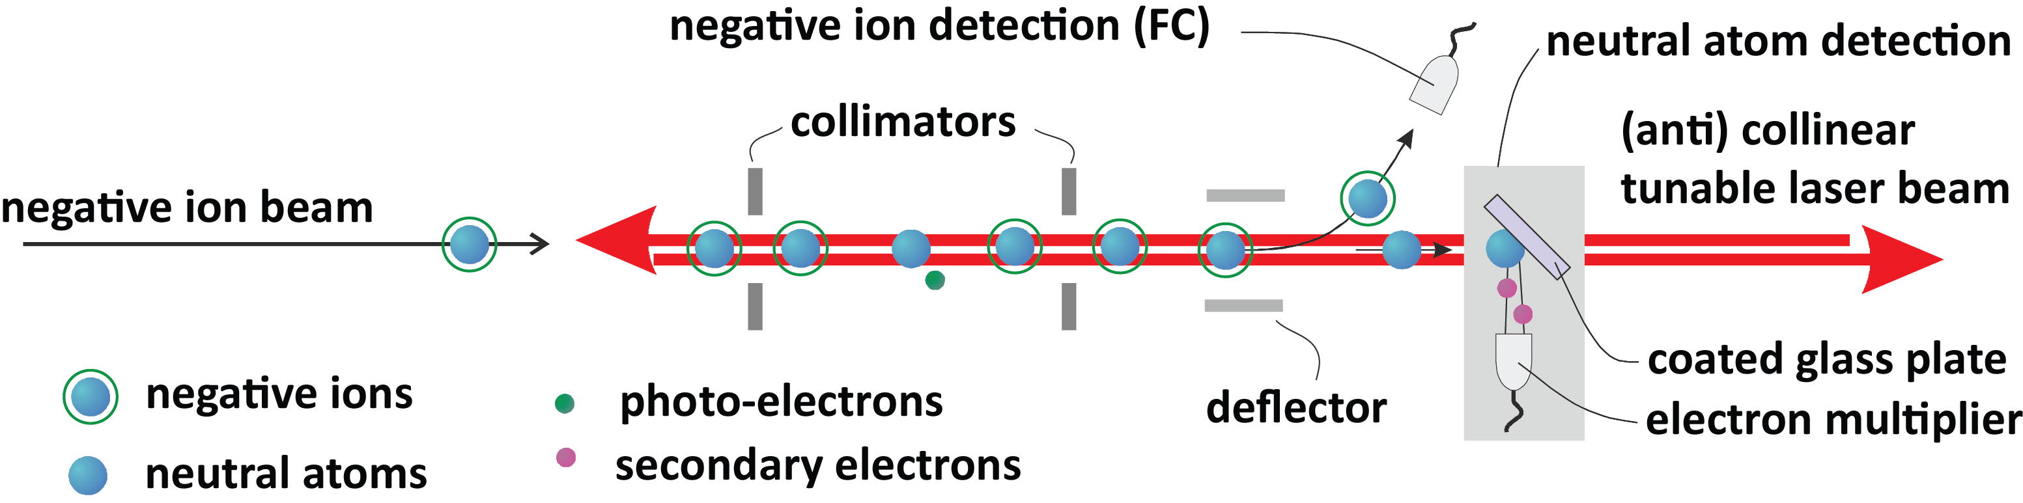
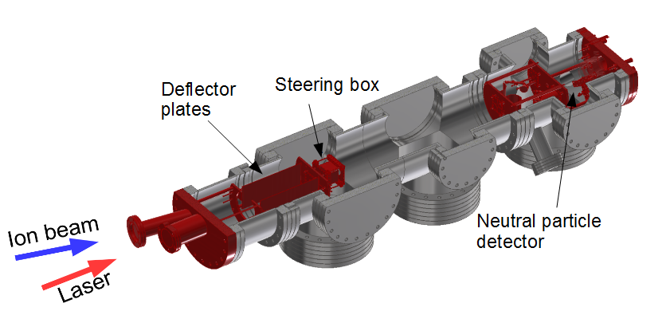
The Method: Collinear laser photodetachment
GANDALPH
Gothenburg ANion Detector for Affinity measurements by Laser PHotodetachment
Iodine
Julia Sundberg
David Leimbach

Slide 6
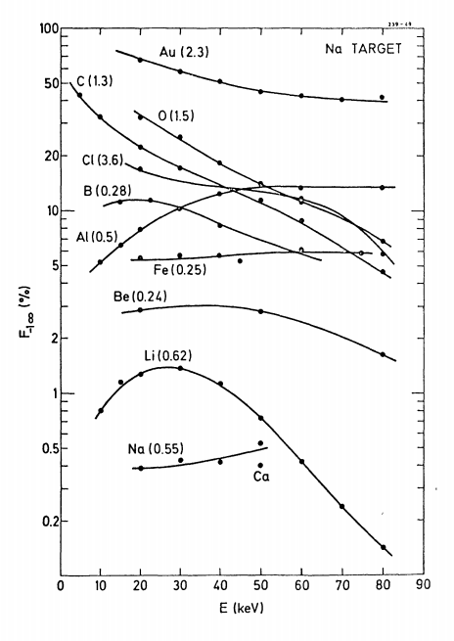
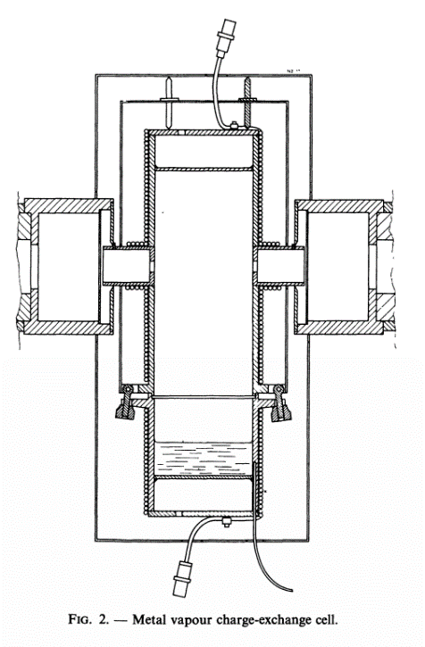
Future of GANDALPH
GANDALPH@GLM requires negative ions from ISOLDE target.
Limits available beams mostly to halogens and chalcogens.
Polonium unlikely to obtain from MK4
Double charge exchange
X⁺
X⁺, X, X⁻
Fraction of X- (%)
(CRIS) Charge exchange cell
Beam energy (keV)
J. Heinemeier, P. Tykesson. Production of negative heavy ion beams by charge exchange in metal vapour. Revue de Physique Appliquee, 1977, 12 (10), pp.1471-1475.

Slide 7
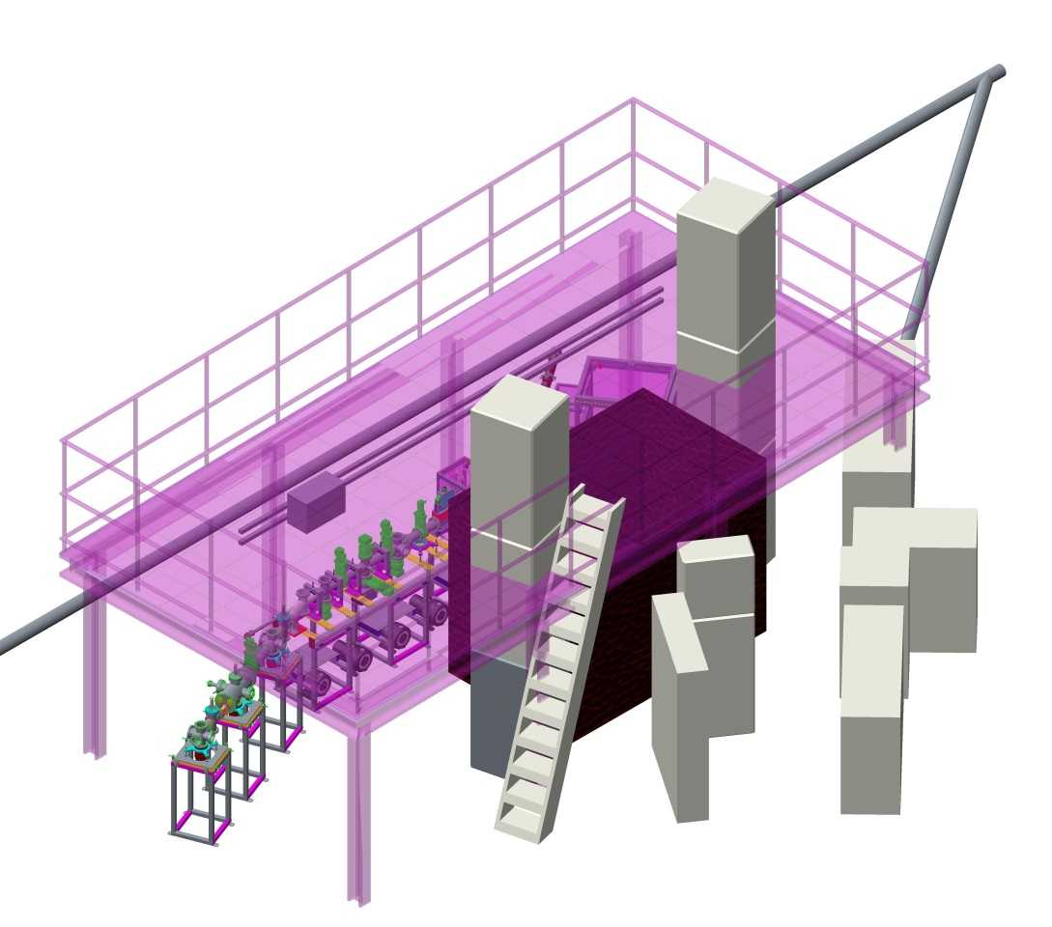
Proposal: Platform above CRIS
Disclaimer: Very preliminary drawing to highlight concept.

Slide 8
Motivation
Create required space to integrate Gandalph and CRIS.
Allow HV services and power to better organized and more accessible (improved safety)
Address laser stability and safety considerations.
Address current safety issues associated with ladder access to gangway above COLLAPS and CRIS.
Increase experimental space in hall

Slide 9
Approach
Design will require consultation with fixed experiments in the hall so that this doesn’t negatively effect their operation.
Consideration for crane access, vibrational stability and impact.
Design effort followed by cost estimation and funding requests.
Installation during the second half of LS2

