Slide 1



AD machine status
Tommy Eriksson CERN/BE/OP

Slide 2
Outline
2017 AD start-up and performance
Machine issues
AD machine developement
Run statistics
Outlook for 2018 & LS2

Slide 3
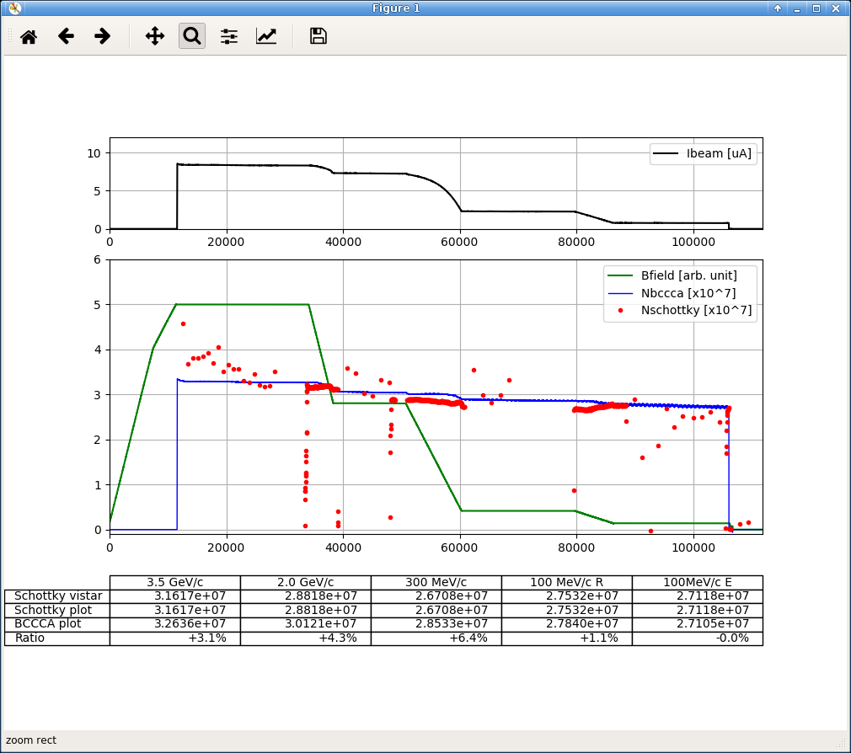
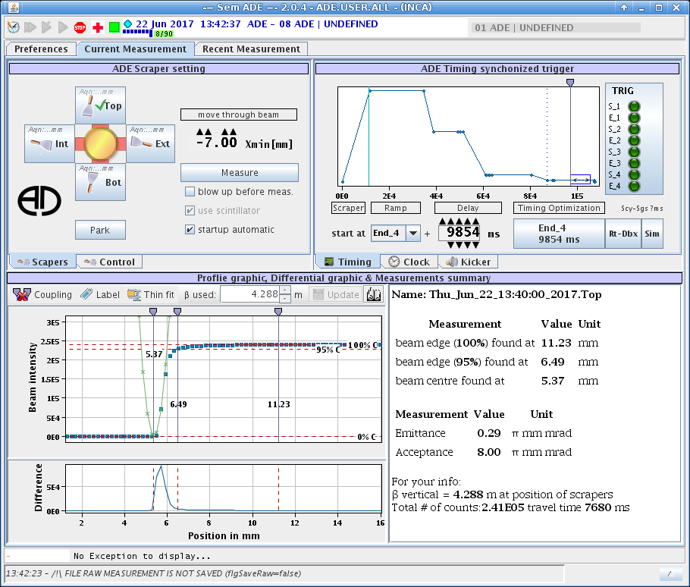
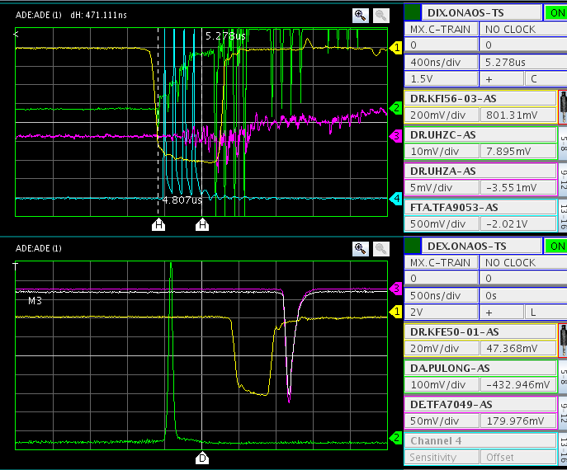
2017 AD performance
Very short start-up:
  Setting-up with beam in only 8 days – only minimal optimisation done
  Issues with kicker controls, synchro/phase PS-AD, RP alarms, destination switching etc. etc.
  Physics start as planned 1/5
Good deceleration efficiency and excellent beam quality at 100Mev/c: Eh/Ev < 0.3 um, absence of “halo”, lbunch=110ns => stable throughout the year

Slide 4
Machine issues (physics run)
Periods with Hor. position fluctuations of ejected beam @ ALPHA, ASACUSA, ATRAP:
  Situation improved towards end of run
  Intermittent fault found on power converter DE0.DHZ45
  Ej. kicker timing drift: unstable during periods, problem found
  Ej. septum pulse shape modified in 2016: additional kick prior to ejection no longer visible
  To be continued…
New kicker electronics/controls: still hiccups & teething problems
RP alarms due to: PS supercycle issues, Inj. kicker malfunctioning, TT2 beam transfer elements etc.
Re-tuning of injection line before & after target done in Sept. to recover reduced intensity
Intensity reduced again the last few weeks, no action. To be addressed during 2018 start-up:
  Capture losses at 3.5 Gev/c due to increased long. emittances ?
  Acceptances reduced ?
  Injection line tuning ?

Slide 5
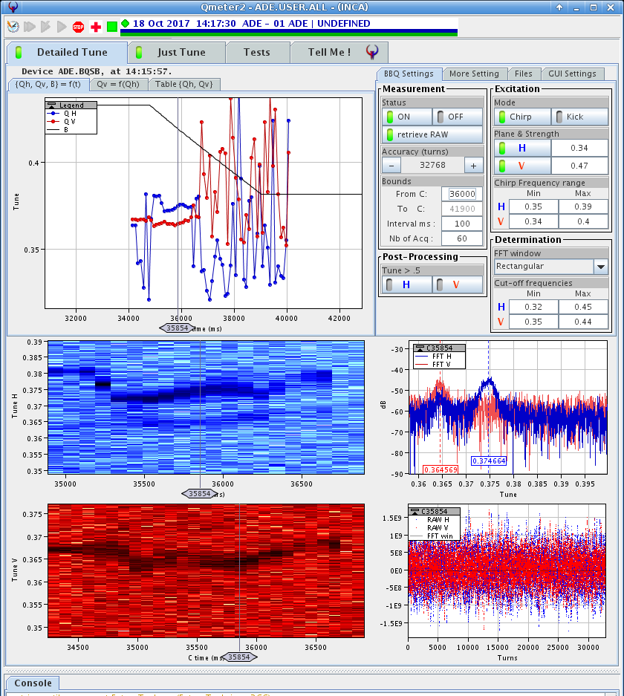
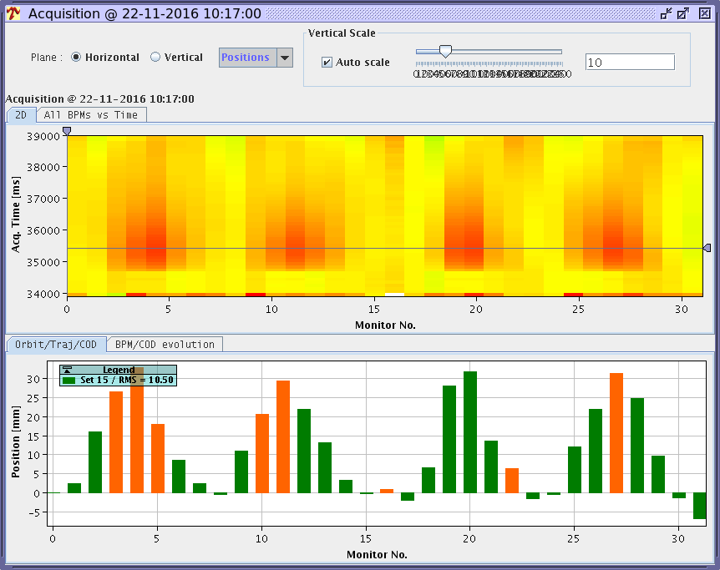
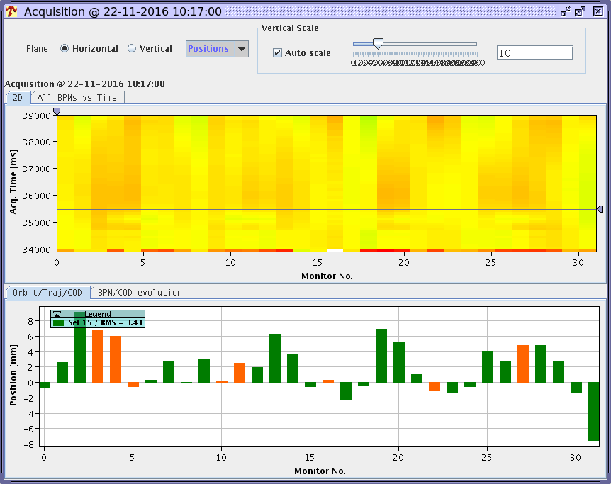
Machine studies
New Q-meter set-up: tune measurements possible on ramps! =>
New orbit measurement system: set-up including ramp measurements & correction using YASP => =>
  => Further optimisation can now be done throughout the cycle to obtain more margins
Stochastic cooling optical notch filter (successful) tests. Will be tested further in 2018 for stability issues.
Tests of Pbar yield dependency of field of 2 final focusing Quadrupoles before target in view of LS2 replacement with permanent magnets – to be continued in 2018

Slide 6
AD statistics
Running for physics since 2000, > 55000 physics hours realized, (no machine runs in 2005 & 2013):
run time (h) | 2000 | 2001 | 2002 | 2003 | 2004 | 2005 | 2006 | 2007 | 2008 | 2009 | 2010 | 2011 | 2012 | 2013 | 2014 | 2015 | 2016 | 2017
Total | 3600 | 3050 | 2800 | 2800 | 3400 | 0 | 2925 | 3800 | 3340 | 4600 | 4610 | 4680 | 5480 | 0 | 2185 | 3300 | 5440 | 5400
Physics | 1550 | 2250 | 2100 | 2300 | 3090 | 0 | 2765 | 3760 | 3140 | 4460 | 4550 | 4530 | 5360 | 0 | 2135 | 3250 | 5375 | 5190
ELENA |  |  |  |  |  |  |  |  |  |  |  |  |  |  |  |  |  | 174
md | 2050 | 800 | 700 | 500 | 310 | 0 | 160 | 40 | 200 | 140 | 60 | 150 | 120 | 0 | 50 | 50 | 63 | 32
Beam available for physics (%) | 86 | 89 | 90 | 90 | 71 |  | 65 | 76 | 81 | 78 | 87 | 84 | 90 |  | 85 | 89 | 86 | 95.4
Uptime AD machine (%) |  |  |  |  | 89 |  | 74 | 81 | 93 | 92 | 91 | 90 | 95 |  | 90 | 92 | 93 | 97.6
Beam time distribution:
ASACUSA 1232h
ATRAP 914h
ALPHA 1622h
AEGIS 1229h
BASE 194h
ELENA 174h
AD md 32h

Slide 7
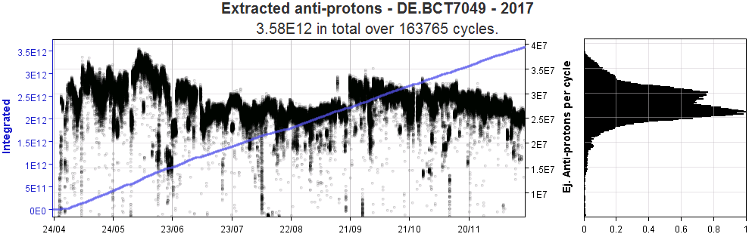
Ejected beam intensity 2017

Slide 8
Faults
~ 50/50 AD vs. Injector (L2, PSB, PS) faults
AD downtime spread over the systems, some examples:
  Power converters; many units in ring & transfer lines
  Infrastructure (cooling water, el. glitches etc.)
  C02/C10 RF systems: various faults
  Target area: water infiltration, interlocks (cooling & chariot positions)
  Electron cooling
  Vacuum
  Injection/ejection kickers

Slide 9
Outlook for 2018 and beyond
2017/18 YETS activities (see F.Butin:s talk for planning):
Ongoing consolidation program:
  Ring magnets renovation, replace degraded shimming. 1 BH (no.6 of 24), 2 Quads (only a few done so far, 56 in total).
  Ring corrector dipole power converters renewal
  Profile measurement system, replace obsolete scrapers/motor drive
  Ccc (high sensitivity BCT); maintenance, cryostat improvement
  C10 RF system; tests of refurbished TH116 triodes => determine consolidation needs
LS2 - heavy activities in ADT & ADR:
  Major ADT refurbishment after 30 years w/o major interventions: new target design & new horns including trolleys, new ventilation building B196, new ventilation/cooling systems, magnet consolidation, infrastructure, decontamination etc.
  Finalise most of ADR consolidation: magnets, RF C02 (PSB finemet prototype), RF C10, stochastic cooling upgrade, new electron cooler, power converters,

Slide 10
Key dates 2017
  https://beams.web.cern.ch/sites/beams.web.cern.ch/files/schedules/Injector_Schedule_2018.pdf
  Close AD ring & Target Area 12:th March
  12 – 25 March: Safety tests, HW tests, cold check-out
  26 March: PS beam available
  26 March – 8 April: setting-up with beam
  9 April: start physics + ELENA pbar commissioning
  Pbar beam for AD physics 9/4 – 12/11 (31 weeks)

