Slide 1
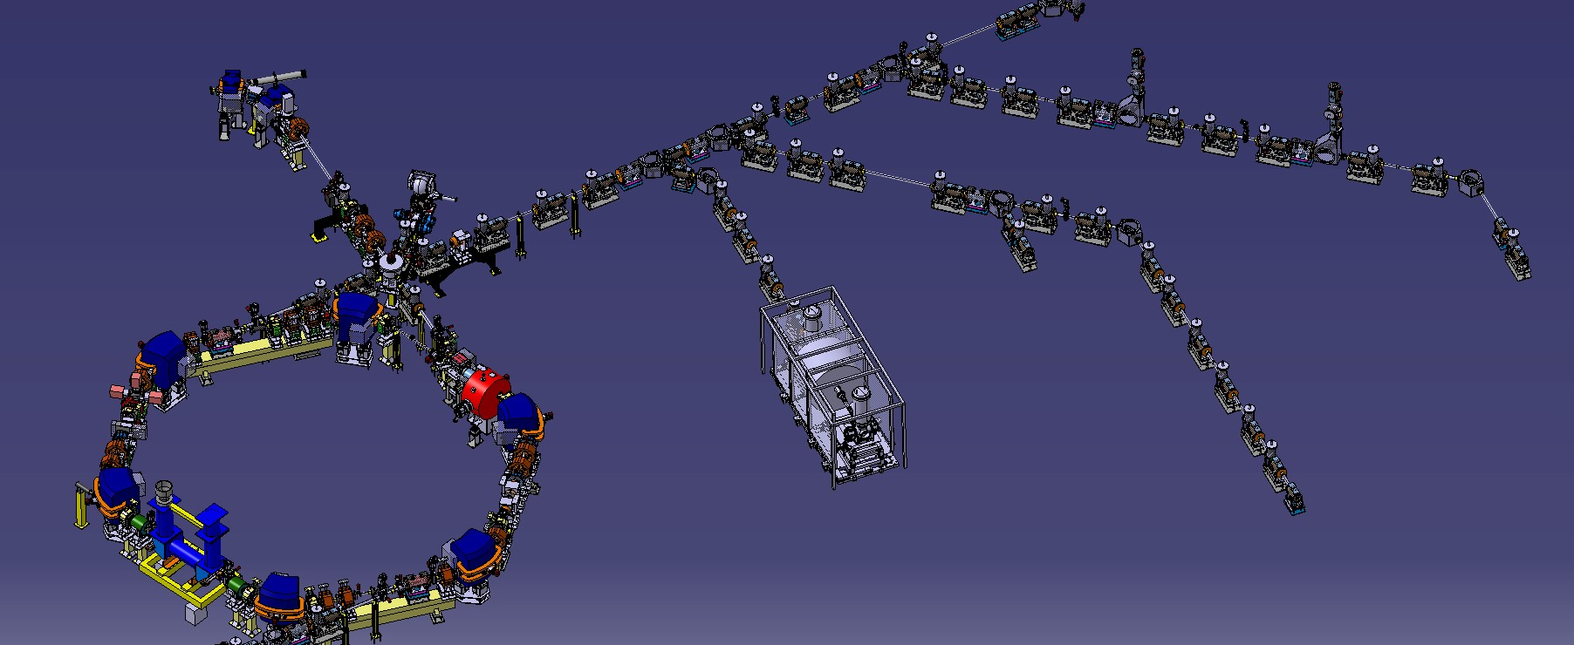
ELENA Status
C. Carli on behalf of the AD/ELENA team(s) AD Users Committee, 23rd January 2018
Introduction
Results from ELENA Commissioning
Electron Cooler
Plans for 2018
Summary and Oitlook

Slide 2
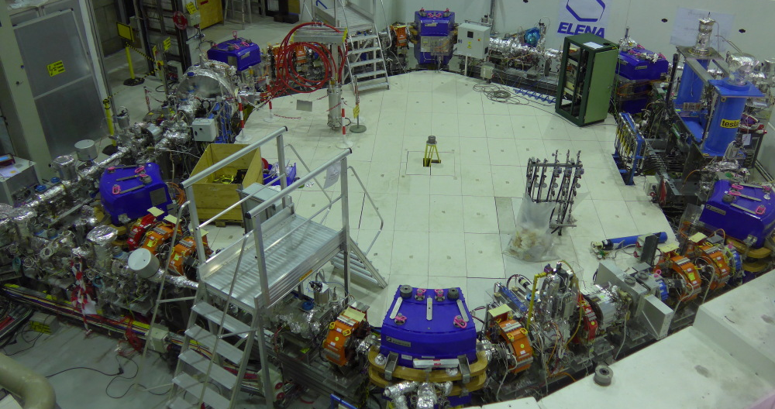
Introduction
Controlled Deceleration of 5.3 MeV Antiprotons from AD down to 100 keV
Improved Capture Efficiency of (typical) existing Experiments and new types of Experiments (GBAR)
Magnetic ring and injection line, electrostatic ejection lines (effective at low energies)
Challenges related to low energy (e.g. magnetic field quality) and intensity
Injection with magnetic
septum and kicker
Magnetic Pick-up
(Schottky diagnostics
for intensity, LLRF..)
Extraction towards new experimental
zone (GBAR) - fast deflector
followed by el.-static transfer lines
Electron Cooler
installed,
bake-out soon
Transfer line
from AD
Wideband RF cavities
(very similar to new
PSB cavities)
Extraction towards
existing experiments
Scraper to
measure emittance

Slide 3
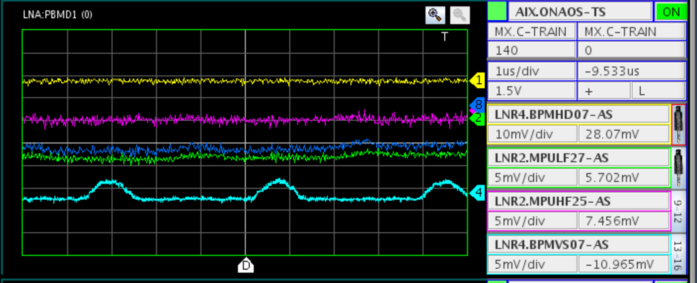
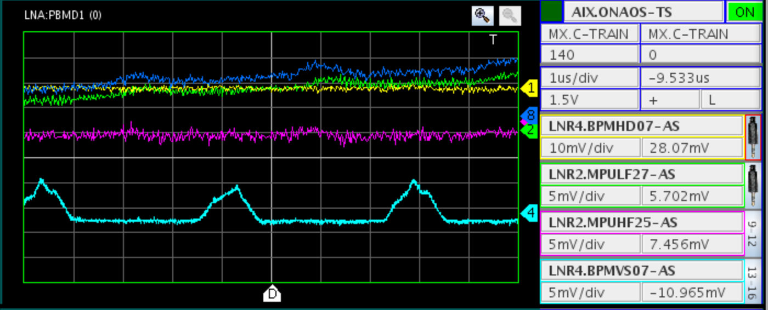
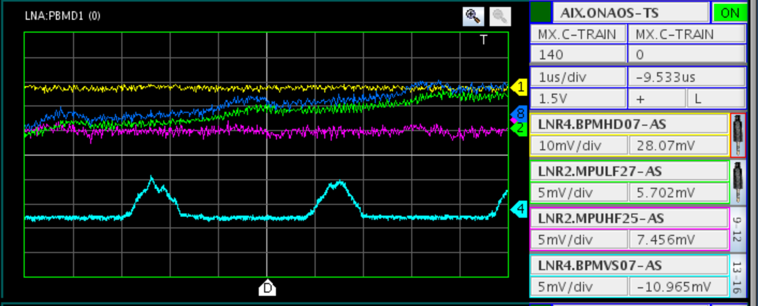
Results from ELENA Commissioning – with H⁻ Beams from Source
Source operated now at 85 keV instead of 100 keV because of problems with the isolation transformer
Few 100 ms life-time observed with RF (very basic functionalities) since spring
Successful commissioning of orbit system, partly tune system and scraper
Issues during summer: poor reproducibility (shot-to-shot fluctuation and long term drift) of H⁻ injection, times technical problems with source, more time than expected to install GBAR line
Improved reproducibility of injection from about end of September (Why? Just careful tuning?)
Two bunches with about 1 to 2.10⁶ H⁻
ions each after 140 ms
  Ready to continue commissioning of
  systems as RF, tune measurement …?
  Measurements from 3rd October (had
  again been difficult on 2nd October)

Slide 4
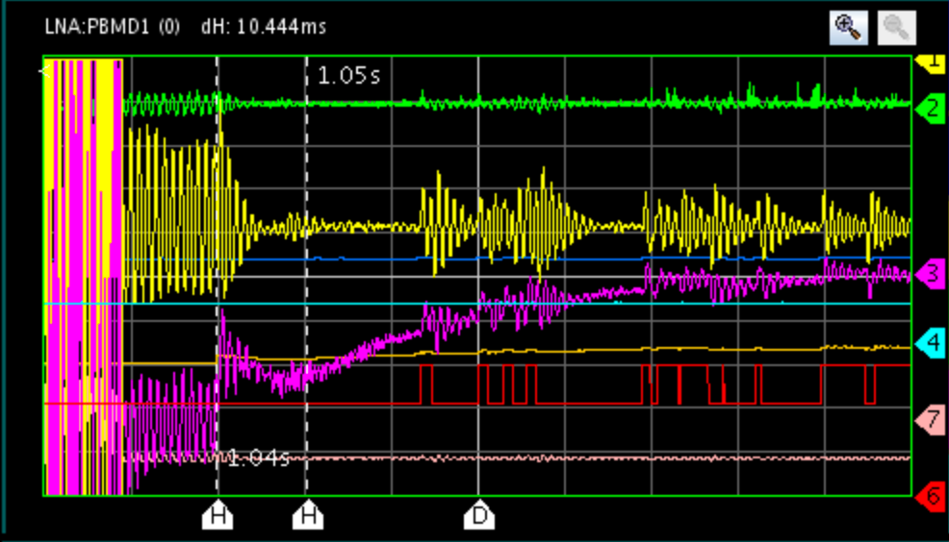
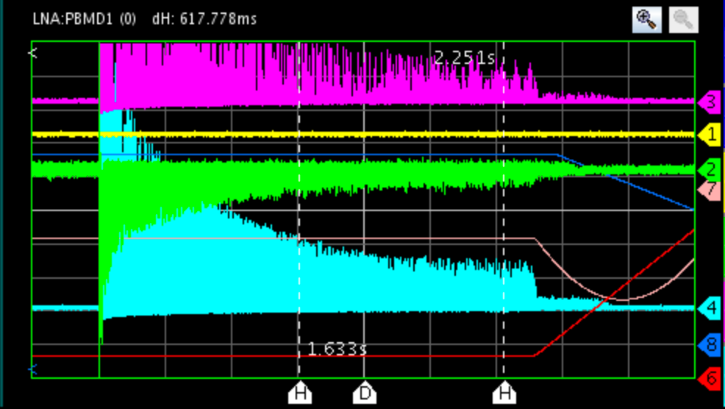
Results from ELENA Commissioning – with H⁻ Beams from Source
RF System
  Issues with noise on magnetic pick-up
  => RF system uses sum signal of position
  pick-up to detect beam phase
  Phase and radial loop operational
  Improved life-time with phase loop
  Sometimes sudden jumps of frequency from
  “B-train” excites synchrotron oscillations
Recent results
  Improved life-time with phase loop
  of RF system
  Allowed further increase of life-time to
  > 1s by adjustments of quadrupole currents
  Small amount of beam accelerated (was not
  aim at that time, fast transition from
  flat-bottom to ramp …)
Phase offset
10 ms/div
Radial offset
Position pick-up sum signal
(not proportional to intensity)
200 ms/div
Life-time > 1s
Small fraction of beam accelerated

Slide 5
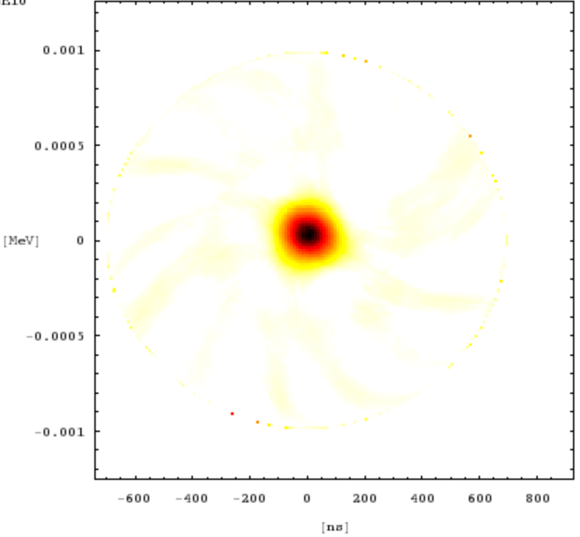
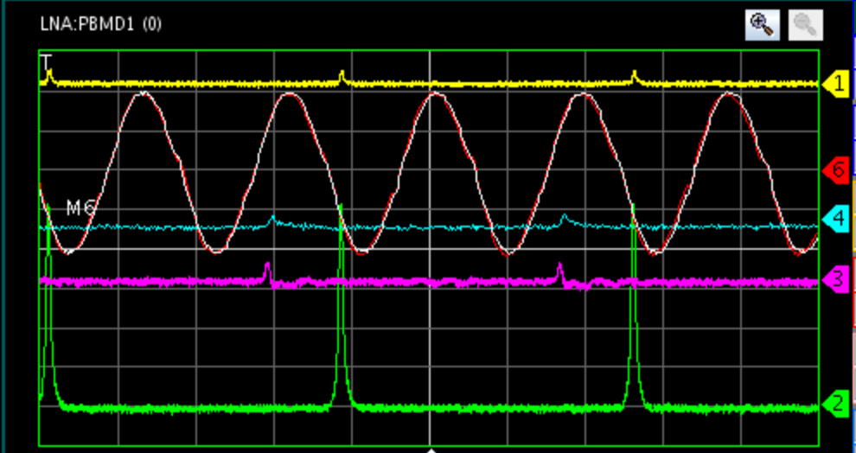
Results from ELENA Commissioning – with H⁻ Beams from Source
H⁻ extraction into LNE50 line towards GBAR
  Modification of timings system: revolution train generated by the Low Level RF system (LLRF) to trigger source and fast deflector for extraction
  Possible to inject with RF on (into “buckets”) to keep small longitudinal emittances and short bunches(had not been foreseen initially)
  Fast deflector for extraction synchronized with RF (even for RF not yet synchronized with external reference)
RF Voltage
2 us/div
-1 0 (keV) 1 y
-400 0 400 (ns) 800
Pick-up sum signal

Slide 6
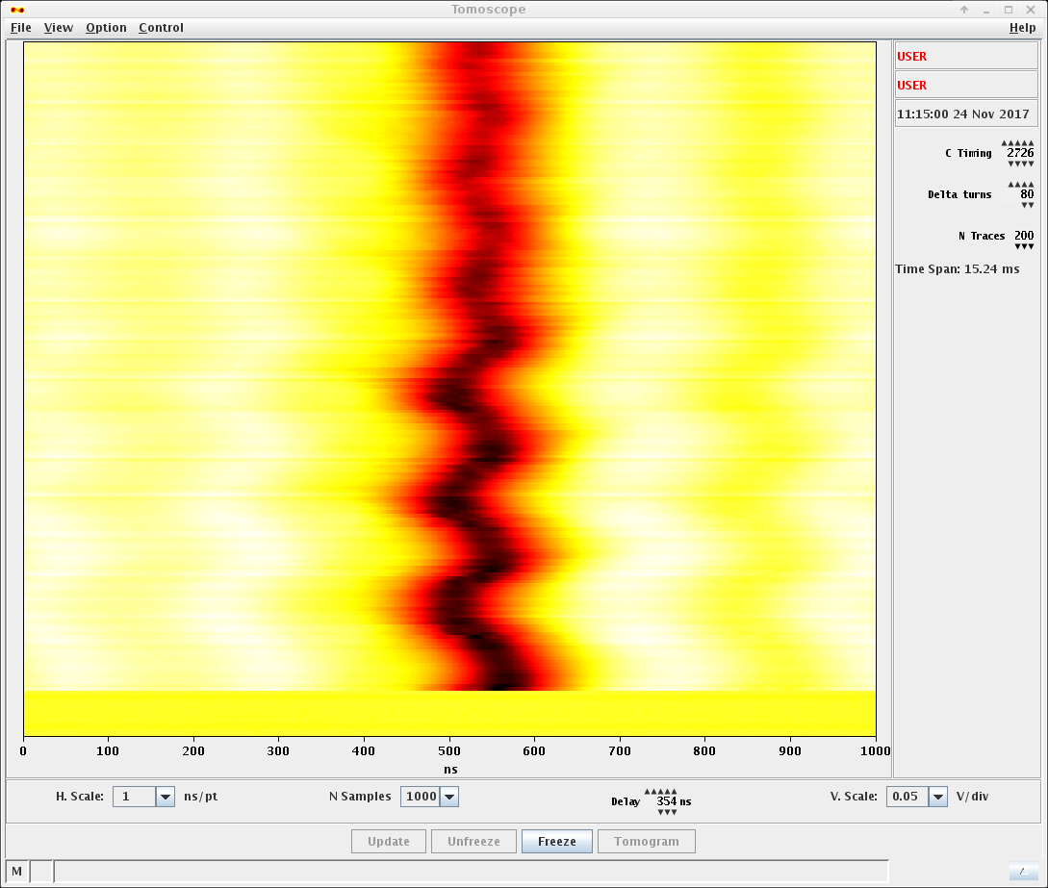
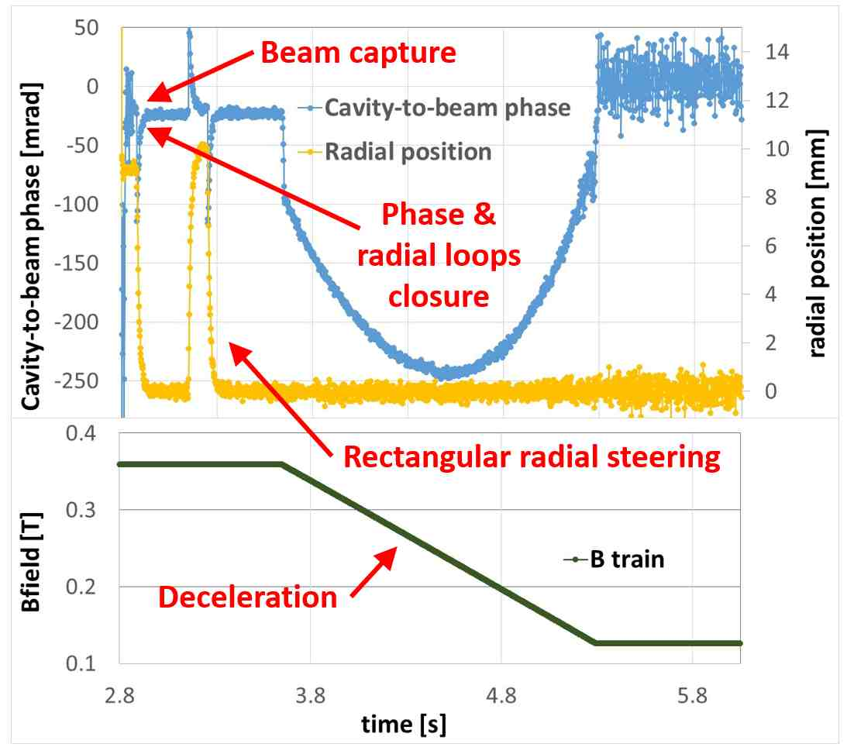
Results from ELENA Commissioning – with Antiprotons from the AD
Successfully deployed in ELENA bunch to bucket transfer from AD (~ 3.2E7 pbars)
of radial loop
Bunch transferred into ELENA waiting bucket -
Phase loop damps synchrotron oscillations

Slide 7
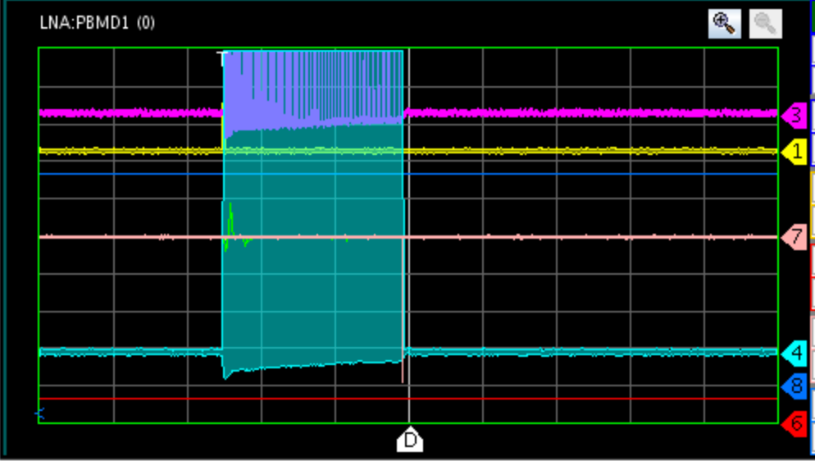
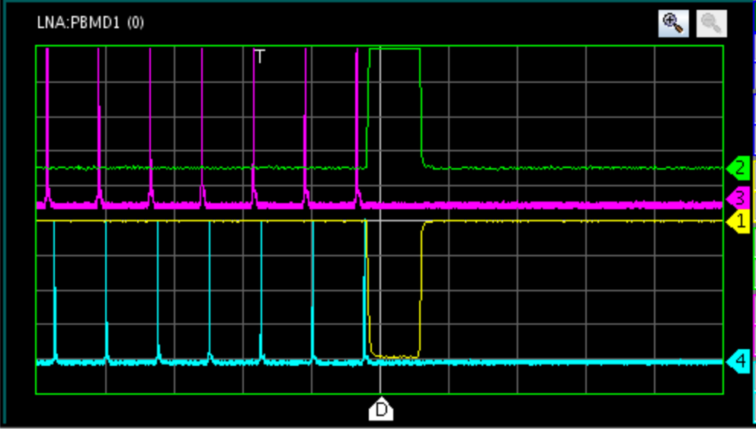
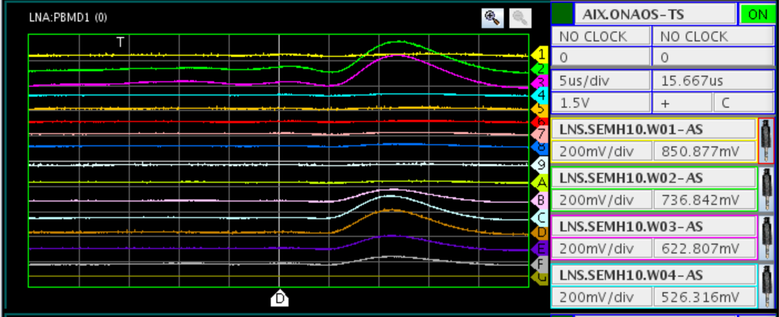
Results from ELENA Commissioning – with H⁻ Beams from Source
H⁻ extraction into LNE50 line towards GBAR (cont’d)
Acquisitions of signals from position pick-ups in ring
  Acquisition with profile monitor
  in LNE50 line
    Signals clearly due to beam ..
    .. difficult to interpret
    Hypothesis: vertical profile
    (horizontal wires) observed
    and connections not correct
20 ms/div
10 us/div
Fast deflector

Slide 8
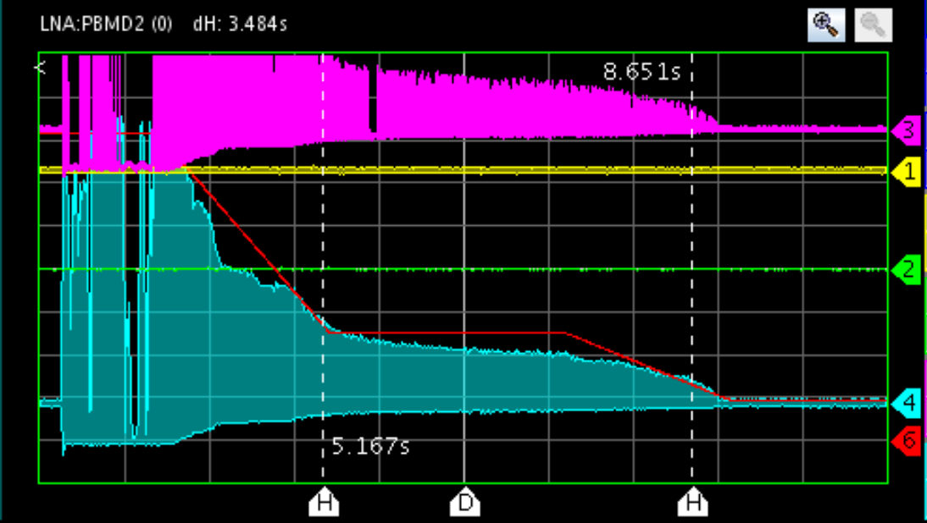
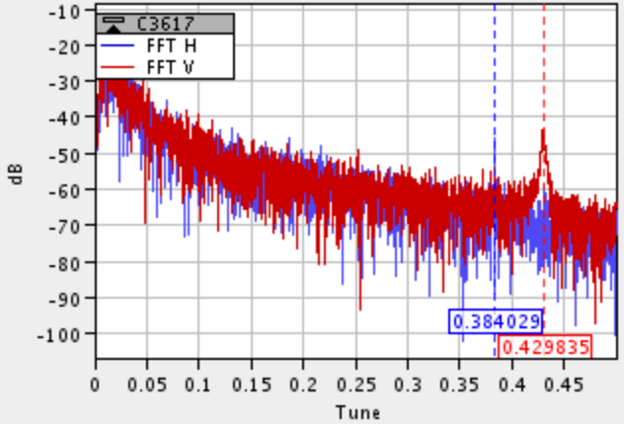
Results from ELENA Commissioning – with Antiprotons from the AD
With Antiprotons from the AD (typically one or two 8hr-shifts per week)
  Successful transfer from the AD, injection with bunch-to-bucket transfer, correction of injection oscillations tested, tests of instrumentation ….
  Some antiprotons (fraction of injected beam) decelerated until end of ramp without electron cooling (lost at 100 keV arriving at the low energy plateau)
Electron cooler installed now and prepared for bake-out: looking forward to completion of ELENA commissioning next year aiming at demonstrating nominal cycle
Test of the Q-meter:
Vertical plane excited, horizontal
tune seen without excitation
Position pick-up sum signal
(not proportional to intensity)
Ramp 650 keV
to 100 keV
Beam in machine during ~6.5 s until end of 2nd ramp
(not yet nominal cycle, longer plateaus)

Slide 9
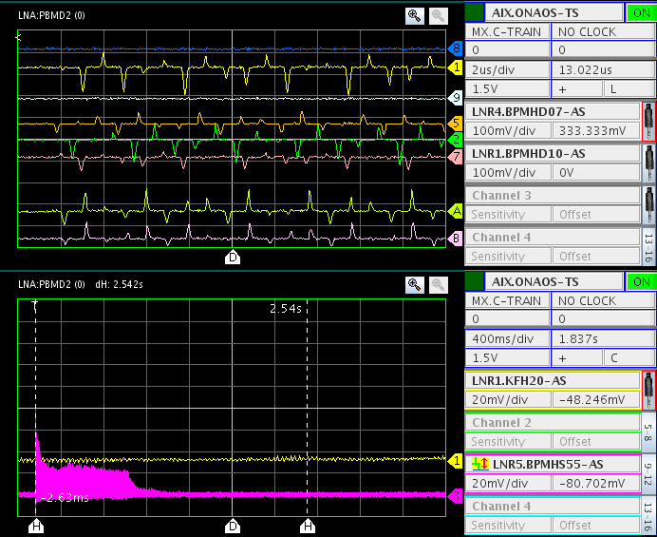
Results from ELENA Commissioning – with Antiprotons from the AD
Correction of injection oscillations
  Use sum signal to detect
  turn-by-turn positions
  Quantify injection
  mis-steerings
  Compute correction
Procedure set up and tested
Good basis to work on
deceleration together with
bunch to bucket transfer

Slide 10
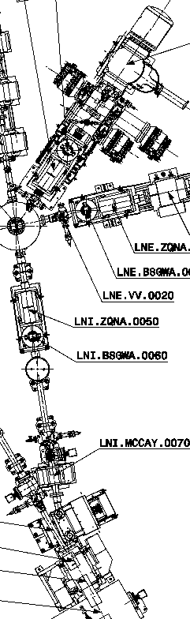
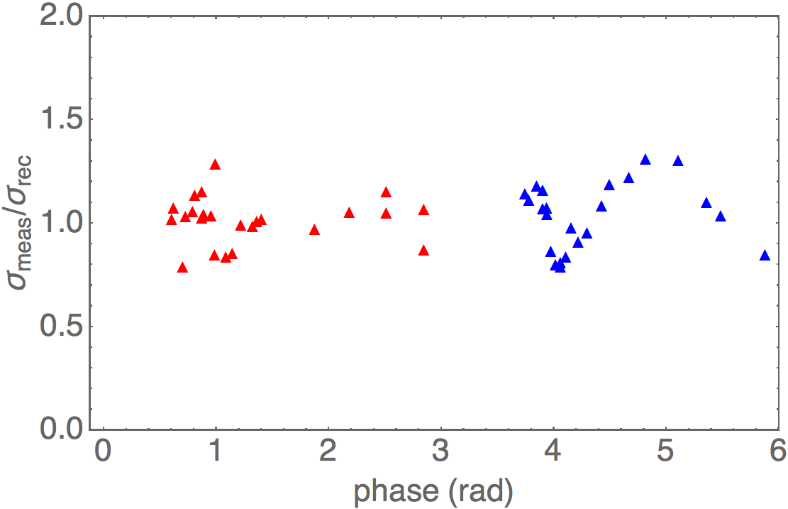
Results from ELENA Commissioning –
Line from Source to Ring
Source
Quadrupole scan to measure beam characteristics
  Variation of the setting of (two) quadrupoles
  Observation of beam sizes with a monitor (TV screen between septum and kicker)
  Reconstructed characteristics at the reference
    Hor.: ε_{x,rms} = 4.71 μm, β_{x} = 1.4151 m and α_{x} = -3.0061
    Vert.: ε_{y,rms} = 5.08 μm, β_{y} = 0.8381 m and α_{y} = -2.6142
Improved setting of line not (yet) tested
Reference location
for reconstruction
Setting of
of 2 quads
varied
vertical
horizontal
TV screen
  Ratio between measured beam size and beam sizes from reconstruction

Slide 11
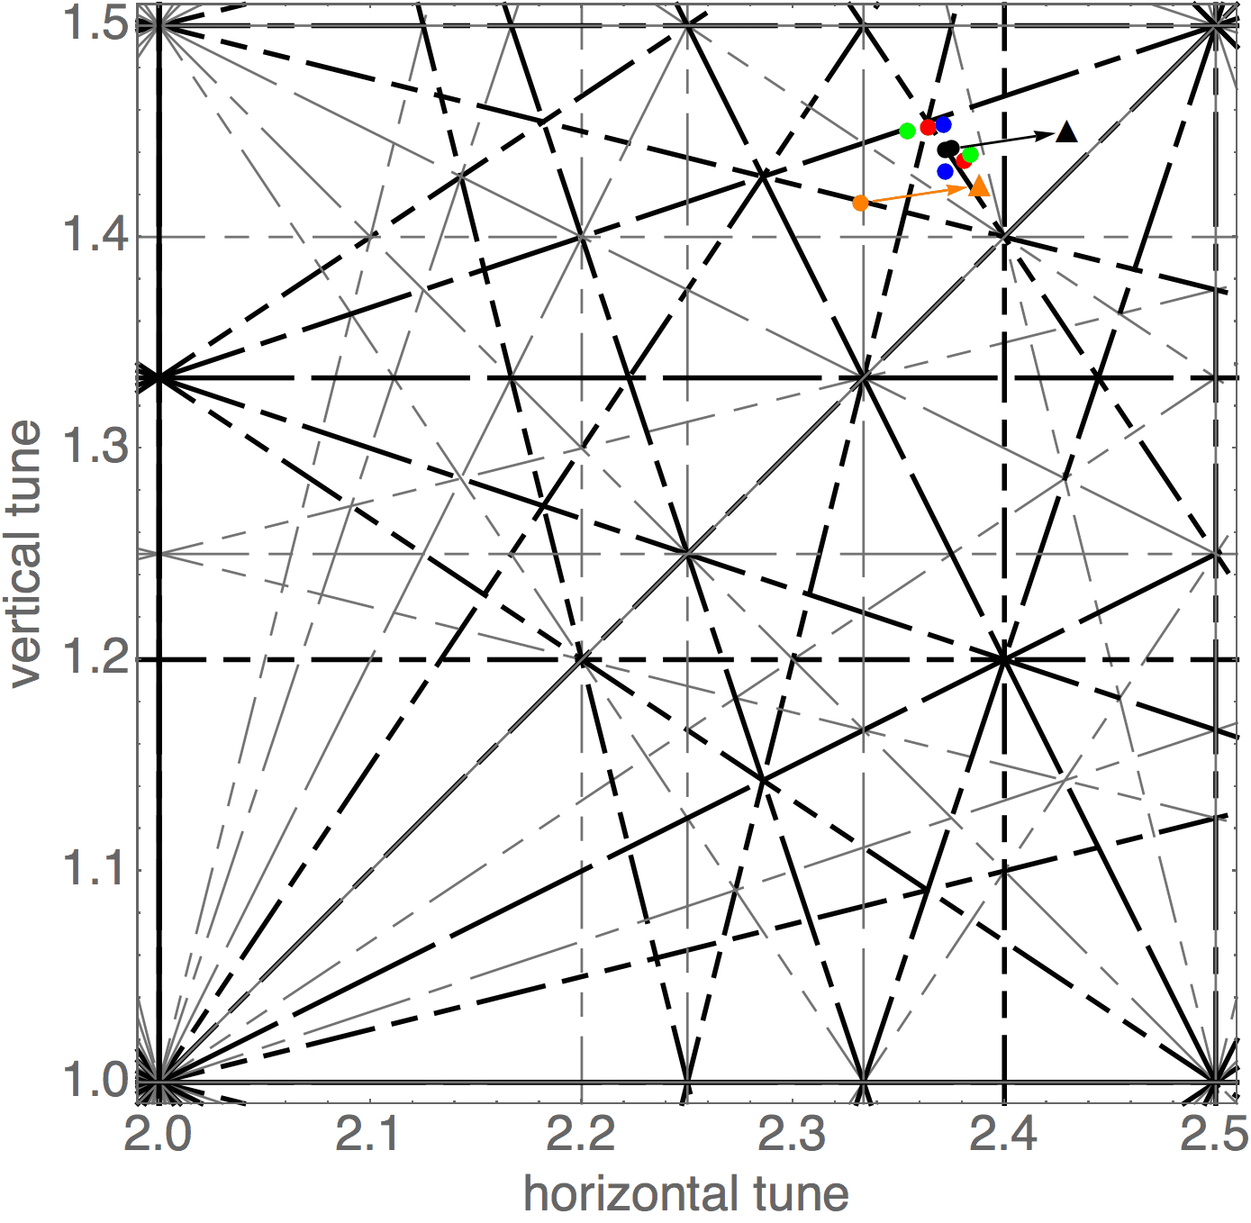
Results from ELENA Commissioning
Working points (at 85 keV with H⁻)
Tune: number (average) of transverse oscillations per revolution (two tunes for the horizontal and vertical plane)
Working point is the combination of the two tunes – must avoid “resonances”
Black: measured working point with
initial quadrupole currents
Red, blue and green: current of one of the three quadrupole circuits changed by ±0.05 A
(Orange: working point from model with programmed quad currents)
Reassuring that behavior about as expected
Resonance diagram with working point(s)
close to 5th order resonance

Slide 12
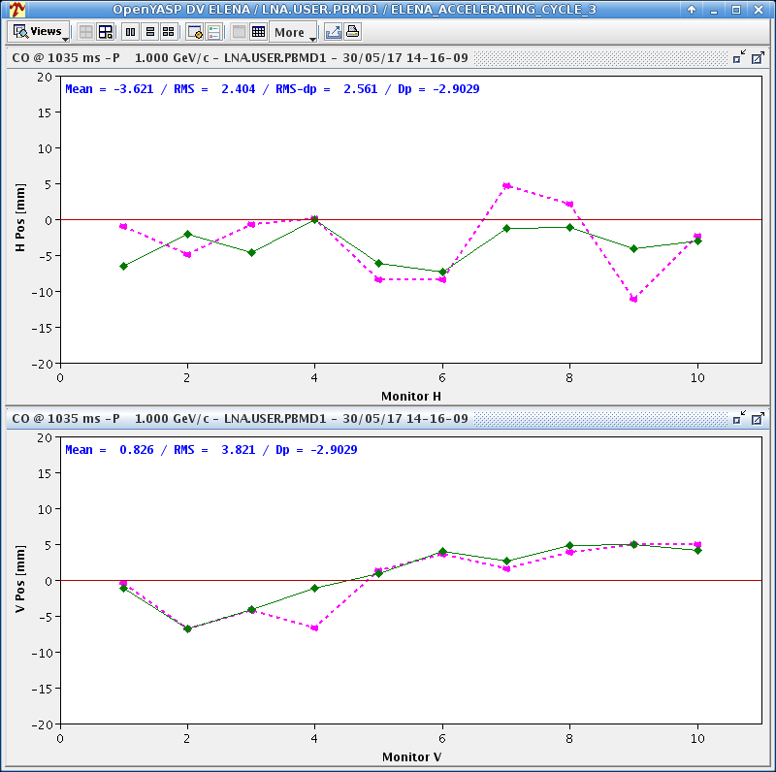
Results from ELENA Commissioning – first orbit corrections for H⁻ at 85 keV
Orbit is the transverse position of the beam as a function of the longitudinal position
  Measured at some locations with “pick-ups”
  Beam not at center of chamber due to perturbations (stray fields magnet mis-alignment ..)
  Corrector dipoles to improve
  Confidence in basic machine optics

Slide 13
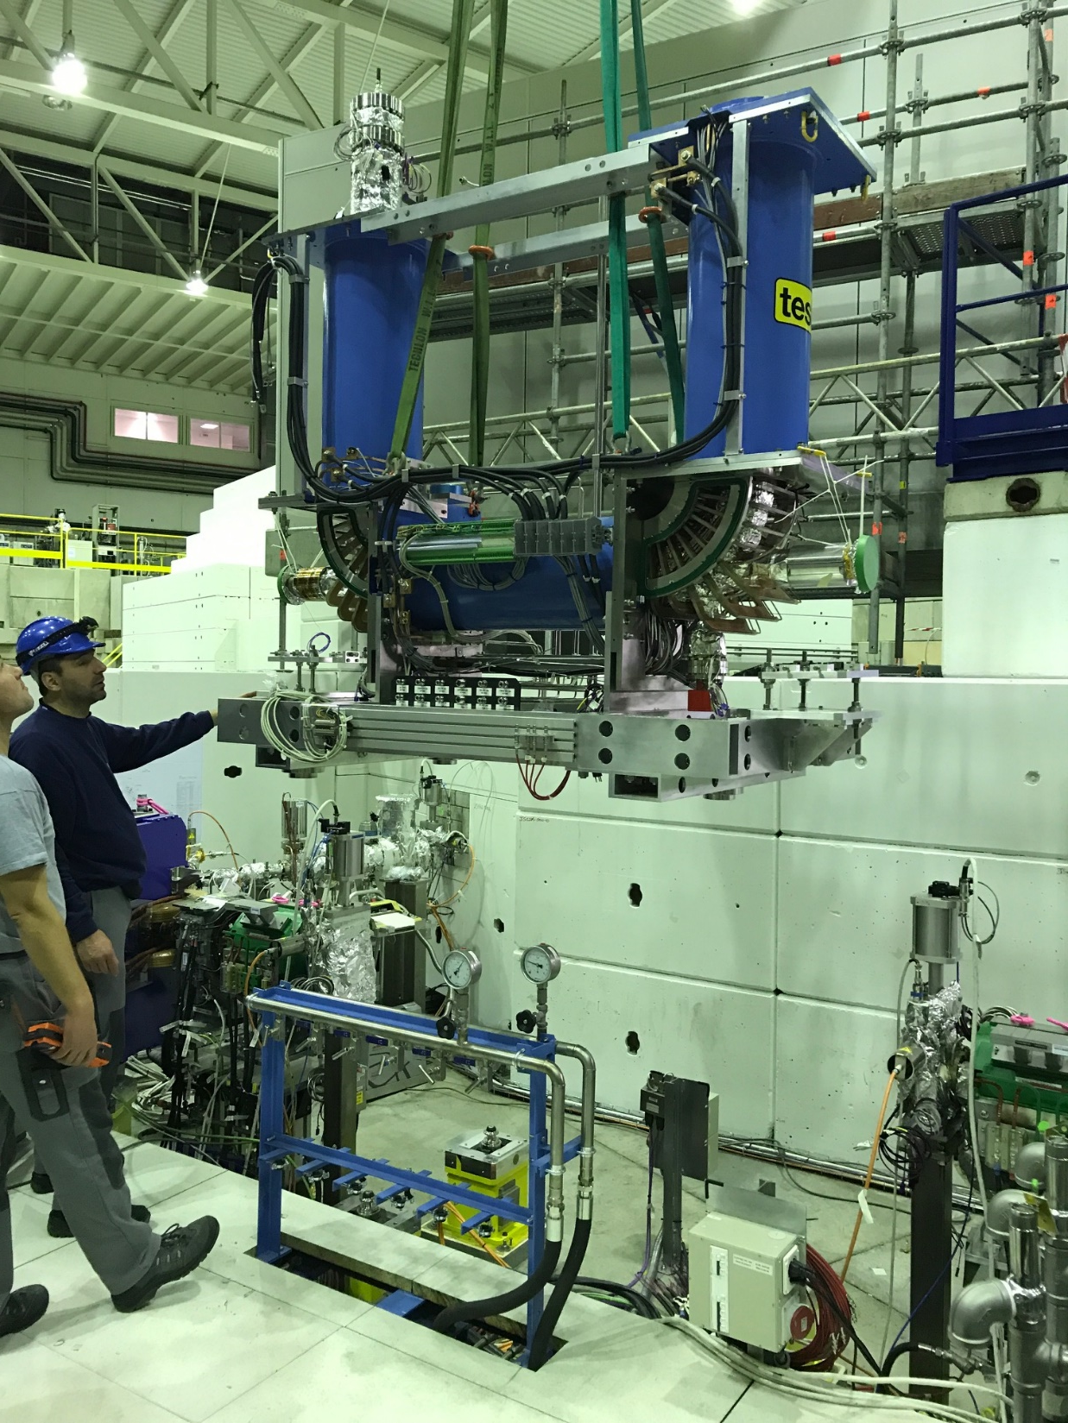
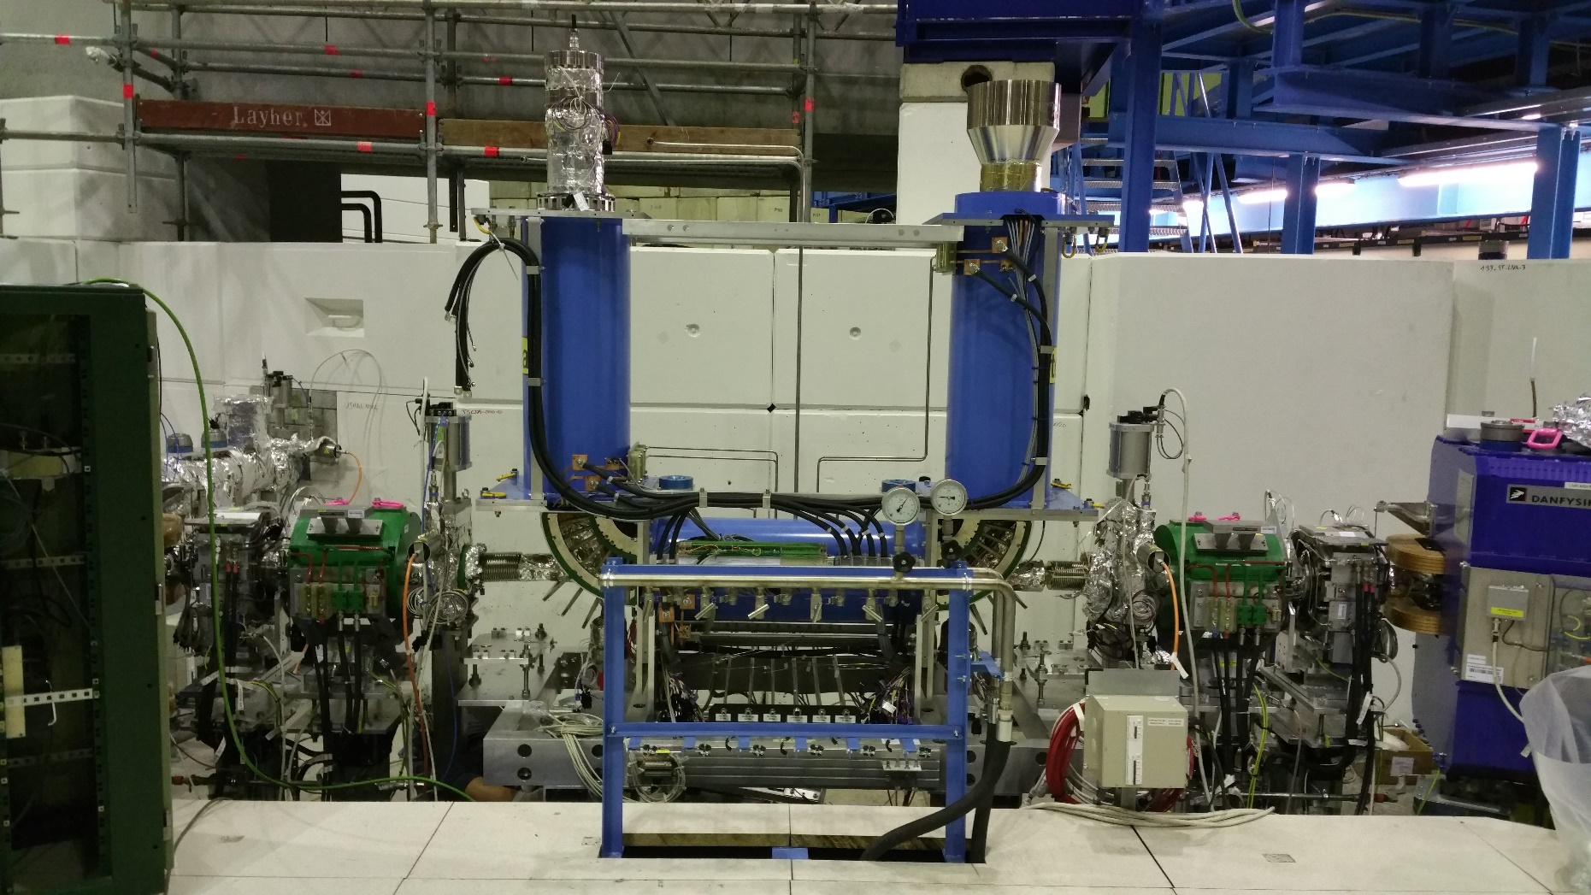
Status of Electron Cooler
Cooler installed beginning of December
  Delay due to issue with alignment (position of upstream vacuum valve)
  Vacuum leak after first bake-out last week 2018
For details see presentation
by Lars Joergensen

Slide 14
Plans for 2018
Consolidation of injection line and injection into ring
  Increase of H⁻ injection efficiency and consolidation of improved reproducibility
    Injection matching and empirical improvements
  Setting up of proton injection and cycle
    Expect similar issues than for H⁻
Acceleration of H⁻ and possibly proton beams
  For machine studies without taking precious antiprotons
Commissioning of electron cooling
  Behavior of 100 keV beam with magnetic system of cooler on?
  Observe cooling preferably with beams from the source
    Probably cooling studies to be done with protons (short H⁻ life-time due to stripping)
Further consolidation of instrumentation and corrections (orbit tune)
New isolation transformer for source and 100 keV H⁻ and proton beams in
Setting up of complete antiproton cycle to complete ELENA commissioning
… highest priority to gain confidence before the installation of the new lines!
First beams to GBAR
  Coordination with cooling studies using protons and inversed polarity?
  When does GBAR expect H⁻ and antiproton beams?

Slide 15
Summary and Outlook
ELENA commissioning up to the end of 2017
  Progress H⁻ beams from source and antiprotons from the AD, setting-up and testing of most systems – no shostopper
  Less progress than expected at the beginning of the year due to various problems (e.g. poor reproducibility of the injection)
  Electron cooler installed at the end of the year not yet available for commissioning
Aim for 2018
  Completion of ELENA ring commissioning
  Get confidence that machine works properly by having an operational antiproton cycle with deceleration, cooling and extraction
  First beams for GBAR
Plans for after 2018
  Installation and commissioning of lines to old experimental are during LS2
  100 keV antiprotons for all experiments after LS2 from 2021 on

Slide 16
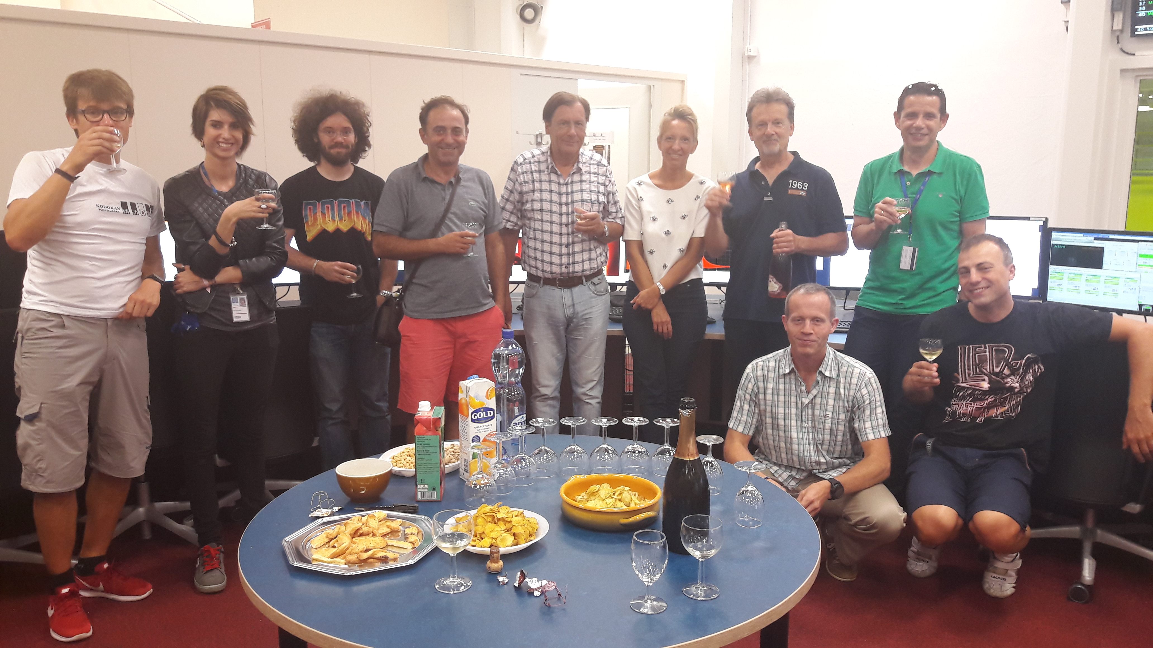
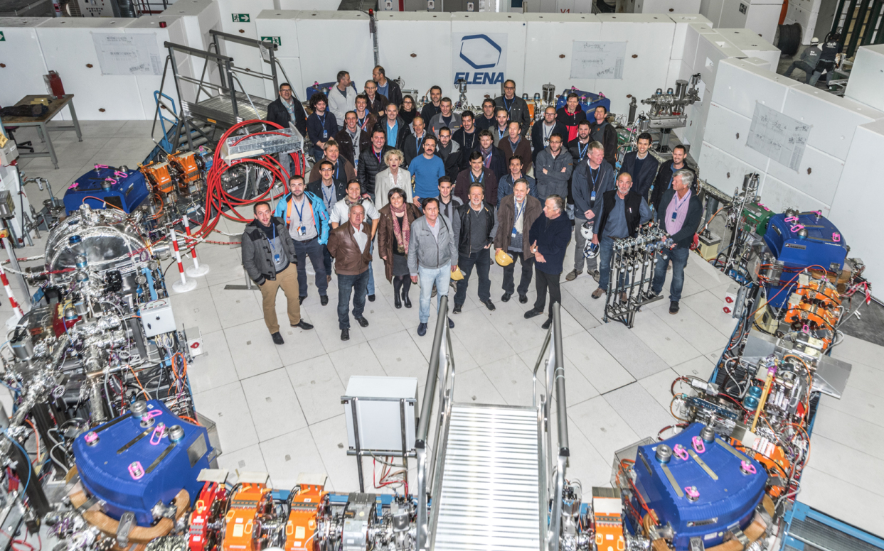
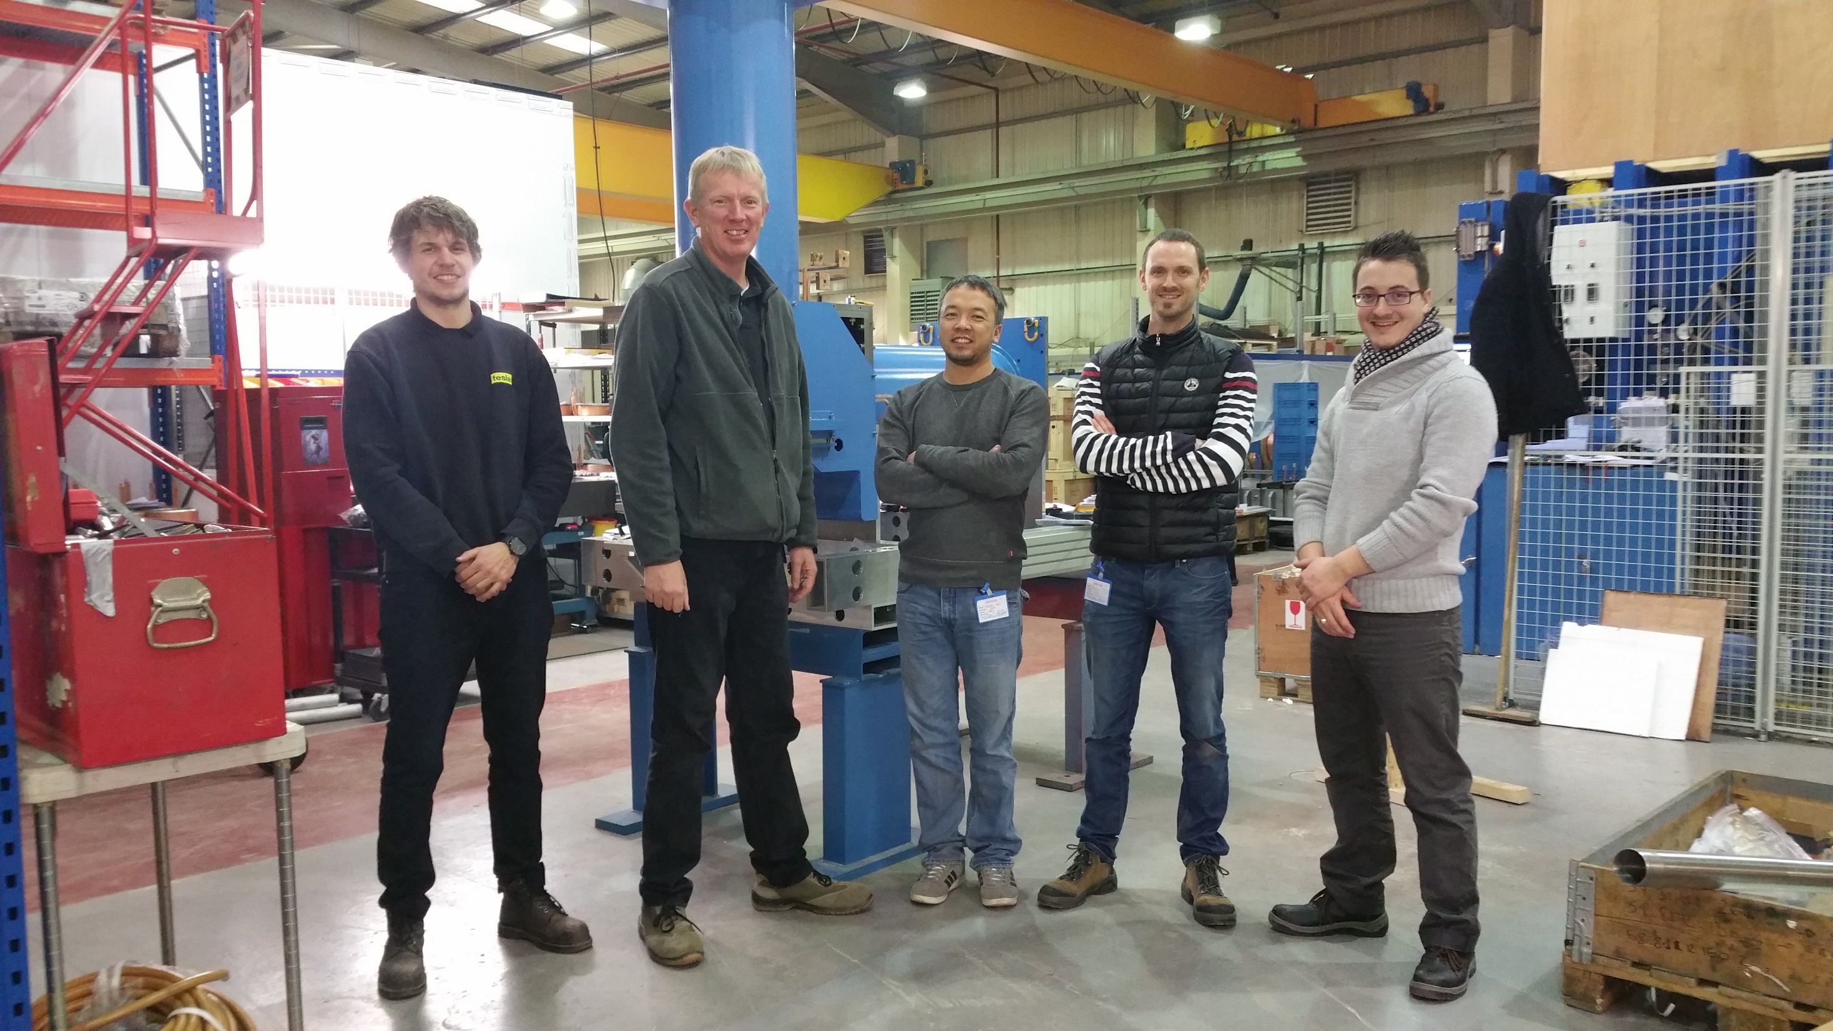
Contributors to the ELENA Project

