Slide 1
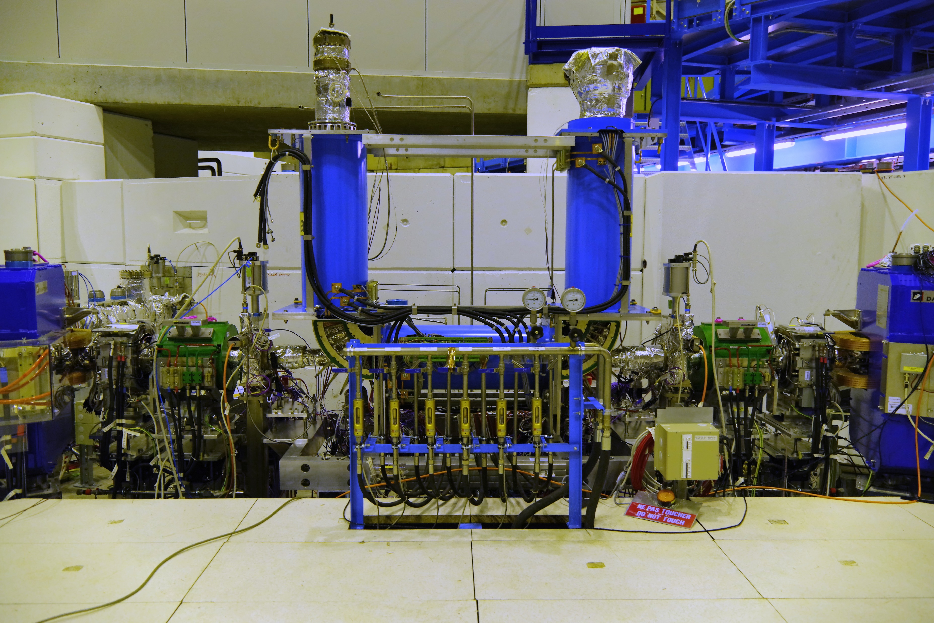
ELENA electron cooler status

Slide 2
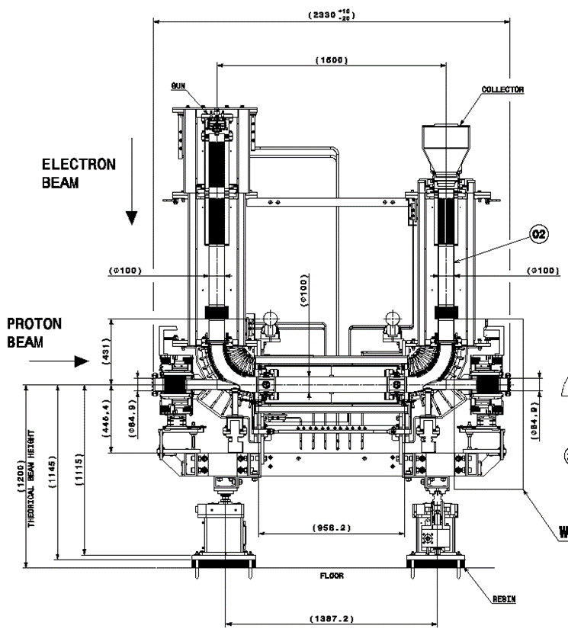

Magnetic Measurements
Measure each (4) standard solenoid to determine how to place the solenoids during assembly (B_{t}/B‖ ≤ 5x10⁻³).
Measure the remaining magnetic circuits (42).
  expansion solenoid, toroids, saddle coils, circular coils, fine-tune coils, Helmholtz coils.
Check the magnetic field model.
  effect of saddle coils, circular coils, fine-tune coils on the transverse field components.
Field map of the electron cooler assembly.
  B_{t}/B‖ ≤ 5x10⁻⁴ in the centre of the drift solenoid.

Slide 3
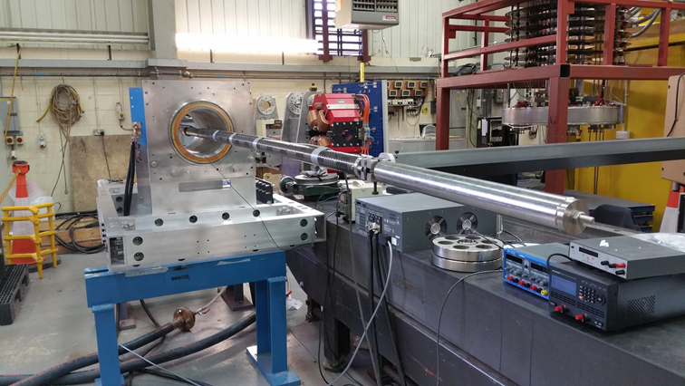
Measurement Setup
Lakeshore Model 460 Gaussmeter with 3-axis HSE probe (1 mG resolution in range up to 300 G, accuracy of ±0.1%).
Probe holder with mirror for precise alignment. Has 4 possible rotational positions with 3 mounting points (0, 10 and 25 mm).
Counter balanced carbon fibre tube to hold probe holder.
Probe carrier and tube driven and positioned with a CMM arm with ±0.5 mm accuracy.
Precise probe alignment made with an autocollimator and spider fixtures.

Slide 4
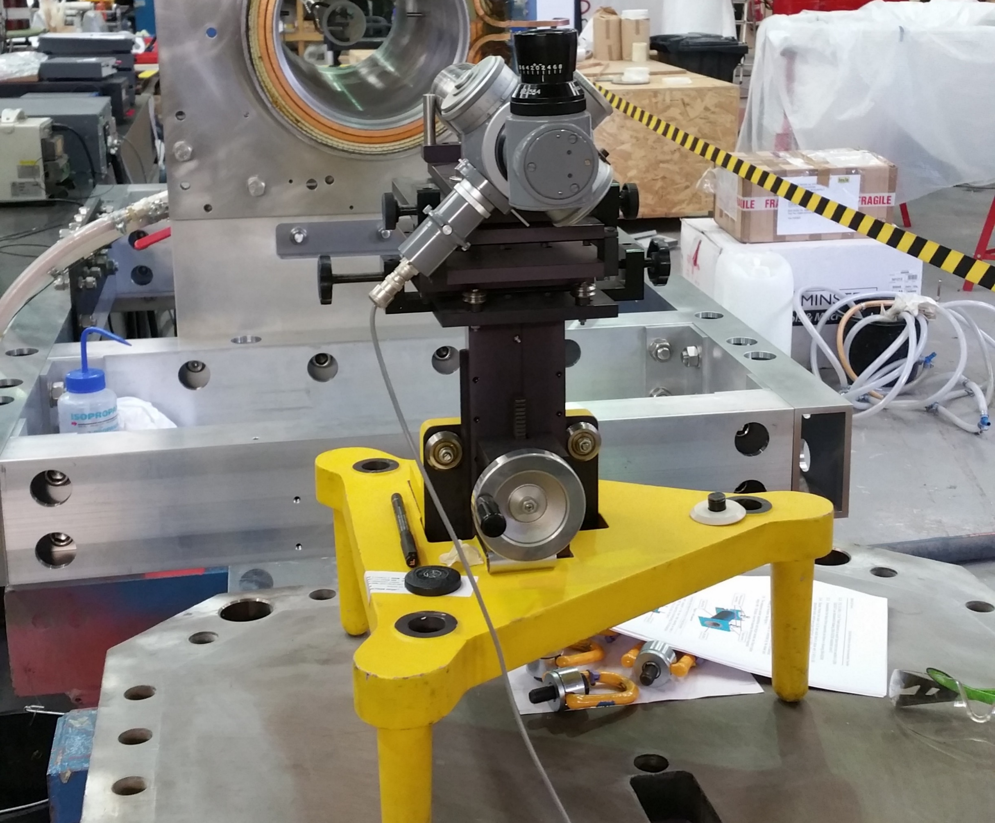
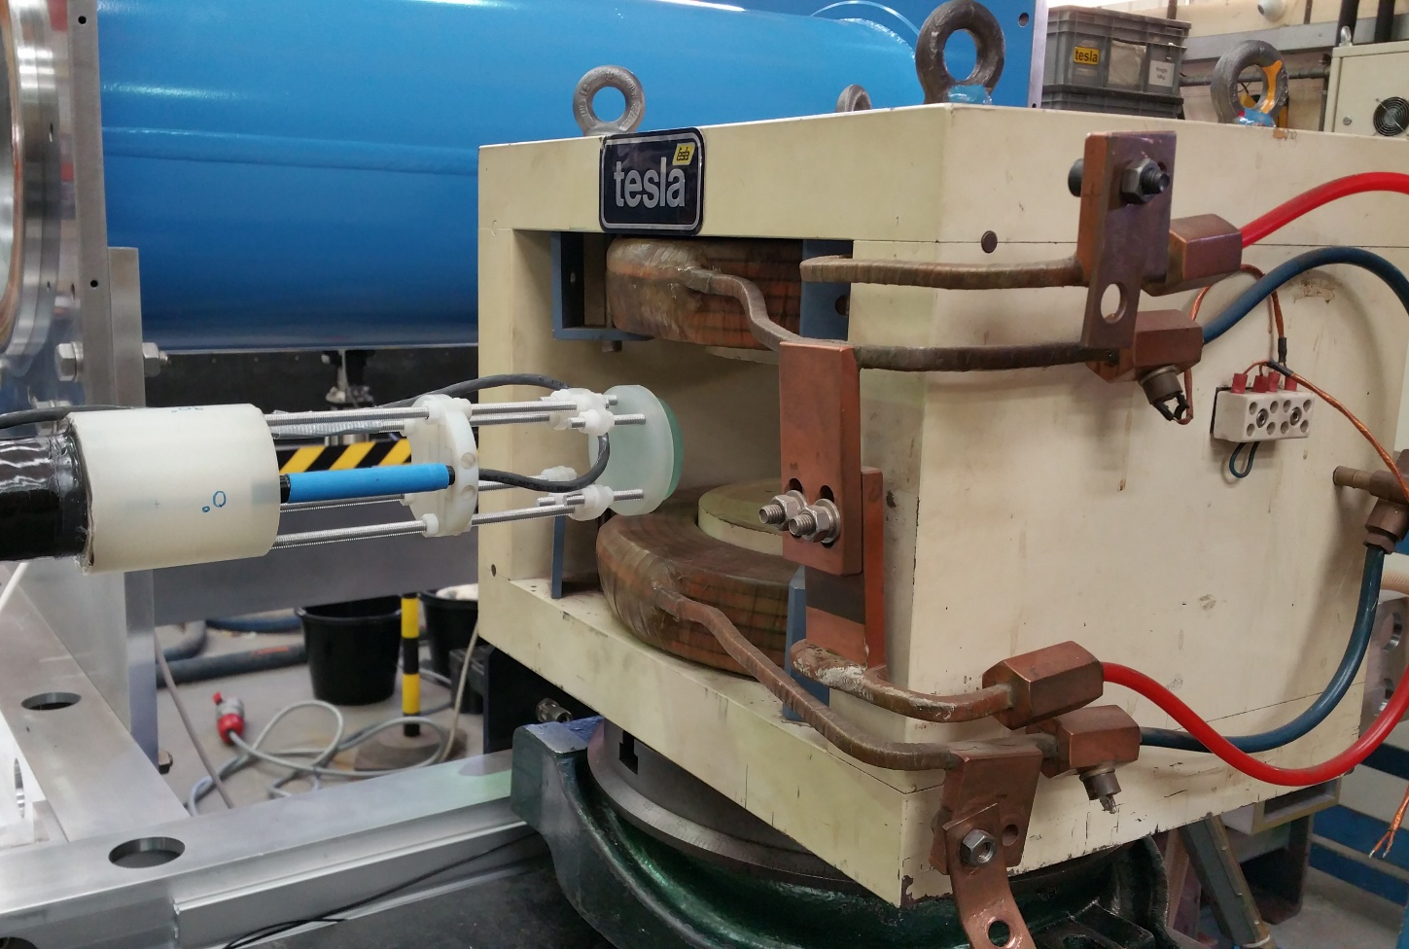
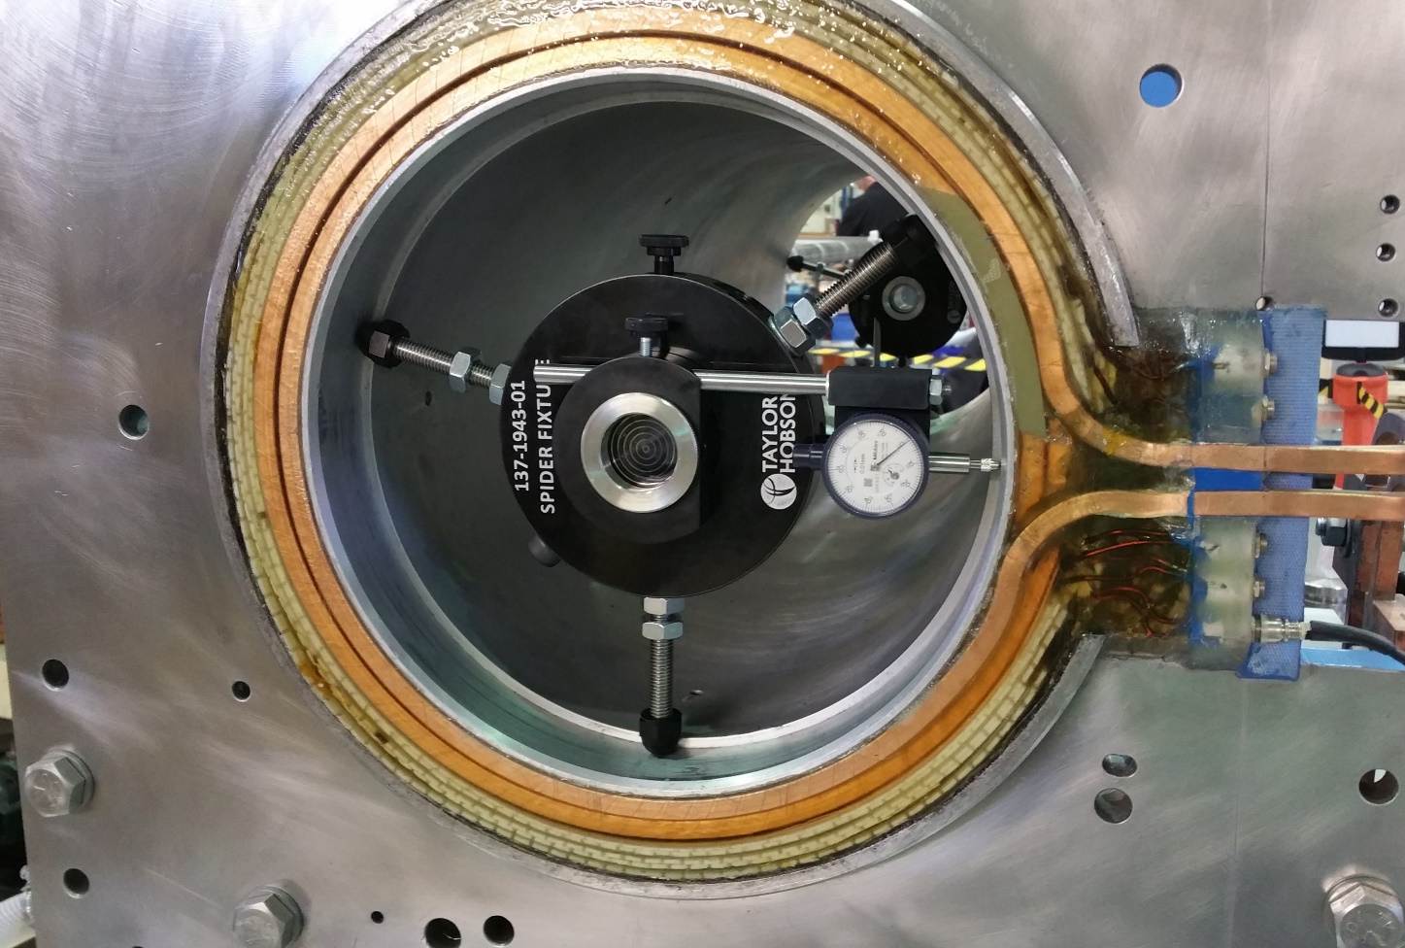

Slide 5
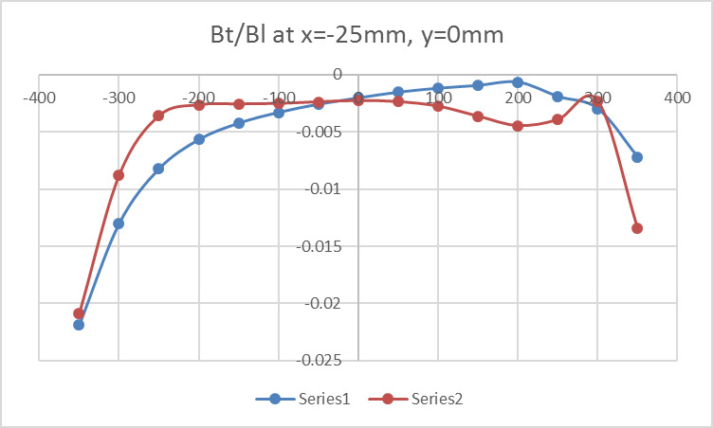
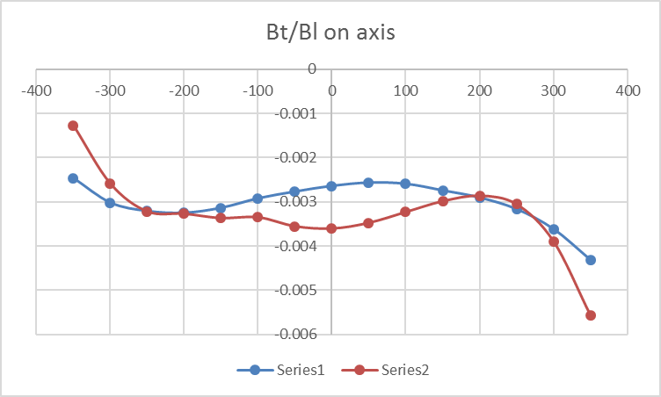
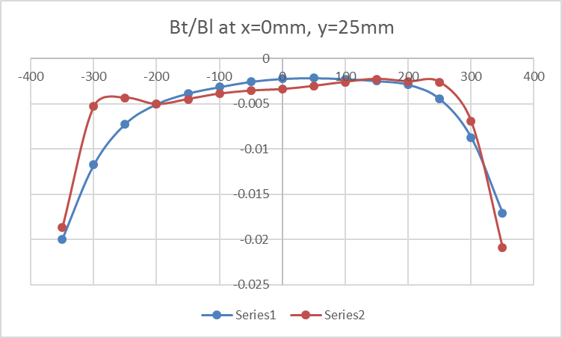
Influence of circular coils on the transverse field of SS#2 (Blue trace without shim, red trace with shim)
To obtain the required accuracy in the measurement particular attention needs to be paid to:
  Alignment of Hall probe to the mirror
  Systematic errors of the measurement system
    Transverse Hall effect
    Hall plate misalignment
      Determine angles between magnetic field and Hall plates through probe characterisation in dipole and solenoid fields.
Field components calculated using the method outlined by A. Wolf in CERN EP INT 84-01

Slide 6
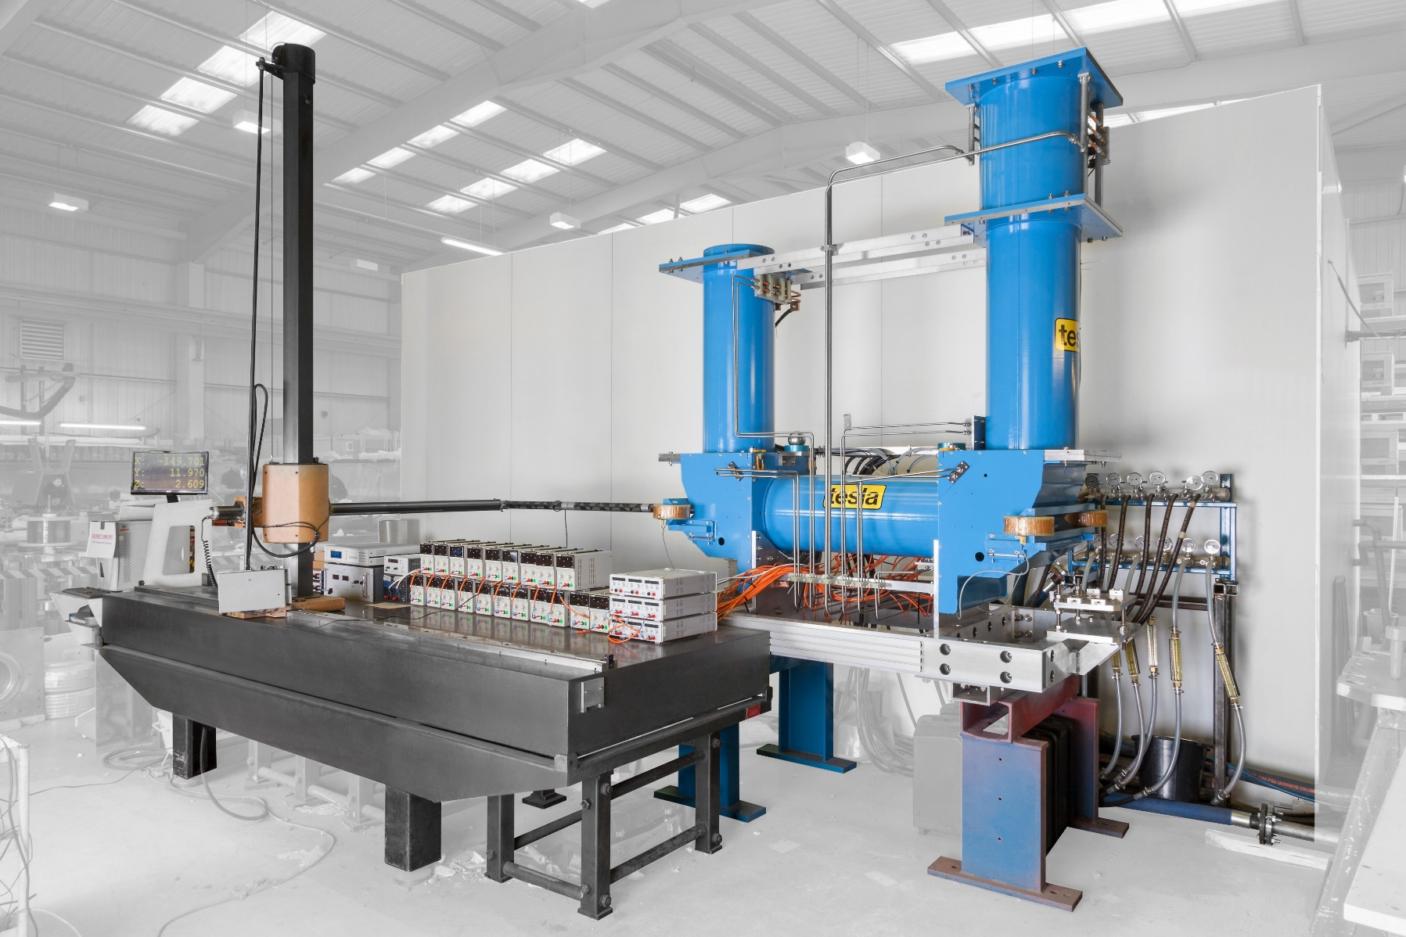
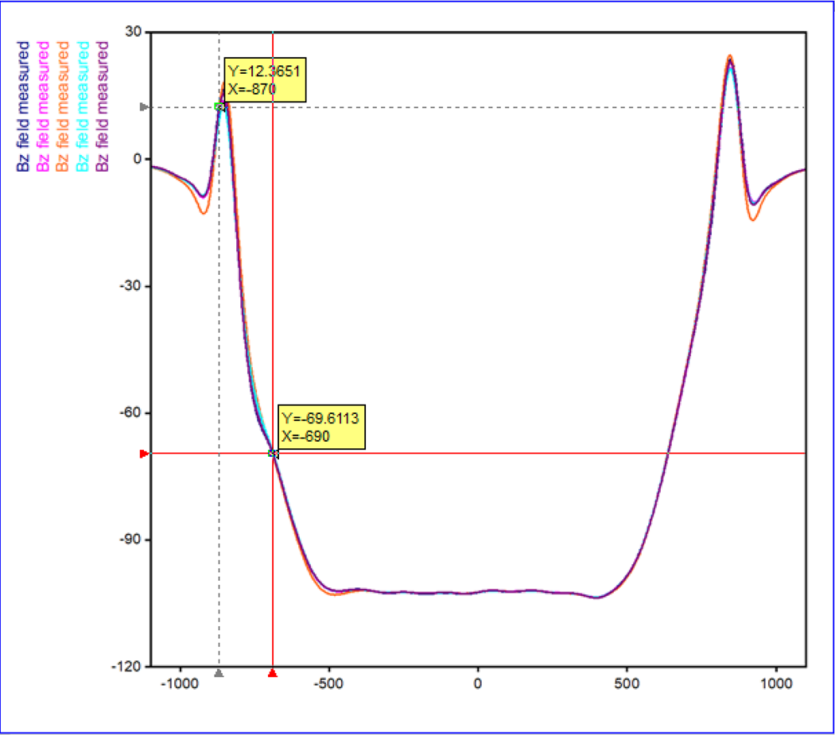
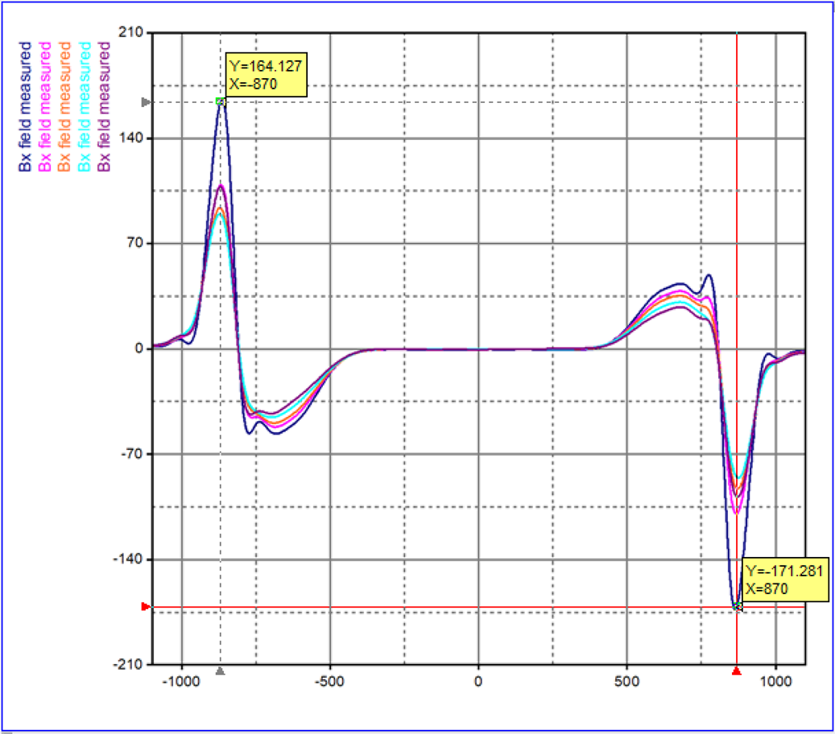
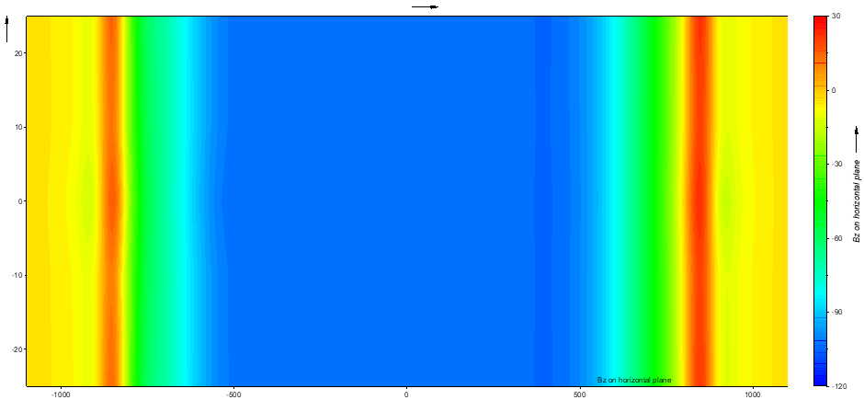
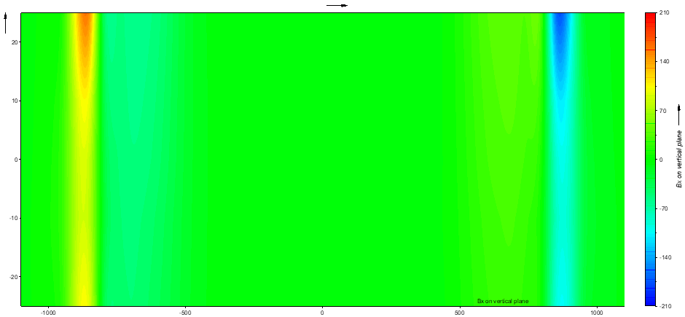
Full Assembly Measurement
Bz vs. horizontal position
Bx vs. vertical position

Slide 7
Conclusions
Probe alignment is very delicate.
  Probe orientation measured at each point making the measurement sequence very long.
  Vertical oscillation of the long carbon fibre tube takes a long time to damp.
Correction of the vertical field component in the full assembly is problematic due to a random offset in the measurement (not present during the measurement of the individual solenoids).
  The correction algorithm gives too large currents in the fine-tune coils.
Anomalous behaviour of By and Bz in the vicinity of the toroid shielding and compact corrector magnet.
  Incorrect model?
  Shielding touching the yoke?
All magnetic elements have been individually measured on and off axis. Data available in EXCEL file.
The effect of the correction coils on the B field is measured.
Standard solenoid 2 chosen as the “drift” solenoid.
Anomalous field behaviour needs to be investigated.
New correction algorithm will be used.
  Helmholtz coils correct the offset.
  Fine-tune coils reduce the spread of the transverse field components.

Slide 8
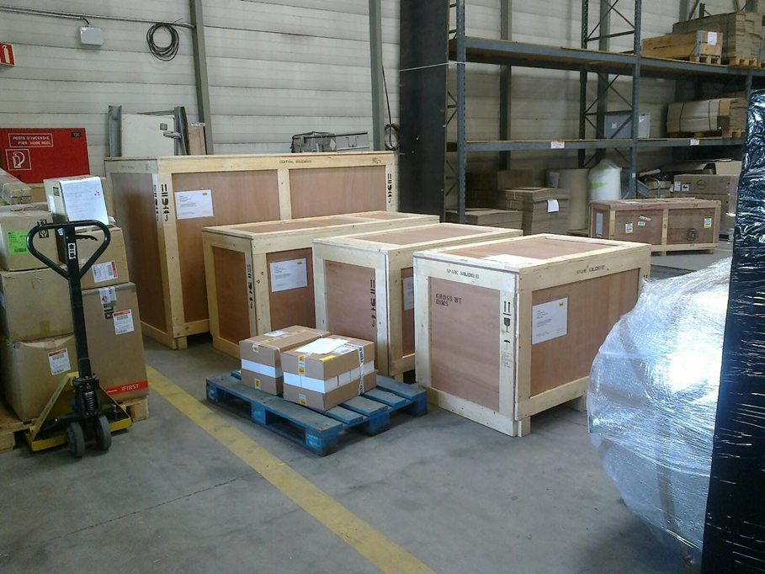
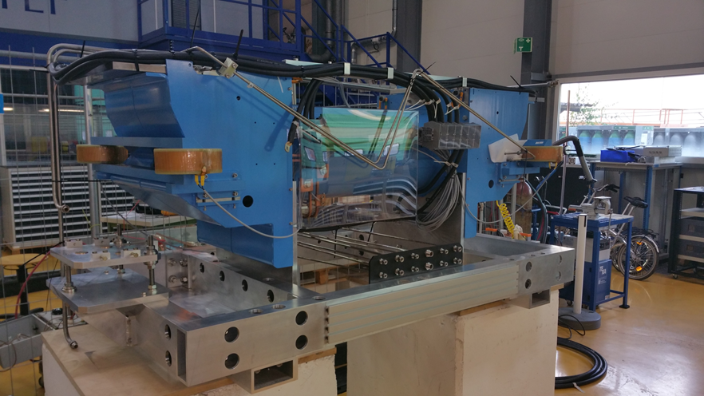
Magnetic system was delivered mid-August
September to October – conformity tests with TE/MSC
Certification ok except for the three spare toroid coils

Slide 9
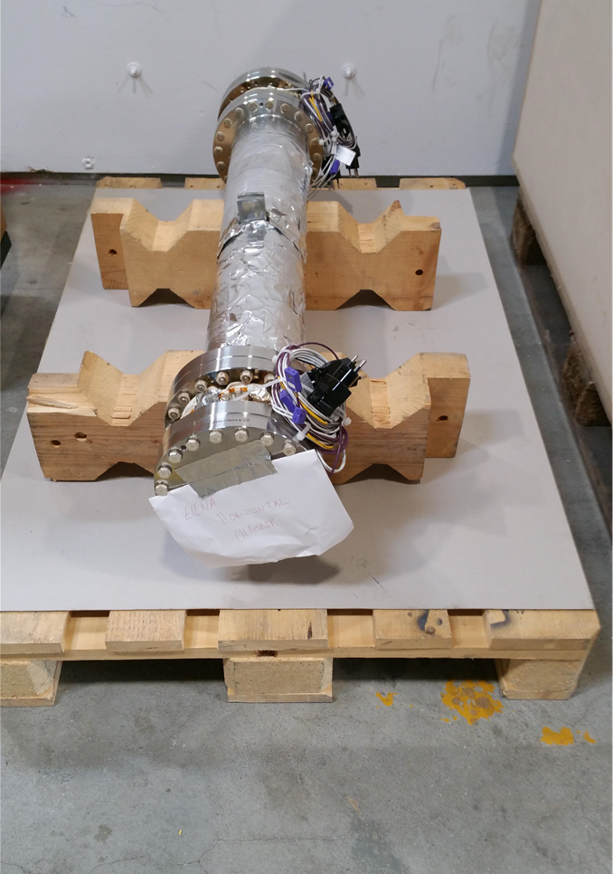
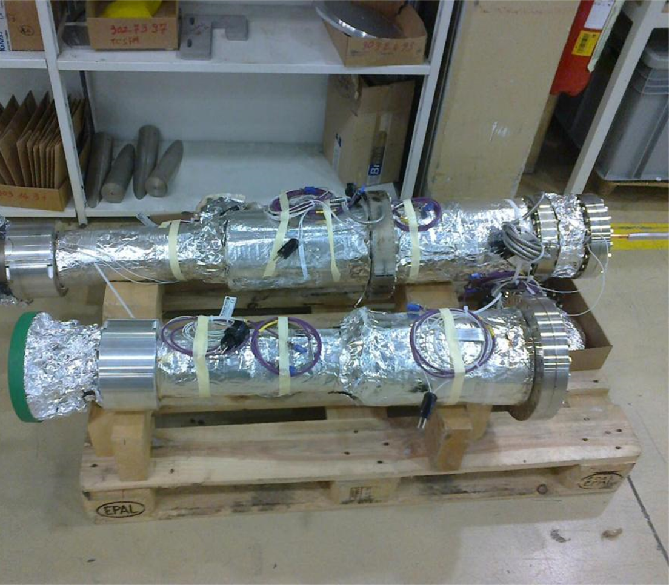
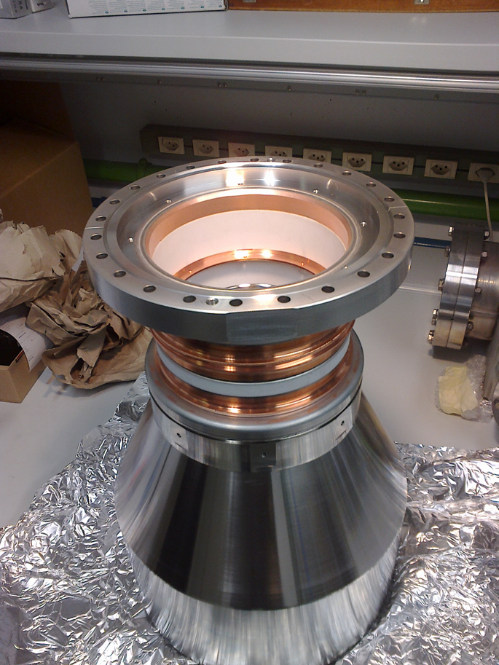
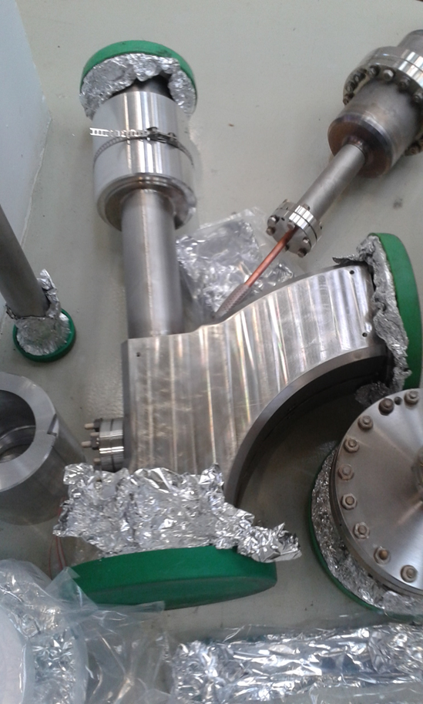
Mechanics
All vacuum elements produced in-house
Difficulties with the NEG coating of the vacuum chambers in particular the two toroid chambers
Delivery of the last vacuum element (toroid chamber #2) in November 2017
Drift chamber with pick-ups
Vertical chambers (top with gun and NEG chamber)
Electron beam collector
Toroid chamber during acceptance tests

Slide 10
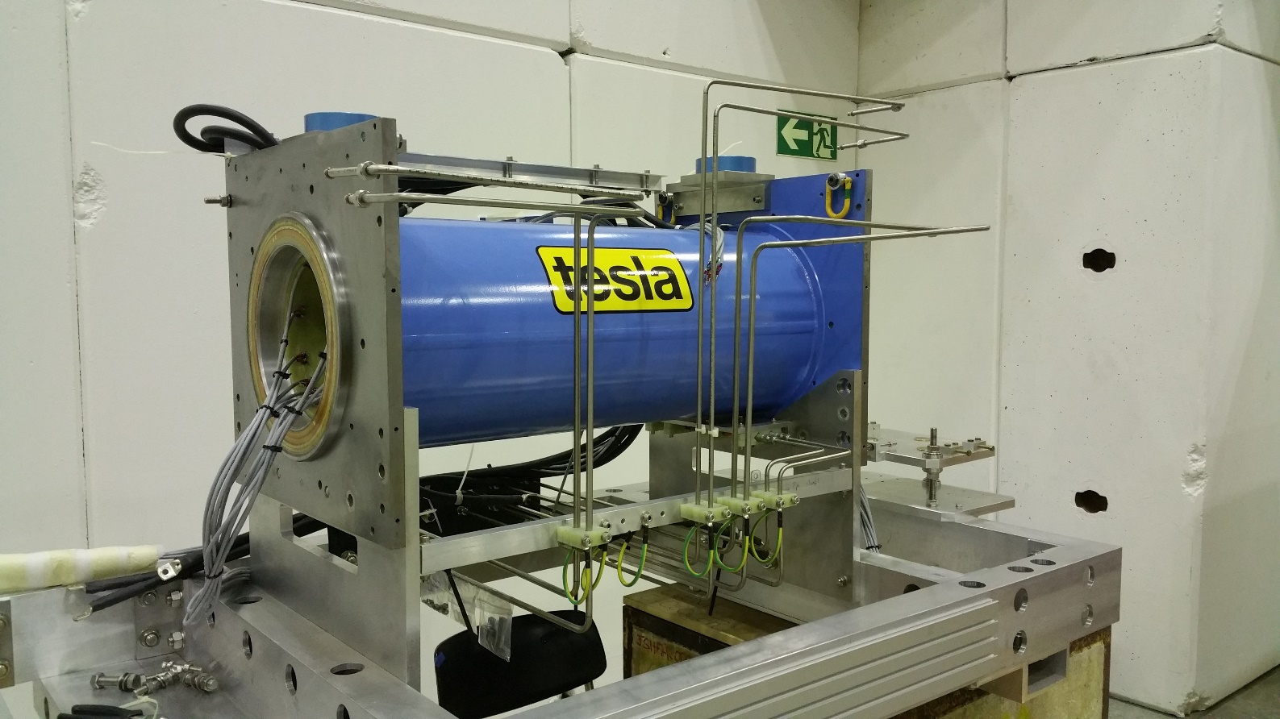
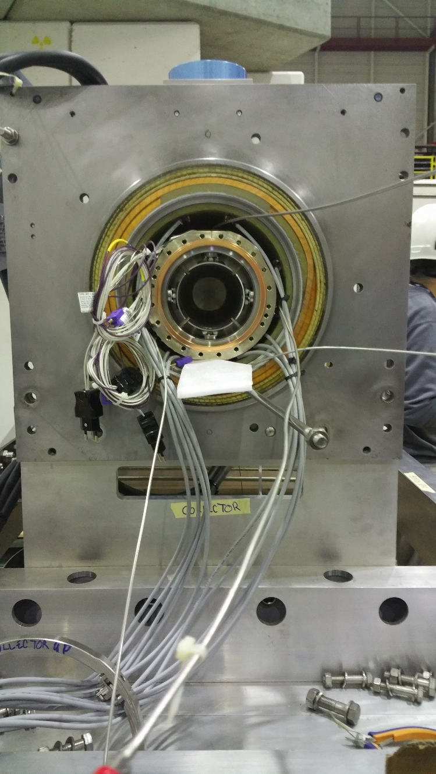
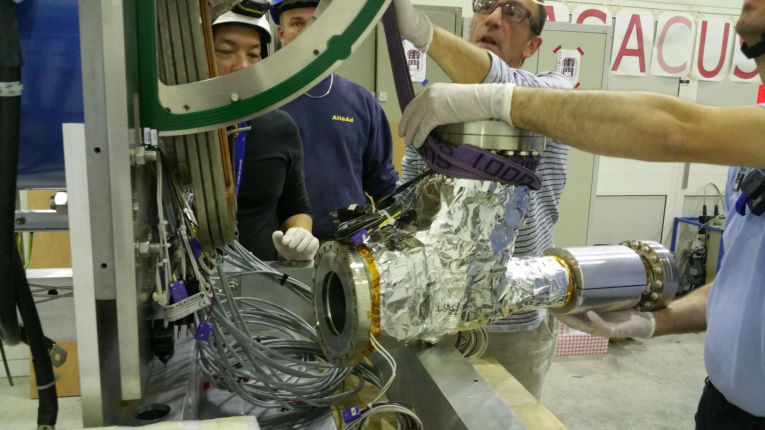
The electron cooler was mounted in the AD hall during November
Connected to ELENA beginning December
Bake-out has just finished …..
There is a leak! Vacuum level reached after bakeout: 2E-9 mbar!!!

Slide 11
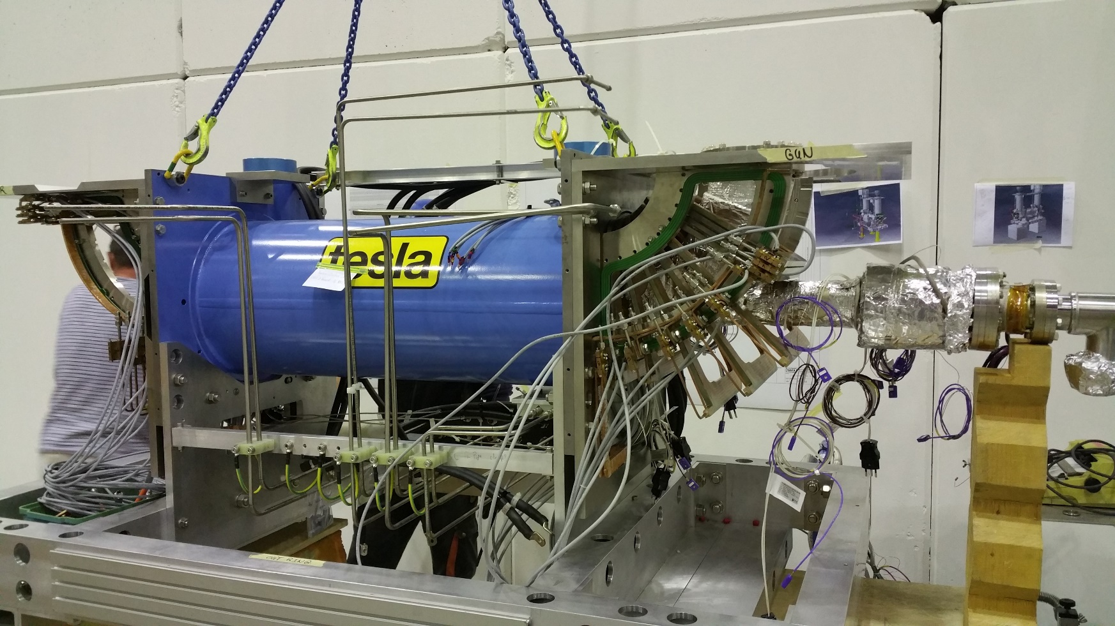
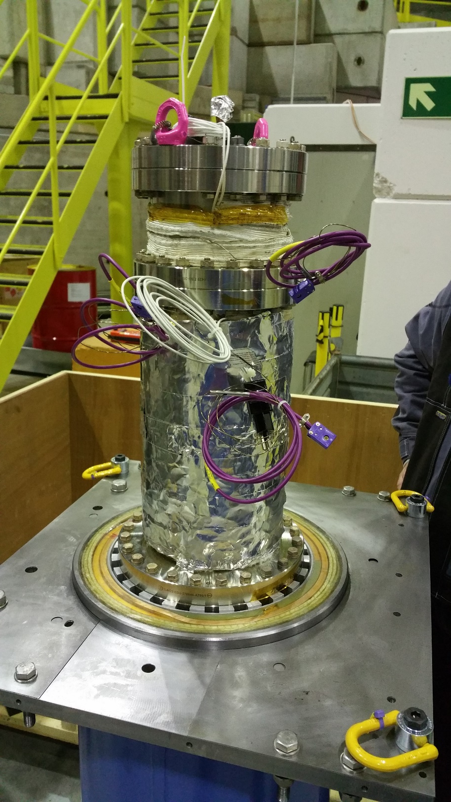
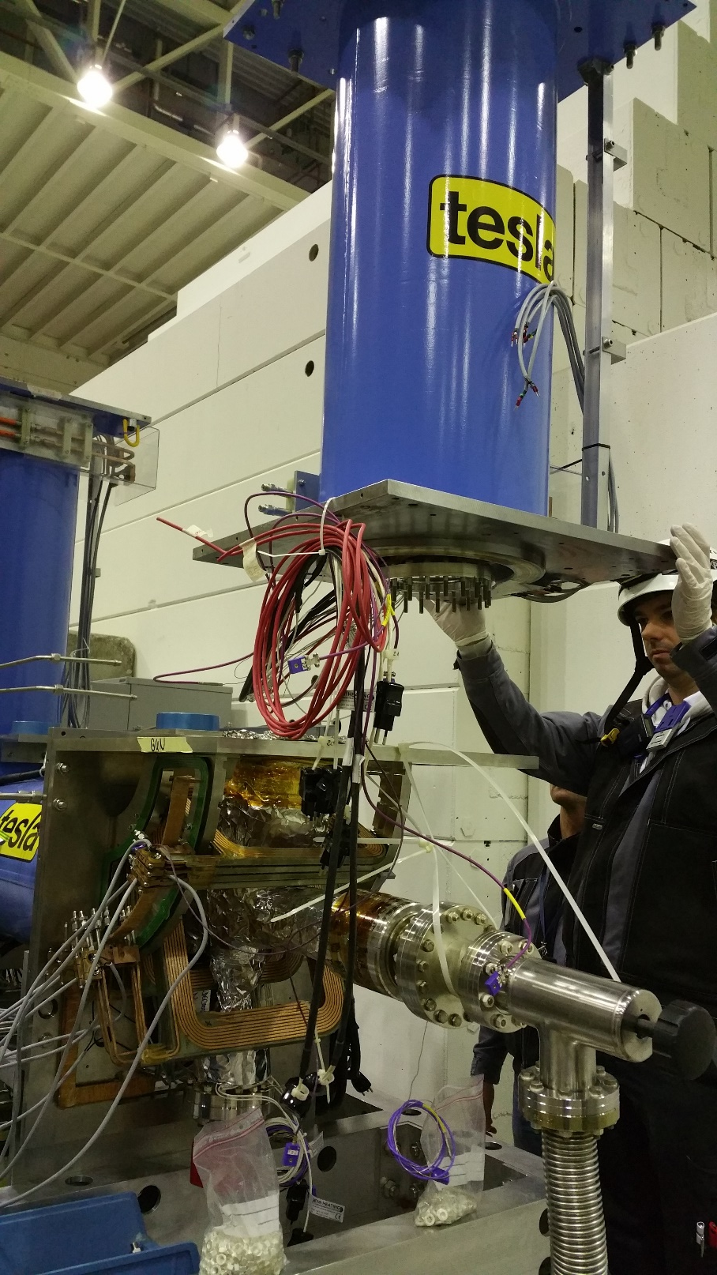
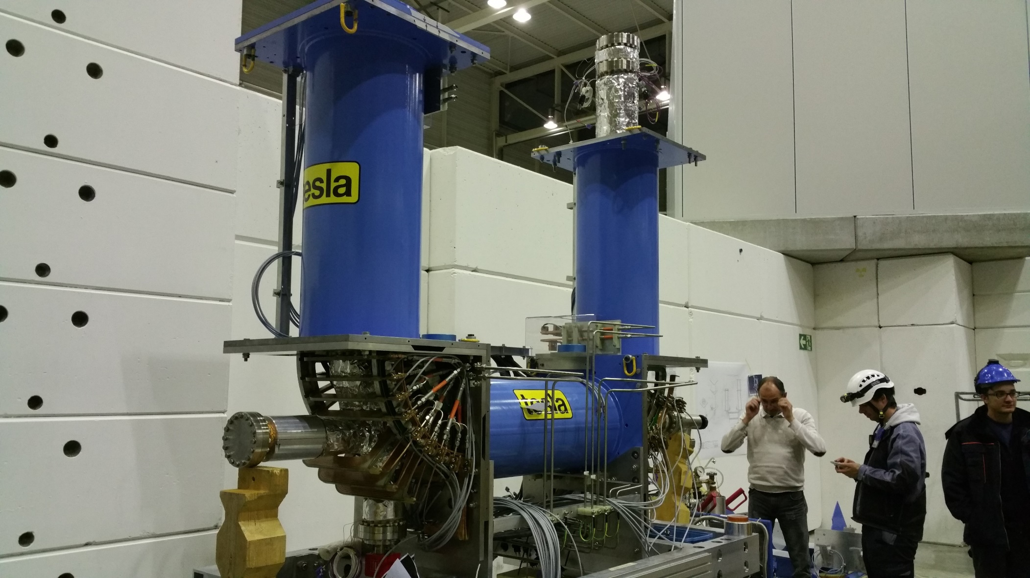

Slide 12
(Almost) ready for commissioning

