Slide 1

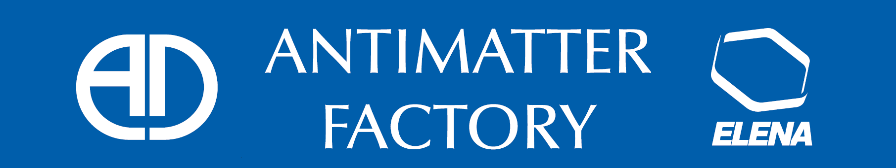
AD YETS and LS2 ACTIVITIES

Slide 2
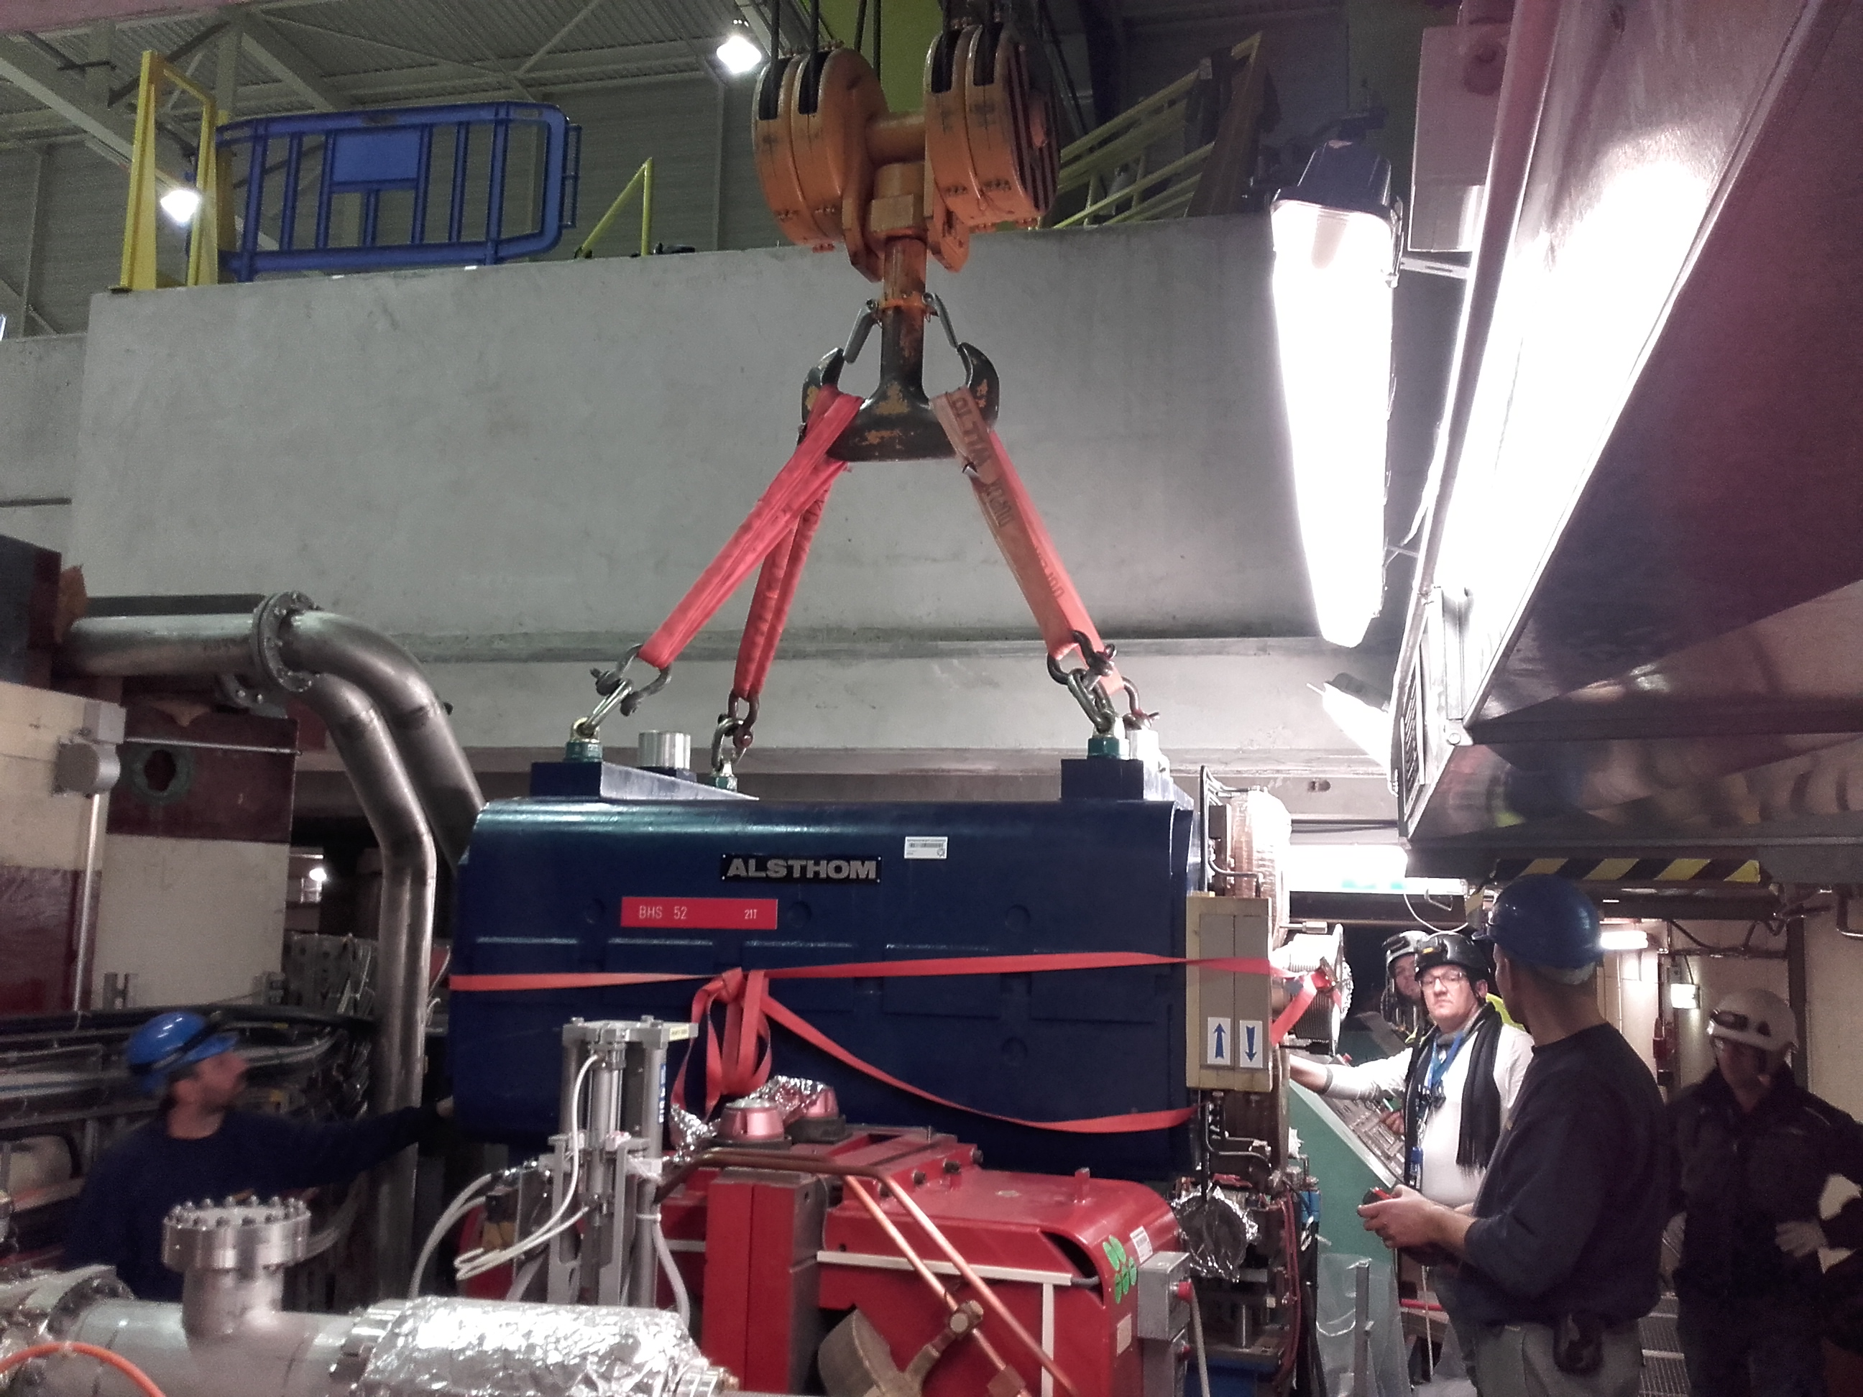
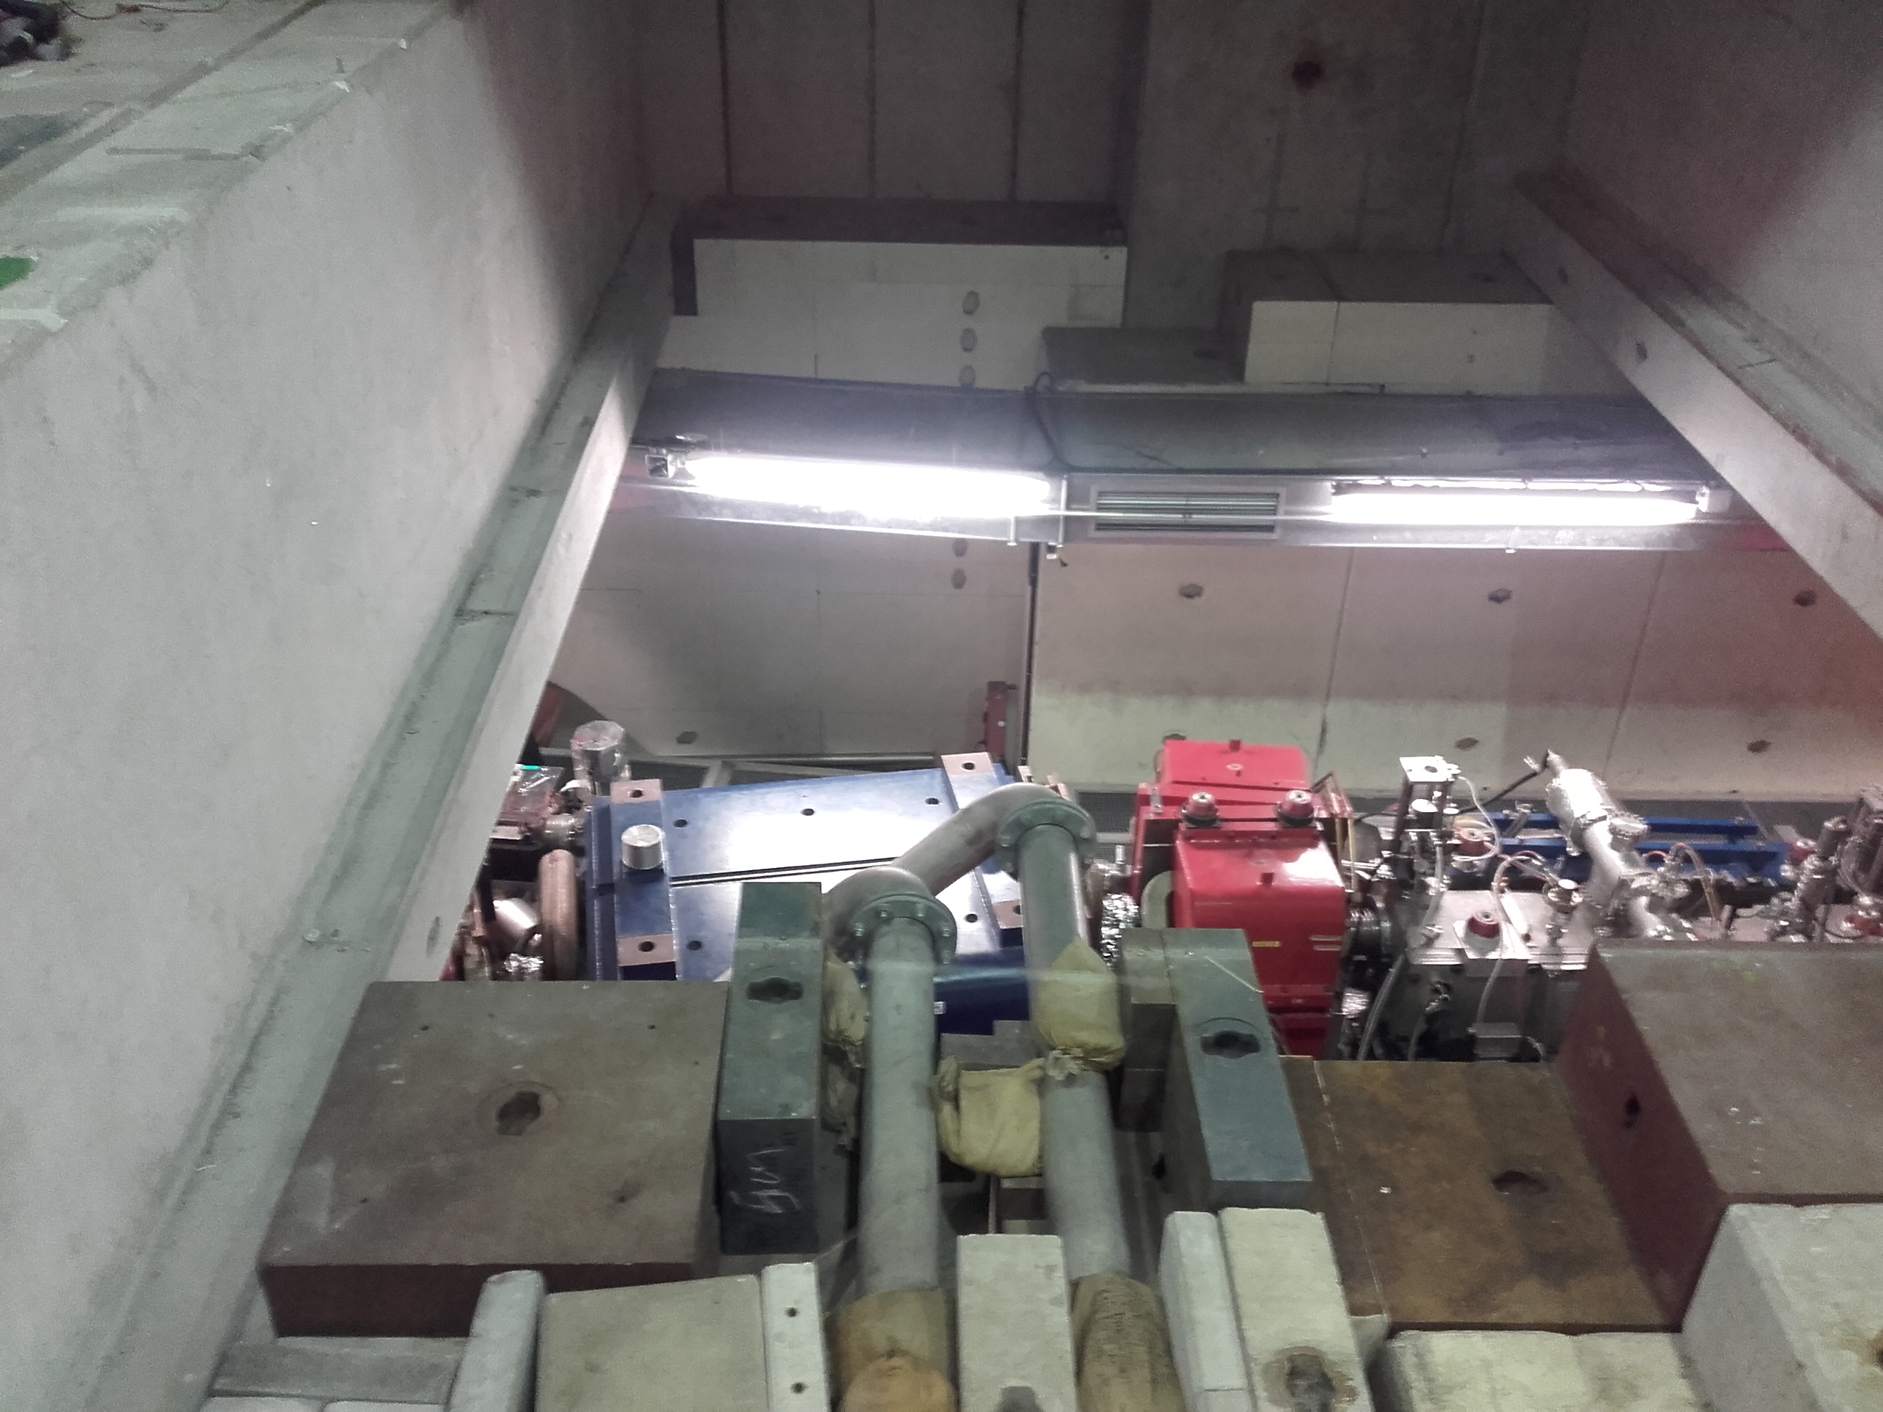
YETS: AD machine ongoing activities
3 Magnets refurbishment in progress
Scraper replacement
Maintenance works for e-cooler, BTV, kickers, vacuum equipment, RF, BCCC
Courtesy: A. Bouvard

Slide 3
YETS: infrastructure maintenance
Demineralized and raw water systems maintenance (no demi water W7)
AUG tests, safety lighting installation
Cables removal line 8000
RP tests with source
ALPHA access control PPE block replacement

Slide 4
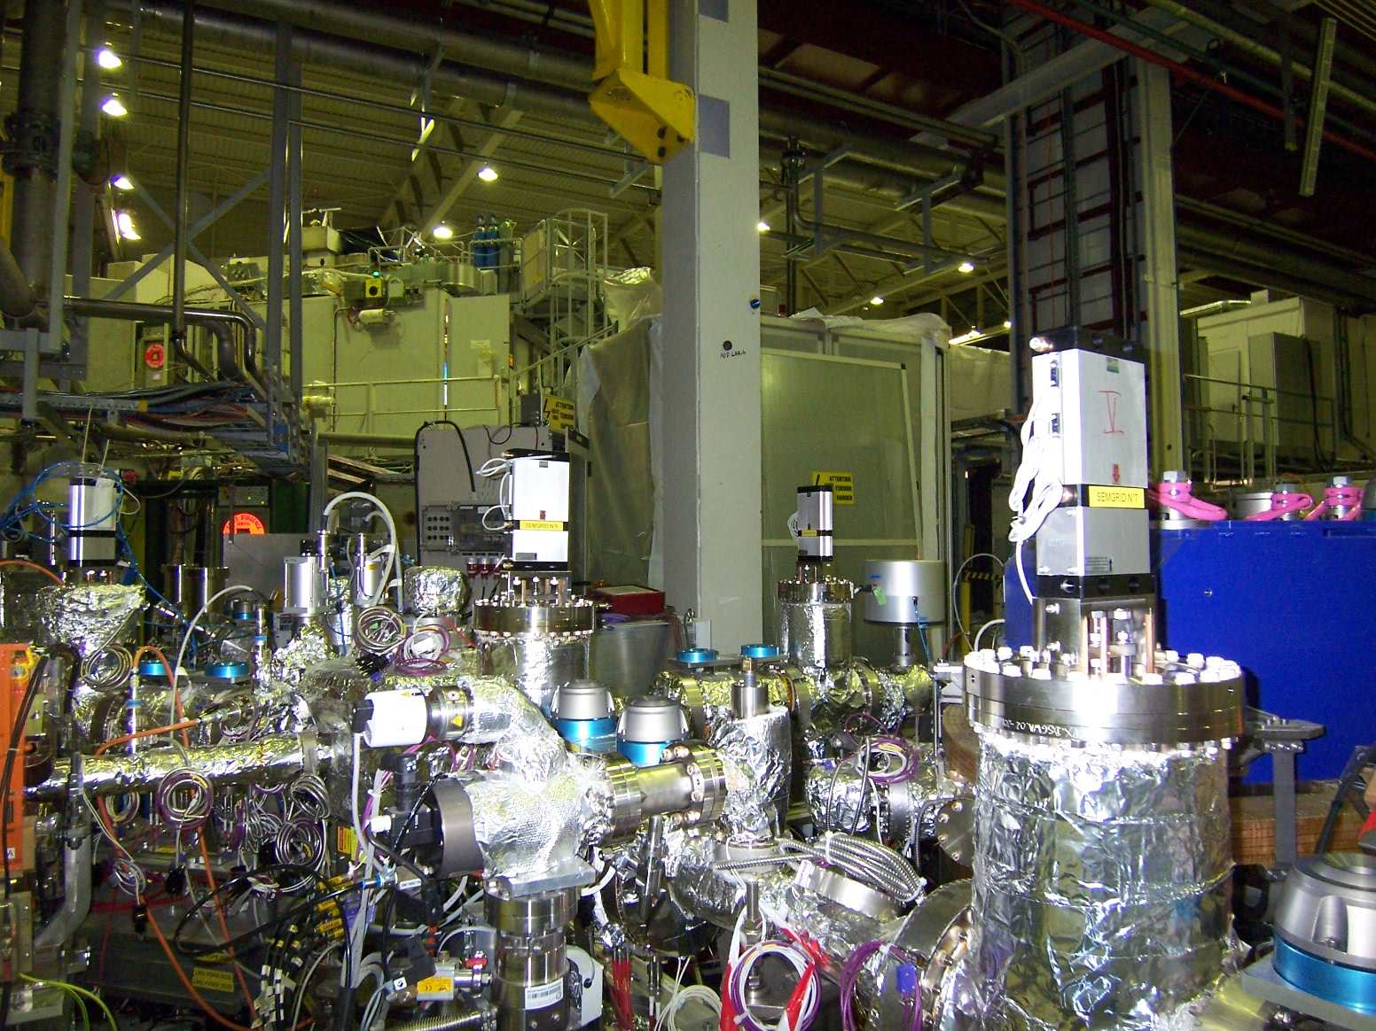
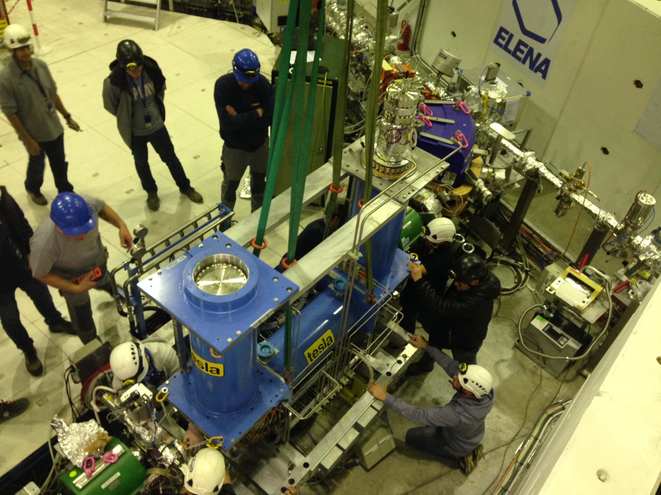
YETS: ELENA works
Ion source maintenance
E-cooler completion and connection + bake-out
LNE50 line completion (LPU, SEM) + bake-out
LNI line completion (SEM’s) + bake-out

Slide 5
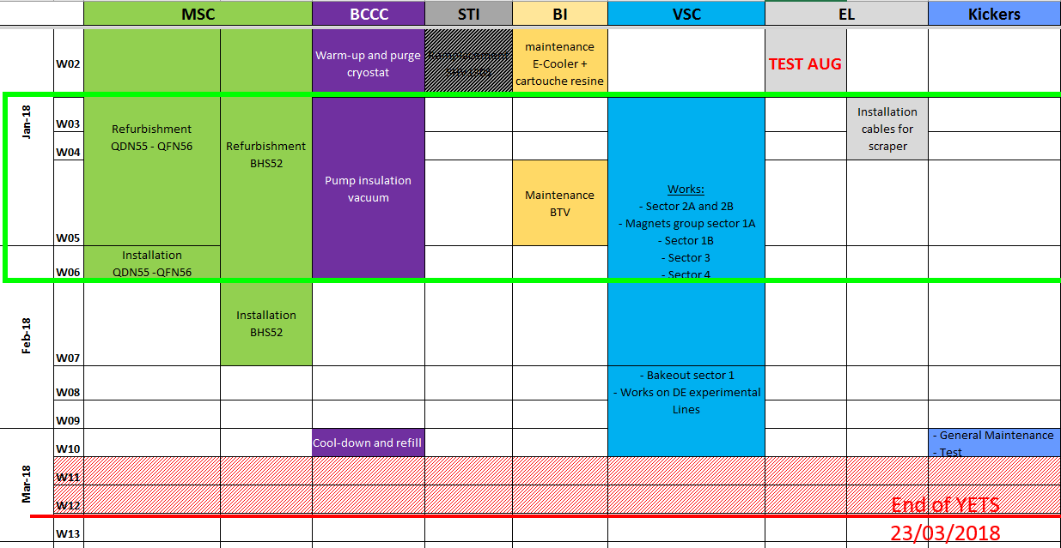
YETS planning (1)

Slide 6
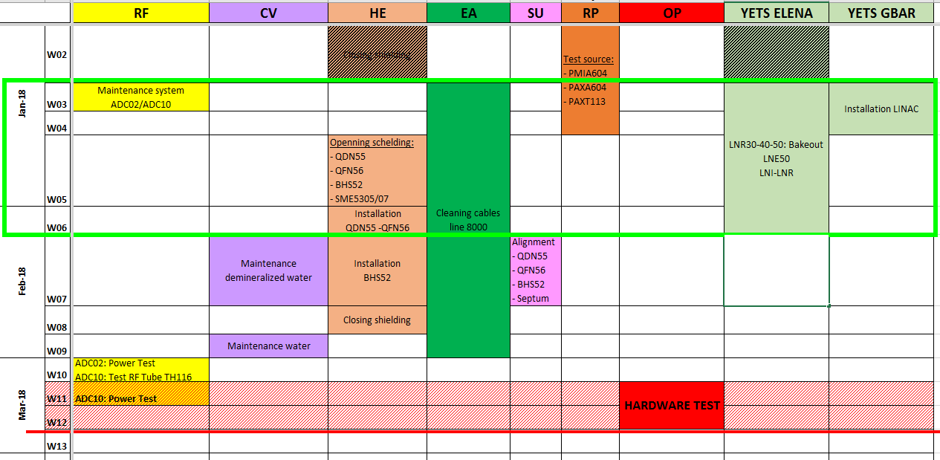
YETS planning 2
Courtesy: A. Bouvard

Slide 7
LS2 at AD: 12 Nov 2018 – April 2021
General situation: similar to LS1, main services partly available
ELENA
  Existing transfer lines removal / electrostatic lines installation
AD ring:
  Main bending magnets repair / quadrupoles refurbishment
  RF Cavity installed in the Injection zone will be removed and replaced by Finemet Cavity
  Stochastic cooling refurbishment / e-cooler replacement
Experimental areas:
  Aegis removal / ASACUSA laser room remodeling
  BASE Exp area enlargement / RFQD removal
Infrastructure:
  Cryogenics fixed installation
  Cooling tower refurbishment
  Injection line power converters
  Magnetic horn pulser
AD target:
  Consolidation / Bdg 196 reconstruction (See STI / M. Calviani)

Slide 8
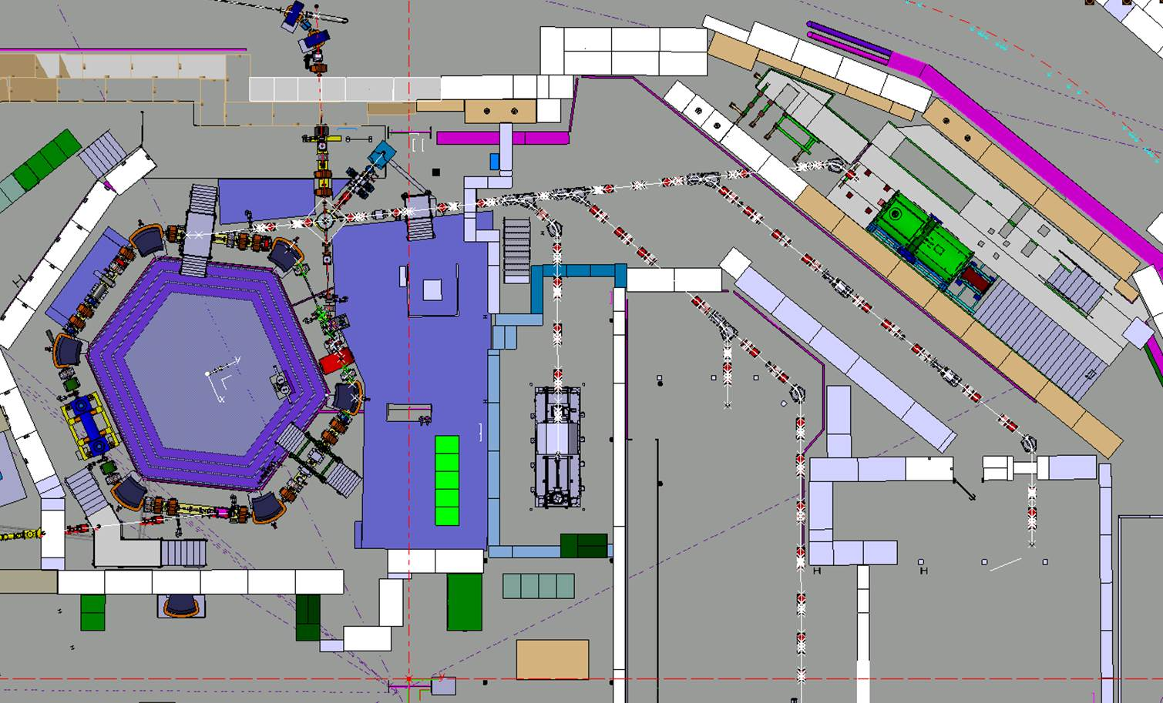
Electrostatic lines to be installed
LNE02
LNE00
LNE01
LNE03
LNE07
LNE06
LNE04
LNE50
LNE05
LNE51

Slide 9
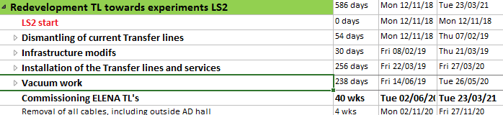
TL’s Master schedule

Slide 10
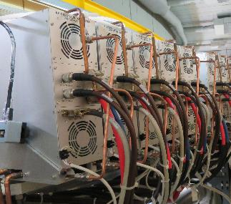
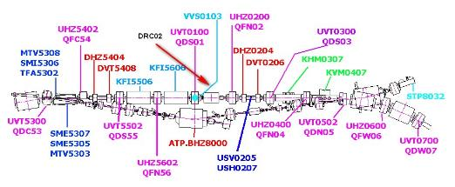
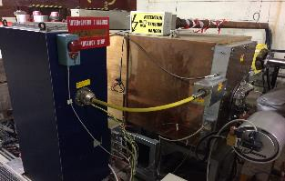
LS2 AD ring: RF
RF cavity: C02 to be replaced by Finemet cavity.
Cabling requested early 2020.
Courtesy: M. Haase

Slide 11
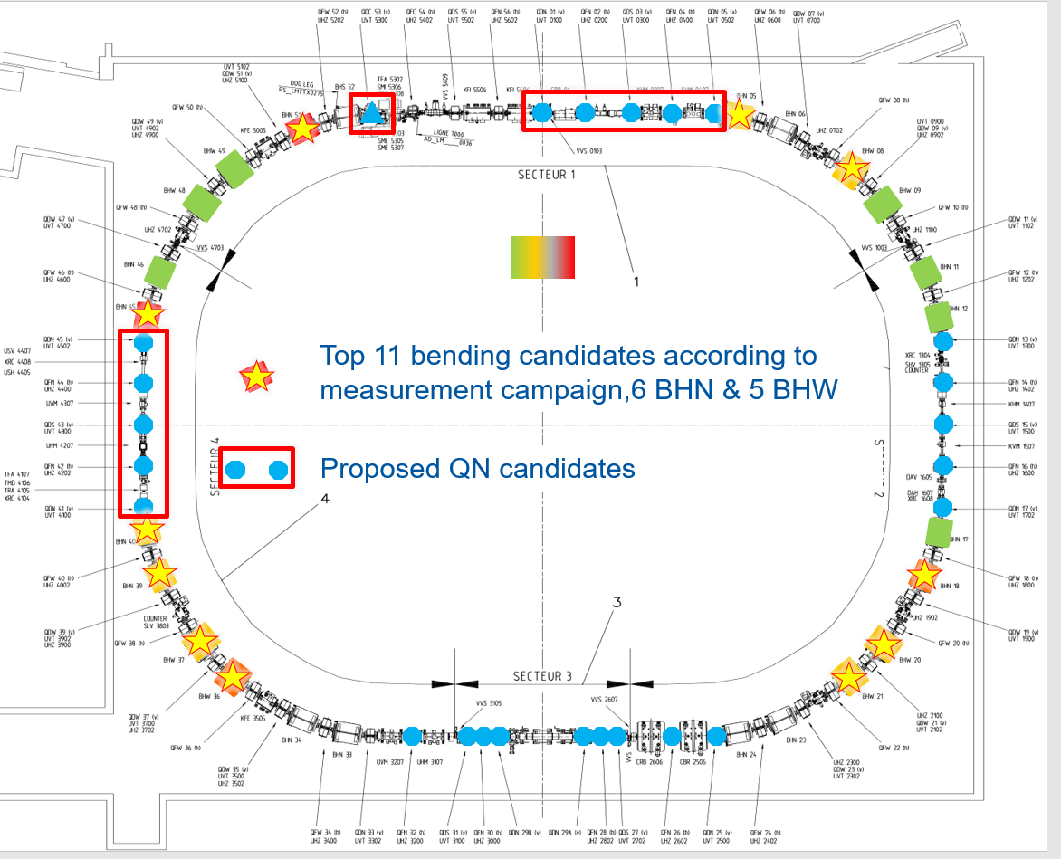
LS2 AD ring: Magnets
Magnets repair / refurbishment: will need a full time HE team on site, scheduling expected from TE/MSC
Courtesy: A. Newborough

Slide 12
LS2 AD ring: instrumentation
Stochastic cooling: exact needs not known accurately, some amplifiers / power supplies needs replacing but cabling work not specified: could possibly be postponed till following YETS
e-cooler replacement: missing info, probably not ready for installation during LS2

Slide 13
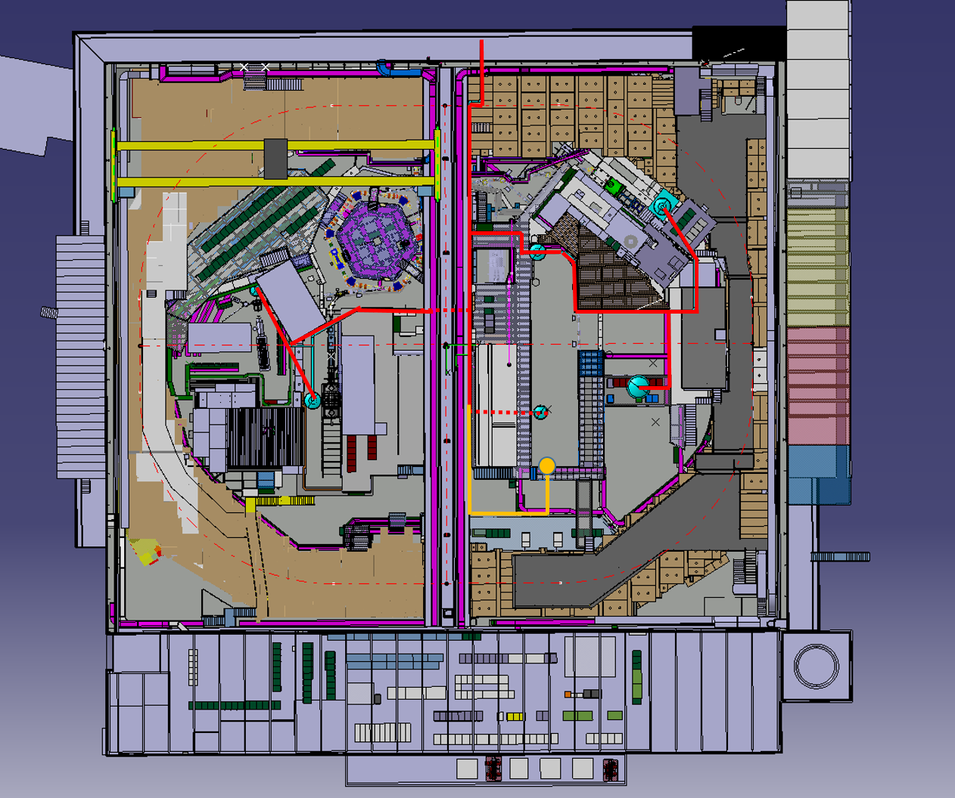
LS2 AD hall infrastructure
Cryogenics fixed installation: design in progress, still planned for LS2, planning and financing to be clarified.
Courtesy: G. Rolando

Slide 14
LS2 AD hall infrastructure
Injection line power converters : expected complete by march 2020. Consolidation work involving cabling. Plan B exists with only half of converters swapped.
Magnetic horn pulser: Consolidation involving cabling to eliminate Hg ignitron switches.
Cooling tower: refurbishment work planned Sept 2019 – May 2020. Experiments expect to be connected to tap water as was done during LS1

Slide 15
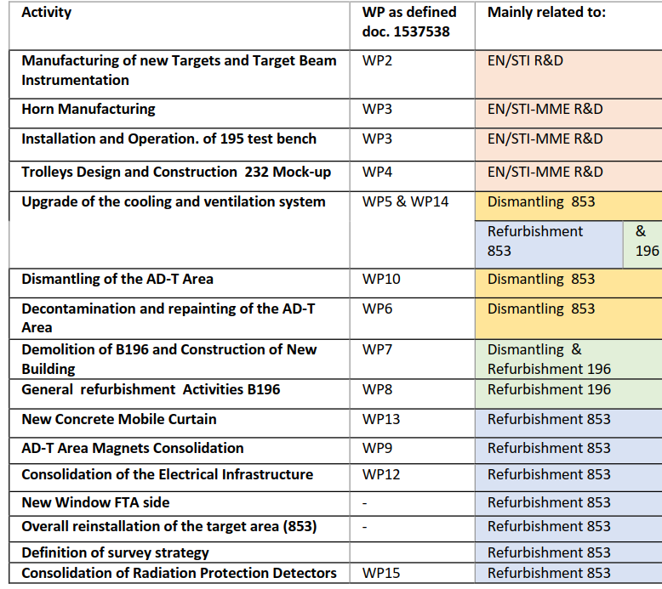
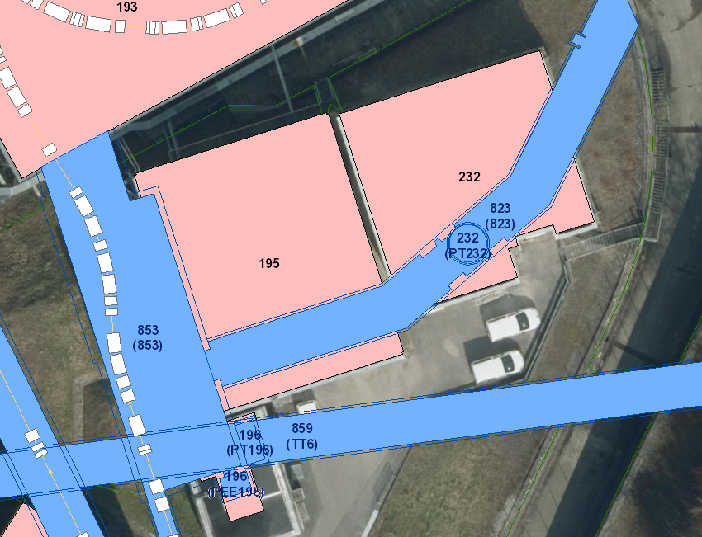
LS2 AD target consolidation
1)
2)
3)
4)
5)
6)
7)
8)
9)
10)
11)
12)
13)
14)
https://edms.cern.ch/panoramas#id=36410861&lon=0.00&lat=0.00&fov=90.00
15)
16)
Courtesy: E. Grenier-Boley

Slide 16
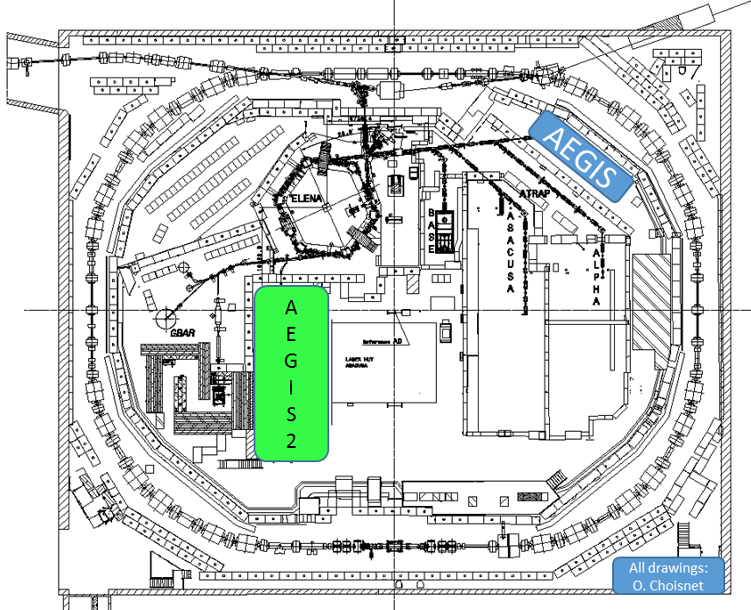
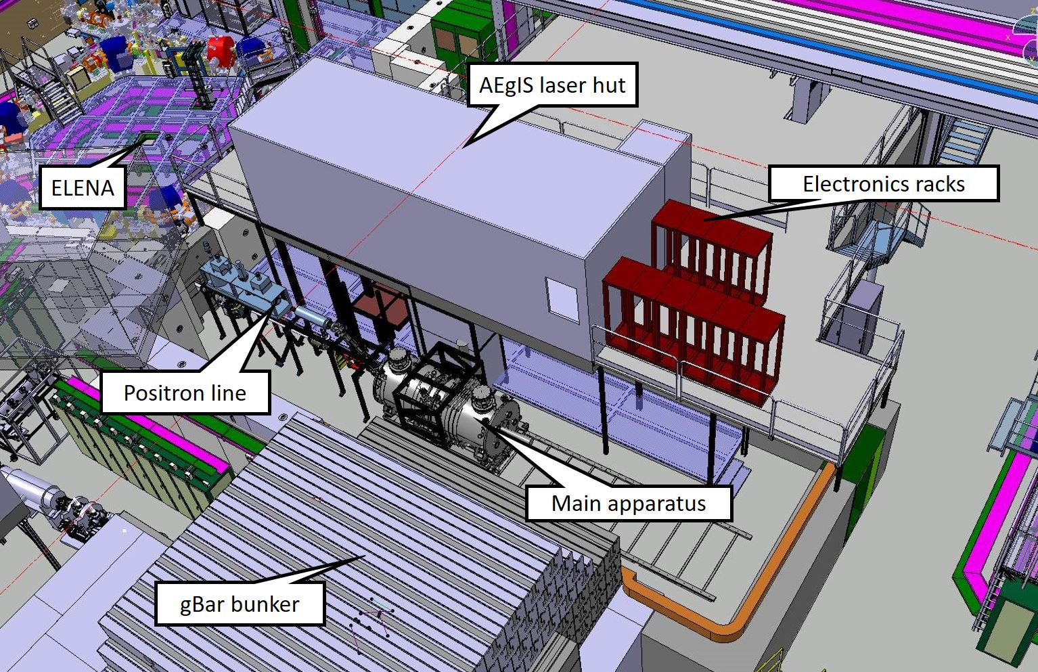
LS2 experimental areas (1)
Aegis removal: ECR under approval, significant installation. Impact on ASACUSA laser room. Financing not clarified.

Slide 17
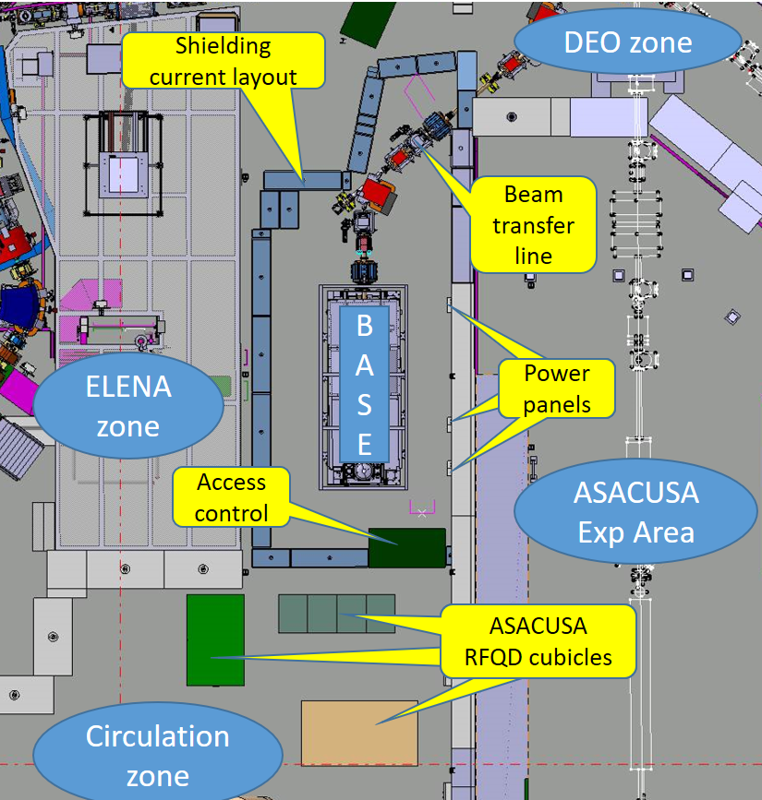
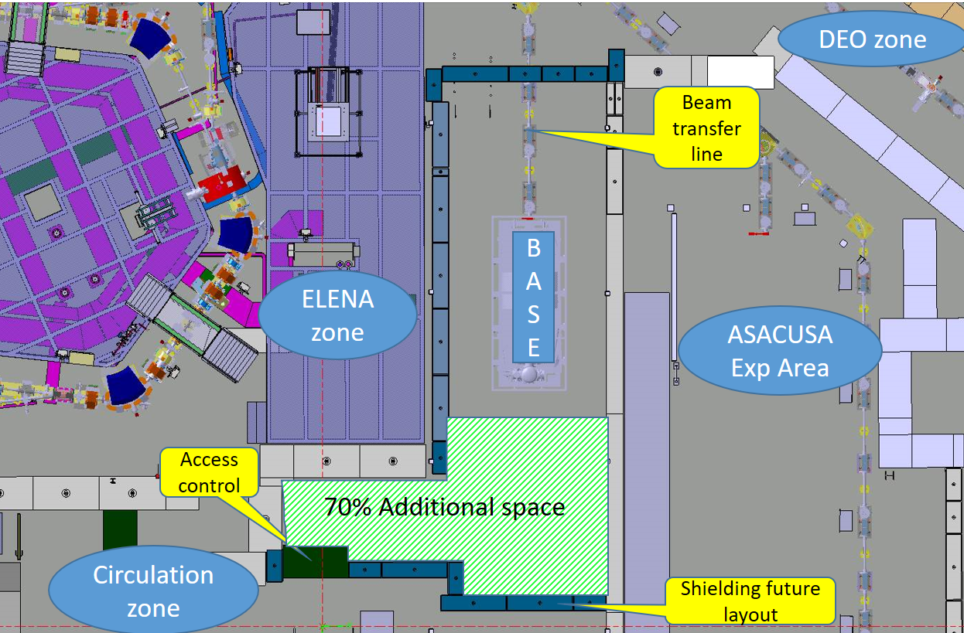
LS2 experimental areas (2)
BASE exp area enlargement: ECR under approval. Financing OK. Mostly shielding reshuffling. 3 additional power sockets needed. ASACUSA RFQD must be removed.

Slide 18
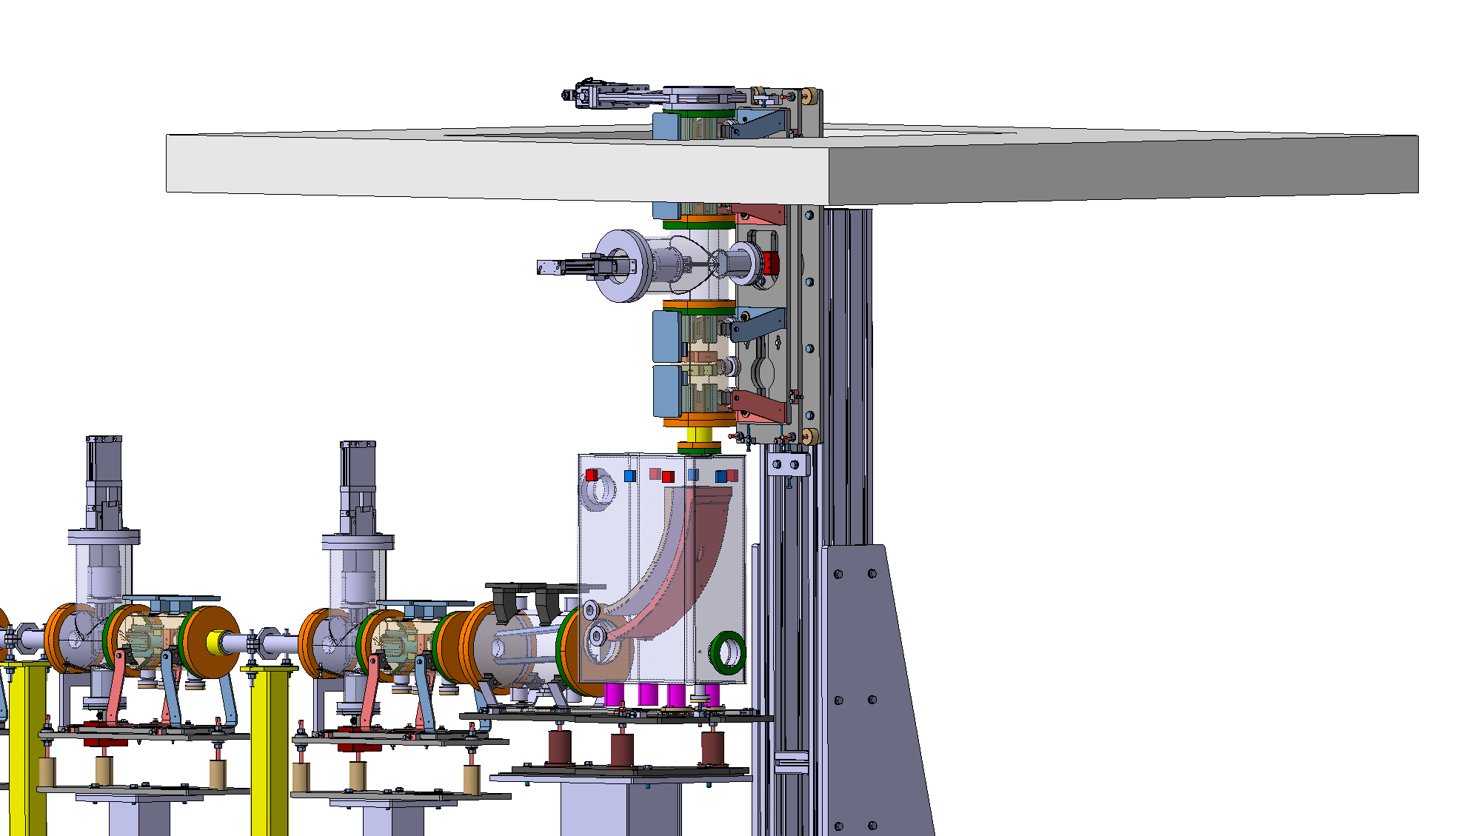
LS2 experimental areas (2)
ASACUSA 2: needs not clarified yet
ALPHA G: works during LS2 not clarified yet
ATRAP: connection to ELENA transfer lines will involve some modifs
200 mm valve
Instead of
160 mm existing

Slide 19
Shifted to YETS beyond LS2
ALPHA / ASACUSA control rooms refurbishment are proposed to be shifted due to missing resources during LS2
Cables removal campaign (TL magnets, …)
Some magnets refurbishment (TBD)

Slide 20
Conclusion
About 17 months of intense activity for ELENA
To be done in parallel with AD machine consolidation / AD hall and exp areas infrastructure works / potentially AEGIS relocation
Integrated schedule being prepared

