Slide 2

AD Experiments
Safety improvements in 2017 and objectives for 2018 & LS2
A. Desmarest EP-DI

Slide 3
Introduction
Thank you to all the contributor
Responsibility | General Infrastructure | Experimental Areas | ELENA
Department-Group | EN-EA | EP-UAD | BE-OP
Infrastructure & Service Coordination | AFTC | EP-UAD + AFTC | AFTC
Consolidation Program & Planning/Coordination | AFTC | EP-UAD + AFTC | N/A
YETS/LS2 Planning & Supervision | AFTC | EP-UAD | BE-OP + BE-ABP + AFTC
Safety | EN-DSO | EP-DSO | BE-DSO
Master-Plan Management | AFTC | EP-UAD + AFTC | BE-OP + BE-ABP + AFTC
A. Desmarest EP-DI

Slide 4
Outline
Incident & Evacuation drill
  Incidents / Accidents
  Evacuation drill
  Lesson learnt
Improvement in 2017 & Objective for 2018-LS2
  Experiment side
  Building side
  Objectives 2018-LS2
Reminder
  Evacuation path
  Transport
A. Desmarest EP-DI

Slide 5
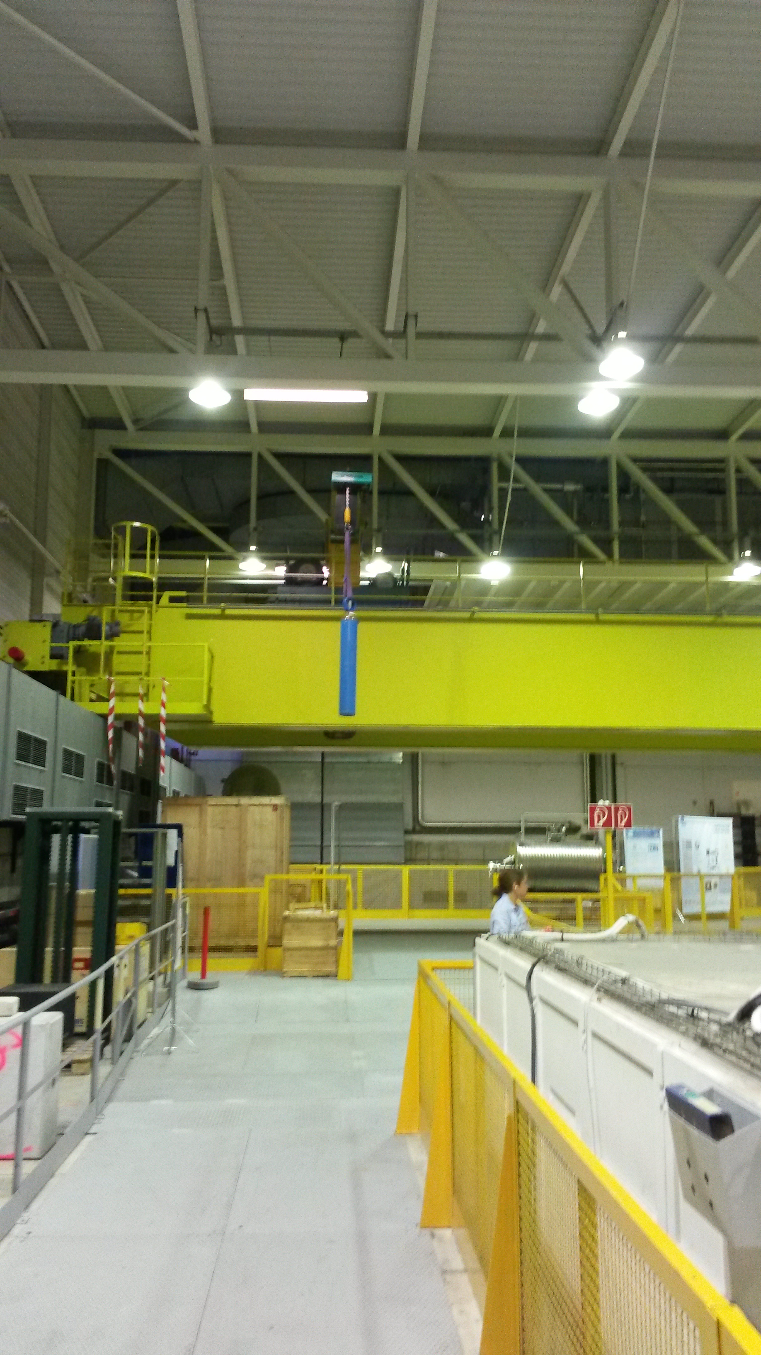
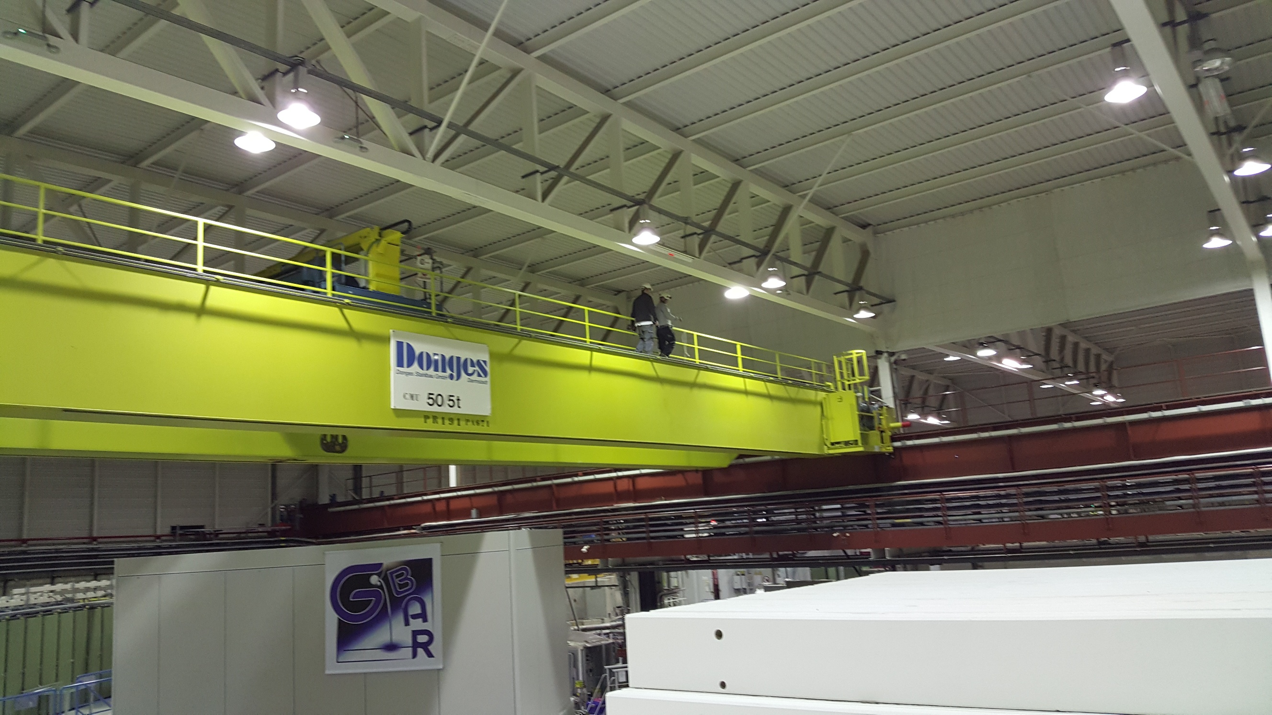
Accidents
Finger cut with a scalpel
Finger burnt with cryogenic fluid (He)
Incidents
Guides without operational dosimeter
A barrier fell on the visitor path
200Bar gas bottles moved with sling(s) using the crane
People walking on the crane
EDMS: 1894662
A. Desmarest EP-DI

Slide 6
Safety deviations
Removal of a RP fence
Beam sent in the experimental area without the beam permit fully approved
Error on lockout procedure
Since 2012
Electrisation
Loads fell
Caps flying over the experiment
Pregnant woman on the visitor path
…
A. Desmarest EP-DI

Slide 7
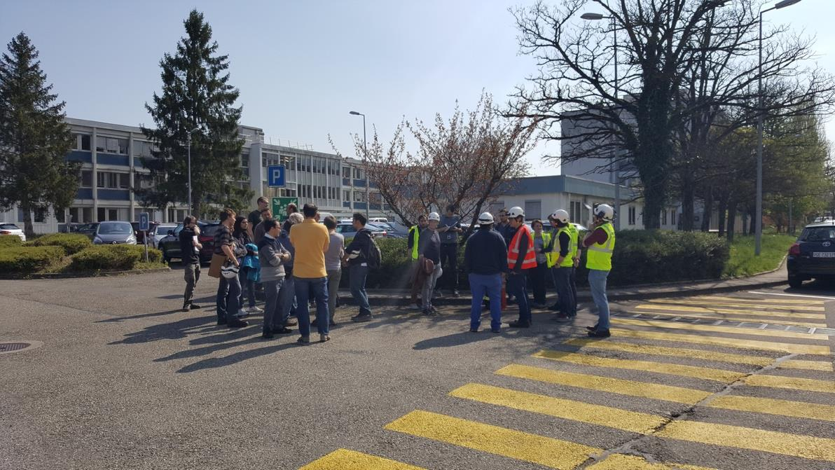
Evacuation drill
1st exercise in the building
Occasion to:
  Update the evacuation path
  Take a picture of the situation in case of real evacuation
  Train emergency guides
A. Desmarest EP-DI

Slide 8
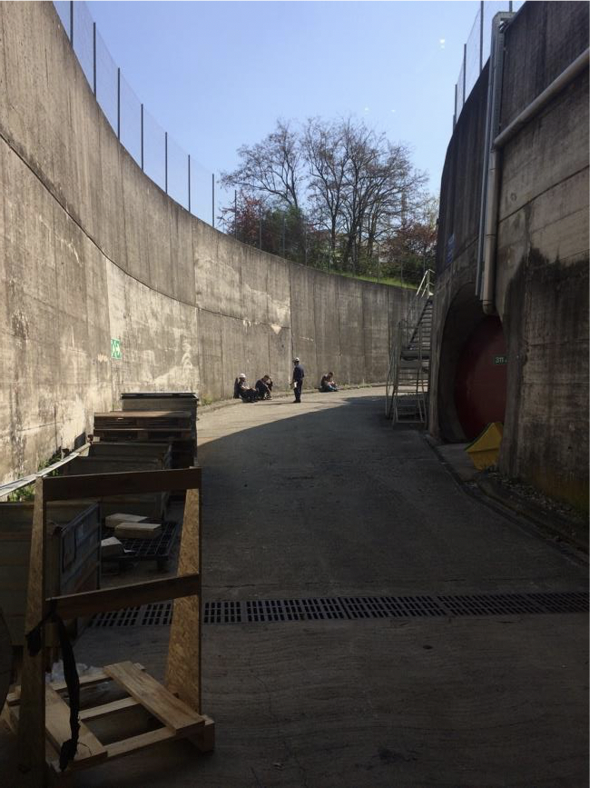
Lesson learnt
People did not evacuate
People did not reach the assembly point or stay there
  Go to their office (B.93)
  Stay in the ramp
Sound of the sirens not loud enough
Evacuation path not really clear
A. Desmarest EP-DI

Slide 9
Outline
Incident & Evacuation drill
  Incidents / Accidents
  Evacuation drill
  Lesson learnt
Improvement in 2017 & Objective for 2018-LS2
  Experiment side
  Building side
  Objectives 2018-LS2
Reminder
  Evacuation path
  Transport
A. Desmarest EP-DI

Slide 10
Experiment side
New AUL network
Relocation of the Fire extinguishers
New laser interlock system (collaboration with BE-ICS)
  For ATRAP in 2017
  For GBAR in 2018
Implementation of the Safety Permit Strategy
New experiment: GBAR
  Radiation leak on the bunker (fully recover)
  Presentation to the authorities
  No impact on the other experiments
A. Desmarest EP-DI
Notes:
Pensez a ajouter une photo de l’experience!

Slide 11
Building side
New evacuation path EDMS
New evacuation alarm
New AUG position and modification of the chains
New emergency lights
Creation of a new IMPACT facility
New defibrillator
A. Desmarest EP-DI

Slide 12
Objective 2018 & LS2
Fire detection
Validation of the new evacuation system
Laser interlock system
  AEgIS
  ASACUSA
Creation of a new AD hall training
  Generic course for the hall
  Access / Guide / Visitor
  Hazards identification and location
New electrical course HxBx in classroom (3hours)
  For the CERN users community
A. Desmarest EP-DI

Slide 13
Outline
Incident & Evacuation drill
  Incidents / Accidents
  Evacuation drill
  Lesson learnt
Improvement in 2017 & Objective for 2018-LS2
  Experiment side
  Building side
  Objectives 2018-LS2
Reminder
  Evacuation path
  Transport
A. Desmarest EP-DI

Slide 14
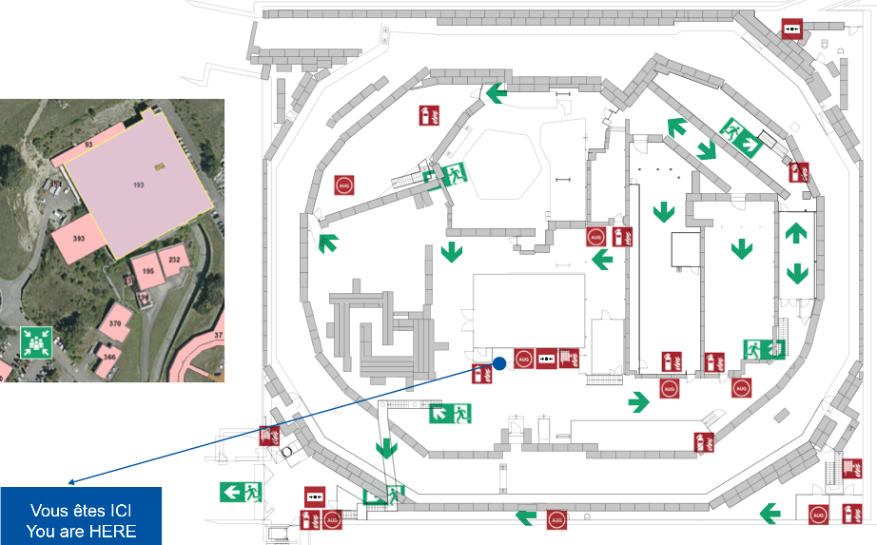
Evacuation path: ground floor
A. Desmarest EP-DI
Notes:
Ale n’aime pas la fleche bleu sans rien ecrit a la fin!!!!

Slide 15
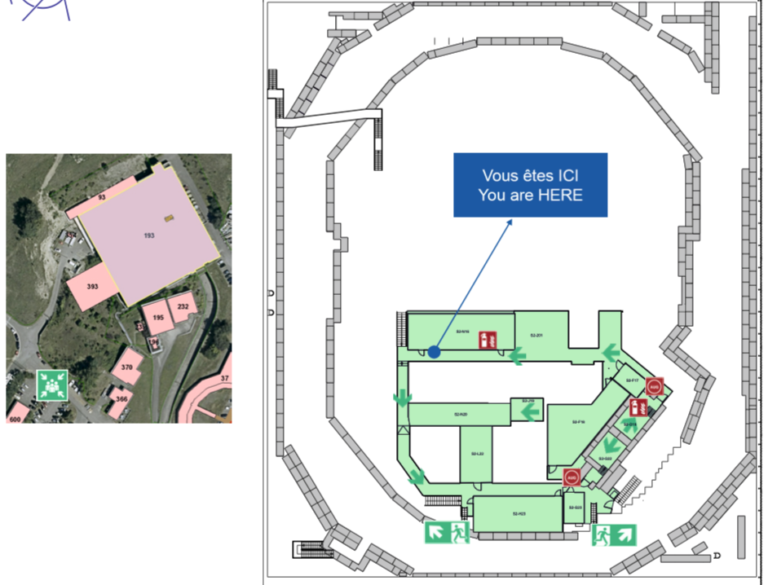
Evacuation path: intermediate floor
A. Desmarest EP-DI

Slide 16
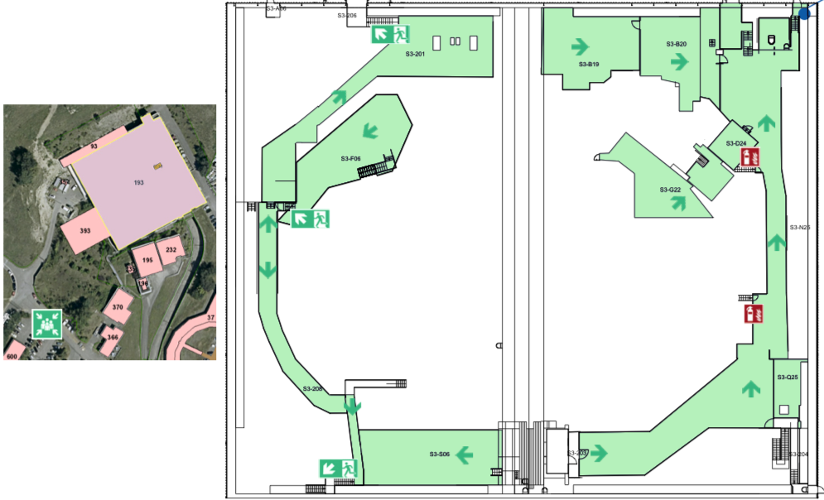
Evacuation path: top floor
A. Desmarest EP-DI

Slide 17
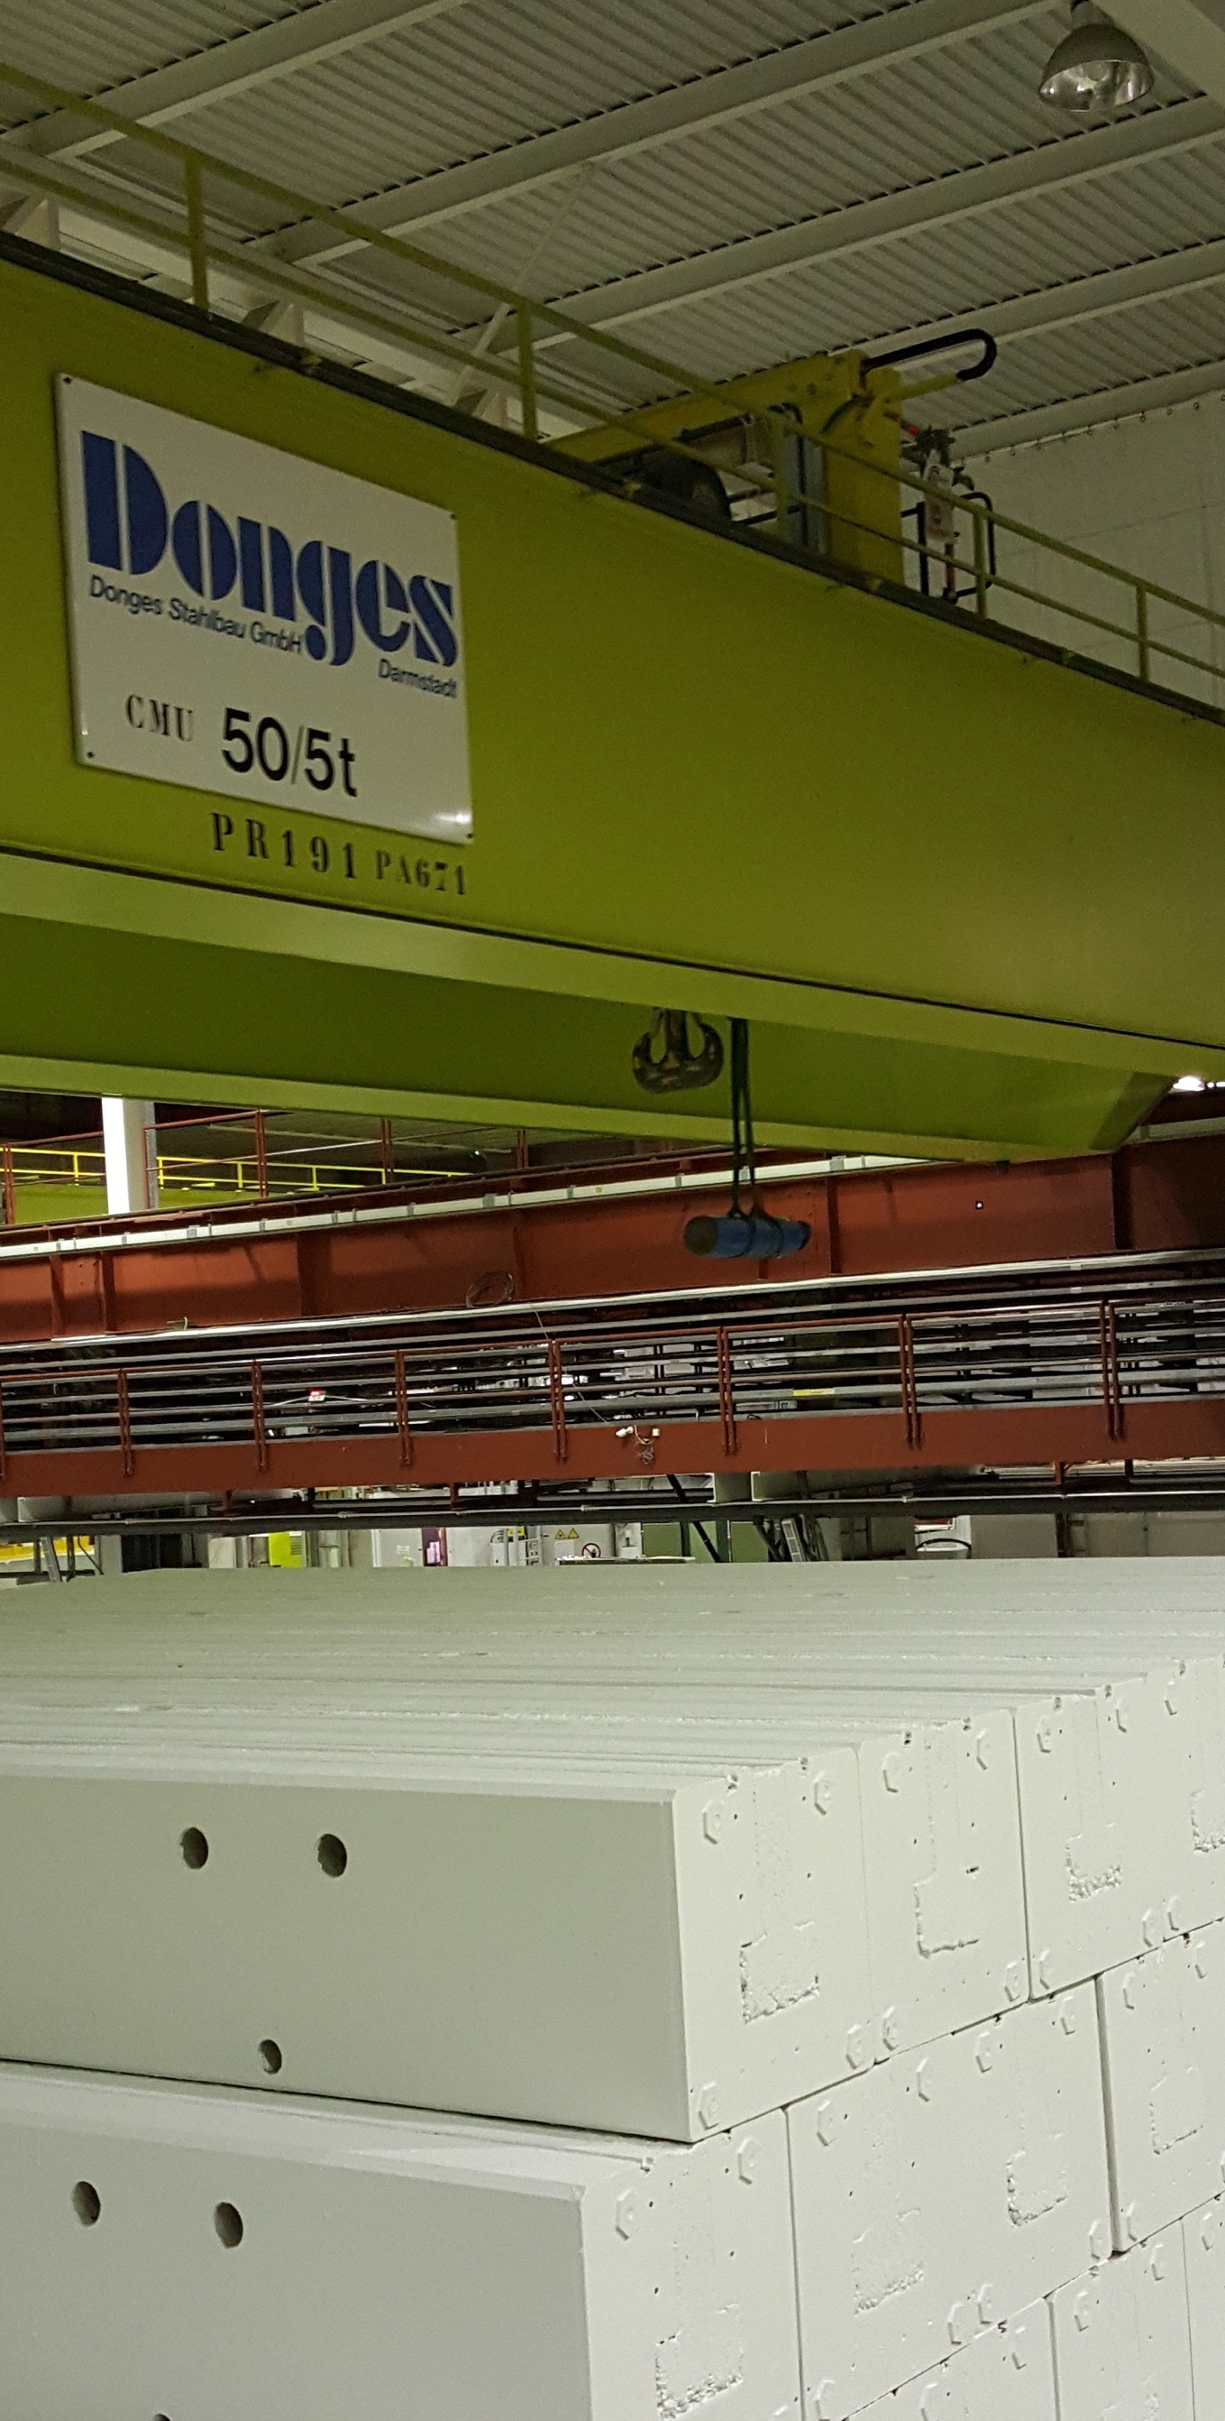
Transport
A. Desmarest EP-DI

Slide 18
Declare all the deviations in the hall
to the DSO, TSO or AFTC
Thank you for your attention!
A. Desmarest EP-DI

