Slide 1






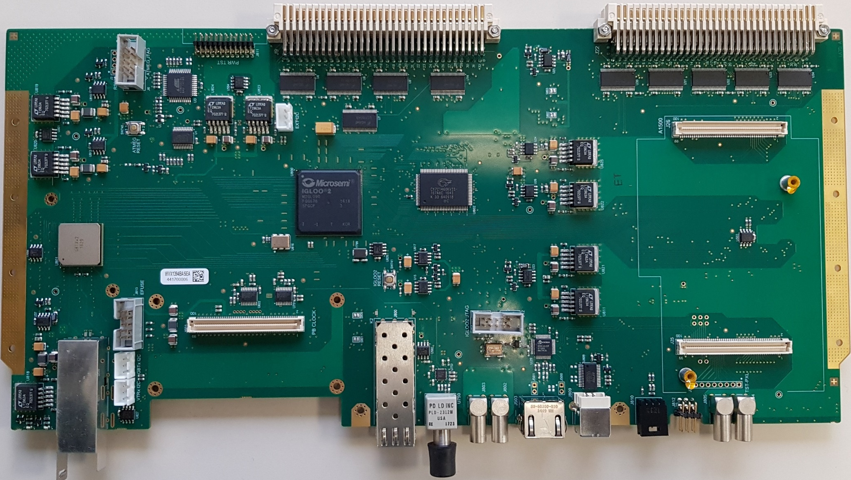
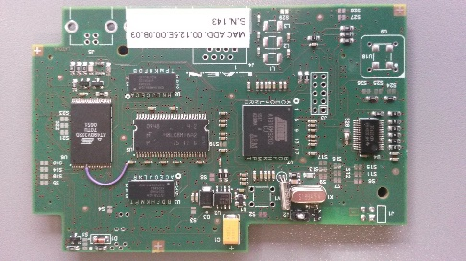

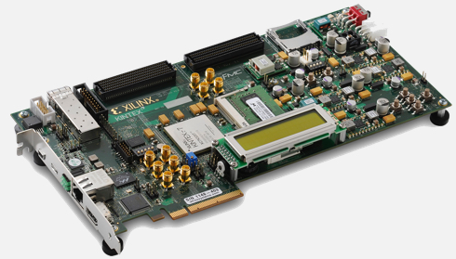


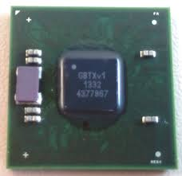
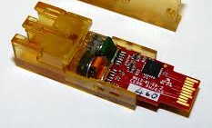

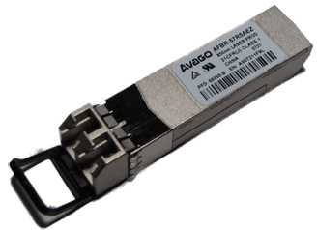
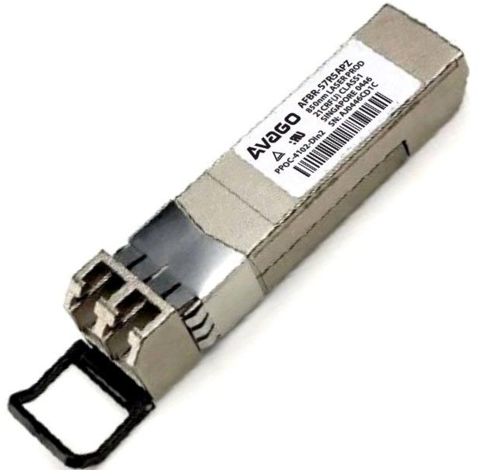



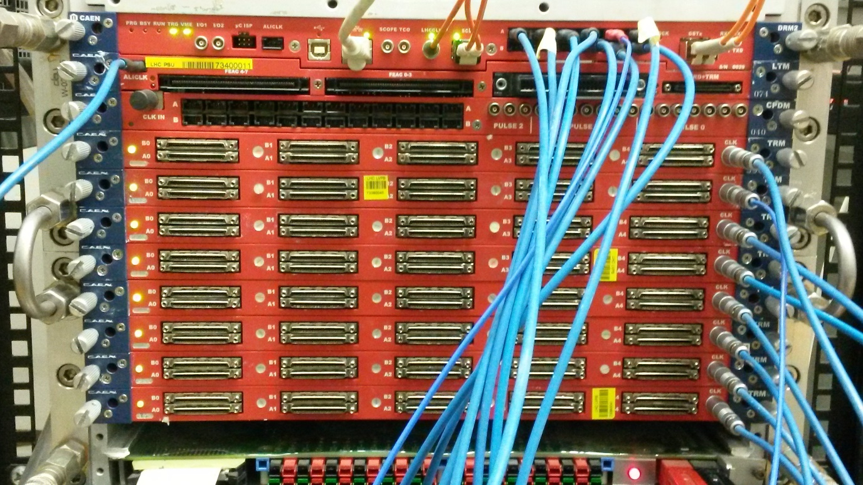
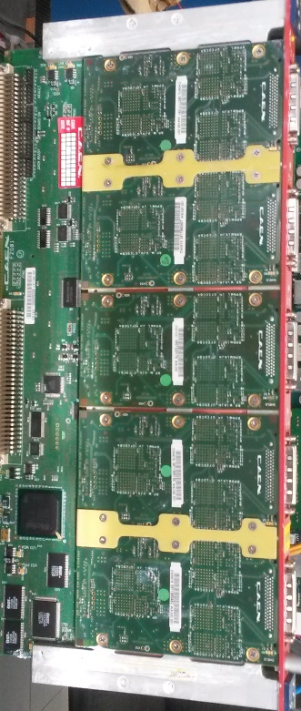
Radiation tests and production-test strategy
for the ALICE TOF readout upgrade board
Davide Falchieri for the ALICE Collaboration
INFN Bologna
davide.falchieri@bo.infn.it
Abstract: The readout board for the ALICE TOF detector named DRM2 is now in the production phase: 88 boards are being produced (72 are needed in the experiment). Since the board will operate in a radiation environment (0.13 krad total dose expected in 10 years), a complete irradiation campaign at the component level was performed. We focus on the irradiation tests on a Microsemi Igloo2 FPGA and two Avago optical transceivers with a 100 MeV proton beam, available at the facility operated by INFN-TIFPA at the Centro di Protonterapia in Trento. This poster also focuses on the board production test strategy.
Summary:
In order to fulfill the new requirements on data acquisition performances given by the higher interaction rates both in proton-proton and in lead-lead collisions during RUN3 and RUN4 in ALICE, an upgraded version of the readout card was designed for the ALICE TOF detector and is now ready for production. The board features a few components which are in common with the previous-generation board, like an on-board ARM-processor mezzanine (A1500), and more up-to-date devices like the Microsemi Igloo2 FPGA and the GBTx ASIC from CERN. An irradiation campaign at the Centro di Protonterapia in Trento was performed in 2018 with the goal to quantify the cross section of the board components to single event upsets (SEUs) as well as to evaluate the susceptibility to latch-up and total irradiation damages up to a dose of a few krad (factor ~10-20 related to the expected dose in the real-life experiment). In a previous irradiation campaign in 2016 we tested several other components like static SRAM, clock and voltage-drop regulators in addition to the Igloo2 FPGA (silicon revision 1) and the optical receivers FLTL8524P28BNL and FLTL8524P28BNV from Finisar. Worryingly, for the FPGA and these last two devices, we observed single event latch-ups.
Using a 100 MeV proton beam, we then studied in 2018 three Microsemi Igloo2 FPGA (using the latest available silicon revision number 3) and two Avago transceivers. For what concerns the FPGA, irradiated with a cumulative fluence up to 4 10¹⁰ p/cm², we did not experience any latch-up events. We also measured a SEU cross section on the internal BRAM as low as 2 10⁻¹⁴ cm² per bit. It is worth mentioning that all the FPGAs were still reprogrammable after receiving a dose of 3.8 krad even if, in one case, a certain annealing time was needed before the FPGA recovered its re-programming capability. Concerning the Avago optical transceivers, we used a sample of 4 AFBR-57R5AEZ and 4 AFBR-57R5APZ. No latch-up events and just one SEU on the former type were observed.
DRM2 board
VME64x with 2eSST for reading TRMs
Microsemi Igloo2 M2GL090 (silicon revision: 3)
KC705
ETH
A1500
BRAM
GBTx
Igloo2
A1500
GBTx
CONET interface
GBT link BER check
An internal BRAM (64kword of 16-bits) was written with known patterns, then continuously read out via CONET and A1500. Errors in the RAM were immediately corrected and logged.
100 FFD chain
VTRx
VTRx
CONET2 SFP
ETH
100 FFD chain with TMR
KC705 was sending a known pattern to the Igloo2 via the GBT link. Data were then sent back like in a loopback and checked against the expected values.
Irradiation results
Two 100-FFD chains were loaded and continuously checked for errors
Avago transceiver irradiation tests (TID + SEU)
100 MeV proton beam
Igloo2 FPGA irradiation tests (TID + SEU)
Device | Cyclotron current (nA) | Flux (p/s) | Duration (s) | Fluence (p) | Dose (krad) | Dose rate (rad/s)
EZ1 | 10 | 1.04 10⁸ | 300 | 3.12 10¹⁰ | 2.93 | 9.78
EZ2 | 10 | 1.05 10⁸ | 300 | 3.15 10¹⁰ | 2.96 | 9.78
EZ3 | 10 | 1.04 10⁸ | 450 | 4.68 10¹⁰ | 4.40 | 9.78
EZ4 | 10 | 1.04 10⁸ | 600 | 6.24 10¹⁰ | 5.87 | 9.78
PZ1 | 10 | 1.04 10⁸ | 300 | 3.12 10¹⁰ | 2.93 | 9.78
PZ2 | 10 | 1.04 10⁸ | 300 | 3.12 10¹⁰ | 2.93 | 9.78
PZ3 | 10 | 1.04 10⁸ | 450 | 4.68 10¹⁰ | 4.40 | 9.78
PZ4 | 10 | 1.04 10⁸ | 600 | 6.24 10¹⁰ | 5.87 | 9.78
Device | Fluence (p) | Dose (krad) | BRAM SEUs | Cross section (1/cm² /bit) | Flip-flop chain SEUs | Flip-flop chain SEUs with TMR | Link loss | GBT link SEUs
IG1 | 1.32 10¹⁰ | 1.24 | 129 | 9.32 10⁻¹⁵ | 0 | 0 | 0 | 0
IG2 | 2.54 10¹⁰ | 2.39 | 439 | 1.65 10⁻¹⁴ | 0 | 0 | 0 | 0
IG3 | 4.06 10¹⁰ | 3.82 | 605 | 2.13 10⁻¹⁴ | 1 | 0 | 1 | 0
We performed the irradiation in steps, to check whether the FPGA was still re-programmable after receiving a certain amount of radiation:
IG1 and IG2 were still programmable after each irradiation step.
IG3 needed 12 hours of annealing before being re-programmable again
Latch-up events: 0
SEU events: 1 on EZ type
Latch-up events: 0
Production board tests
88 DRM2 boards are currently being produced at CAEN in order to provide the 72 cards required for the experiment plus spares. The production-test strategy is built upon a 3-stage approach: a first test is done at the manufacturer site (CAEN), followed by a second test performed at CERN using the same setup system as at CAEN. Before their insertion in the detector (planned during 2019), the boards are finally tested in the custom ALICE TOF VME crate where all real-life functionalities (like reading out the full crate at sustained rate) are tested together. DRM2 boards which successfully pass all the 3 steps will be installed in the experimental crates while the commissioning stage in situ will start in late 2019.
TRM
VME
DRM2
KC705
ETH
DRM2
List of tests:
switch on (check voltages/currents)
program Igloo2 FPGA
check CONET link
check VME
check SSRAM
GBTx Efuse programming
check GBTx + data acquisition
ETH
TRM
TRM
…
TRM
GBT link
TRM
GBT link
The DRM2 has to demonstrate to be able to acquire data from 9/10 TRM boards at a sustained trigger rate of 33 KHz for 2 hours. Data are then processed offline to check their quality.

