Slide 1

CMS High-Granularity Calorimeter (HGCAL)
TWEPP Seminar, 20 September 2018, David Barney (CERN)

Slide 2
Today’s Tasting menu
Appetizer
Motivation for upgrading
CMS endcap calorimeters
Starter
The choice of high granularity
Main Course
The CMS HGCAL design and prototyping
with a side order of electronics challenges
Dessert
Measured HGCAL performance
After-seminar mints
Status and challenges ahead

Slide 3
Appetizer
Motivation for upgrading CMS endcap calorimeters for HL-LHC

Slide 4
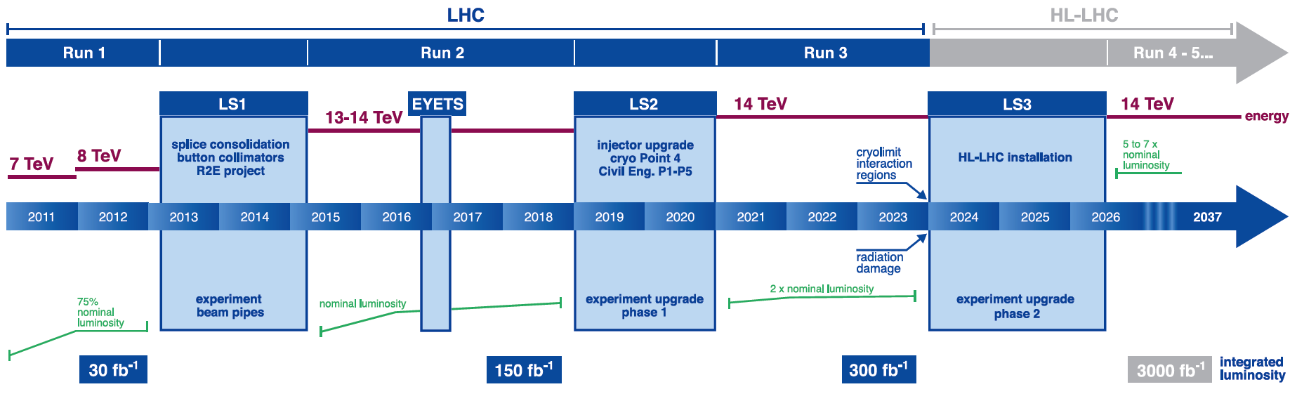
Luminosity provided by HL-LHC opens new doorways to physics
HL-LHC: levelled L = 5x10³⁴cm⁻²s⁻¹ and pileup 140, with potential for 50% higher L & pileup
Physics reach will include SM & Higgs, with searches for BSM including reactions
initiated by Vector Boson Fusion (VBF) and including highly-boosted objects
→ Narrow (τ) jets or merged (hadronic decays of W, Z) jets
→ Ideally want to trigger on these narrow VBF & merged jets
Good jet identification and measurement: crucial for HL-LHC

Slide 5
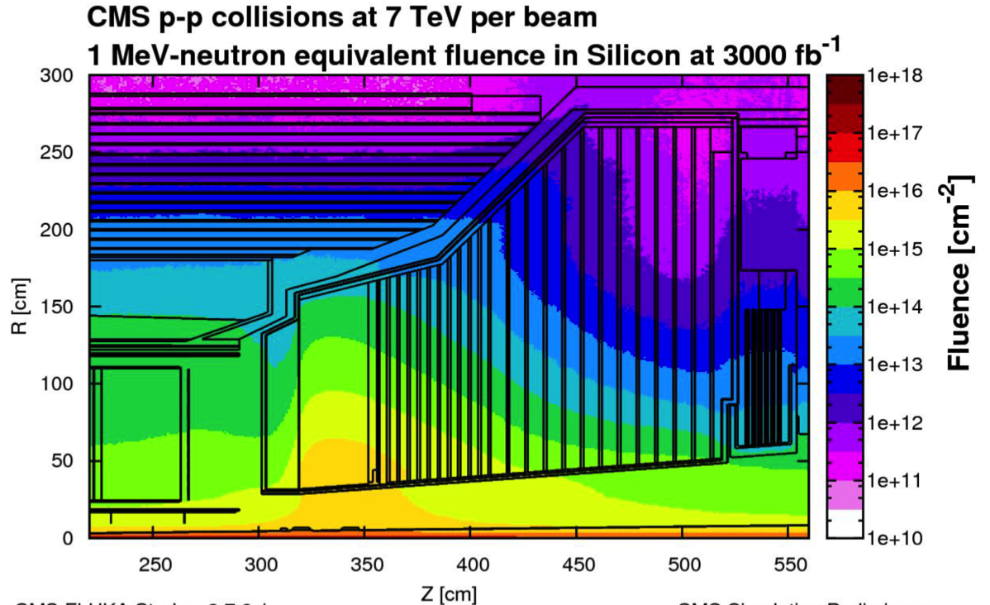
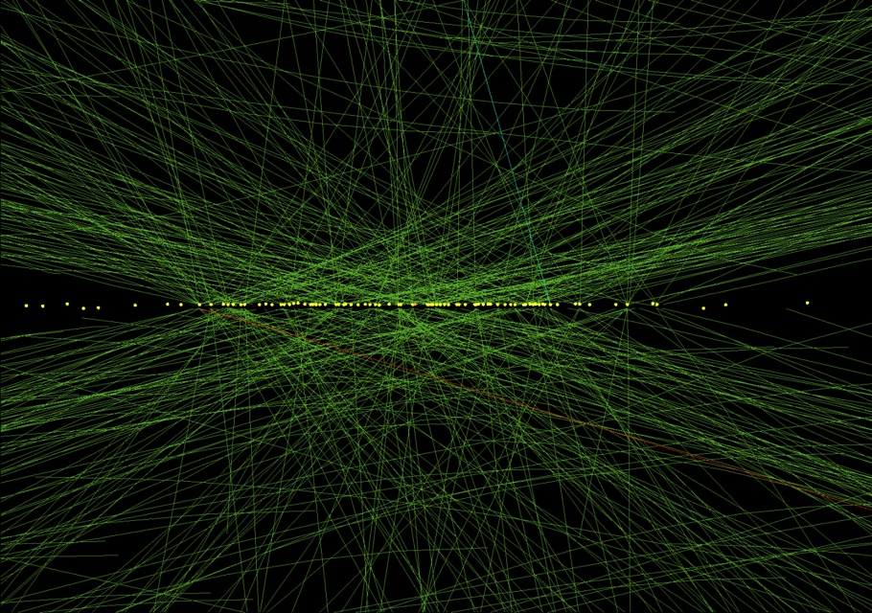
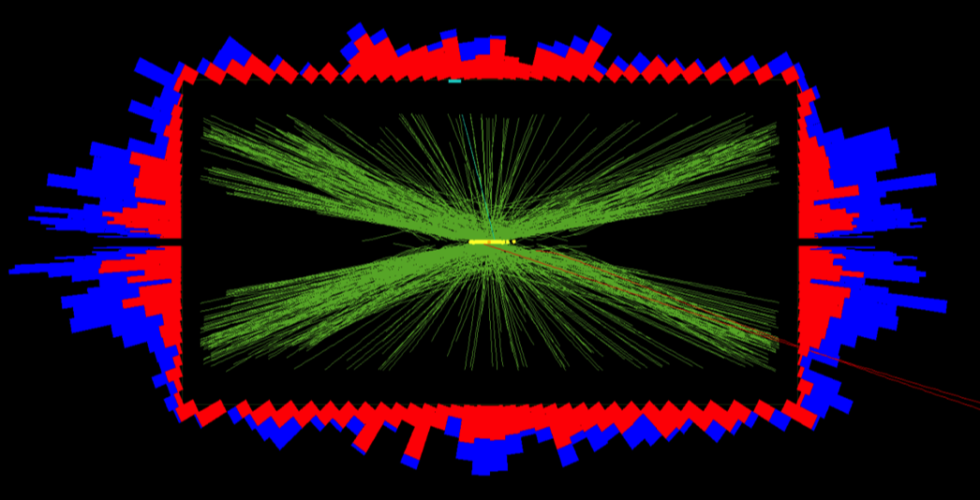
Existing CMS endcap calorimeters cannot cope with the expected radiation or pileup @ HL-LHC
CMS @ HL-LHC:
~10¹⁶ 1 MeV n_{eq} cm⁻² @ 3ab⁻¹
in forward calorimeters,
with pileup ~200
And up to 2 MGy absorbed dose
78 pileup events in 2012. Expect 140-200 @ HL-LHC

Slide 6
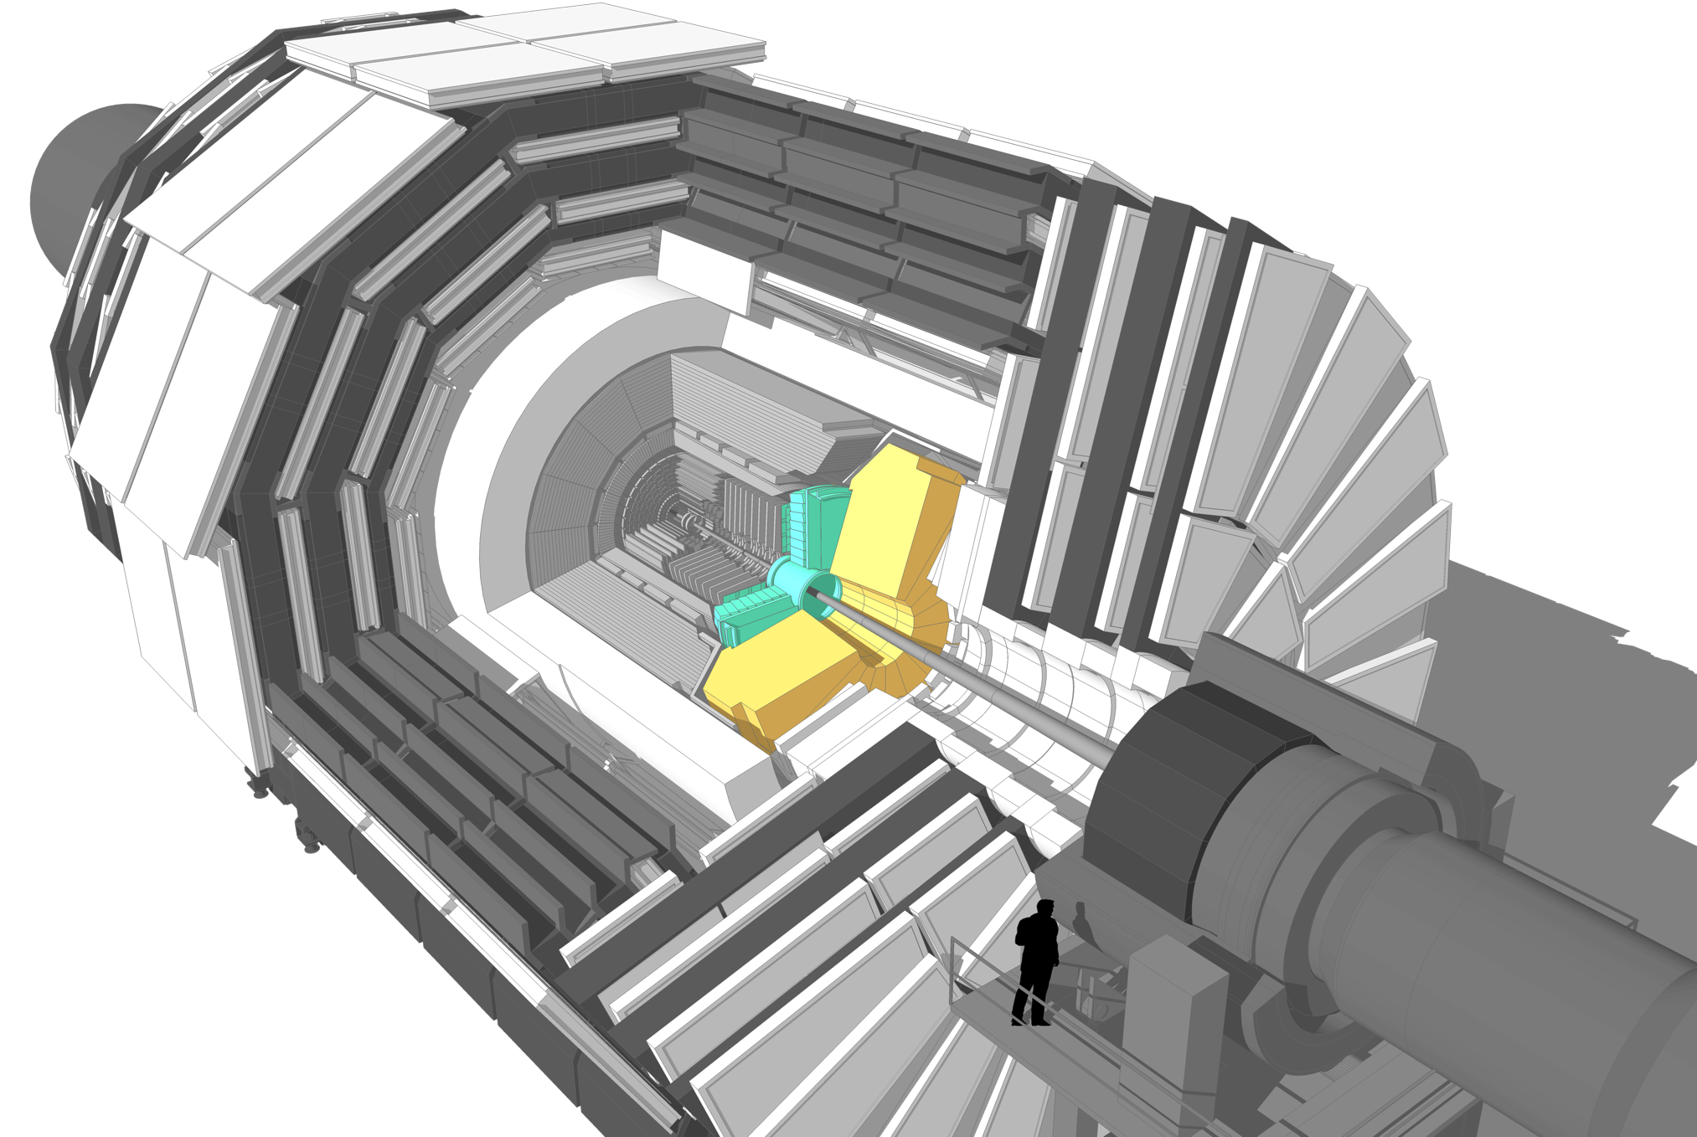
CMS will replace its endcap calorimeters for HL-LHC: the High Granularity Calorimeter

Slide 7
Starter
The choice of high granularity

Slide 8
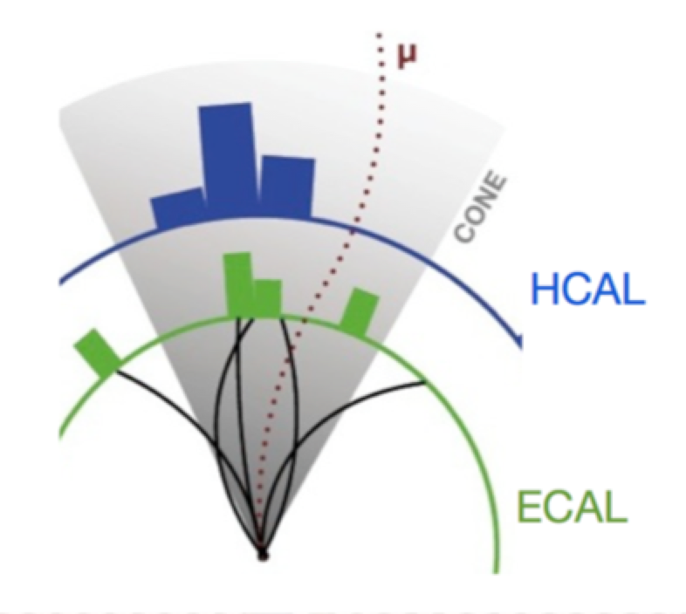
Real need to improve jet energy resolution for the next generation of calorimeters
Multi-jet final states (outgoing quarks, gluons)
Missing energy relies upon accurate jet energy measurements
Need to separate heavy bosons (W, Z, H) in hadronic decays
“Typical” jet:
~62% charged particles (mainly hadrons)
~27% photons
~10% neutral hadrons
~1% neutrinos
Jet reconstruction:
weighted sum of energies in a cone → energy of original parton
Resolution: driven by calorimeter with worst resolution (HCAL)

Slide 9
Two main approaches for improving jet energy resolution
Substantial improvement of the energy resolution of hadronic
calorimeters for single hadrons:
dual (or triple!) readout, e.g. DREAM
Precise reconstruction of each particle within the jet
→ reduction of HCAL resolution impact:
particle flow algorithms and imaging calorimeters
e.g. CALICE detectors for linear colliders (CLIC, ILC),
CMS HGCAL
Both techniques aim at separating charged/neutral
& electromagnetic/hadronic components

Slide 10
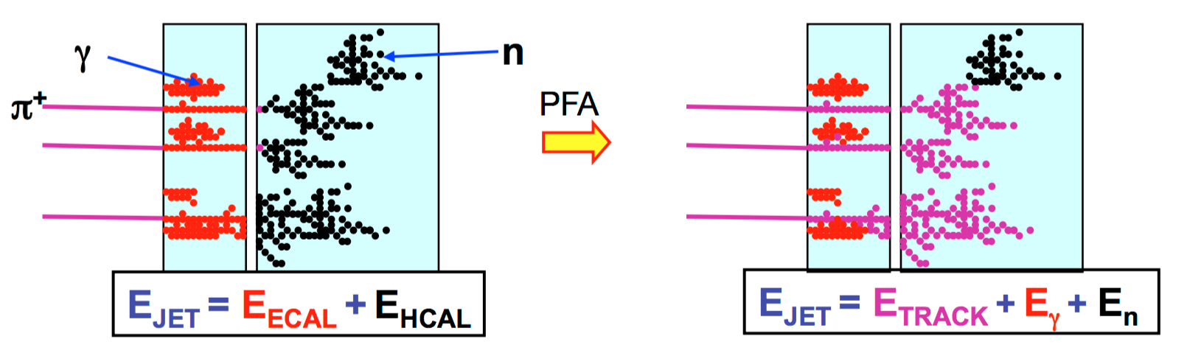
Particle flow technique: make best use of all detectors to measure jet energies
Idea: for each individual particle in a jet, use detector with best energy/momentum resolution
Charged tracks = Tracker
e/photons = ECAL
Neutral hadrons (only 10%) = HCAL

Slide 11
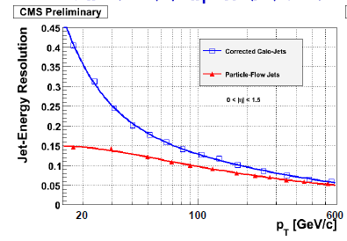
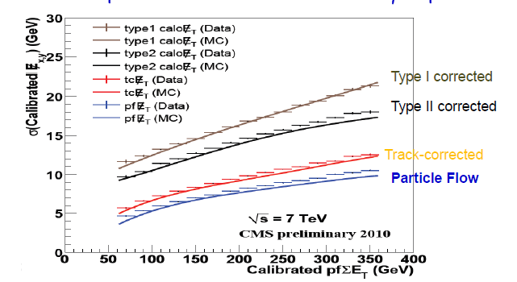
Particle flow already used in Aleph, Delphi & CMS (all have relatively low resolution HCALs)
Simulation: jet energy resolution
Data: Missing energy resolution
Measurement of jets in CMS is enhanced greatly
by the use of particle flow techniques

Slide 12
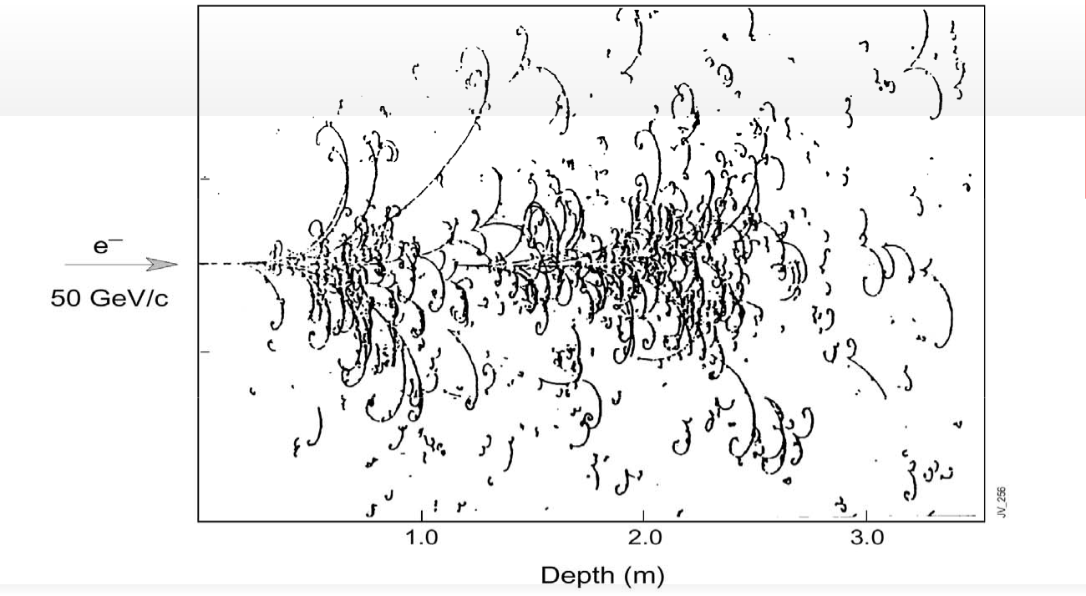
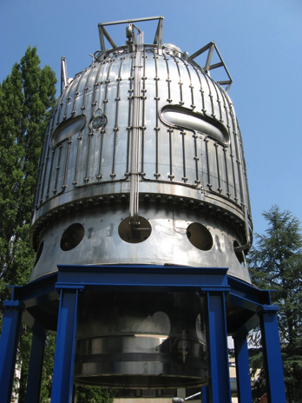

The previous generation of calorimeters could “see” showers! Can we do this again?
γ + Coul. Field →
_{e}+ _{e}-

Slide 13
HGCAL has the potential to visualize individual components of showers
Simulation of 140 pileup events in CMS

Slide 14
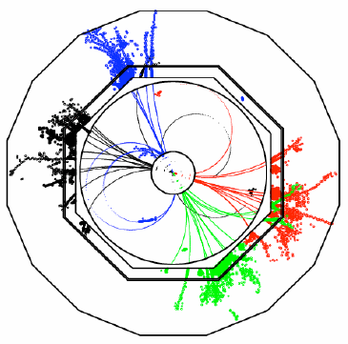
For best results: high granularity in 3D – separation of individual particle showers
For a Particle-Flow Calorimeter:
Granularity is more important than energy resolution
Lateral granularity should be below Molière radius in ECAL and HCAL
In particular in the ECAL: small Molière radius to provide good two-shower separation (particularly in high pileup environment)
→ dense absorbers and thin sensors
Sophisticated software needed!

Slide 15
Main Course
The CMS HGCAL design & prototyping

Slide 16
A wise person once said (about the HGCAL):
“there are no show-stoppers; it is all just engineering”
Another person responded:
“HGCAL is perhaps the most challenging
engineering project ever undertaken in particle physics”

Slide 17
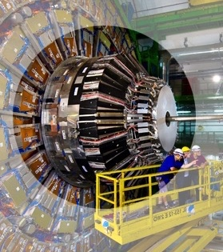
Overall mechanical design of HGCAL heavily constrained by present endcap calorimeters
Present CMS endcap calorimeters
HGCAL design
Concept: remove complete endcap calo. system and replace with HGCAL

Slide 18
Overall design of HGCAL driven by need for radiation-hard segmented sensors
To realise a high-granularity calorimeter, we need:
low cost/area active material(s), radiation-tolerant on-detector electronics, high-bandwidth data transmission, powerful FPGAs for off-detector electronics
Look for proven and adequately radiation-hard active materials
To build a dense e.m./hadronic calorimeter with a good energy resolution, small R_{M}, good two-shower separation (e.m. and hadronic), with high lateral and longitudinal readout granularity
A silicon-sensor-based sampling calorimeter
(absorber materials – W, Pb, Cu, Stainless Steel)
followed by plastic scintillator tiles with direct SiPM readout for the lower radiation level region
(absorber material SS)

Slide 19
Granularity is driven by calibration requirements and energy resolution target
Calibration of Silicon sensors and scintillator tiles is with MIPs
→ need good S/N for MIPs after 3ab⁻¹
→ low-capacitance Si cells → small area (0.5—1.1cm²)
→ Scint. cells with small area for high-efficiency light collection
Fine longitudinal sampling needed to provide good energy resolution (minimize sampling term) especially with thin active layers
(e.g. 100-300μm silicon sensors)

Slide 20
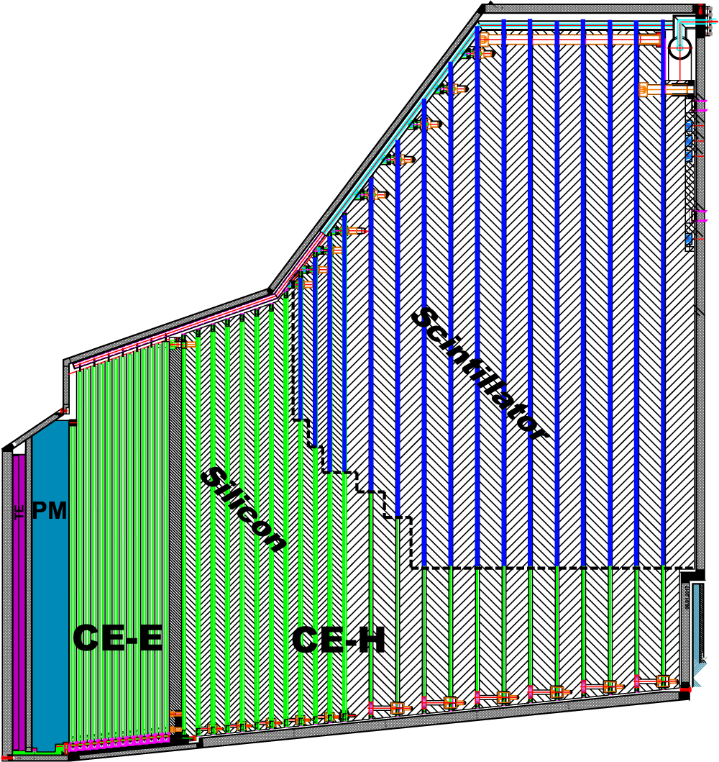
CMS HGCAL: a sampling calorimeter with unprecedented number of readout channels
Active Elements:
Hexagonal modules based on Si sensors
in CE-E and high-radiation regions of CE-H
Scintillating tiles with SiPM readout in
low-radiation regions of CE-H
Key Parameters:
HGCAL covers 1.5 < η < 3.0
Full system maintained at -30ºC
~600m² of silicon sensors
~500m² of scintillators
6M Si channels, 0.5 or 1.1 cm² cell size
  Data readout from all layers
  Trigger readout from alternate layers
  in CE-E and all layers in CE-H
~27000 Si modules
~110 kW per endcap
~2.3m
~2m
Electromagnetic calorimeter (CE-E): Si, Cu/CuW/Pb absorbers, 28 layers, 26 X₀ & ~1.7λ
Hadronic calorimeter (CE-H): Si & scintillator, steel absorbers, 24 layers, ~9.0λ

Slide 21
~600m² of silicon sensors (3x CMS tracker) in radiation field peaking at ~10¹⁶n/cm²
Planar p-type DC-coupled sensor pads
simplifies production technology
( consider n-type sensors for 300μm sensors in lower radiation region of HGCAL )
Hexagonal sensor geometry preferred to square
makes most efficient use of circular sensor wafer
reduces number of sensors produced & assembled into modules ( factor ~ 1.3 )
8” wafers preferable to 6”
reduces number of sensors produced & assembled into modules ( factor ~ 1.8 )
300μm, 200μm and 120μm active sensor thicknesses
match sensor thickness (and granularity) to radiation field for optimal performance
Simple, rugged module design & automated module assembly
provide high volume, high rate, reproducible module production & handling

Slide 22
Thinner sensors: less decrease in charge collection efficiency vs fluence than thicker sensors

Slide 23
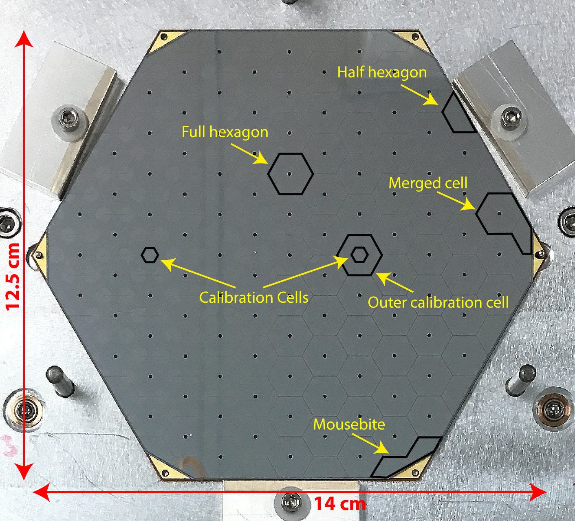
Hexagonal silicon sensors are divided (mostly) into hexagonal cells, with some special cells
6” prototype sensor
~55pF per cell
O(nA) per cell
(before irradiation)
Prototype 6” and 8” sensors made by three producers

Slide 24
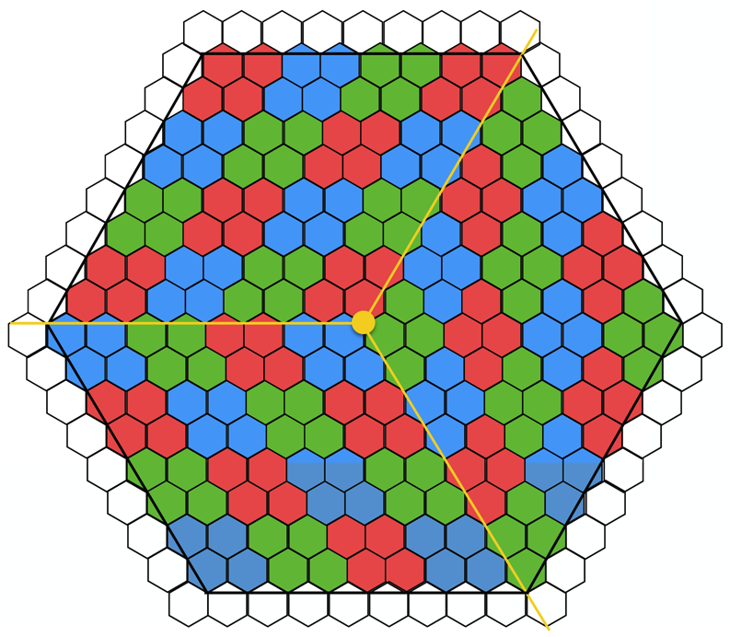
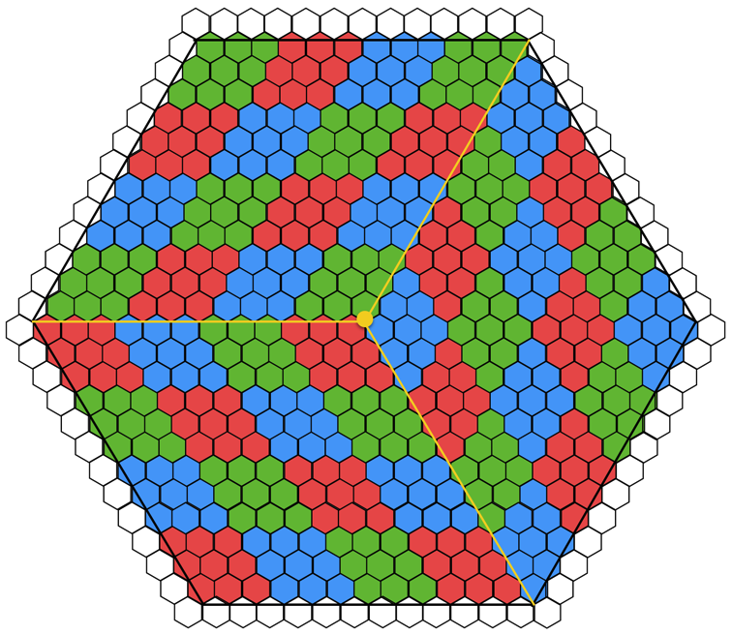
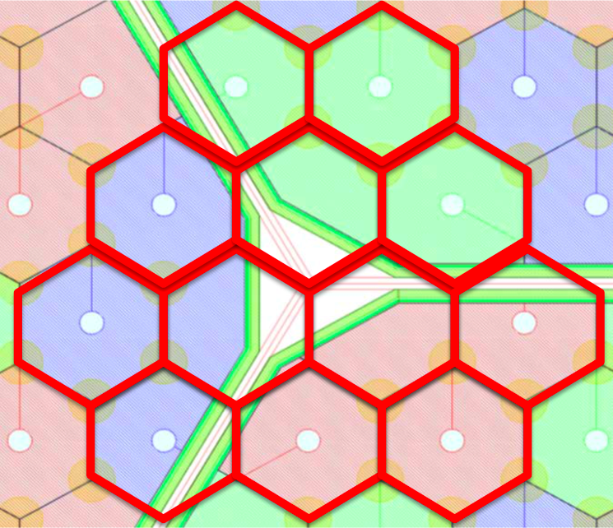
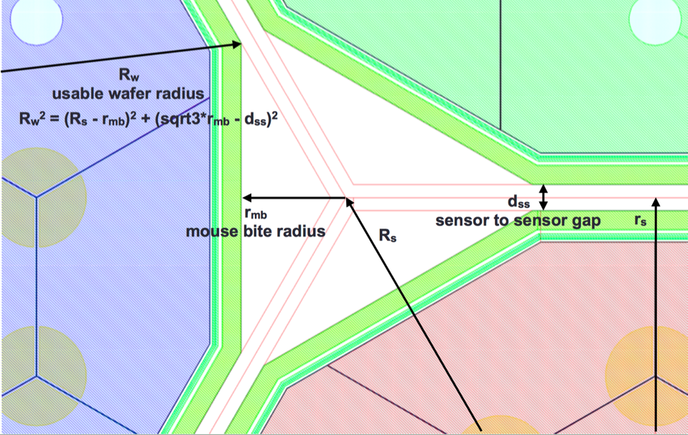
8” silicon sensors will be hexagonal, divided with 3-fold symmetry into hexagonal cells
192 cells/sensor
432 cells/sensor
⌀ ~ 190mm
All cells have C~65pF
Coloured groupings
of cells represent
trigger readout units
~4.5cm² (half the area of
a single crystal in the
present ECAL endcap)

Slide 25
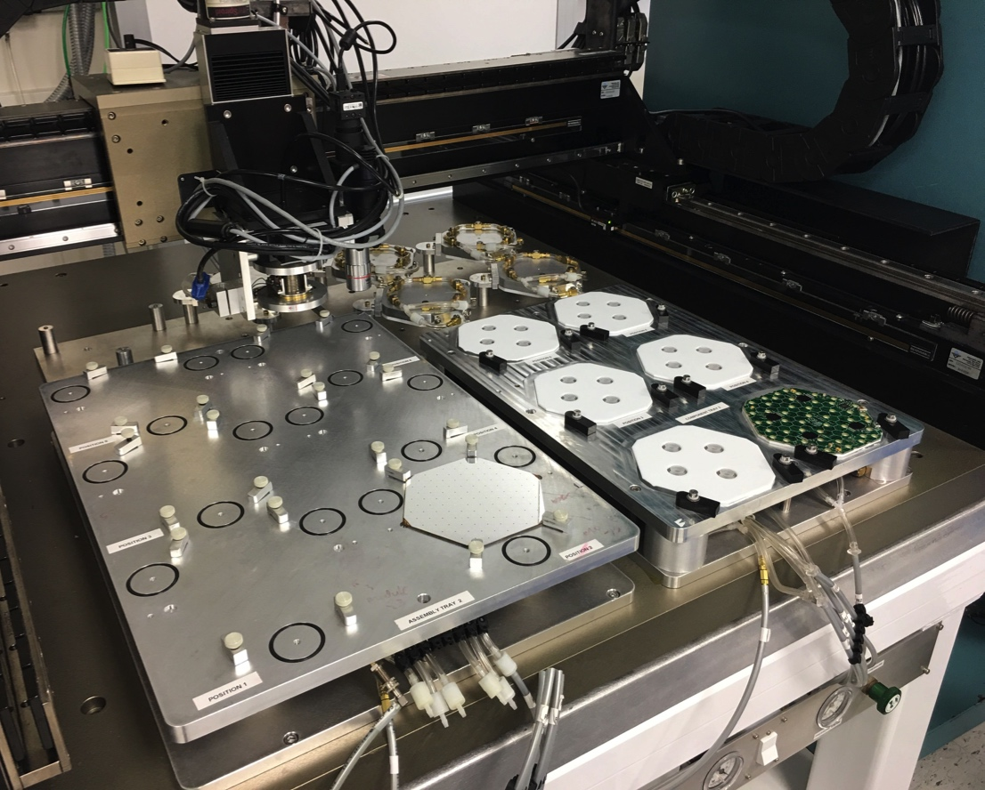
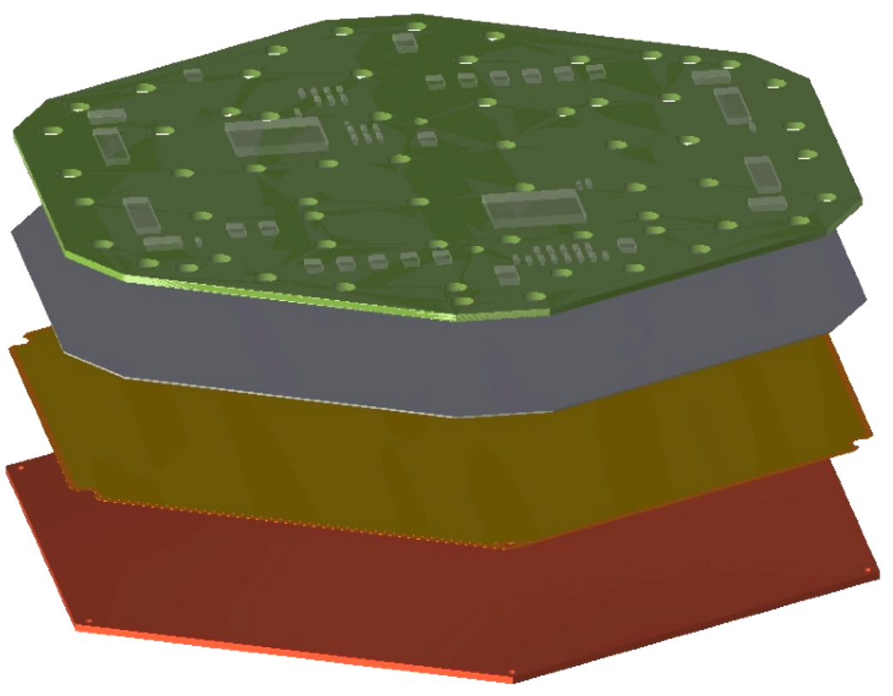
Silicon modules are glued assemblies, made with standardized gantry, wire-bonders etc.
Automated gantry @ UCSB
used previously for CMS tracker assembly
PCB
Silicon
Kapton
Baseplate
~60 modules already made and used for test purposes.
Another ~60 being made at UCSB now

Slide 26
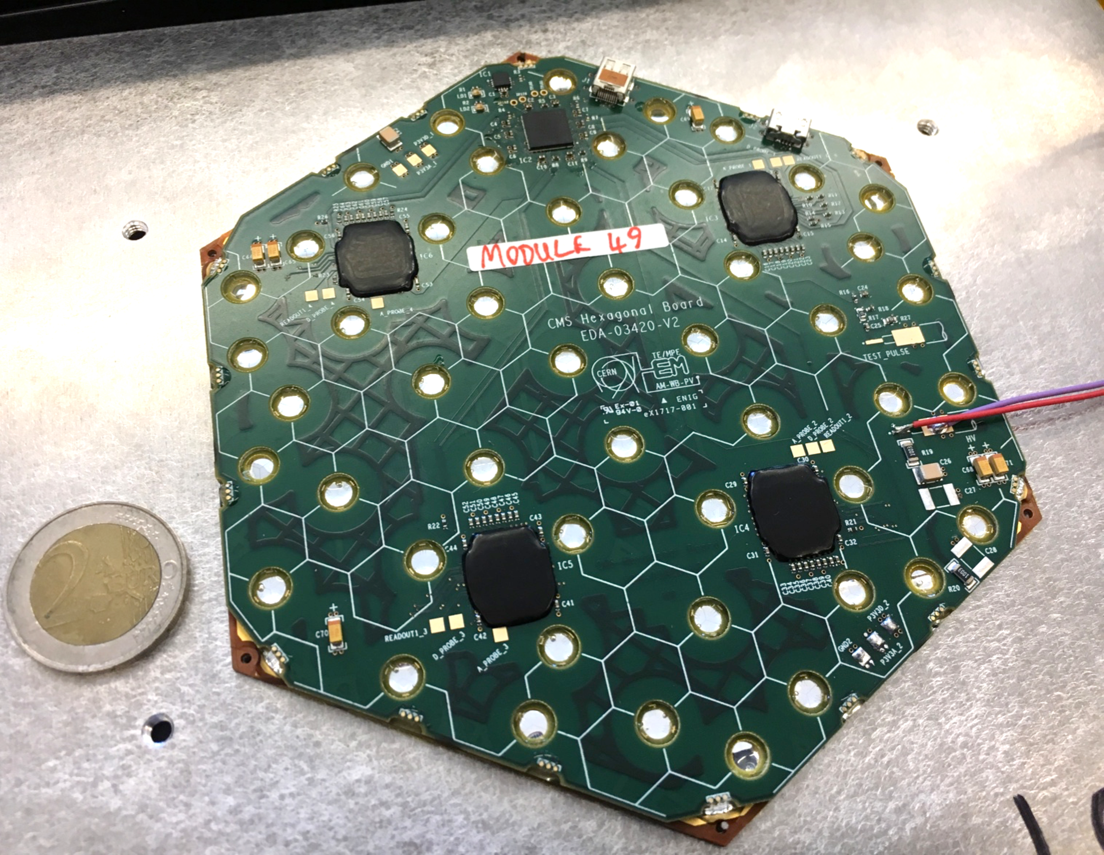
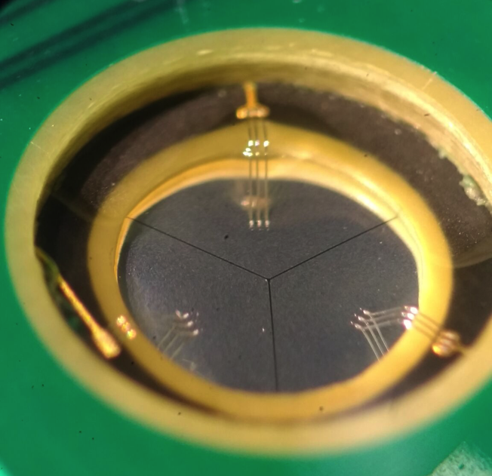
HGCAL will include 27000 modules based on hexagonal silicon sensors with 0.5-1cm² cells
Silicon sensor glued to baseplate and PCB containing front-end electronics
Wire bonding from PCB to silicon through stepped holes

Slide 27
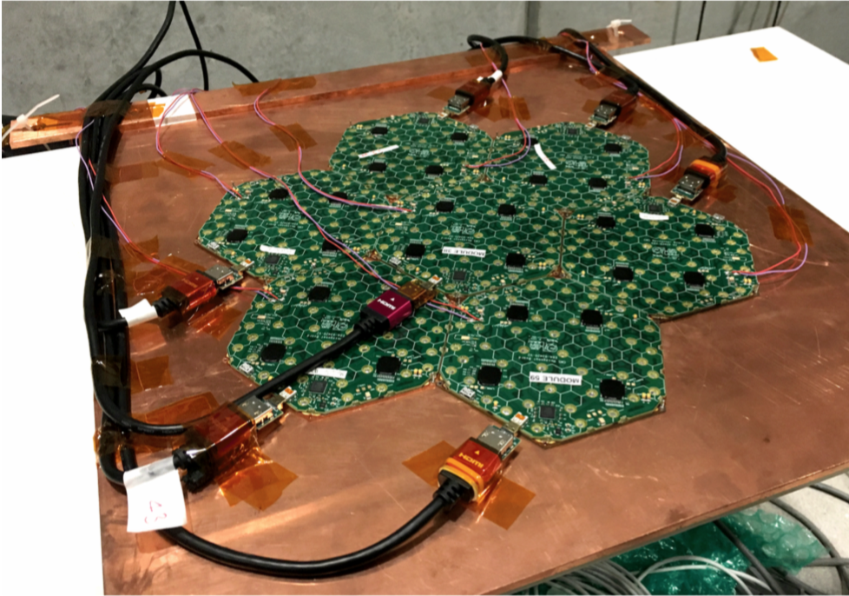
Silicon modules are arranged in hexagonal matrices to cover fiducial area of HGCAL
7 hexagonal modules for 2017 beam test

Slide 28
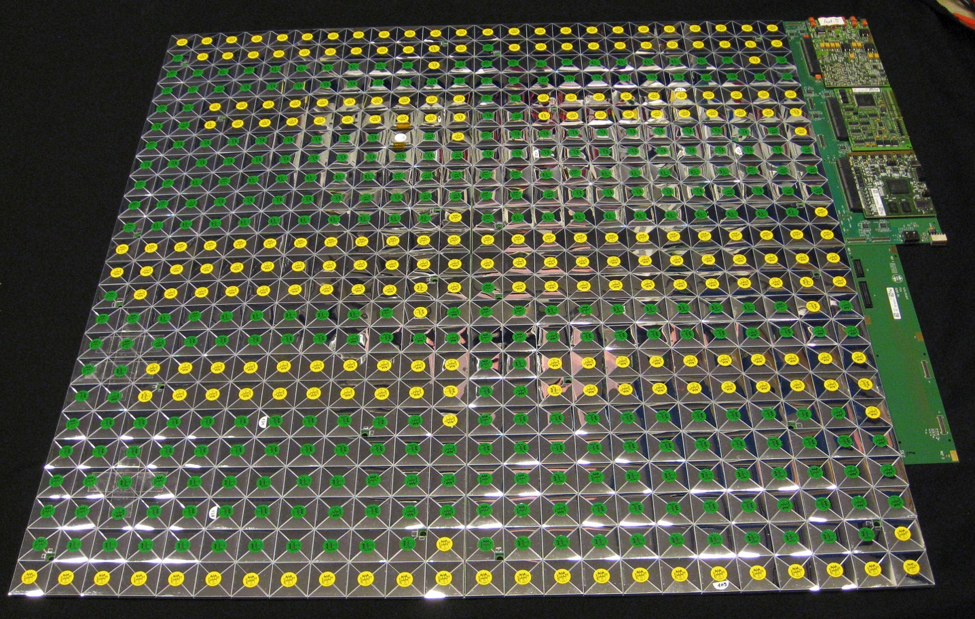
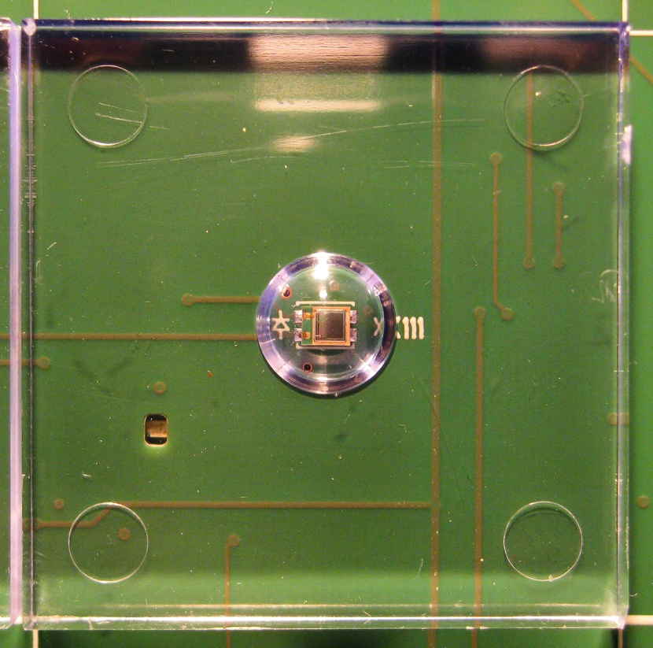
HGCAL will also include 500m² of scintillator tiles with on-tile SiPM readout
SiPMs already used successfully in e.g. CMS HCAL Phase 1 upgrade
Tile boards or “megatiles” limited in size by CTE of different components
For first beam tests, modified CALICE AHCAL used for rear hadron calorimeter:
3x3cm² scintillator tiles + direct SiPM readout

Slide 29
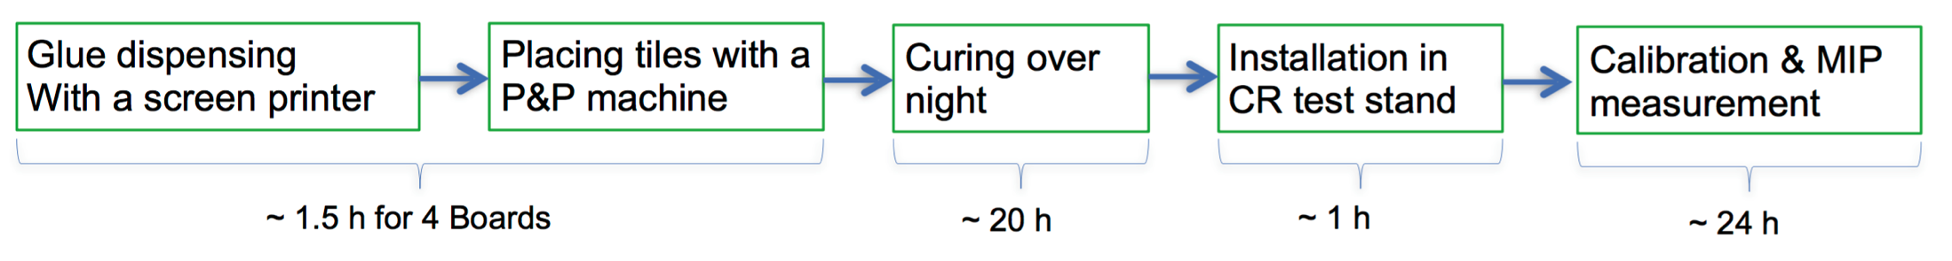
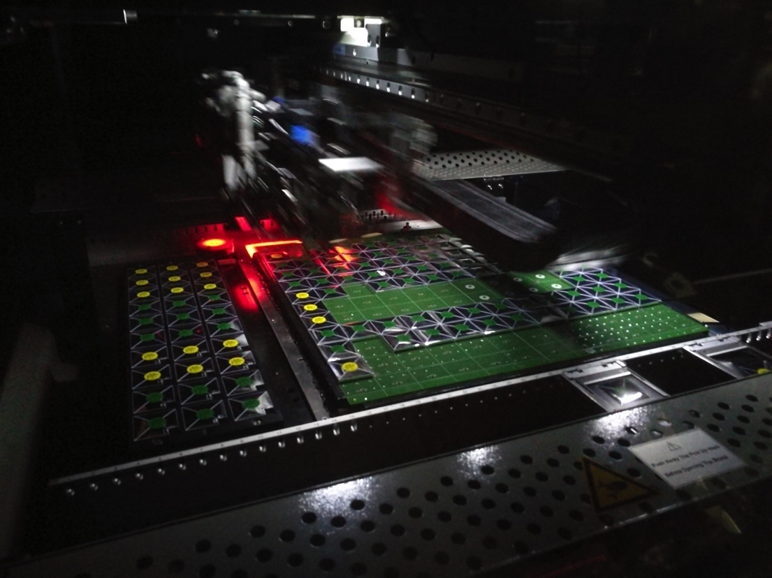
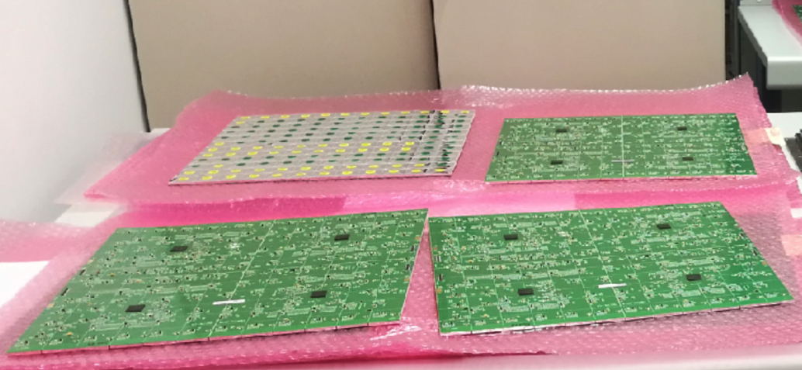
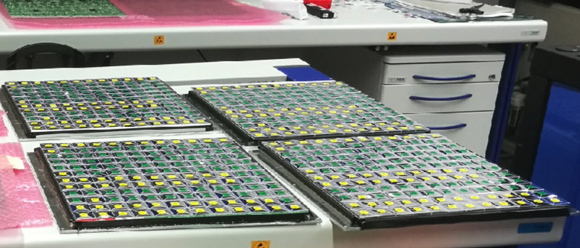
Automated assembly already used for
CALICE prototypes: 28000 tiles on 158 boards
30 x 30 x 3 mm³ tiles, automatically wrapped and placed by “gantry” machine

Slide 30
HGCAL Electronics: combining some of the most challenging aspects from other detector types!
Calorimeter
Pixel
Tracker
High dynamic range
Triggering capability
Radiation
Space constraints
#readout channels
Physical size
MIP sensitivity
MIP sensitivity
Low power
And full-scale production
must start in ~2021!
HGCAL

Slide 31
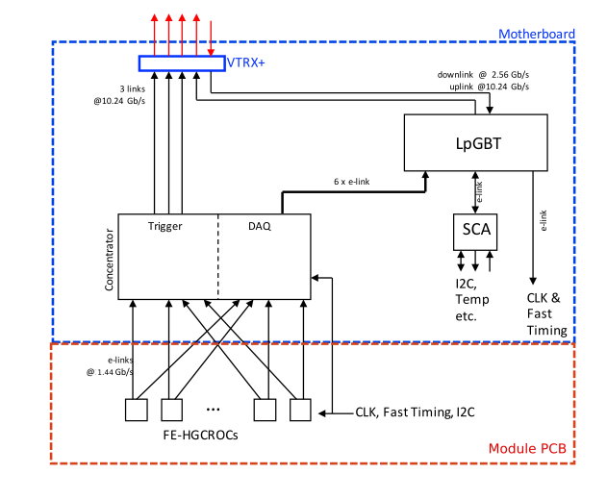
On-detector control/readout is a mixture of
ASICs and “generic” developments
Phase-II “generic”
developments
Motherboard
Concentrators
HGCAL ASICs
Compression connectors
join the 2 PCBs
Hexaboard
HGCROC

Slide 32
The front-end ASIC is particularly challenging in the compact & mixed-technology HGCAL
Compatibility with –ve & +ve inputs for n-on-p and p-on-n silicon and SiPMs
Low noise* (<2500e⁻) despite ~65pF silicon cell capacitance
  Measure MIPs (~3.5fC in 300μm silicon) with S/N > 3 for whole lifetime of HL-LHC
High dynamic range (~0.2fC → 10pC, i.e. 16-bits)
  → Use 130nm CMOS with 1.5V supply
  Integral linearity better than 1% over full range
Provide timing information to < 100ps for signals above tens of fC
  Need clock distribution jitter 10-15ps (same specs as for other CMS detector upgrades)
Fast shaping time (<20ns) to minimize out-of-time pileup
On-detector digitization, linearization and zero suppression
Creation of trigger sums
Buffering of data to accommodate 12.5μs L1 latency
<20mW per channel (~limited by cooling power) include I_{leakage} compensation
High radiation resistance (~2MGy and 10¹⁶ n_{eq}/cm² & SEU robustness)
*want S/N ~8 at beginning of HL-LHC for 1 MIP in 120μm silicon ~ 1.5fC;
upper limit from 1.5TeV photon shower producing ~6000 MIPs in a single cell

Slide 33
HGCROC ASIC: a significant evolution from the Skiroc2 ASIC developed for CALICE
AMS 350nm
Commercial 130nm CMOS
Test
Vehicles
Skiroc2→Skiroc2-CMS → TV1→TV2 → HGCROC-V1→HGCROC_DV1→HGCROC
TWEPP 2011
N. Seguin-Moreau
Link
TWEPP 2016
C. de la Taille
Link
TWEPP 2017
D. Thienpont
Link
TWEPP 2018
C. de la Taille
Link

Slide 34
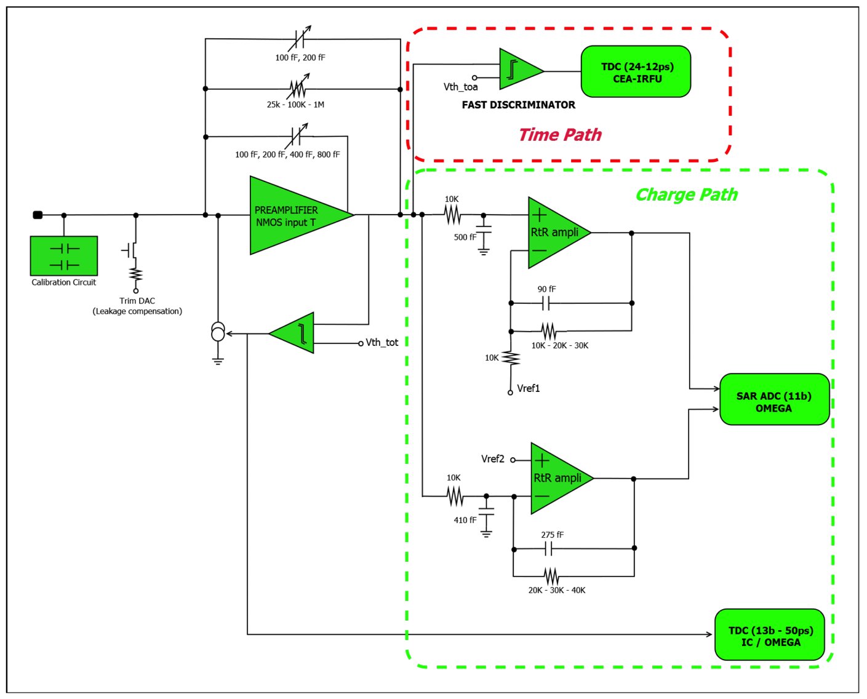
HGCROC: includes on-chip ADC, and TDCs for ToT (low power high dynamic range) & ToA (timing)
ToA: TDC for
Δt < 100 ps
ADC for
Q < 150 fC
ToT: TDC for Q > 50 fC
Skiroc2-CMS ASIC (2016) already had some of these features, inc. ToT & ToA
First simplified HGCAL ASIC (HGCROC-V1) in 130nm CMOS being tested now
See talk from C. de la Taille

Slide 35
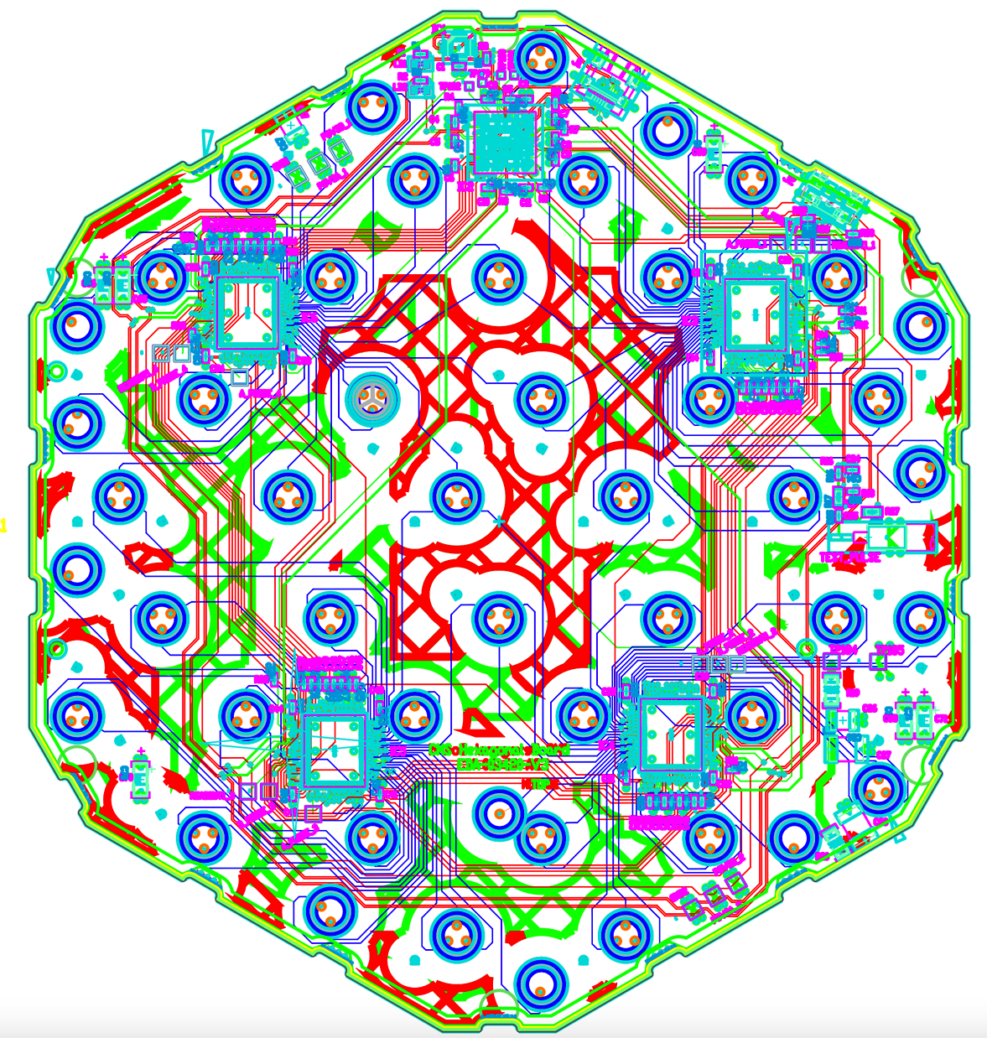
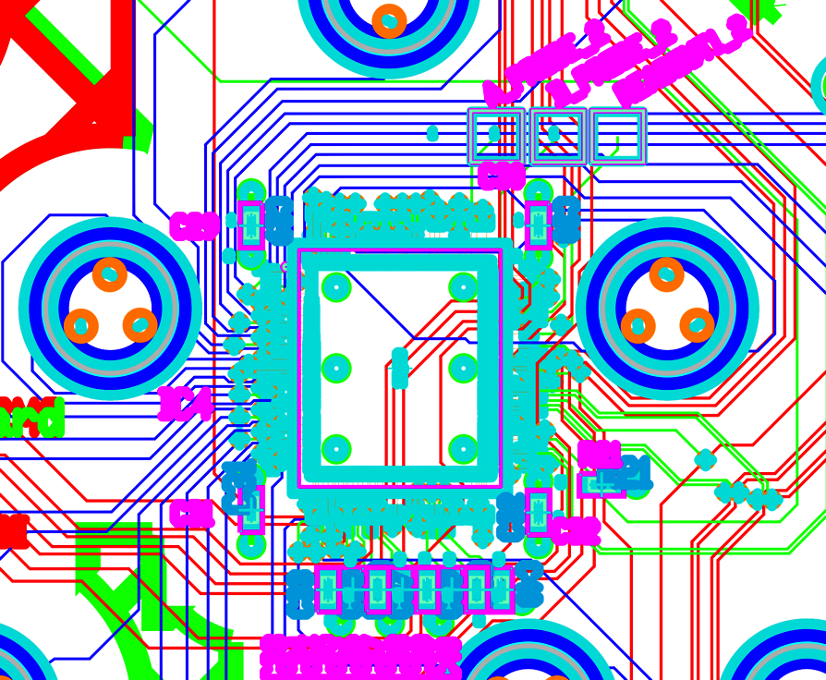
The Hexaboard front-end PCB is very challenging, partly due to the bonding holes
FPGA for control
& data aggregation
μHDMI for powering, control & data
μUSB for FPGA programming
Stepped holes for wire-bonding to Si
are not trivial to manufacture
Exploring use of embedded vias
to ease the layout – but increased cost
6” hexaboard for 4xSkiroc2-CMS, 128 Si channels

Slide 36
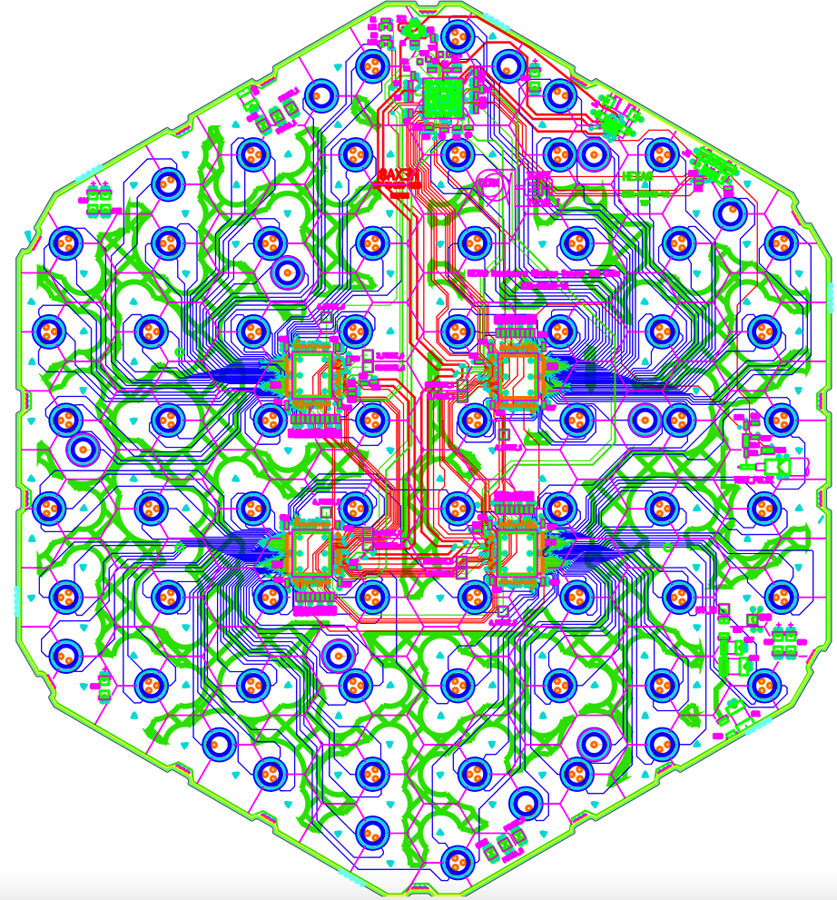
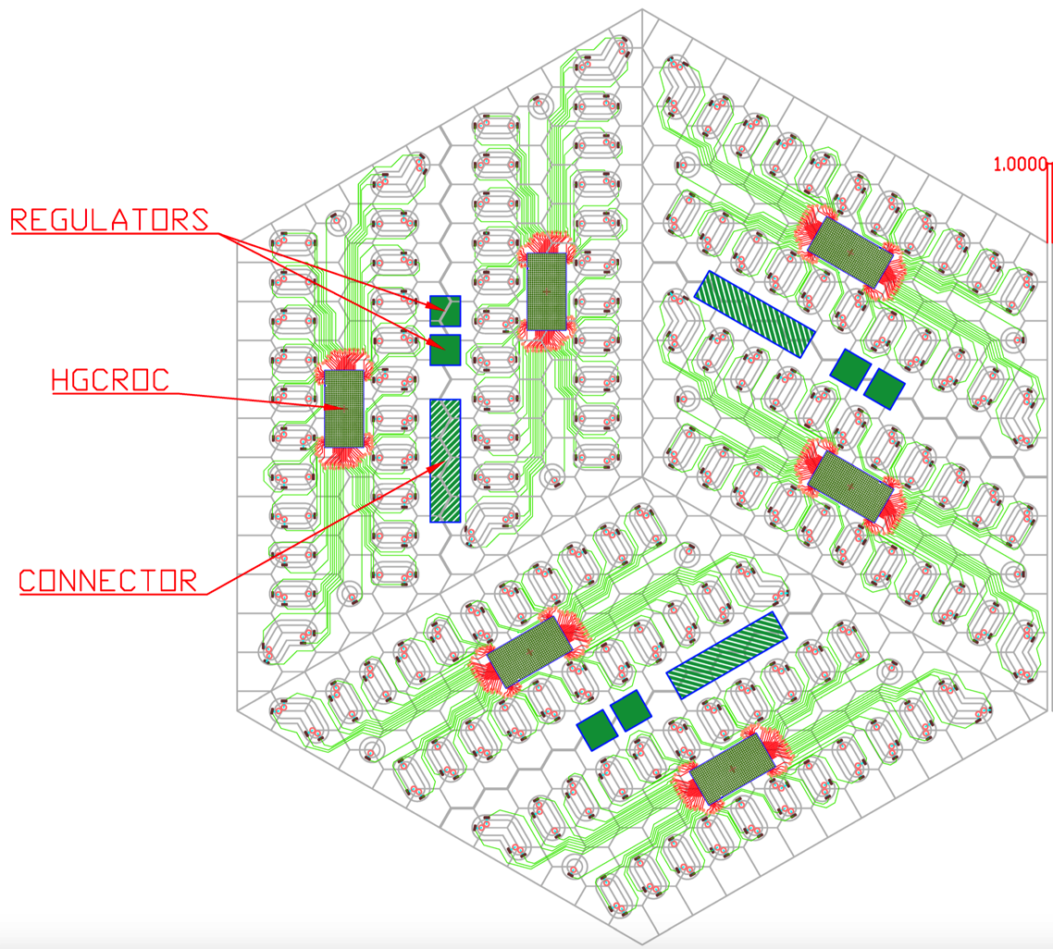
Hexaboard is evolving to final size and components, but complexity persists
8” hexaboard for 4xSkiroc2-CMS,
192 Si channels (due soon @ CERN)
8” hexaboard for 4 or 6xHGCROC,
192 or 432 Si channels. Holes will be ovals.

Slide 37
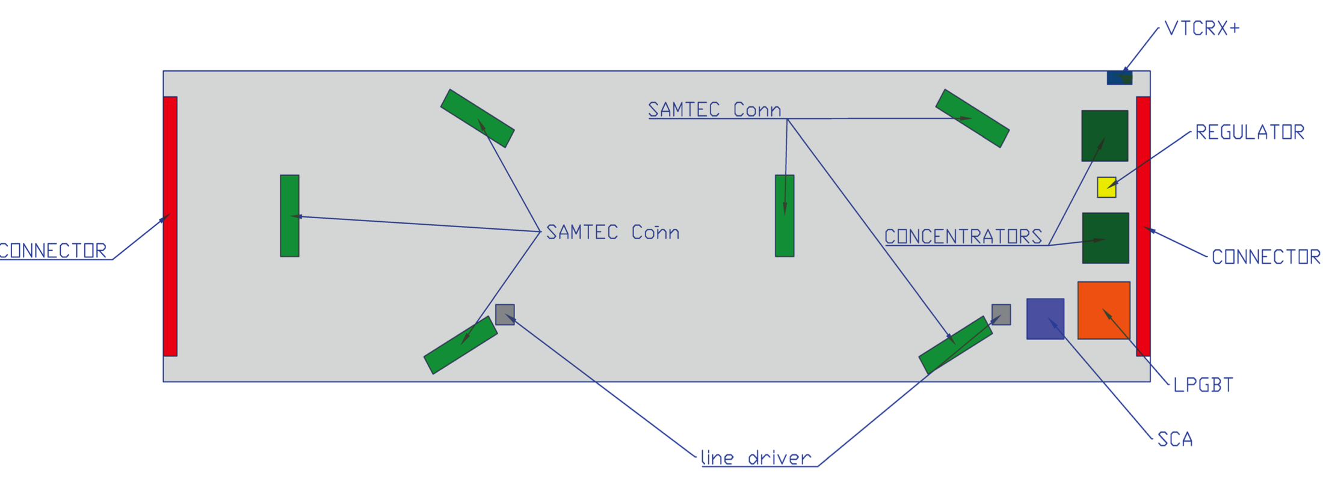
Motherboard connects to 2-5 hexaboards & contains electrical/optical interfaces
Motherboard functionality:
Aggregates, formats & serializes the data (read at the L1 trigger frequency of up to 750kHz) in the data concentrator ASIC
Selects trigger sums of interest, aggregates, formats and stores these data in a 12-bunch-crossing FIFO in the trigger concentrator ASIC
Interfaces concentrators to lpGBT → VTCRX+ for data/trigger transmission
Receives and distributes fast control signals
Take input from on-detector environmental sensors and transmits outside
Distributes power to detector modules – LV & bias
LV & bias

Slide 38
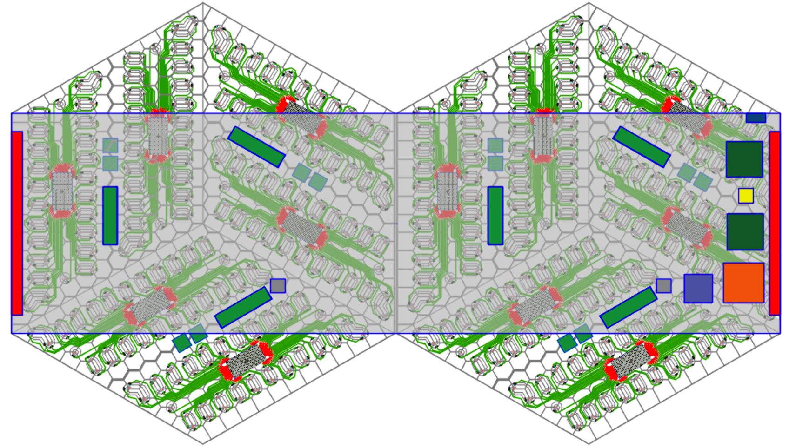
Motherboard connects to 2-5 hexaboards & contains electrical/optical interfaces
In TDR: Vertical space between hexaboard and motherboard ~1.6mm maximum!

Slide 39
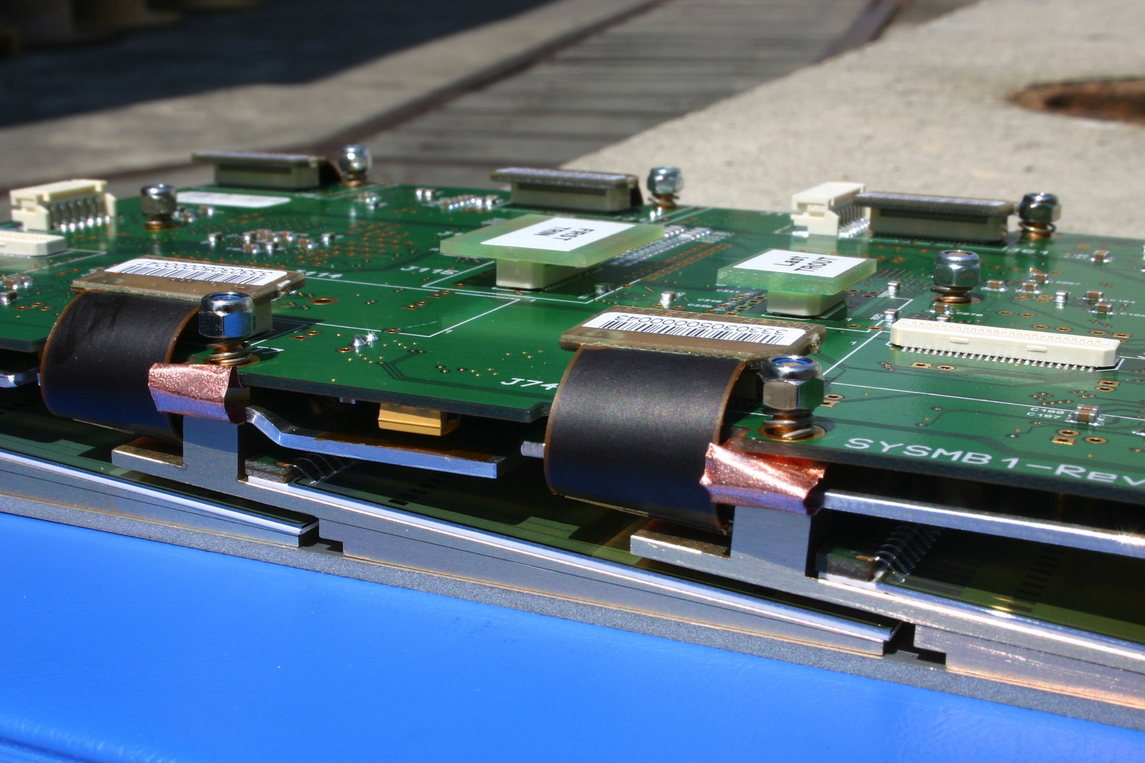
Preshower is a compact device, with one layer requiring ~5cm for absorber, cooling & modules
Motherboard
Silicon
~2.5cm
Baseplates
+2.5cm for cooling screen and absorber

Slide 40
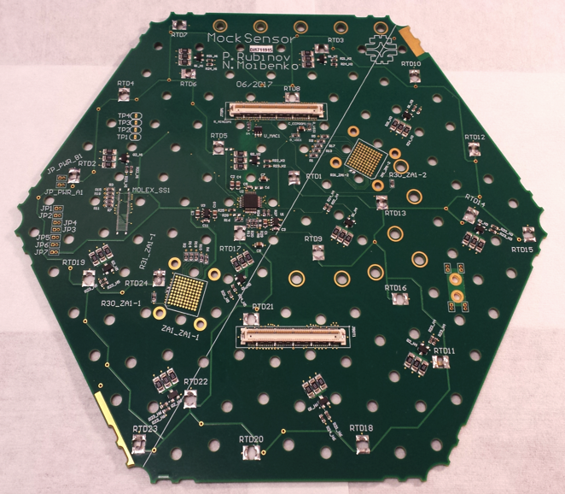
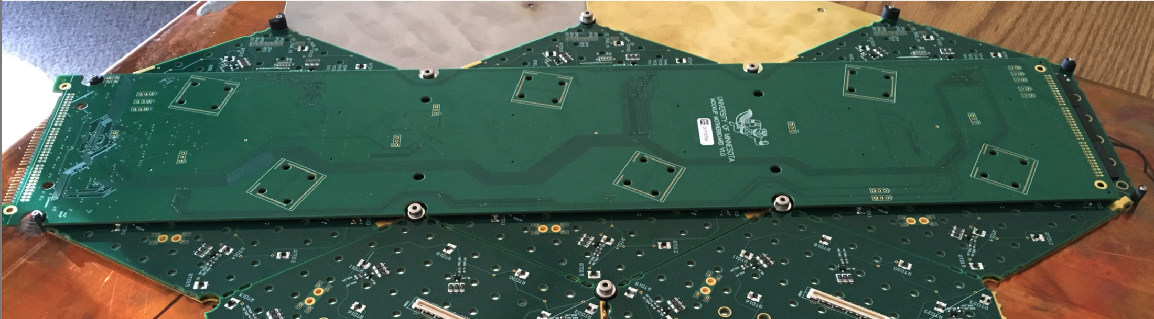
“dummy” cassette being assembled with PCBs containing only connectors and heat loads
8” hexagonal PCBs glued to silicon and baseplates → modules
3 modules connected to a single “motherboard” providing power, data concentrator and optical links

Slide 41
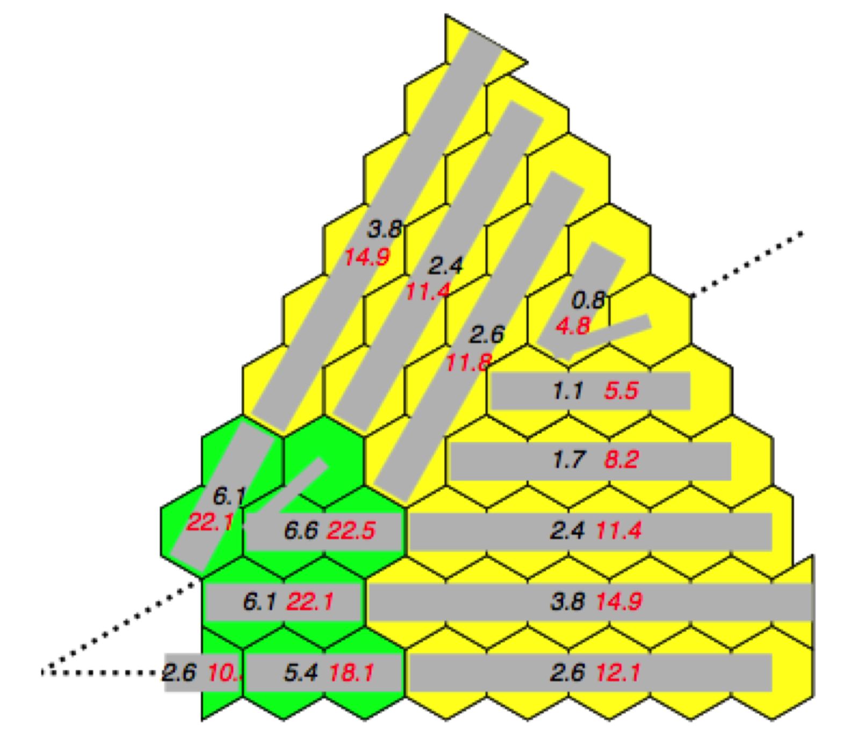

Layout of motherboard puts the active elements in the lowest radiation region possible

Slide 42
Baseline powering scheme places DC-DC converters behind CE-H, outside the cold volume
DC-DC need to withstand ~10¹⁴n/cm²
Can potentially replace them in LS4, LS5…
Most heat dissipation outside of cold volume
Significant copper inside cold volume
☺
DC-DC
☹
LDO

Slide 43
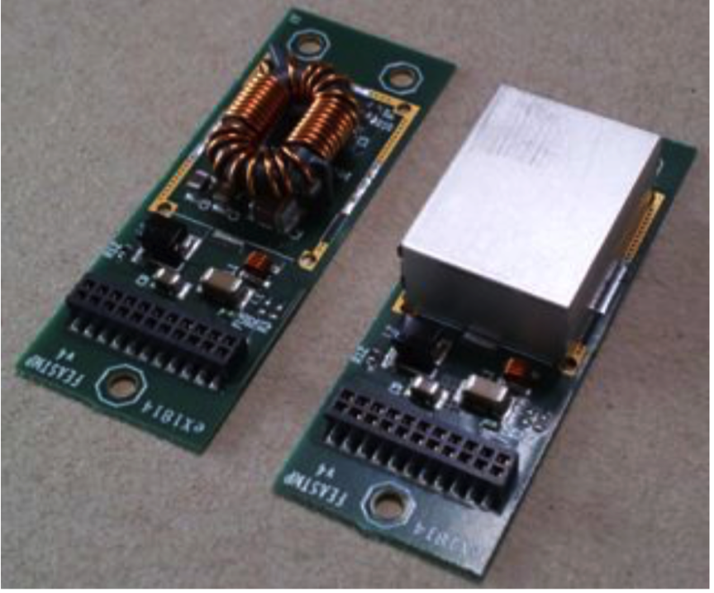
Alternative is to place e.g. modified version of FEASTMP modules on the cassettes
FEASTMP-CLP
Present versions of FEASTMP are:
too tall to fit in the gap
not sufficiently radiation tolerant
(~2-3x10¹⁵n/cm² at 2nd module from inner edge of HGCAL)
Even if TDR gap (1.6mm) is doubled…
9.4mm
Motherboard
~3mm
Receiving PCB
Hexaboard
Silicon
HGCAL design

Slide 44
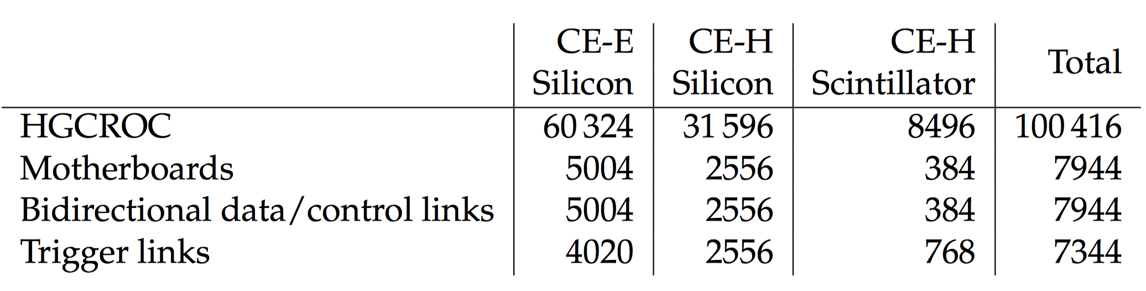
Some on-detector electro/optical components in numbers
#lpGBT = #motherboards
#data concentrator ASICs = #data/control links
#trigger concentrator ASICs = #trigger links

Slide 45
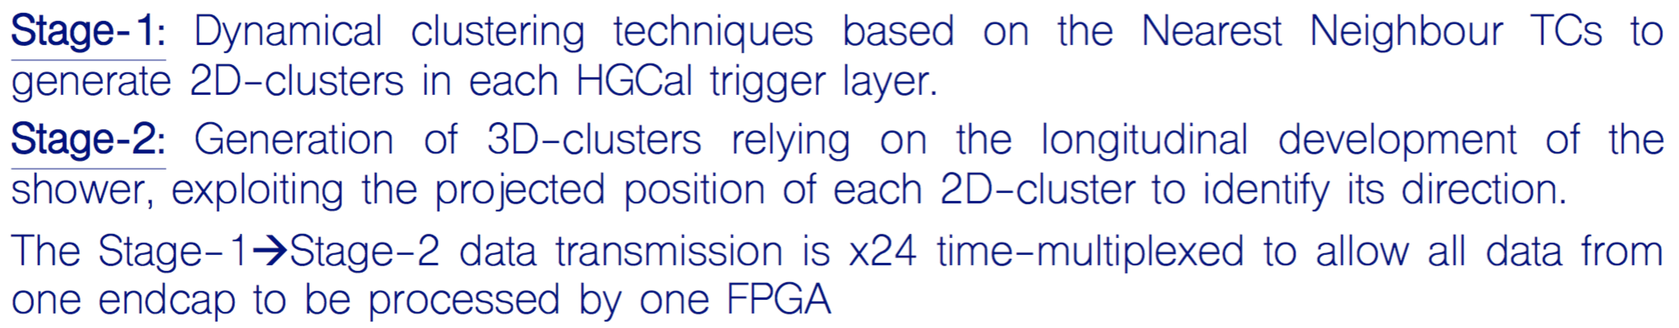
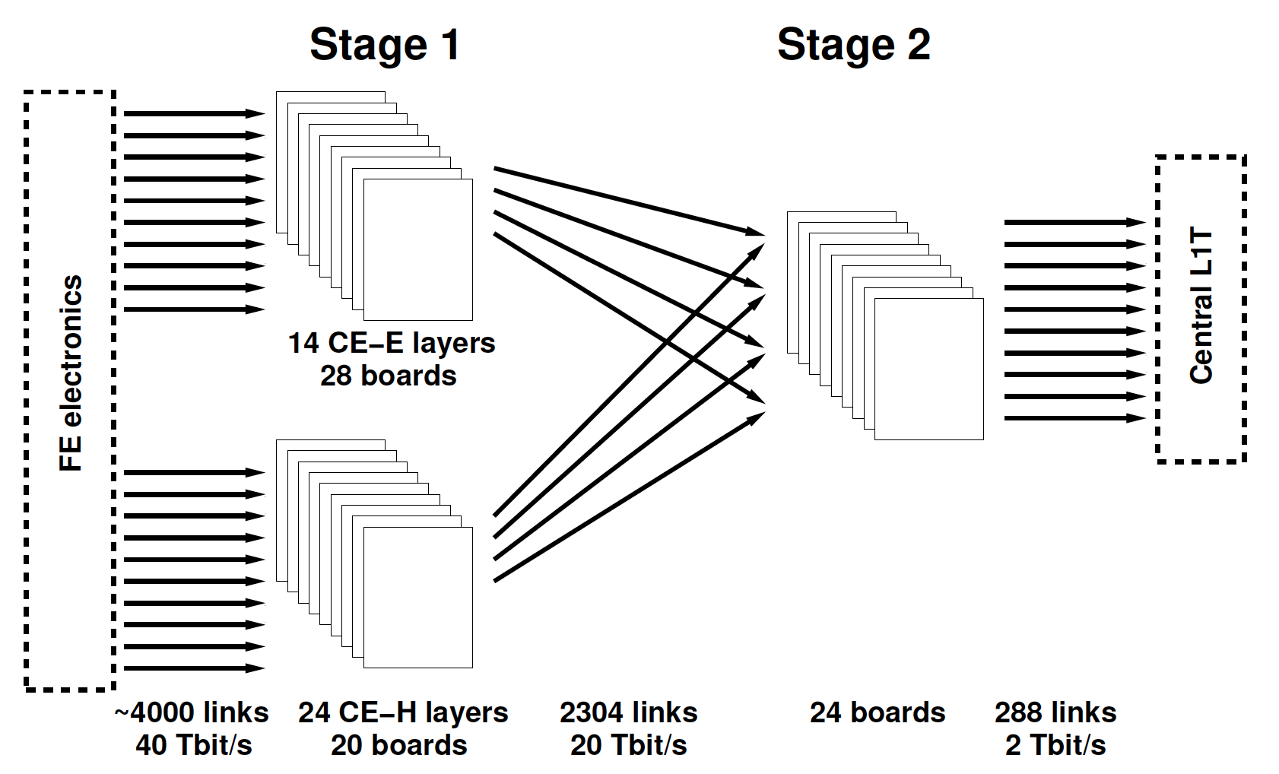

~1 million trigger cells (TC) in HGCAL, c.f. <10000 in present CMS endcap calorimeters
On-detector 1.5μsec
Off-detector 3.5μsec
Time
multiplexing
TK+
CALO+
MUON
Presently exploring Serenity ATCA board for Trigger & DAQ back-end
See talk from A. Rose

Slide 46
Putting it all together

Slide 47

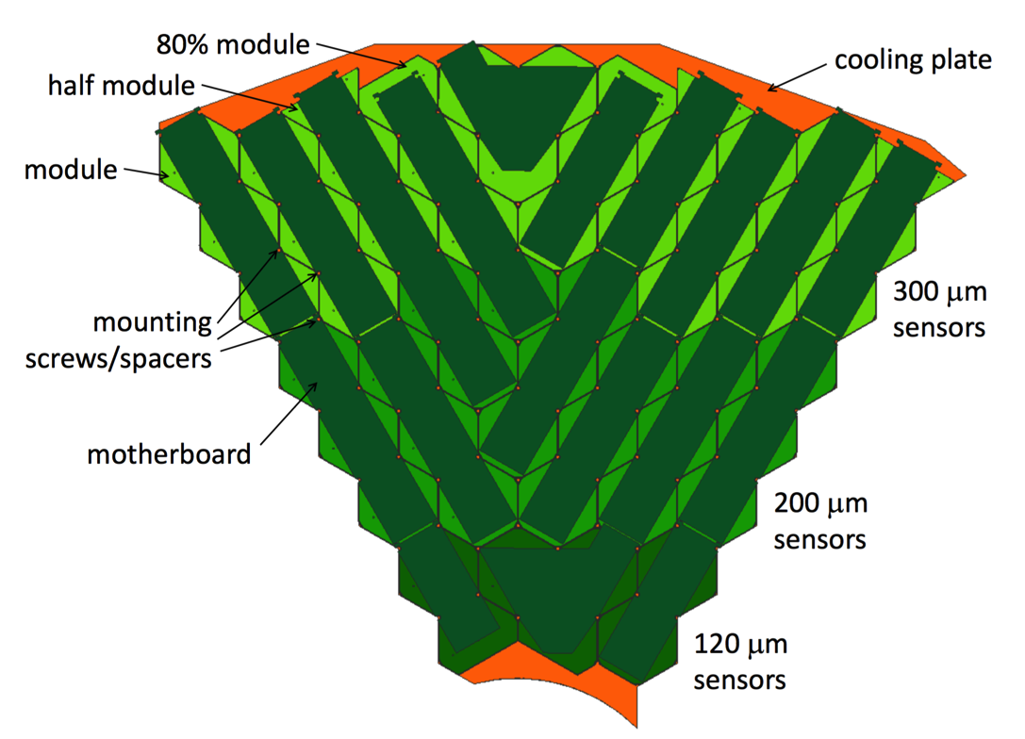
CE-E cassettes are self-supporting sandwich structures with Pb, Cu and Cu/W as absorbers
Stainless-steel clad
Pb absorber 2.1mm Stainless-steel clad
Modules placed on both sides of Cu cooling plane and “closed” with steel-wrapped Pb plates
PCB motherboard
ASICs etc. PCB sensor board
Silicon
CuW baseplate
~24 mm
Cu cooling plate

Slide 48
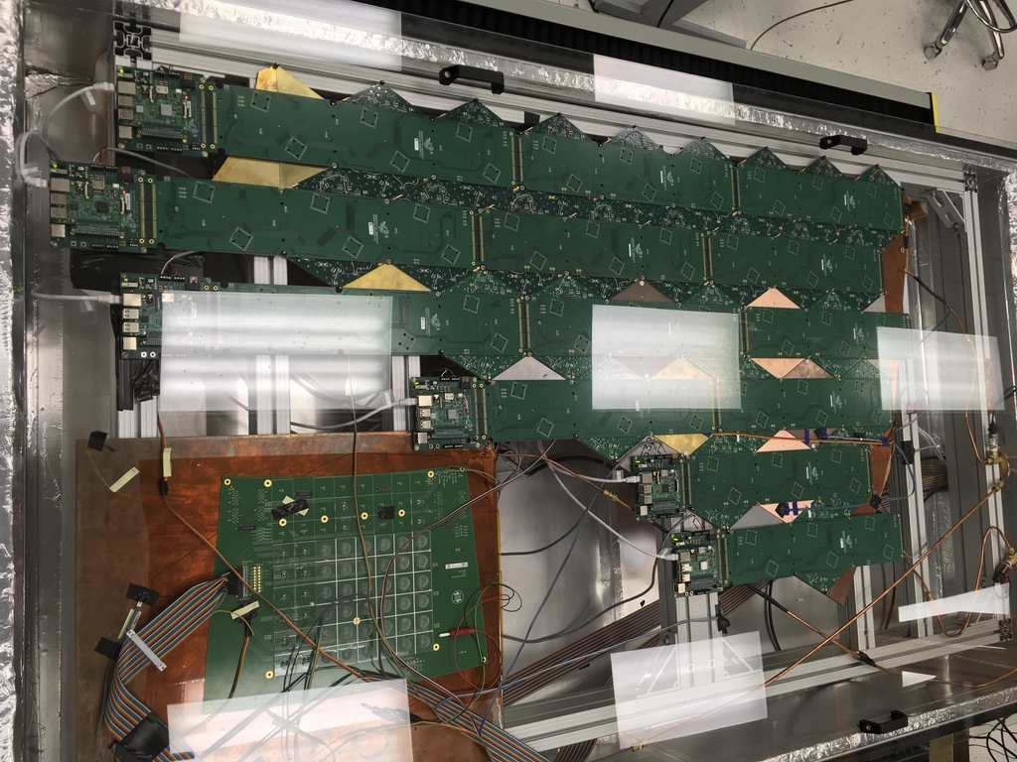
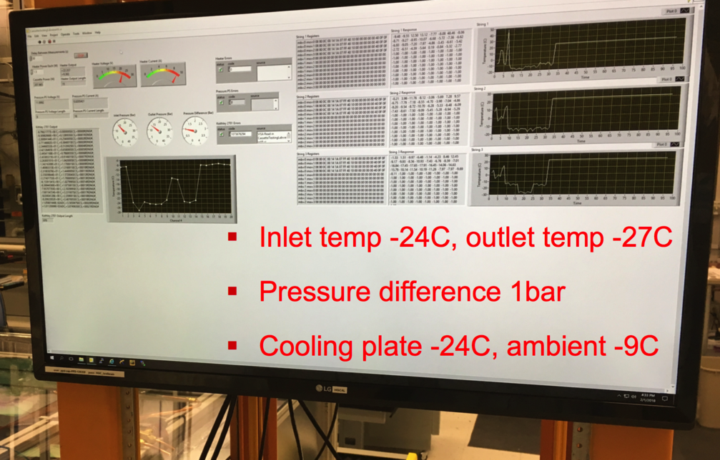
Dummy cassette is installed in a cold box to study heat-transfer characteristics – works well!
@FNAL

Slide 49
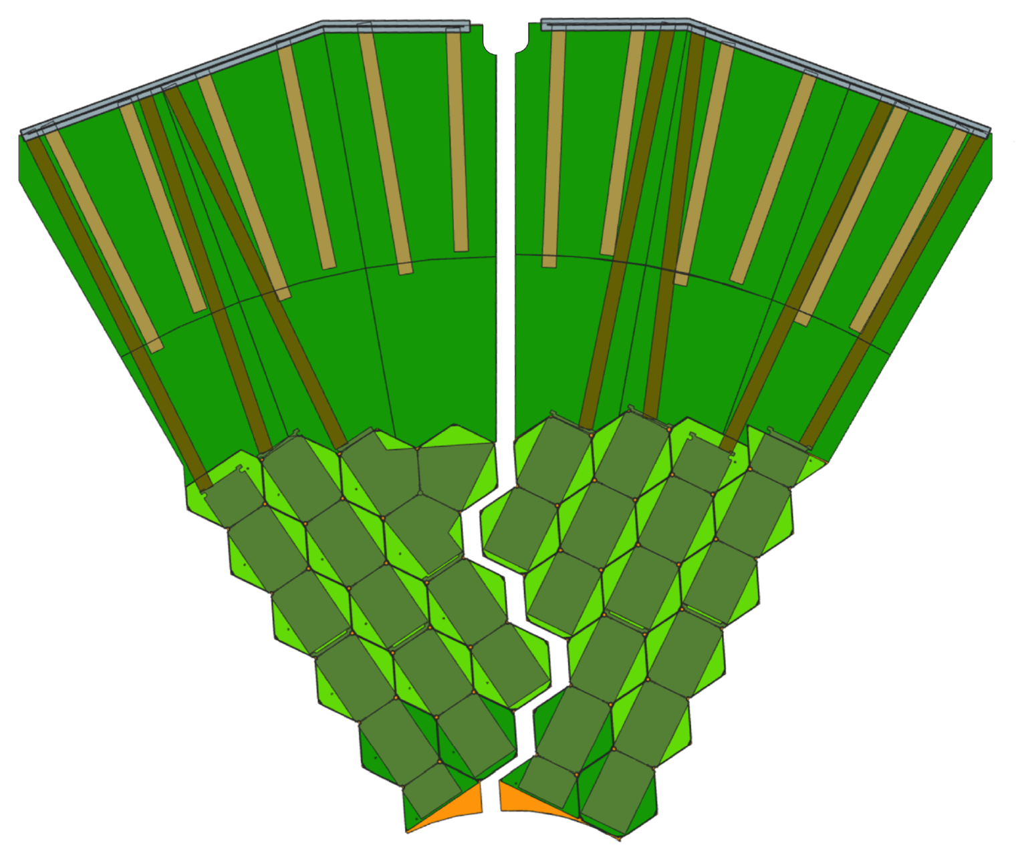
CE-H cassettes: some have all silicon (a la CE-E); some have mixture of Si and scint/SiPM
Scintillator + SiPM
Silicon

Slide 50

Wedge-shaped “Cassettes” containing arrays of silicon modules or silicon+scintillator/SiPM
Silicon-only layer (in CE-E) showing
“cassettes” and different sensor thicknesses
Mixed layer (in CE-H) with silicon at
high η and scintillator+SiPM at low η

Slide 51

Assembling CE-E: self-supporting cassettes are assembled horizontally
Cassette installation
onto CE-E back flange

Slide 52



CE-H is assembled in two steps: absorber material, followed by insertion of cassettes

Slide 53


Final assembly steps: attach CE-E to CE-H, then rotate whole CE to vertical for lowering

Slide 54


There are two options for removing the existing endcaps and lowering the new ones
Crawler crane (rented)
~1400 tonnes, transported in 75 trucks!
Needs large roof openings
Can move around the site
Linear winch crane (custom made)
Similar in principle to original CMS crane
Calorimeter can be rotated in this system
(no need for separate rotating table)

Slide 55



Linear winch crane can also rotate the endcaps

Slide 56
Dessert
Measured HGCAL performance

Slide 57

Prototype silicon modules + CALICE AHCAL tested at CERN in 2017; more in 2018
Si + Pb CE-E
Si + SS front CE-H
CALICE AHCAL
Electrons, pions, muons
Nearly 2 tonnes, 3m long

Slide 58


Beam tests in 2016 & 2017 validated basic design; good stability; MIPs seen in all parts
S/N ~ 8
Mips (for calibration) seen from muons and also single particles within hadronic showers

Slide 59


Beam tests in 2016 & 2017 validated basic design; good comparison to simulation
Electron energy resolution
Transverse shower shape
Distributions from electrons and pions match those predicted by simulation (to within 5%) demonstrating accuracy and scalability
First indications that HGCAL performance is as expected from simulation
More test beam data will be taken in a few weeks @ CERN

Slide 60



First 2018 beam test @ CERN featured 28-layer CE-E section
MIP distribution from online DQM
100 GeV electrons: occupancy plots for all 28 layers (last 3 layers are noisy)

Slide 61

Silicon sensors also have good intrinsic timing resolution that does not degrade with radiation
~10 MIPs at 0 fb⁻¹; ~20 MIPs at 3000 fb⁻¹
Can look at shower evolution in 5D
(energy, X, Y, Z, t)
→ Particle Flow
Constant term ~20ps

Slide 62

HGCAL TDR was submitted in Nov. 2017
R&D continues; construction starts in 2020
Approved on 18th April 2018!
CMS-TDR-17-007

Slide 63
A Little Extra
Challenges ahead

Slide 64
With the approval of the TDR (18th April 2018) we are entering a phase transition
Finalization of design, prototyping towards final systems (2 years)
EDR (~May/June 2020) and ESRs
  This is a much faster timescale than the original LHC-experiment construction phase
Market Surveys, orders, preproduction, qualification of final components
Production starts in <3 years !

Slide 65

Synoptic view of HGCAL: ~5 years to finalize design, produce components, assemble, install

Slide 66
Highly-granular calorimeters, such as HGCAL, will provide much more information than any previous calorimeter.
Building and exploiting the HGCAL brings major technological challenges. An exciting time for detector and software development!

Slide 67
backup

Slide 68



Efficiency of detecting hadronic & em components differs from unity: non-compensation
Electromagnetic component
Non-em component (charged)
Fraction of non-em component (“h”) detected is far lower than for the em-component (“e”): e/h > 1 for most detectors. This leads to:
Non-linearities
Non-Gaussian response
Relatively poor energy resolution
em fraction is large & varies with energy & fluctuates with non-Gaussian tails

Slide 69
Hadron showers contain electromagnetic and hadronic components
Electrons, photons
π⁰ → 2γ
➔ em sub-shower
ABSORBER
em component
π⁰
n
π⁻
Charged hadrons
Nuclear fragments, protons
Neutrons, soft γs
Breakup of nuclei
(20%)
(25%)
(15%)
(40%)
n
nuclear fragment
non-em component
Either not detected or often too slow to be within
detector time window ➔ invisible energy

Slide 70


Particle flow resolution is clearly better than calorimeter alone
Simulated ILD calorimeter/PF performance
(slide shamelessly stolen from Katja Kruger from BTTB5)

Slide 71

Molière radius of HGCAL is ~28mm, but high granularity → much finer details can be resolved
Coloured rectangles:
= % shower energy deposited in that layer
Shower max

Slide 72

VBF H→γγ, with 720 GeV VBF jet (2 charged π + γ) & 175 GeV γ incident on CMS endcap; pileup 200
Showers from the two photons are visible in the layers of the electromagnetic part
L2
L5
L8
L11
L14
L17
ΔR~0.2
L20
L23
L26

Slide 73

VBF H→γγ, with 720 GeV VBF jet (2 charged π + γ) & 175 GeV γ incident on CMS endcap; pileup 200
Showers from the two pions become visible in the layers of the hadronic part
L28
L30
L31
L32
ΔR~0.2
L34
L35
L36
L37
L39
L40
L41
L42

Slide 74

Regions of silicon or silicon + scintillator/SiPM governed by radiation field
Silicon in high-radiation regions
Scintillator
Silicon

Slide 75
Full simulated reconstruction and performance of HGCAL is in its infancy
The detailed implementation of the detector geometry necessarily lags behind technical design choices. In autumn 2016, before the making of many of the important engineering decisions that are described in the TDR, the HGCAL geometry implemented in the CMS simulation and reconstruction software, CMSSW, was frozen to allow simulation work to proceed.

Slide 76



Occupancy of cells reaches ~70% in a small high-η region, but is <20% for most of HGCAL
avg. cell occ. > 0.5 mip
Pileup = 200, L_{INT}=3000fb⁻¹
Top num.: avg. cell occ. > 0.5 mip
Bottom: avg. trig. cell occ. > 2 mip_{T}
η = 1.57
avg. trig cell occ. > 2 mip_{T}
Pileup = 200, L_{INT}=3000fb⁻¹
Colours = different thicknesses

Slide 77


As an illustration, granularity and timing can mitigate the effects of pileup → 5D detector!
Possible due to the choice of CE sampling parameters and electronics
VBF (H→γγ) event with one photon and one VBF jet in the same quadrant,
No timing cut
Cut Δt < 90ps (3σ at 30ps)
γ
VBF
jet
Plots show cells with Q > 12fC (~3.5 MIPs - threshold for timing measurement) projected to the front face of the endcap calorimeter.

Slide 78


e/γ reconstructed from single 3D TPG cluster with cuts on transverse & longitudinal profiles
1.7 < η < 2.9
L1 E_{T} > 30 GeV
Efficiency of HGCAL standalone e/γ trigger algorithm >90% @ 40 GeV E_{T}
e/γ background trigger rate with E_{T} > 30 GeV
~O(100kHz) before isolation, track matching etc.

Slide 79


HGCAL jet trigger based on anti-k_{T} algorithm, exploiting dense core of jets for pileup mitigation
Jet size ~ ΔR=0.2: good balance between pileup mitigation & minimization of energy fluctuations
L1 E_{T} > 150 GeV
Efficiency of HGCAL standalone jet trigger algorithm >90% @ 200 GeV E_{T}
& quite insensitive to pileup
Jet background trigger rate with E_{T} > 150 GeV ~O(10kHz) before isolation, track matching etc.

Slide 80


G4 simulation used to predict performance of HGCAL in presence of pileup: E/m resolution
Single unconverted γ in CE-E
reconstructed in r<2.6cm
→ insensitive to pileup
H-γγ, both γ in HGCAL
(γ do not convert in TK)
Pileup 200
Stochastic term between 24-31%

Slide 81



Jet identification greatly improved using shower-shape information from HGCAL
Δη
Zee PU200
Zee
QCD PU200
L_{10%} – layer in which ΣE >10%
σ_{VV} – radial spread
Δη (electron cluster–track)
10% bkgnd @ 95% signal
10 < pT < 20 GeV
1% bkgnd @ 95% signal
pT > 20 GeV
*PCA = principle component analysis

Slide 82




Longitudinal and transverse shower shapes can also distinguish VBF jets from pileup jets
EE/FH/BH refer to names
of parts of HGCAL at time
of TP (2016): simulation
is based on this (not very different) geometry
Pileup jets tend to start earlier in the calorimeter and be less collimated than VBF jets

Slide 83

Traditional “cylindrical onion” hermetic particle detector, with distinct dedicated layers
Tracker: tracking and vertexing: charge identification and momentum measurements
Calorimetry: energy measurements of charged and neutral particles. Separated into electromagnetic and hadronic sections
B-field: to filter particles etc.
Dedicated muon detectors

Slide 84



ECAL also includes a 2-layer silicon-strip-based “Preshower” in its endcaps, to aid particle ID
6 x 6cm² silicon sensor, 32 strips ~ 1cm²/strip
4 planes of 1072 sensors = 137000 channels, ~16m² total (largest silicon-based calorimeter!)
Used mainly for π⁰ identification, but ID power not as good as foreseen due to upstream TK material

