Slide 1
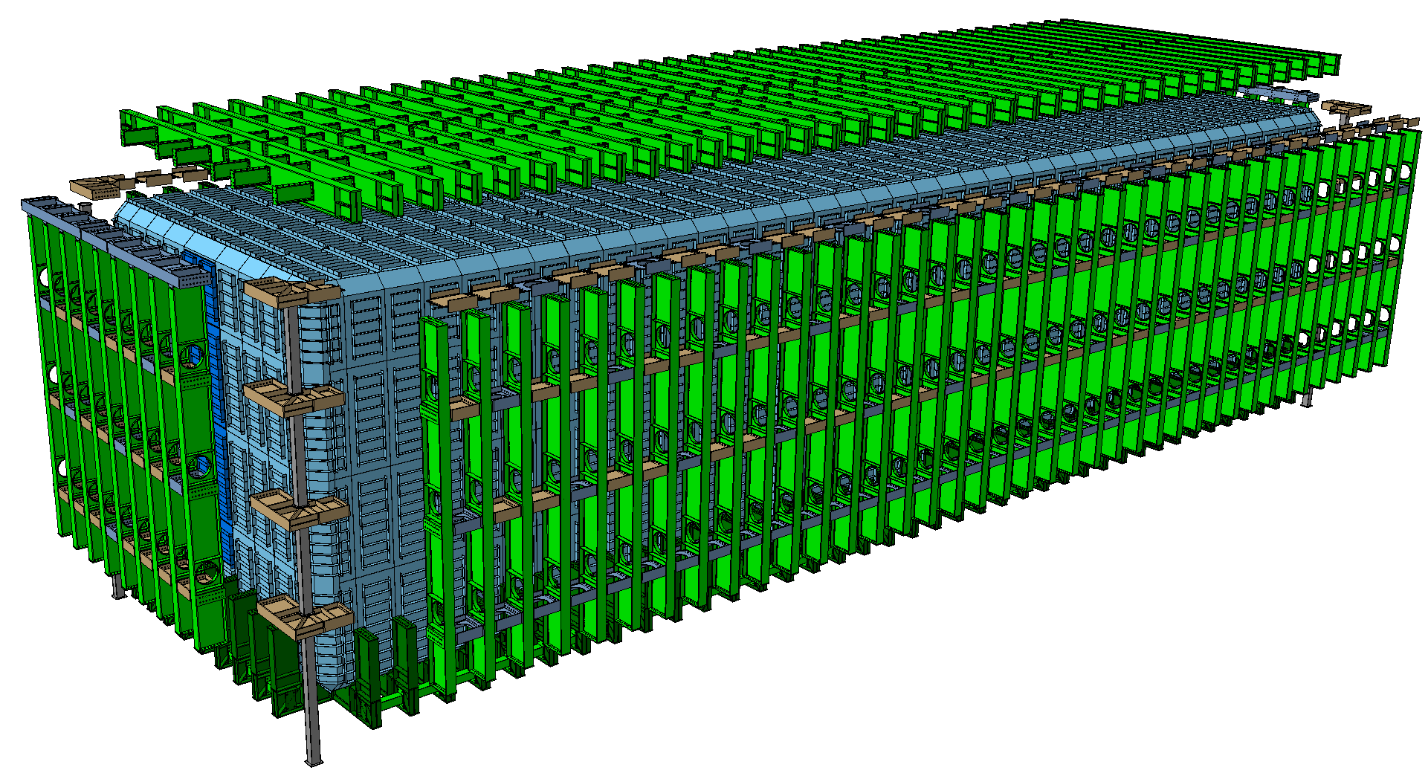
Test activities
Marzio Nessi, CERN
  roof design
  Splicing in various locations
end wall
design
  Side wall belts.
  Tolerance compliant
  Connections (pinned)
  floor design
  First 3 belts with Moment connections
  Concept of inner warm membrane with
  stiffened panels

Slide 2
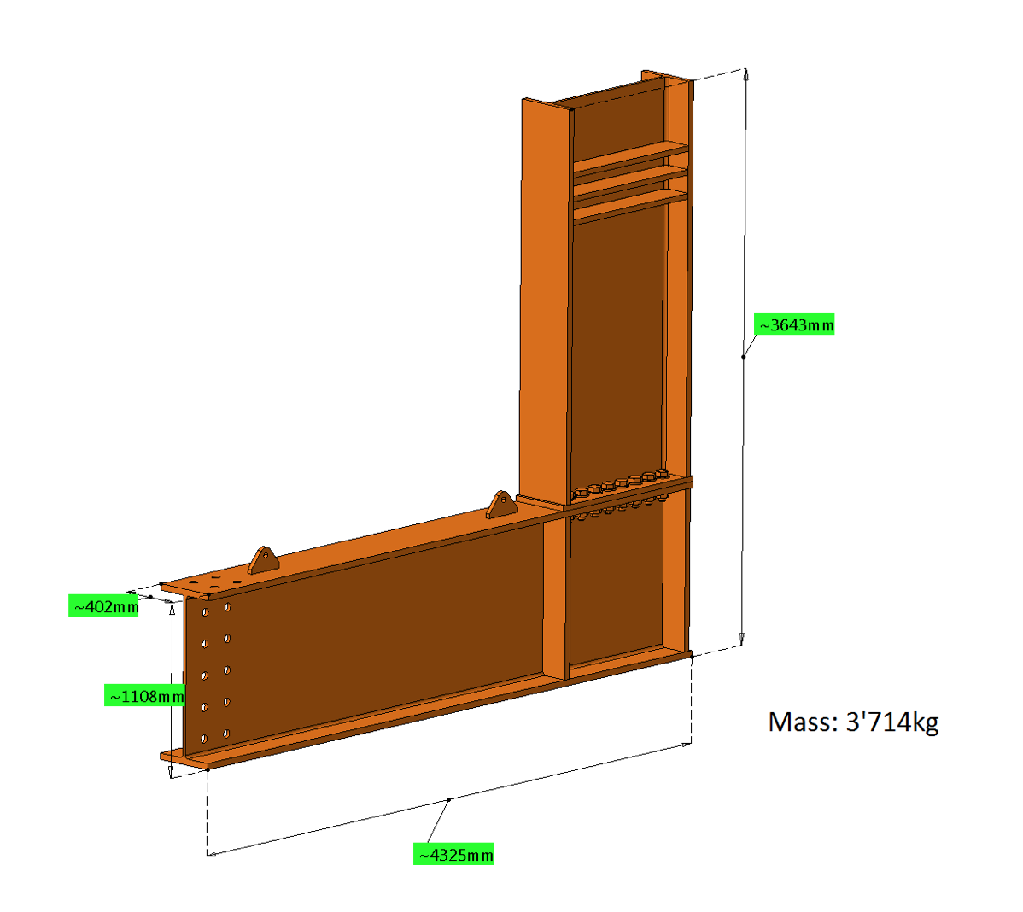
https://edms.cern.ch/document/1890324

Slide 3
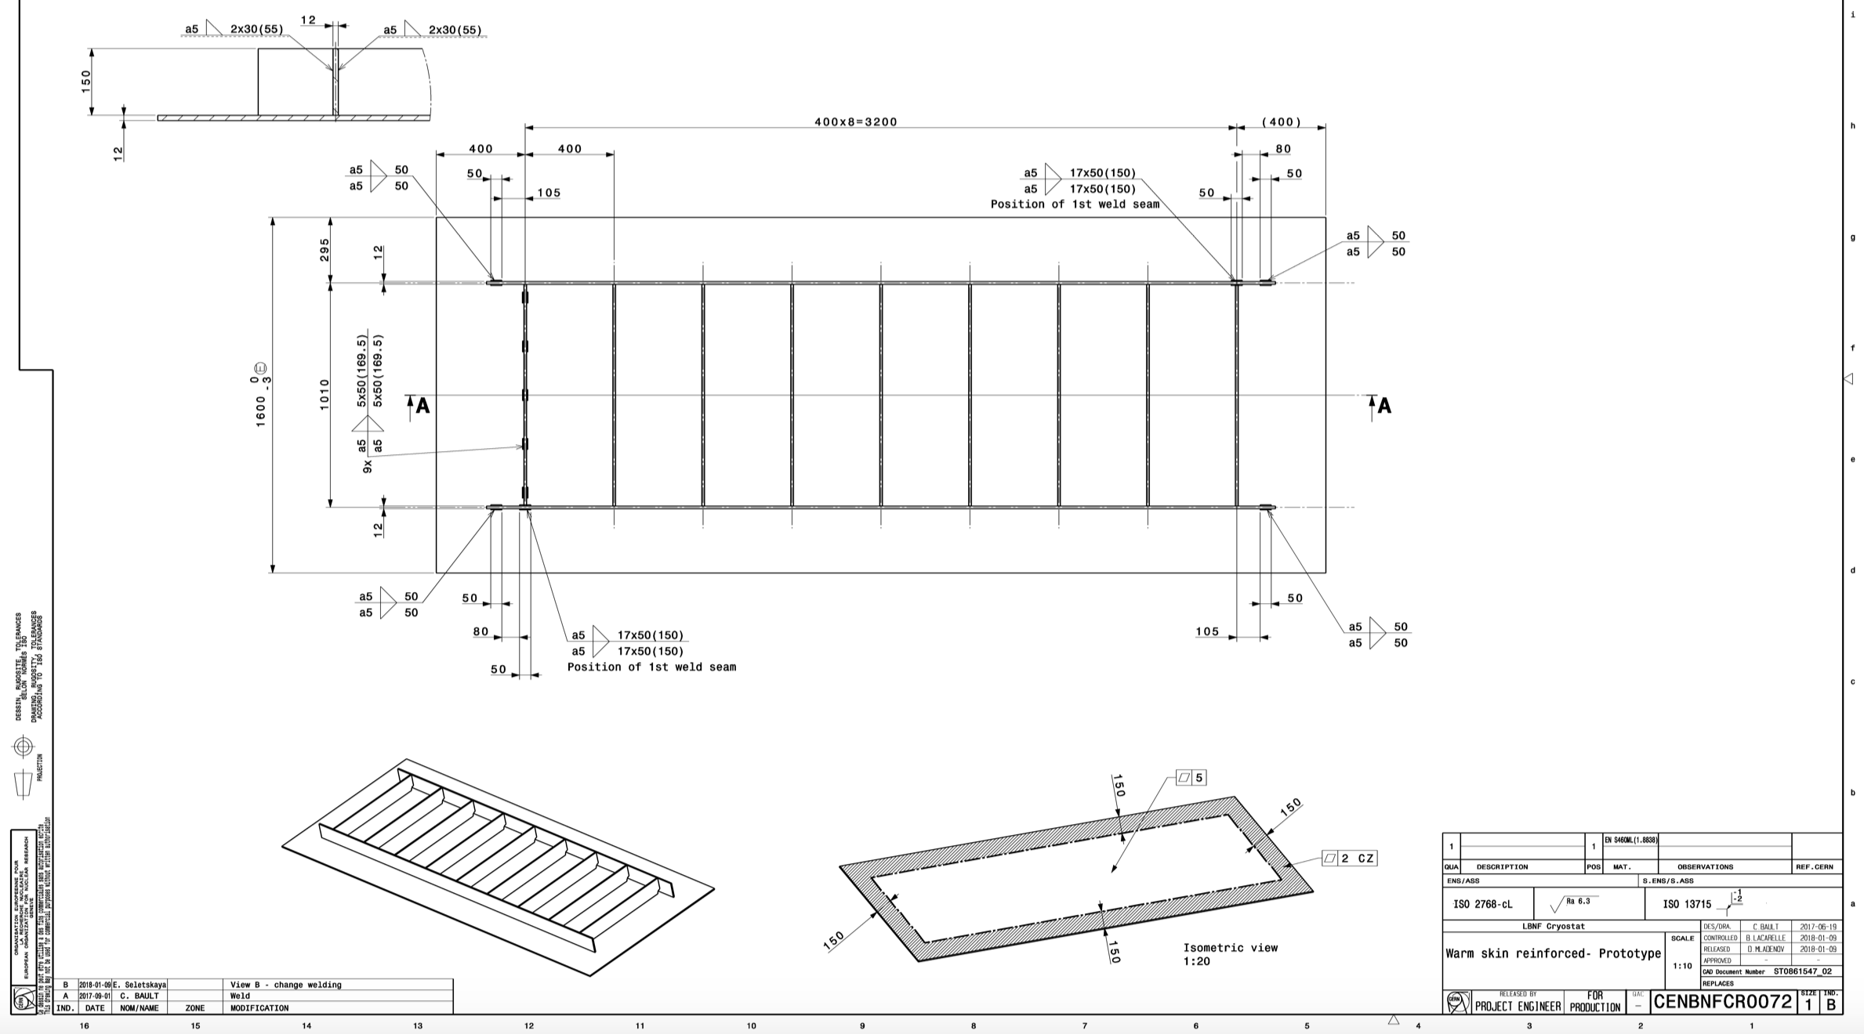
https://edms.cern.ch/document/1890324

