Slide 1

Indigenous Development & Manufacturing of Steels for
LBNF-DUNE
Indira Gandhi Center for Atomic Research (IGCAR)
Kalpakkam – 603102, Tamilnadu, INDIA.

Slide 2
Outline of Presentation
About IGCAR, Kalpakkam
Long Baseline Neutrino Facility (LBNF) – FNAL
LBNF Cryostat Warm Vessel
Materials for LBNF Cryostat Warm Vessel – S460ML
Indigenous Manufacturing Feasibility of LBNF Warm Vessel
Summary

Slide 3
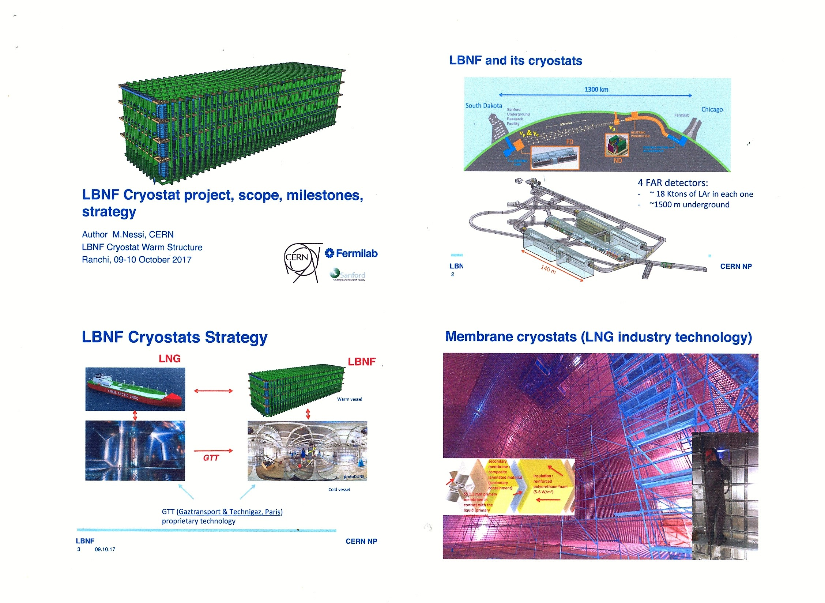
LBNF & Its Cryostats

Slide 4
LBNF CRYOSTAT – Warm Vessel
Alternative:
US section:
W 44 x 16 x 290
Dimensions, tolerances and surface condition as per ASTM A 6/A 6M – 16.
The two main components of the warm structure of the cryostat: I-beam: HL1100M and I-beam: HE600B
Standards Applicable:
  Section properties in accordance with EN 10365:2017
  Steel making process in accordance with EN 10025-1
  Dimensions in accordance with EN 10365:2017
  Tolerances in accordance with EN 10034:1993
  Surface condition in accordance with EN 10163-3:2004, class C, subclass 1

Slide 5
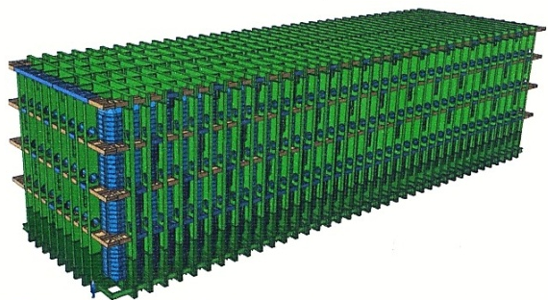
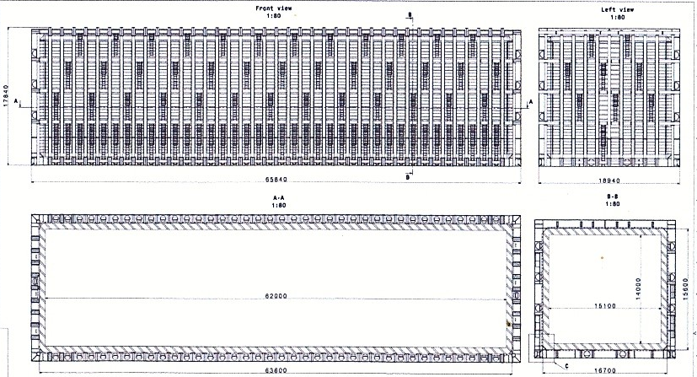
LBNF CRYOSTAT WARM VESSEL - Sections

Slide 6
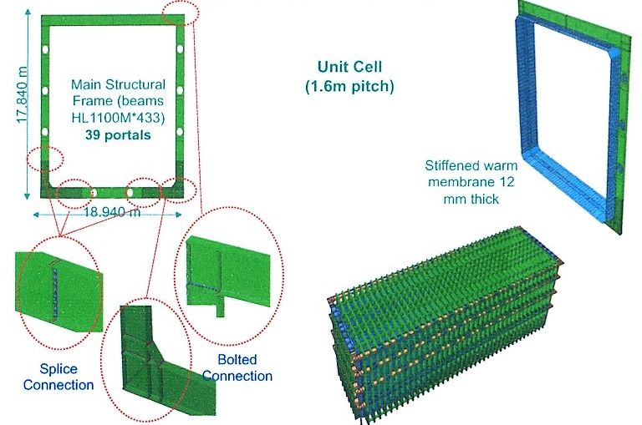
LBNF CRYOSTAT WARM VESSEL
- Unit Building Sections

Slide 7
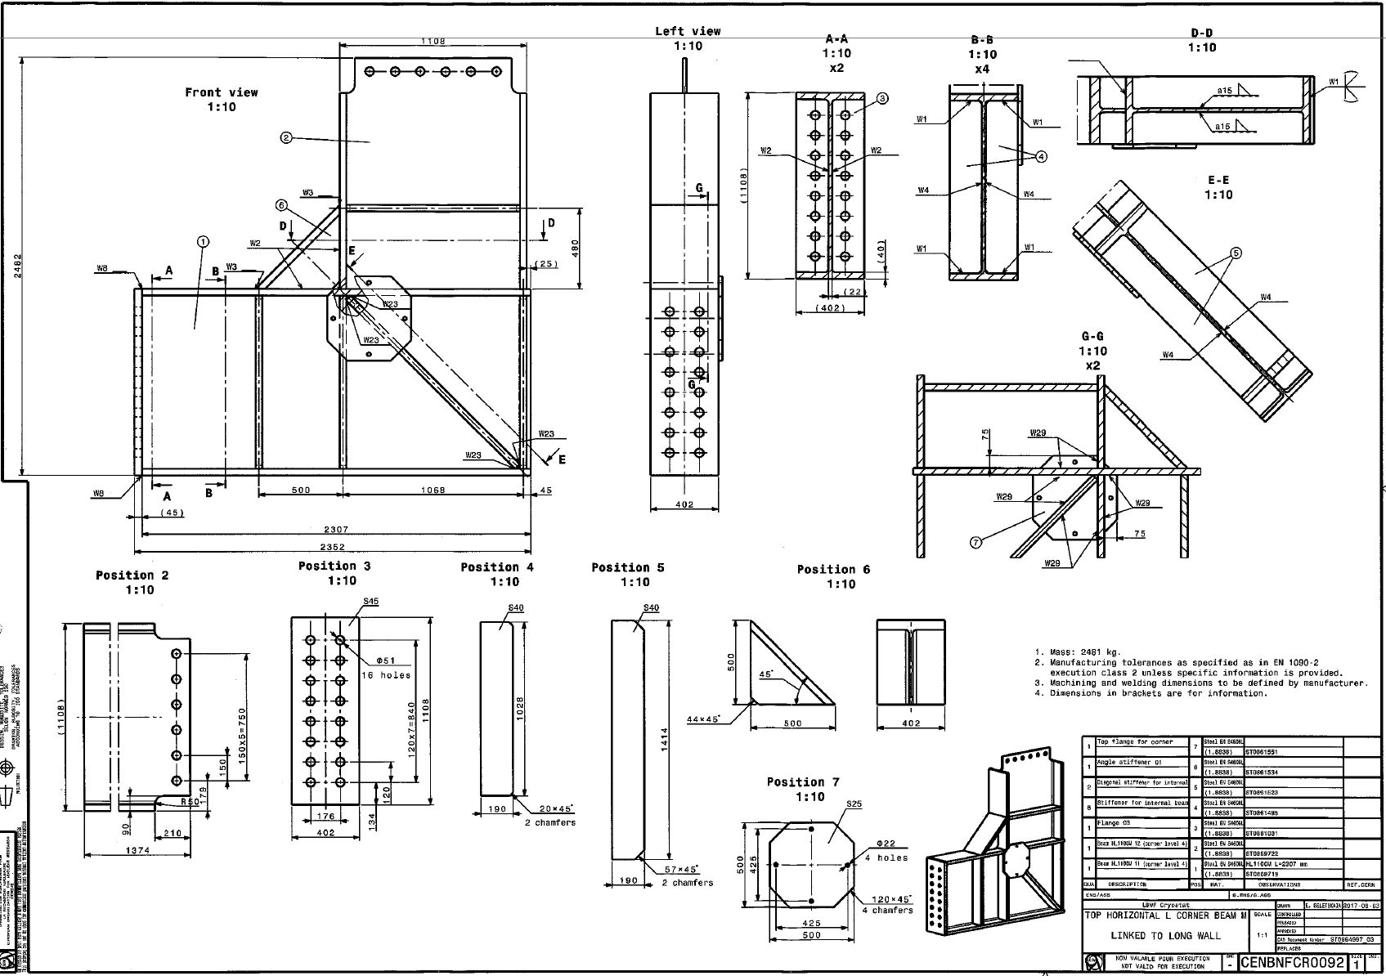
LBNF CRYOSTAT COMPONENT (Typ.)

Slide 8
APPROXIMATE MATERIAL REQUIREMENT
I-Beams
Profile | Length [m] | Mass [T]
Quantities / Cryostat
HL1100M | 3,800 | 1,650
HE600B | 360 | 80
Total for 4 Cryostats
HL1100M | 15,200 | 6,600
HE600B | 1,440 | 320
Total |  | 6,920
Plates
Thickness [mm] | Area [m²] | Mass [T]
Quantities / Cryostat
12 | 6,150 | 583
25 | 117 | 23
30 | 118 | 28
35 | 224 | 62
40 | 299 | 94
45 | 993 | 353
Total for 4 Cryostats
12 | 24,600 | 2,332
25 | 468 | 92
30 | 472 | 112
35 | 896 | 248
40 | 1,196 | 376
45 | 3,972 | 1,412
Total |  | 4,572
Total Projected Requirement:
S460ML Steel: 11,492 T
1st Delivery: July 2020
+ 3 six monthly deliveries

Slide 9
Material Specifications – LBNF Warm Vessel
The materials for the beams and the plates is: S460ML (EN 10025-1; EN 10025-4).
Mechanical Properties: EN 10025-4:2004
Minimum yield strength R_{eH} per nominal thickness [MPa] |  | Tensile strength R_{m} per nominal thickness [MPa]
≤ 16mm | 460 | ≤40mm | 540-720
> 16mm ≤ 40mm | 440 | >40mm ≤ 63mm | 530-710
> 40mm ≤ 63mm | 430
Minimum elongation: 17 [%]
Minimum values of absorbed impact energy
Longitudinal |  | Transverse
[°C] | [J] | [°C] | [J]
+20 | 63 | +20 | 40
0 | 55 | 0 | 34
-10 | 51 | -10 | 30
-20 | 47 | -20 | 27
-30 | 40 | -30 | 23
-40 | 31 | -40 | 20
-50 | 27 | -50 | 16
Element | Wt. %
C (max.) | 0.18
Mn (max.) | 1.7
Si (max.) | 0.6
P (max.) | 0.03
S (max.) | 0.025
Al (Total min.) | 0.02
Nb (max.) | 0.05
V (max.) | 0.12
Ti (max.) | 0.05
Cr (max.) | 0.3
Mo (max.) | 0.2
Ni (max.) | 0.8
Cu (max.) | 0.55
N (max.) | 0.025
Fe (max.) | Balance

Slide 10
Indigenous Manufacturing Feasibility at
RUBM, Jindal Steel & power Limited (JSPL)
Dr. S. Raju and Utpal Borah from IGCAR visited JSPL, Raigarh on 17th and 18th
January 2018 along with officials from HEC, Ranchi to assess feasibility of
indigenous manufacturing of LBNF warm vessel components. Manufacturing the
Alloy S460ML steel, plates and beams up to 900 mm deep are of no concern.
Beam Profile / Plate Thickness | Feasibility | Comments
Beam - HE600B | Yes | In regular production
Plates – 12, 25, 30, 35, 40 & 45 mm | Yes | In regular production
Beam - HL1100M | Currently up to 900 mm deep x 300 mm flange Beams | The JSPL Rail and Universal Beam Mill (RUBM) is rated for profile rolling up to 1000 mm deep x 400 mm flange beams

Slide 11
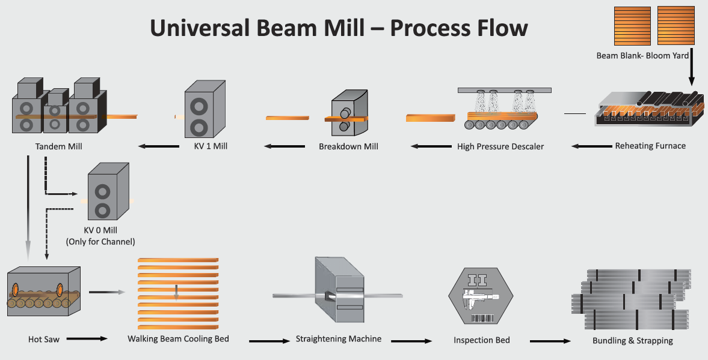
RUBM in JSPL, Raigarh, INDIA
Shape rolling technology is used for beams.
900 mm deep beams are in regular production in JSPL
The rolling mill is capable of rolling up to 1000 mm deep x 400 mm flange beams
1000 mm deep beams have not yet been manufactured at JSPL as there have been no order yet for this size.
For manufacturing 1000 mm deep beams new beam blank to be developed with associated backward integration of the continuous casting facility.
New rolls and roll pass need to be developed.
Query has been sent by JSPL to the RUBM designer/supplier in Germany regarding capability of the mill to manufacture HL1100M beams. Response from the mill supplier is awaited by JSPL.

Slide 12
S460 ML Steel Chemistry: √
Lead time of about a year for standardization of steel development & beam product rolling out is required. Backward Integration of production line right from casters, beam blank making and rolling mill reengineering (HL1100 size only) etc., are needed. JSPL Can Deliver, if commercial terms are worked out.
Product Development √
Technology Reengineering Needed: For beams deeper than 900 mm, if rolled product is preferred
If welded beams are acceptable: NOT AN ISSUE; any shape & dimension can be fabricated
Property equivalence of rolled versus welded products certified
IMPORTANT Technical Issue with Welded Beams
Welded beams will have convex curvature ; implications in final assembly ?
Convex curvature

Slide 13
Timeline for delivery can be met, based on the production capacity of JSPL; 12,000 T or upwards is easily possible
Comprehensive, Q&A; based on ISO standards (equivalent Euro norms); Mechanical and Impact properties at -40ºC on product possible at JSPL
JSPL has their own shipping & transportation logistics
SUMMARY

Slide 14
Thank You

