Slide 1
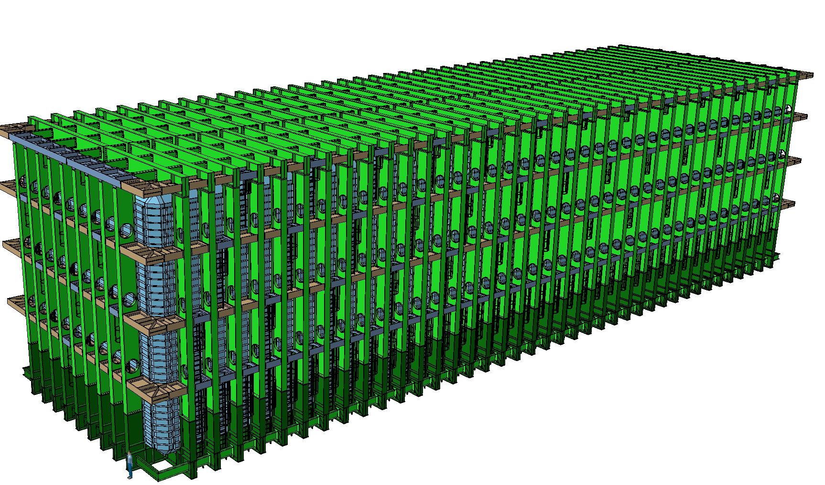


Bolts - specifications, installation, and inspection
Dimitar MLADENOV - CERN EP/NU
LBNF Cryo Safety Panel Informal meeting
CERN, 30-31 January 2018

Slide 2
Fasteners - Geometry and shape
Geometrical data:
For the bolt
For the nut
And for the washer

Slide 3
Mechanical Properties
Mechanical Properties & Material Specifications
For the bolt
For the nut
And for the washer

Slide 4
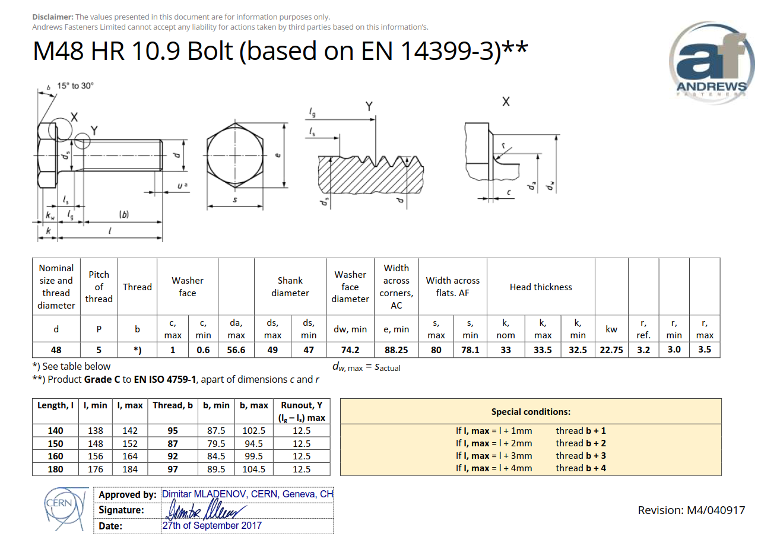
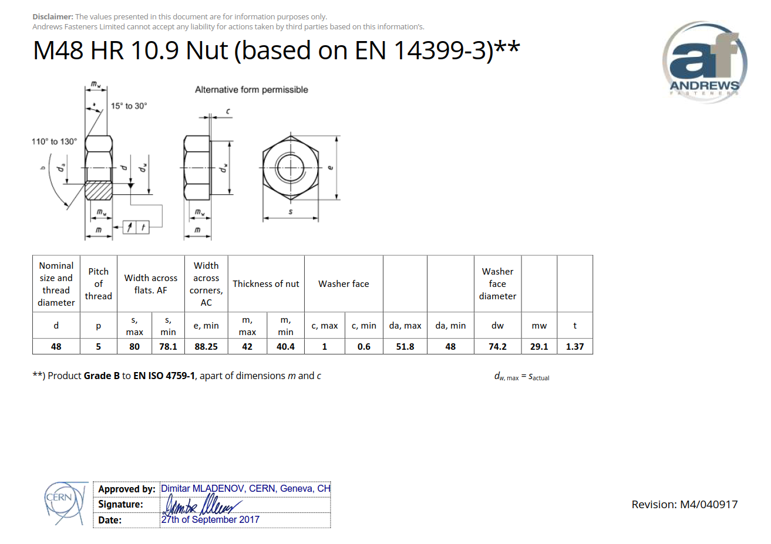
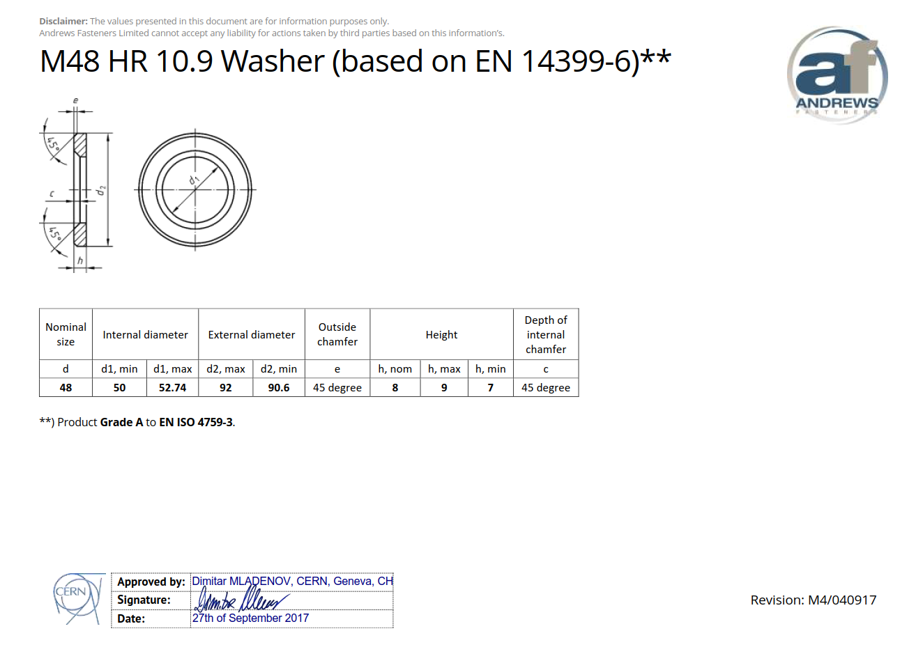
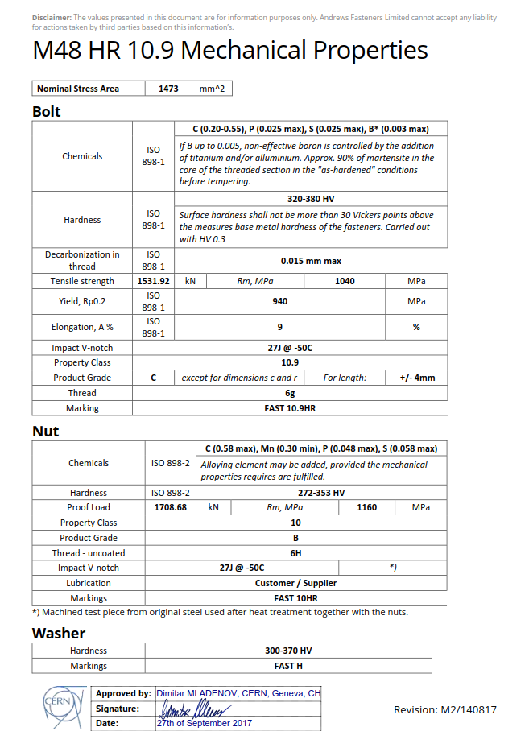
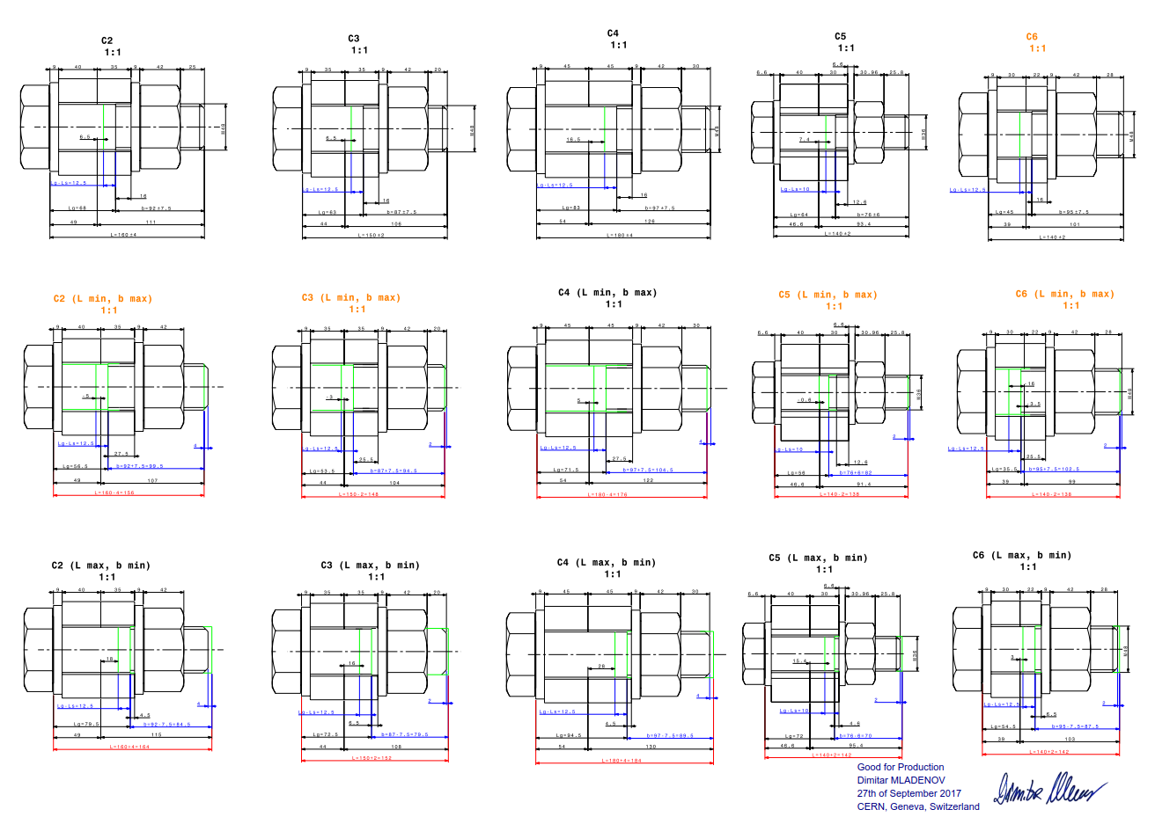
Fasteners - Geometry and shape – Sign off

Slide 5
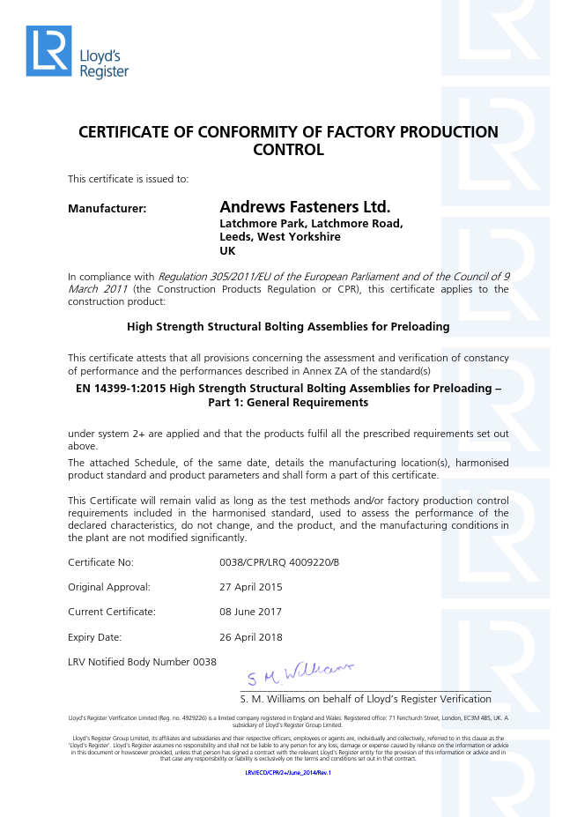
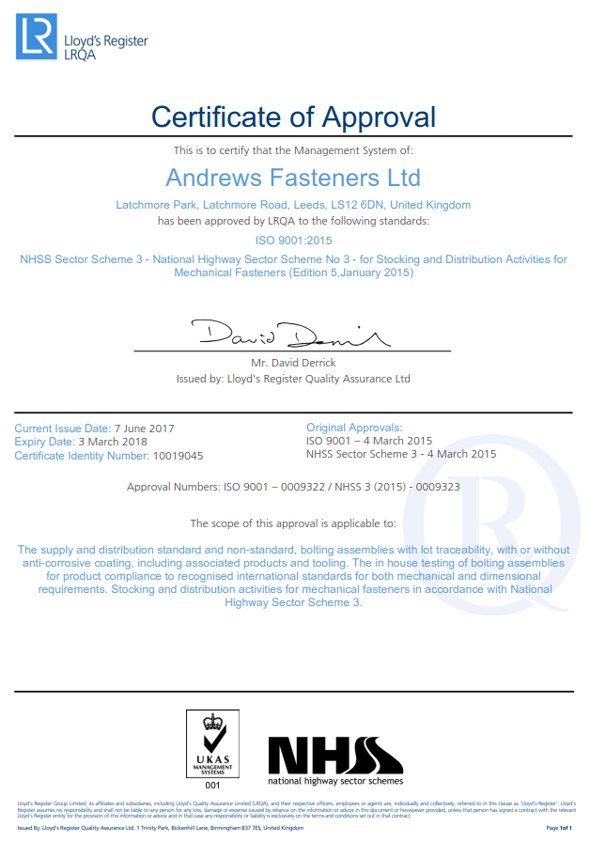
Company certifications
Manufacturing company certifications (Lloyd’s)

Slide 6
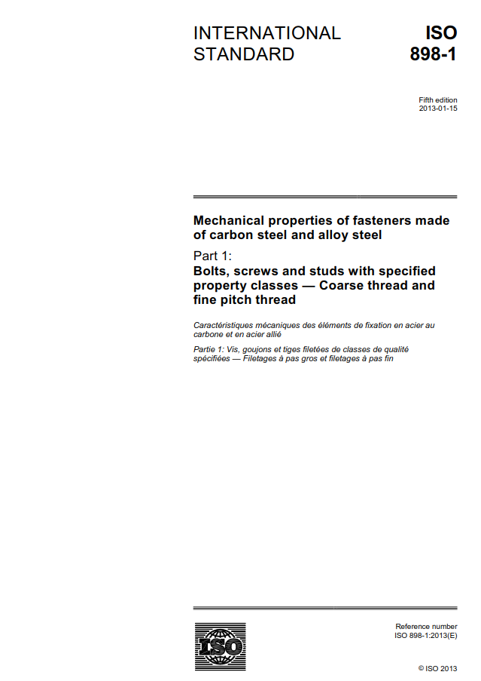
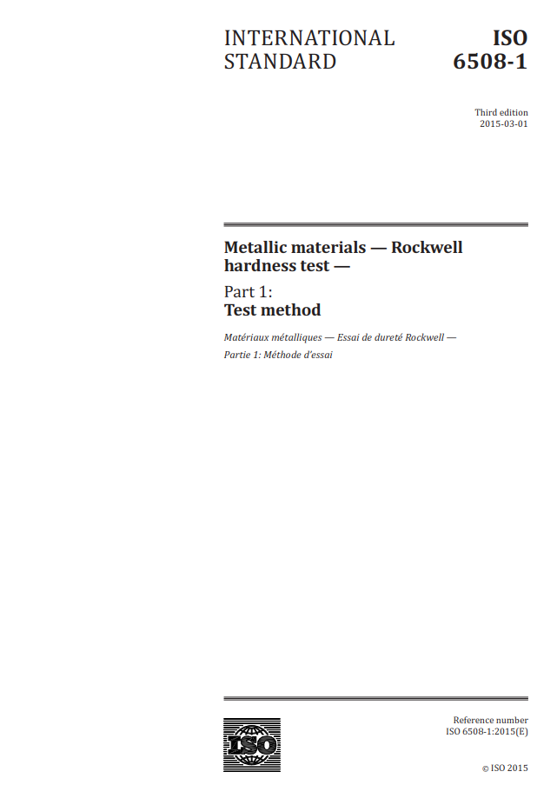
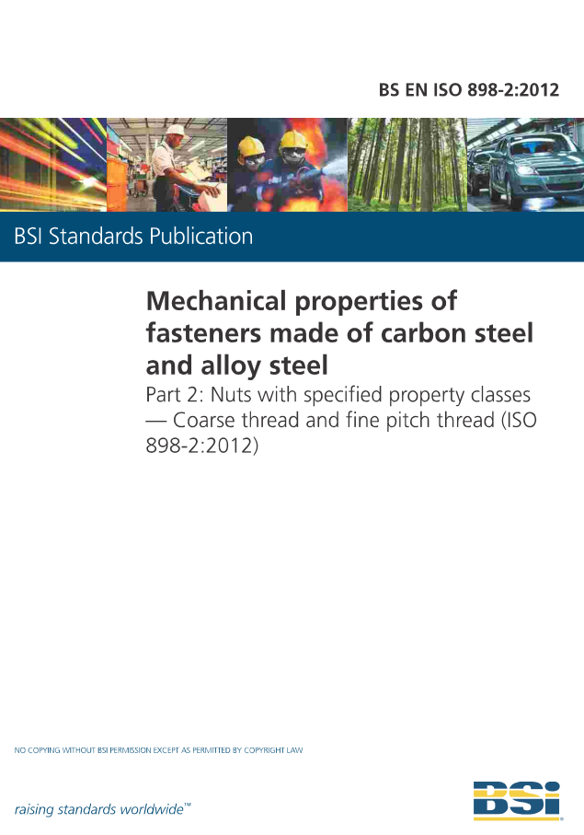





ISO & EN standards in force

Slide 7
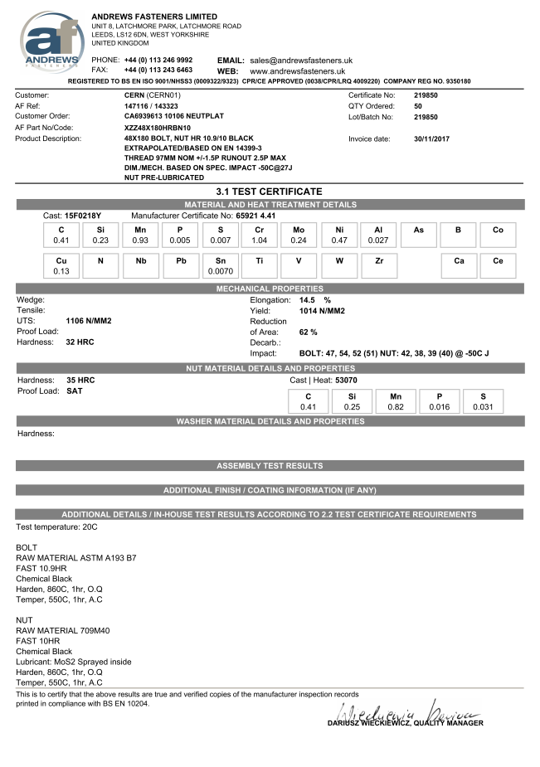
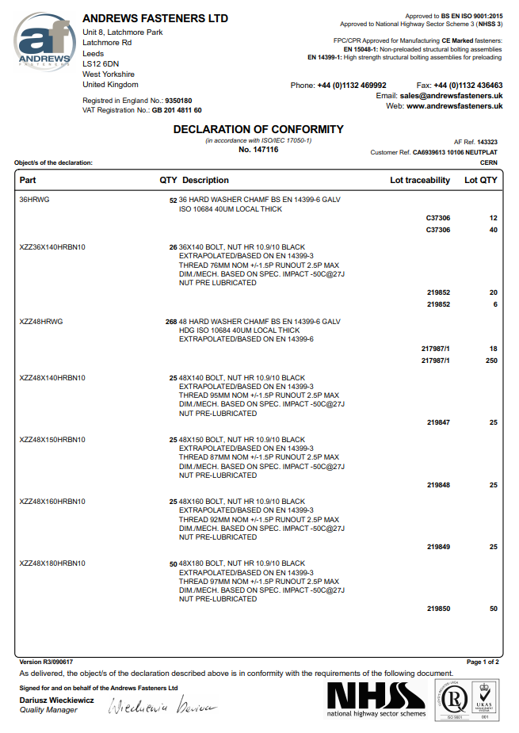
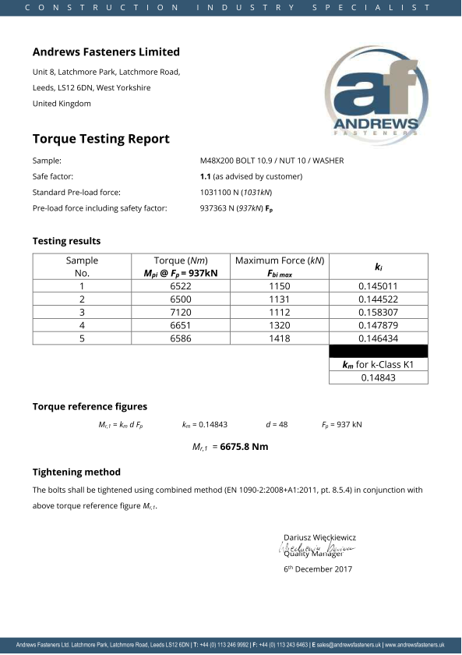
LBNF – Bolts certifications
Material
Heat treatment
Mechanical properties
Declaration of conformity
Torque Testing Report (very important)

Slide 8
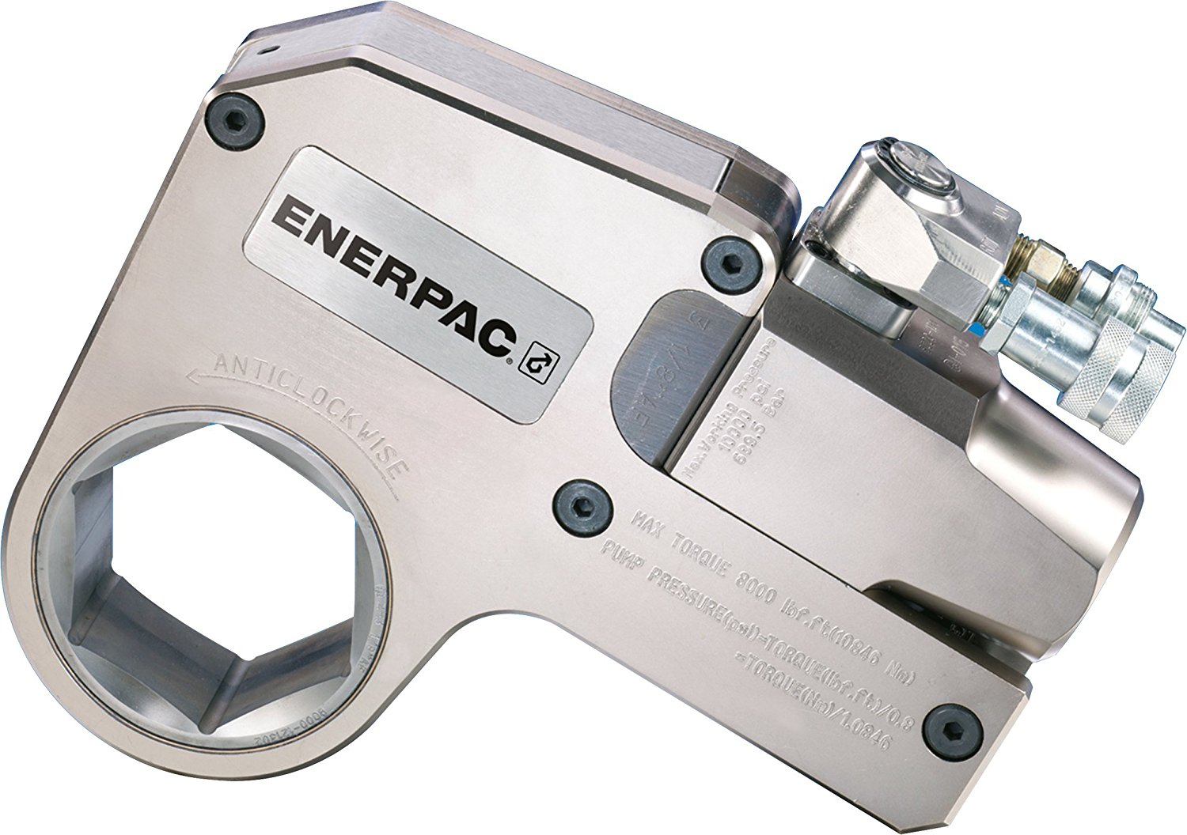
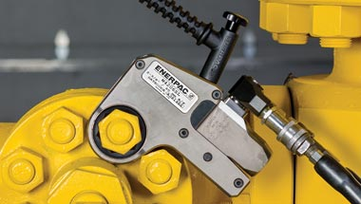

Bolts - Tightening
Torque Testing Report

Slide 9
Thank you!

