Slide 1
Pressure regulation LAr cryostat NP04

Slide 2
Cool-down Operation
LN2 in
GN2 out
GAr at 1.05 bar
Safety valve, at 350 mbarg
Pre-safety valve, at 150 mbarg
GAr out
LAr in
LAr in
GAr in
LAr cryostat
Cool-down p ~ 150 mbarg
No electronics
No recirculation
Open pre-safety p = 150 mbarg
Open safety p = 350 mbarg

Slide 3
Filling Operation
LN2 in
GN2 out
GAr at 1.05 bar
Safety valve, at 350 mbarg
Pre-safety valve, at 250 mbarg
GAr out
LAr in
LAr in
LAr cryostat
Filling p ~ 1.070 bar
No electronics
No circulation
Open pre-safety p = 250 mbarg
Open safety p = 350 mbarg

Slide 4
Normal Operation
LN2 in
GN2 out
GAr at 1.05 bar
Safety valve, at 350 mbarg
Pre-safety valve, at 250 mbarg
GAr out
LAr in
LAr cryostat
Normal operation p ~ 1.070 bar
Stop electronics p = 200 mbarg
Stop recirculation p = 200 mbarg
Open pre-safety p = 250 mbarg
Open safety p = 350 mbarg

Slide 5
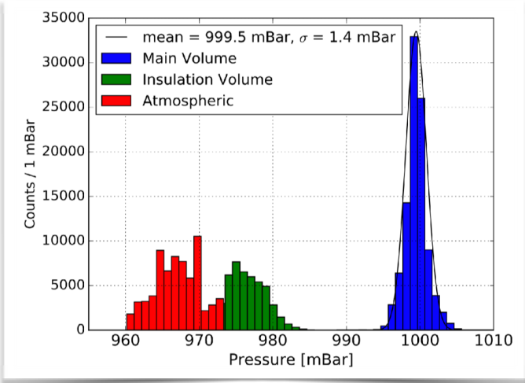
Experience 182 Normal Operation

