Slide 1
Physics of Small Systems in Run 3 and 4
Jan Fiete Grosse-Oetringhaus, CERN
WG5 Meeting
06.03.18
Content
Chapter outline
Expected data sample
Tail of the N_{ch} distribution

Slide 2

Motivation
Run 1 discoveries have changed our perception of small systems
Huge potential to learn about underlying dynamics and
non-perturbative QCD
  Unified description from pp to AA
Two distinct areas
  Low multiplicity limit
  Transition from pp to pA to AA
Where can we go with run 3 and 4
  Quantitatively and qualitatively
C. Bierlich

Slide 3
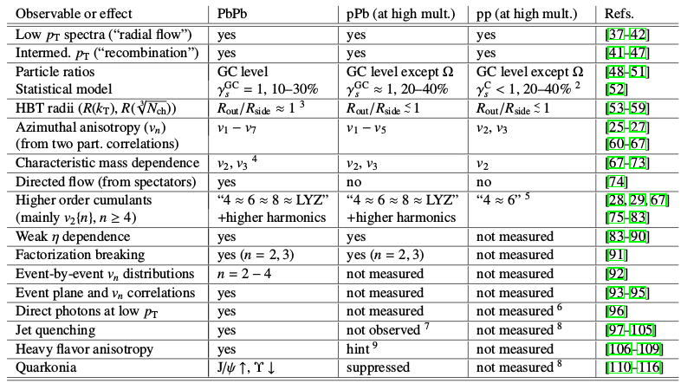

Chapter Outline
Historic overview, wrt initial LHC program (1 page)
Table of “heavy ion” observations, and their current
status in pPb and pp and some comments (1 page)
Open questions and theoretical implications, and
observables which address them (3 pages)
  Nature of collectivity / initial vs final state
  Are “collective effects” caused by final-state interactions
  in pp and pPb? → we should see jet quenching
  and medium-quark interactions
    R_{AA}, X+jet correlations
    HF v_{n}, Strangeness enhancement
  (Smooth?) transition from pp to pPb to PbPb
  Is there a turn on of at low N_{ch}?
    Subevents
    Higher order c_{n} (may be hopeless..)
Make clear why pp and pPb are needed
Integrate different modelling approaches (hydro, CGC, escape, …)
Shortcomings of current modelling in small systems (need to argue how run 3 and 4 can improve this)
(Loizides, 1602.09138)

Slide 4
Chapter Outline (cont.)
Key observables and performance figures (10 pages)
v_{n}, c_{n}
  Higher orders
  Subevent method
  With PID + strangeness
  HF + quarkonia
  P(v_{n}) should be within reach in pp even!
Strangeness enhancement
Energy loss
  “RAA”
    Hadrons (and jets)
    Definition of R_{AA} in pp to be discussed
  X+jets (X=photon,W,Z,[hadron,jet])
  Heavy Flavour
Thermal radiation?
Distribute performance studies among experiments (aim at no repetition)
Avoid shopping list

Slide 5
Chapter Outline (cont.)
Data-taking strategy, proposed L_{int}, and implications per experiment (total 1 page)
  High multiplicity triggering, pile up, MB sample
  pp
    ALICE: additional several month pp program
    ATLAS/CMS: special runs (mu~1) or special conditions at end of fill
    LHCb: either in nominal (mu~5) or special running
    HM sample: 200 pb⁻¹ pp (per experiment)
    How much MB for low-multiplicity questions?
  p-Pb scheduled run
    1000-2000 nb⁻¹
  Open questions: shall we also make plots/discussion for 10x (100x) these values? As showcase for beyond run 4, or other detectors?
Summary (1 page)
under discussion
none of this endorsed
within the experiments

Slide 6
Multiplicity Distribution
Update
Estimates at large multiplicities in pp require assumption of distribution
  Tail very sensitive to extrapolation
  We would like to use a common distribution
  This avoids that performance by different experiments is different due the choice of multiplicity distribution instead of due to the different experiment
Two step extrapolation procedure
  Fit tail of measured distributions with functional form, based on
    ALICE data from 0.9 to 8 TeV (|η| < 1.5, p_{T} > 0, N_{ch} >= 1)
    ATLAS data from 0.9 to 13 TeV (|η| < 2.5, p_{T} > 0.1 GeV/c, N_{ch} >= 2)
  Inter/extrapolate parameters to desired energies
    HL-LHC: 5.5 TeV (PbPb) and 14 TeV (pp)
    HE-LHC: 10.5 TeV (PbPb) and 27 TeV (pp)
independent
extrapolation

Slide 7

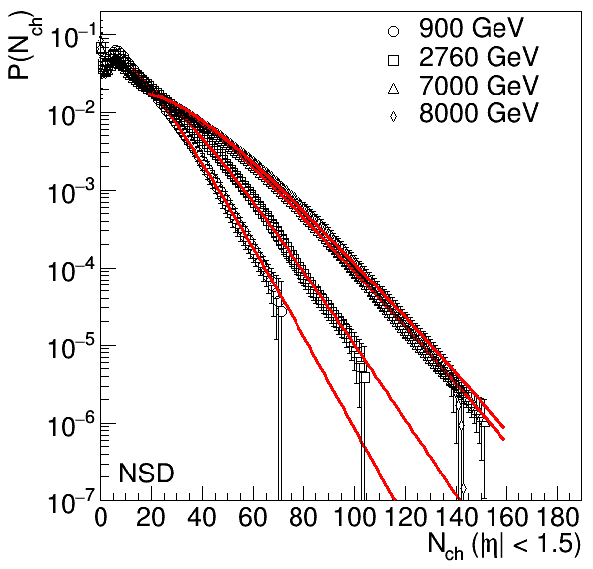
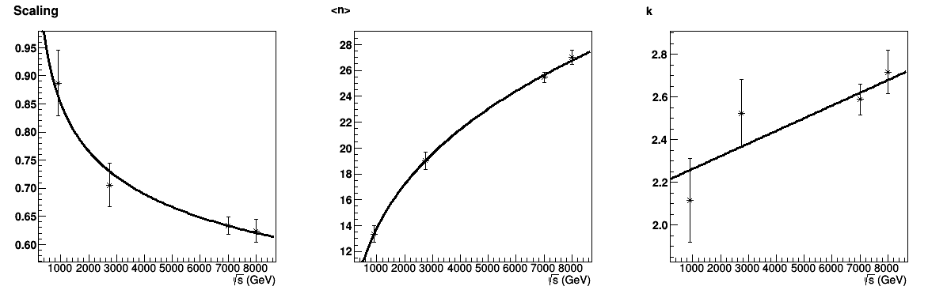
Extrapolation Procedure
Negative binominal distribution (NBD) fit to tail
  Tail = contains 20-40% of cross-section
NBD parameters:
Scaling
<n>
k
NBD

Slide 8
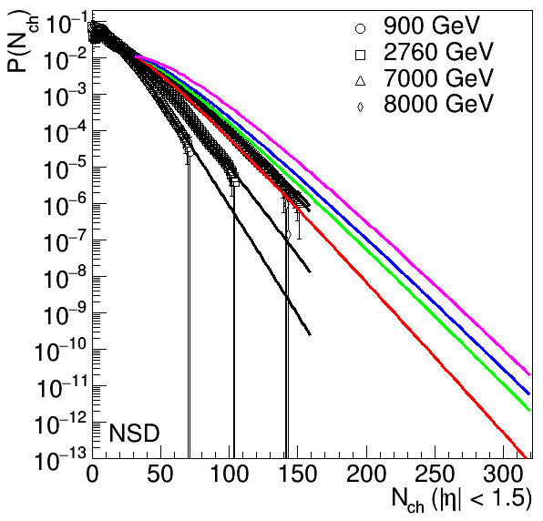
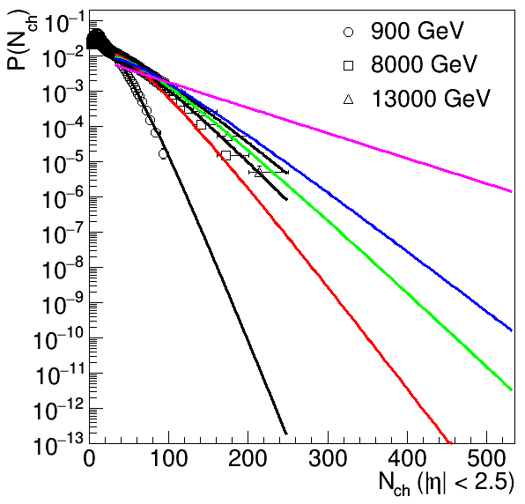
Extrapolated Distributions
ALICE based extrapolation
ATLAS based extrapolation
HL-LHC
5.5 TeV
14 TeV
HE-LHC
10.5 TeV
27 TeV
Large difference for
27 TeV, to be understood
different η range

Slide 9
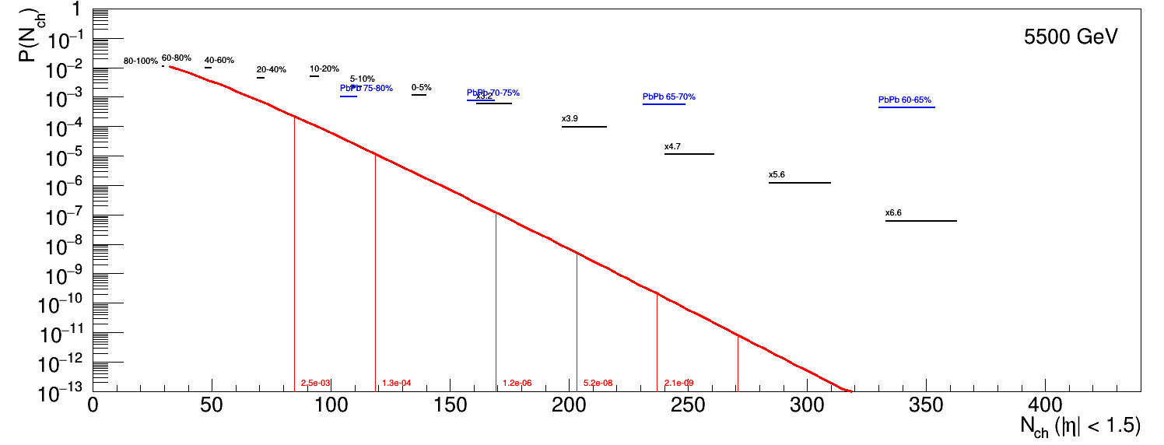
Compare to pp and pPb: 5.5 TeV
PbPb
PbPb 70-75%
pPb
5-7x<N_{ch}>
7-10x<N_{ch}>
10-12x<N_{ch}>
12-14x<N_{ch}>
14-16x<N_{ch}>
pp 5.5 TeV
Events / pb⁻¹ → 165M 89M 83k 3.5k 140

Slide 10
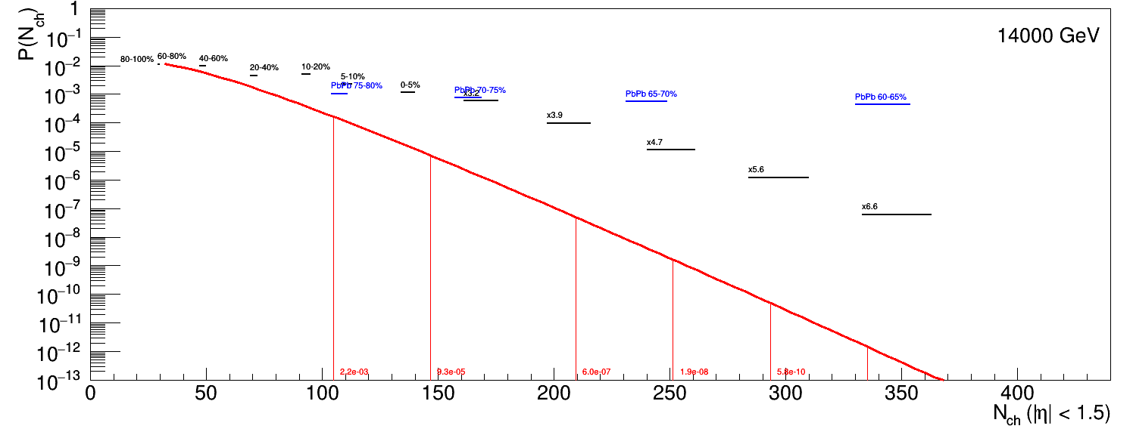
Compare to pp and pPb: 14 TeV
PbPb
PbPb 70-75%
PbPb 60-65%
pPb
400 events / pb⁻¹
E.g. 200 pb⁻¹ → 80k events
5-7x<N_{ch}>
7-10x<N_{ch}>
10-12x<N_{ch}>
12-14x<N_{ch}>
14-16x<N_{ch}>
pp 14 TeV
Events / pb⁻¹ → 1.5G 65M 418k 13k 400

Slide 11
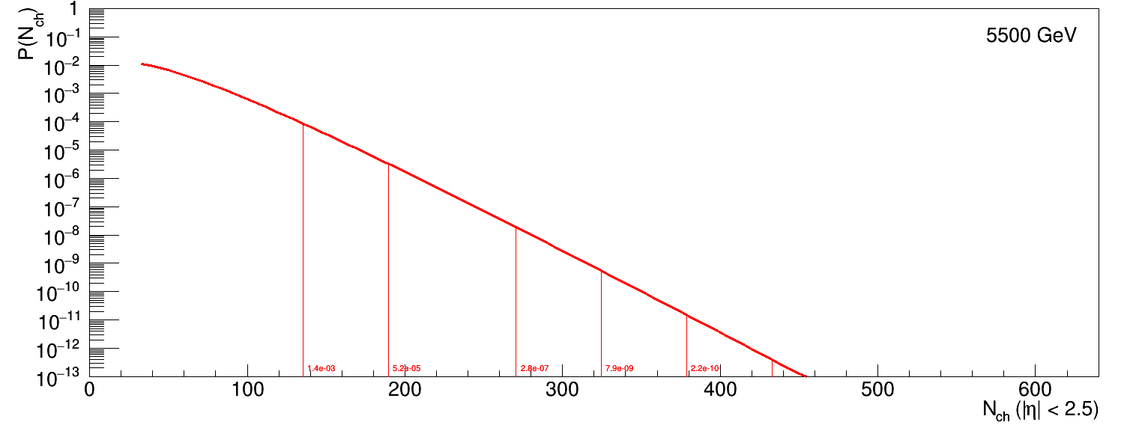
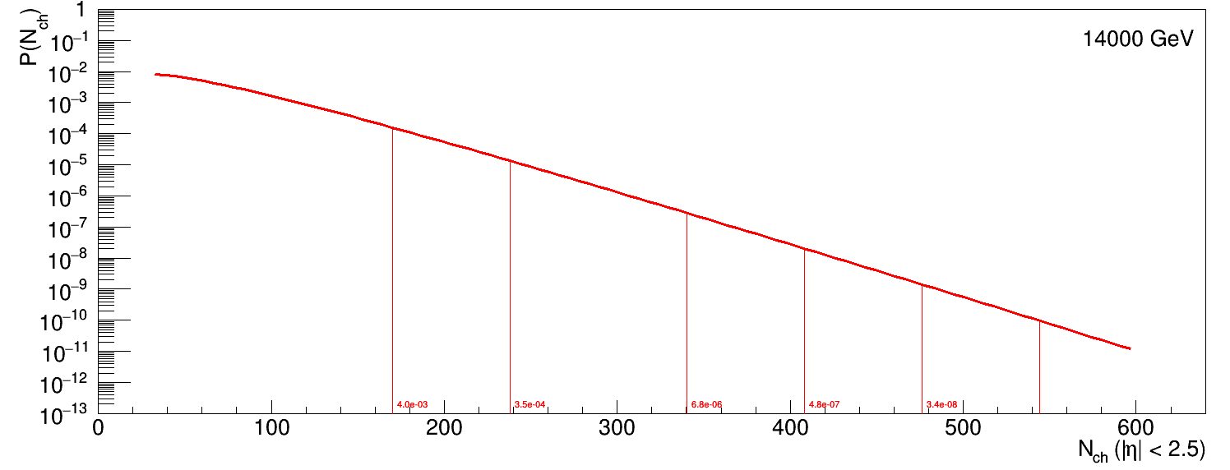
ALICE vs ATLAS-based Extrapolation
ALICE based
ALICE based
5-7x<N_{ch}>
14-16x<N_{ch}>
5-7x<N_{ch}>
14-16x<N_{ch}>
5.5 TeV
14 TeV
factor 2
smaller
factor 10
smaller
factor 2
larger
factor 60
larger
ATLAS based
ATLAS based
5-7x<N_{ch}>
14-16x<N_{ch}>
5-7x<N_{ch}>
14-16x<N_{ch}>
Tail very sensitive (ongoing work…)
difficult to assign an uncertainty
for now work with pessimistic extrapolation at 14 TeV

Slide 12
Wide Overlap between pp and PbPb
pp
PbPb
~65%
If pp behaves as HI, we should see “standard” HI physics
  If not, we can see the differences
200 pb⁻¹ allow to study equivalent
Pb-Pb multiplicity up to 60-65%
Practical consequence: performance plots can be made from existing HI measurements (assuming identical signal)
14 TeV
n*<N_{ch}> | Range (|η| < 1.5) | Events / 200 pb⁻¹
12-14 | 251-293 | 2.6M
14-16 | 293-335 | 80k
PbPb* equiv 65-70% | 202-291 | 156M
PbPb* equiv 60-65% | 291-409 | 95k
PbPb* equiv 55-60% | 409-558 | 4

Slide 13
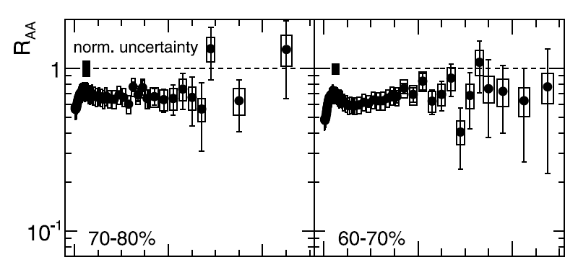
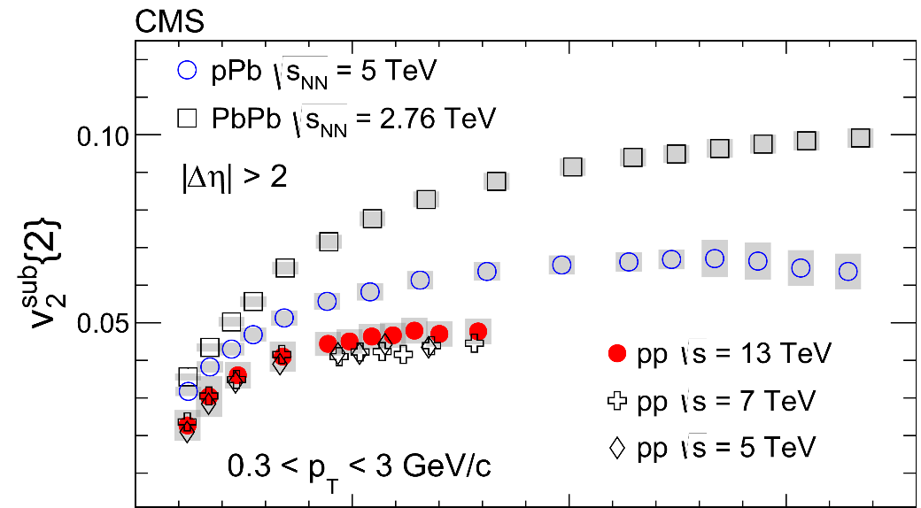
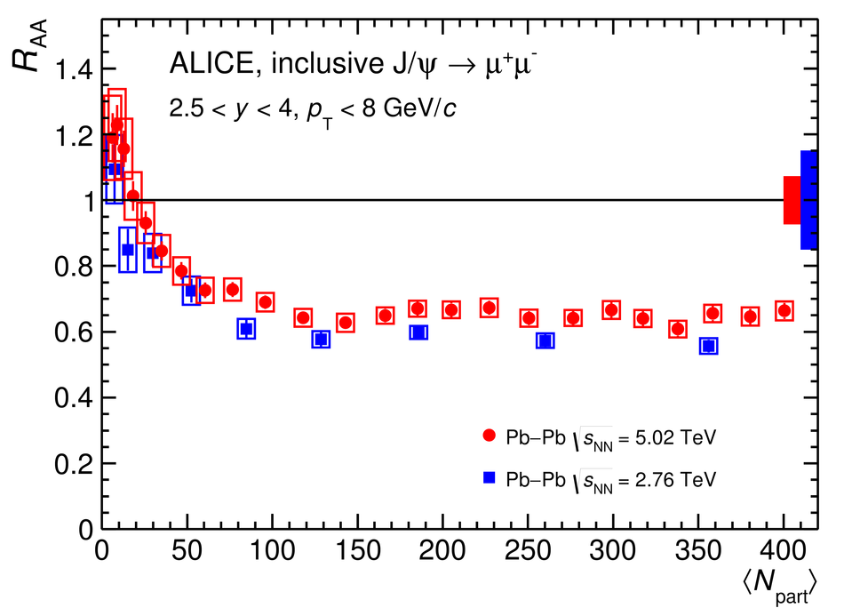
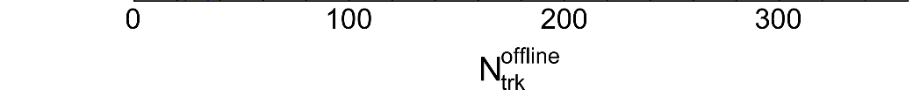
Examples
PLB766(2017)212
PLB720(2013)52
65%
160k events
65%
0
50 GeV
PLB765(2017)193
NB. Normalization of “R_{AA}” in pp not obvious (,obviously…)
Notes:
CMS 300 → about 250

Slide 14
Join the Group!
Join our mailing list: hllhc-wg5-smallsystems@cern.ch
Next meeting: Tu 20 afternoon or Thu 22 morning, to be finalized
Participants
  TH: Christian Bierlich, Stefan Floerchinger, Aleksi Kurkela, Guilherme Milhano, Korinna Zapp
  ATLAS: Jiangyong Jia, Mingliang Zhou
  CMS: Maxime Guilbaud, Wei Li
  ALICE: Peter Christiansen, Andrea Dainese, Debasish Das, JFGO, Alexander Kalweit, Christian Klein-Boesing, Constantin Loizides, Yaxian Mao, Naghmeh Mohammadi, Zhong-Bao Yin, Valentina Zaccolo
  LHCb: Michael Winn

Slide 15
Summary
Chapter
  Chapter outline defined
  L_{int} assumption for performance plots decided
Multiplicity distribution in pp
  Extrapolation done based on ALICE and ATLAS data
  Large uncertainties in the tail unavoidable
Quite some work ahead!

Slide 16
Backup

Slide 17
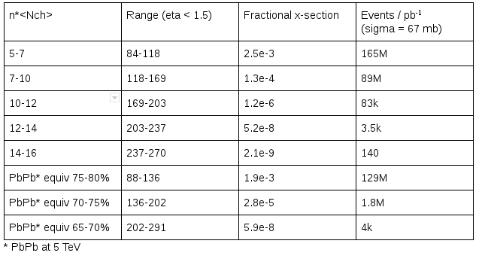
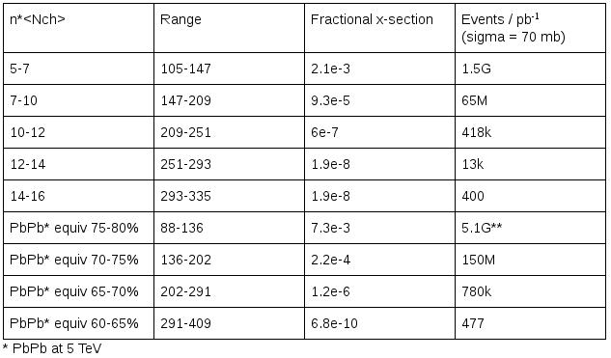
Event Classes
5.5 TeV
14 TeV
Extracted within |eta| < 1.5, but n*<Nch> is eta-range independent
(assume eta distribution flat, should be ~fine for current ATLAS/CMS acceptance)
Can be used by ALICE/ATLAS/CMS

