Slide 1
MQXFS1d Welding Status
Antonios Vouris
Cold Mass Status Meeting
25 January 2018

Slide 2
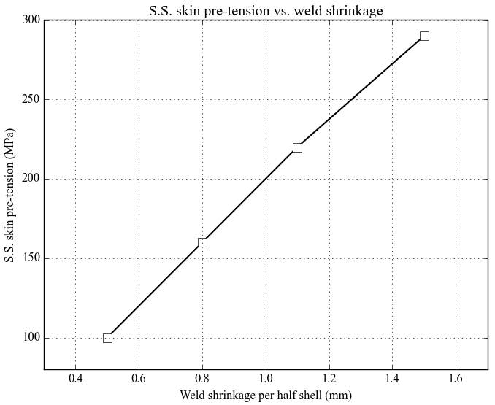
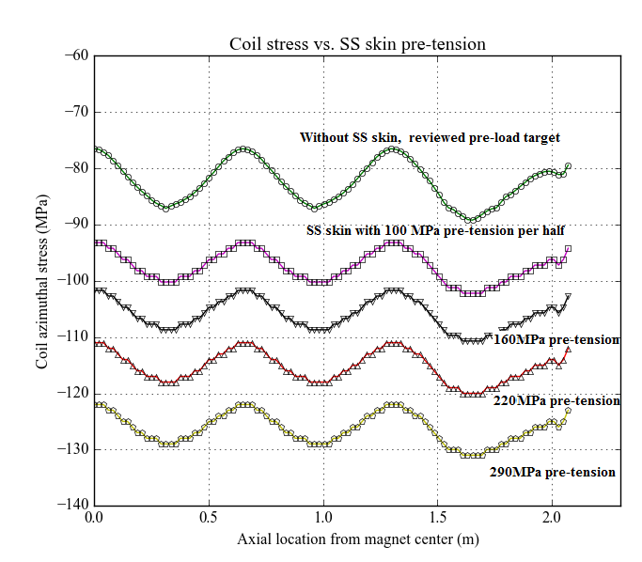
Coil pre-stress changes with SS skin pre-tensions
Impact of the SS skin has been performed in our 3D model by applying different interferences between S.S. vessel and the magnet structure.
The plot on the right presents the coil (pole) azimuthal stress along the magnet length with deferent SS skin pre-tensions induced by welding shrinkage.

Slide 3
Δ σ_{Coil} compared with Giorgio’s results
The coil stress increases by ~3.2 MPa / 0.1mm weld shrinkage (half shell). This denotes about 48 MPa coil stress increasing is expected for a 50 mil (1.5 mm) weld shrinkage (half shell).
This value is close to the results Giorgio presented in the his slides “MQXF – Vessel Welding” (05/12/2017) .
Both 2D and 3D results shows the current weld shrinkage is relatively high for the coil pre-stress.

Slide 4
Calculation of Shell Weld Preparation
Stainless shell
Aluminum magnet shell
C_{ALTOT} =Total Circumference of Outside surface of Aluminum shell
C_{STEELAFTOTAL}
C_{STEELAFTOT} = Total Circumference of Inner surface of Steel shell after welding
Measured dia. of Aluminum Shell O.D. = 614.657 mm = 24.199 in.
Criteria to achieve correct tightness after welding: C_{STEELAFTOT} = C_{ALTOT} - .020 in.
C_{ALTOT} = 24.199 in. x ∏ = 76.023 in.
C_{ALTOT}
C_{STEELBEFTOT} = C_{STEELAFTOT} + Total Shrinkage during welding
Total shrinkage during welding = .090 in. (over entire azimuth) = .045 in. per side.
Therefore, C_{STEELBEFTOT} = 76.023 in. -.020 in. + .090 in. = 76.093 in.
Stainless shell
And the inside diameter of the steel before welding is 76.093/ ∏ =24.221 in.
Aluminum magnet shell
C_{BW}
C_{BW} = Circumference of inside of steel shell half before welding
G
G
G = Gap size before welding per side = .094 in.
C_{BW}
C_{STEELBEFTOT} = C_{BW} +C_{BW} +G+G
Therefore, C_{BW} = (C_{STEELBEFTOT} - 2G)/2
C_{STEELBEFTOTT}
Therefore, C_{BW} = (76.093 in.– .188 in.)/2 = 37.952 in.

Slide 5
Calculation of Shell Weld Preparation
C_{OUTSTEELAFTOT}
Stainless shell
(Using Outside Diameter)
Aluminum magnet shell
C_{ALTOT} =Total Circumference of Outside surface of Aluminum shell
C_{STEELAFTOT} = Total Circumference of Inner surface of Steel shell after welding
C_{STEELAFTOTAL}
Measured dia. of Aluminum Shell O.D. = 614.657 mm = 24.199 in.
Outside dia. Stainless Shell after welding = 24.199 in. + (.330)(2) = 24.859 in.
Criteria to achieve correct tightness after welding: C_{STEELAFTOT} = C_{ALTOT} - .020 in.
Outside circumference of steel after welding = C_{OUTSTEELLAFTOT} = 24.859 in. x ∏ = 78.096 in.
C_{ALTOT}
C_{OUTSTEELBEFTOT} = C_{OUTSTEELAFTOT} + Total Shrinkage during welding
C_{OUTSTEELBEFTOTT}
Total shrinkage during welding = .090 in. (over entire azimuth) = .045 in. per side.
C_{OBW}
Stainless shell
Therefore, C_{OUTSTEELBEFTOT} = 78.096 in. -.020 in. + .090 in. = 78.166 in.
Aluminum magnet shell
And the outside diameter of the steel before welding is 78.166/ ∏ =24.881 in.
C_{OBW} = Circumference of outside of steel shell half before welding
G
G
G = Gap size before welding per side = .094 in.
C_{OUTSTEELBEFTOT} = C_{OBW} +C_{OBW} +G+G
Therefore, C_{OBW} = (C_{OUTSTEELBEFTOT} - 2G)/2
Therefore, C_{OBW} = (78.166 in.– .188 in.)/2 = 38.989 in.
C_{OBW}

Slide 6
Shell Half before Welding
(Using Outside Diameter calculated geometrically)
Inside Radius of steel shell
½ C_{STEELBEFTOTT} = 76.093 in/2 = 38.046 in.
½ G
½ G
½ G = .094 in./2 = .047 in.
C_{BW} = 37.952 in.
Wall thickness of shell = .330 inches.
C_{BW}
Inside dia of shell = 24.221 inches.
½ C_{STEELBEFTOTT}
Outside dia of shell = 24.221 inches + (.330)(2) = 24.881 in.
Shell wall thickness
Outside circumference of shell = 24.881 x ∏ = 78.166 in.
C_{OUTBEF}
Therefore C_{OUTBEF} = outside circumference of shell half – (½ G)(2) = (78.166/2) – (.047)(2) = 38.989 in.

Slide 7
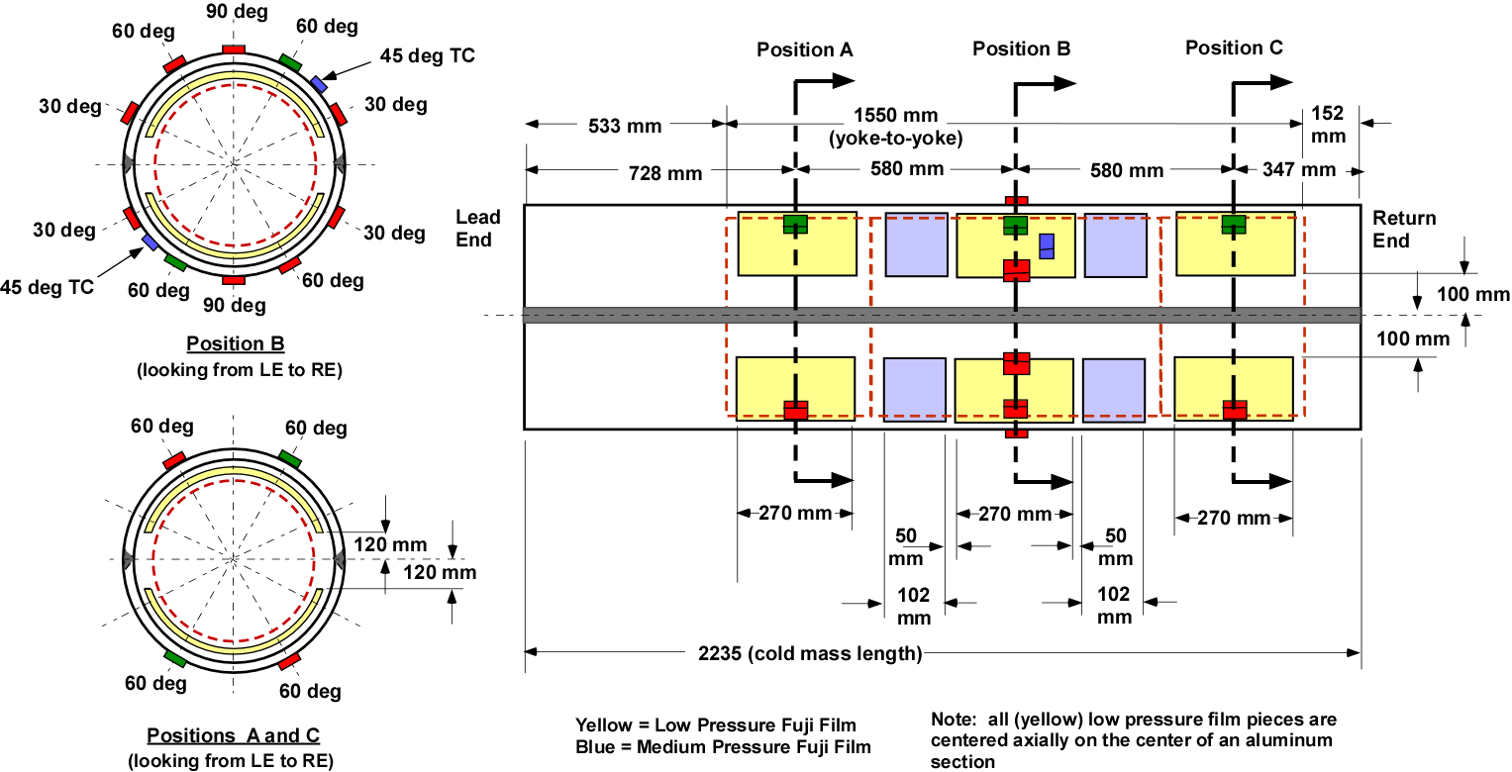
Fuji film plan

Slide 8
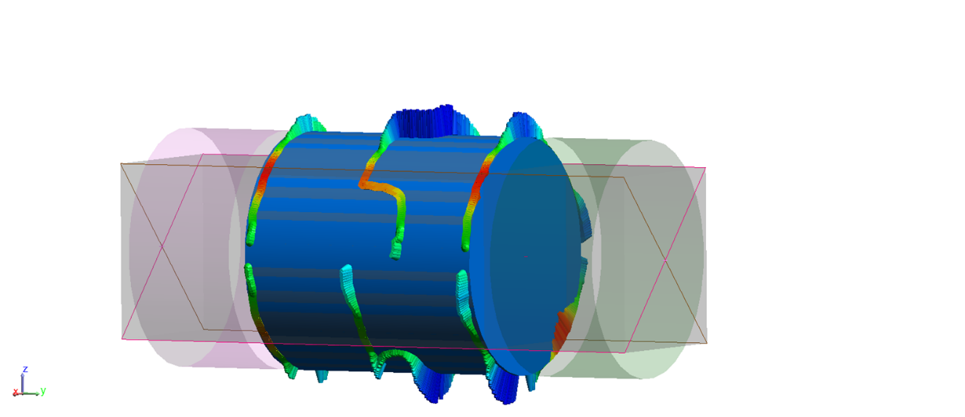
Measurements of center section of MQXFS1C shell.

Slide 9
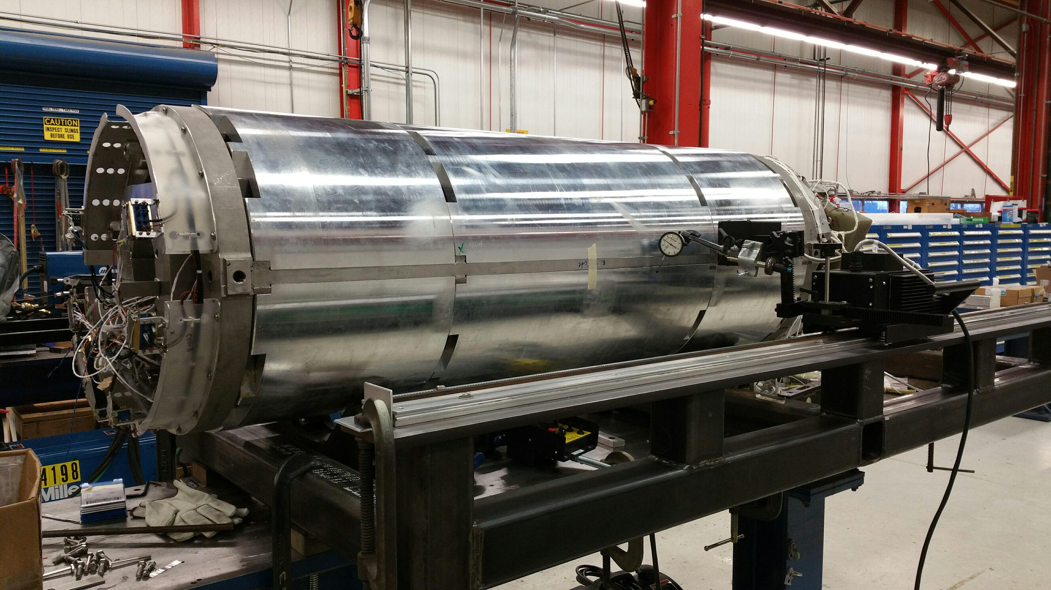
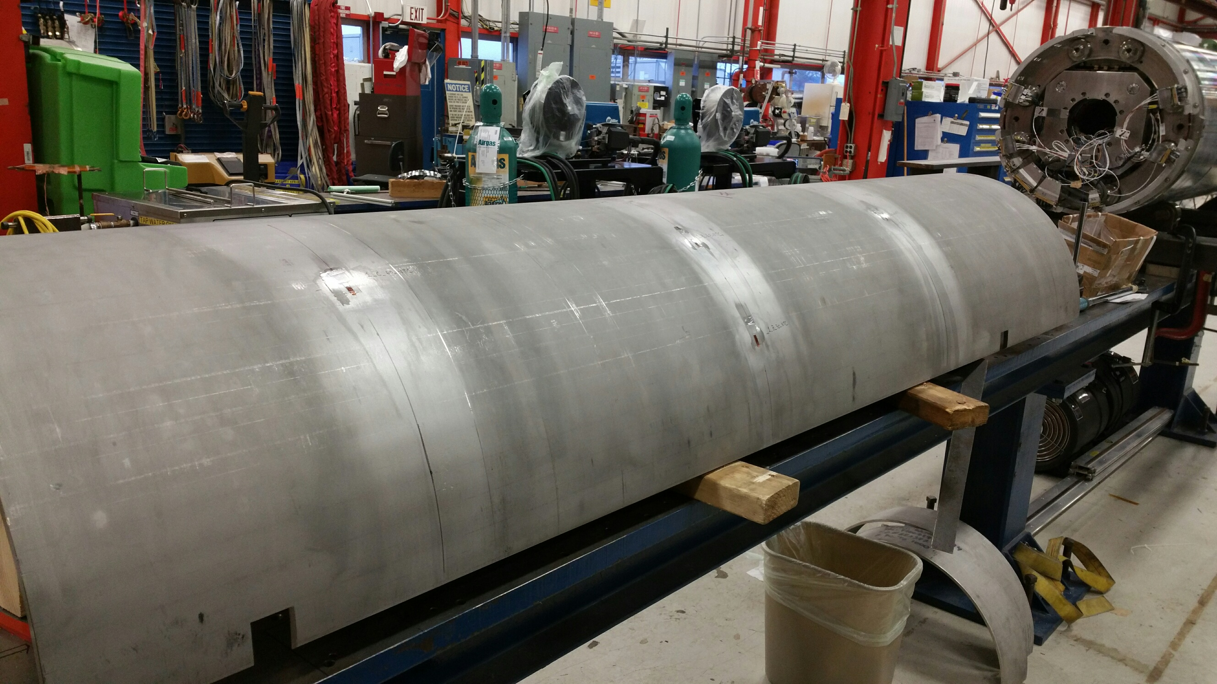
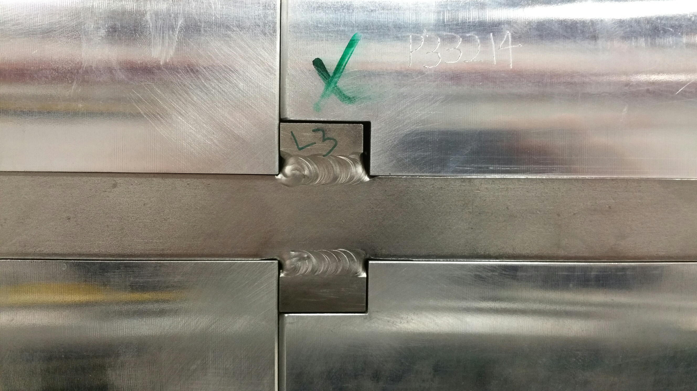
Status
Next steps:
Wire up the strain gauges
Scribe the centerline both sides
Insert the Fuji films
Fit up the shells
Welding
  Final shell leveling wrt. equipment
  Monitor temperatures
  Measure strain gauges after each passes

