Slide 1
Status of Expansion Loop and Bus Design
R. Bossert January 26, 2018

Slide 2
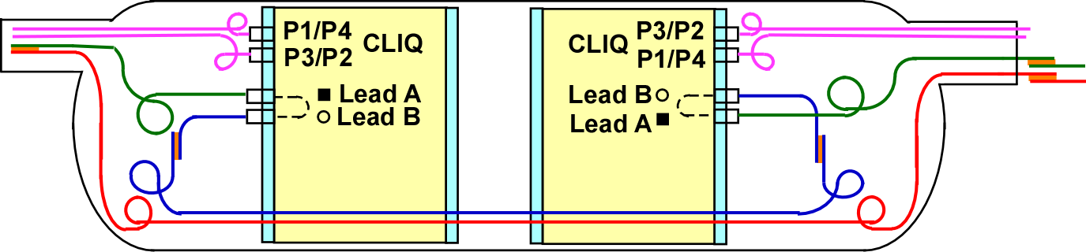
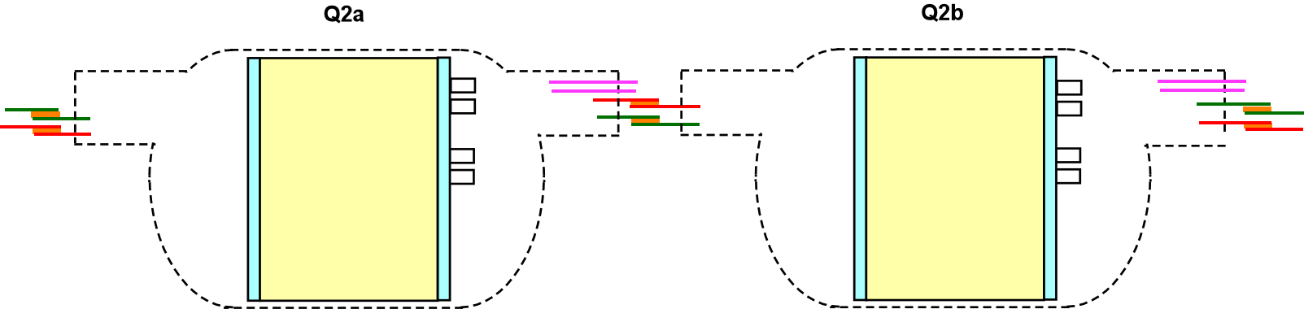
Q1a
Q1b
General Buss loop configuration –
Q3a
Q3b

Slide 3
Q1 Configuration (same as Q3) with voltage taps shown
= Position of Voltage Tap

Slide 4
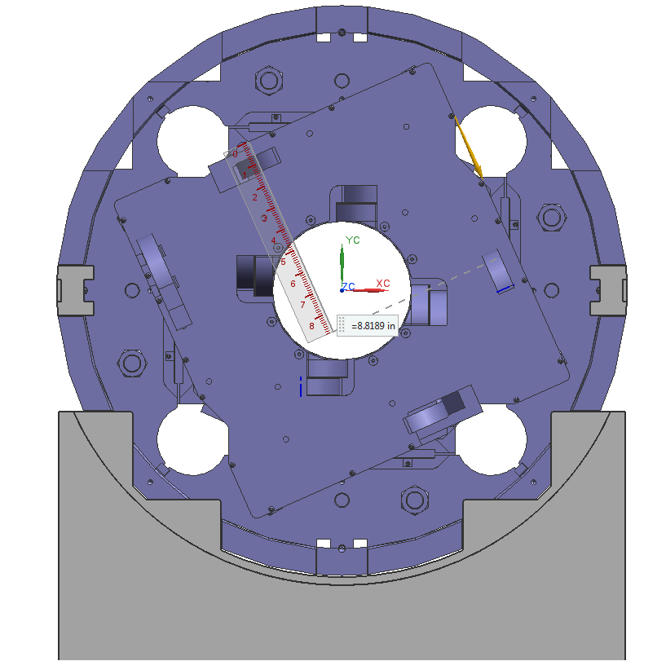
End views of Expansion loops looking into the Lead End of both Magnets
Q1a/Q3a
Q1b/Q3b
Instrumentation port position
Instrumentation port position
CLIQ
Leads
CLIQ
Leads
CLIQ
CLIQ
Bus port
Key:
Green line power leads
Blue line local bus
Red line through bus
Purple line CLIQ leads
Q1b/Q3b is flipped vertically with respect to Q1a/Q3a

Slide 5

Space in End Dome
100 mm
There is approximately 100 mm of space inside the dome between the “pizza box” and the dome cover. This should provide enough space for the loops to be able to move axially by 50mm. Precise shape of inside of end dome still needs to be received at Fermilab.

Slide 6
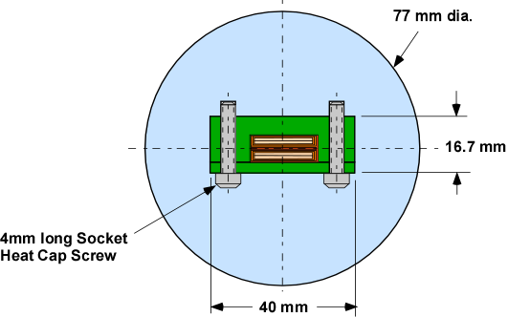
Through Bus original configuration
Original Concept – bus centered in bus port
6

Slide 7
New through bus configuration

Slide 8
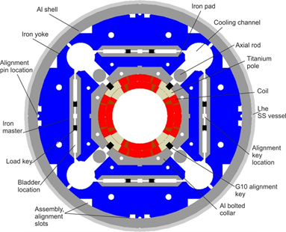
Bus in bus port with “Spider”

Slide 9
More Detailed view
Section B-B
Section A - A

Slide 10
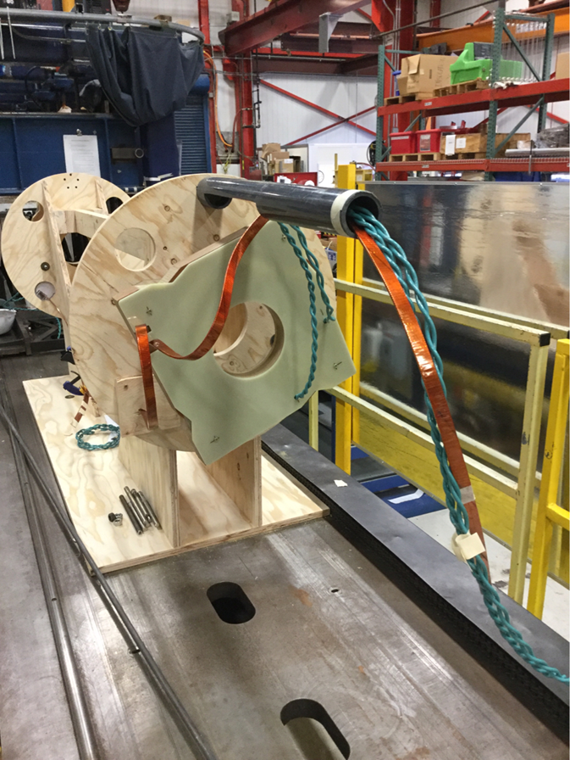
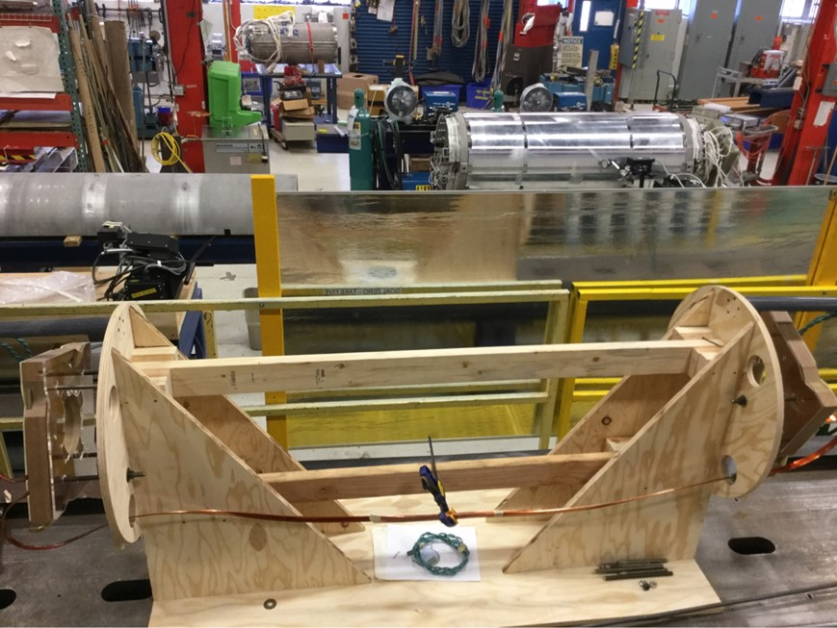
Overall views of mockup

Slide 11
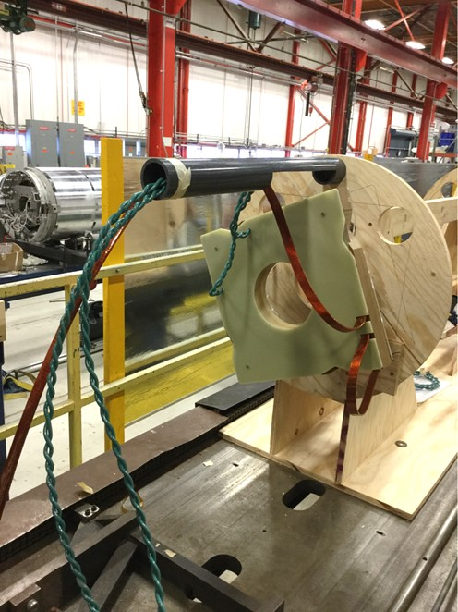
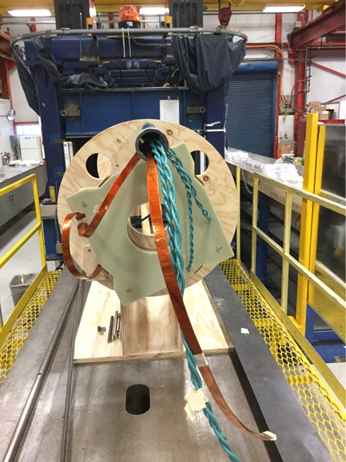
Mockup of Expansion Loops and Through Bus
Instrumentation port position
Q1a/Q3a
Q1b/Q3b
CLIQ
Leads
CLIQ
Bus port
Instrumentation port position
CLIQ
Leads
CLIQ
Bus port
Note: Through bus not yet installed.

Slide 12
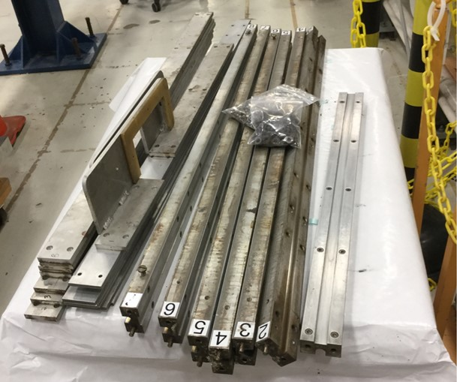
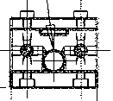
Bus Soldering Fixture

Slide 13
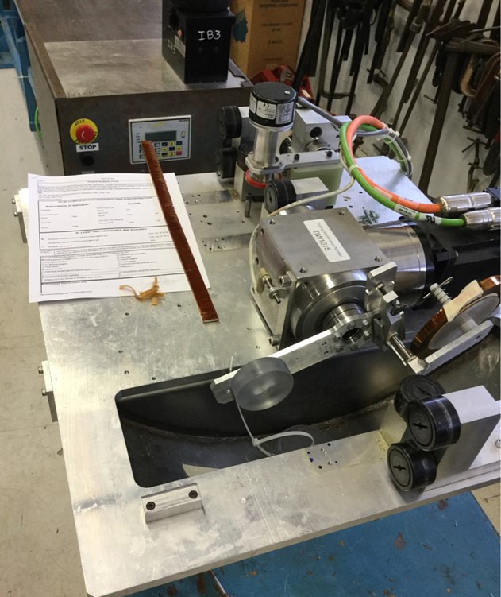
Bus Wrapping Fixture

Slide 14
Next Steps:
Finish rework of bus soldering fixture
Solder short bus for mockup
Manufacture bus housing, “spiders” and bus housing port for mockup.
Install bus into mockup
Manufacture gauge to duplicate dome inside surface.
Calculate amount of expansion needed for each loop.
Finish routing leads, expansion loops and CLIQ leads.
Understand splice configuration and design fixtures for completing splices.
Duplicate mockup for Q2.
Troubleshoot bus wrapping fixture.
Extend bus soldering fixture to 10 meters
Manufacture full length prototype bus, including wrapping, and mount into a prototype housing.
Test full length bus configuration in a long model?

Slide 15
Items still needed from LBNL/CERN to complete mockup and design:
Verification that bus configuration and position is acceptable (from magnetic analysis).
Configuration of inside of end dome.
Sample of CLIQ lead (to verify that our model is close to the correct size and stiffness).
Parameters needed for Q2.

Slide 16
Summary
Mockup of Q1/Q3 expansion loops is underway.
Plan for bus wrapping as well as bus soldering exists. Fixtures for both are available from previous projects but will need rework (or rebuild).
Bus and bus housing conceptual design exists, needs to be verified.
Not yet started on Q2 mockup.
Still need to design and complete splices and splice tooling.
Will also attempt to make a “test bus” for a future iteration of the short model.

