Slide 1
Development of emerging superconductors for high field applications
Andrea Malagoli
CNR-SPIN
5 March 2018
FCC Conductor Development Workshop, CERN
Andrea Malagoli

Slide 2
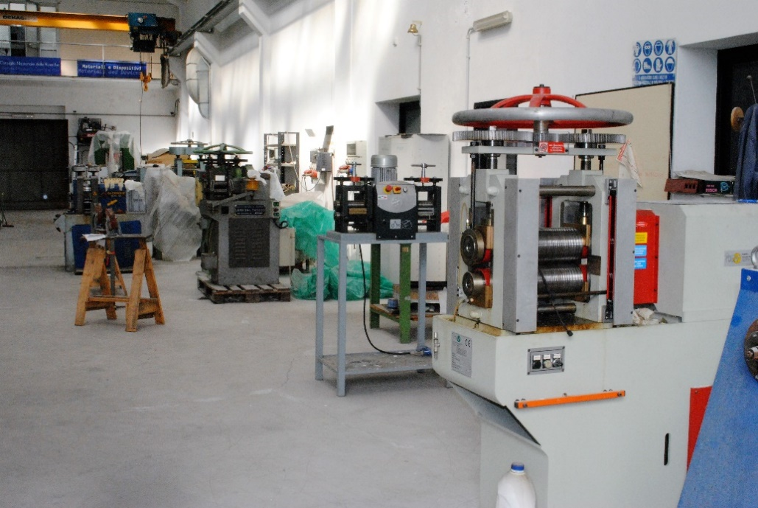
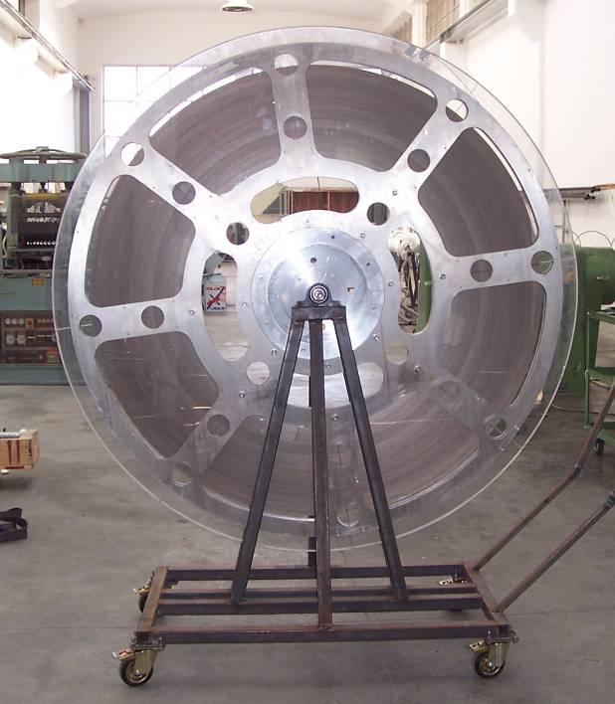
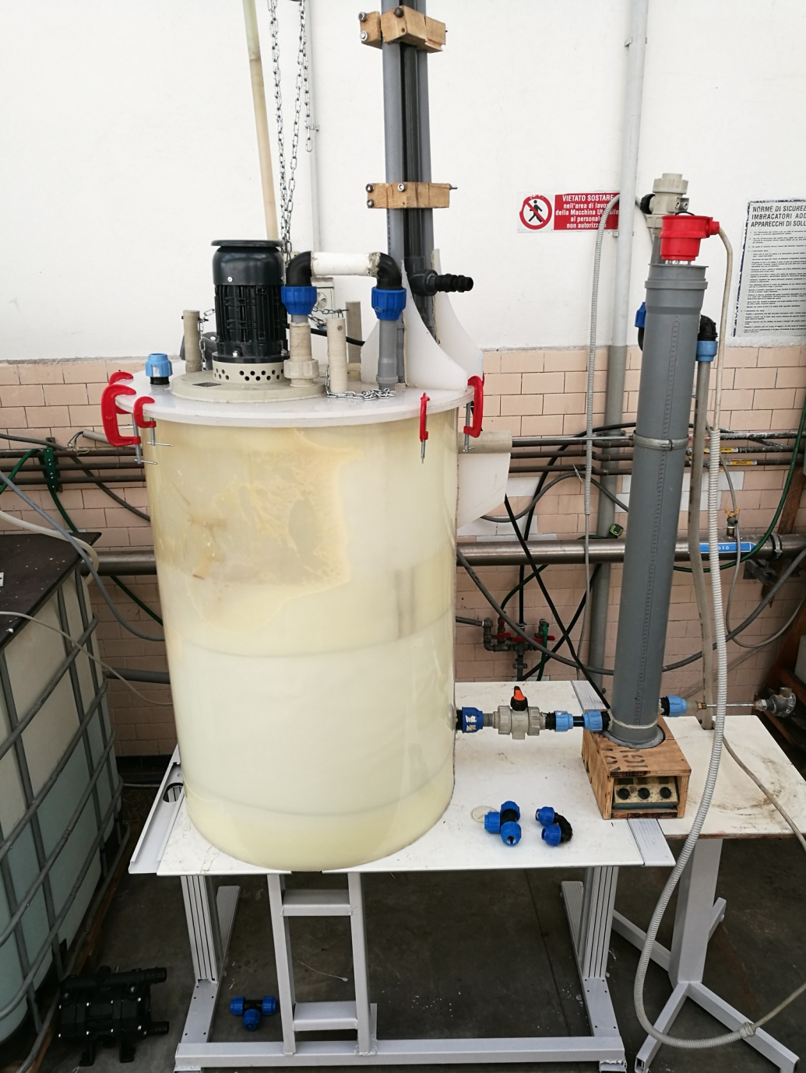
Powder In Tube - lab @ SPIN
Our lab has the unique capability to combine powders and wires development up to long length scale
New polypropylene (PP) chemical reactor system for B purification
(V = 300 L)
First in the world
1.6 km long batch of MgB₂ tape
18 batches realized
Addendum fcc-gov-cc-0086/edms 1750320/ke 3507 of the memorandum of understanding for the fcc study
Collaboration SPIN-CERN (A. Ballarino, S. Hopkins)
The scope of this collaboration is to advance the performance of three superconducting materials (Bi-2212, MgB₂, IBS), using industrially scalable productive methods, to make them suitable for high-field magnet applications.
MgB₂: increase the operating field by adopting an original doping method;
Bi-2212: reproduce the performance today obtained by high pressure heat treatment with a mechanical deformation process;
5 March 2018
FCC Conductor Development Workshop, CERN
Andrea Malagoli

Slide 3
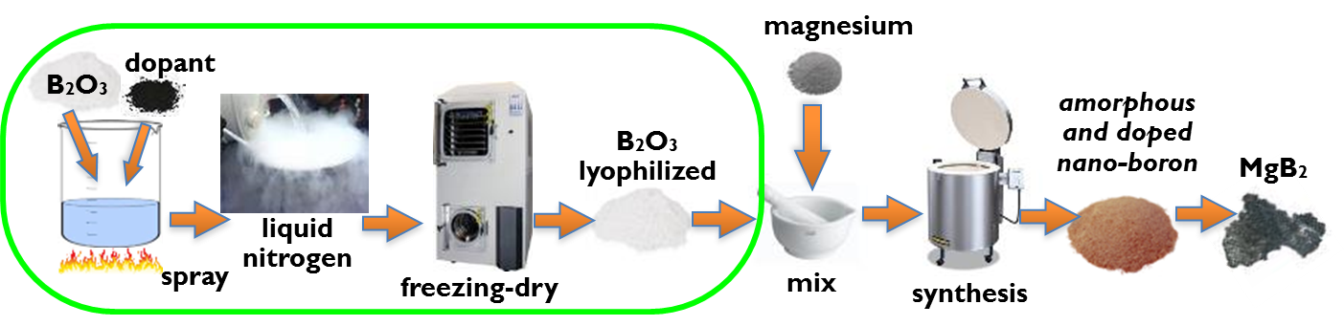
MgB₂: increase the operating field by adopting an original doping method
Maurizio Vignolo, G. Bovone, C. Bernini, F. Loria, C. Ferdeghini, and A.S. Siri
Innovative B for FCC
Traditional Moissan process for B production:
3 Mg + B₂O₃ 3MgO + 2B
to be removed
by acid treatments
Doping of boron starting from boron oxide precursor
CaF₂, ZnCl₂, starch, graphite, graphene
to increase H_{c2} value
BN, CaF₂, B₄C, etc.
to increase pinning force
5 March 2018
FCC Conductor Development Workshop, CERN
Andrea Malagoli
Notes:
La nostra idea per incrementare le prestazioni dei conduttori in MgB2 si basate sul metodo brevettato da SPIN per preparare un boro nanometrico drogato partendo dalla nanostrutturazione e drogaggio del precursore ossido di boro. B2O3 viene solubilizzata in acqua con aggiunte di droganti solubili o insolubili che producono soluzioni omogenee. L’omogeneità chimica viene mantenuta nella fase solida che si ottiene congelando criogenicamente la soluzione, l’acqua viene poi eliminata per liofilizzazione. Al termine del processo qui schematizzato si ottengono polveri nanometriche omogeneamente drogate di B2O3 che viene ridotta a B elementare con classica reazione magnesiotermica
Dopo lavaggi acidi il boro è pronto per essere reagito a MgB2.
Sostanze solubili disperdendosi a livello atomico in soluzione daranno poi sostituzioni sul sito del B o del Mg mentre sostanze insolubili di dimensioni nanometriche daranno nella fase solida dispersioni omogenee in grado di formare centri di pinning nella fase finale MgB2.
In un caso si innalzerà Hc2 e nel secondo si accrescerà la forza di pinning, quindi incremento delle prestazioni di Jc.

Slide 4
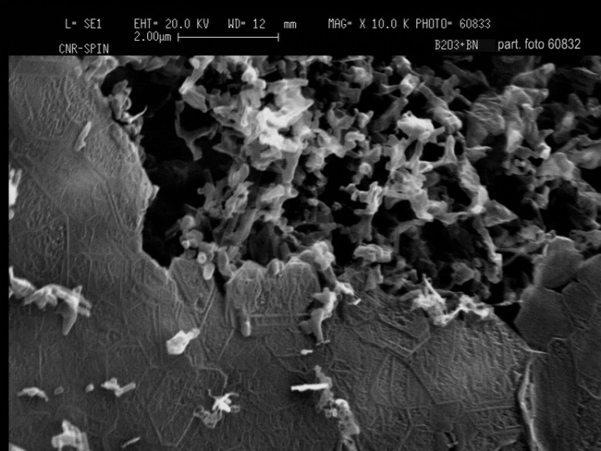
Boron oxide after freezing dry process
5 March 2018
FCC Conductor Development Workshop, CERN
Andrea Malagoli
Notes:
L’ossido di boro dopo liofilizzazione presenta sia particelle di dimensioni micrometriche come in fig in alto a sx, sia particelle di dimensioni nanometriche come nelle due successive immagini ad ingrandimanto 20K e 80K. Comunque, osservando le sfere di 20 micron ad alto ingrandimento (le 3 foto in basso) notiamo che queste al loro interno presentano una elevata porosità e risultano costituite da nanoparticelle di 20-40 nm. Le pareti delle microsfere risultano sottili alcuni nanometri e facilmente frantumabili e costituite anchesse di nanoparticelle di 20-40 nm (particolare ultima immagine basso a dx).

Slide 5
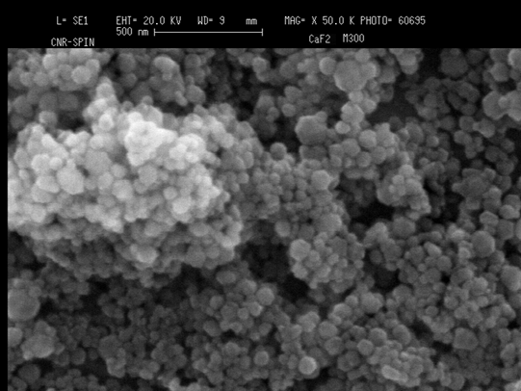
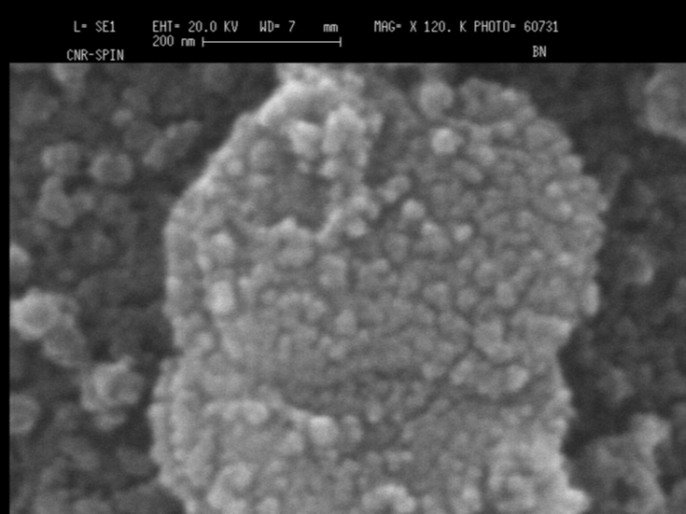
Preparation of doping agents
Nanosized CaF₂ by chemical synthesis:
NH₄F + CaCl₂
Nanosized BN by ball milling of
micrometric powder
average grain size: 20 nm
average grain size: 20 nm
5 March 2018
FCC Conductor Development Workshop, CERN
Andrea Malagoli
Notes:
In figura osserviamo nanoparticelle di possibili agenti droganti, per esempio fluoruro di Ca nanometrico è stato prodotto per sintesi chimica, nano BN per macinazione.

Slide 6
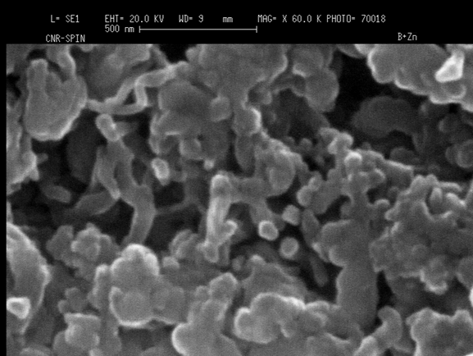
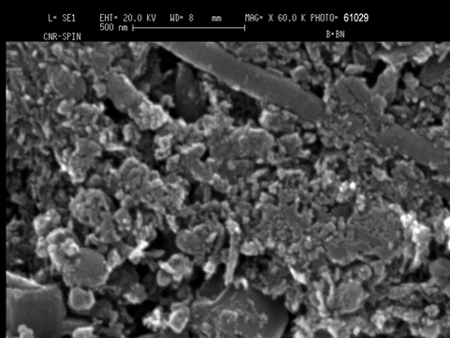
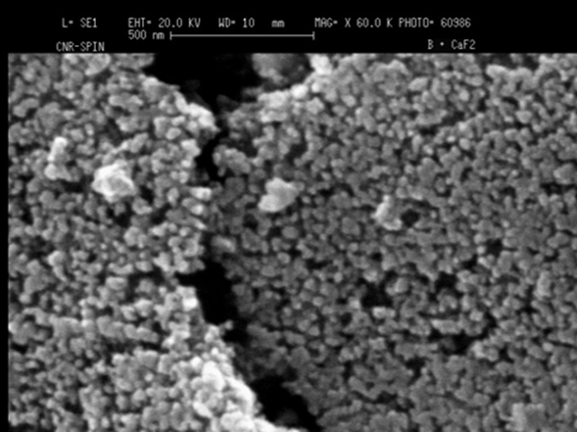
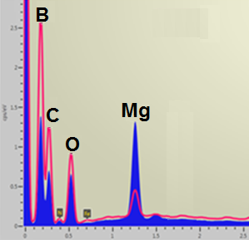
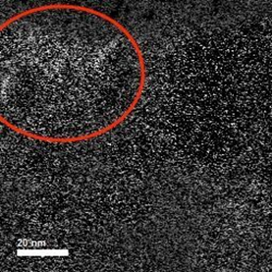
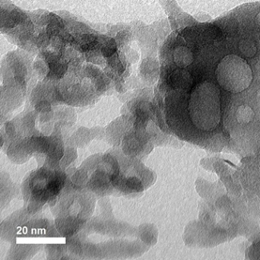
Doped boron after thermal reduction with magnesium and acid digestion processes
BN-doped boron
CaF₂-doped boron
ZnCl₂-doped boron
Starch -doped boron
Nitrogen signal
by EDX analysis
Ca
TEM analysis
5 March 2018
FCC Conductor Development Workshop, CERN
Andrea Malagoli
Notes:
In questa slide sono riportate alcune polveri di boro drogate ottenute con processo di liofilizzazione della B2O3 vista in precedenza, dopo aver subito la reazione magnesiotermica e lavaggi acidi. Nel primo caso abbiamo un boro drogato nitruro di boro, da eds vediamo la presenza di N segno che non si è degradato durante la reazione con Mg ne durante lavaggi acidi, nella successiva abbiamo drogaggio con CaF2 qui pero F si è perso (con Fluoro è faciele che accada lavorando in crogiolo aperto) poi b drogato con zinco cloruro e amido. In tutti I casi le dimensioni nanometriche dell’ossido di boro si è mantenuta dando B nanometrico. Con Zn in realtà I grani sembrano essersi saldati tra loro.

Slide 7
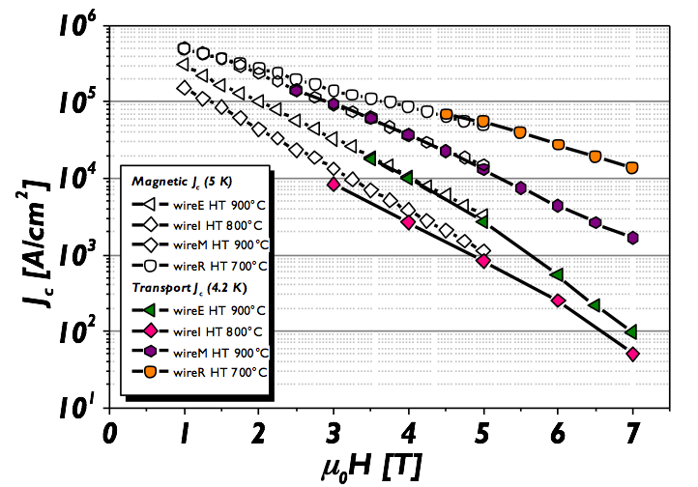
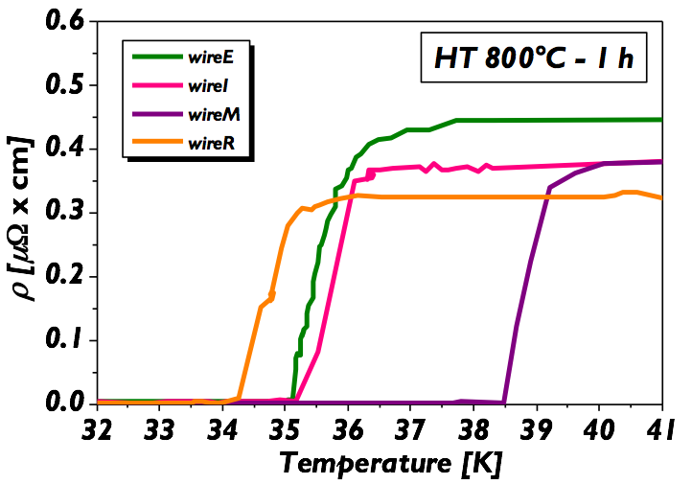
MgB₂ from pure B: nanostructuration of boron powder are maintained
The lab-made nano-sized B
has been used to prepare
MgB₂ wires by PIT
tecnique:
5 March 2018
FCC Conductor Development Workshop, CERN
Andrea Malagoli
Notes:
Infine possiamo osservare come anche dopo la sintesi dell’MgB2 le dimensioni nanometriche dei precursori si siano mantenute, anche se si possono osservare agglomerati micrometrici di nanoparticelle.
Con il nano B puro sono stati preparati fili in MgB2 con diverse tecniche, in-situ, ex-situ , via MgB4 e RLI (IMD internal magnesium diffusion) e si sono testate le correnti critiche con tecniche magnetiche e di trasporto. Usando lo stesso boro si sono ottenuti I diversi comportamenti qui riportati.
Il migliore risultato è con tecnica RLI, mentre le misure di Tc mostrano un sorprendente valore di onset di 39K per il campione via MgB4.
In conclusione si è mostrato come sia possibile preparare agenti droganti di dimensioni utile a formare centri di pinning, sia possibile ottenere B2O3, B e MgB2 nanometrico con il processo di liofilizzazione.
I fili così ottenuti mostrano interessanti prestazioni, attualmente stiamo lavorando per trovare l’agente dopante e la sua concentrazione più opportuni per portare sostituzioni e centri di pinning. E incrementare le prestazioni.

Slide 8
Final remarks
The production of B₂O₃, B and MgB₂ on nano-scale has been demonstrated ( we need still to improve the homogeneity)
maintaining the doping agent dispersion in the precursors has been checked
wires samples shown a Jc of 10⁴ a/cm2 @ 7 T and 4.2 K and aTc onset of 39 K
We are working on the doping of MgB2 in order to enhance its performances at high magnetic field
5 March 2018
FCC Conductor Development Workshop, CERN
Andrea Malagoli

Slide 9
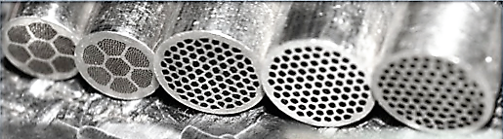
Bi-2212: to reproduce the performance today obtained by high pressure heat treatment with a mechanical deformation process
A Malagoli, A Leveratto, L Leoncino, C Ferdeghini
Addendum fcc-gov-cc-0086/edms 1750320/ke 3507 of the memorandum of understanding for the fcc study
The goals:
Optimisation of the architecture and deformation process of Bi-2212 multifilamentary wire samples for high density
The target J_{E} is 400–600 A/mm² at 16 T and 4.2 K measured on optimised samples, both as short lengths and on a suitable VAMAS sample holder.
5 March 2018
FCC Conductor Development Workshop, CERN
Andrea Malagoli

Slide 10
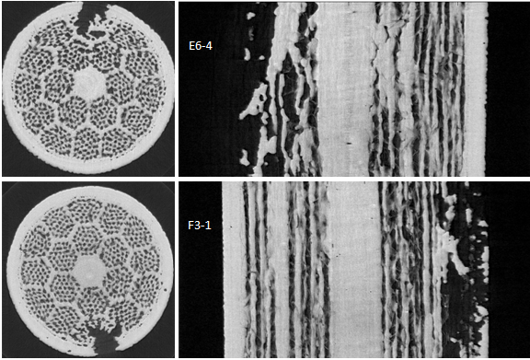
Bi-2212 wires status
Key positives
Critical points to face
A flexible conductor technology
  Round, rectangular, square…..
  Fine filaments
  Twisted
  Multiple architecture
Excellent conductivity matrix without any need for diffusion barrier
If reacted under OP (50-100 bar) the properties are well above the applications requirements: J_{E} ≈800 A/mm² @16T
The fabrication route is the same industrialized for Nb-based and MgB₂ superconductors
Mechanical properties: low E and low Yield Strength
Bubbles and internal pressure formation in long length (≥1m) wires due to Carbon impurity (evolving in CO₂) and porosity
Wind and react technique like Nb₃Sn but, if OP needed, more complex
  890 C, not 670 C
  50/100 bar overpressure, not 1 bar
Costs
5 March 2018
FCC Conductor Development Workshop, CERN
Andrea Malagoli

Slide 11
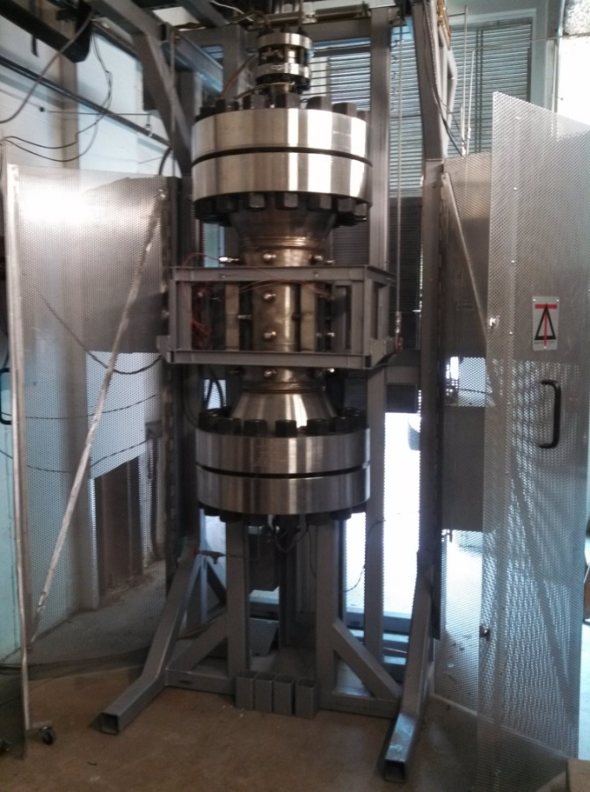
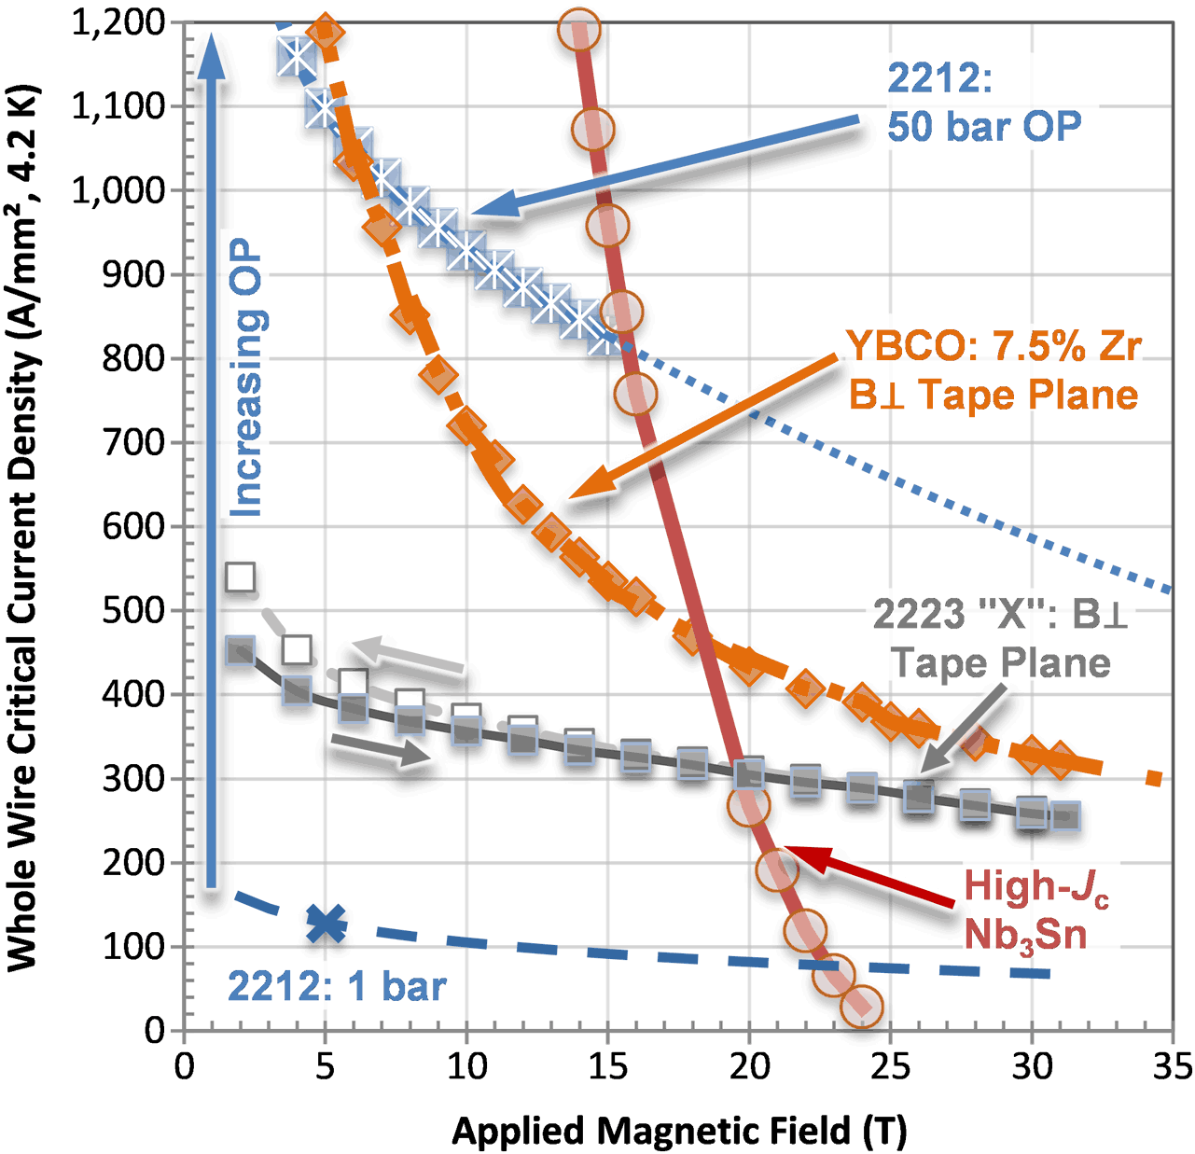
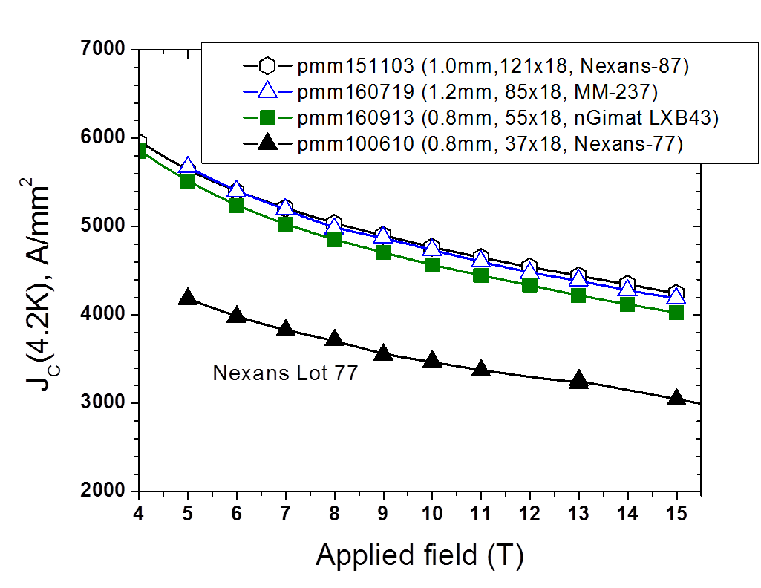
OP Heat Treatment @ ASC (Tallahassee, FL)
Courtesy by D. Larbalestier
successfully replaced the classical powder producer Nexans with two new suppliers, nGimat and MetaMateria
OP-furnace:
6 zone, active vol. 13 cm x 40 cm
Properties have significantly improved
5 March 2018
FCC Conductor Development Workshop, CERN
Andrea Malagoli

Slide 12
Bi-2212 wires status
Key positives
Critical points to face
A flexible conductor technology
  Round, rectangular, square…..
  Fine filaments
  Twisted
  Multiple architecture
Excellent conductivity matrix without any need for diffusion barrier
If reacted under OP (50-100 bar) the properties are well above the applications requirements: J_{E} ≈800 A/mm² @16T
The fabrication route is the same industiralized for Nb-based and MgB₂ superconductors
Mechanical properties: low E and low Yield Strength
Bubbles and internal pressure formation in long length (≥1m) wires due to Carbon impurity (evolving in CO₂) and porosity
Wind and react technique like Nb₃Sn but, if OP needed, more complex
  890 C, not 670 C
  50/100 bar overpressure, not 1 bar
Costs
≈30% in the
wire
≈20 ppm in the powders
5 March 2018
FCC Conductor Development Workshop, CERN
Andrea Malagoli

Slide 13
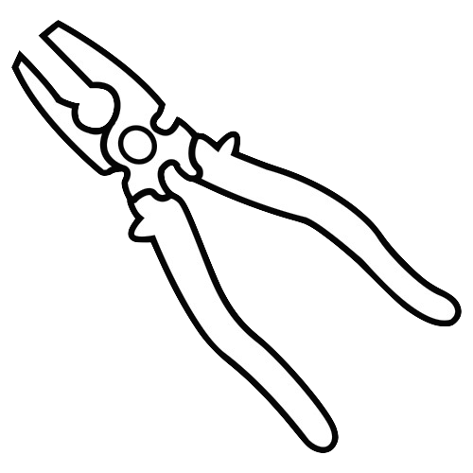
GDG - process @ SPIN
Groove-rolling / drawing alternation
A. Malagoli et al Supercond. Sci. Technol., 26 (2013) 045004
A. Malagoli et al Supercond. Sci. Technol., 27 (2014) 055022
A. Leveratto et al Supercond. Sci. Technol., 29 (2016) 045005
5 March 2018
FCC Conductor Development Workshop, CERN
Andrea Malagoli

Slide 14
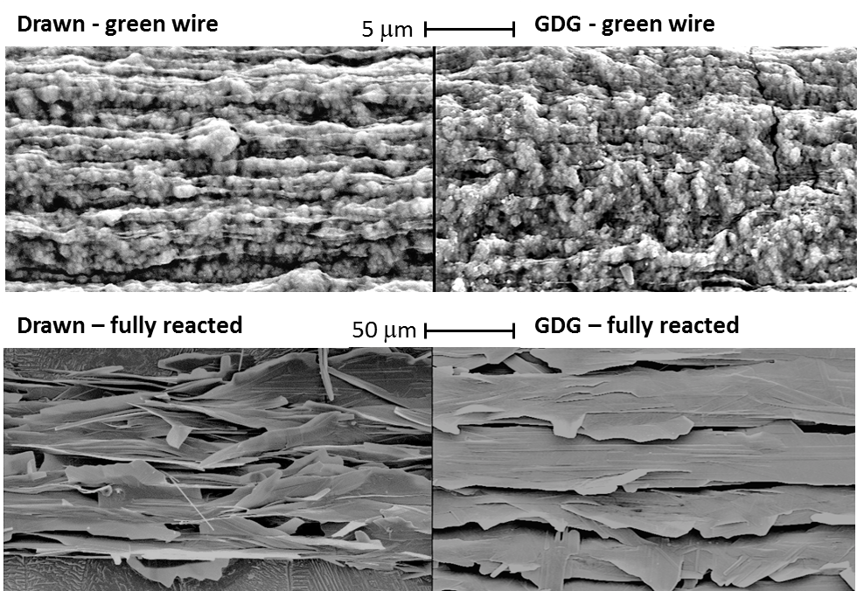
What actually happened?
We actually observed what we hypothesized: after flowing in the longitudinal direction the voids (visible in the left figure) were filled thanks to a compression in the transversal direction due to the groove-rolling.
Not a 100% dense wire but the residual porosity is low enough to avoid agglomeration
No bubbles, no internal pressure
5 March 2018
FCC Conductor Development Workshop, CERN
Andrea Malagoli

Slide 15
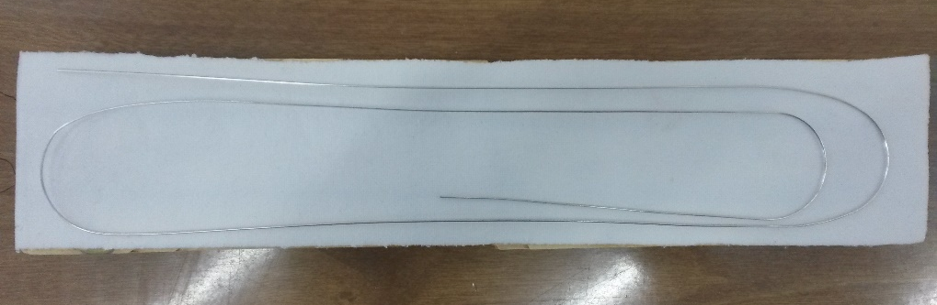
1.4 m long sample
central portion
No Ic degradation!!!!
Same results at the ends of the wire
5 March 2018
FCC Conductor Development Workshop, CERN
Andrea Malagoli

Slide 16
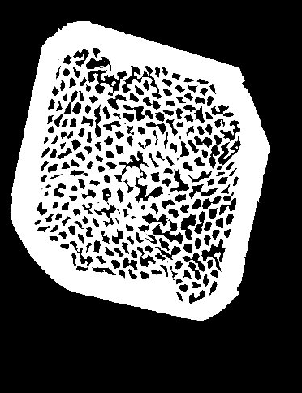
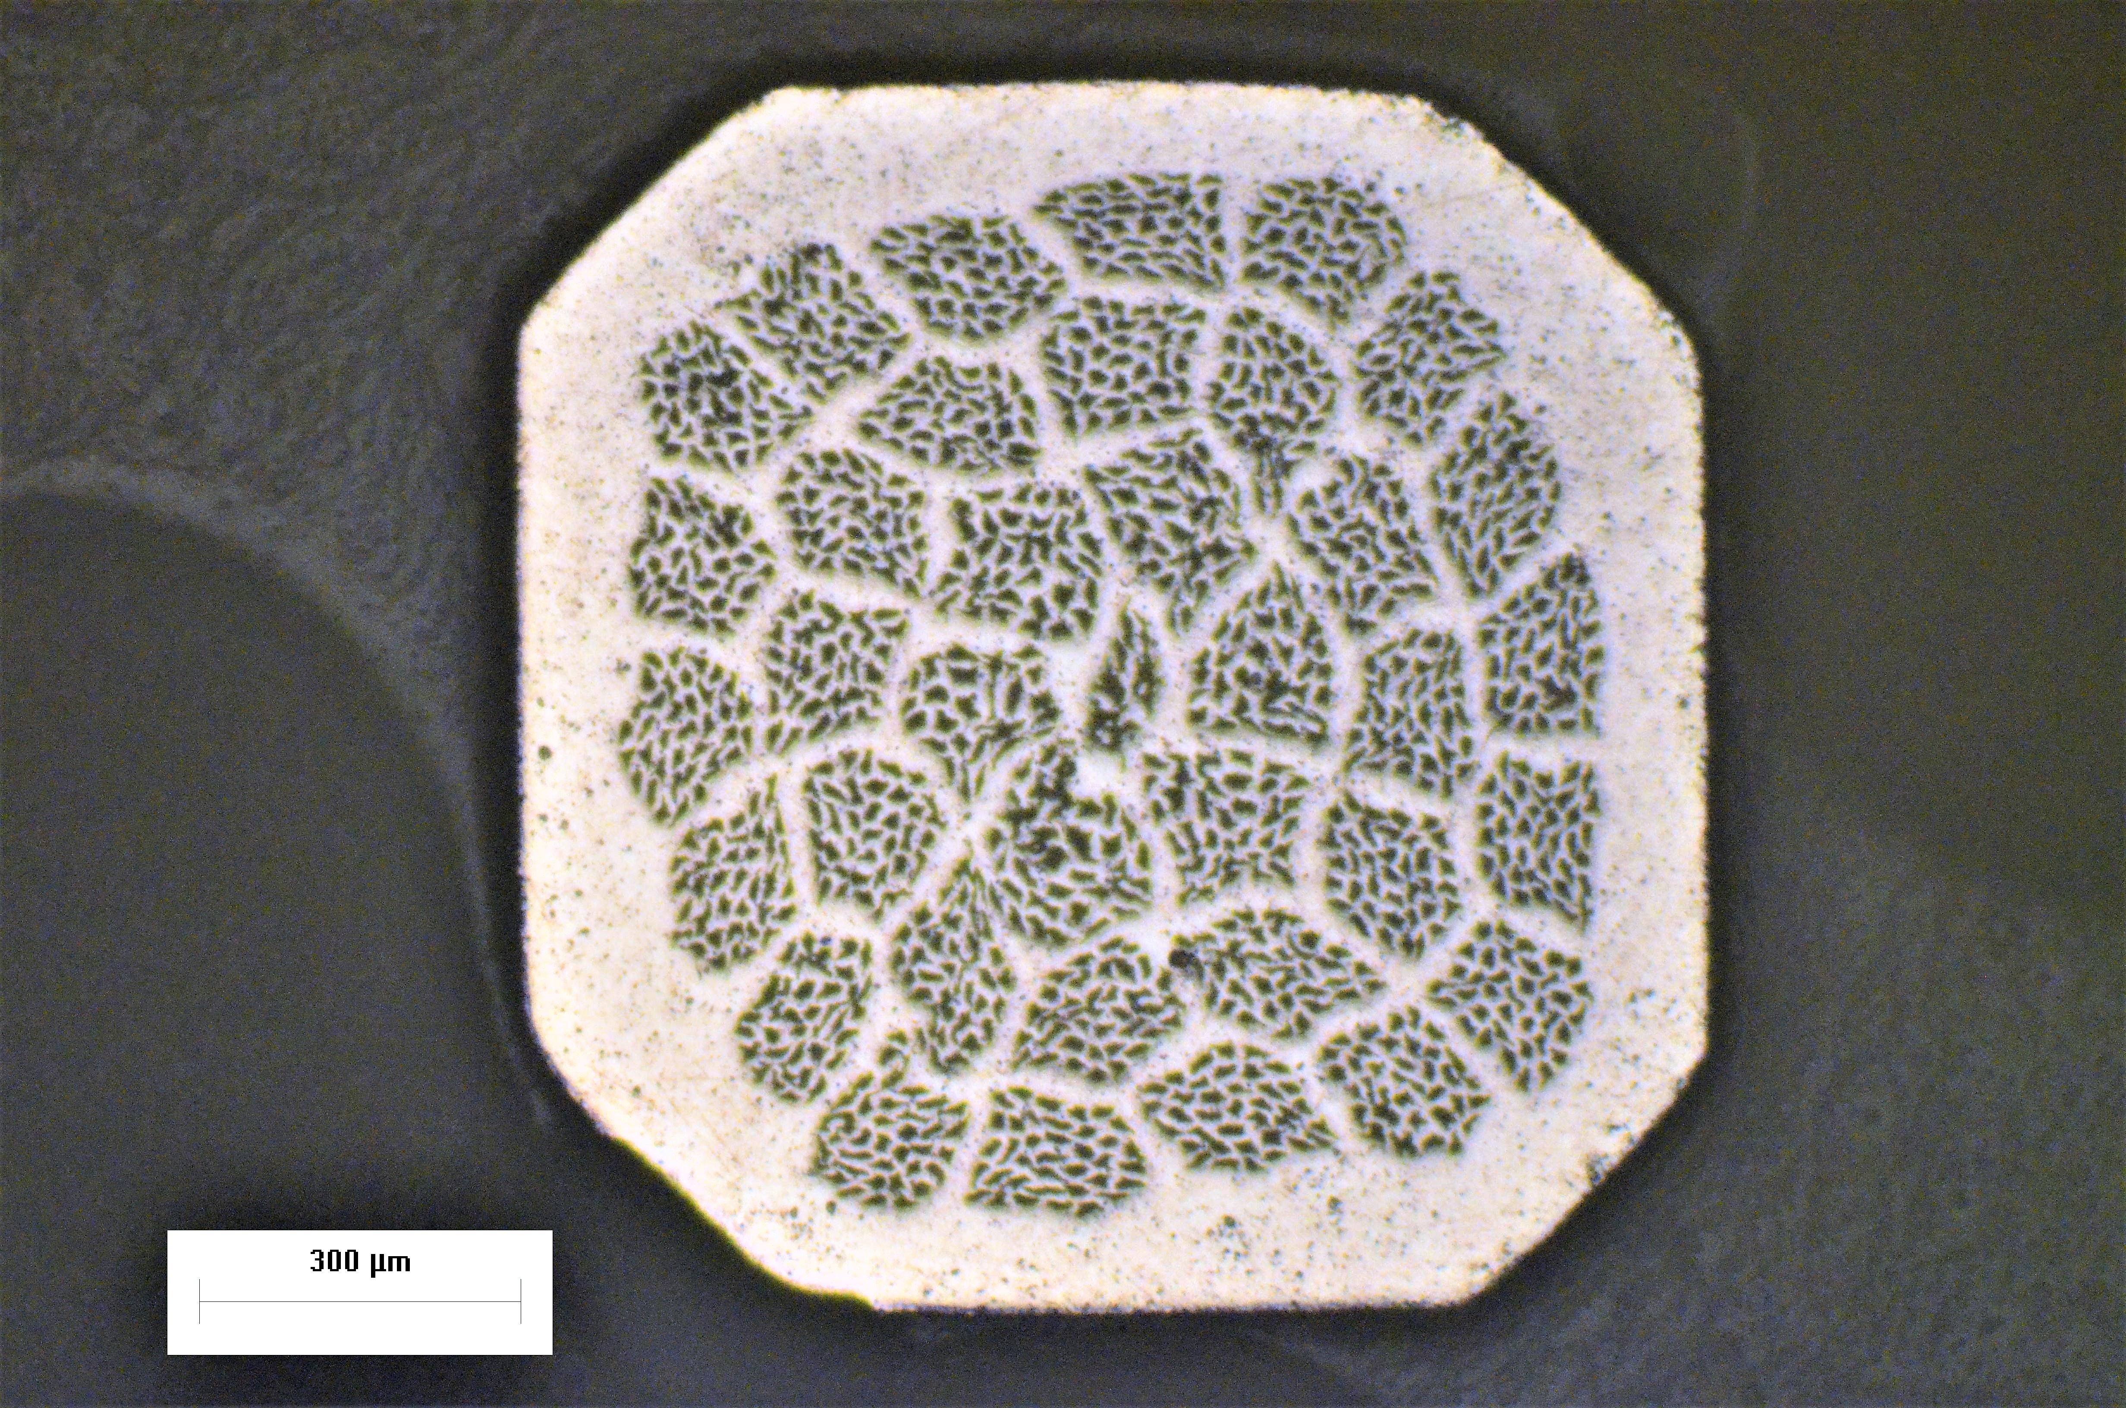
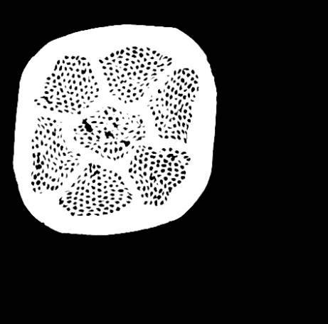
Toward the optimization: architecture
333 filaments
f.f. = 22%-24%
OST – NHMFL
f.f. = 28%
1332 fil.
SPIN, f.f. = 24%
SPIN, f.f. = 18%
595 filaments
f.f. = 16%-18%
5 March 2018
FCC Conductor Development Workshop, CERN
Andrea Malagoli

Slide 17
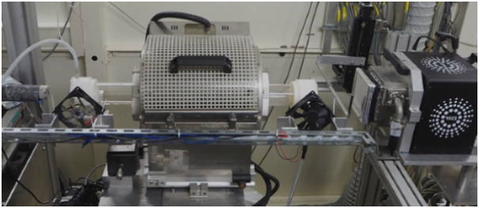
Toward the optimization: heat treatment
Melt region – Why does J_{c} vary with T_{max}?
2212 formation region How to form more, better connected 2212?
GB–analysis through I_{c}(T) measurements
In-situ analysis through XRD @ ESRF of the evolution of:
  Phases
  Microstructure
  Grain orientation
Annealing step – Needed to increase J_{c}, but do not know what occurs.
I. Pallecchi et al SuST. 30, (2017) 095005
888°C
0.2h
10°C/h
878°C
830°C
50°C/h
2.5°C/h
836°C 48h
160°C/h
80°C/h
Cooling to RT – Overdope 2212 with oxygen to increase pinning and J_{c}.
5 March 2018
FCC Conductor Development Workshop, CERN
Andrea Malagoli

Slide 18
Final remarks
It is reasonable to think about Bi-2212 applications without necessarily using OP
It might be however interesting to apply OP process at low pressure (below 10 bar) to GDG wires
Large room for Je improvement from architecture optimization, but from our analysis it comes out that there could be still room even for heat treatment optimization. The goal of 400-600 A/mm² at high field (16-20 T) is not so far!
2212-SPIN: 1 bar GDG
5 March 2018
FCC Conductor Development Workshop, CERN
Andrea Malagoli

Slide 19
Final remarks
It is reasonable to think about Bi-2212 applications without necessarily using OP
It might be however interesting to apply OP process at low pressure (below 10 bar) to GDG wires
Large room for Je improvement from architecture optimization, and hopefully also from heat treatment optimization. The goal of 400-600 A/mm² at high field (16-20 T) is not so far!
GDG is already an industrial process and thus reliable and particularly cheap
  Costs are depending on Ag
Mechanical properties are very challenging. Something is going on but a lot has to be done
Soon we will start with the realization of long lenght (100-200 m) wires for winding
5 March 2018
FCC Conductor Development Workshop, CERN
Andrea Malagoli

