Slide 1
Matteo Tropeano

Slide 2
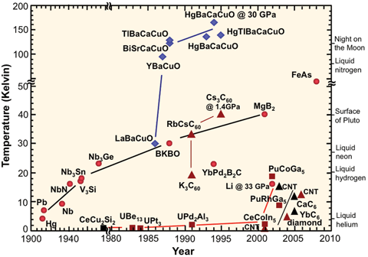
Critical temperature plot
Highest T_{c} material of the LTS family

Slide 3
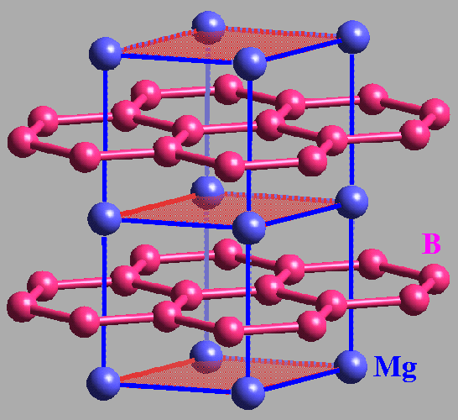
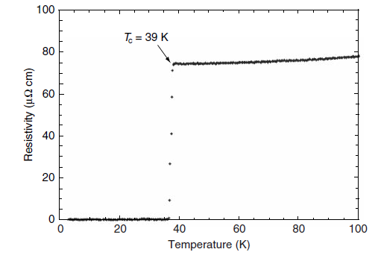
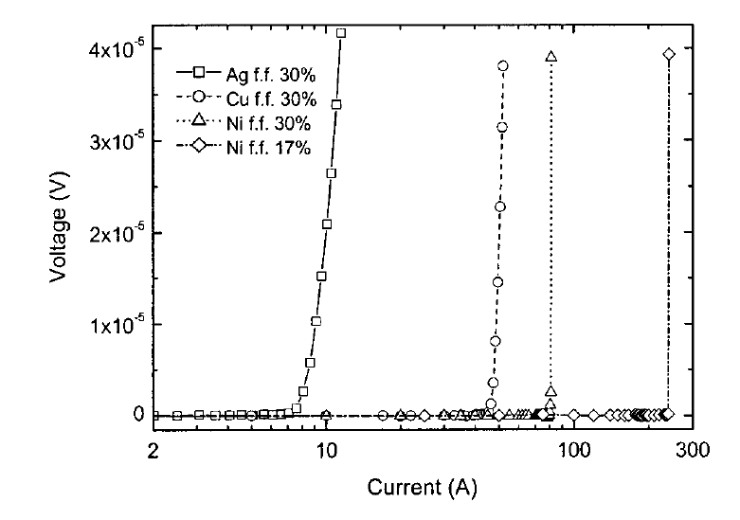
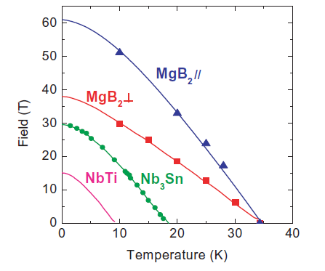
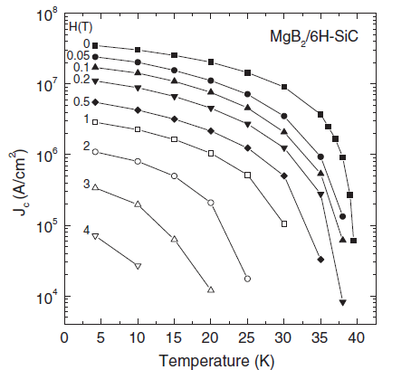
MgB₂ properties
Relatively high Tc,
simple structure and
common materials
No evidence of “weak link”,
no need of high degree of texturing
PIT process for the
fabrication of wire
Nagamatsu et al. 2001
Superconductivity at 39K in magnesium diboride
Nature 410 63-4
D.C Larbalestrier et al. 2001
Strongly linked current flow in polycrystaline form of the superconductor MgB₂
Nature 410
G.Grasso et .al. 2001
Large transport current in unsintered MgB₂ SC tapes
APL Volume 72, number 9
High critical field
Large critical current density
Iwasa Y et al. 2006
A round table discussion on MgB₂:
towards a wide market or a niche production?
IEEE Trans. Appl. Supercond 16 1457-64
Zeng et al. 2003
Superconducting MgB₂ thin film
on silicon carbide substrate by HPCVD
APL 82 2097-9

Slide 4










MgB₂ wire manufacturing companies
Ready for industrial production
2 different manufacturing process
ex-situ and in-situ technique
Interested in industriall production
of wires or wires+magnet
Early stage company, 2013,
Based in Cambridge UK
granted by UK SMART
for R&D activities on MgB₂
Located in Portorico
MgB₂ wires for Cryo-free MRI
MRI magnet, open 1.5T, 3T
Interested in the MgB₂ technology
Bruker BEST
1000 m of MgB2 wire
already demonstrated
in collaboration with IFW Dresden
Patents on MgB2 wires
Several R&D activities
Published paper

Slide 5



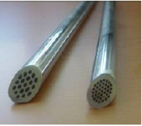
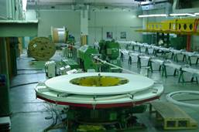
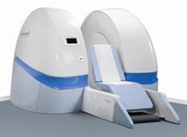
2003
2005
2006
Columbus Superconductors
srl
Columbus Superconductors SpA
R&D target
First 1.6 km MgB₂ long wire
in a single unit length
75% CNR+Researchers
25% ASG
ASG became the main shareholder to sustain industrial investment and to start the business plan
Superconducting wire
Superconducting
magnet
MRI

Slide 6
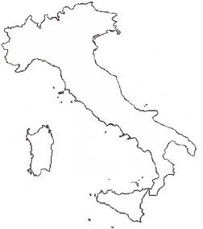
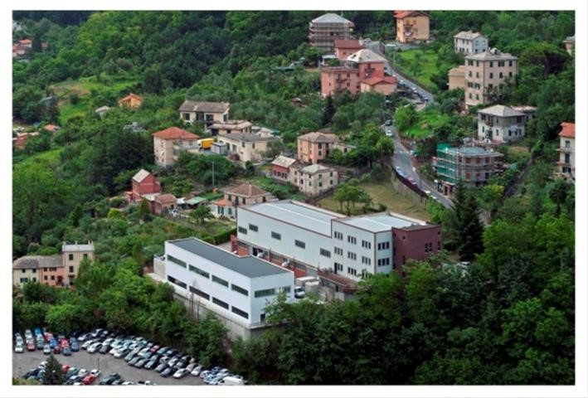
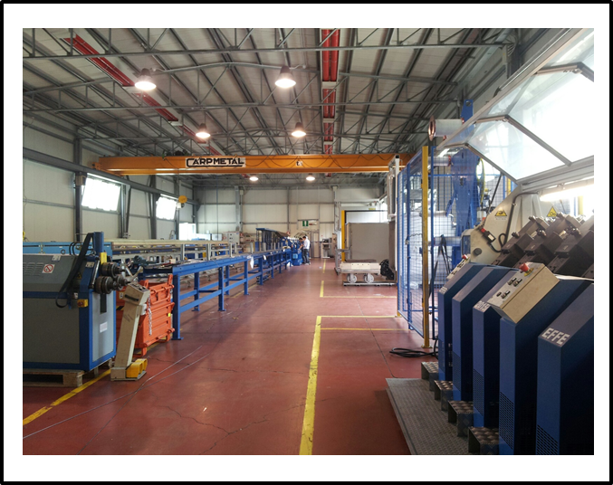
The actual plant is fully operational for MgB₂ wire production with about 35 employees
MgB₂ chemical synthesis also fully implemented
Wire unit length today up to 2- 4 Km in a single piece –length
It will be possible up to 10 Km with the full scale up of the process
Columbus MgB₂ tape production for MRI has exceeded 500 Km of fully tested and qualified wires
Columbus MgB₂ round wires production for cable has exceeded 200 Km of fully tested and qualified wires (end 2015-2016)

Slide 8
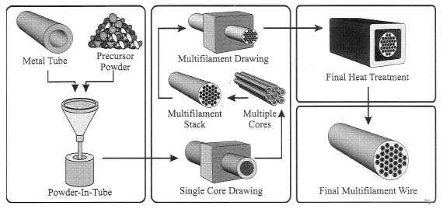
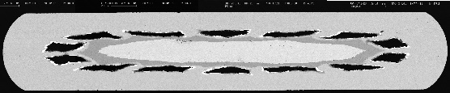
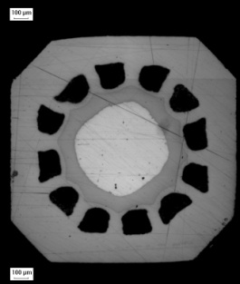
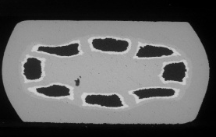
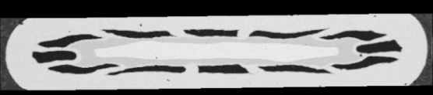
Ex-situ process
Home made MgB₂ powders
Precursor quality, doping
synthesis temperature,
granulometry
Conductors configuration:
different shape, aspect ratio,
number of filaments,
materials

Slide 9

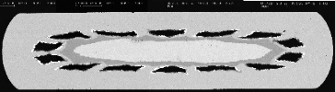


Powder optimization
Purity and granulometry control
Grain connectivity
MgO at grain boundaries
Pinning and/or doping control
Sheath materials
Mechanical properties of the raw metals
MgB₂ / sheath reaction
Deformation process
Drawing-rolling-swaging
Optimization of intermediate (500-800°C) and final thermal treatment (900°C)
Application voted design
Layout of the conductor: shape, dimensions, number of filament
Magnetic, electrical, thermal and mechanical properties

Slide 10
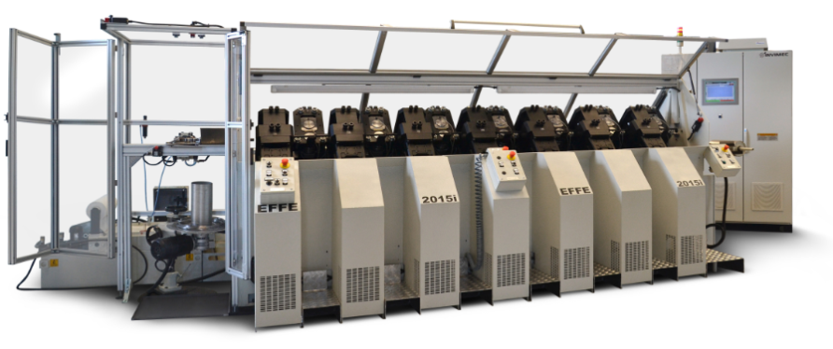
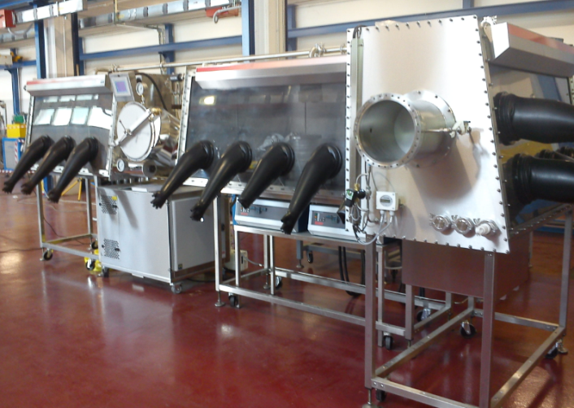
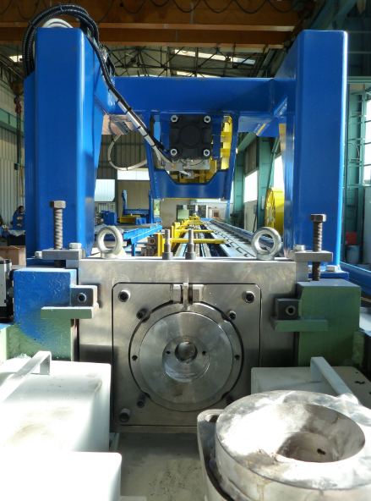
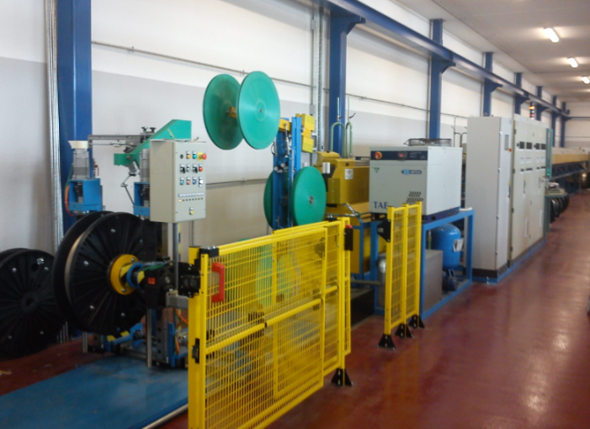
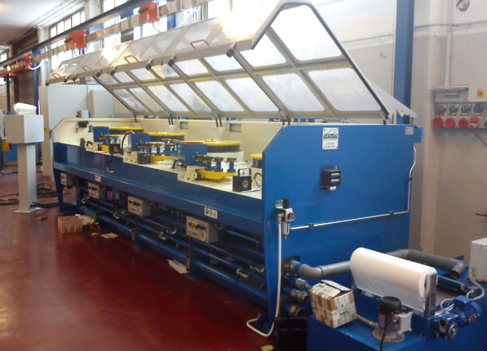
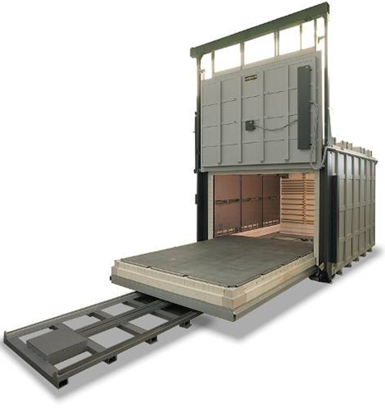
Clean synthesis of powders
High power straigth
drawing machine
Multistep rolling machine
39 new machines
15 existing machines will be still used over 21,
10 main upgrades to the technical infrastructures
1 new 2 floors buildiing
2.280m² of covered workshop area
20 direct production units
20 meter long
in-line furnace
4 meter furnace
for annealing HT
Multistep drawing machine

Slide 11
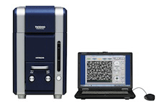
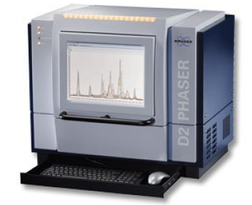
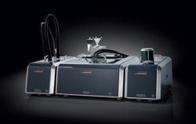
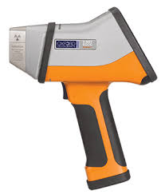
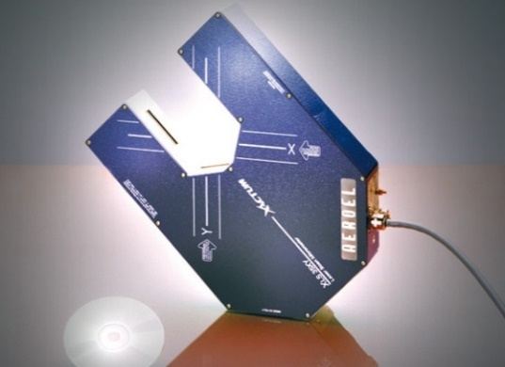
SEM with EDS
Optical stereomicroscopes
XRD
DLS-Particle size analyzer
XRF
Industrial video cameras for surface defect detection
Eddy currents defect detector
Critical current evaluation (10K-30K, field up to 1.8T)
Quality management system is in compliance with the standard
  ISO 9001:2008
Quality Control is done through all the process area
from incoming raw material to the final product
Defined responsibility in the control process
Dedicated operative instructions and procedure
Real time data collections of production and quality records
Materials traceability

Slide 12
Wire solution for MRI

Slide 13
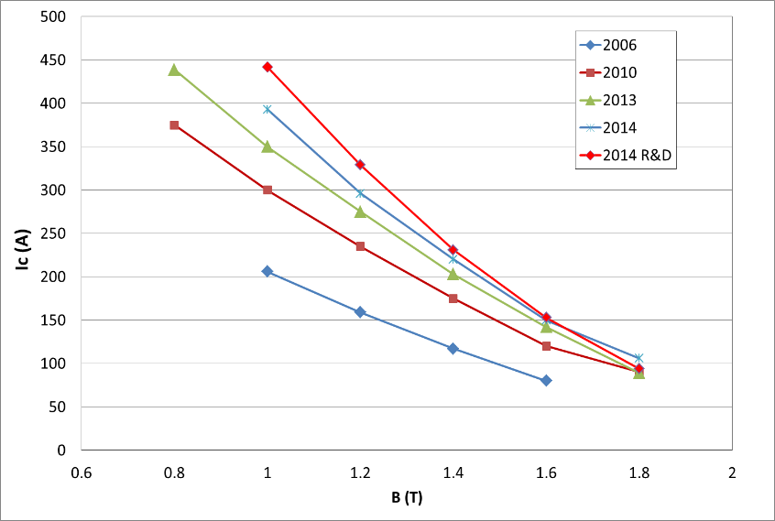
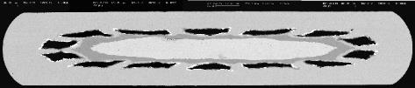

Wire solution for MRI
Original MR-Open conductor
  Wire product we used to validate our MgB₂ technology
  It showed us that MgB₂ can be produced with high yield and low cost – still in production today
  Two-fold improvement in performance – 50% less wire needed
Wire layout in 2006:
14 filaments
Unit piece length 1.6 Km
2014
Since 2010:
12 filaments
Improved fabrication process
Unit piece length 4.0 Km
Synthesis in controlled atmosphere
T = 20K
2006

Slide 14
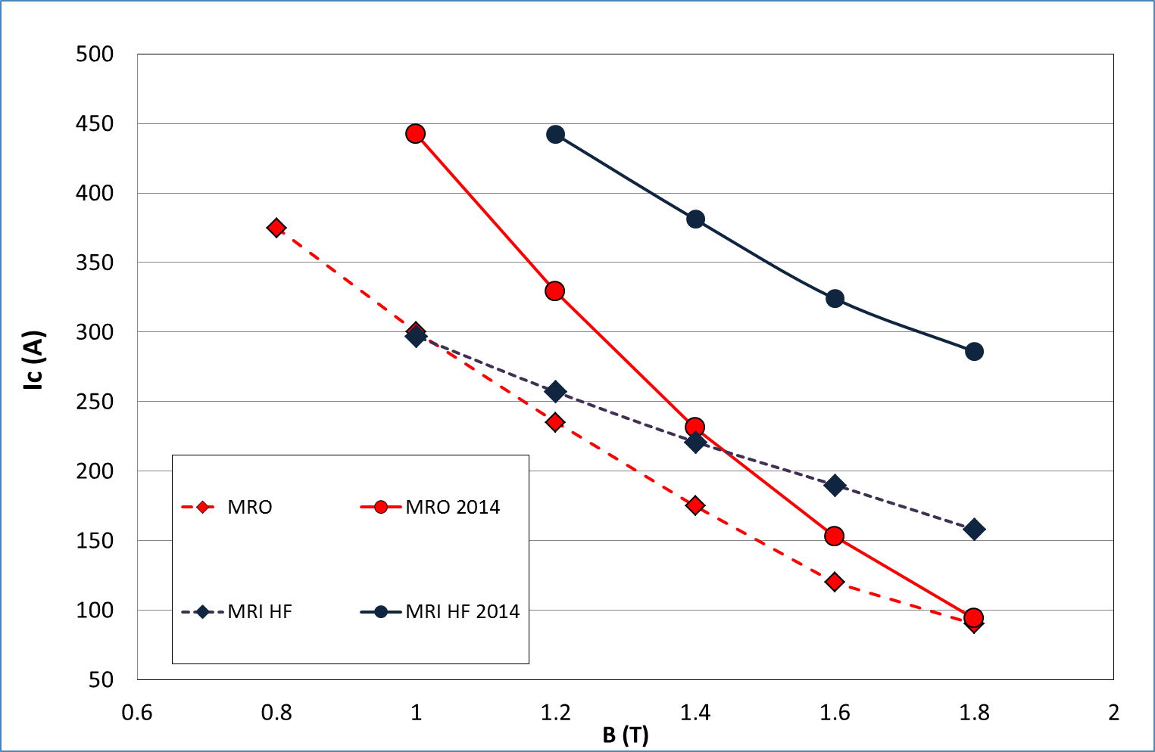
Wire solution for MRI

Slide 15
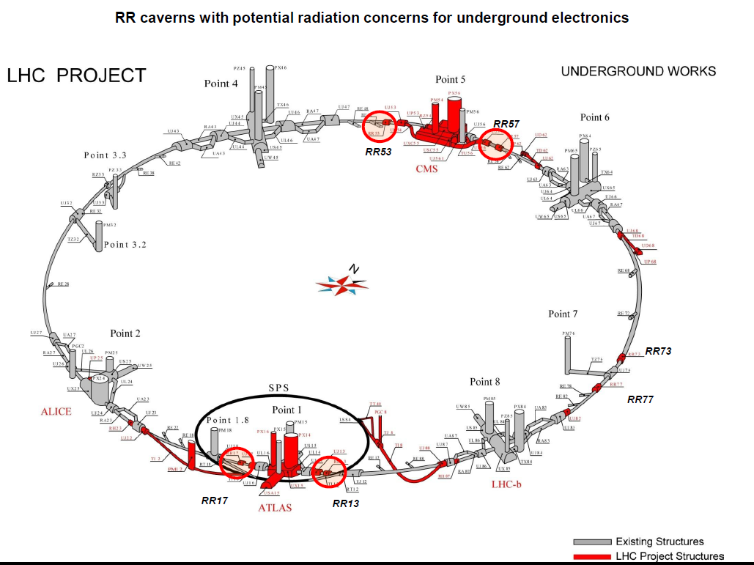
Hi-Lumi LHC upgrade
SC link project
Development of long superconducting lines for the powering of the LHC magnets via remote power converters
Total currents to be transferred: up to ∼ 190 kA per line
Length: from a minimum of 150 m to a maximum of about 600 m with a significant vertical transfer for the locations where the power converters are to be located at the surface

Slide 16
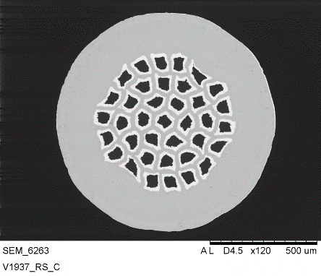
More than 200km
already deliverd
and
qualified
Final configuration
diameter: 0.93mm
37 filaments
Materials: Monel, Ni, Nb
FF: 11.5%
Copper-Tin electrodeposition

Slide 17
Industrial cabling machine

Slide 19
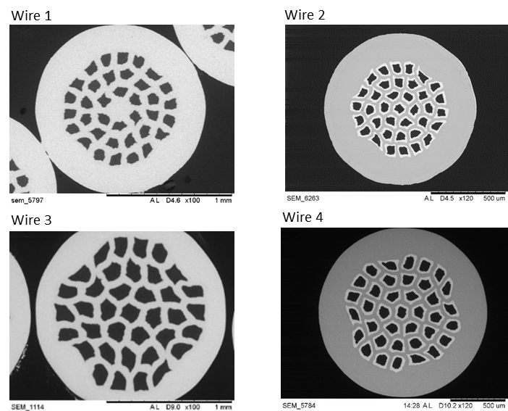
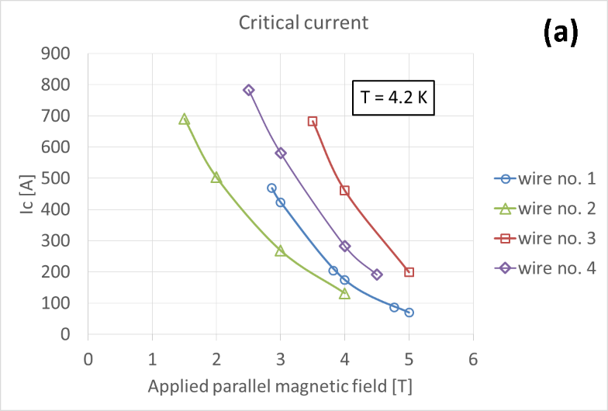
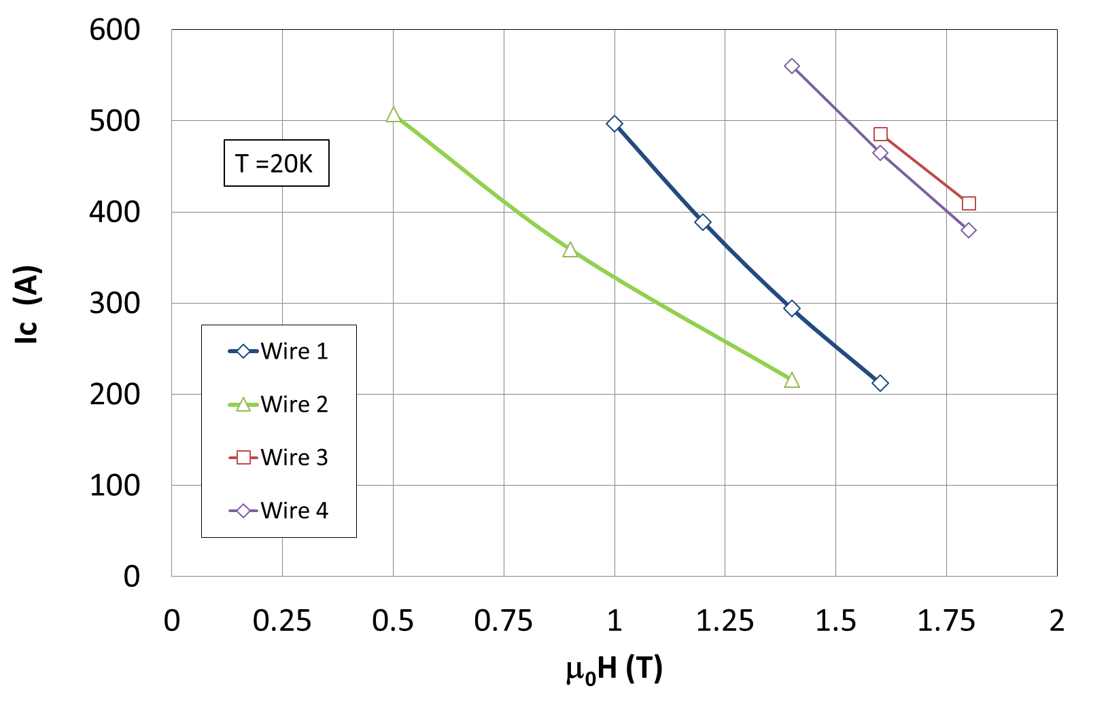
Round wires configuration
Properties | Wire 1 | Wire 2 | Wire 3 | Wire 4
Diameter (mm) | 1.3 | 1 | 1.5 | 1.5
Materials | Monel Nickel | Monel Nickel Nb | Monel Nickel | Monel Nickel Nb
MgB2 fraction | 17% | 12% | 30% | 12%
Critical current at 20K, 1T | 500A | 300A | >650A | >650A
Critical current at 4.2K, 3T | 280 | 400 | >700 | 600
Critcal bending radius | 125 | 100 | 200 | 150

Slide 20
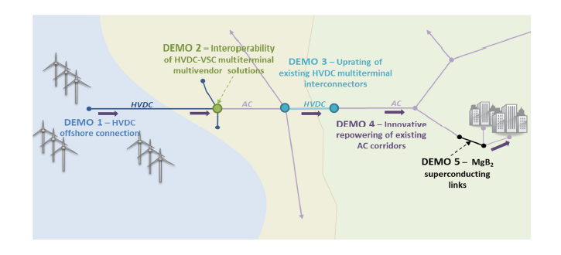
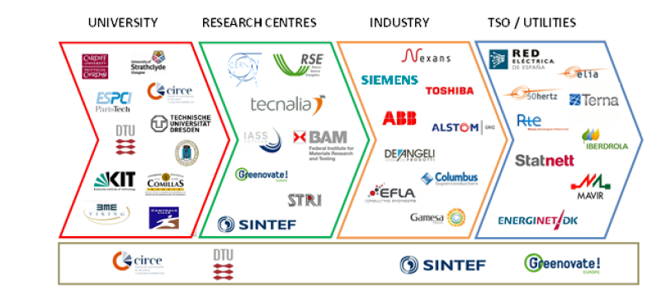
EU FP7 Best paths project
BEST PATHS aims to develop and test high-capacity transmission technologies needed to meet Europe’s long-term energy goals and the incorporation of renewable energy sources.
5 demonstration programs carry out by 39 partners
Total budget: 62.8 M€
EU contribution: 35.5 M€
Demo 5 budget: 6.7 M€
EU contribution: 4 M€

Slide 21
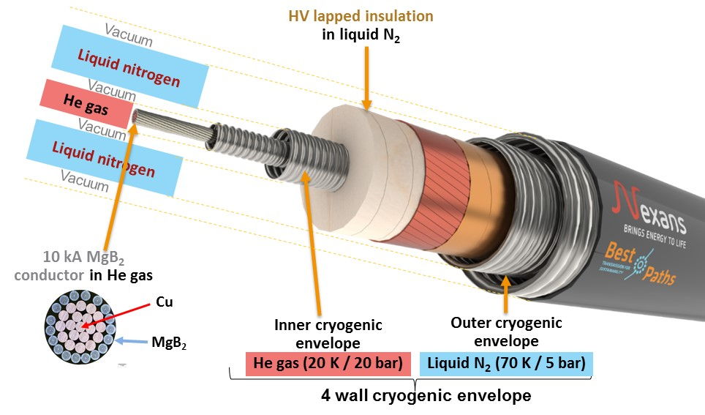
Demo 5 Best Paths project
Demonstrate full-scale 3 GW class HVDC superconducting cable system operating at 320 kV and 10 kA
Validate the novel MgB₂ superconductor for high-power electricity transfer
Provide guidance on technical aspects, economic viability, and environmental impact of this innovative technology

Slide 22
H2020 EASI-Train

Slide 23



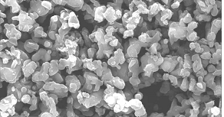

Conductor development x FCC
Jc enhancement
MgB2 wires
Boron
Particle size
Connectivity
Filling factor
Doping and pinning
B-purity
Granulometry
C-doping
C-encapsulated B
Pinning
FF up to 30-33%
Number of filaments
Filaments size
MgB₂ density
In field behaviour
Grain boundaries
Wire design
Deformation process

