Slide 1
Fe-based superconductors for
very high field applications
Valeria Braccini
CNR-SPIN Genova, Italy
V Braccini FCC Conductor Development Workshop CERN, March 5th, 2018

Slide 2
Acknowledgments:
Collaboration between
CNR – SPIN (M Putti, V Braccini, A Malagoli, M Vignolo)
and CERN (A Ballarino, S Hopkins)
within the Addendum FCC-GOV-CC-0086 of the
Memorandum of Understading FCC-GOV-CC-0004 for the FCC study
The scope of this collaboration is to advance the performance of three superconducting materials (Bi-2212, MgB₂, IBS), using industrially scalable production methods, to make them suitable for high-field magnet applications.
V Braccini FCC Conductor Development Workshop CERN, March 5th, 2018

Slide 3
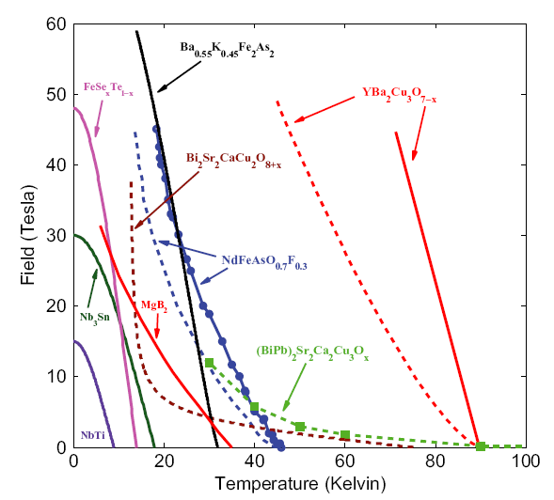
Phase diagram of technical conductors
IBS
HTS
FCC should reach a collision energy of 100 TeV thanks to a four times larger radius and double the magnetic field of the LHC. The latter requirement necessitates the development of superconducting materials with increased operating field.
Whilst most efforts are focused on Nb₃Sn wires, this is an opportunity to assess the potential for high field application of newer superconductors.
MgB₂
C. Tarantini et al., PRB 84, 184522 (2011)
V Braccini FCC Conductor Development Workshop CERN, March 5th, 2018

Slide 4

Project in China
From Xin SHI,
Institute of High Energy Physics, Beijing
18th Lomonosov Conference on Elementary Particle Physics, Aug 2017
V Braccini FCC Conductor Development Workshop CERN, March 5th, 2018

Slide 5

Objectives of our collaboration with CERN
IBS: develop prototype IBS conductors that meets the J_{c} requirements through reliable, simpler and scalable techniques that could enable industrialization
V Braccini, G Sylva, A Malagoli, E Bellingeri, C Ferdeghini, M Putti, A Provino, P Manfrinetti
Bi-2212: to reproduce the performance today obtained by high pressure heat treatment with a mechanical deformation process
A Malagoli, A Leveratto, L Leoncino, C Ferdeghini
MgB₂: increase the operating field by adopting an original doping method
M Vignolo, G Bovone, M Capra, C Bernini, F Loria, A S Siri
V Braccini FCC Conductor Development Workshop CERN, March 5th, 2018

Slide 6
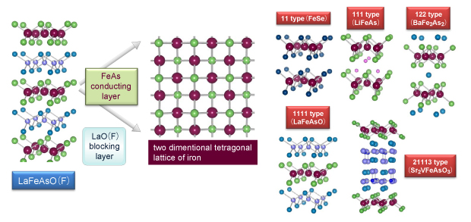
Iron-based superconductors
Y. Kamihara, T. Watanabe, M. Hirano, H. Hosono: J. American Chemical Society, 130, 2008, S. 3296-3297
T_{c} ~8 K
T_{c} ~18 K
T_{c} ~38 K
T_{c} ~55 K
V Braccini FCC Conductor Development Workshop CERN, March 5th, 2018

Slide 7
H_{c2} and J_{c} of IBS single crystals and thin films
Single crystals
Thin films
Putti et al., SUST 23, 034003 (2010)
V Braccini FCC Conductor Development Workshop CERN, March 5th, 2018

Slide 8
J_{c} of technical conductors: comparison
V Braccini FCC Conductor Development Workshop CERN, March 5th, 2018

Slide 9

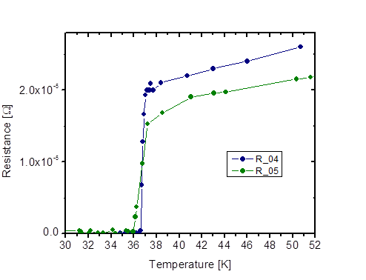
(Ba,K)Fe₂As₂ ex situ PIT tapes
Collaboration with E Wiesenmayer, S Marchner, D Johrendt (LMU München, Germany) within
Ba_{0.6}K_{0.4}Fe₂As₂ powders from LMU
free from impurity phases
A Malagoli et al 2015 SuST 28 095015
V Braccini FCC Conductor Development Workshop CERN, March 5th, 2018

Slide 10
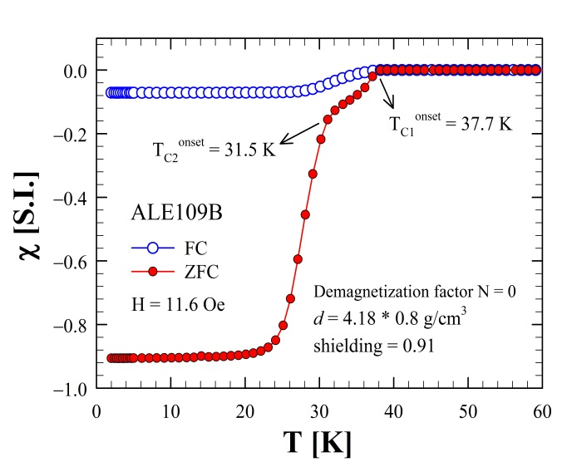
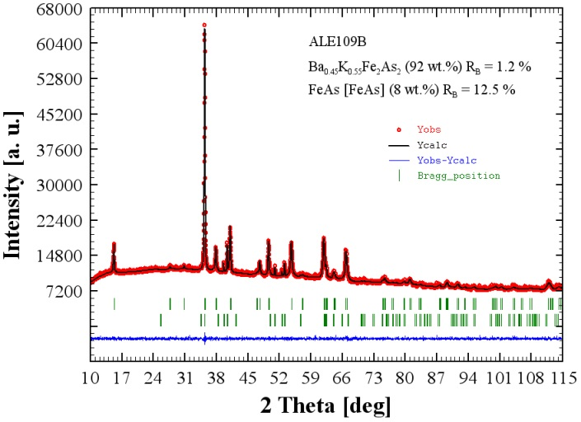
Production of home-made pure (Ba,K)Fe₂As₂ powders
Powders more than 90 wt.% pure in the 1:2:2 phase, with 8 wt.% of FeAs as extra phase.
Amount of polycrystalline sample prepared is up to 4.0 g.
V Braccini FCC Conductor Development Workshop CERN, March 5th, 2018

Slide 11
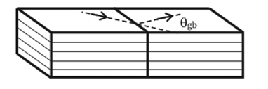
Dependence of J_{c} on the misorientation angle
Lee et al., Appl. Phys. Lett. 95, 212505 (2009)
Katase et al., Nat. Commun. 2, 409 (2011)
Sagakami et al.,Physica C 494, 181 (2013)
122 bicrystals
11 bicrystals
S. Kawale et al., IEEE TAS 25, 7300305 (2015)
Si et al, Appl. Phys. Lett. 106, 032602 (2015)
11 bicrystals
In HTS J_{c} decreases exponentially with GB angle.
In IBS, GBs are weak link but critical misorientation angle is >10°, higher than the 4° of YBCO.
IBS has Advantageous GBs over HTS
V Braccini FCC Conductor Development Workshop CERN, March 5th, 2018

Slide 12
Idea
Given that in IBS the misorientation angle is about 10° and therefore the weak link behaviour is much less critical than in YBCO, it is possible to deposit on biaxially textured metallic substrate with a simpler structure than commercial ones.
Furthermore, oxidation of the metallic template is not an issue for IBS.
It is possible to reduce or even remove buffer layers
Reduce complexity and costs of production
Obtain a larger J_{e}
Ni alloys + oxide buffers
(CeO2, LaZrO2, CZO)
Iron alloys (Fe/Ni)
Collaboration with
A Augieri, G Celentano, A Mancini, A Vannozzi
ENEA Frascati, Italy
V Braccini FCC Conductor Development Workshop CERN, March 5th, 2018

Slide 13
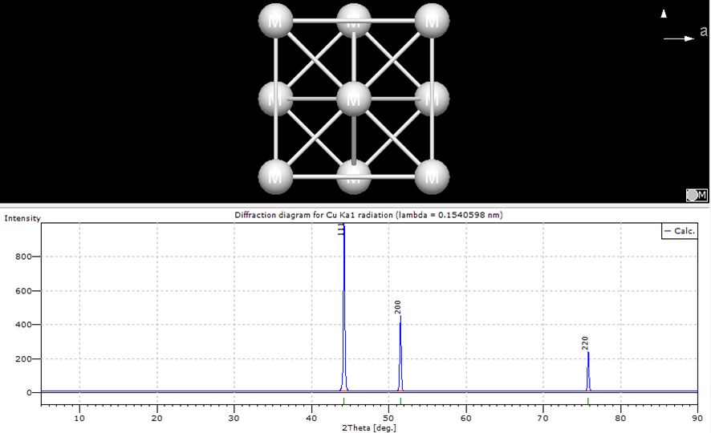
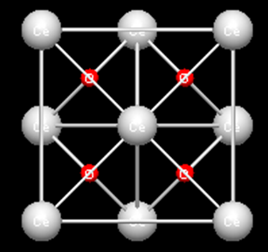
NiW5% + CeO₂
Prepared @ENEA Frascati, I
NiW5%
CeO2
NiW biaxially textured + CeO₂ buffer layer deposited via PLD
(11) thin films grow biaxially textured on NiW + CeO₂
Rocking Rolling Direction:
Out-of-plane orientation
scan:
in-plane orientation
θ – 2θ: epitaxial FST film
V Braccini FCC Conductor Development Workshop CERN, March 5th, 2018

Slide 14
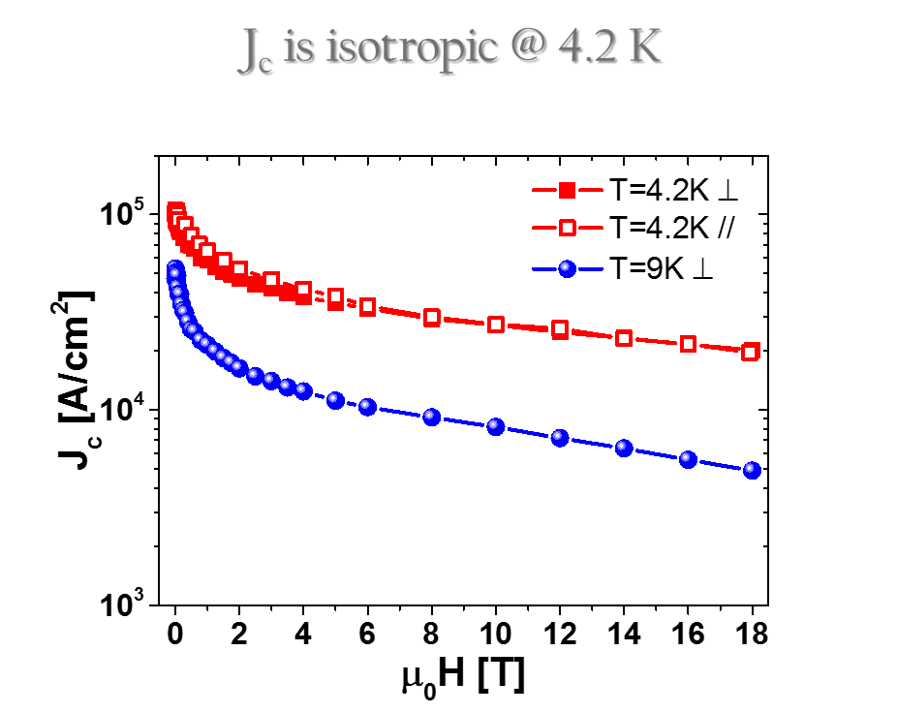
H_{c2} and J_{c} up to 18 T
@ ENEA Frascati
T_{c} ≈ 18 K
ΔT_{c0} ≈ 3 K in 18 T
H_{c2} has a very low anisotropy
V Braccini FCC Conductor Development Workshop CERN, March 5th, 2018

Slide 15
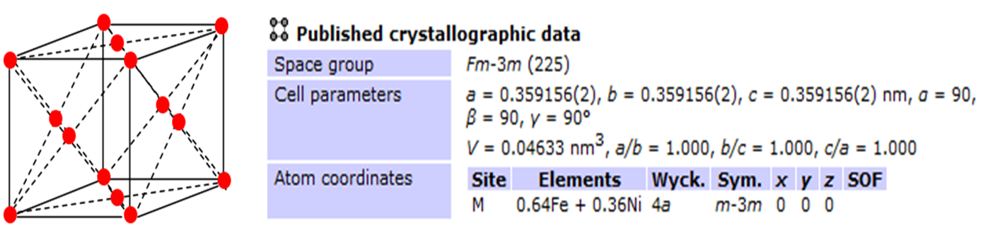
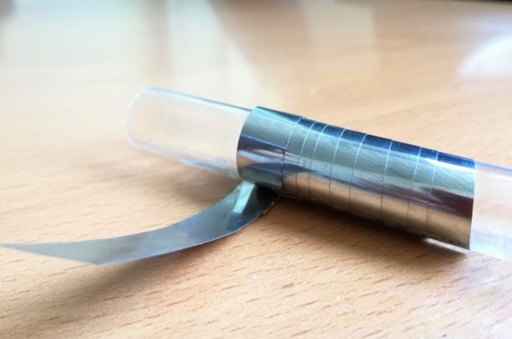
INVAR36 (36Ni/64Fe)
Commercial alloy 64% Fe , 36% Ni
Low cost
FCC structure, compatible with Fe(Se,Te)
From rods Ø 2 – 10 mm => drawn / flat rolled =>
=> 50 / 70 μm + HT @ 1000 °C / 2h in Ar/H₂ atmosphere
20 μm
V Braccini FCC Conductor Development Workshop CERN, March 5th, 2018

Slide 16
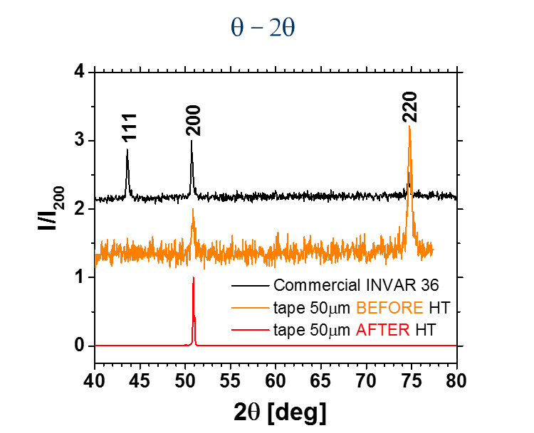
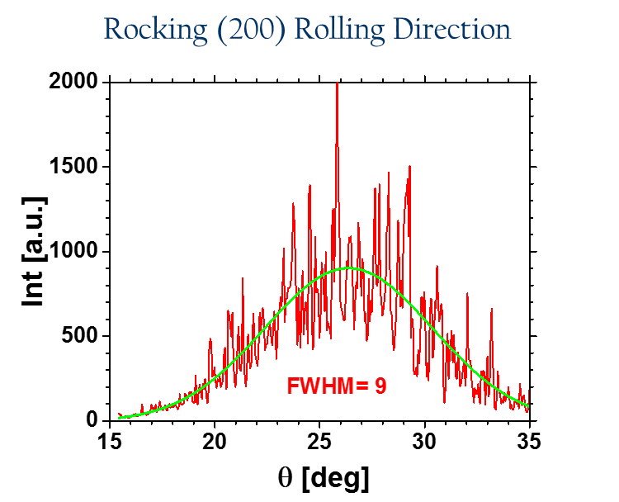
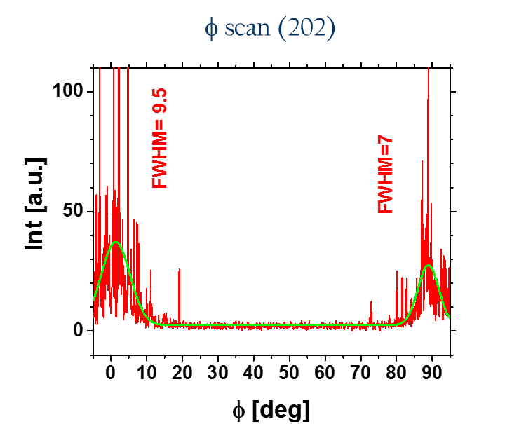
INVAR36 (36Ni/64Fe)
Commercial alloy 64% Fe , 36% Ni, FCC
Biaxial texture
V Braccini FCC Conductor Development Workshop CERN, March 5th, 2018

Slide 17
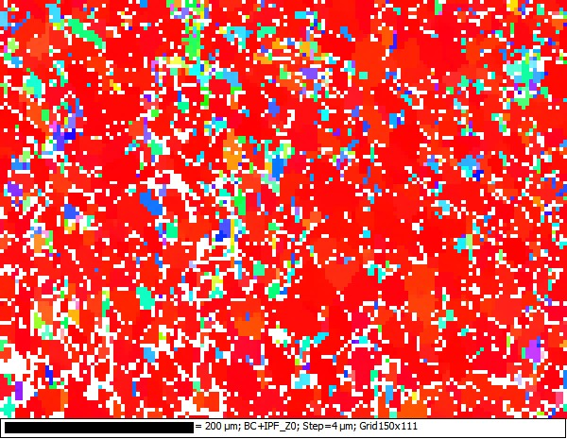
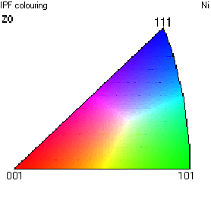
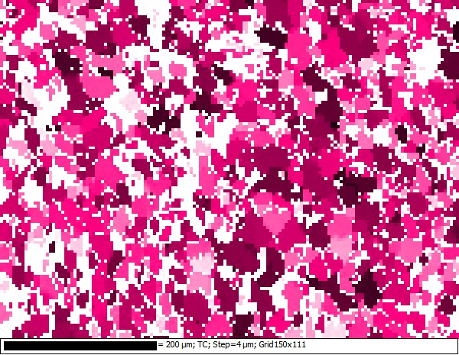
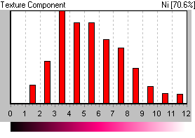
EBSD analysis on INVAR tape
EBSD OXford NORDLYS NANO
on FEG-SEM LEO1525
@ ENEA Frascati
INVAR 500x Map Data 1 - BC+IPF_Z0
INVAR 500x Map Data 1 - Scattered Data
Presence of
twinned grains
INVAR 500x Map Data 1 - TC
INVAR 500x Map Data 1 - Scattered Data
V Braccini FCC Conductor Development Workshop CERN, March 5th, 2018

Slide 18
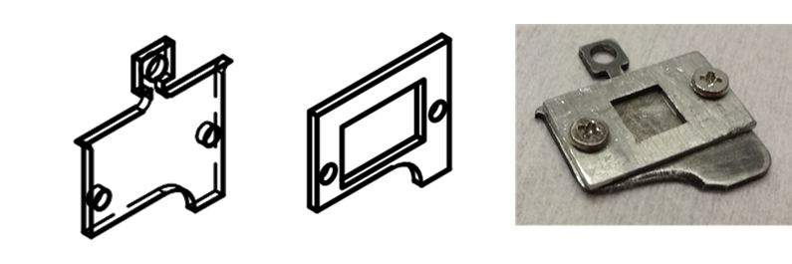
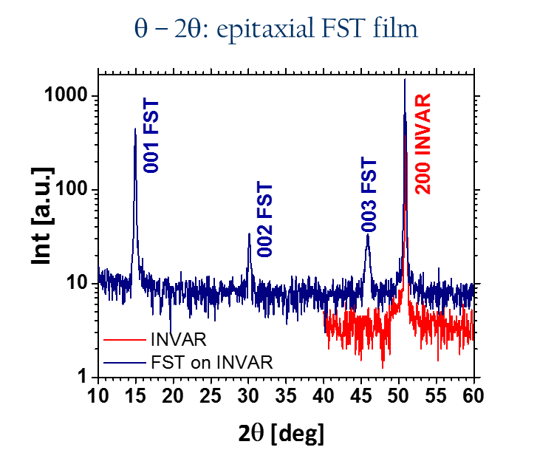
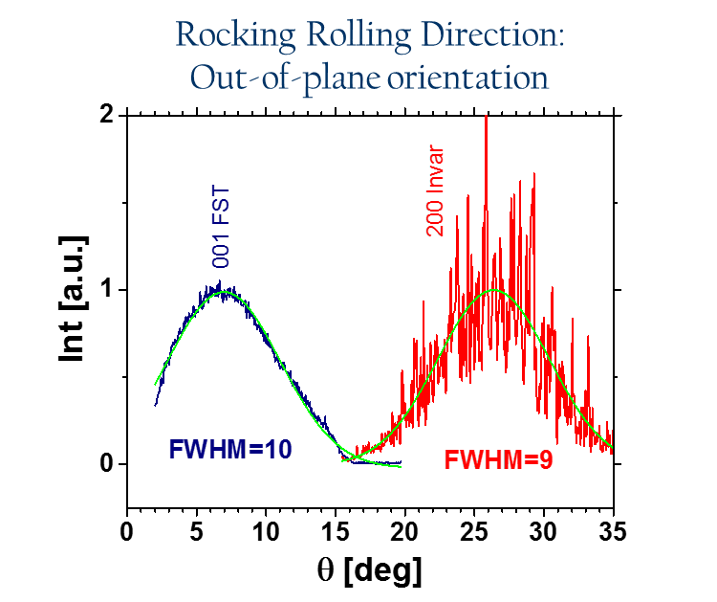
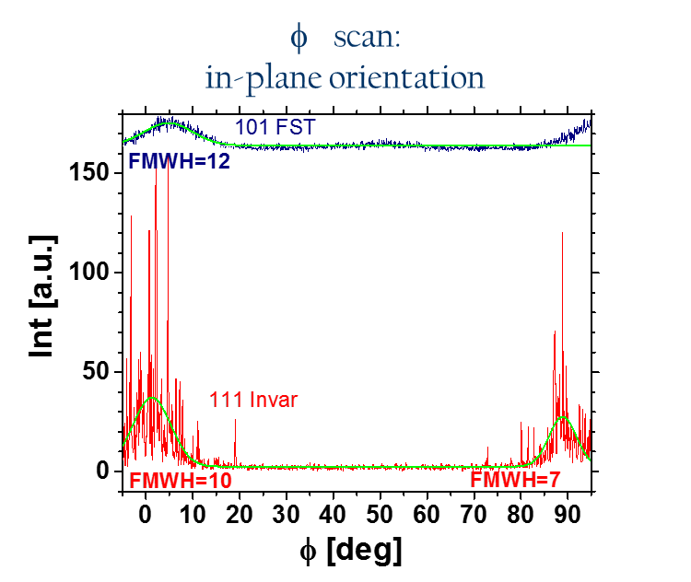
First attempts of growth of Fe(Se,Te) on textured INVAR
11 thin films deposited on INVAR through PLD with Nd:YAG laser
Growth of epitaxial thin films on INVAR has been demonstrated
V Braccini FCC Conductor Development Workshop CERN, March 5th, 2018

Slide 19
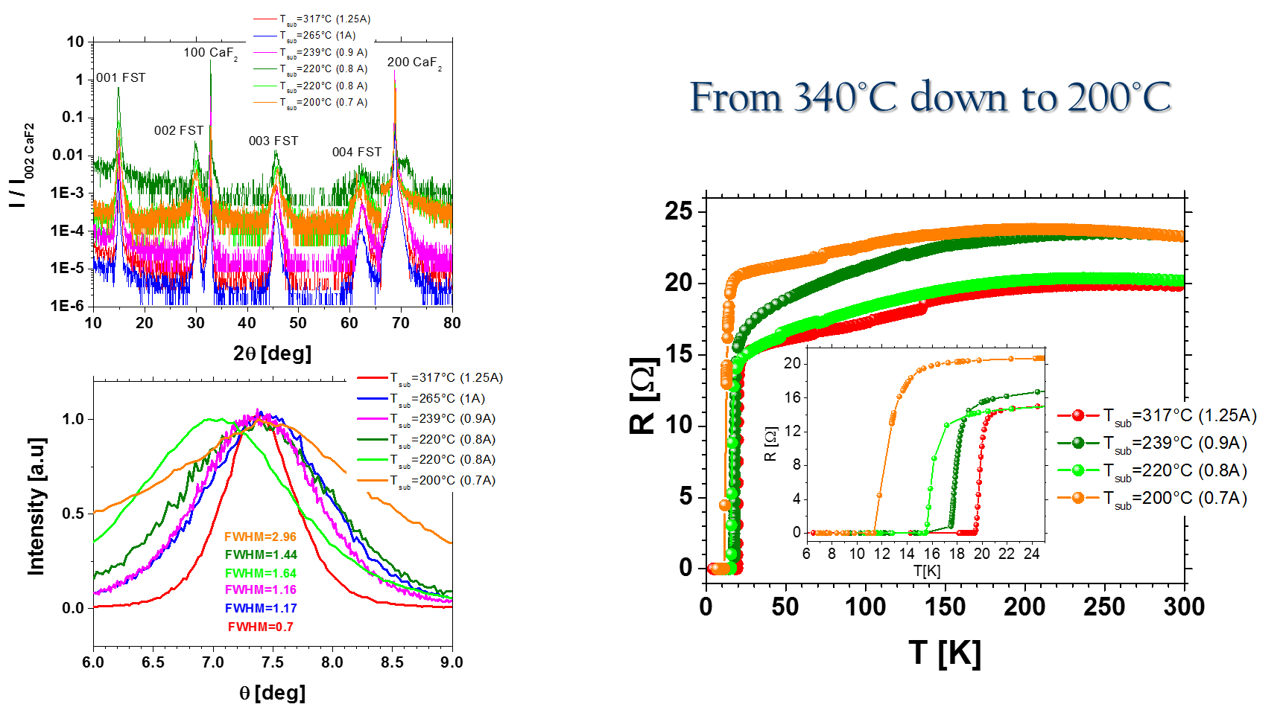
Lowering deposition temperature
V Braccini FCC Conductor Development Workshop CERN, March 5th, 2018

Slide 20
Conclusions and perspectives
NiW + oxide buffer:
We have demonstrated the possibility of growing epitaxial superconducting Fe(Se,Te) thin films on simple RABiTS (NiW + CeO₂) with high T_{c} and good J_{c} performances
Simpler buffers:
We are working on simpler buffers, i.e. oxides deposited via chemical methods, NbN, not superconducting FeSeTe, …..
INVAR (36Ni/64Fe):
We have demonstrated the possibility of texturing FeNi (INVAR) commercial alloy and depositing expitaxial Fe(Se,Te) thin films without any buffer
We are working to obtain good superconducting thin films
V Braccini FCC Conductor Development Workshop CERN, March 5th, 2018

