Slide 1
Modelling electron flow
Adam Steinberg [Undergraduate]
University of Oxford
22/03/18

Slide 2
Or in brief:
What happens when we change things?
The question:
Can we model the evolution of particles through our system of magnets, accounting for a wide possible range of multiple parameters?

Slide 3
What might we adjust?
At this early stage:
  Most parameters are free
  So we want a general as simulation to explore any potential adjustment
Anything that is specific needs be easy to change
In the future:
  Will consider likely errors,
  e.g. a magnet in slightly the wrong place

Slide 4
Which tools are we using?
Generating data → Astra
Visualising data → Post-Processor

Slide 5
What is Astra?
A Space-Charge Tracking Algorithm
Models an accelerator
Calculates how particles will travel through it
Easy to swap in/out components

Slide 6
Why use Astra?
Rather than an alternative?
At low energies, the space charge effect is significant
Electrons try to push away other electrons
Astra can handle this,
  but calculation time will be slower

Slide 7
Some of our free parameters
General: | Electron gun: | Cavities: | Magnets:
Positions of components | Current | Max field gradient | Field geometry
Aperture width | Emittance | Length | Peak field
 | Energy | Travelling/standing wave
 | Distribution | Frequency

Slide 8
Some of our free parameters
General: | Electron gun: | Cavities: | Magnets:
Positions of components | Current (50mA) | Max field gradient (40V/m) | Field geometry (solenoid)
Aperture width (5mm) | Emittance (0.005 pi mrad) | Length (0.28m) | Peak field (0.225T)
 | Energy (30KeV) | Travelling/standing wave (standing)
 | Distribution (uniform) | Frequency (3.1GHz)

Slide 9
Some of our free parameters
General: | Electron gun: | Cavities: | Magnets:
Positions of components | Current (50mA) | Max field gradient (40V/m) | Field geometry (solenoid)
Aperture width (5mm) | Emittance (0.005 pi mrad) | Length (0.28m) | Peak field (0.225T)
 | Energy (30KeV) | Travelling/standing wave (standing)
 | Distribution (uniform) | Frequency (3.1GHz)
Specified in:
Main Astra input file | Input gun file | Input field file | Input magnets file

Slide 10
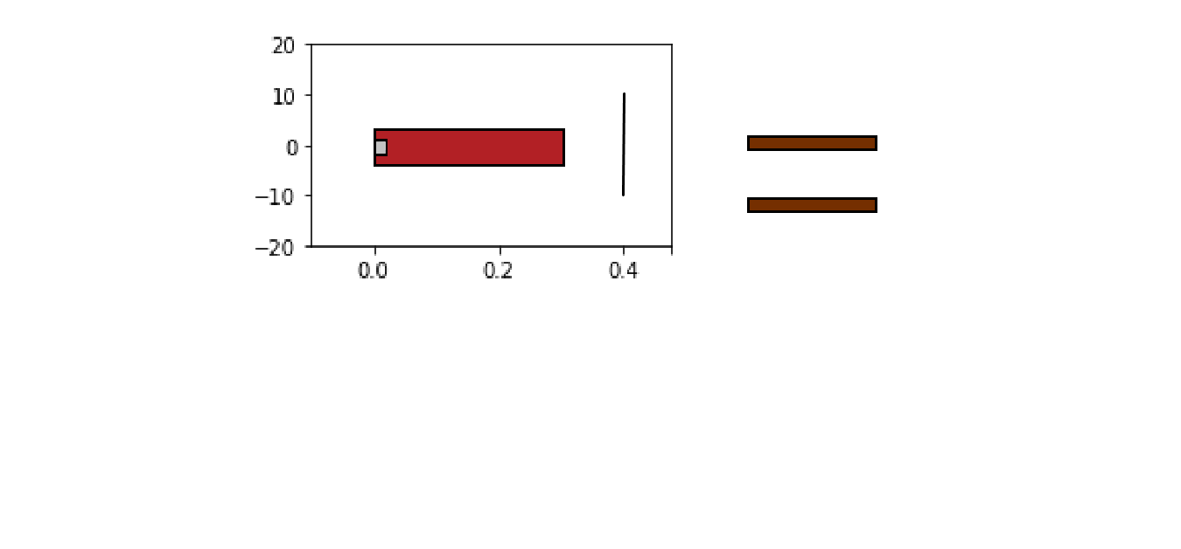
What does our model accelerator look like?
20
10
0
10
Electron Gun
Target
Accelerating Fields
20
(4 MeV industrial Linac)
0.0
0.2
0.4

Slide 11
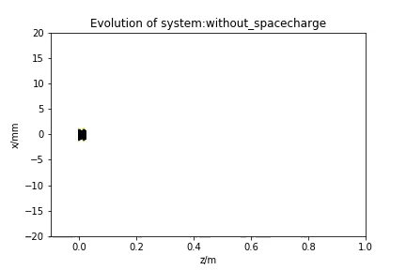
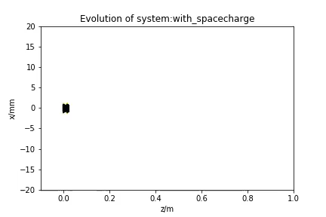
Does the space charge effect matter?
Run 2 simulations,
  1 with space charge effects included
  1 without space charge
Note:
  Many particles go backwards or hit the aperture on the side of the cavity

Slide 12
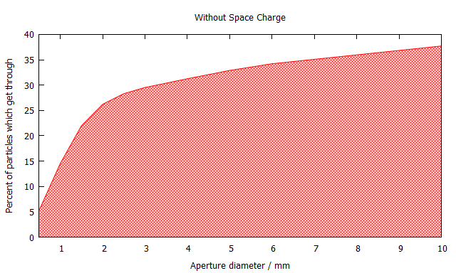
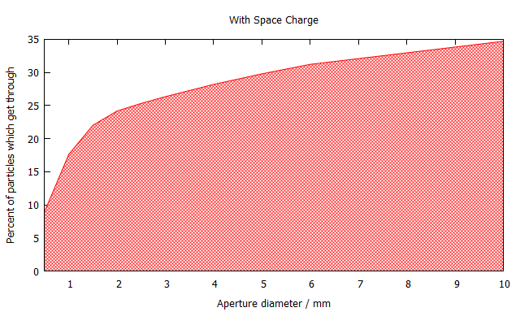
What do the numbers say?
Without Space Charge
With Space Charge
40
35
0
10
0
10
Aperture diameter / mm
Aperture diameter / mm
So space charge is significant (as expected)

Slide 13
Can we improve on this?
20
20
20
10
10
10
0
0
0
10
10
10
Electron Gun
Solenoid
Solenoid
Target
Accelerating Fields
20
20
20
0.0
0.0
0.0
0.2
0.2
0.2
0.4
0.4
0.4

Slide 14
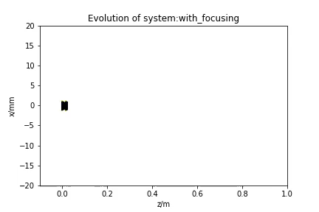
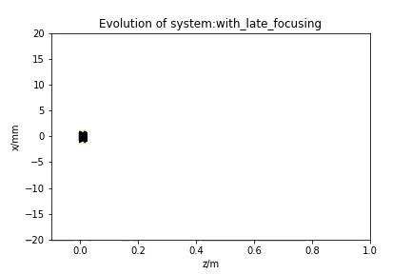
Does it matter where you put the focusing?

Slide 15
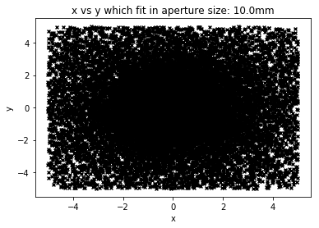
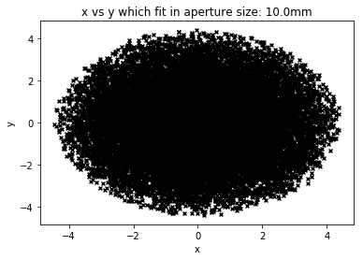
Looks different on the target?
Early focusing
Late focusing

Slide 16
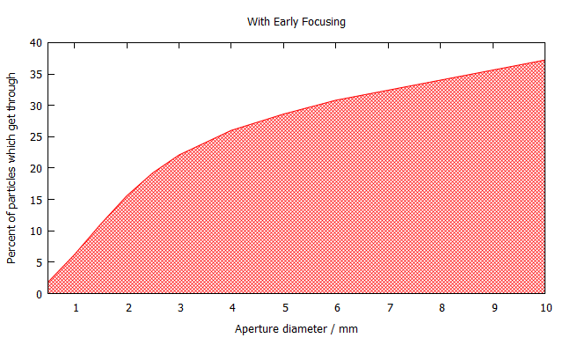
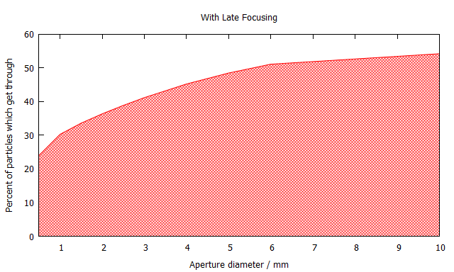
The numbers make it all clear
Early Focusing
Late Focusing
40
60
0
10
0
10
Aperture diameter / mm
Aperture diameter / mm
With these parameters, late focusing is more effective

Slide 17
What do these results tell us?
Directly, these results don’t mean much, as we have so many free parameters that will change
This is a tool that lets us test parameters quickly and easily
Chop and change philosophy

Slide 18
In summary:
We have a lot of free parameters
At this stage, we want to keep as many options open as possible
The next step is to focus in and compare our options
This tool will help us to quickly and easily test out ideas
Thank You

