Slide 1
Cloud-based Electronic Infrastructure for Radiotherapy Support in Challenging Environments
Jatinder R Palta PhD
Rishabh Kapoor MS
Virginia Commonwealth University Richmond, VA, USA

Slide 2
Goal
Provide a cloud based software infrastructure to facilitate global collaboration in radiotherapy;
  Electronic data sharing,
  Remote treatment planning,
  Remote peer review,
  Remote equipment troubleshooting,
  ………

Slide 3
Process oriented view of the cloud-based electronic platform: Gen X

Slide 4
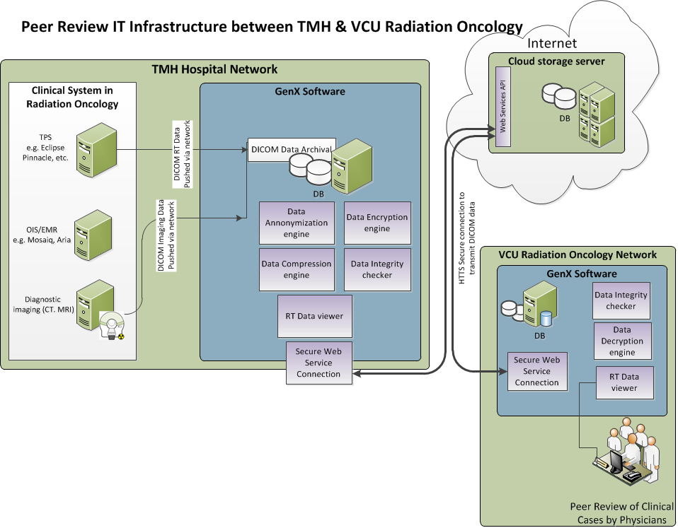
GenXViewer Architecture

Slide 5
The GenXViewer Components
  Web-based Secure Archiving System in the Cloud
      Web-based secure DICOM-RT PACS
  Local Secure Archiving System
      Local secure DICOM-RT PACS
  GenXViewer Uploading / reviewing station
      Auto-anonymizing / uploading / case review tool

Slide 6
GenXViewer Components
  1. Web-based Secure Archiving System in the Cloud: Web-based RT PACS
  Secure archiving system in the cloud that stores DICOM / non-DICOM anonymized data.
  Communicates with local secure archiving system for transfer of data.
  Database
    A collection of database tables
    Database scheme, which is designed as a combination of DICOM object hierarchy and the requirements of the data collection and review process for protocol based data submission system.
    A collection of stored procedures
    An access application client designed for database management
  Support for 12 bit gray scale clinical images
  Support for the storage of complimentary data to facilitate peer-review (for e.g. PDF, word, JPEG files).

Slide 7
GenXViewer Components
  2. Local Secure Archiving system– Web-based RT PACS
  Database is similar to the cloud based secure archiving system.
  Provides functionality of auto upload and download of data from the cloud based secure archiving system.
  Facilitates user account management.
  Network installation and interface facilities.
  Provide secure communication with Treatment Planning systems for transfer of DICOM data.
  Support for 12 bit gray scale clinical images
  Support for the storage of complimentary data to facilitate peer-review (for e.g. PDF, word, JPEG files).

Slide 8
GenXViewer Components
3. PRS Uploading / Reviewing station
Software functionalities
  DICOM Q / R service to query and retrieve DICOM RT data from PACS
  DICOM Push service to receive RT data from RT-TPS
  Auto-Anonymization of patient information before submitting to PRS web-server.
  Support for 12 bit gray scale clinical images
  Facility to select peer-reviewers
  Facility to attach additional supporting documents with the case submitted.
  Generate a unique GenX Case ID for each case submitted for peer review.
  Automatic notification to peer reviewers via email.
  Local case review capabilities.
  Automatic notification of status of submitted cases.

Slide 9
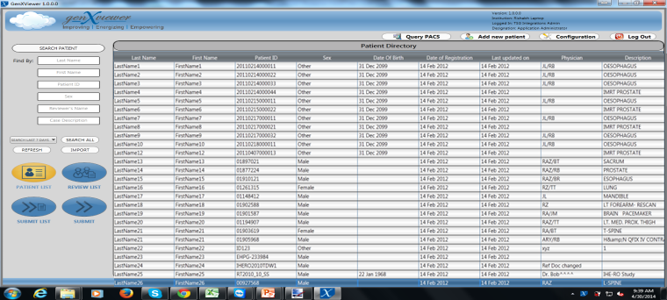
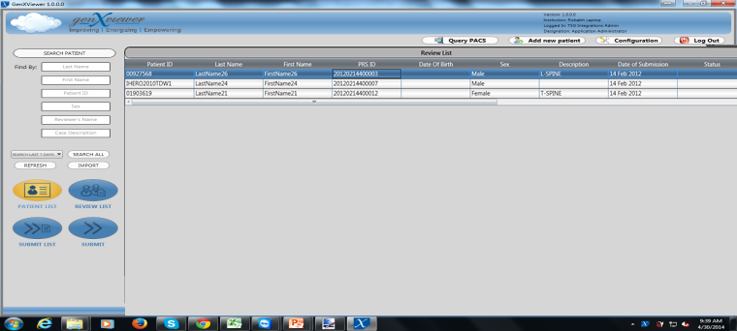
Screenshots of Patient directory & Review worklist on the local review station

Slide 10
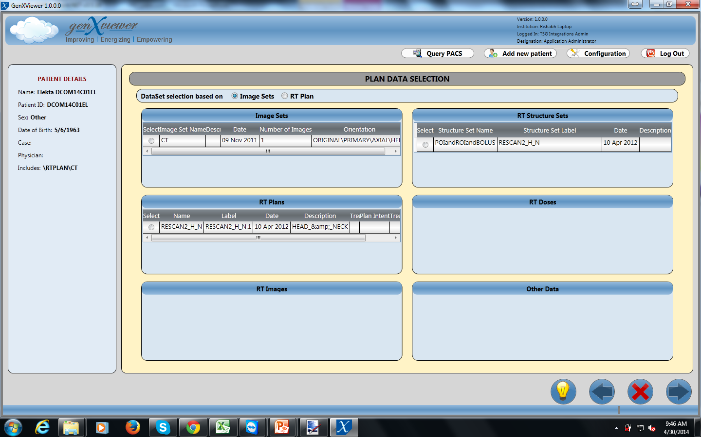
Screenshots of the DICOM RT data selection window.

Slide 11
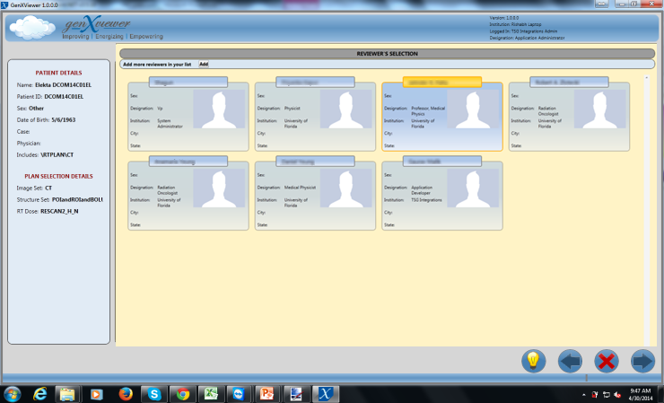
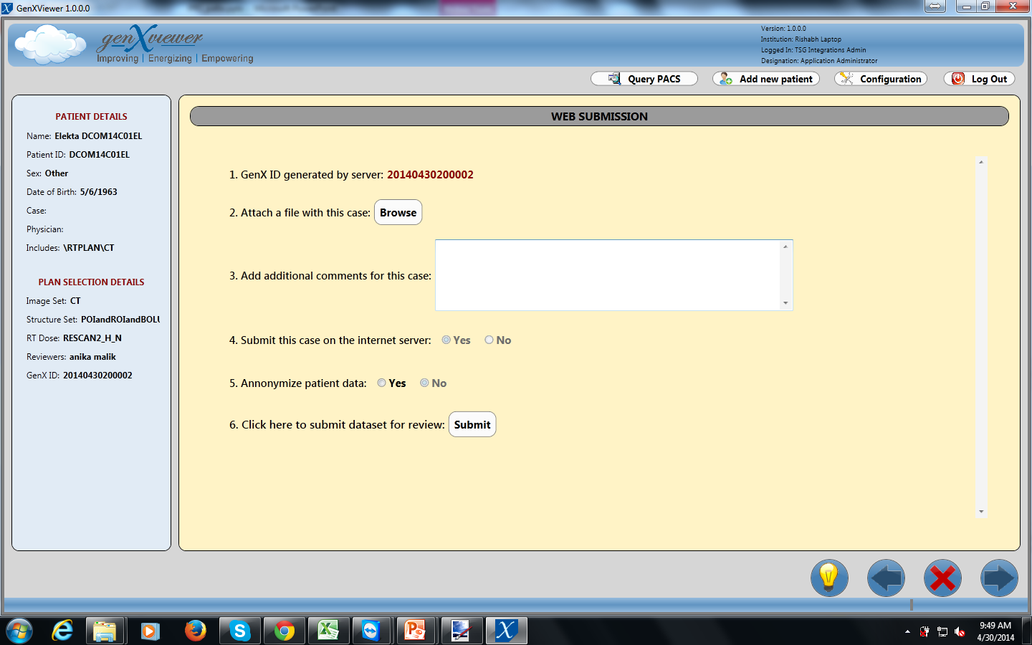
Screenshots showing the reviewer selection screen and submission screen. Patient data anonymization is performed before the case is submitted for review.

Slide 12
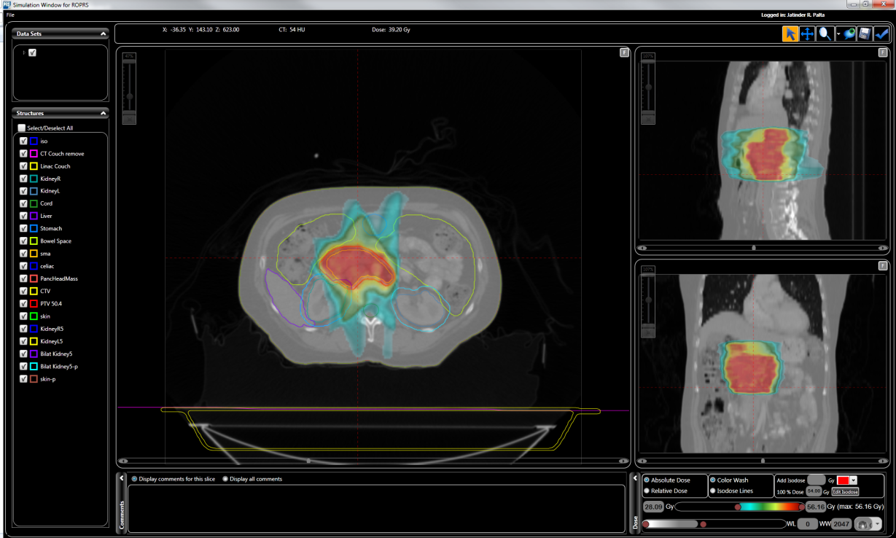
  PRS Uploading / reviewing station - Review Process
Visualize the case
  Transverse, coronal and sagittal views of images
  CT images (in future MR / PET images will be presented)
  Scrolling, zooming and panning of images
  Dose display on images - color wash, isodose levels, absolute / relative dose.
  Point dose display
  Display of structures
  DVH computed and displayed
  Demographics (real or anonymized)

Slide 13
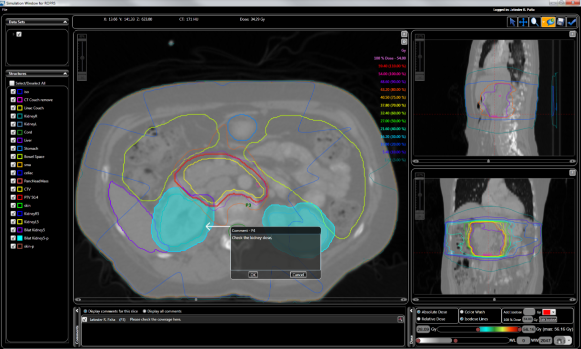
  PRS Uploading / Reviewing Station - Review Process
Record Comments
Comments can be recorded
  For a plan.
  for a transverse, coronal or sagittal section.
  via annotating a point or free-hand drawing.
Comment text can be of any length
Record any number of comments for a case
Comments are stacked serially and displayed
Reviewer can modify/delete/add comments
On submission of comments by the reviewer an email is generated and sent to the submitter giving the status of the case.
Comments are automatically transferred to the submitter’s local database.
Submitter displays the review comments and takes appropriate further action

Slide 14
Live Demonstration
(Subject to WiFi availability)

