Slide 1
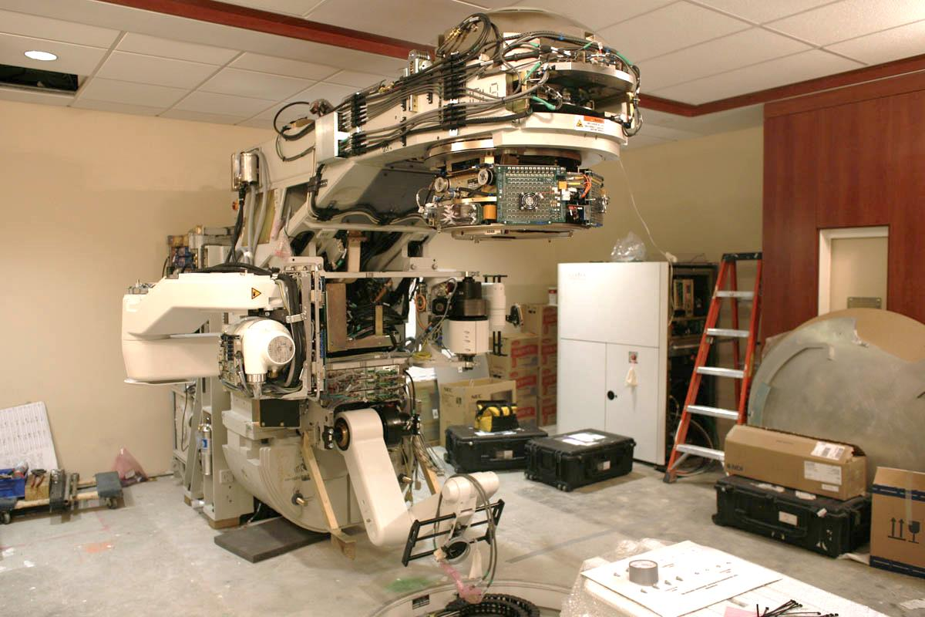

Overview of RTT Technology Options Study
Peter McIntosh (STFC Daresbury Laboratory)
CERN-ICEC-STFC Burying the Complexity:
Re-Engineering for the Next Generation of Medical Linear Accelerators for Use in Challenging Environments
Park Royal Hotel, 22 – 23 March 2018
Accelerators in a new light

Slide 2
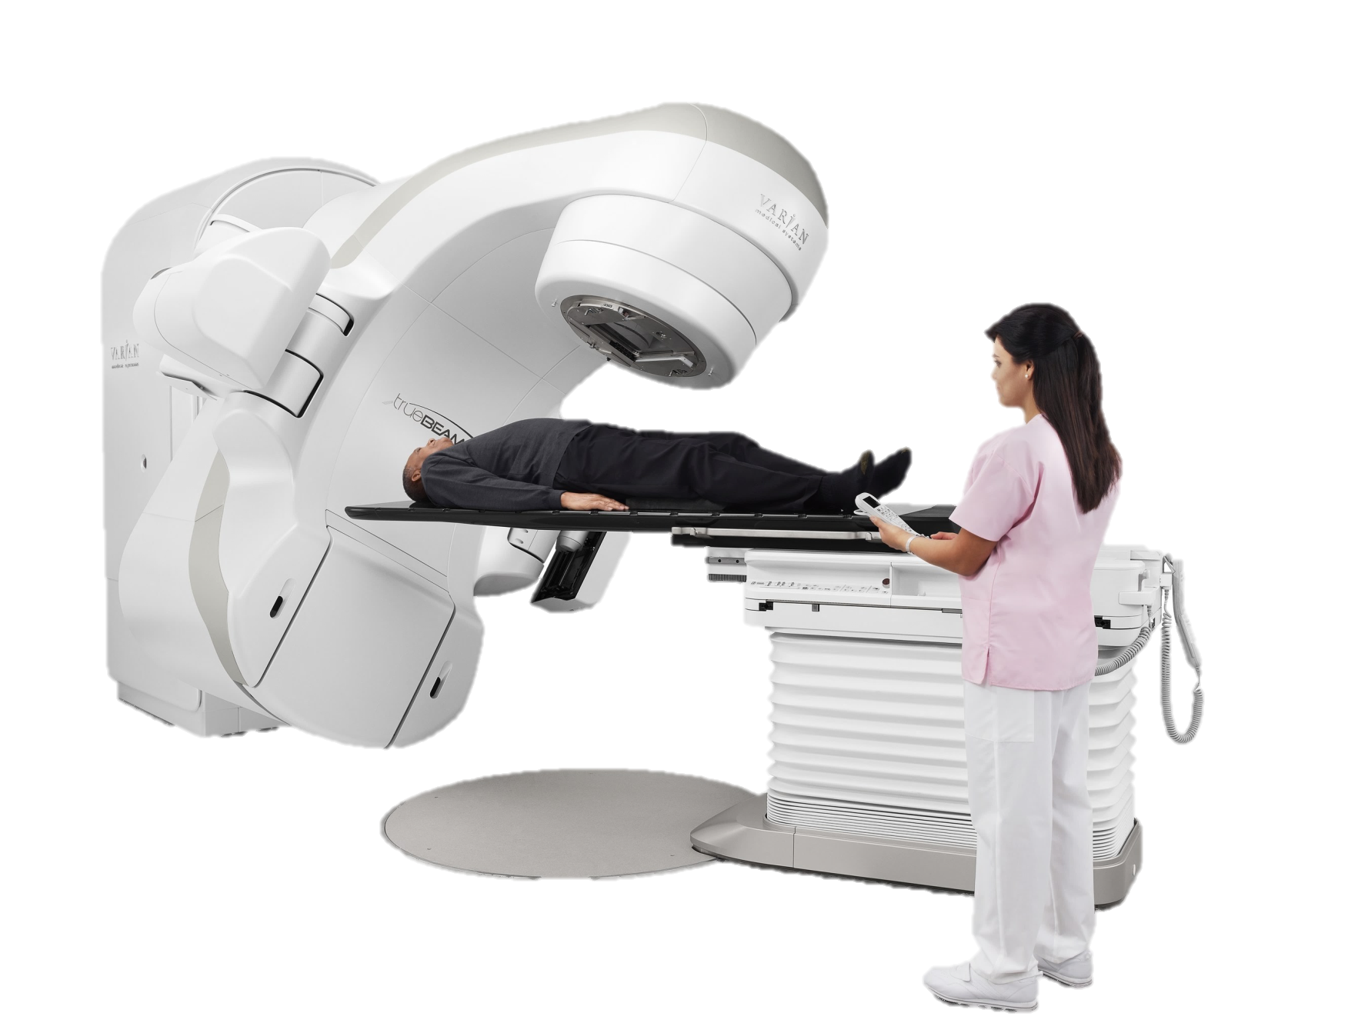
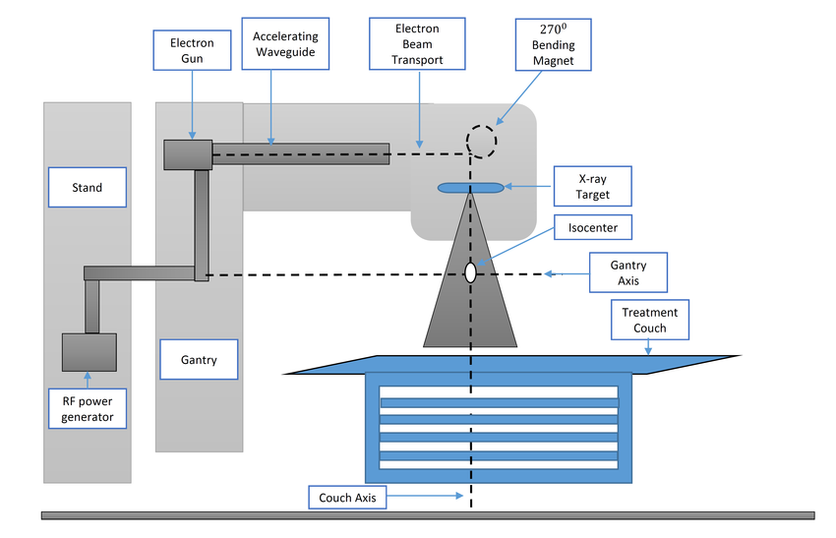
Conventional RTT Technology
Varian TrueBeam ®

Slide 3
RTT Technology Options Study
Objective:
The theme of this activity is to:
Assess a variety of different linac and RF source configuration options:
  Technology developments in frequency ranges outside of the conventional 2.856 GHz provision.
  Solid state, magnetron and klystron RF power delivery capabilities.
  Advances in both Standing Wave and Travelling Wave linac performance.
To define a new RTT system configuration which can not only outperform, but also offer a simpler, more efficient and robust system integration platform which can be more appropriately applied for ODA country exploitation.
Such an RT treatment systems must be able to operate:
in less stable power delivery environments, with challenging temperature and humidity conditions,
requiring an operational capability which is able to cope with such demanding specifications.

Slide 4
Workpackages and Deliverables
WP1: Determination of RTT system implementation constraints:
Deliverable: Implementation specification report (M1).
WP2: Assessment of SW/TW linac performance capabilities appropriate
for RT treatment application:
Deliverable: RT linac assessment study report (M2).
WP3: Assessment of RF amplifier technologies appropriate for RT
treatment application:
Deliverable: RF amplifier technology study report (M2).
WP4: RTT system integration assessment:
Deliverable: Linac system configuration report which can define a more effective RT treatment platform, utilising more efficient, cost effective and robust linac and RF technologies (M3).

Slide 5
Collaborating Partners
PARTNER NAME | PARTNER INSTITUTE e.g. CERN, ICEC | PROJECT ROLE e.g PI, Co-I, Consultant
Peter McIntosh | STFC, Daresbury Lab. | PI
Alan Wheelhouse | STFC, Daresbury Lab. | Co-I
Graeme Burt | CI, Lancaster University | Co-I
Rob Apsimon | Lancaster University | Researcher
David Constable | Lancaster University | Researcher
Ivan Konoplev | JAI Oxford | Co-I
Paul Collier | CERN | Collaborator
Walter Wuensch | CERN | Collaborator
Igor Syratchev | CERN | Collaborator
Eric Montisinos | CERN | Collaborator
Hubert Foy | African Center for Science and International Security, Ghana | Collaborator (ODA)
Surbhi Grover | Radiation Oncology, Hospital, Univ. Pennsylvania, | Collaborator (ODA)
Emmanuel Amankwaa-Frempong | Dept of Molecular Medicine, Univ. of Science and Technology, Kumasi, Ghana | Collaborator (ODA)
David Jaffray | ICEC | Collaborator (ICEC)

Slide 6
Scope of Programme
Assessment of suitable linac and RF amplifier configurations will enable exploration of both low and high frequency technologies which offer the ability to exploit modern, high operational performance devices which can provide a more modular approach for RTT system integration.
Low Frequency:
Taking advantage of high power, solid-state amplifier solutions at frequencies below 1GHz are of particular interest, whereby such implementation can significantly simplify the RTT system integration complexity through removal of all high-voltage power supply systems.
High Frequency:
At higher frequencies above S-band, advanced linac technologies also offer the advantage of very high accelerating gradients (approaching 50MV/m) which can significantly reduce the physical footprint of the linac structure within the RT treatment platform.
In addition at such high frequencies, the development of multi-beam klystron technologies has advanced considerably, offering high efficiencies and reduced HVPS complexity and associated costs.
Configurations:
In terms of the modularity which can then be employed, an assessment of configuration options will fundamentally explore the necessity for having the linac embedded within the rotating gantry and whether there are more effective approaches in detaching not only the RF amplifier system, but also the linac structure itself.
Technology Limitations:
The intricacies of then providing robust RF and/or electron beam delivery through rotating RF and beam delivery interfaces has been a fundamental inhibitor for limited commercial system solutions which have adopted this approach in the past and so reassessing current technology viability will be of particular significance.
Lots of discussion in these areas at the last CERN-ICEC-STFC Meeting in October 2017!

Slide 7
ODA Country Perspectives
Stability
  ODA country energy challenges are major factor – how can system be made more resilient to power fluctuations:
    Solar, wind, diesel, batteries, energy storage, gyroscopic supplies …. Improve reliability and quality.
  Humidity also significant challenge – RTT packaging should be able to cope with large variations:
    Noted that Halcyon system environmental spec is: 16-27C (ambient) and 15-80% humidity
    RTT facility operating temperature is however typically much higher at ~42C
  Dust – RTT facility must also operate in such environments reliably:
    Sealing of rotating components or even removing, AC management, air filtration systems etc
  Need to package RTT system to be compliant with ODA country constraints – to be defined
Quality Control
  What automation can be incorporated, some dictated by regulatory requirements.
Operation
  Priority to have modular systems, easy maintenance, rapid recovery times, better upgradability and functionality.
  Operational costs are very important:
    System reduction, simplification, improved efficiency, standardised components.
  Patient driven RTT aesthetics very important:
    What ODA country factors should be taken into account?
  How can key components be removed
    Circulator, magnets, vacuum pumping – how can system be made more robust (combining components)!

Slide 8
Africa RTT Consultation
Hubert Foy (African Center for Science and International Security, Ghana) offered to perform a selected consultation with a core group of current linac operators in 6-8 key countries in Africa.
To provide an opportunity to learn from a diverse audience, some of the design needs associated with current RTT linac technology operation in the continent.

Slide 9
RTT Options Study Project Planning
 | M1 |  | M2 |  | M3
Assessment of RTT system constraints
ODA consultation
Implementation specification report (D1)
Linac technology data collection
RTT linac assessment study report (D2)
RF power source data collection
RF power source technology study report (D3)
RTT system integration assessment
RTT system configuration report (D4)
Kick-off
Meeting
Daresbury
18/1/2018
1st Review
Meeting
CERN
8/3/2018
Close-out
Meeting
TBD
Today’s Meeting
Project Start: 18th January 2018
Project End: 18th April 2018

Slide 10
Session 2: Study of Accelerator Technology Options
Time | Title | Speaker
11:00 | Overview of RTT Technology Options Study | Peter McIntosh (STFC)
11:15 | RTT platform specification | Rob Apsimon (Lancaster)
11:35 | ODA Country RTT Operation Perspectives | Hubert Foy (ACSIS, Ghana)
11:50 | Preliminary RTT Technology Option Capture | Graeme Burt (Lancaster)
12:10 | Discussion
12:30 | Session Close

