Slide 1
Preliminary Technology Option Data Capture
D.A. Constable

Slide 2
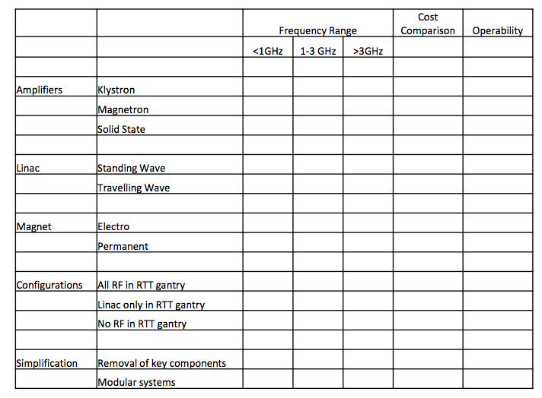
Introduction
Collate parameters of available RTT technology options:
  Create table of key parameters, e.g. frequency, peak output power, dimensions, weight, cooling, etc…
  Identify suitability of specific sources in different frequency regimes.
  Identify configurations/solutions which could reduce system complexity and improve system robustness.

Slide 3
RF System Considerations
Several additional components required depending on choice of RF source:
  Electron beams require magnets.
  High powers require cooling.
  Input signal may be required for amplifier.
  Modulator required for high voltage pulse to RF amplifier.
Such components add complexity to RF system.
Typical failures:
  Electron source in RF amplifier.
Magnet
Cooling
Modulator
RF Amplifier
RF Output to Linac
Input Signal

Slide 4
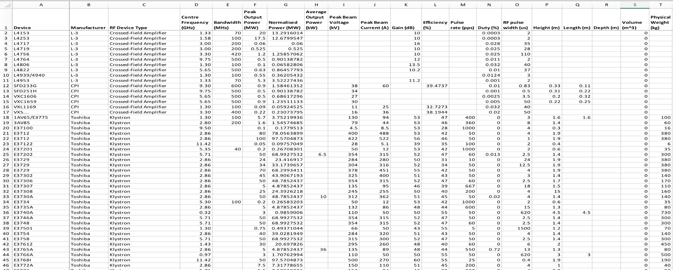
RF Source Summary
Data collection of sources identified:
  Target frequency range 10 MHz – 18 GHz.
  Not all parameters could be found, e.g. weight, dimensions, cost.
  ~360 devices identified thus far - non-exhaustive list.
  Focused on devices which are available commercially.

Slide 5
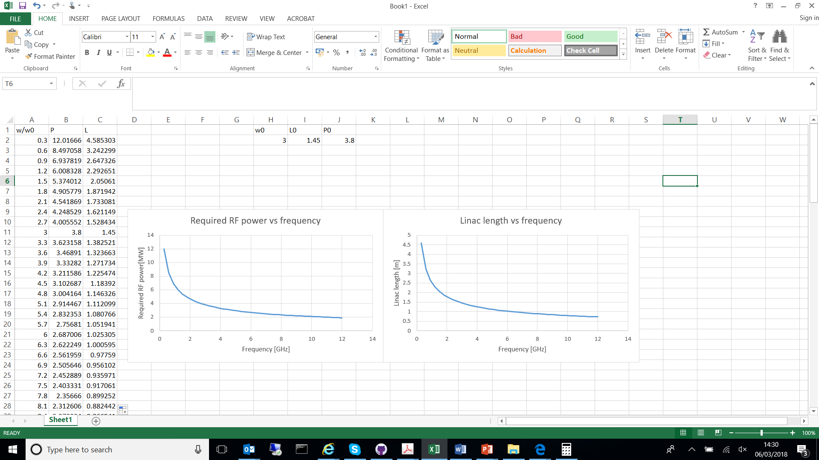

Required RF Output Power for a Linac
R. Apsimon - RTT Platform Specification Assessment
To allow comparison of RF source performance:
  For a 1.45 m linac, a (minimum) RF power of 3.88 MW is required at 3 GHz.
  Will use this as benchmark.
$$P_{RF}^{linac}∝\frac{1}{\sqrt{ω}L_{linac}}$$

Slide 6
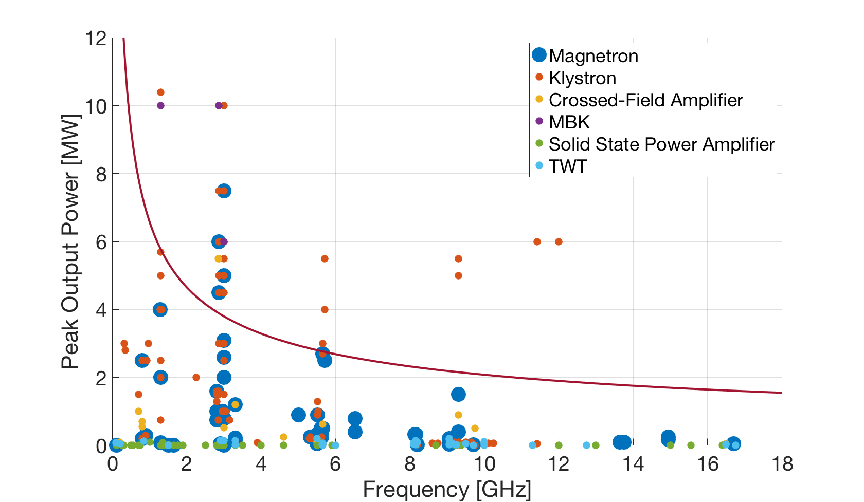

Peak Output Power Comparison
$$P_{RF}^{linac}∝\frac{1}{\sqrt{ω}L_{linac}}$$
Comparison of single devices:
  Larger RF power required for lower frequency.
  Magnetrons & klystrons offer largest peak power across all frequencies.
  TWTs and SSPAs would require multiple devices to meet example specification.
  Few single devices meet required specification.

Slide 7
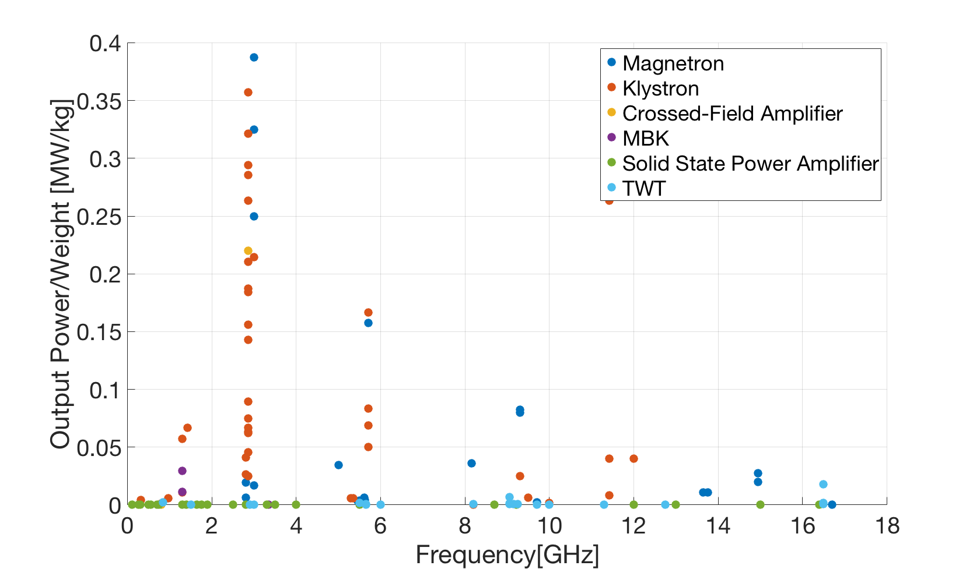
Output Power per Unit Weight
Comparison of single devices:
  View of output power per unit weight.
  Magnetrons and klystrons offer best performance.
  Very high power klystrons ~3 GHz (~100 MW).

Slide 8
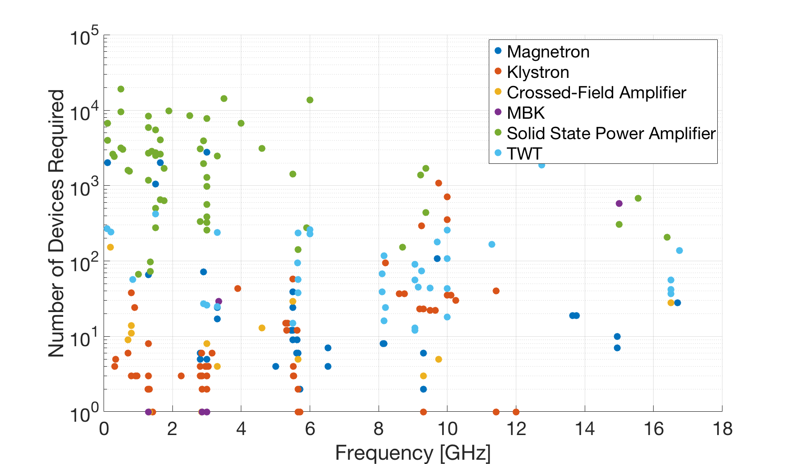
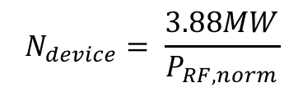

Number of Devices to Meet Benchmark
$$P_{RF,norm}=P_{RF,0}\sqrt{\frac{f}{f_{0}}}$$
Calculate the number of devices required to meet a normalised benchmark:
  Normalised output power of 3.88 MW at f₀ = 3 GHz (RTT specification report).
  SSPA require least number (~hundreds) at hundreds of MHz.
  Klystrons, MBKs, CFAs and magnetrons require least number, over <10 GHz.
  Power combining could become challenging with many sources.
  Conservative max. limit of 1,000 units might be imposed.
$$N_{device}= \frac{3.88MW}{P_{RF,norm}}$$

Slide 9
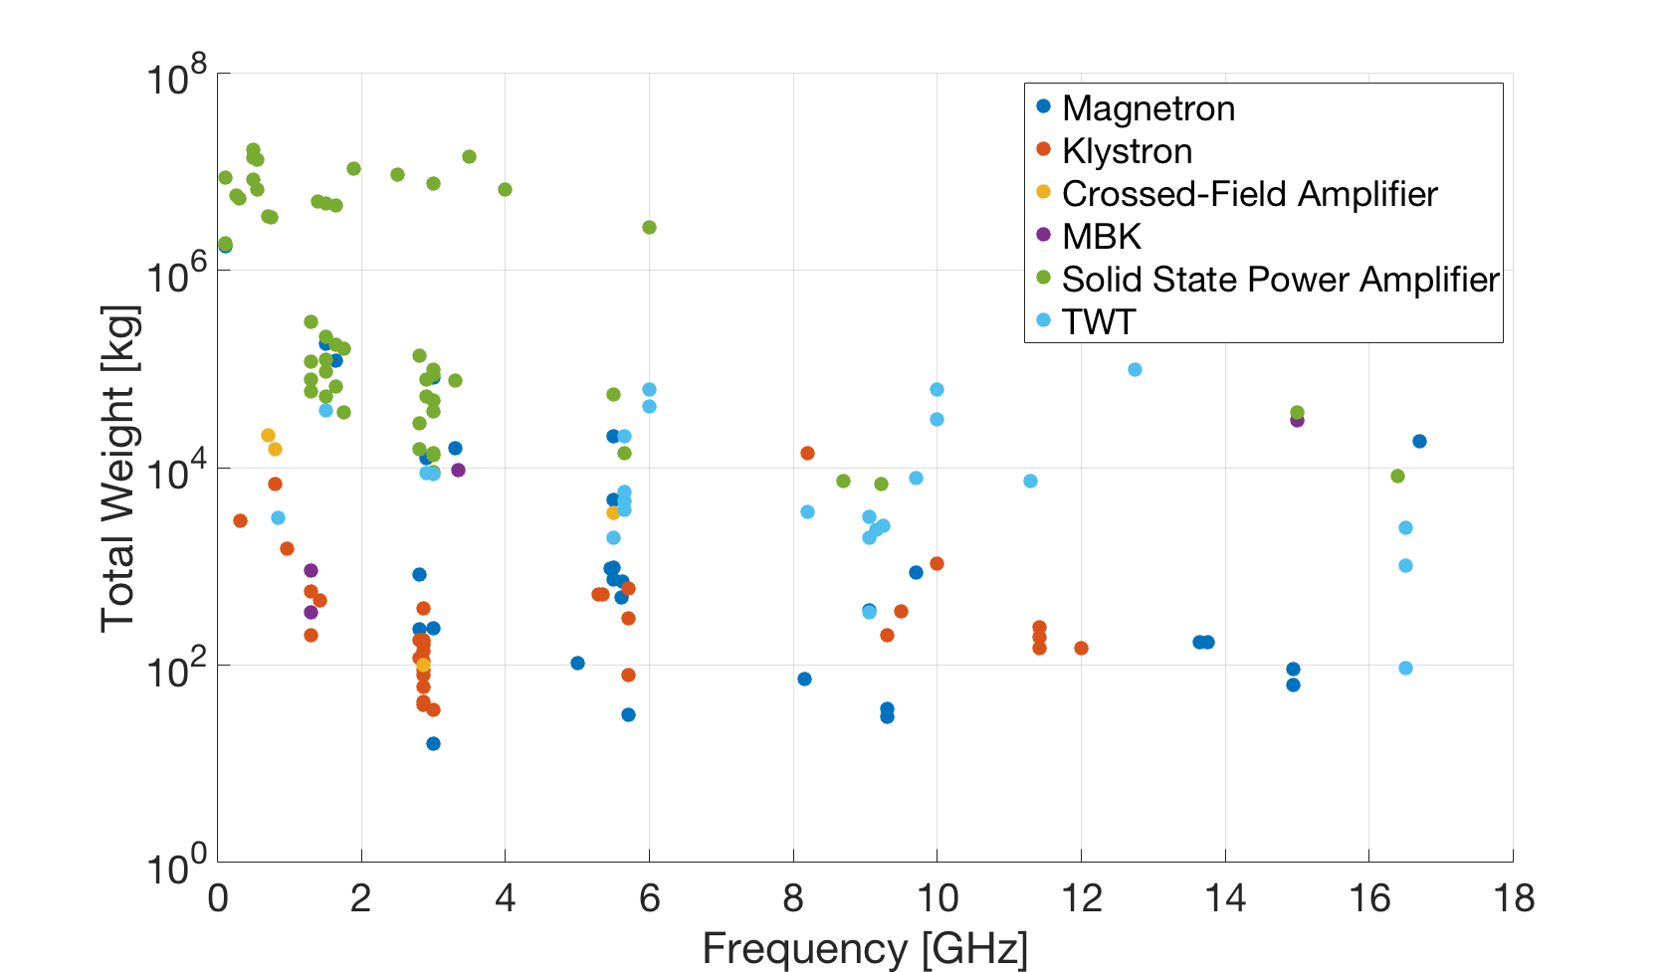

Total Weight of RF Sources to
Meet Benchmark
$$Total Weight=N_{device}∗Weight$$
Significant spread in data:
  Magnetrons and klystrons present lowest weight across frequency range.
  SSPA are largest weight.
Data represents weight of the source only:
  Does not account for cooling, magnets, power supply, waveguide, power combiners, etc…
  Total installation weight could be much larger.

Slide 10
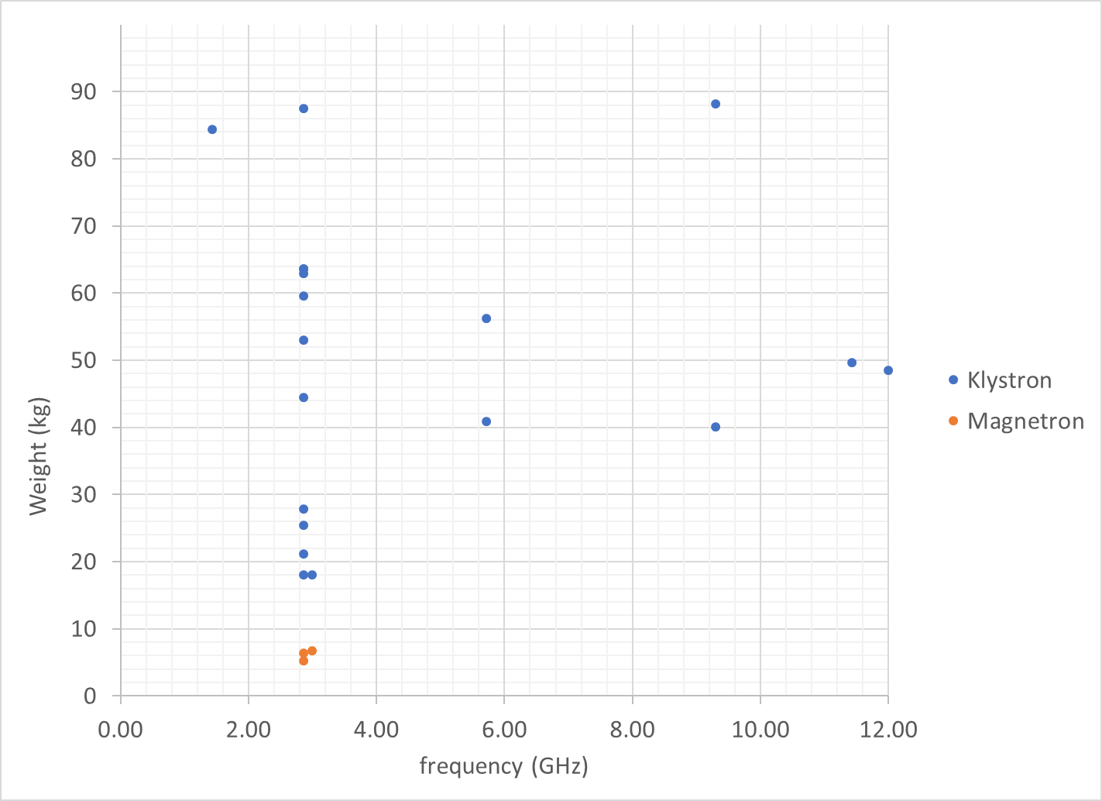
Klystrons and Magnetrons
If we exclude using multiple sources combined and remove highly over-specified sources (50 MW klystrons) we get the following
Magnetrons are far lighter but need a 15 kg magnet as well so in reality they have similar weight
3 GHz is far smaller and lighter but doubling the weight isn’t likely an issue.

Slide 11

Initial Conclusions from Data
Across entire frequency range, klystrons deliver desired output power in single device:
  Other devices can be put into specific frequency categories.
  Based on number of devices required.
Low frequency (< 1.3 GHz):
  SSPAs.
  Crossed Field Amplifiers.
Between 2-4 GHz:
  Magnetrons.
  Klystrons.
Above 4 GHz:
  Klystrons.
  Magnetrons
  TWTs.
  Crossed Field Amplifiers.

Slide 12
Example RF Source Configurations

Slide 13
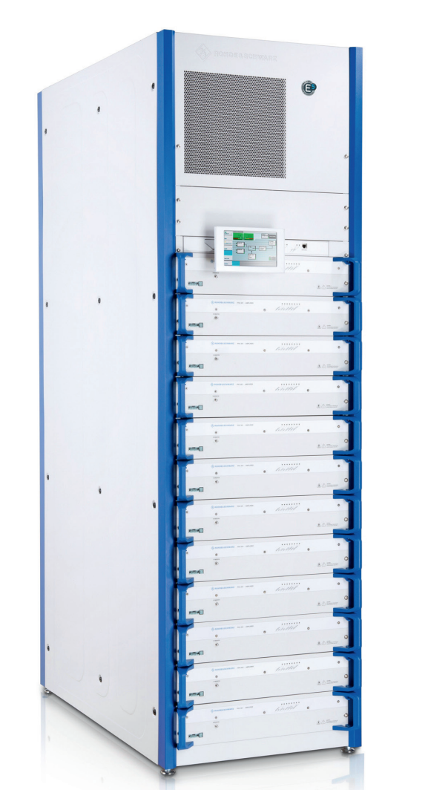
Solid State Power Amplifier Example
Suggested frequency: ~400 MHz
Rhode & Schwarz THU9:
  Peak output power, 100 kW.
  Centre frequency, 200 MHz.
  Bandwidth, ~200 MHz
  Dimensions, 2m x 2.4m x 1.1m
  Weight (estimate), 150 kg per unit.
  Forced air cooling.
  No magnet or modulator required.
Power required at 400 MHz for benchmark linac, 10.4 MW:
  Minimum number required, 140.
  Total weight (estimate), 21,000 kg.
  Total size, 739 m³.
  Would need to be separate from linac.
Data sheet:
https://cdn.rohde-schwarz.com/pws/dl_downloads/dl_common_library/dl_brochures_and_datasheets/pdf_1/service_support_30/THU9-THV9_bro_en_5214-5990-12_v0503.pdf

Slide 14
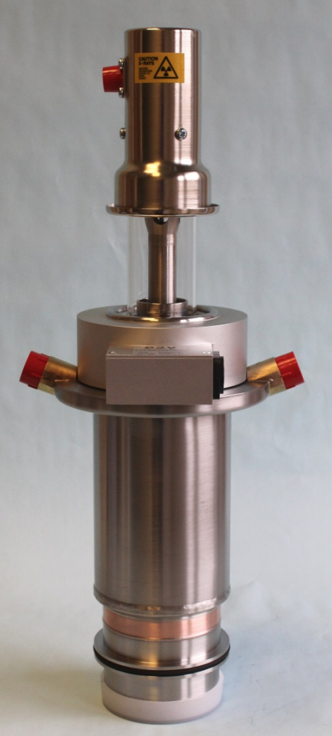
Magnetron Example
Suggested frequency: 2.86 GHz
e2v MG6028:
  Peak output power, 5 MW.
  Centre frequency, 2.86 GHz.
  Bandwidth, 3 MHz.
  Dimensions, 0.477m x 0.147m x 0.147m
  Weight (estimate), 8 kg.
  Liquid cooled.
  Pulse width, 3 us.
  Electromagnet required, 50 kg.
  DC power supply required.
Power required at 2.86 GHz for benchmark linac, 3.9 MW:
  Minimum number required, 1.
  Total weight, 58 kg.
  Total size, 0.477m x 0.147m x 0.147m.
  Could easily be implemented on linac gantry.
Data sheet:
https://www.e2v.com/shared/content/resources/A1A-MG6028_5_v1.pdf

Slide 15
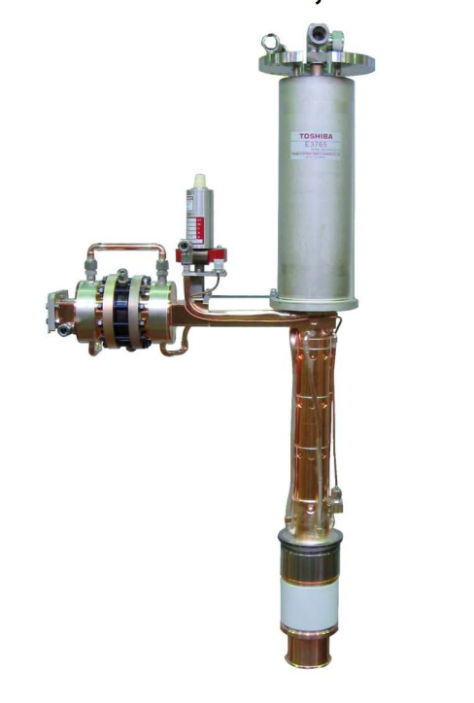
Klystron Example
Suggested frequency: ~2.86 GHz
Toshiba E3765A:
  Peak output power, 5 MW.
  Centre frequency, 2.856 GHz.
  Bandwidth, ~2 MHz
  Dimensions, 1.3m x 0.468m x 0.468m
  Weight (estimate), 100 kg.
  Liquid cooling.
  Pulse width, 11.5 us.
  Electromagnet and modulator required.
Power required at 2.86 GHz for benchmark linac, 3.9 MW:
  Minimum number required, 1.
  Total weight, >100 kg (no data for magnet).
  Total size, 1.3m x 0.468m x 0.468m
Data sheet:
https://etd.canon/eng/product/read_binary.php?cid=400000100200&pid=20140730_4021&fn=E3765,A_PI(E)_rev1.pdf

Slide 16
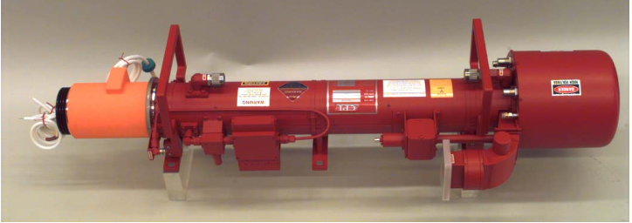
Travelling Wave Tube Example
Suggested frequency: 5.5 GHz
CPI VTC-5764C:
  Peak output power, 200 kW.
  Centre frequency, 5.5 GHz.
  Bandwidth, ~500 MHz
  Dimensions, 0.21m x 0.21m x 1.11m
  Weight (estimate), 132 kg.
  Water cooled.
  PPM focussed
  Pulse width, 1-100 us.
Power required at 5.5 GHz for benchmark linac, 2.8 MW:
  Minimum number required, 14.
  Total weight, ~1,850 kg.
  Total size, 0.65 m³
Data sheet:
http://www.cpii.com/docs/datasheets/110/VTC5764C.pdf

Slide 17

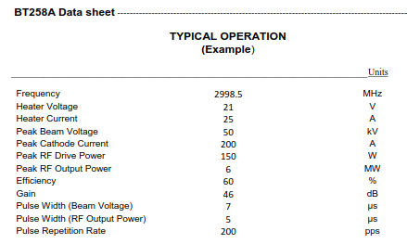
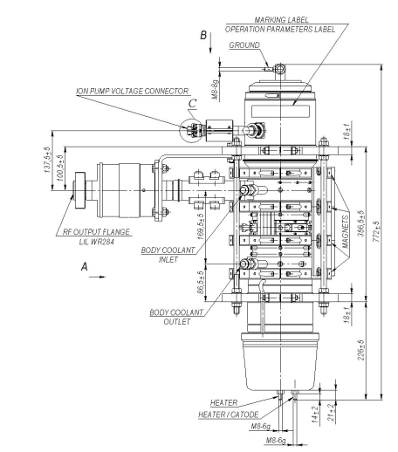
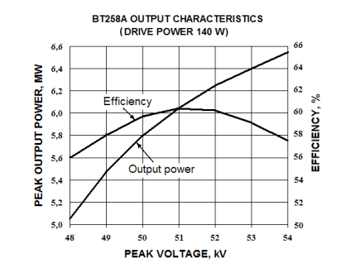
Multiple-Beam Klystron (MBK) Example
I. Syratchev, “Personal overview of special issues of the robust/reliable medical accelerator,” CERN-ICEC-STFC Workshop on Innovative, Robust and Affordable Medical Linear Accelerators for Challenging Environments, 2017.
0.72m long
92 kg (incl. PPM solenoid)
No oil tank.
Positioning: arbitrary (rotation possible)
Modulator required.
Data sheet: https://nelsoncreateddotcom.files.wordpress.com/2017/05/vdbt-bt258a-b.pdf

Slide 18
RF Source Examples Summary
Device Type | Magnetron | Klystron | Crossed-Field Amplifier | Solid State Power Amplifier | Travelling Wave Tube | Multiple-Beam Klystron
Individual Unit Peak Output Power (MW) | 5 | 5 | 0.5 | 0.1 | 0.2 | 6
Frequency (GHz) | 2.86 | 2.86 | 9.75 | 0.4 | 5.5 | 2.998
Efficiency (%) | 60 | 50 | ~50 | No data | ~25 | 60
Required RF power (MW) | 3.9 | 3.9 | 2.68 | 10.4 | 2. 8 | 3.88
Units Required for ~5 MW at 3 GHz | 1 | 1 | 6 | 140 | 14 | 1
Total Volume (m³) | 0.0103 | 0.2847 | 0.3 | 739 | 0.65 | ~0.2
Cooling | Forced air or water | Water | Forced air | Forced air | Water | Water
Magnet Required | Yes, electromagnet | Yes, PPM | Yes, electromagnet | No | Yes, PPM | Yes, PPM
Total Weight (kg) (incl. magnets) | 58 | 150 | 150 (estimate) | 21,000 | 1,850 | 95
Modulator Required | Yes | Yes | Yes | No | Yes | Yes

Slide 19
Example Implementation
I. Syratchev, “Personal overview of special issues of the robust/reliable medical accelerator,” CERN-ICEC-STFC Workshop on Innovative, Robust and Affordable Medical Linear Accelerators for Challenging Environments, 2017.
Multiple MBKs driving multiple linacs:
  Over-pressurised bunker to isolate RF sources.
Control over RF sources:
  Single klystron feeds single linac.
  Single klystron feeds multiple linacs.
  Achieved with mechanical switches.
Extension in lifetime of RF source:
  Not all devices active at all times.
  Should minimize downtime if one source fails.
Tentative proposal
RF rotating
joint
treatment
Klystron/modulator
Isolated ‘bunker’
RF switch
Patient preps.
2-20 MW
Patient preps.
Maximize facility put through
in the most economic way.

Slide 20
Summary
Data collection of potential RF sources conducted:
  Available data suggests klystrons, MBKs or magnetrons are best options for RTT source.
  <10 units can easily meet RF power demands.
  Additional components (magnets, cooling, modulators) increase complexity of RF installations.
  SSPAs will be a very large/massive solution at present.
Possible implementation:
  Multiple RF units feeding multiple linacs.
  Use of existing technologies to improve robustness.
  Remove sources from linac assembly.
  Ease of access, improved lifetime.

