Slide 1
Linear accelerator simulations for stable and sustainable operation of developing country radiotherapy linear accelerators
Marco Carlone, BC Cancer
Stewart Boogert, Royal Halloway

Slide 2
Linac operability is an important consideration in any environment
Training on linac service personnel is difficult at BC Cancer
Communication between Medical Physicists and Linac Service technicians is challenging everywhere
We suggest that this is a critical component of any linac operation plan, especially for challenging environments

Slide 3
Linac Physics is Complicated
Electron beam acceleration in waveguide is advanced physics.
There is a convoluted relationship between the basic physics and clinical beam properties.

Slide 4
Teaching Linac Physics
Should relate basic physical principles to clinical parameters.
Needs a hands on component.
Jargon issues between service engineers and physicists.
Few teaching resources aimed at the radiotherapy physicist

Slide 5
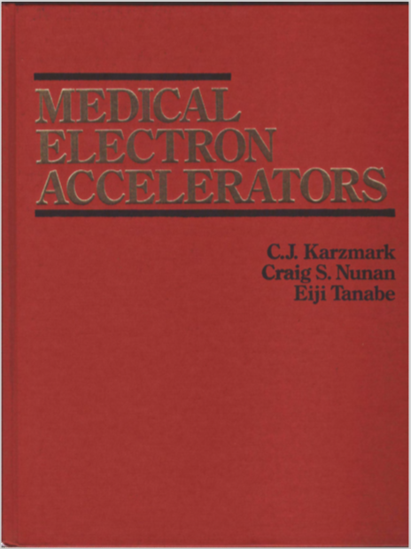

Slide 6









The Accelerated Education Program
Princess Margaret Cancer Centre
Upcoming Course
Accelerator Technology (ATec)
February 28 - March 3, 2017
Led By: Dr. Marco Carlone &
Mr. Bern Norrlinger
Connect with Us!
Web: www.aepeducation.ca
Email: aep@rmp.uhn.ca
Twitter: @AEPcme
YouTube: AEP Education
LinkedIn: Accelerated Education Program

Slide 7
Challenges with the ATec Course
4 day length is too short for any in depth teaching.
Relating linac theory to linac service/QA problems is difficult.
Clinical linacs at PMH were not available.

Slide 8
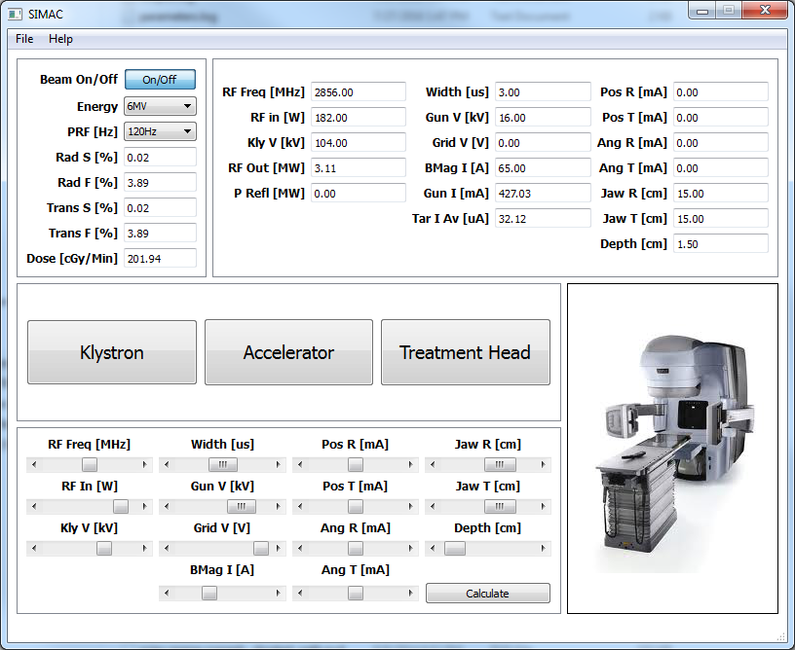
SIMAC
Simulate Linac
Most linac physics can be modeled using simple analytical approximations
Response is consistent with a real linac response.
Meant to simulate the service mode of a clinical linac

Slide 9
Using SIMAC
Linac operating values
Mode selection
Clinical parameters
Linac parameter control

Slide 10
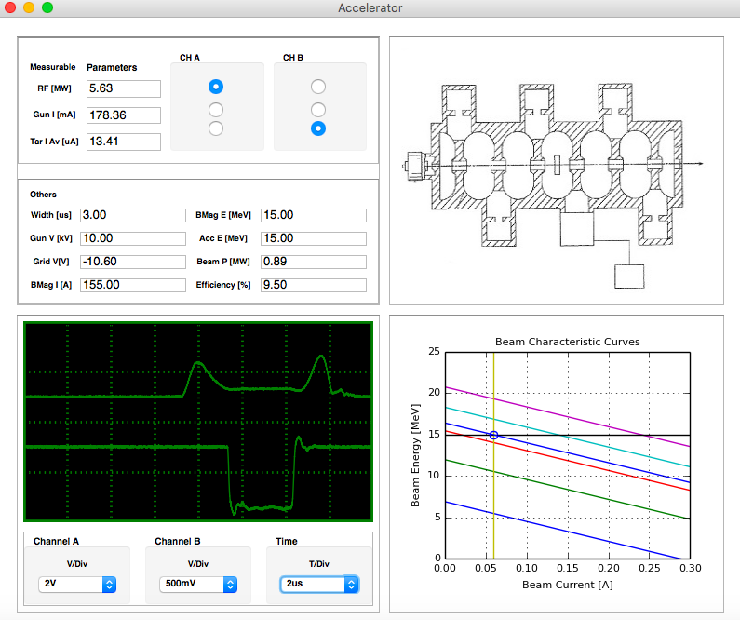
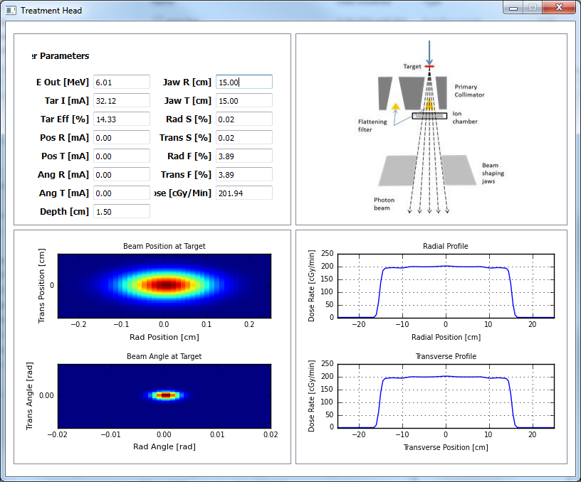
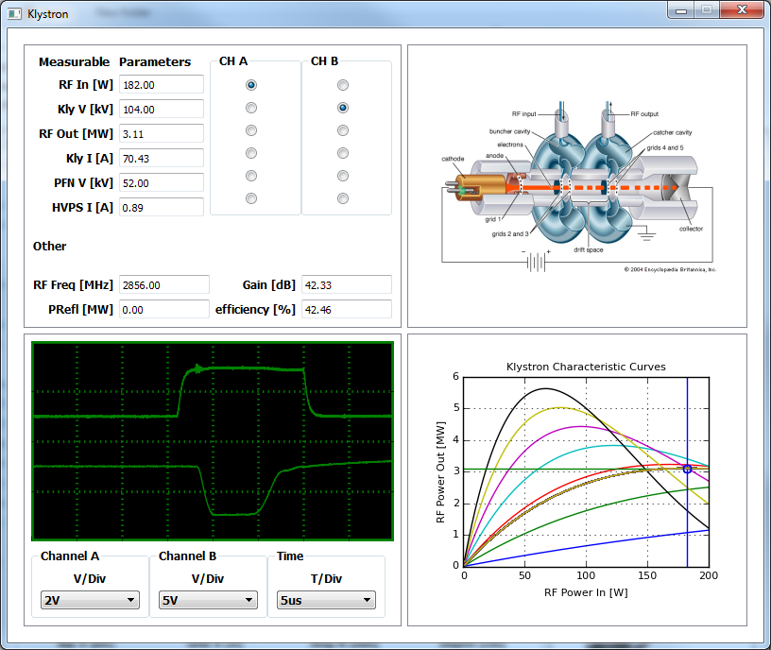
Linac Physics modules in SIMAC
The linac Load line is modelled using the concept of “Shunt Impedance”
Photon transport is modelled using breamstallung yield tables (NIST) and linear attenuation in the FF and water phantom
Klystron saturation is modelled using an analytical (Bessel) function
Electron beam position and angle on the target

Slide 11
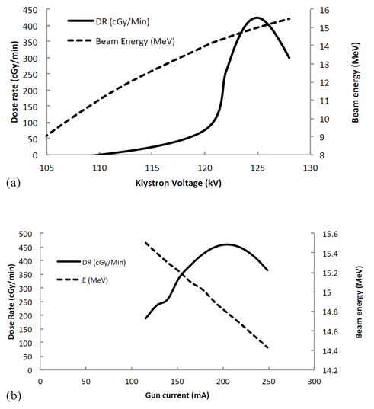
Teaching of beam “tuning” with SIMAC

Slide 12
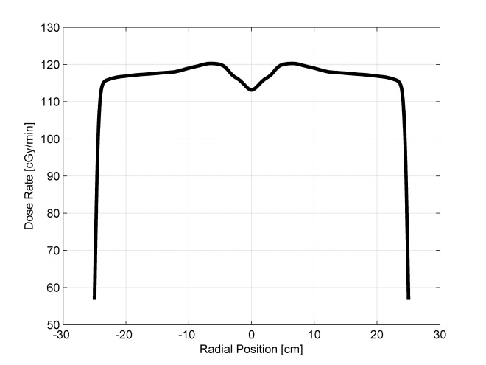
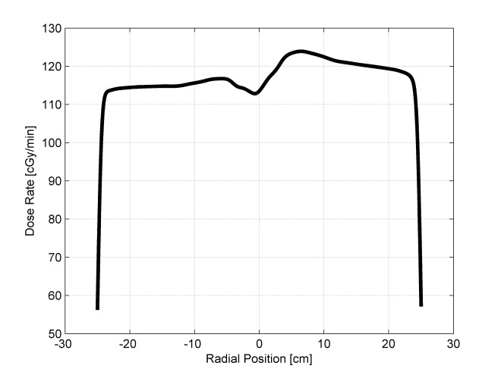
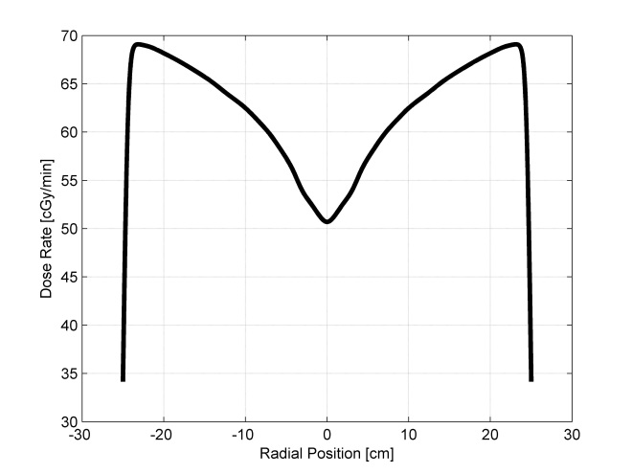
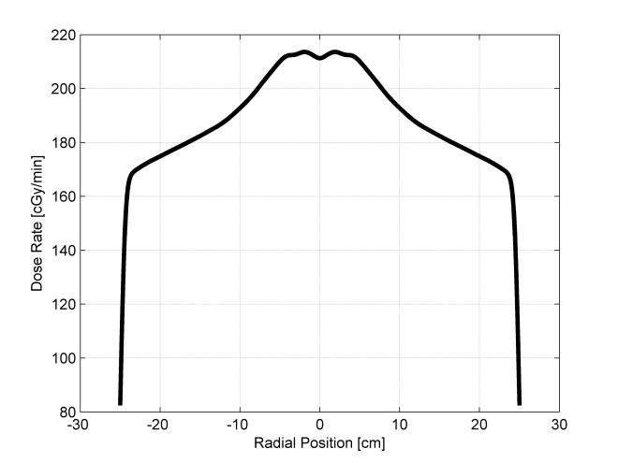
Using SIMAC to teach Flatness & Symmetry as a response to beam steering and energy
6 MeV beam on 6MV flattening filter
Pos_R = 100 mA, Ang_R = 0
4.5 MeV beam on 6MV flattening filter
7.5 MeV beam on 6MV flattening filter

Slide 13

www.simaclinac.com

Slide 14

Simac is freely available

Slide 15
Work Package 5
Address the operability of a medical linac
  Address the knowledge issues around linac service by improving the SIMAC experience
    (Have good linac drivers)
  Provide automation tools to assist linac repairs by modeling include linac failures
    (Provide a driver assist mode for already good drivers)

Slide 16
Work Package 5
Deliverable 1: Help expand the online SIMAC community by making SIMAC fully web-based.
Deliverable 2: Demonstrate the feasibility of a diagnostic data collection system.
Deliverable 3: Report on potential algorithms to implement a machine learning model to interpret fault data.

Slide 17
Deliverable 1
SIMAC is mature and has been used
Assemble a complete set of linear accelerator physics modules
  Building a comprehensive “flight simulator” for LINACS
  Maintain code in GitHub repository to maximize community involvement

Slide 18
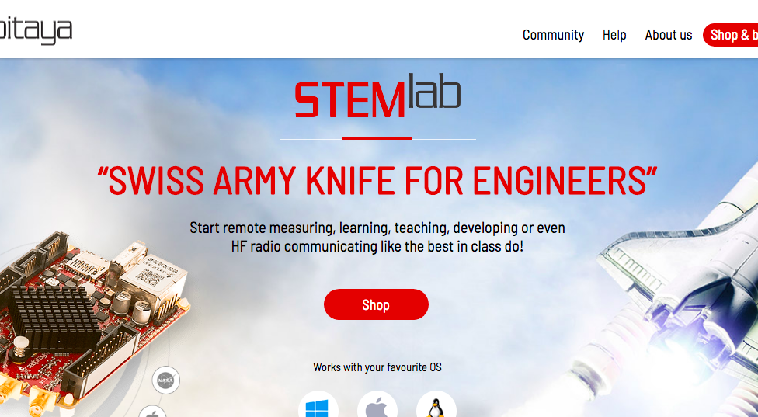
Deliverable 2
Install data loggers on existing linacs and demonstrate the feasibility of collecting this data

Slide 19
Deliverable 3
Collection of data from existing machines
Consultation on potential machine learning algorithms and implementations
Demonstration of simple predictive model of known failures

Slide 20
Linac failure categories
Modulator/injector failure
Beam delivery error (steering)
MLC malfunctions
Power supply failures
Control system failures
Mechanical failures
Broken wires
Many others (some simple, sone not)

Slide 21
Linac failure categories
Modulator/injector failure
Beam delivery error (steering)
MLC malfunctions
Power supply failures
Control system failures
Mechanical failures
Broken wires
Many other smaller categories
I would guess these are the majority

Slide 22
Linac failure categories
Modulator/injector failure
Beam delivery error (steering)
MLC malfunctions
Power supply failures
Control system failures
Mechanical failures
Broken wires
Many other smaller categories
These are the most intimidating, and most difficult to teach

Slide 23
The Art of Linac Maintenance
There is a challenging learning curve
  Service technicians are not physicists
  Distinguishing between electronics/control system problems and linac physics problems can be challenging when learning

Slide 24
Objective with deliverable 3
To assist service technicians with diagnosis problems involving linac physics.
To reduce the “fear factor” of a large complicated machine.
It is not intended to provide a comprehensive linac fault diagnosis repair automation

Slide 25
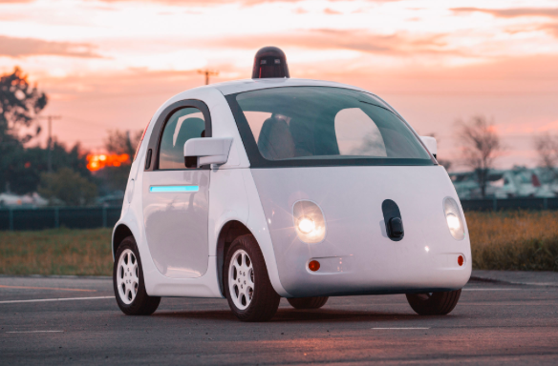
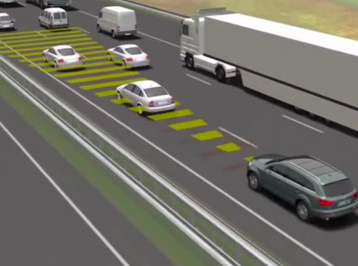
Deliverable 3 is more like driver assist as opposed to a driverless car.

Slide 26
Questions/comments?

