Slide 1
CMS related materials research and device design
(deetectors and scincilators)
Juozas Vaitkus
Vilnius University

Slide 2
Two roots of interests and contributions
Starting 1995 VU prof. G.Tamulaitis team contributed in characterization PbWO₄ as a part of Ukrainian team which suppled CERN by these materials. (With this Ukrainian team VU collaborated in Soviet time, too.) Later other materials were included, also.)
CMS detector group initiated founding the Central European Consortium (CEC) in 2009 for modeling of semiconductor detectors related with the coming upgrades, and investigation of its parameters in the realistic conditions, we joined this CEC, but shortly was decided to transfer it to RD50 community.

Slide 3
Early CMS related activities
1. Photoluminescence of PbWO4 single crystals By: Tamulaitis, G; Buracas, S; Martinov, VP; et al. PHYSICA STATUS SOLIDI A-APPLIED RESEARCH Volume: 157 Issue: 1 Pages: 187-198 (1996)
2. Influence of variable tungsten valency on optical transmittance and radiation hardness of lead tungstate (PWO) scintillation crystals. By: Burachas, S; Beloglovski, S; Makov, I; et al. NUCLEAR INSTRUMENTS & METHODS IN PHYSICS RESEARCH SECTION A 505 (3) 656-662 (2003)
3. Radiation hardness and recovery processes of PWO crystals at-25 degrees C By: Novotny, R. W.; Burachas, S. F.; Doering, W. M.; et al. IEEE TRANSACTIONS ON NUCLEAR SCIENCE 55 (3) 1283-1288 Part: 2 (2008)
4. O. Militaru, T. Bergauer, M. Bergholz, P. Blüm, W. de Boer, K. Borras, E. Cortina Gil, A. Dierlamm, M. Dragicevic, D. Eckstein, J. Erfle, M. Fernandez, L. Feld, M. Frey, M. Friedl, E. Fretwurst, E. Gaubas, F.J. Gonzalez, P. Grabiec, M. Grodner, F. Hartmann, S. Hänsel, K.-H. Hoffmann, J. Hrubec, R. Jaramillo, W. Karpinski, V. Kazukauskas, K. Klein, V. Khomenkov, R. Klanner, M. Krammer, K. Kucharski, W. Lange, V. Lemaitre, D. Moya, J. Marczewski, A. Mussgiller, T. Rodrigo, T. Müller, J. Sammet, P. Schleper, J. Schwandt, H.-J. Simonis, A. Srivastava, G. Steinbrück, D. Tomaszewski, S. Sakalauskas, J. Storasta, J. Vaitkus, A. Lopez Virto, I. Vila and E. Zasinas. Simulation of electrical parameters of new design of SLHC silicon sensors for large radii. Nuclear Instruments and Methods in Physics Research Section A 617 (1-3), 563-564. (2010).
5. E. Gaubas, T. Ceponis, A. Jasiunas, A. Uleckas, J. Vaitkus, E. Cortina, and O. Militaru. Correlated evolution of barrier capacitance charging, generation, and drift currents and of carrier lifetime in Si structures during 25 MeV neutrons Irradiation. APPLIED PHYSICS LETTERS 101, 232104 (2012)

Slide 4
New chalenges
During discussions with CMS leaders and at RD 50 Workshops after presentations of CMS experiment because evident the necessity to enter 1 and above e17 neutrons/cm² integrated fluence environment.
It become a challenge for both: semiconductors and scintilators, including a necessity of fast timing (10 ps)
These tasks appeared in the AIDA-2020 program.

Slide 5
The selected publications related to CMS calorimeters (scintilators)
Prof. G.Tamulaitis group, CERN RD 18 & AIDA 2020 WP 14
1. Photoluminescence of PbWO4 single crystals By: Tamulaitis, G; Buracas, S; Martinov, VP; et al. PHYSICA STATUS SOLIDI A-APPLIED RESEARCH Volume: 157 Issue: 1 Pages: 187-198 Published: SEP 16 1996
2. Influence of variable tungsten valency on optical transmittance and radiation hardness of lead tungstate (PWO) scintillation crystals. By: Burachas, S; Beloglovski, S; Makov, I; et al. NUCLEAR INSTRUMENTS & METHODS IN PHYSICS RESEARCH SECTION A-ACCELERATORS SPECTROMETERS DETECTORS AND ASSOCIATED EQUIPMENT Volume: 505 Issue: 3 Pages: 656-662 Published: JUN 11 2003
3. Radiation hardness and recovery processes of PWO crystals at-25 degrees C By: Novotny, R. W.; Burachas, S. F.; Doering, W. M.; et al. IEEE TRANSACTIONS ON NUCLEAR SCIENCE Volume: 55 Issue: 3 Pages: 1283-1288 Part: 2 Published: JUN 2008

Slide 6
The selected publications related to CMS calorimeters (scintilators)
Prof. G.Tamulaitis group, CERN RD 18 & AIDA 2020 WP 14
4. Application of two-photon absorption in PWO scintillator for fast timing of interaction with ionizing radiation By: Auffray, E.; Buganov, O.; Korjik, M.; et al. NUCLEAR INSTRUMENTS & METHODS IN PHYSICS RESEARCH SECTION A-804 Pages: 194-200 Published: DEC 21 2015
5. Free carrier absorption in self-activated PbWO4 and Ce-doped Y-3(Al0.25Ga0.75)(3)O-12 and Gd3Al2Ga3O12 garnet scintillators. By: Auffray, E.; Korjik, M.; Lucchini, M. T.; et al. OPTICAL MATERIALS Volume: 58 Pages: 461-465 Published: AUG 2016.
6. Luminescence rise time in self-activated PbWO4 and Ce-doped Gd3Al2Ga3O12 scintillation crystals. By: Auffray, E.; Augulis, R.; Borisevich, A.; et al. JOURNAL OF LUMINESCENCE Volume: 178 Pages: 54-60 Published: OCT 2016
7. Non-Linear Optical Phenomena in Detecting Materials as a Possibility for Fast Timing in Detectors of Ionizing Radiation. By: Korjik, M. V.; Auffray, E.; Buganov, O.; et al. IEEE TRANSACTIONS ON NUCLEAR SCIENCE Volume: 63 Issue: 6 Pages: 2979-2984 Published: DEC 2016
8. Significant improvement of GAGG:Ce based scintillation detector performance with temperature decrease. By: Korjik, M.; Alenkov, V.; Borisevich, A.; et al. NUCLEAR INSTRUMENTS & METHODS IN PHYSICS RESEARCH SECTION 871 Pages: 42-46 Published: NOV 1 2017
9. Subpicosecond luminescence rise time in magnesium codoped GAGG:Ce scintillator. By: Tamulaitis, G.; Vaitkevicius, A.; Nargelas, S.; et al. NUCLEAR INSTRUMENTS & METHODS IN PHYSICS RESEARCH SECTION 870 Pages: 25-29 Published: OCT 21 2017

Slide 7
The selected publications related to CMS tracking detectors and calorimeters (semiconductor detectors)
Prof. E.Gaubas group, CERN RD 50 & AIDA 2020 WP 15
Starting by:
Wide bandgap semiconductor detectors for harsh radiation environments. By: Grant, J; Cunningham, W; Blue, A; et al. NUCLEAR INSTRUMENTS & METHODS IN PHYSICS RESEARCH SECTION A-ACCELERATORS SPECTROMETERS DETECTORS AND ASSOCIATED EQUIPMENT Volume: 546 Issue: 1-2 Pages: 213-217 Published: JUL 1 2005
Recent publications
1. In situ characterization of radiation sensors based on GaN LED structure by pulsed capacitance technique and luminescence spectroscopy. By: Gaubas, E.; Ceponis, T.; Meskauskas, D.; et al.. SENSORS AND ACTUATORS A-PHYSICAL Volume: 267 Pages: 194-199 Published: NOV 1 2017
2. Study of neutron irradiated structures of ammonothermal GaN. By: Gaubas, E.; Ceponis, T.; Deveikis, L.; et al. JOURNAL OF PHYSICS D-APPLIED PHYSICS Volume: 50 Issue: 13 Article Number: 135102 Published: APR 5 2017
3. Anneal induced transforms of radiation defects in heavily electron irradiated Si diodes By: Rumbauskas, V.; Meskauskaite, D.; Ceponis, T.; et al. JOURNAL OF INSTRUMENTATION Volume: 11 Article Number: P09004 Published: SEP 2016
3. Study of Charge Carrier Transport in GaN Sensors. By: Gaubas, Eugenijus; Ceponis, Tomas; Kuokstis, Edmundas; et al. MATERIALS Volume: 9 Issue: 4 Published: APR 2016
4. Study of surface recombination on cleaved and passivated edges of Si detectors. By: Gaubas, E.; Ceponis, T.; Vaitkus, J. V.; et al. SEMICONDUCTOR SCIENCE AND TECHNOLOGY Volume: 31 Issue: 3 Article Number: 035003 Published: MAR 2016
5. ESR SPECTROSCOPY OF ALANINE IMPACTED BY HIGH ENERGY IRRADIATIONS FOR WIDE RANGE DOSIMETRY. By: Ceponis, T.; Gaubas, E.; Venius, J.; et al. LITHUANIAN JOURNAL OF PHYSICS Volume: 56 Issue: 1 Pages: 49-54 Published: 2016
6. Review-Carrier Lifetime Spectroscopy for Defect Characterization in Semiconductor Materials and Devices By: Gaubas, E.; Simoen, E.; Vanhellemont, J . ECS JOURNAL OF SOLID STATE SCIENCE AND TECHNOLOGY Volume: 5 Issue: 4 Pages: P3108-P3137 Published: 2016

Slide 8
The selected publications related to CMS tracking detectors and calorimeters (semiconductor detectors)
Prof. J.Vaitkus group, CERN RD 50
Starting by:
1. Vaitkus J, Gaubas E, Kazukauskas V, Lacroix Y, Sakai S, Smith K, Storasta J, Wang T Space charge effects and carrier capture transient behaviour in semi-insulating GaAs and GaN. Proc. 12th Internat. Conf. on Semiconducting & insulating materials. pp.185-189, 2002
2. J. Vaitkus, W. Cunningham, E. Gaubas, M. Rahman, S. Sakai, K.M. Smith, T. Wang. Semi-insulating GaN and its evaluation for alpha particle detection / Nuclear instruments & methods in physics research. Section A. 2003, vol. 509, no. 1-3, p. 60-64.
3. Gaubas E, Kazlauskas K, Tomasiunas R, Vaitkus J, Zukauskas A Radiation-defect-dependent photoconductivity transients and photoluminescence in semi-insulating GaN, APPLIED PHYSICS LETTERS 84 (25): 5258-5260 (2004)
4. Vaitkus J, Gaubas E, Kazukauskas V, Blue A, Cunningham W, Rahman M, Smith K, Sakai S A new radiation hard semiconductor-semi-insulating GaN: Photoelectric properties. Physics of Semiconductors: 27th International Conference on the Physics of Semiconductors, CP772, 207-208, 2005. AIP Conference Proceedings.
5. Sellin, PJ, Vaitkus, J New materials for radiation hard semiconductor detectors. Nuclear Instruments and Methods in Physics Research Section A: 557 (2): 479-489 FEB 15 2006.

Slide 9
The selected publications related to CMS tracking detectors and calorimeters (semiconductor detectors)
Prof. J.Vaitkus group, CERN RD 50 & AIDA 2020 WP 15
Recent publications
1. Mekys, A., Rumbauskas, V., Storasta, J., Makarenko, L., Kazuchits, N., Vaitkus J.V., Hall effect and magnetoresistance investigation of fast electron irradiated silicon. Lith. J. of Physics, Vol. 54(2), pp. 94-98 (2014).
2. J.V. Vaitkus, V. Rumbauskas, G. Mockevicius, E. Zasinas, A. Mekys An evidence of strong electron–phonon interaction in the neutron irradiation induced defects in silicon Nuclear Instruments and Methods in Physics Research Section A:, 796, , Pages 114-117 (2015).
5. Zasinas, E.; Vaitkus, JV. Disordered small defect cluster in silicon. Lithuanian J. Physics, 55 (4 ) 330-334 (2015)
6. Vaitkus, J. V.; Mekys, A.; Rumbauskas, V.; et al. Neutron irradiation influence on mobility and compensation of dark conductivity in Si. Lithuanian J. Physics 56 (2 ) 102-110 (2016).
Carrier mobility dependence on the fluence is one of key parameters that defines
CCE in the detectors and the required bias voltage

Slide 10
Nearest plans
Test the GaN pixels (fabricated at Amono, Ltd., Poland, according our design
TCAD detector simulations taking into account the mobility and lifetime dependence on fluence
Look forward to approach 10 ps resolution for callorimeters

Slide 11
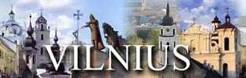
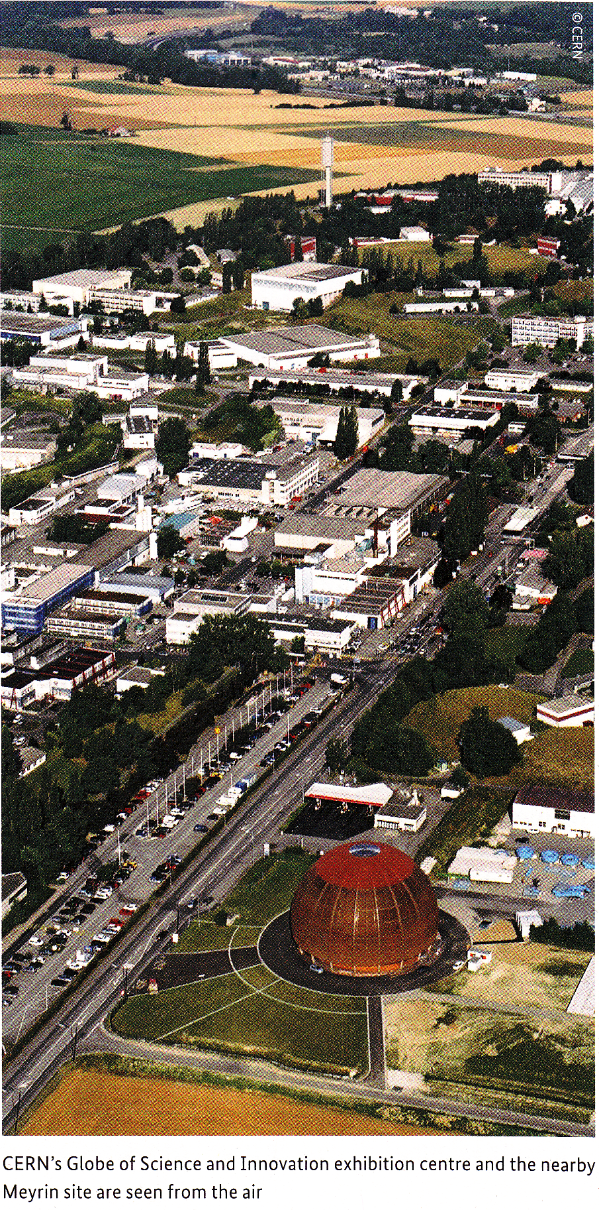
Thank you
for your attention!
CERN

