Slide 1
A Massive Open Online Course about Particle Accelerators
May 2018
Nicolas Delerue, LAL
(CNRS and Univ. Paris-Sud, University Paris-Saclay)

Slide 2
Motivation
The TIARA survey has shown that there is a good offer of accelerator courses at Master and PhD level.
However there is a lack of accelerator courses for undergraduates except in a few Universities and large laboratories.
Undergraduates from most Universities are not offered any opportunity to learn accelerator physics.
The TIARA report recommendation was: To establish an `e-learning' course, `Introduction to Accelerator Science and Technology', primarily aimed at physics and engineering students at the undergraduate level, but potentially accessible to any interested person.
An Massive Open Online Course (MOOC) could achieve such goal.
This MOOC is implemented as part of ARIES WP2.4.

Slide 3
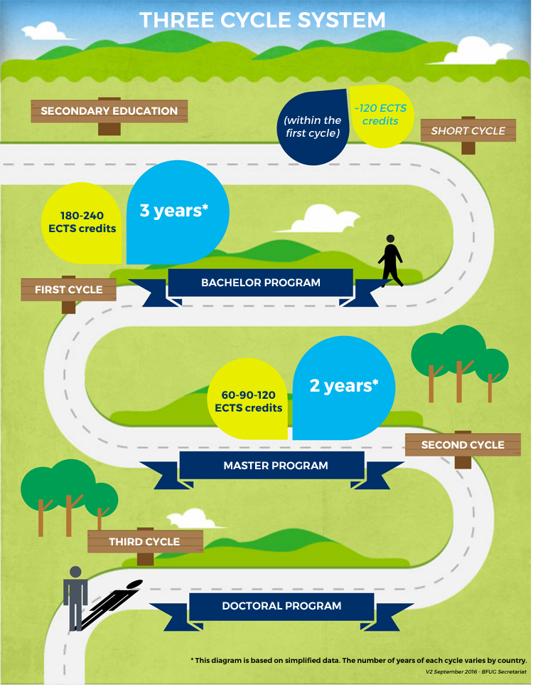
About our target audience
Source: https://www.ehea.info/pid34438/three-cycle-system.html
Studies in the European Higher Education Area are organised according to a 3 cycle system.
This is often called the “Bologna process”.
In the EHEA students are awarded credits (ECTS) for successfully attending a course.
At the end of the first cycle, “bachelor program” (3 years of studies) they will have earned between 180 and 240 ECTS.
Our target audience is students at the end of the first cycle or at the beginning of the second cycle.
That is student who have earned between 200 and 300 ECTS in physics or related subjects.

Slide 4
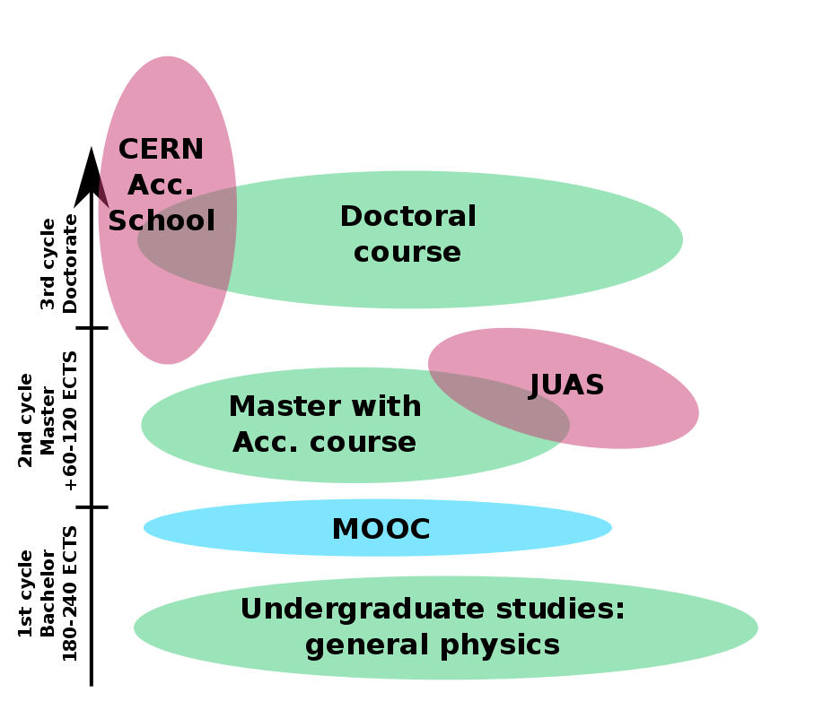
The MOOC in the European landscape
Our target audience is students at the end of the first cycle.
Before they go to JUAS or CAS or graduate/doctoral studies.

Slide 5
Other target audiences?
Many other target audiences that have been suggested.
It has been decided to stick to the TAIRA recommendation (primarily aimed […] students […], but potentially accessible to any interested person).
But other audiences are welcome as well:
  Young engineers and scientists: They should have a scientific level similar (or higher) than the students we are targeting so they will be able to attend the MOOC easily.
  Technicians: some modules will accessible for them and some may be require a scientific level too advanced.
  Other countries (non EU): Not part of the target audience, but welcome to attend. It has been suggested to expand the MOOC to developing countries (SESAME,…) however this is not the current target.

Slide 6
Work done so far
Two experts committees have been set-up:
  A technical committee has looked and solved the technical issues.
  A syllabus committee has discussed the pedagogical matters.
Both committees meet about once a month (by video) until they fulfilled their charge.
Their findings are documented in minutes, in an IPAC’18 paper (MOMPL050) and in the milestone document produced at the first year.

Slide 7
The technical side
The recording will be split between several partners (Riga, Lancaster, CNRS/Paris-Sud,...).
The files of the courses will be released with an open license (Creative Commons CC-BY-NC-SA).
One large international platform will be used to broadcast the MOOC (discussions are still ongoing) but:
The files will be available to any country or University willing to have it on a national or local platform.
Given the diversity of rules in Europe to deliver a diploma, no diploma will be issued by the consortium, however:
  MOOC platforms usually issue certificate of attendance.
  If some universities want to issue a diploma following their own rules and using the MOOC as a support they will be welcome to do so.

Slide 8
Proposed broadcast model for the MOOC
Course files
(video+quizz)
Course coordination
International
MOOC platform
National
MOOC platform
(if requested)
University
MOOC platform
(if requested)
International
Forum
National
Forum
University
Forum
Platform/country/University specific assessment
University specific certificate
Platform specific certificate
Platform specific certificate

Slide 9
Language
The MOOC will be in English with English sub-titles.
However, we are aware that in some countries it may be difficult to have student follow a course in a foreign language.
Each country/language group will be welcome to provide translation files/sound track if they wish so.

Slide 10
Differences between a MOOC and a normal course
A MOOC is not a normal lecture.
It is no meant to be watched by blocks of one hour.
Instead it can be watched “concept by concept” when students have time.
They can replay the video related to a concept if they have not properly understood it.
This means that one hour of video is equivalent to 3-4 hours of normal lecture.
The course will be split in several “topics” of about one hour each.
Each topic will be will be split in several “concepts”.

Slide 11
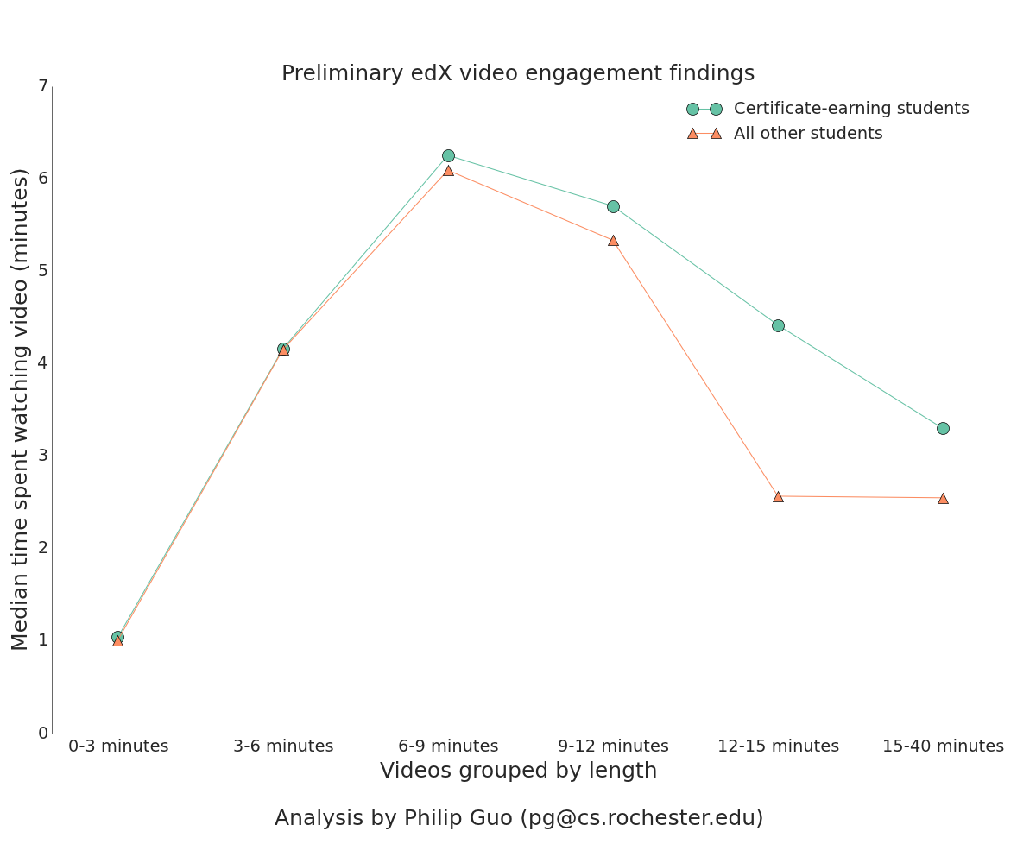
About the duration of each video
There have been studies (not by us) to find to optimal duraction for a video explaining one concept.
Several study point to an ideal duration of about 6-9 minutes (see for example the image below). Sone other studies point to even shorter duration!
This would mean about 8-15 videos per hour.
Source: https://blog.edx.org/optimal-video-length-student-engagement

Slide 12
Syllabus
The syllabus committee has met several times to discuss about what the content of the syllabus should be.
To guide us a quick survey of what is taught in European Universities has been made.
It is based on the replies from 16 european educational institutions.
For each syllabus received we looked at the topics addressed to look for trends.
There is a large diversity among European syllabus.
This survey is not exhaustive, it was just meant to look for trends.

Slide 13
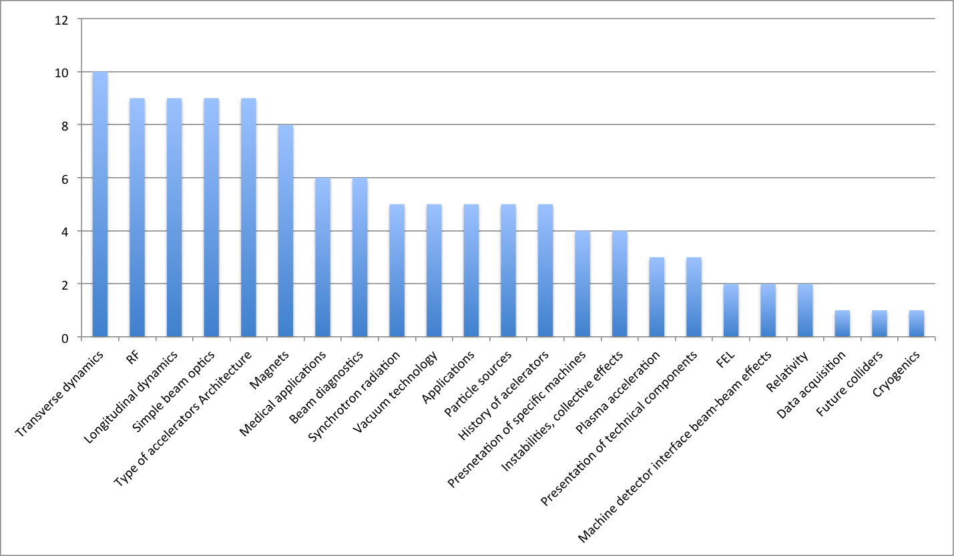
Trends in syllabus

Slide 14
Full list
Transverse dynamics | 10
RF | 9
Longitudinal dynamics | 9
Simple beam optics | 9
Type of accelerators Architecture | 9
Magnets | 8
Medical applications | 6
Beam diagnostics | 6
Synchrotron radiation | 5
Vacuum technology | 5
Applications | 5
Particle sources | 5
History of accelerators | 5
Presentation of specific machines | 4
Instabilities, collective effects | 4
Plasma acceleration | 3
Presentation of technical components | 3
FEL | 2
Machine detector interface beam-beam effects | 2
Relativity | 2
Data acquisition | 1
Future colliders | 1
Cryogenics | 1
Note: this is not exhaustive, it is just a sampling based on the data I collected.

Slide 15
Trends in syllabus (topics cited > 8 times)
Topics cited at least 8 times:
  Transverse dynamics
  RF
  Longitudinal dynamics
  Simple beam optics
  Type of accelerators/Architecture
  Magnets

Slide 16
Trends in syllabus (topics cited 5-6 times)
Topics cited 6 or 5 times (no topics cited 7 times):
  Medical applications
  Beam diagnostics
  Synchrotron radiation
  Vacuum technology
  Applications
  Particle sources
  History of accelerators

Slide 17
Course content
We decided to aim for a course equivalent to a 30-hour class. This corresponds to 10 hours online.
Based on feedback from several persons who had experience with teaching and/or online courses, the course has been split in 4 modules.
One introductory module (4 hours).
Three specializations (6 hours).
Note: the funding available should cover at least one specialization module.
The first step will be to prepare the introductory module.
We will try to use unified notation based on CAS (and JUAS).
Accelerator
physics
Accelerator engineering
Applications
Introductory course

Slide 18
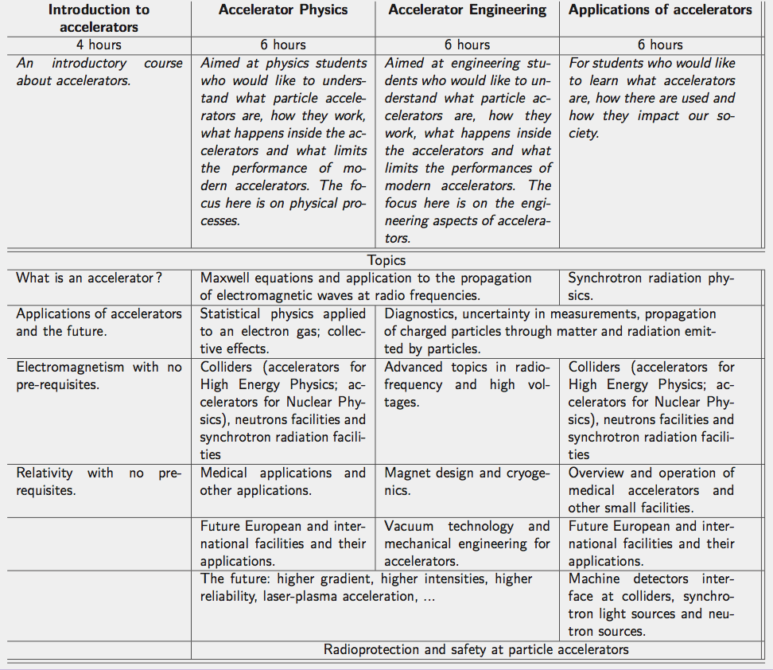
Draft syllabus

Slide 19
Draft syllabus: Introductory course
Duration : 4 hours
What is an accelerator?
Philippe Lebrun has agreed to coordinate this course.
Applications of accelerators and the future
Angeles Faus-Golfe has agreed to coordinate this course.
Electromagnetism with no pre-requisites
Vittorio Vaccaro has agreed to coordinate this course.
Special Relativity with no pre-requisites
Elias Metral has agreed to coordinate this course.
Trying to get a good balance in countries and gender among coordinators proved challenging => Finding coordinators was more difficult than expected!
Note: each topic will be split in several 7-12 concepts, each concept will be presented in a video with a maximum duration of 7 minutes.

Slide 20
Schedule
1st May 2017: Start of the ARIES project
Until May 2018:
  Define the syllabus of the course
  Identify course coordinators
  Define the technical infrastructure
  Write a report on the MOOC
June 2018:
  Identify lecturers
Summer 2018 - Spring 2019:
  Prepare the lectures
  Record the lectures
Spring 2019 – Autumn 2019:
  Prepare the MOOC for delivery
Before May 2020 (Compulsory milestone):
  MOOC ready for delivery
Autumn 2019 or Autumn 2020:
  First delivery of the MOOC on an online platform

Slide 21
Outlook
The ARIES MOOC will address the main recommendation from the TIARA education report.
The syllabus is defined.
Topics coordinators identified for the introductory courses.
Lecturers are being identified for the introductory courses.
Finding topics coordinators was more difficult than expected => if you know people who might be interested in coordinating one of the topics of the advanced modules, email me (delerue@lal.in2p3.fr).
Strong interest at IPAC’18.
Project on schedule for a delivery before May 2020 (probably autumn 2019).

Slide 22
Thank you

