Slide 1
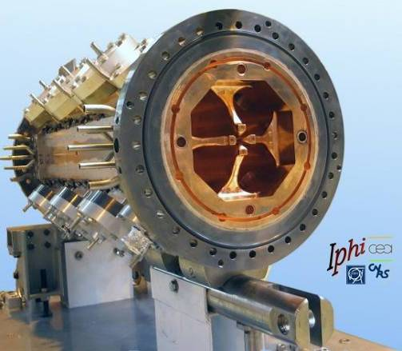




STATUS of the IPHI facility
(Injecteur Protons Haute Intensité)
C. Marchand
CEA Paris-Saclay/IRFU/DACM

Slide 2
Content of talk
Goals and history
IPHI layout description
RFQ conditioning and first beam (2014/2016)
Neutron production and beam diagnostic tests (2017/2018)
Present upgrades
Roadmap towards CW

Slide 3
IPHI goals and history
Goal: Develop R&D in France on High Intensity Proton Injector technology
  100 mA CW proton beam up to 11 MeV (352 MHz RF)
  Develop expertise for future proton accelerator projects (IFMIF, SPL, ESS, …)
  Develop compact neutrons sources to replace phased out R&D nuclear reactors
  Provide facility to test and develop novel non intercepting beam diagnostics
Initial layout (PAC’97 Vancouver, PAC 2000 Vienna) inspired by LEDA design
  SILHI source + LEBT+ RFQ (8m, 5 MeV) + DTL (11 MeV) + MEBT (CEA/CNRS)
Actual layout (HIHBB 2004)
  Rescoping in 2002 in framework of CEA/CNRS/CERN collaboration
  IPHI limited to SILHI+LEBT+RFQ (6m, 3 MeV)+MEBT, DTL descoped
Notes:
Rappeler ici les 3 layouts historiques (97, 2000 et 2003)

Slide 4
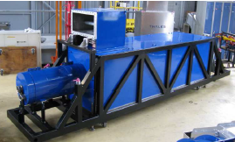
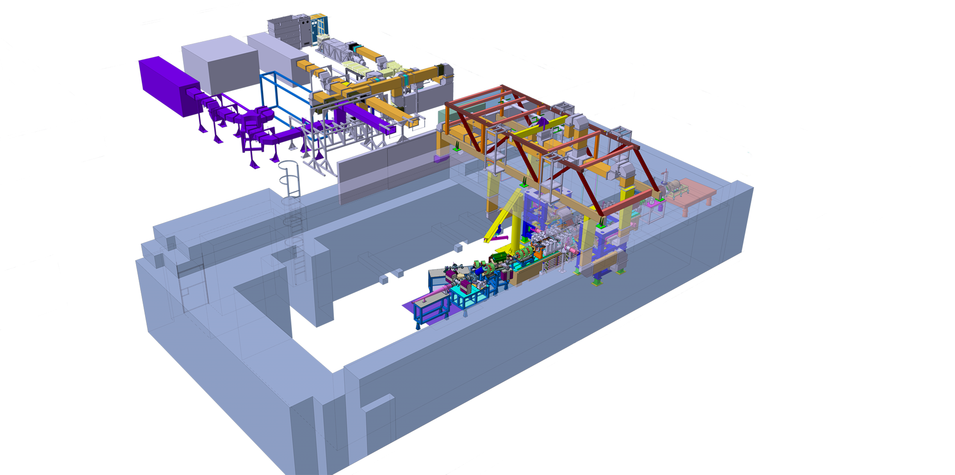
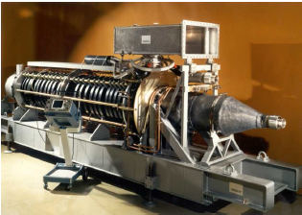
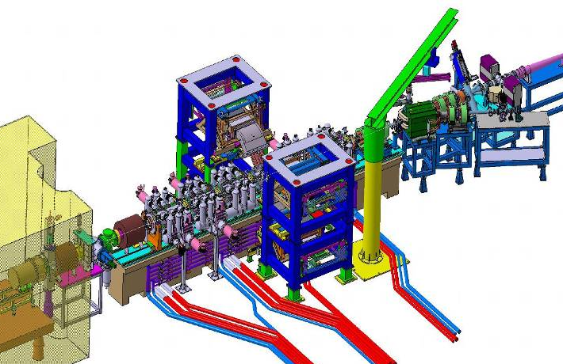
Overview of IPHI installation
2.8MW @352MHz pulsed
  240kW average
  10µs <Tp< 3600µs
  1Hz< Freq < 50Hz
K3
K1
K2
NEW (Sept 2018)
1,3MW @352MHz CW
Notes:
Layout 3D général, puis layout 2D général avec RF, puis layout 2D

Slide 5
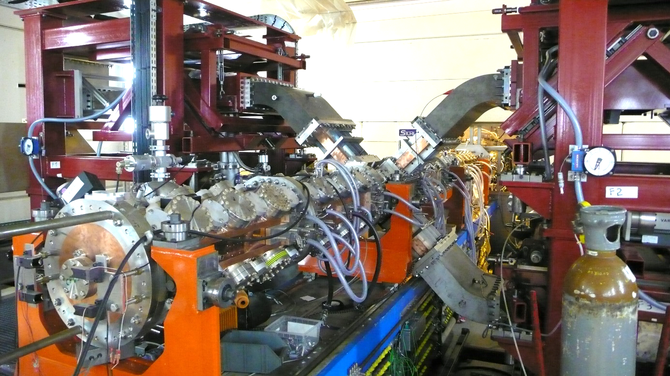
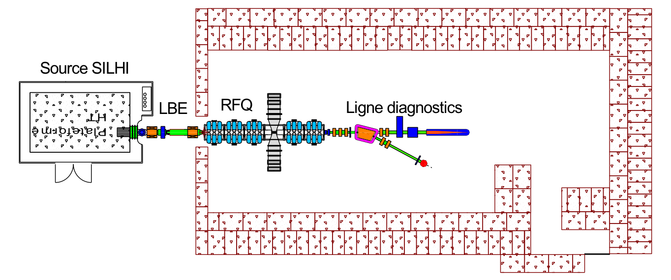
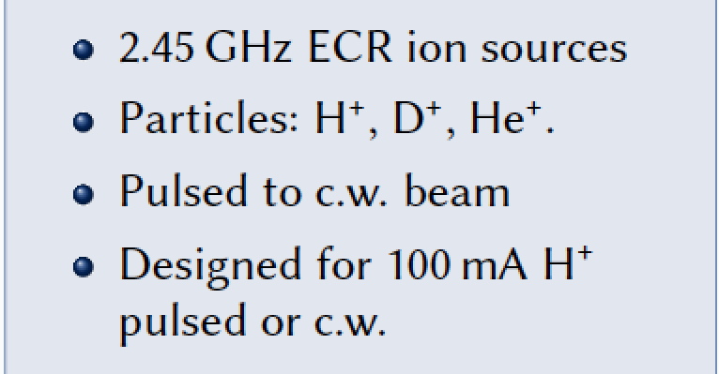
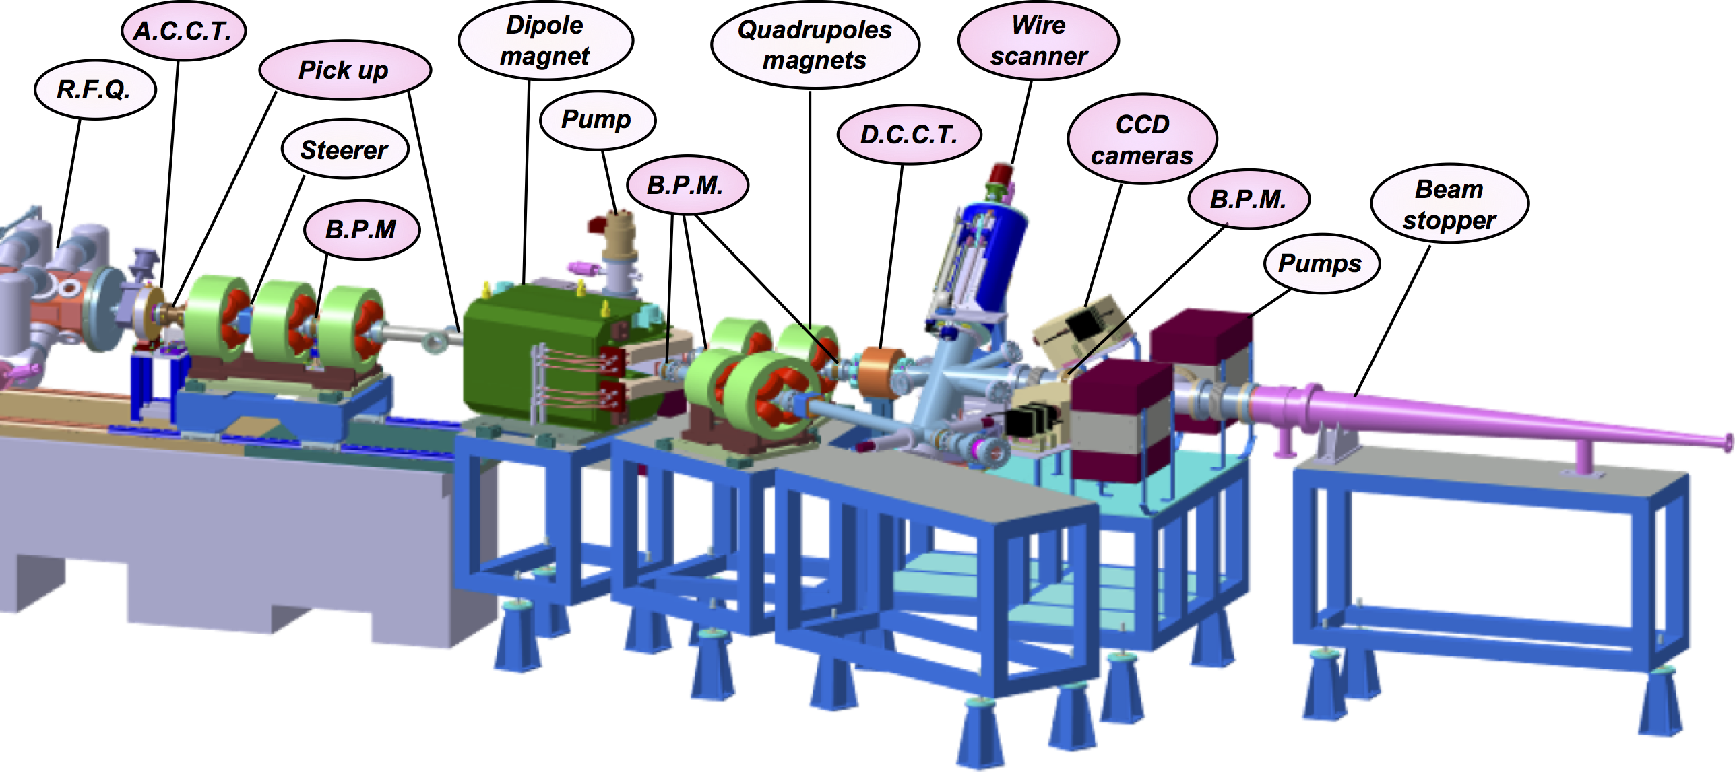
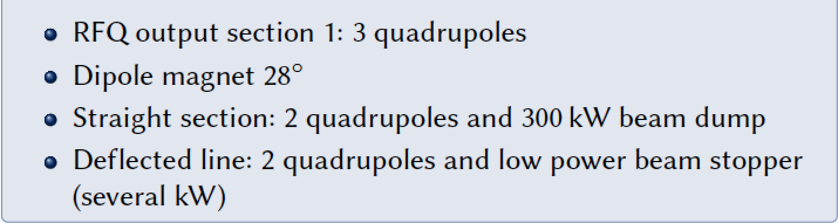
IPHI beam line components
LEBT
900kW dissipated power
300kW (100mA,3MeV)
Notes:
Photos et paramètres succincts Source-LEBT-RFQ-MEBT (silde 20 Gobin+Pottin)

Slide 6
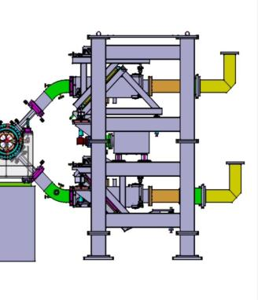
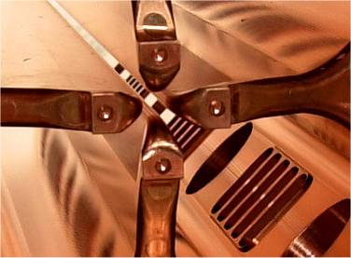
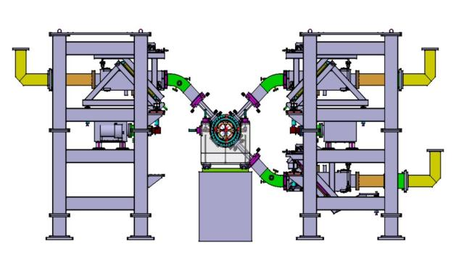
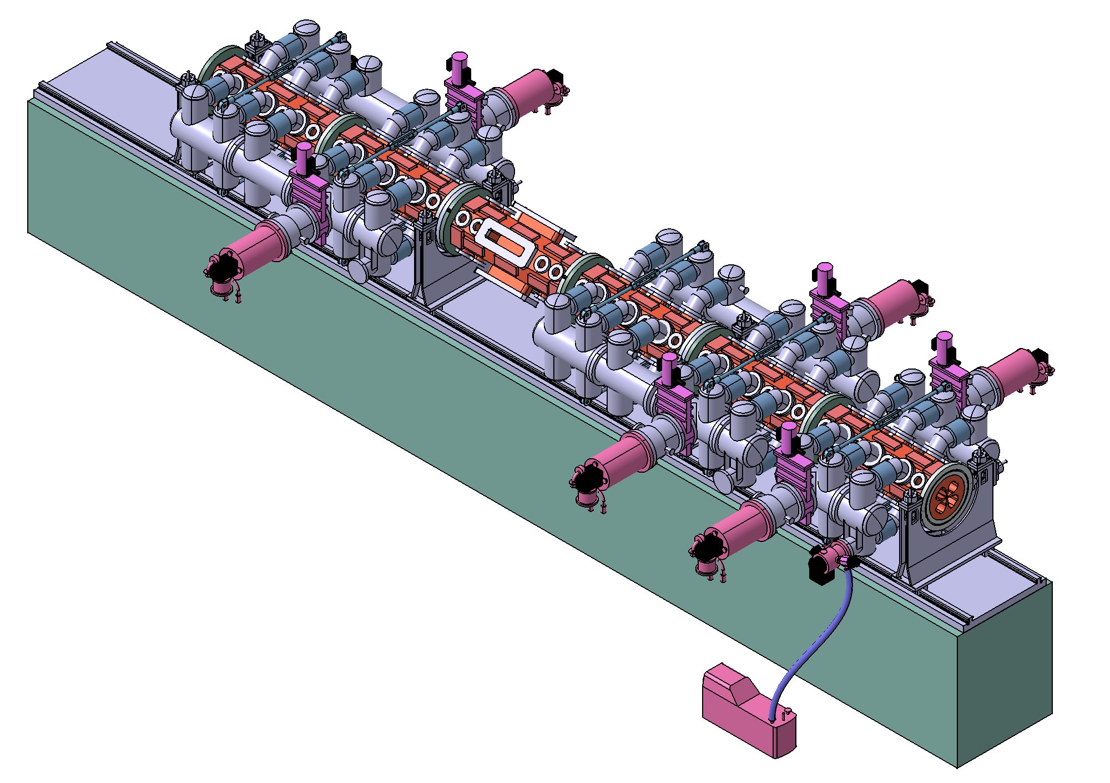
RFQ specifications
Q₁
Q₂
Q₃
Q₄
6 sections (3 segments)
2 end plates
2 coupling plates
60 pumping ports
4 RF injections on 4th section
96 RF stub tuners
268 water cooling channels
Notes:
Figure 3D avec liste specs

Slide 7
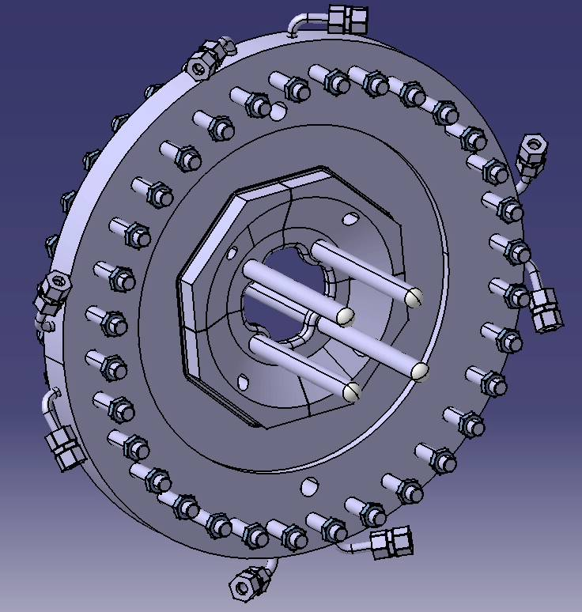
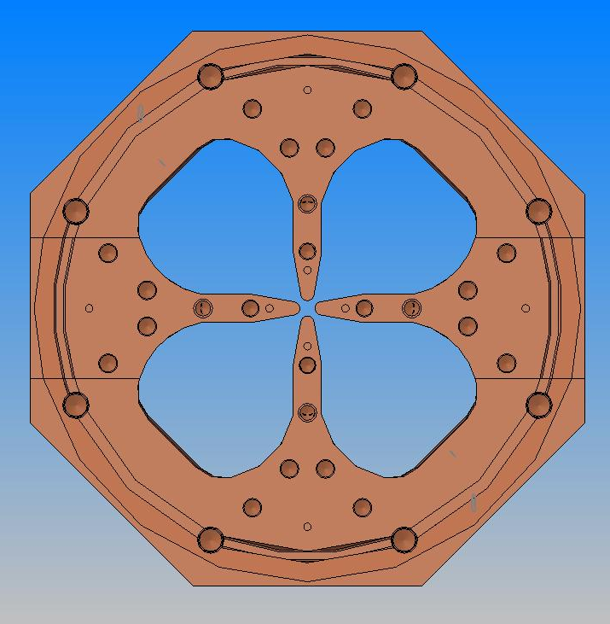
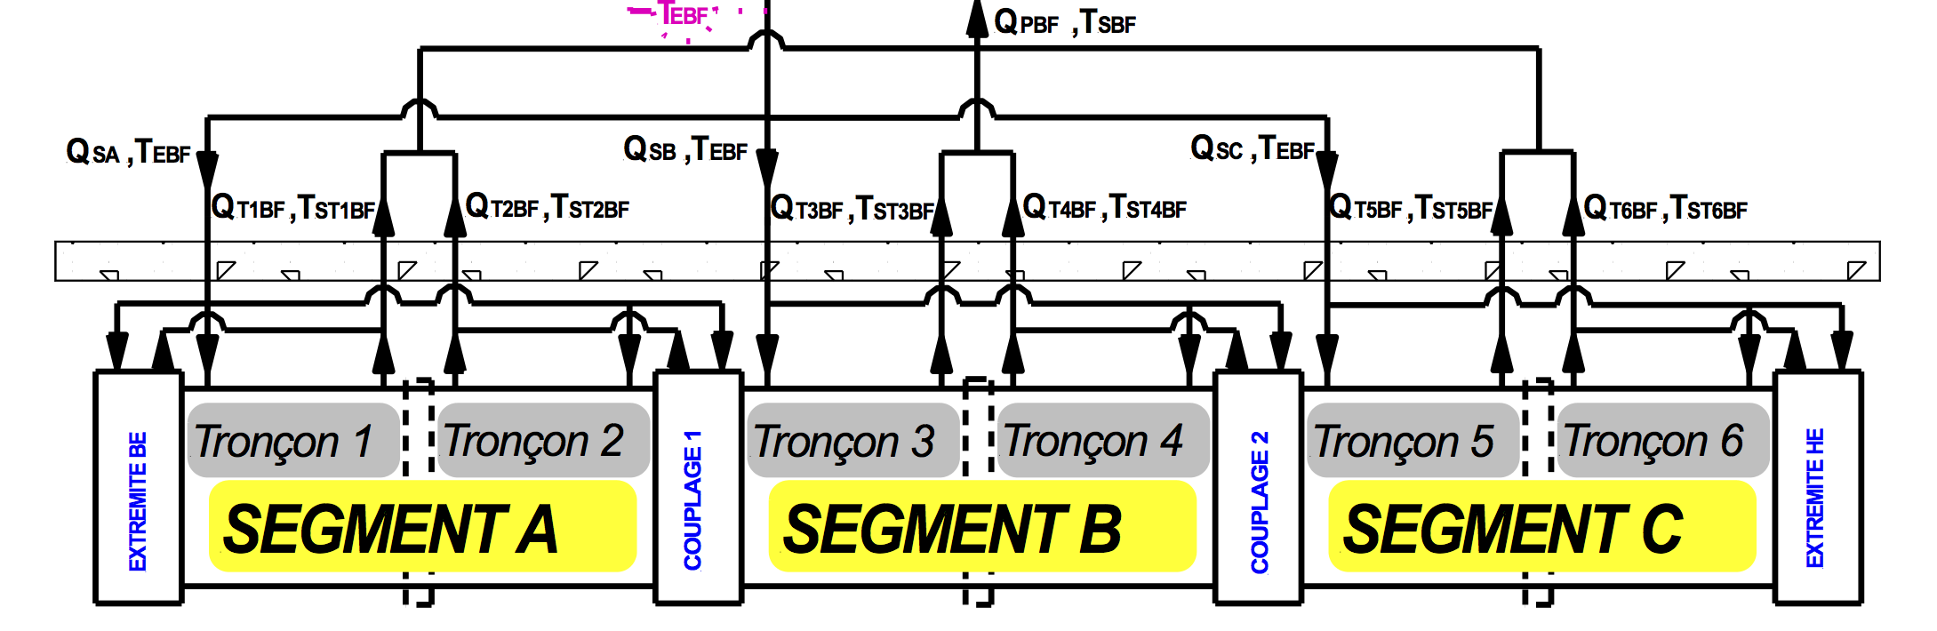
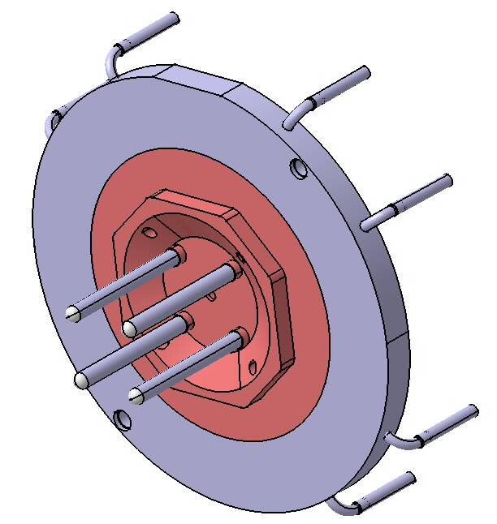
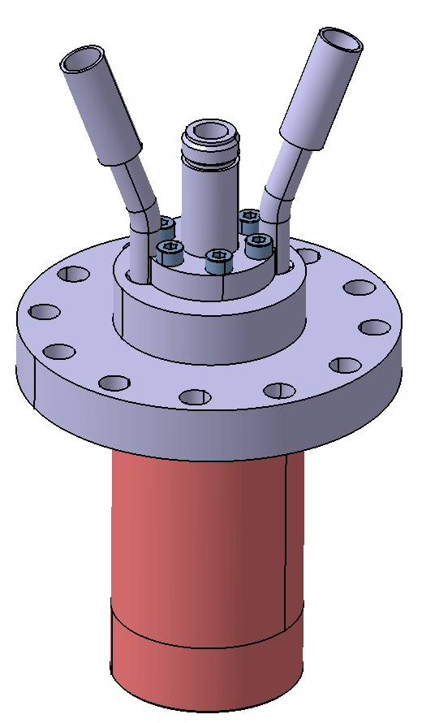
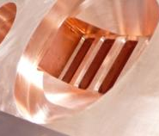
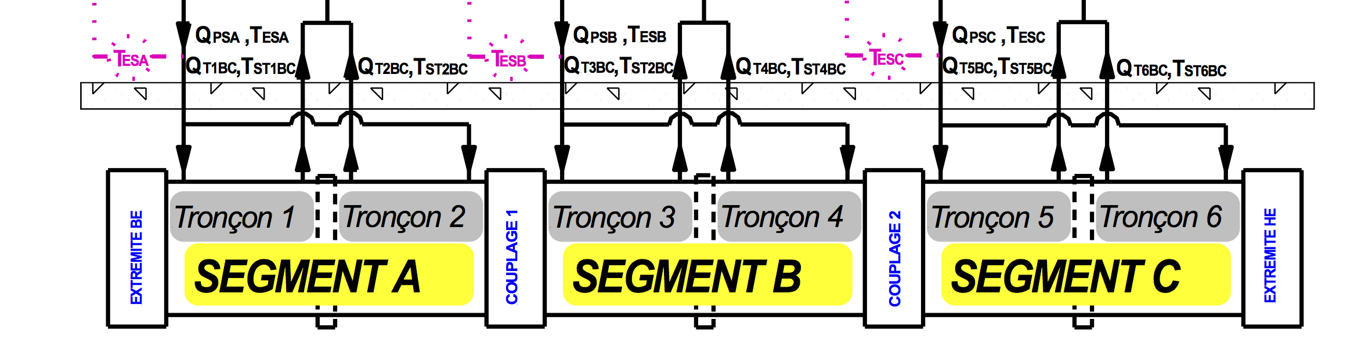
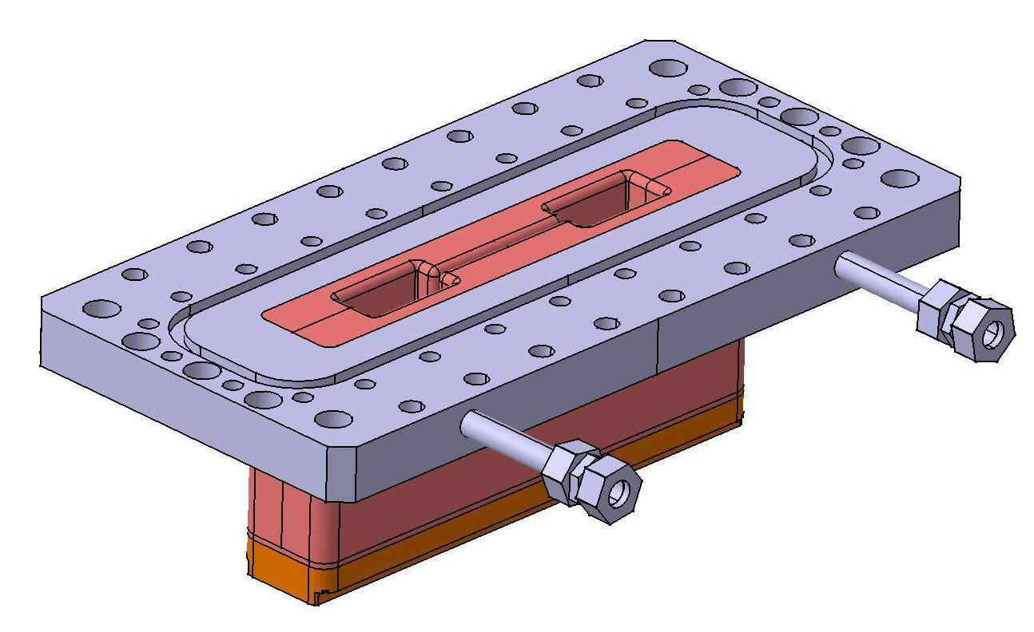
RFQ cooling system
One « cold » loop: (11->30°C)
Channels 1,2 of all RFQ segments
+ Coupling plates+ end plates
2
1
Three « warm » loops (1/segment):
Channels 3,4,5 of one RFQ segment
+ Slug tuners + vacuum ports (+ RF ridges)
5
4
3
Notes:
Boucles de refroidissement et description sommaire pompage et ridges

Slide 8
RFQ cooling system
Minimal cooling for RFQ conditioning (2014-2016)
-> d.c. limited to < 1%
Three « warm » loops (1/segment): 25°C
Channels 4 of one RFQ segment
4
Notes:
Boucles de refroidissement et description sommaire pompage et ridges

Slide 9
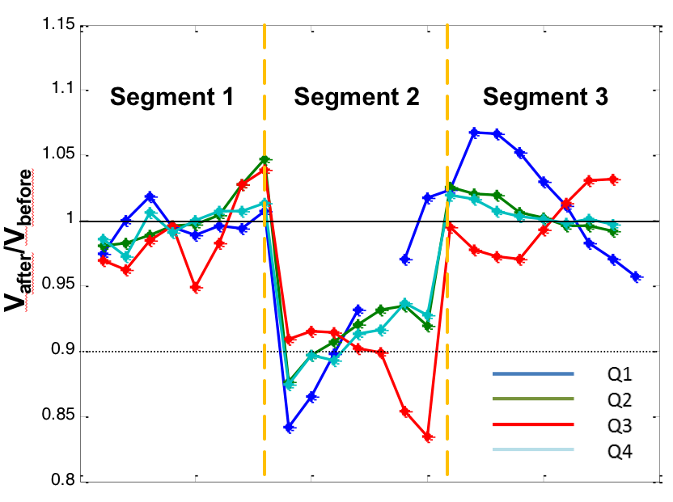
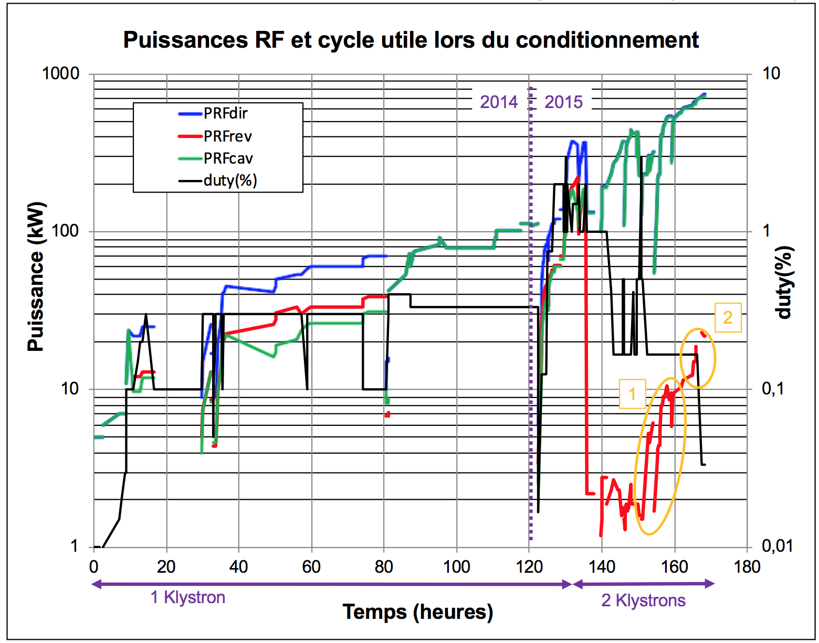
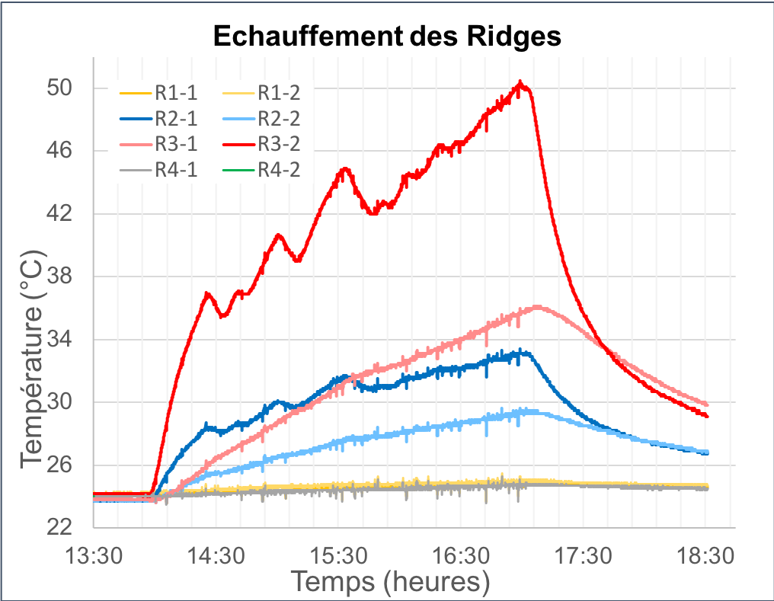
Initial RFQ conditioning (2014-2015)
Loss of 10% voltage in segment 2
Frequency shift: ~ -80 kHz
Fluctuations in reflected power
Heat up on RF entries in Q₂, Q₃
Notes:
Plot conditionnement + glitch freq + loi tension + ridge warming, inspection, repair

Slide 10
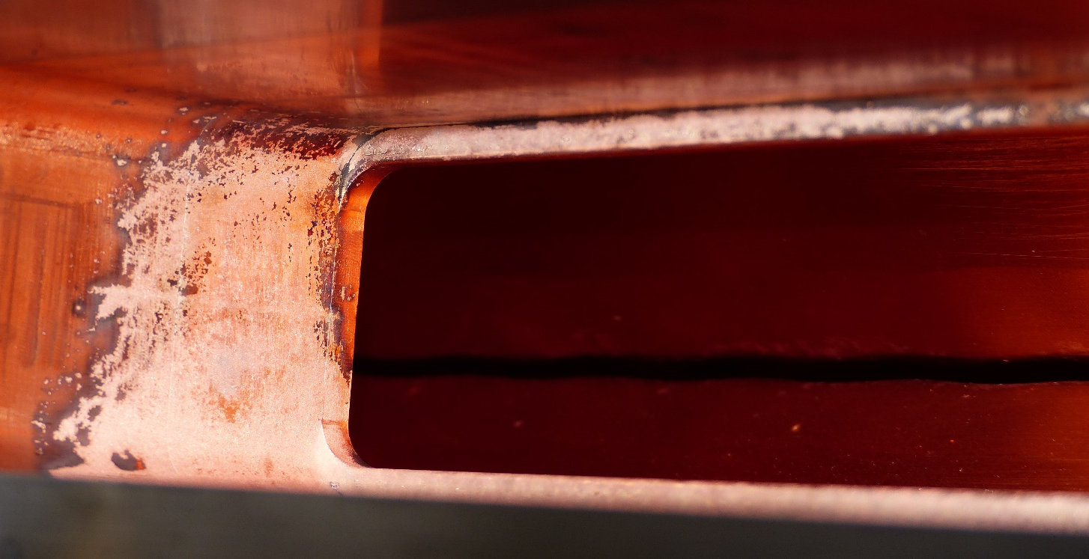
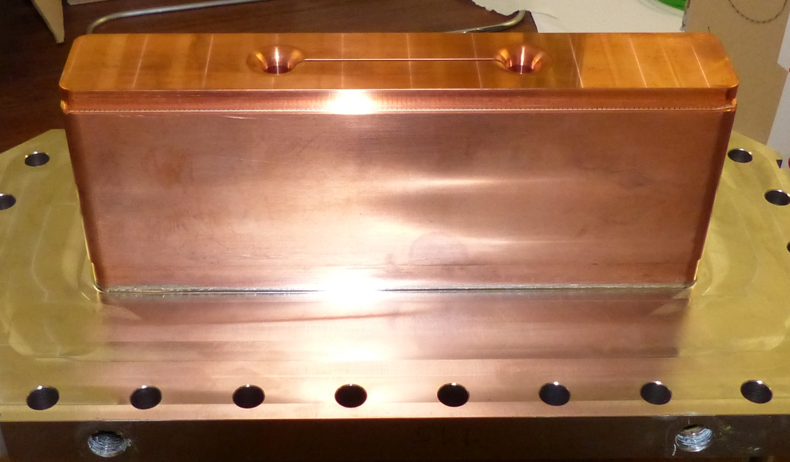
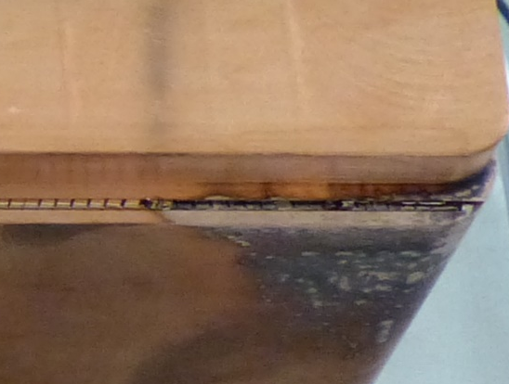
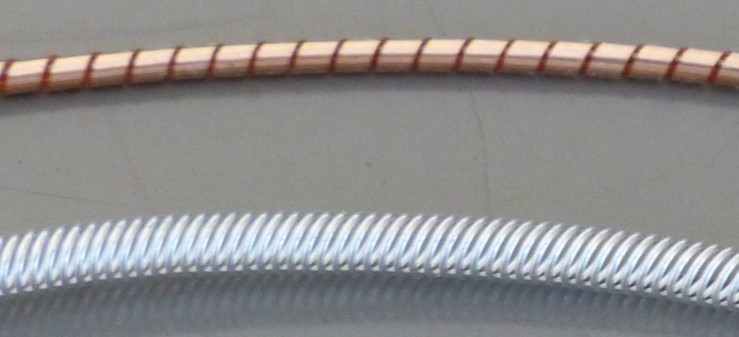
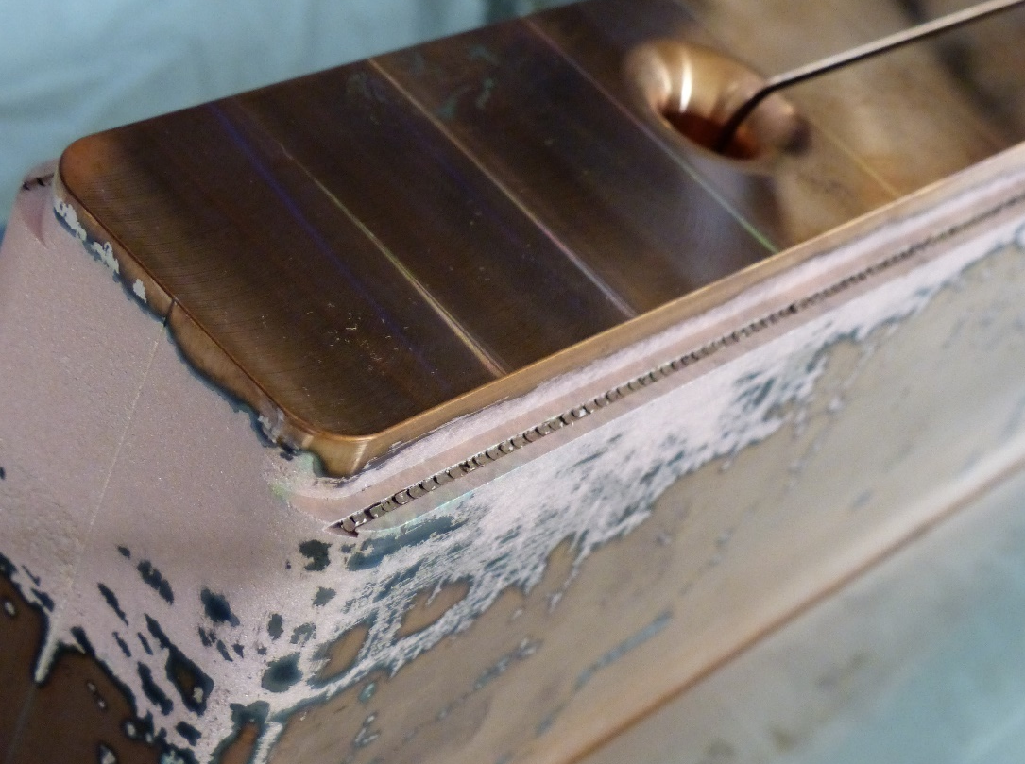
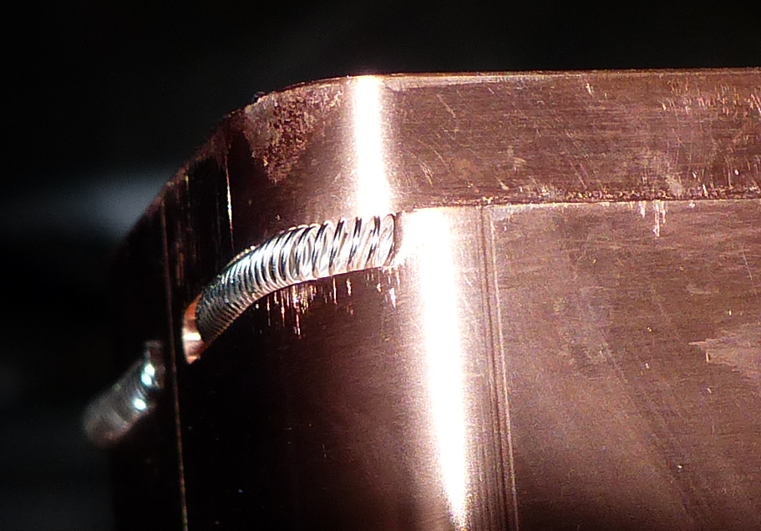
Initial RFQ conditioning (2014-2015)
Ridge status in Q₂, Q₃
after dismounting
Fix to solve issue
Heavy sparking
Clean ridges
Vaporized RF seal
Change RF seal
Missing seal on side
Add seal on side
Frequency shift: ~ -80 kHz
Fluctuations in reflected power
Notes:
Plot conditionnement + glitch freq + loi tension + ridge warming, inspection, repair

Slide 11
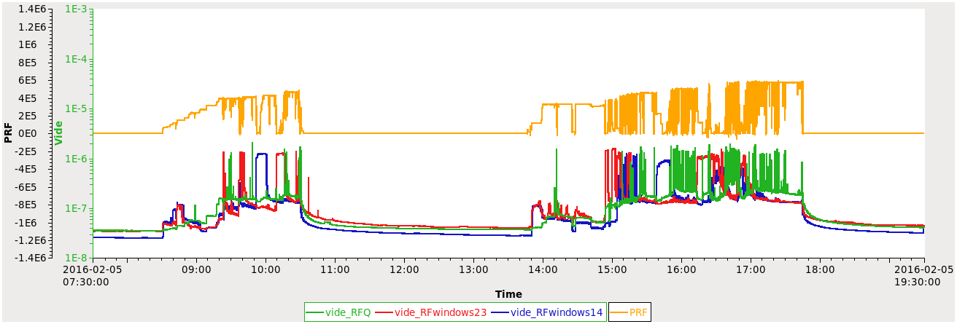
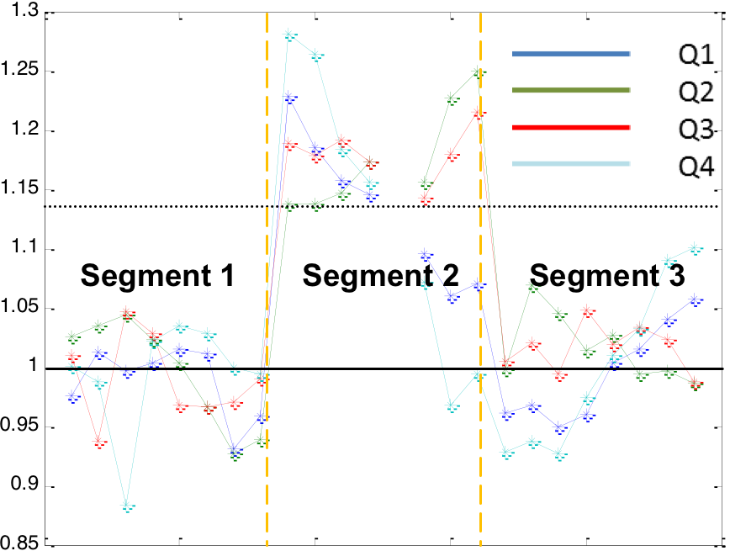
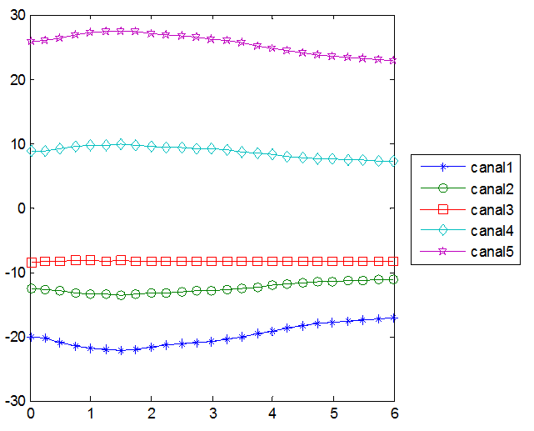
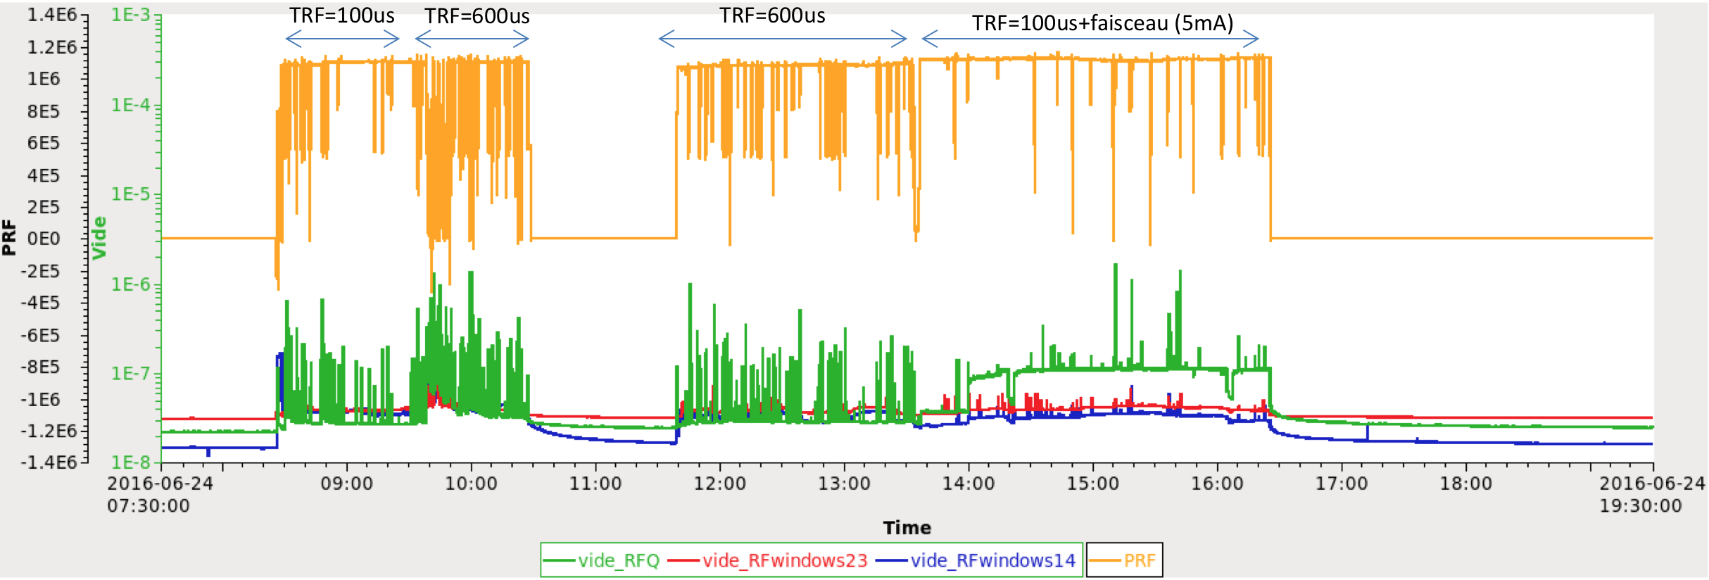
RFQ conditioning (2016)
After replacing ridges:
Frequency shift: ~ +100 kHz
1.2 MW peak power, 0.6% d.c. (600μs, 10 Hz)
Increase of voltage in segment 2 (13%)
dF/dT (kHz/°C
Can be corrected increasing segment 2 loop temperature by ~4°C
Notes:
Plot conditionnement + loi tension + dF/dT pour ratrapper 100 kHz décalage

Slide 12
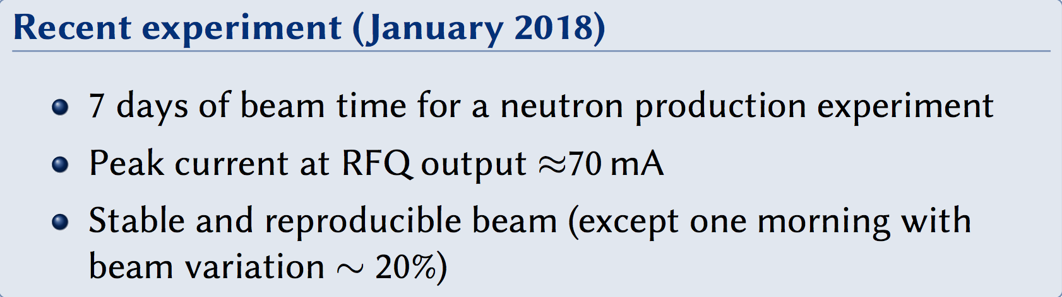
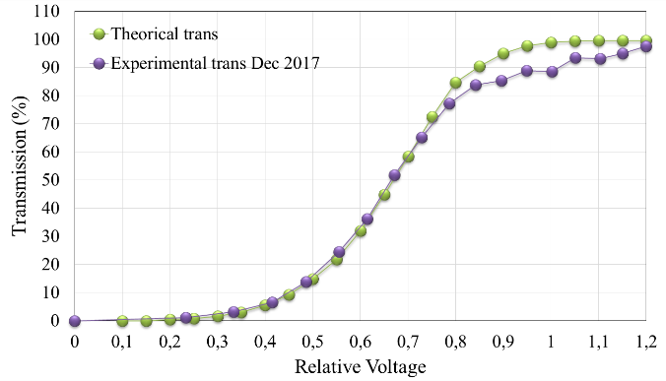
IPHI beam (low d.c.)
First IPHI beam: spring 2016
Transmission | Simulated | Experimental
RFQ | 98 % | 96 %
Transmission | Simulated | Experimental
LEBT | 70 % | 73 %
RFQ | 98 % | 93 %
Notes:
Transmission initiale + profil faisceau + transmission améliorée

Slide 13
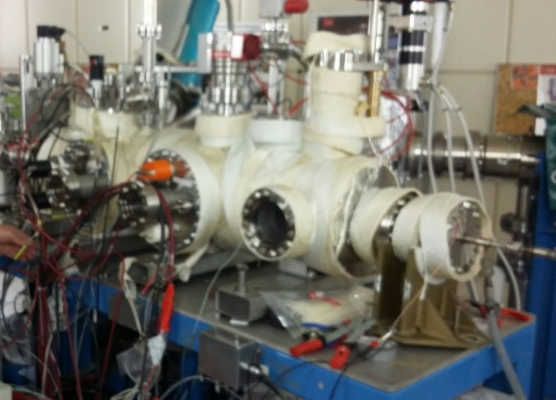
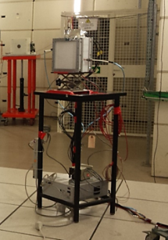
2017 & 2018 experimental setups
MCP IPM
Neutron production
³He n TOF detector
8 m
Diagnostic tests
(prototypes for ESS)
Be target + moderator
nBLM detector
Notes:
Setup 2D pour production neutrons et tests diagnostics ESS

Slide 14
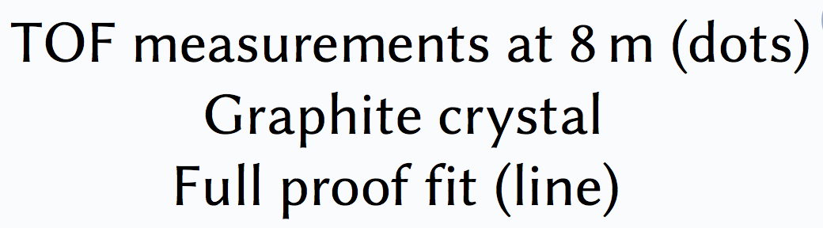
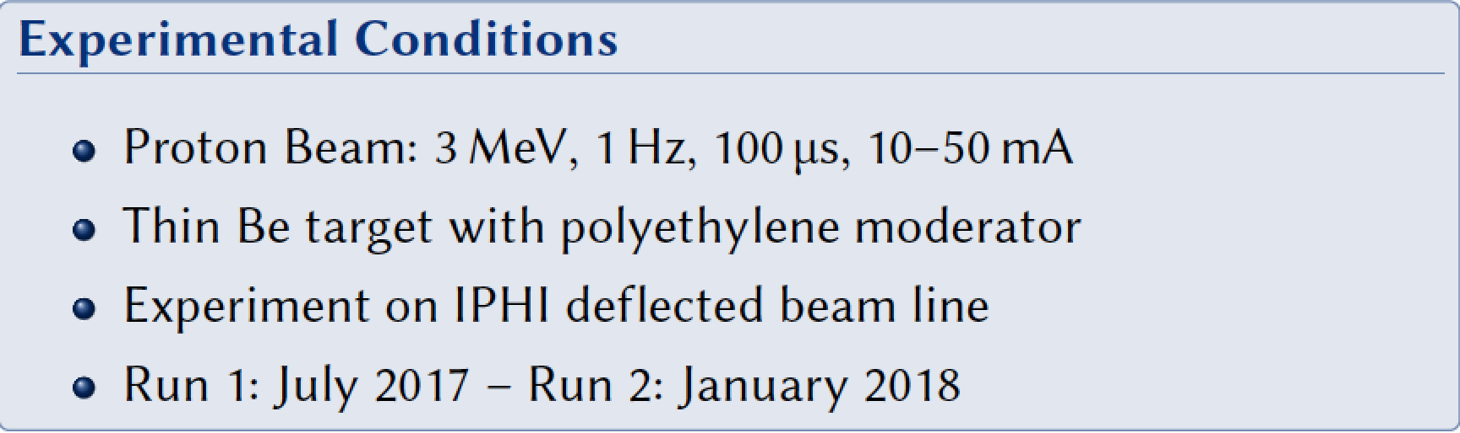
Neutron production runs
Neutron angular anisotropy
measured by nBLM without moderator
Notes:
Tests production neutrons

Slide 15
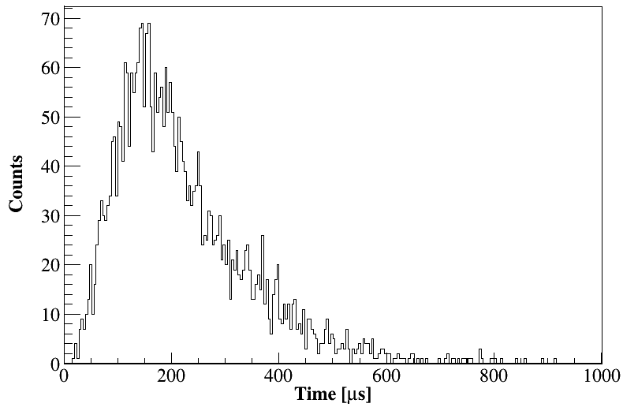
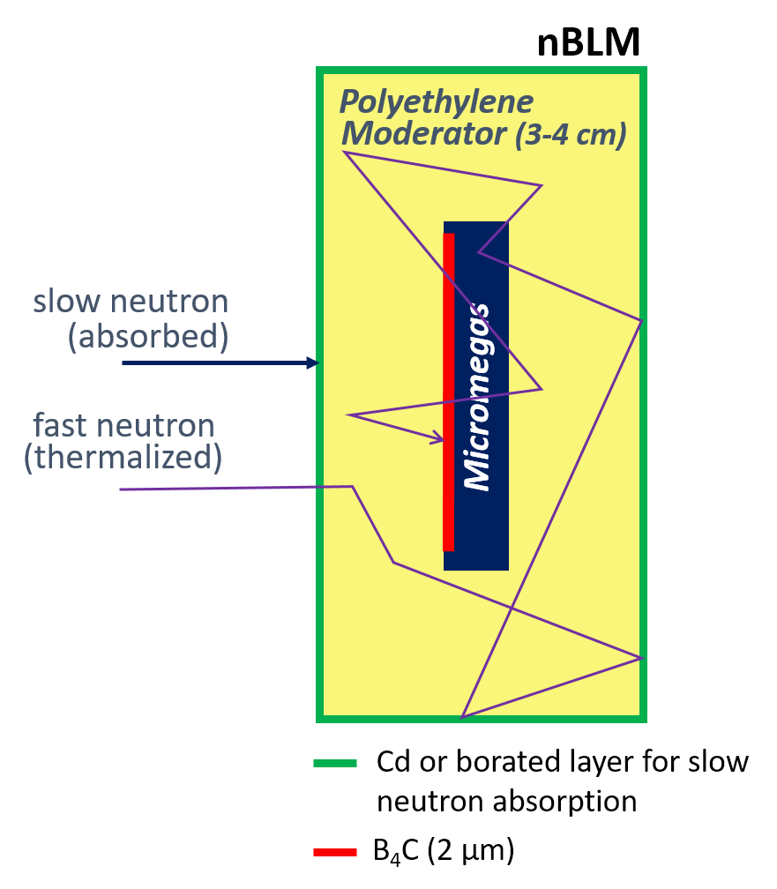
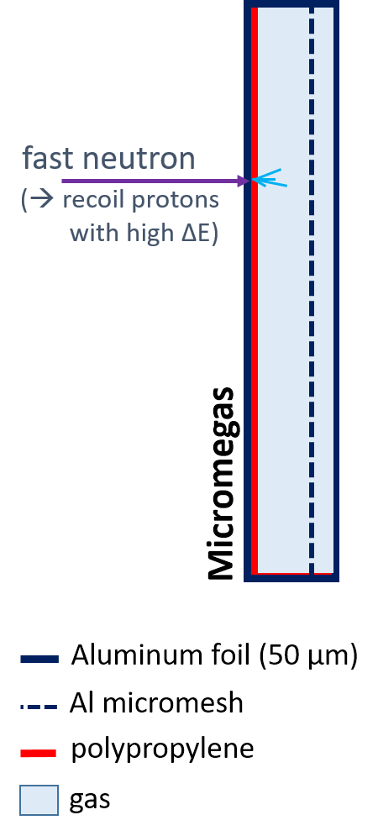
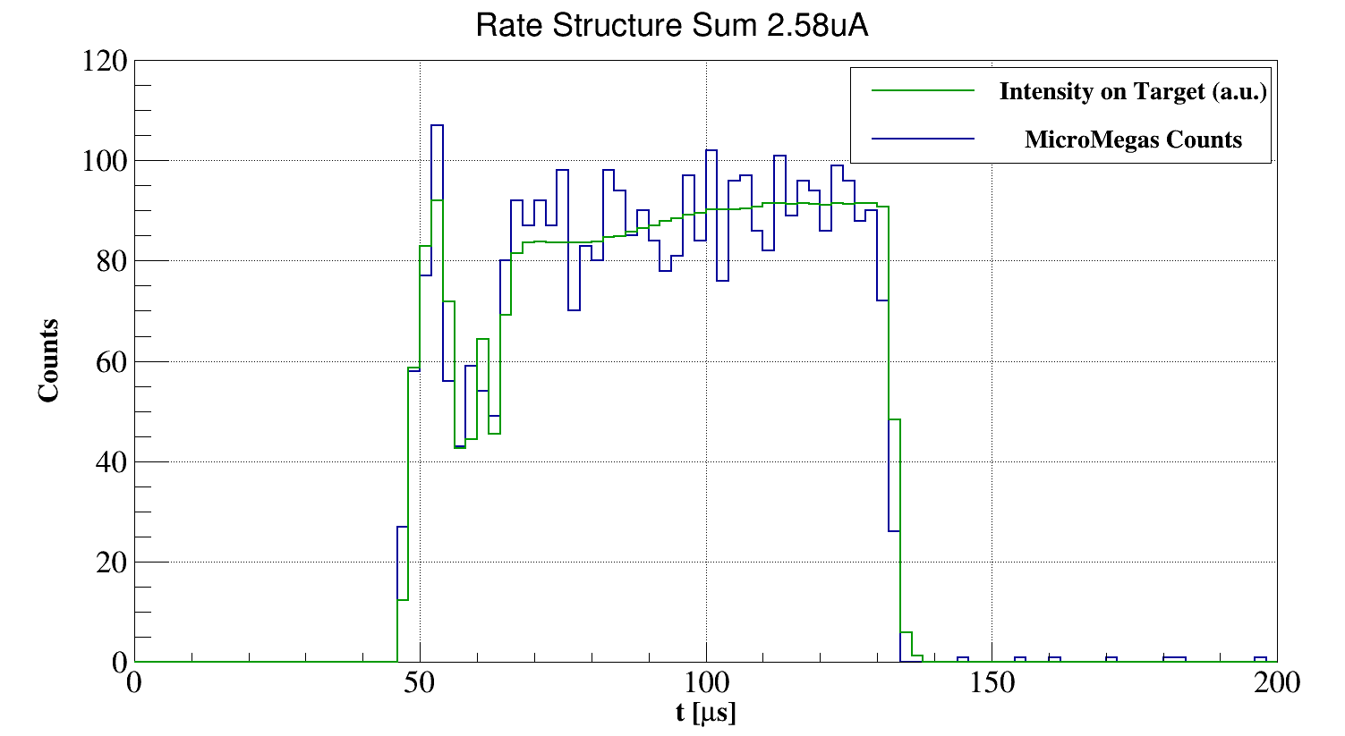
nBLM diagnostic tests
neutron Beam Loss Monitors
nBLM station: fast (top) and slow nBLM
Time response of the slow nBLM detector
SLOW nBLM
FAST nBLM
(n, α) ¹⁰B reaction on B₄C
Detection of fast neutrons after moderation in polyethylene (~4cm)
10-6 < En < 100 MeV
Efficiency: few n.cm2.s-1
Time response: >200 μs
Monitoring of small bean losses
Recoil protons (n,p) on mylar
Fast neutrons directly measured
En > 1 MeV
10 to 100 less efficient
Time response: ~10 μs
Mainly MPS
Time response of the fast nBLM detector
and beam current on target
Notes:
Test diagnostics nBLM

Slide 16
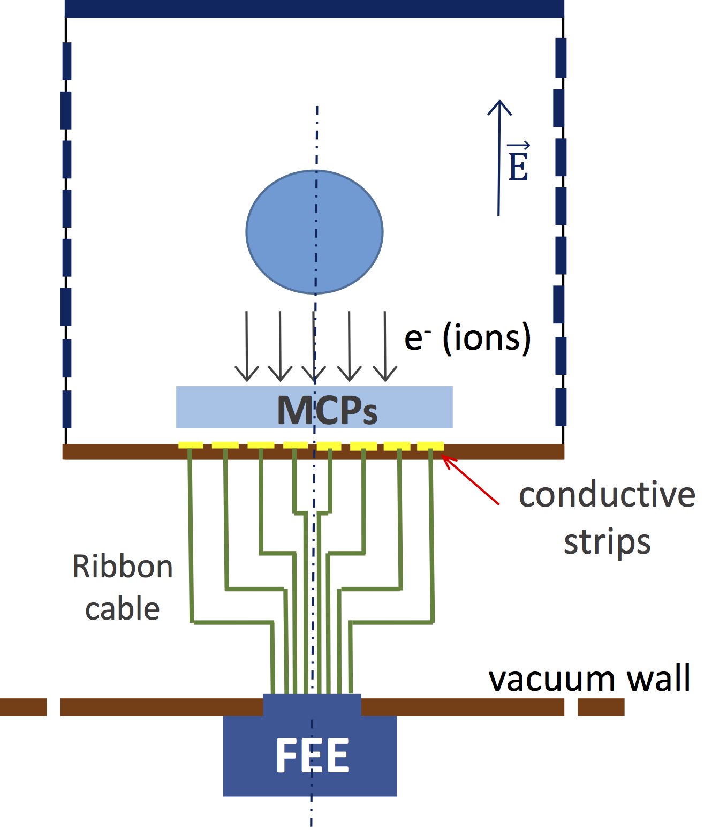
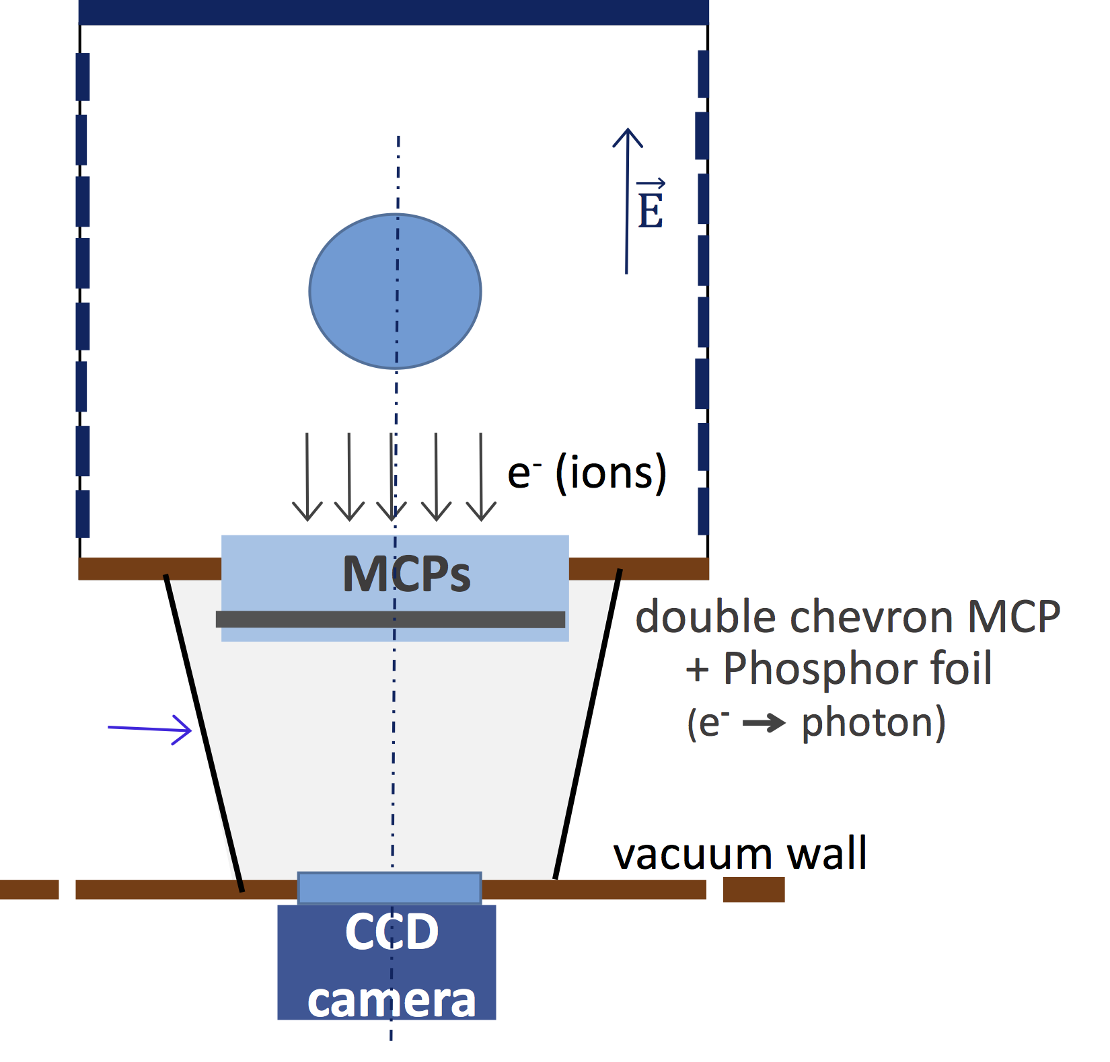
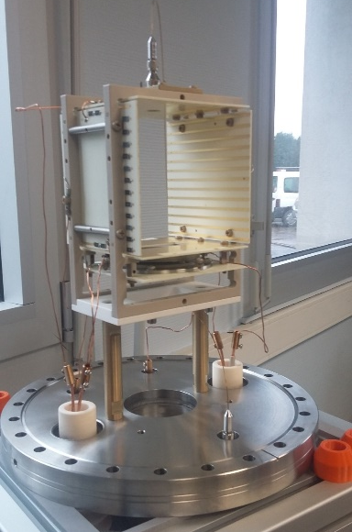
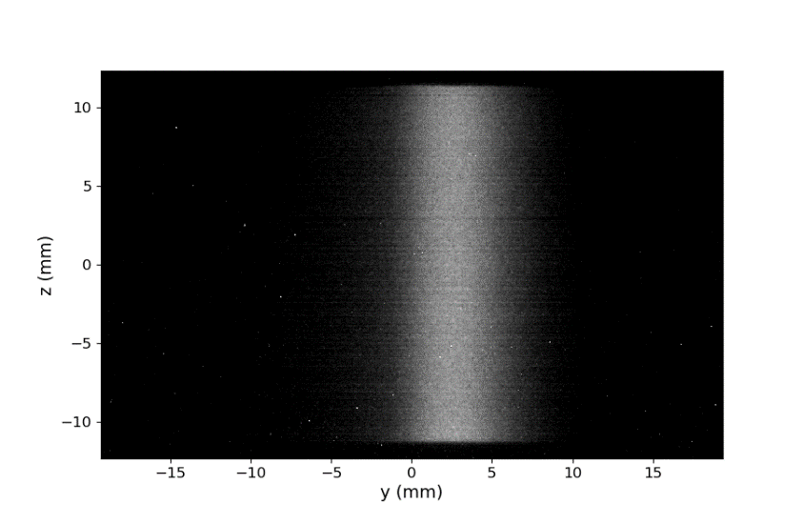
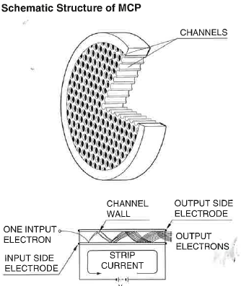


IPM diagnostic tests
Goal: to measure the beam transversal profile at high energy and very low residual gas pressure with a non intrusive technique based on residual gas ionization
MCP Hamamatsu
dX (IPM/BPM) mm
Notes:
Tests diagnostics IPM

Slide 17





Ongoing RF upgrades
New analog LLRF (pulsed)
(->september 2018)
Connect K3 pulsed klystron
(-> september 2018)
SAT new K2 CW klystron
(end of june 2018)
Notes:
Uogrades RF (klys pulsé + LLRF), cooling

Slide 18

Roadmap towards CW
Low d.c. beam run Sept. 2018 with pulsed klystron
Conditioning of RFQ to ESS d.c. (4%)
First tests for IPHI-neutrons at 7 kW end of 2018
Deliver pulsed beam for ARIES TNA
Second tests for IPHI-neutrons at 50 kW for SONATE project
Push conditioning to full CW with increased instrumentation
Preliminary SONATE layout
Notes:
Planning + 3D IPHI-neutrons

