Slide 1
ARIES
Promoting Innovation
Report from WP14
ARIES Annual Meeting -
Riga - May 24th, 2018
Marcello Losasso, CERN

Slide 2
Outline
Introduction to WP14
Status of WP14
  Partners & Objectives
  Tasks highlights
  Deliverables/Milestones and future Timeline
Conclusions

Slide 3
Status of WP14 – promoting innovation
Progress:
T14.3 Production samples almost 100% completed: many months in advance.
Sintering of the MgB₂ onto the Cu in progress.
All MS and D in the reporting period achieved and/or anticipated.
Status of contractual obligations (Milestones, Deliverables):
Open issues, difficulties (if any) : NA
MS42 | Appointing of an Industrial Advisory Board, (IAB) | WP14 | 14.3 | M12 | 09/04/2018 | Achieved | Report
MS47 | Reviewed requirements document | WP14 | 14.6 | M12 | 18/04/2018 | Achieved | Report
MS45 | First HTS Short Length produce via new process | WP14 | 14.5 M14 | Achieved | Report in preparation
D14.1 | Set-up of the Proof-of-Concept innovation-funding scheme | WP14 | 14.2 | M12 | 23/04/2018 | Achieved | Report

Slide 4
WP14 objectives
The objectives of the WP14 are:
to ensure that technology developments inside ARIES are properly evaluated and assessed with the final aim to provide society with identified commercial applications of the supported research potential.
Relation with industry (ARIES meets industry events) is key to coordination and joint research activities, increasing synergies between laboratories, universities, specialized institutes and applied research institutes in the consortium.
Provide examples of innovative actions by implementing research projects to developing HTS cable with cost-performance impact, materials for extreme thermal management, and AM of MgB2
      CERN – Wigner – CNI – RHP - BrevettiBizz
      CosyLab – Brucker – STFC - UNI Ge

Slide 5
IAB : MS42
Industry Advisory Board (IAB), appointed by STC, is a committee foreseen by CA, object of MS47. It shall:
Give advice on industrial activities within the project
Contribute to selecting projects for funding
Help in setting up business plans.
Appoint the Evaluation Committee selecting projects for PoC
Members of the IAB sign a NDA concerning information that they could access during their collaboration with ARIES.
    J.L. Lancelot (consortium PIGES, Fr)
    J.Lucas (Elytt, Sp)
    J.Allen (Elekta, UK)
    T.Eriksson (GE, Sweden)
    I.Bland (Comet, CH)

Slide 6
WP14 tasks
Task 14.1. Coordination and Communication – M.Losasso→ usual management task
Task 14.2. Proof-of-Concept innovation fund - M.Losasso→ PoC fund should be used to demonstrate commercial viability of selected technologies investigated in the frame of EUCARD3, and supported by market assessments, evaluations and business plans.
Set-up the innovation criteria for eligibility, selection and award of PoC fund
Monitor the funded project developments.
Support the prior market assessment and the commercial viability of the technologies.
Support perspective studies on industrial application of EUCARD technology.
Task 14.3. Collaboration with industry - M.Losasso→ should be the task linking the activity of the industrial partners and ARIES beneficiaries and also the task providing support actions for PoC management.
Set-up an Industrial Advisory Board, defining its mandate and scope.
Organize and manage the ARIES meets industry event
Manage the possible IP in ARIES project(s), the licensees and the partnership with industries.
Implement Market pull actions.
Disseminate the output of R&D developed in the project.

Slide 7
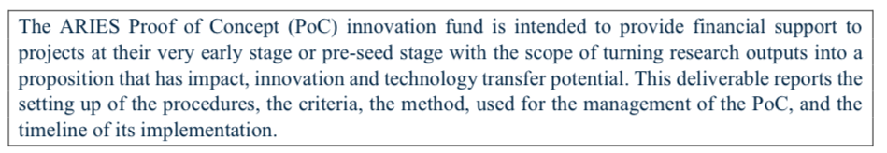
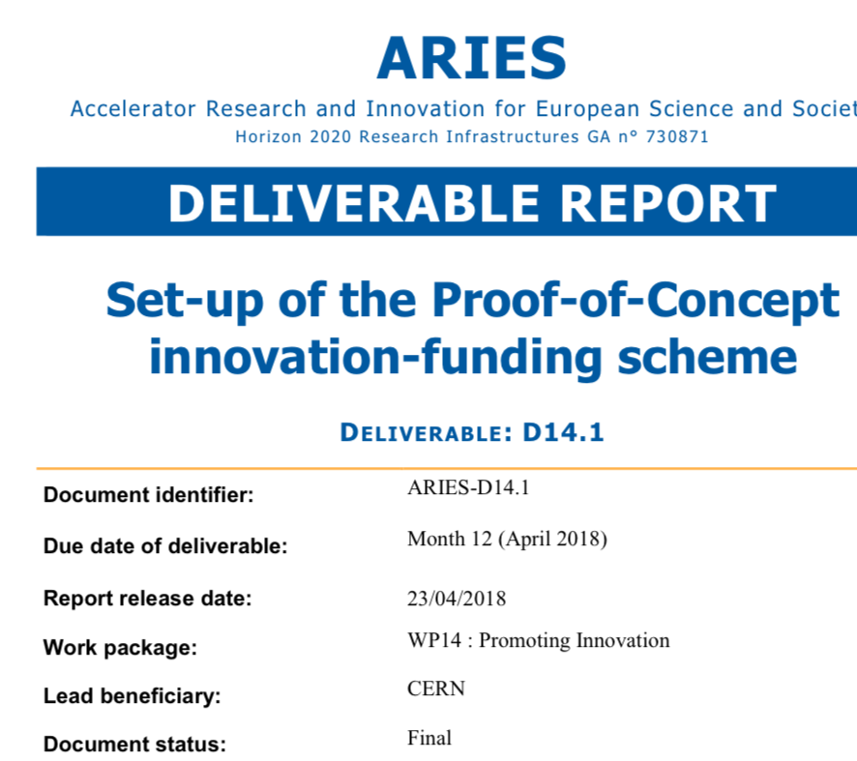
WP14.2 PoC highlights
Task 14.2. Proof-of-Concept innovation fund
In Y1 we have:
Set-up criteria for eligibility, selection and award
Set-up a body to perform evaluation of proposals (EvCo)
Launched a call for proposals
Collected valid proposals for assessment
Performed the evaluation
EDMS n 1818311 v.1.0

Slide 8
EvCo
The Evaluation Committee, appointed by IAB, is composed by:
Marcello Losasso, chair - CERN
John Allen – Elekta
Jean-Luc Lancelot - Sigmaphi/PIGES
Francesco Estraffalces – Fondazione CNI
Francis Martin – International Irradiation Association
Julio Lucas – Elytt
Tomas Eriksson – GE Healthcare
Hanspeter Vogel – Research instruments
EvCo representatives from industries, professional associations, laboratories
IAB and EvCo have almost the same composition: many IAB members
have volunteered to be part of EvCo. Thanks to them !

Slide 9

PoC: where we are
Sept 2017 → STC approves the documents prepared by WP14 detailing criteria and management of PoC, including mrthod for project selection ( D14.1 )
Nov 2017 → a PoC dedicated web site is made public according to a communication strategy
Dec 2017 → the call is open
End of March 2018 → call is closed
We are in the final phase of the evaluation.

Slide 10
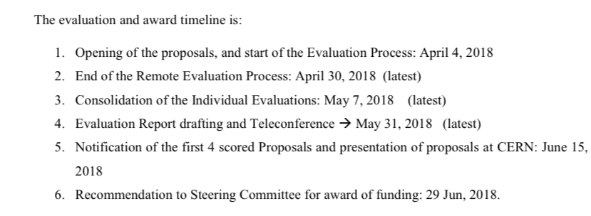
Timeline of evaluation process

Slide 11
Projects presented
10 projects have been presented
9 projects have been considered eligible
The evaluation is currently at the last steps of iteration.
We are finalizing the report of evaluation and we will ask the STC to invite the first 4 projects to present in CERN, on June 15th, their proposals for a formal and final awarding of the PoC.

Slide 12
Eligible proposals
Proposal | Proposal title | Lead Applicant | Name of coordinator:
number
#1 | Field Confined Radiofrequency ion Source for Medical and Industrial Applications | CIEMAT | Mr. Rodrigo Varela
#2 | Fast closing UHV all-metal gate valve for use in particle accelerator systems | GSI Helmholtzzentrum für Schwerionenforschung GmbH | Dipl. –Phys. Ivan Prongrac
#3 | Atomic Layer Deposition: an innovative approach for next generation particle accelerators | Laboratory CEA | Dr. Thomas Proslier
#4 | Accelerator Diagnostics using innovative Adaptive Optics (InnoAdo) | University of Liverpool | Prof. Carsten P Welsch
#5 | Compact Hybrid Quadrupole for Diffraction Limited Storage Ring | Synchrotron SOLEIL | Dr. Kitegi Charles
#6 | Investigation of new methods for the manufacturing of Copper-Diamond Composites with tailored thermo-physical properties | RHP – Technology GmbH - SME | Dr Erich Neubauer
#7 | SRF Surfacing | Laboratory CEA | Dr Claire Antoine
#8 | Eliminating the spread of antibiotic resistance through wastewater | University of Huddersfield | Prof. Rob Edgecock
#9 | Development of hybrid electron accelerator system for the treatment of marine diesel exhaust gases | RIGA TECHNICAL UNIVERSITY – center of high energy Physics and Accelerator Technologies | Prof. Toms TORIMS

Slide 13
PoC: an exercise of co-innovation
Good mix of academia (3 Universities), laboratories (5 laboratories), industries (8 industries).
All eligible proposals have reached the threshold for evaluation
Are all high quality and promising interesting developments.
I thank you all participants for their contributions !

Slide 14
WP14.3 highlights
W14.3 (Relation with industry) aims to increasing synergies between laboratories, universities, specialized institutes and applied research institutes.
  Jointly with WP3, TIARA and AMICI, acted to promote a pilot EC action to finance a large program of accelerator relevant projects. Meeting organized on Feb 6/7 2018, in Brussels, with participation of industries and EC.
  A workshop in CERN, on Dec 1, 2017, organized in cooperation among WP3 and WP14, on EB application for diesel motor exhaust gas purification.
  A workshop organized with AMICI in CERN, on May 16th 2018, with participation of IPR experts from 4 EU laboratories, to address the problematic of IPR in collaborations.

Slide 15
3 tasks in partnership with industries
Task 14.4. Industries for resistant materials
  Task Leader is F.Carra.
Task 14.5. HTS cable development for accelerators magnets
  Task Leader is L.Rossi.
Task 14.6. Accelerator Timing System
  Task Leader is J.Gutleber

Slide 16
WP14.4
Task 14.4. Industries for resistant materials – F.Carra
Contribute in material development in collaboration with WP17 (Material for extreme thermal management).
Produce samples for the R&D (both for extreme T, than for AM)
Demonstrate feasibility of production for industrialisation (with large dimensions, small tolerances
  ….materials for accelerator components, beam instrumentation, new applications
Presentation to this AM by FC on Thursday plenary

Slide 17
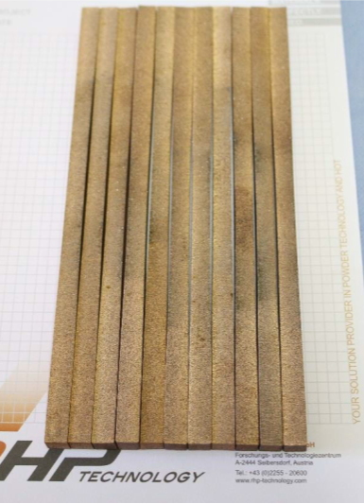
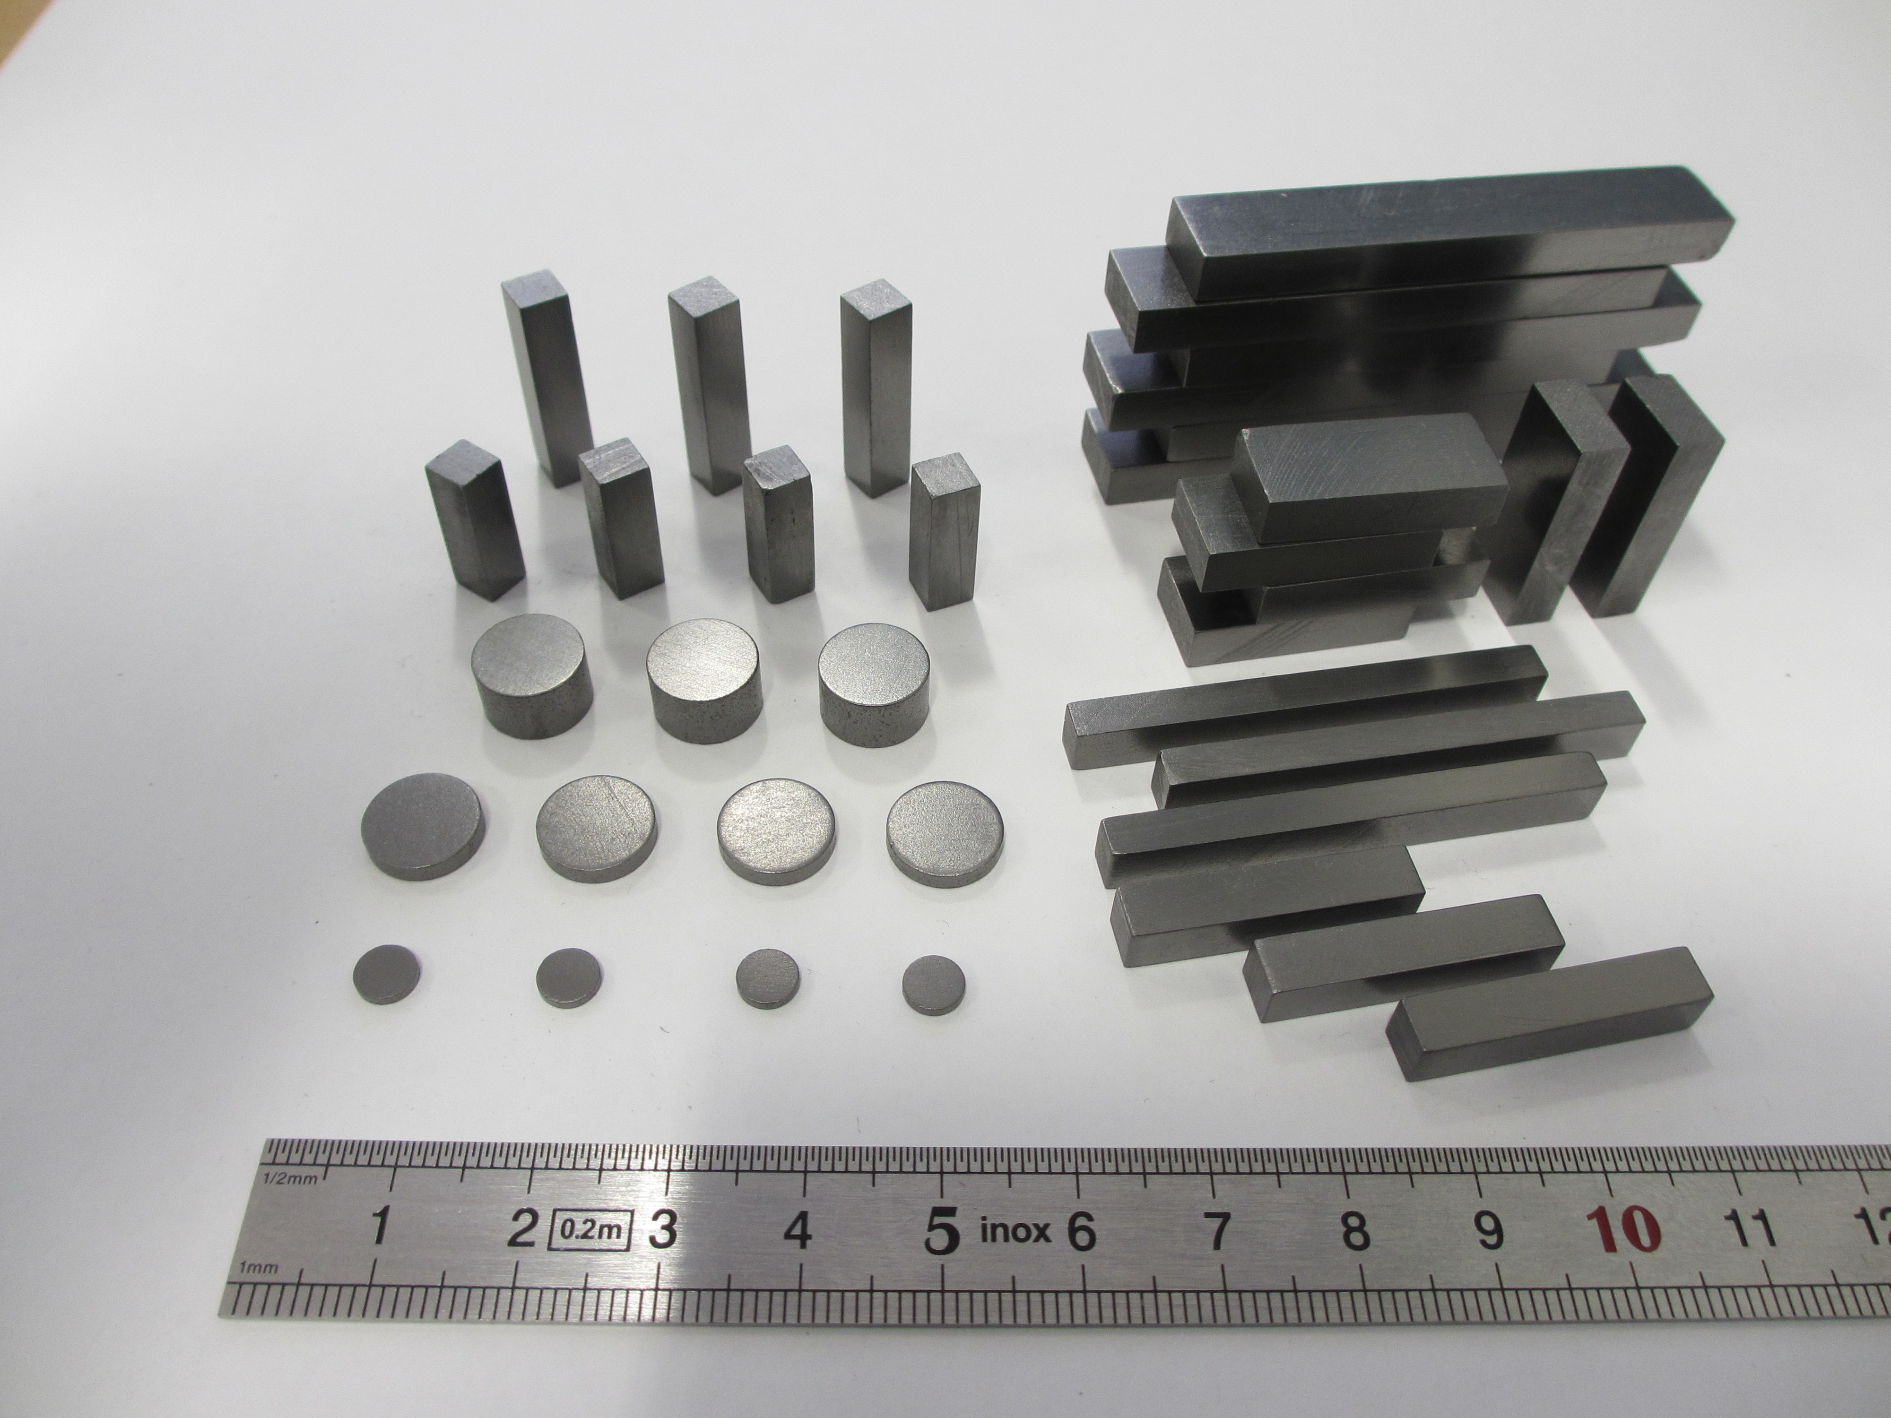
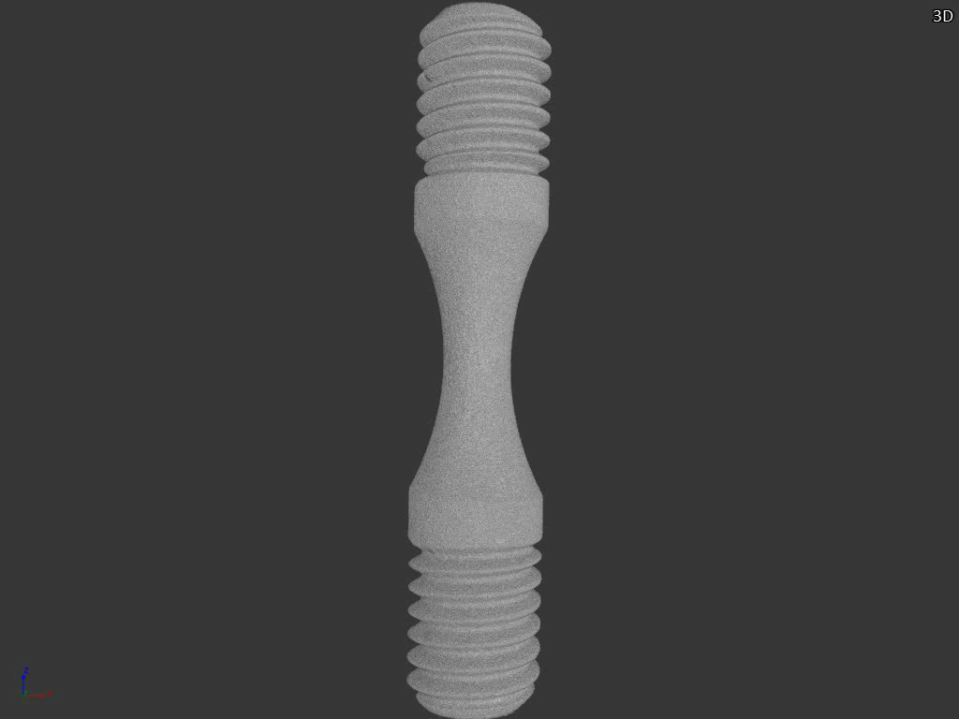
WP14.4 highlights courtesy of F.Carra, CERN
1st year dedicated to the production of components for D14.3 (due by M24, but anticipated by 1 year to match WP17 milestones and deliverables)
Production at RHP and Brevetti Bizz included:
  25 threaded MoGr samples for dynamic tests at Politecnico di Torino
  35 CrGr specimens for characterization at CERN MechLab
  10 CuCD rods installed in HiRadMat (HRMT36 – Multimat)
  10 CuCD specimens for characterization at CERN MechLab
  10 metal-diamond samples for luminescence studies at GSI and CERN
CuCD rods for tests in HiRadMat
Also, start of the R&D at RHP for the MgB₂ deposition on metallic substrate
Courtesy of S. Bizzaro, Brevetti Bizz
and D. Grech, RHP
CrGr specimens for characterization at CERN

Slide 18
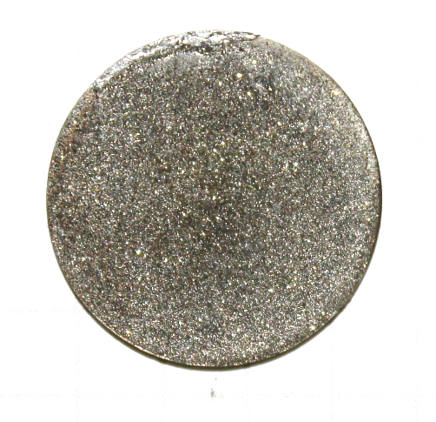
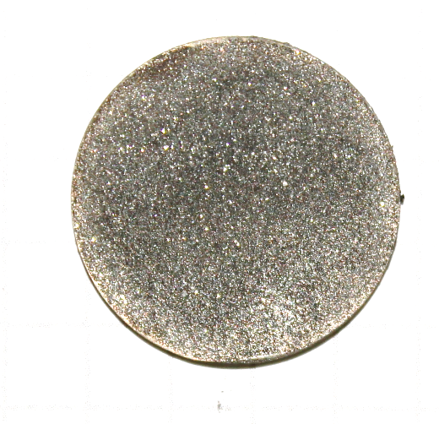
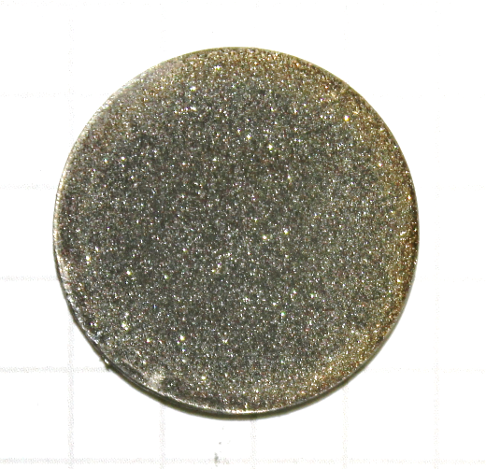
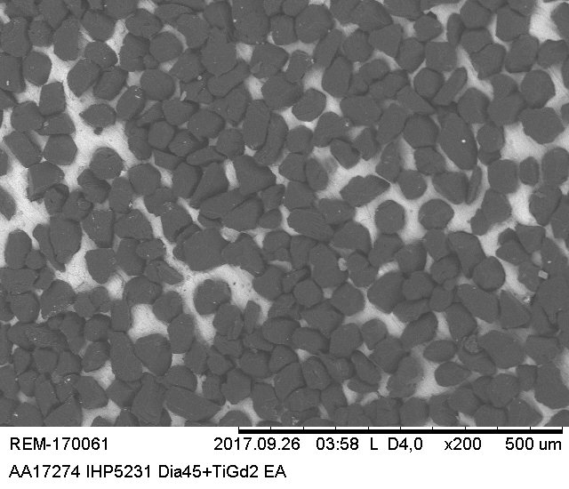
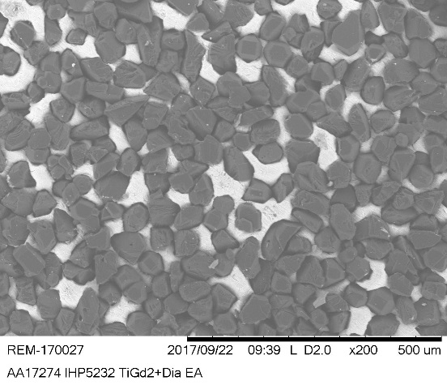
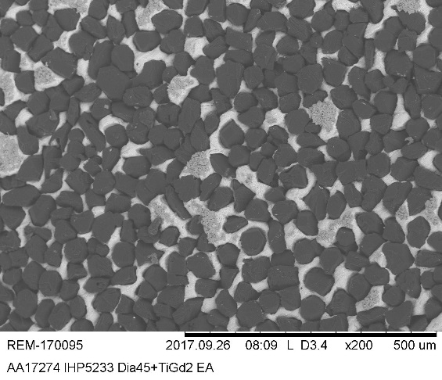
WP14.4 highlights courtesy of F.Carra, CERN
Specimens for luminescence studies at GSI and CERN
IHP5231-A
900°C/5min/30MPa
IHP5232-A
900°C/15min/30MPa
IHP5233-A
900°C/30min/30MPa
Courtesy of
D. Grech, RHP

Slide 19
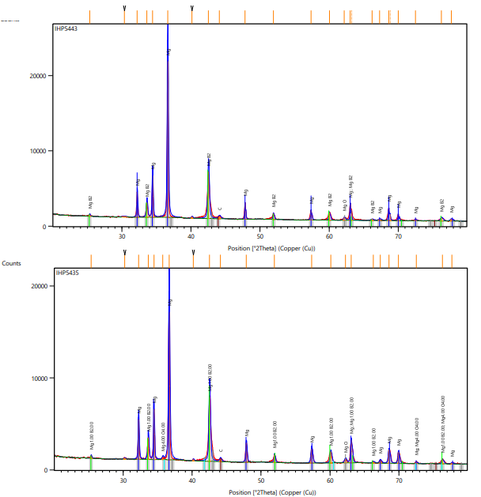
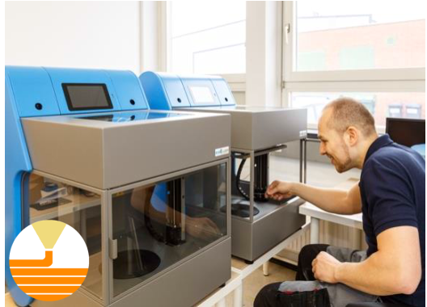
WP14.4 highlights
R&D on MgB₂ additive manufacturing
Courtesy of D. Grech, RHP

Slide 20
WP14.5
Task 14.5. HTS cable development for accelerators magnets- L.Rossi → Define the requirements of the new generation higher performance-lower cost HTS tape
Define the new process for halving the production cost and doubling the Jc eng.
Production of pilot production (5 to 15 m long) and verification of higher performance (Jc eng > 600 A/mm2 - vs. 400 for Eucard2 - at 4.2 K and 20 T).
Production of at least two long lengths (80-100 m) and verification of the electrical, mechanical and magnetic properties (see above).
Test of the two long lengths in a dipole magnet capable of 5-8 T
Presentation from Carmine Senatore to this AM

Slide 21
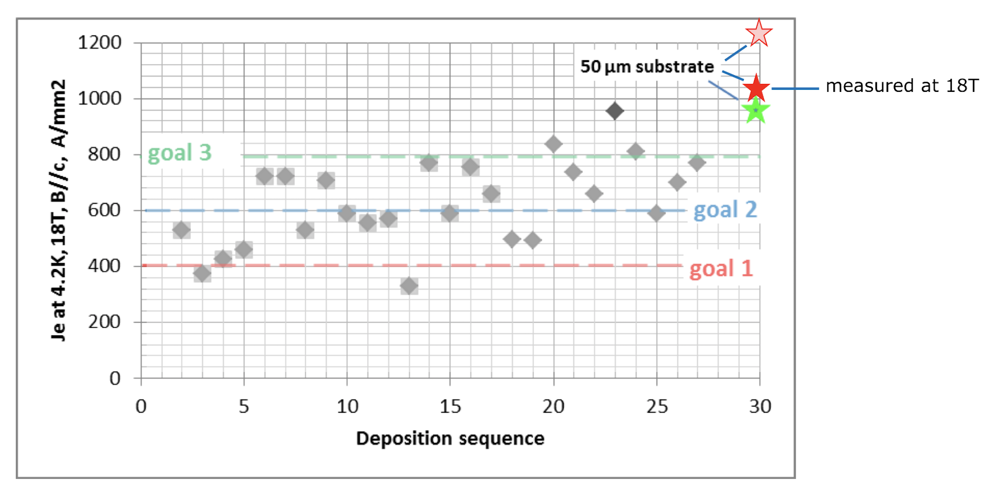
WP14.5 highlights
The goal of MS45 had been fully achieved with two month advance
(April 2018, M12, vs June 2018, M14).
The progress of the technology is evident and steady.

Slide 22
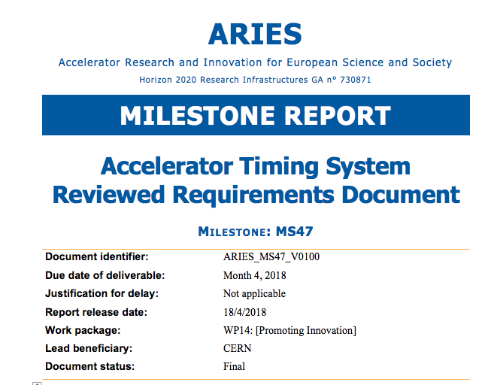
WP14.6 highlights : MS45
Task 14.6.Accelerator Timing System –J.Gutleber → Bring lifecycle and documentation to EN13485 level
Identify cost reduction levers, review architecture, design, BOM
Assess market opportunities, identify potential customers
Make specifications, BOM, user documentation openly accessible
This document captures the fundamental needs and requirements of a main timing system for small to medium sized particle accelerators.
It is the basis for the subsequent steps of a co-innovation between CERN and company Cosylab: the architecture, design and bill of material for a generally usable main timing system.

Slide 23
Milestones / Deliverables
It is time to start preparing the first of the two industrial events
these will be organized by Wigner and STCF, in H and UK.
At this AM we will define a plan for this.

Slide 24
Conclusions
WP14 has achieved in Y1 all the deliverables and milestones
Few of these have been anticipated on the schedule
The activity is progressing very well, with results all good, and in some cases remarkable
In the next few weeks PoC project awards will be formalized and we will be getting ready for projects monitoring.
We will prepare discussing organization of industrial events.

Slide 25
Backup
Slides

Slide 26
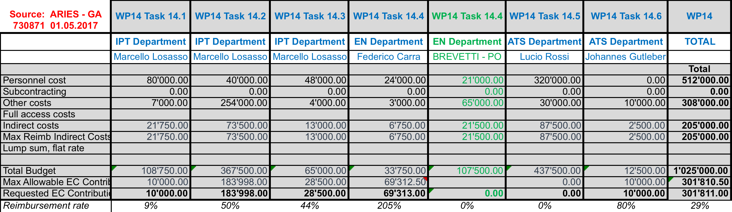
Budget / CERN part

Slide 27
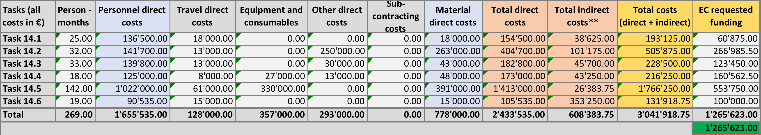
Total WP14 budget /breakdown for tasks

Slide 28
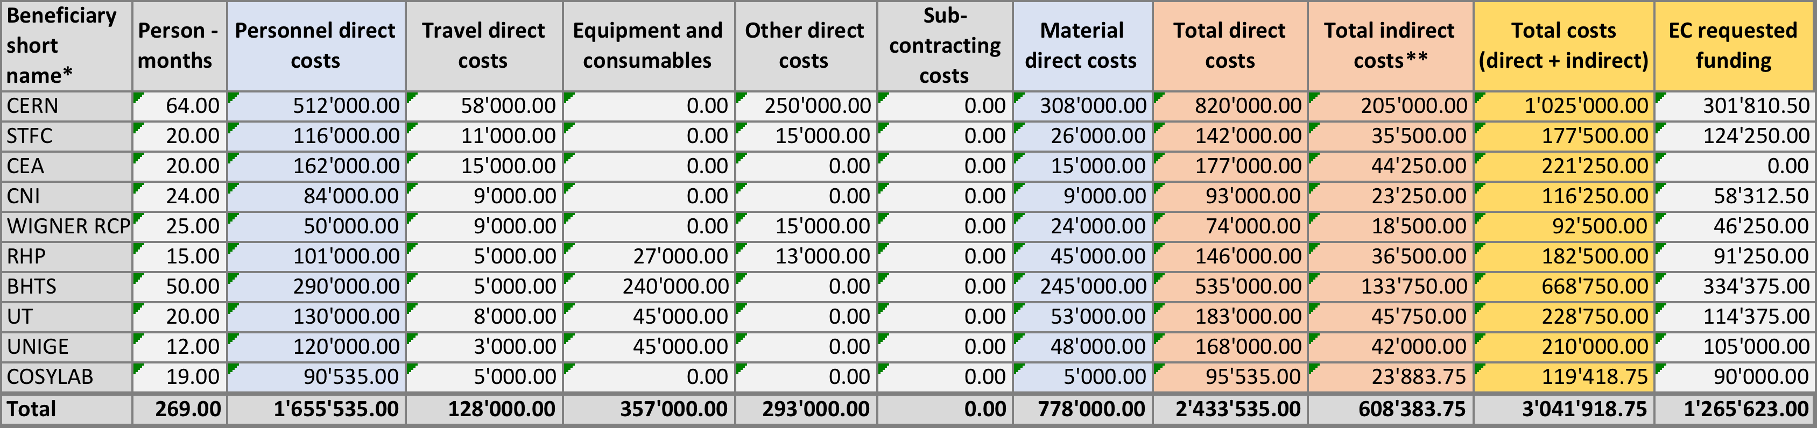
Total WP14 budget /breakdown for participants and beneficiaries

