Slide 1
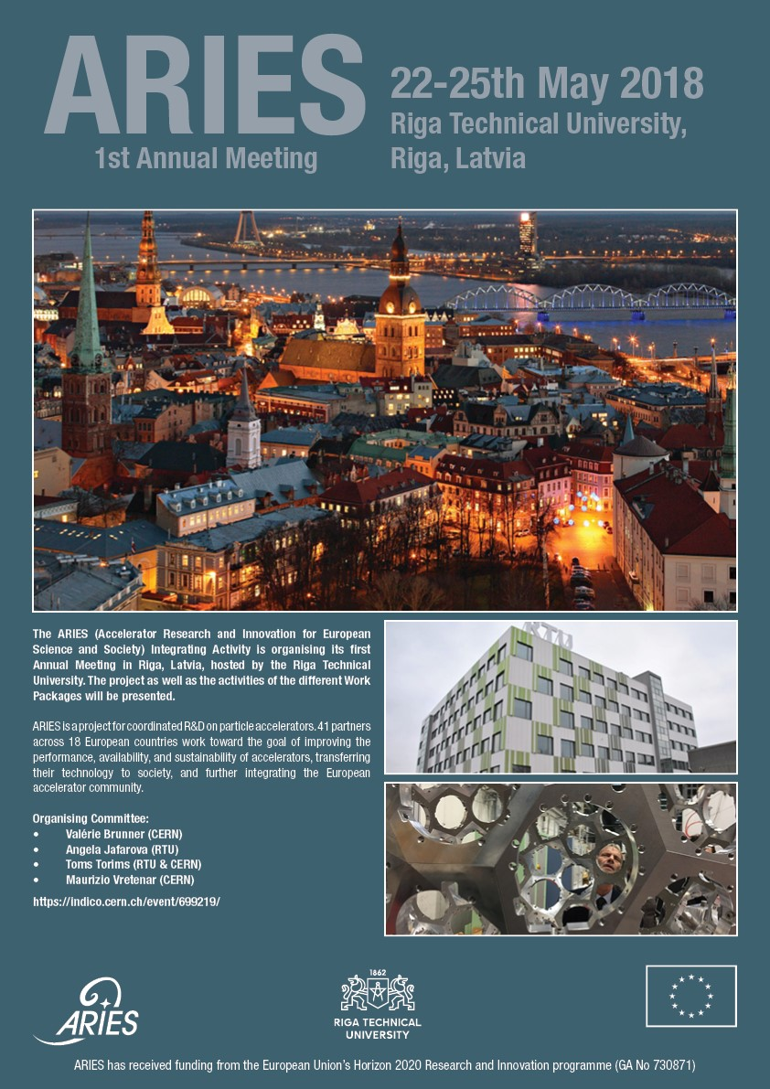
Development of metallic and ceramic composites for particle accelerators
ARIES 1st Annual Meeting
24 May 2018 | Riga, Latvia
Federico Carra, CERN
With several contributions from the participants to WP14 and WP17

Slide 2


Outline
Introduction
Accelerator applications of advanced composites
  Beam absorbers
  Luminescence screens
  Superconductive thin films
Wrap-up on WP14.4 status
Notes:
Explain quick summary

Slide 3
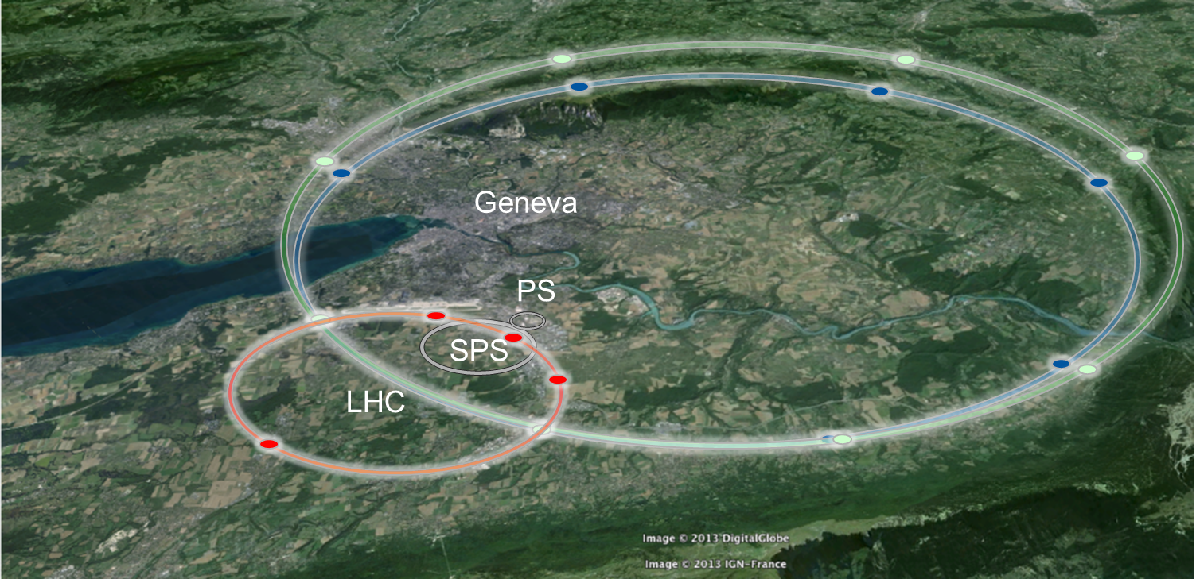

Introduction: Advanced composites for accelerators
The energy stored in particle accelerators is expected to significantly increase in the incoming years
With respect to the LHC, the HL-LHC will store 2x energy (700 MJ) and the FCC-hh more than 20x energy (8.5 GJ)
Novel advanced composites able to interact with such bright beams are being developed and produced in the scope of WP14 (task 4) and WP17 of ARIES
FCC
HL-LHC beam energy: 700 MJ
v = 390 km/h
120 t Australian road train

Slide 4


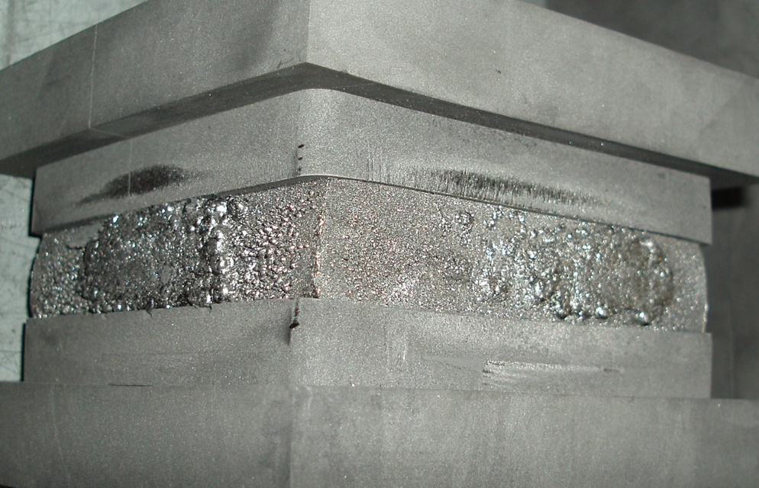
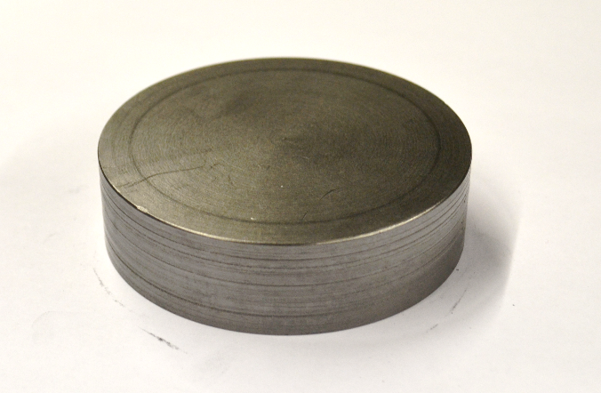
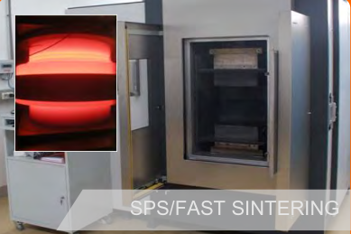
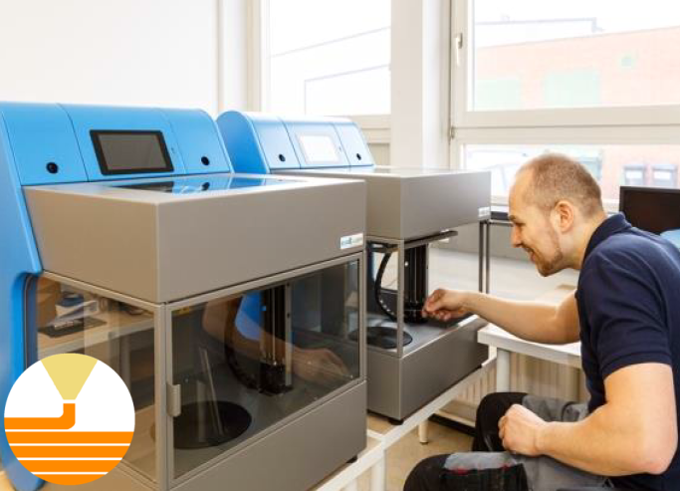
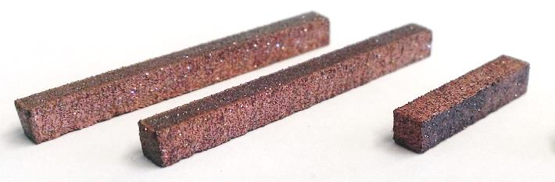
Introduction: Advanced composites for accelerators
Material production takes place at RHP (AT) and Brevetti Bizz (IT)
State-of-the-art techniques are adopted to manufacture the composites
  Spark plasma sintering
  Rapid hot pressing
  Liquid-phase sintering
  Additive manufacturing
  …and more!

Slide 5
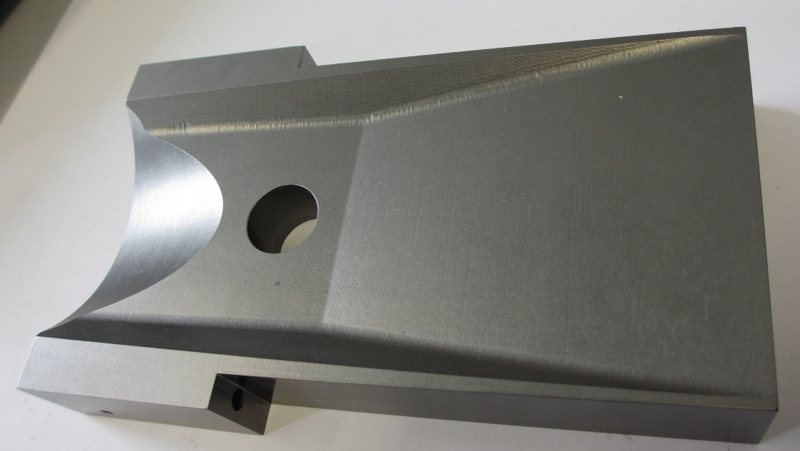
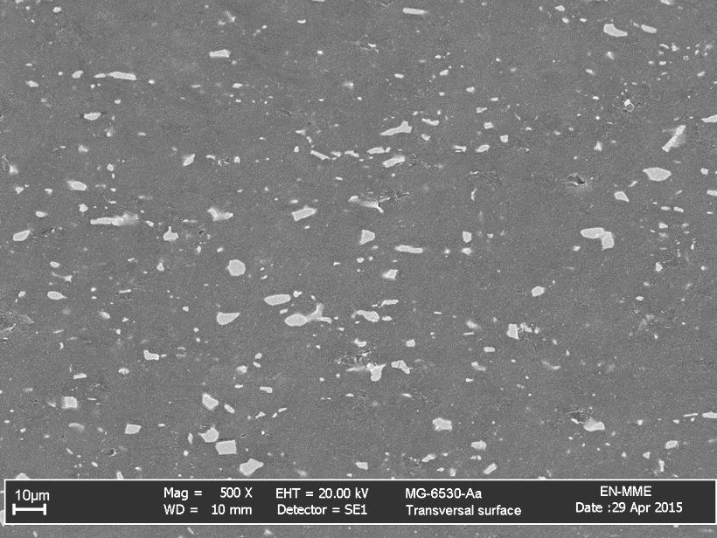
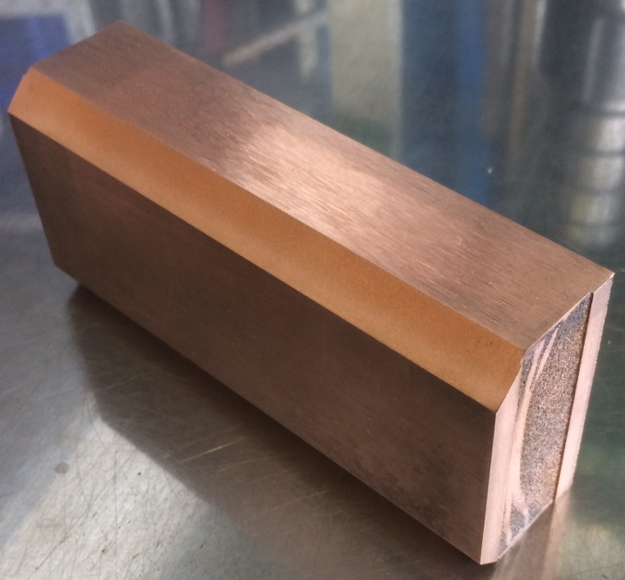
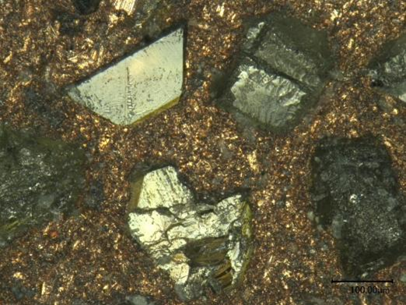
Accelerator applications: beam absorbers
Beam absorbers and beam intercepting devices, such as LHC collimators, require materials with a wide set of properties (thermal shock resistance, thermal and electrical conductivity, radiation hardness, outgassing, …)
Materials currently adopted (graphite, CFC, high-ρ metals) cannot satisfy all these requirements
Composites built at RHP and Brevetti Bizz combine properties of carbon allotropes and metals: Molybdenum-graphite (MoGr) and Copper-diamond (CuCD)
MoGr: ρ ~2.5 g/cm³, transverse isotropy with respect to the sintering plane. Outstanding thermal conductor (800 W/m/K). Easily machinable.
CuCD: ρ ~5 g/cm³, isotropic. Copper matrix with diamond reinforcement. Very good thermal and electrical conductor. High hardness and mechanical properties, difficult to machine.

Slide 6
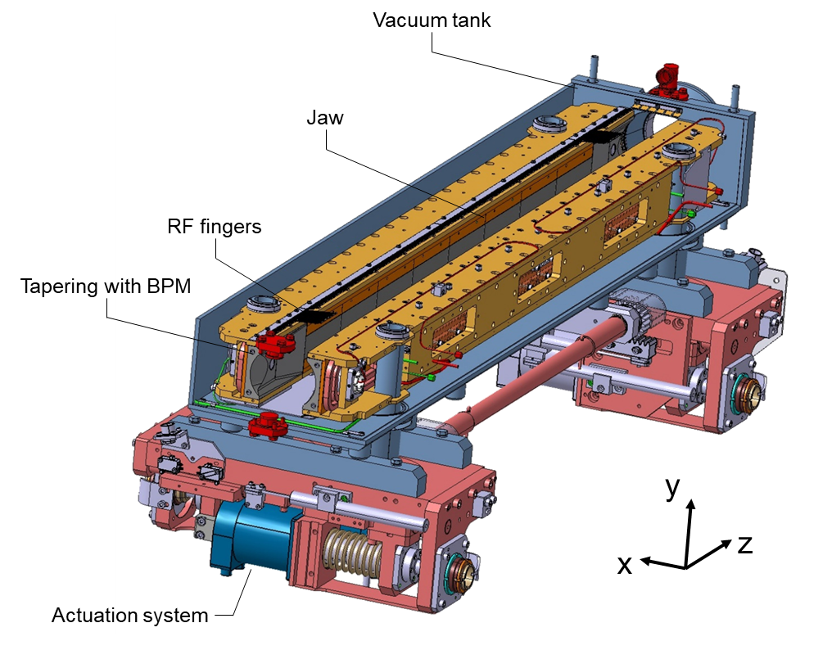
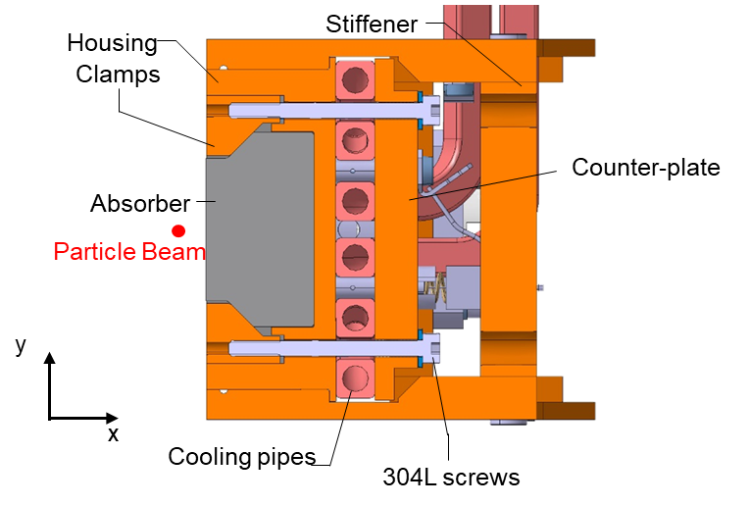
Accelerator applications: HL-LHC collimators
MoGr, thanks to its low density, is proposed to replace CFC in primary and secondary collimators. Other compositions are also under development.
CuCD is denser and represents a more robust option for tertiaries, currently in W-alloy
Both materials can be coated to further enhance the surface thermal and electrical exchange

Slide 7
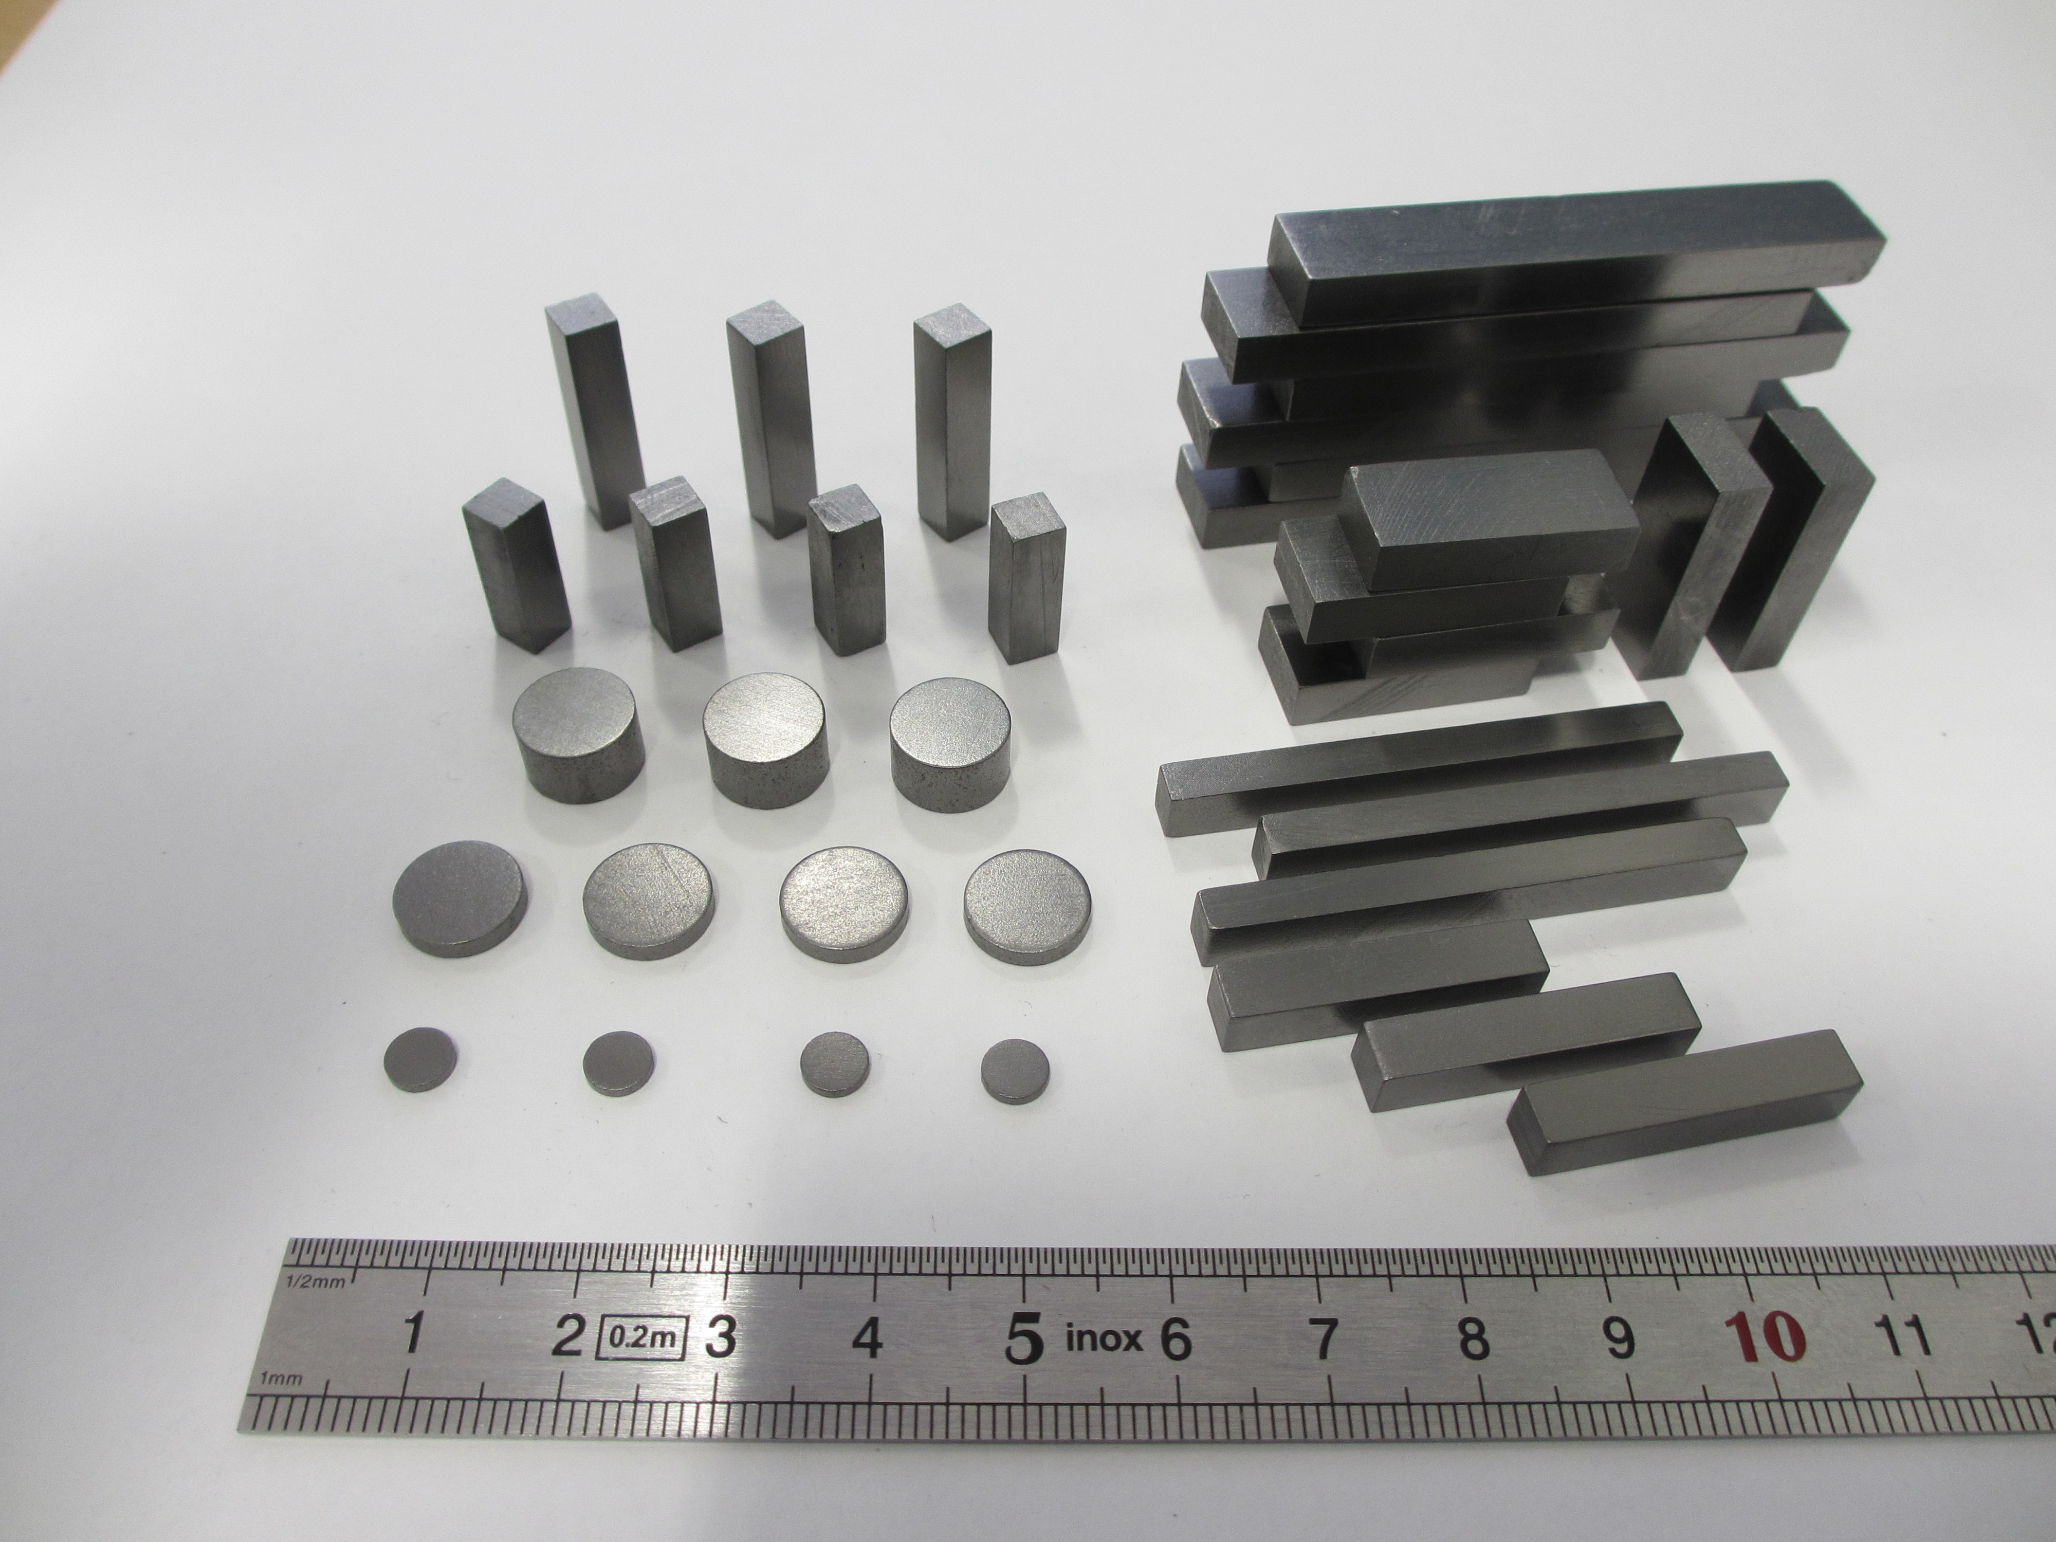
Accelerator applications: HL-LHC collimators
MoGr, similar ceramic graphite and CuCD are characterized in the frame of WP17:
  Thermophysical characterization at the CERN mechanical lab
  Dynamic testing at Politecnico di Torino
  Beam-impact response at HiRadMat (CERN)
Samples of complex shapes produced in the scope of WP14.4
Graphite-ceramic specimens produced at
Brevetti Bizz; characterization of the thermophysical properties at CERN

Slide 8
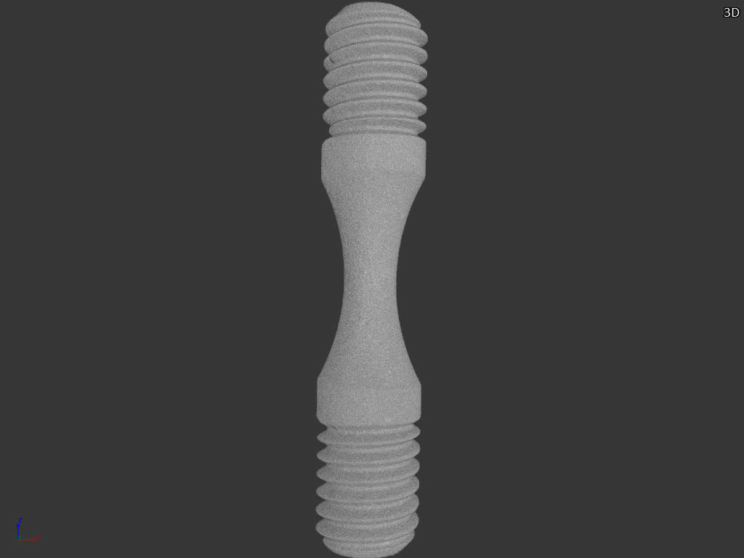
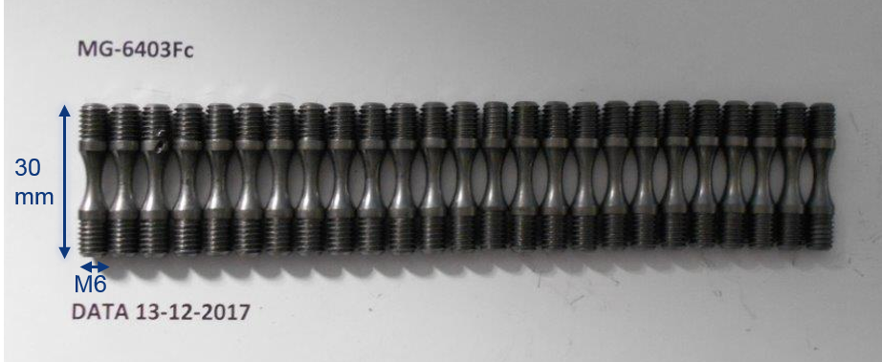
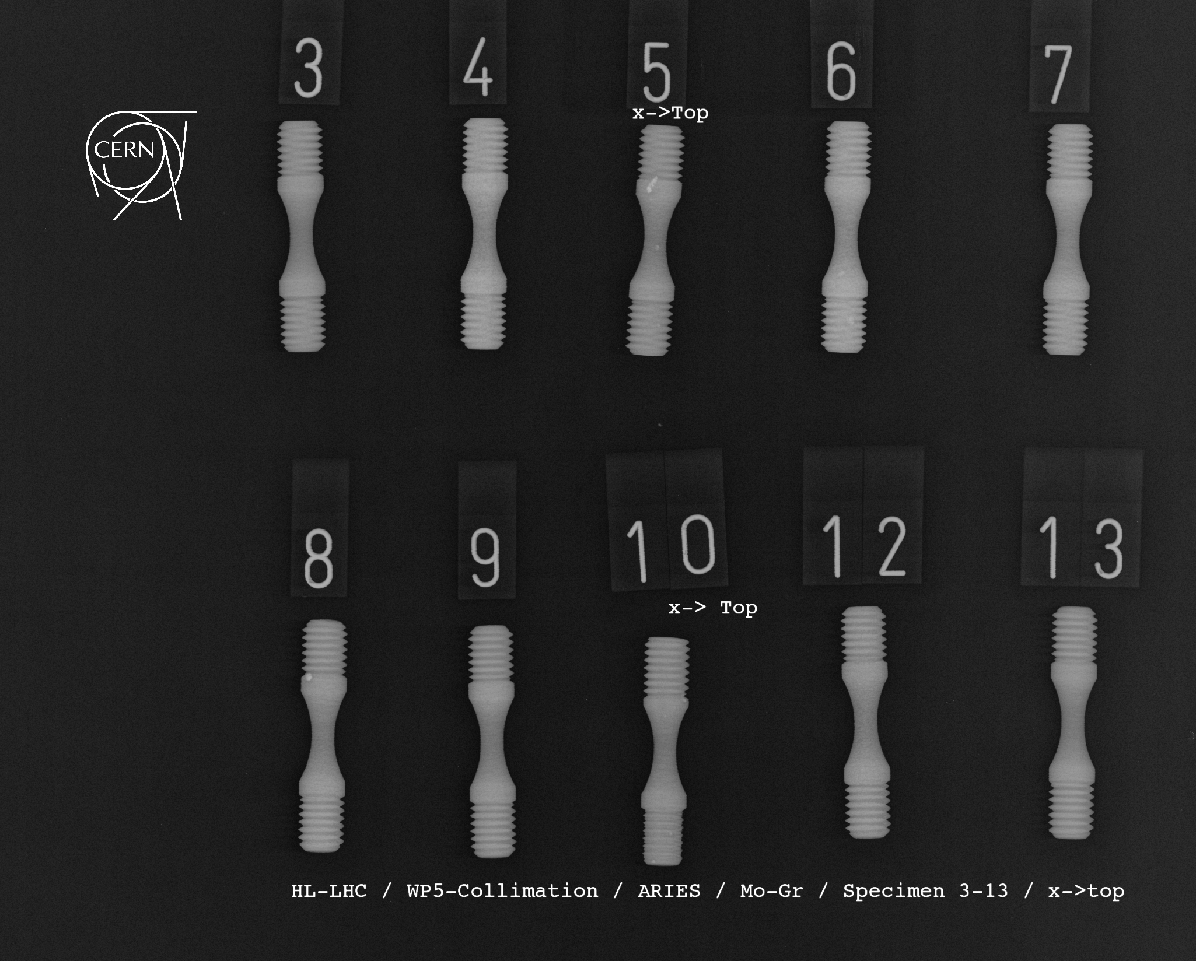
Accelerator applications: HL-LHC collimators
MoGr threaded specimens produced at Brevetti Bizz for dynamic testing with the Hopkinson bar at Politecnico di Torino
Also tested at CERN (NDT: new tomograph) to detect internal defects, carbide clustering, etc.
Courtesy of M. Jedrychowski, CERN

Slide 9
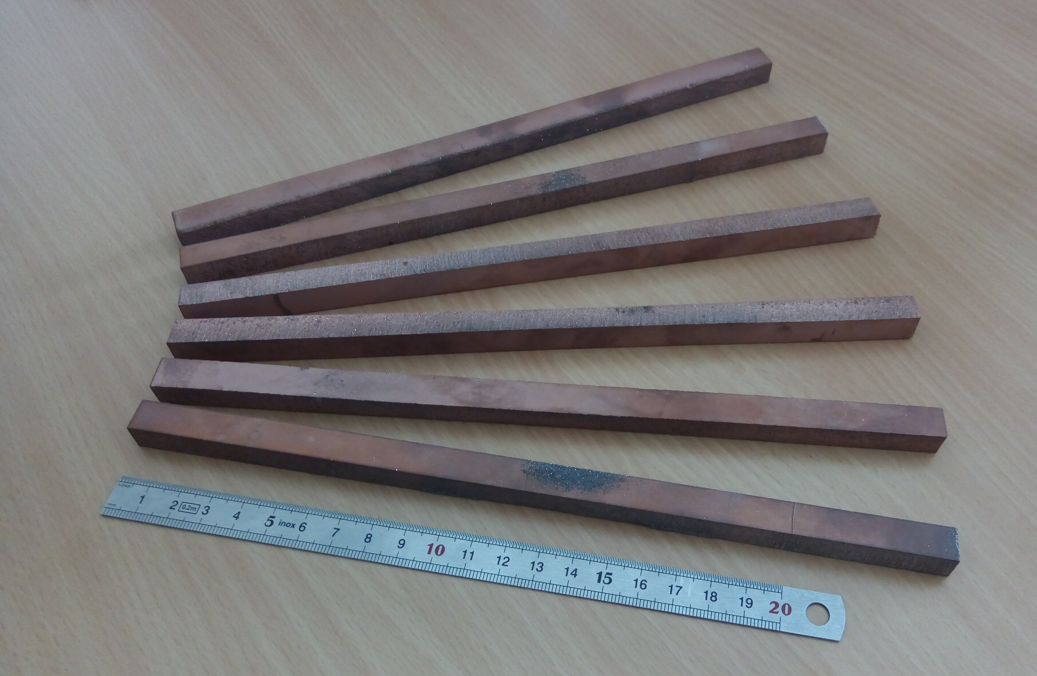
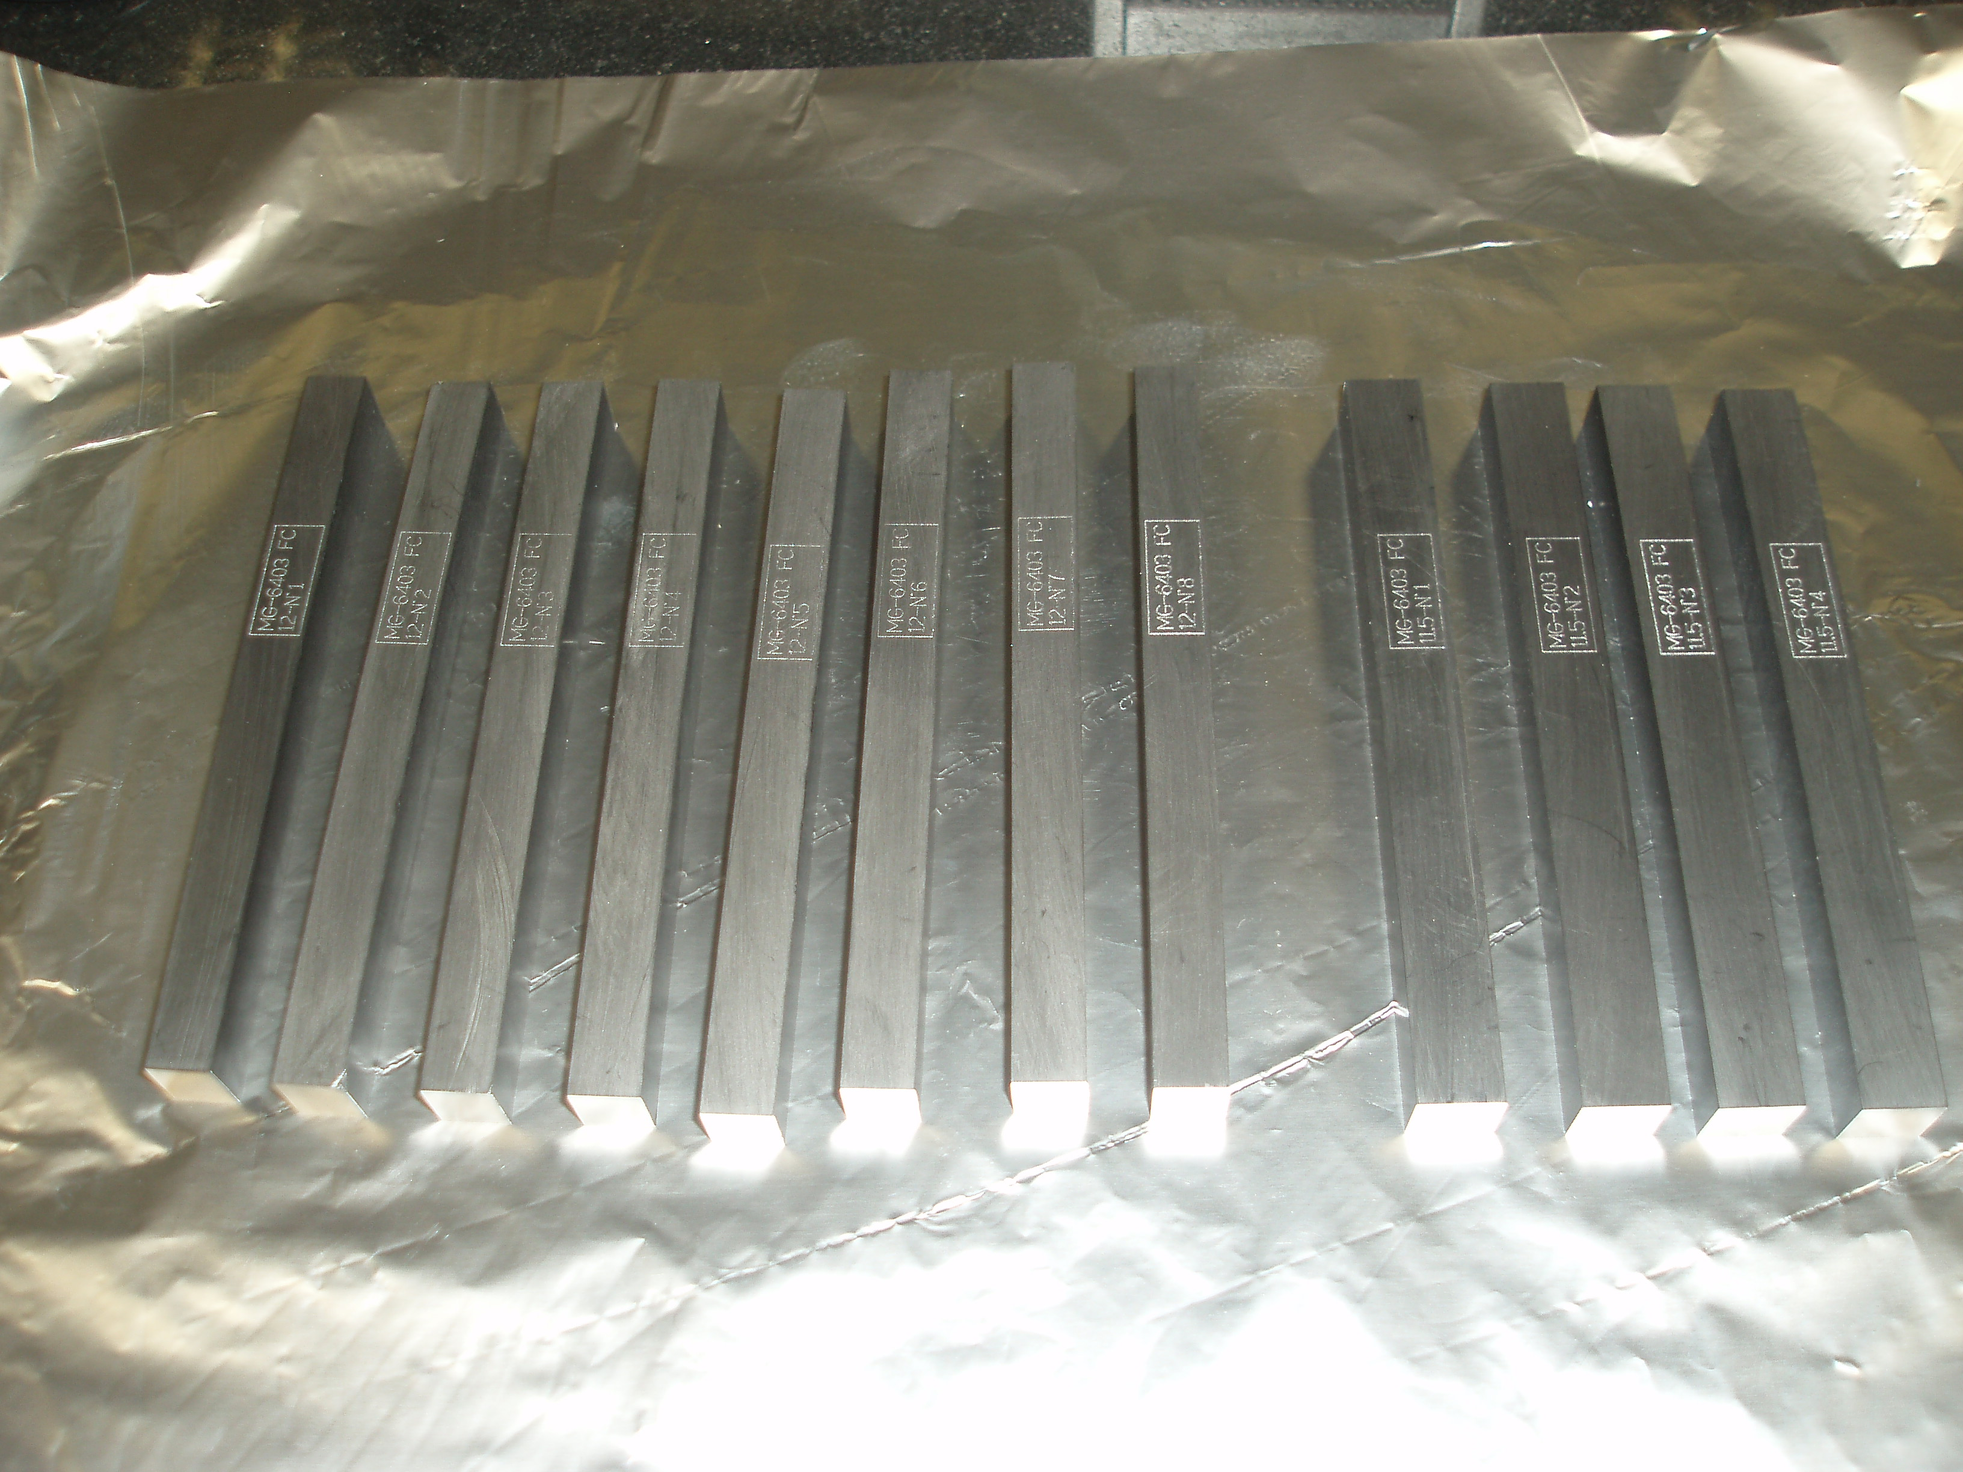
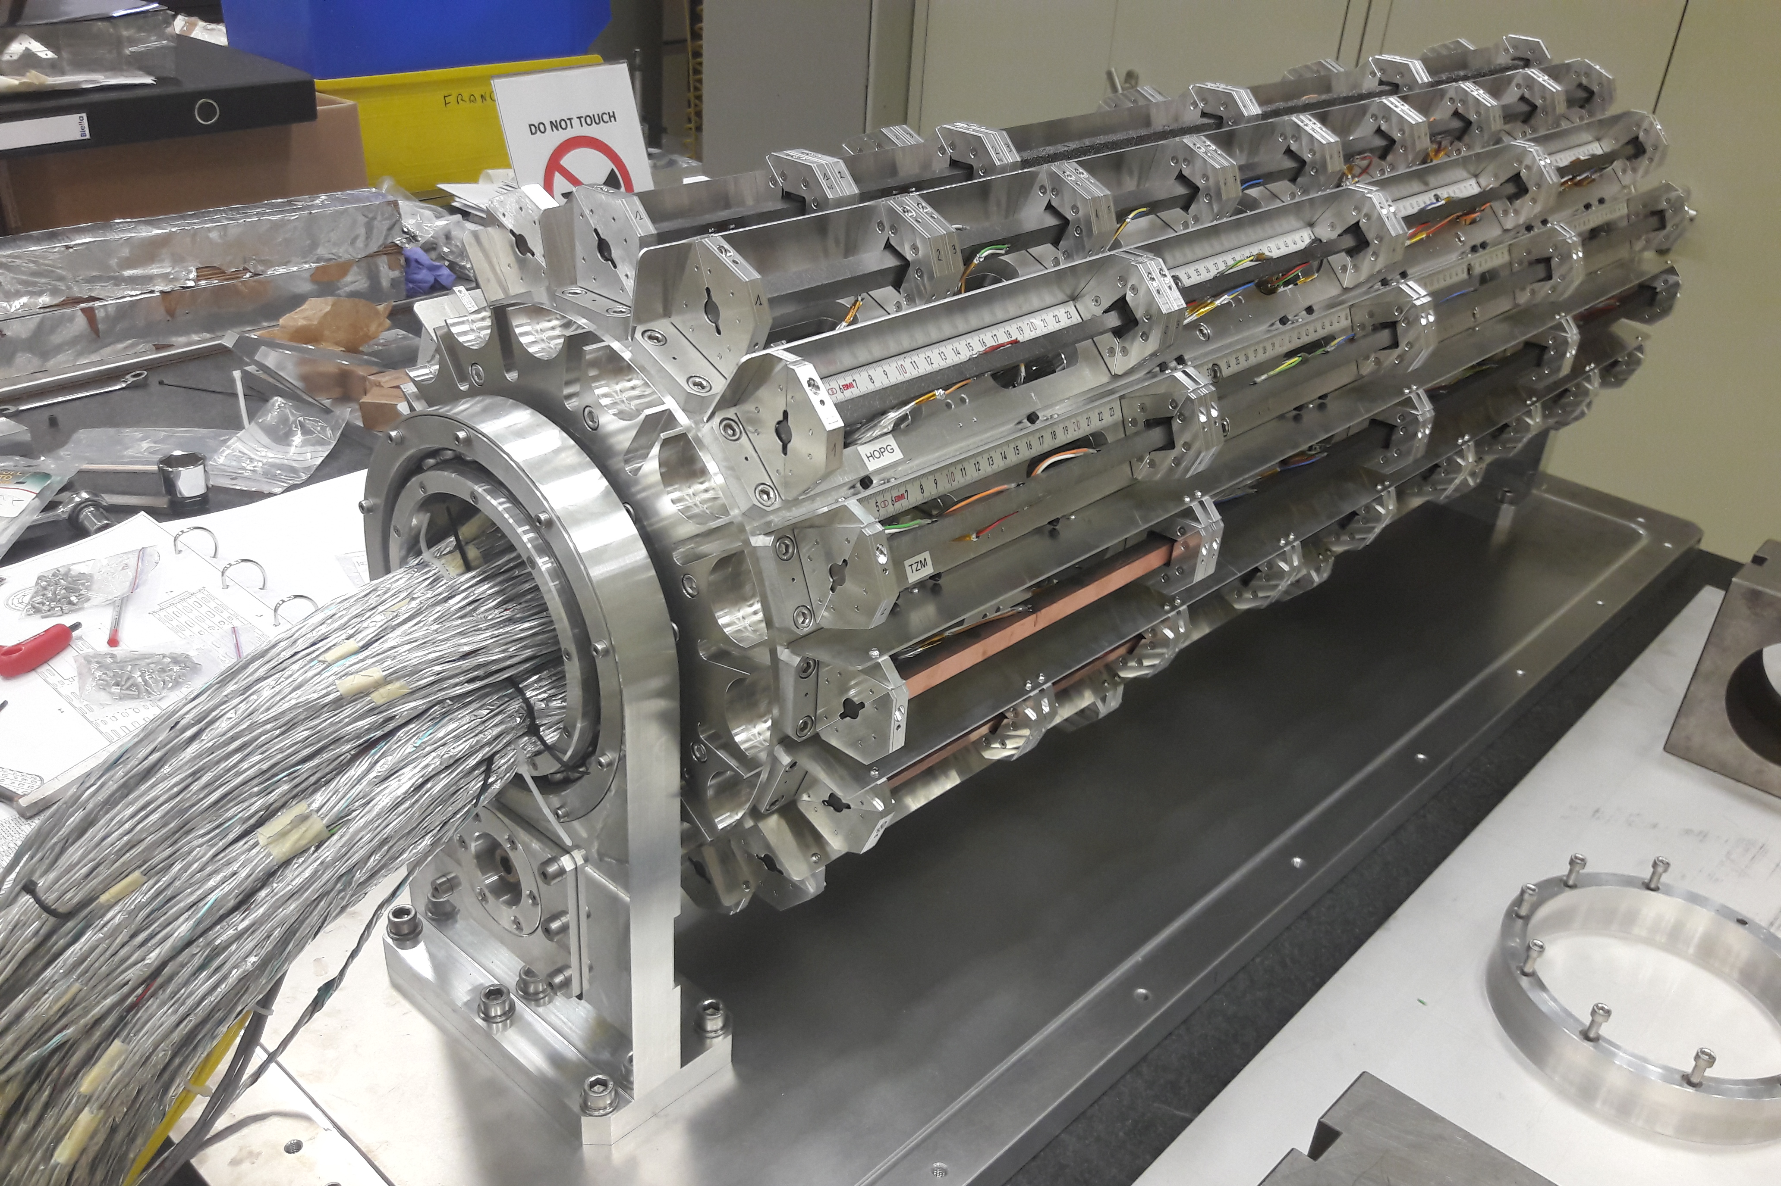
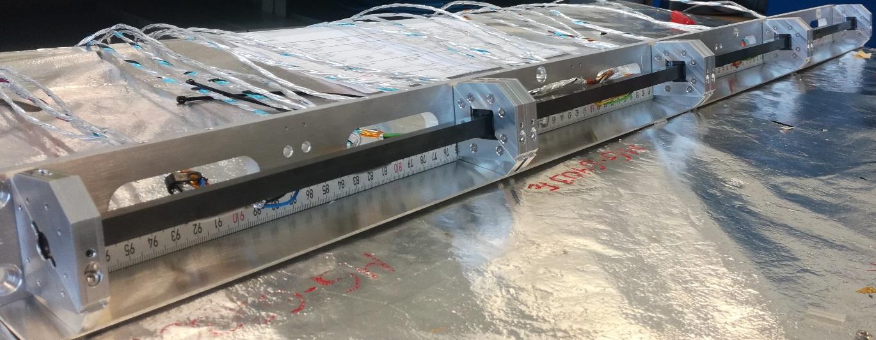
Accelerator applications: HL-LHC collimators
Slender rod specimens of MoGr and CuCD, coated and uncoated, for beam-impact tests at HiRadMat (HRMT36 – Multimat) → see talk from M. Pasquali

Slide 10
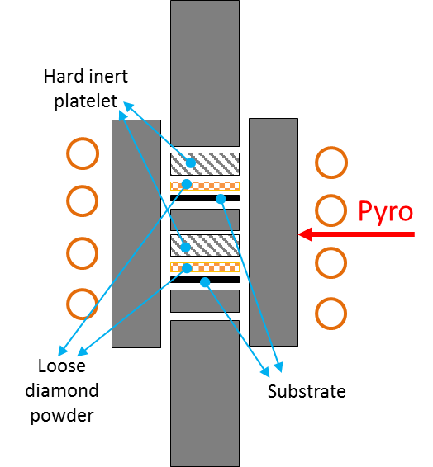
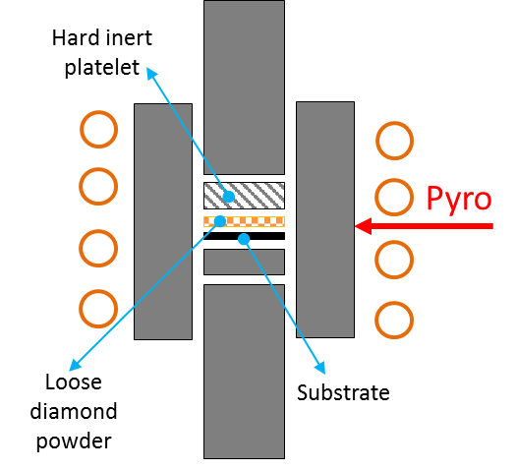
Accelerator applications: luminescence screens
The addition of diamond particles to metallic substrates is a technique exploitable in the construction of beam instruments such as luminescence screens
Diamonds act as scintillators upon interaction with incident high energy beam. Requirements:
  Smaller diamond particle size -> higher resolution of the incident beam
  Smaller Z-number of the substrate -> lesser interaction between high energy beam and substrate material
  Tougher substrate -> higher resistance to induced heat / sputtering damage
Production at RHP by induction hot pressing in the scope of WP14.4
Substrates investigated: Ti and Al alloys, Ti composites
Influence of diamond powder size, type and purity under study
Courtesy of D. Grech, RHP

Slide 11
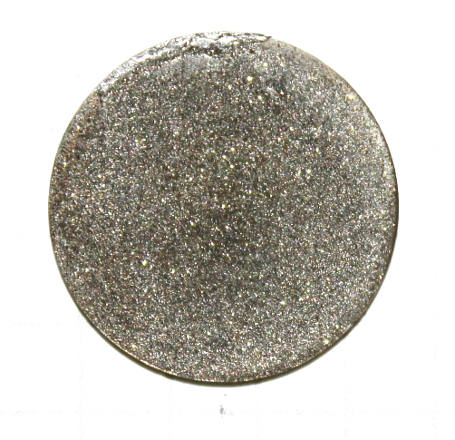
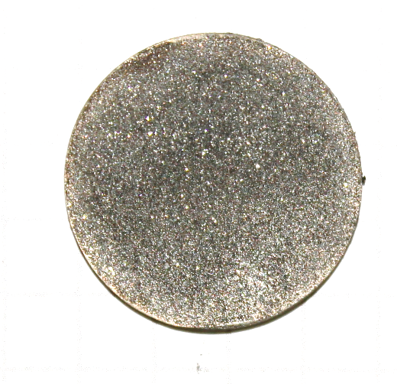
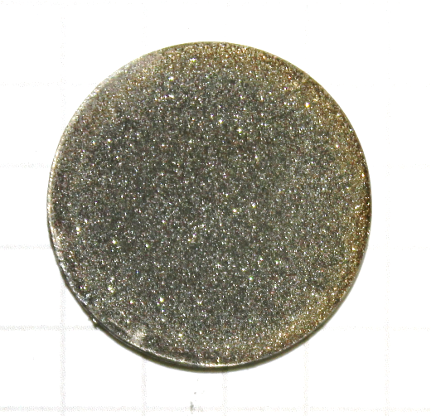
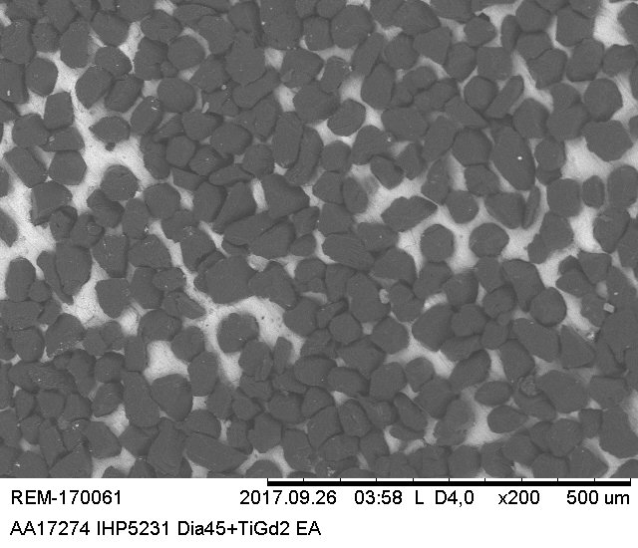
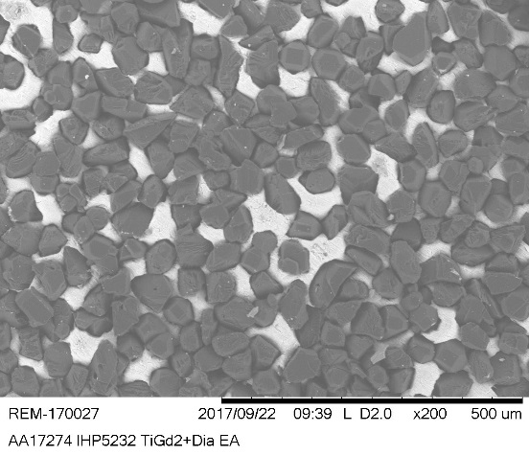
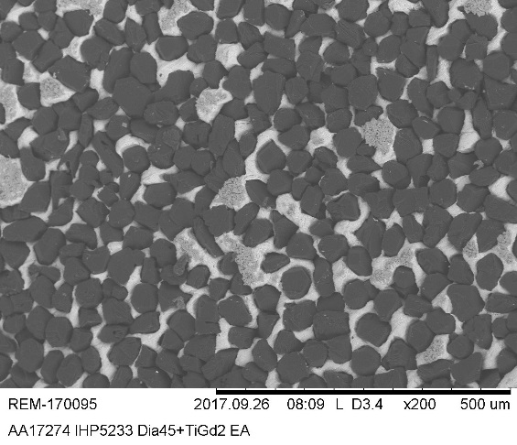
Accelerator applications: luminescence screens
Several specimens produced so far at RHP, 10 of those under testing at GSI and CERN
IHP5231-A
900°C/5min/30MPa
IHP5232-A
900°C/15min/30MPa
IHP5233-A
900°C/30min/30MPa
Courtesy of D. Grech, RHP

Slide 12
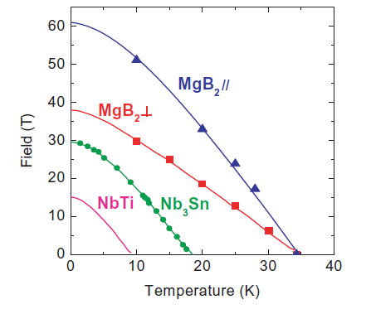
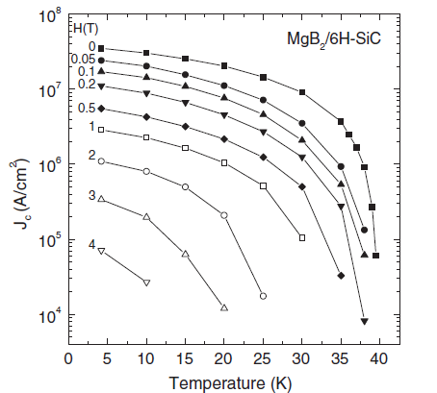
Accelerator applications: HTS thin films on metallic substrates
High Temperature Superconductors (HTS) seem the best choice for future accelerators in need of high magnetic fields
Already adopted in the LHC for current leads, next step is to use them in “hybrid” configuration magnets
Thin-HTS deposition on metallic substrate: technology of interest for SRF cavities and beam pipes
Several fields of application also outside accelerators (medicine, green energy, nuclear waste transmutation, wind turbines, …)
Courtesy of M. Losasso, CERN

Slide 13
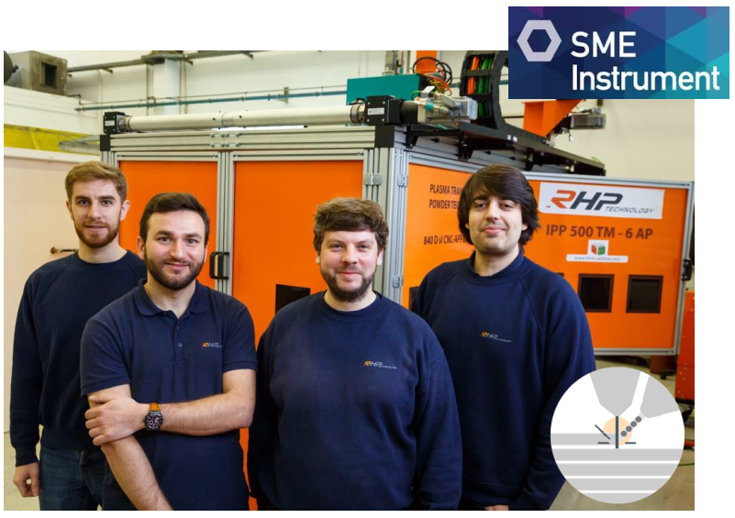
Accelerator applications: HTS thin films on metallic substrates
At RHP (WP14.4): development of MgB₂ layers on metal substrates (e.g. copper)
Aim is to synthetize the MgB₂ powder, characterize it, and deposit it on a substrate by means of 3D printing → Plasma Transferred Arc (PTA)
Direct synthesis of MgB₂ from precursors:
  Mg + 2B → stoichiometric
  Mg + 2B → 5wt% excess of B
Procedure
  Cold pressing of powders
  Pellet preparation at 650°C, 2h under vacuum
  Densification
  XRD analysis of the phases
Courtesy of D. Grech, RHP

Slide 14
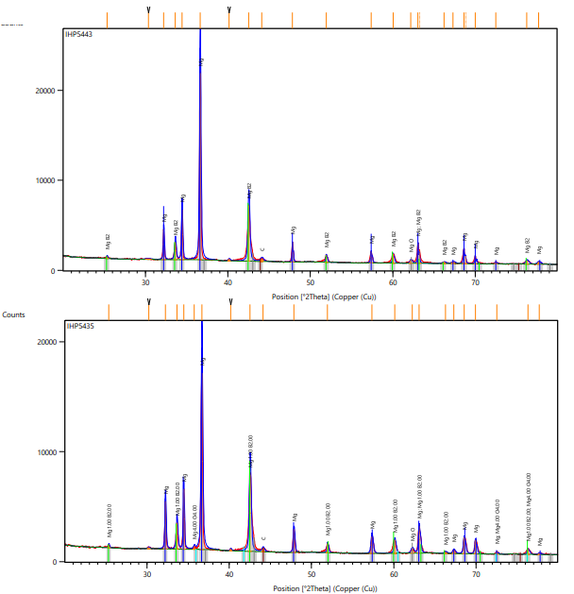
Accelerator applications: HTS thin films on metallic substrates
Better results obtained with the 2nd method (excess of B)
However, no pure MgB₂ shyntesis (major phase is Mg, then MgB₂, with traces of MgO and C)
Next steps
  Increase the B content (10wt%)
  Inductive hot pressing for the same T and t, under a pressure of 30 MPa
Method 1
Method 2
Courtesy of D. Grech, RHP

Slide 15
WP14.4 milestones and deliverables
All the samples produced are part of D14.3
Deliverable Number | Deliverable Title | Lead beneficiary | Type | Dissemination level | Due Date (in months)
D14.3 | Production of material samples of carbon-based composites and metal-diamond composites | CERN | Demonstrator | Public | 24
D14.3 : Production of material samples of carbon-based composites and metal-diamond composites
Production of: 50 samples of carbon-based composites with different production cycles and 30 samples of metal-diamond composites, 20 for high energy impact studies and 10 for luminescence studies
Our goal: complete it by 2018, to match WP17 milestones and deliverables
Almost completed! Only missing 10 CuCD samples, already produced at RHP, under shipping

Slide 16

WP14.4 milestones and deliverables
The full scope of the production throughout 4 years include:
Production objectives:
  30 samples of MgB₂ on metal substrate (0% – R&D ongoing)
  30-50 samples of CuCD (40%)
  40 samples of metal-diamond composite for luminescence studies (25%)
  50 samples of carbide-graphite or metal-graphite composites (100%)
  1 large size block of carbide-graphite or metal-graphite composite with tight mechanical tolerance to proof industrialisation (0% – R&D ongoing)
RHP
BrevettiBizz
So far so good!

Slide 17

Thank you for your attention!

Slide 18
Backup slides

Slide 19
Budget
Beneficiary short name* | Person - months | Monthly personnel costs | Personnel direct costs | Travel direct costs | Equipment and consumables | Other direct costs | Sub-contracting costs | Material direct costs | Total direct costs | Total indirect costs** | Total costs (direct + indirect) | EC requested funding
CERN | 3.00 | 8'000.00 | 24'000.00 | 3'000.00 | 0.00 |  |  | 3'000.00 | 27'000.00 | 6'750.00 | 33'750.00 | 9'312.50
Bizz Brevetti | 6.00 | 3'500.00 | 21'000.00 | 5'000.00 | 50'000.00 | 10'000.00 |  | 65'000.00 | 86'000.00 | 21'500.00 | 107'500.00 | 60'000.00
RHP | 6.00 | 3'500.00 | 21'000.00 | 5'000.00 | 110'000.00 | 10'000.00 |  | 125'000.00 | 146'000.00 | 36'500.00 | 182'500.00 | 91'250.00
Total | 15.00 | 59'365.00 | 66'000.00 | 13'000.00 | 160'000.00 | 20'000.00 | 0.00 | 193'000.00 | 259'000.00 | 64'750.00 | 323'750.00 | 160'562.50

