Slide 1
ARIES Industrial and Societal Applications Network
Rob Edgecock / University of Huddersfield
On behalf of the WP3 members!

Slide 2
Outline
Introduction to WP3
  Tasks
  Partners
  Objectives
Activities and plans
Conclusions

Slide 3
WP3
ISA: Industrial and Societal Applications of accelerators
Three science areas:
  Industrial and environmental applications of electrons up to 10MeV
  Accelerator radioisotope production
  Applications of electron beams up to ~140 MeV
Doing real work (i.e. not organise workshops)
Focus is on improving or developing new applications

Slide 4
WP3
Task 3.1. Coordination and Communication (HUD)
- Coordinate the WP activities
- Monitor the progress of WP tasks and ensure the obligations are met
- Manage the WP budget and use of resources and prepare internal and deliverable reports
Task 3.2. Low energy electron beam applications: new technology development (INCT)
- Study and document the requirements for current e-beam applications
- Study the introduction of new technology from the research area to bring improvements to these applications
- Develop a standard electron beam unit to make the transition to electron beam applications easier for newcomers
Task 3.3. Low energy electron beam applications: new applications (FEP)
- Study the use of electron beams in the environmental area
- Study the expansion of the use of electron beams in the industrial area
- Document the new applications and the requirements on the accelerator technology
Task 3.4. Medium energy electron beams (CNRS)
- Study of the applications of electron beams up to 140 MeV in the medical and other areas
- Study of the construction of high performance electron linear accelerator up to 140 MeV
Task 3.5. Radioisotope production (CIEMAT)
- Document the requirements for compact accelerators for radioisotope production
- Optimise the design of a new compact cyclotron for PET isotope production, with the aim of maximising the production
- Analyse different solutions for a compact source for PET, with the aim of improving the performance and cost
- Study which existing and possibly new therapeutic isotopes are of interest clinically and how they can be produced
using particle beams
- Study and compare novel acceleration techniques for ^{99m}Tc and therapeutic isotope production

Slide 5
WP3 - Partners
Full partners:
  CERN (Maurizio Vretenar)
  Ciemat (Conchi Oliver/Diego Obradors)
  CNRS (Angeles Faus-Golfe)
  Fraunhofer FEP (Frank-Holm Roegner)
  University of Huddersfield (RE)
  IBA (Candice Nagel)
  INCT (Andrzej Chmielewski)
Associates:
  EBtech
  IAEA
  iiA
  Slovak Medical University
  ITEP

Slide 6
Some Activities – Task 3.1
Proof-of-concept fund: WP3 part of/submitted 3 proposals:
  Eliminating the spread of AMR through wastewater (HUD)
  Development of hybrid electron accelerator system for the treatment of marine diesel exhaust gases (RIGA)
  Novel ion source for the AMIT cyclotron (CIEMAT)
Webinar(s) in preparation
  With iiA
  Aim is to introduce the benefits of e-beams to new users
  1st webinar: introductory, mainly for γ-users
  If successful, more will follow

Slide 7
Some Activities – Task 3.1
H2020 proposal under consideration
  SC2: CE-SFS-30-2019: High-quality organic fertilisers from biogas digestate - up to 5 MEUR - in collaboration with at least 3 Chinese partners - companies required - opens: 16th Oct 2018; closes: 23rd January 2019
  Propose the use of e-beams
  Still in the very early stages

Slide 8
Some Activities – Task 3.2
Current applications of electron beams have been documented (see MS13)
Effects of Electron Beam Interaction
Thermal Processes
Heat Production
Non-thermal Processes
Chemical Reactions
Biocidal Effects
Vacuum
Atmosphere
Atmosphere
- Evaporation
- Melting
- Welding / Joining
- Hardening
- Micro- structuring
- Curing
- Crosslinking
- Shrink wrap
- Drying print-inks
- 3D printing
- Grafting
- Crystal defects (gemstone colouring, semiconductors)
- Disinfection of animal
feed
- Seed treatment
- Food treatment
- Sterilisation of
products
- Sterile packaging
- Inactivation of pharma
Waste

Slide 9

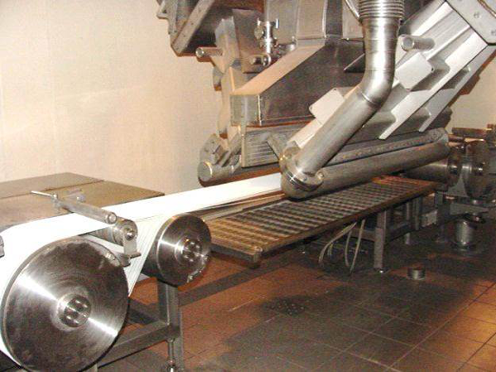
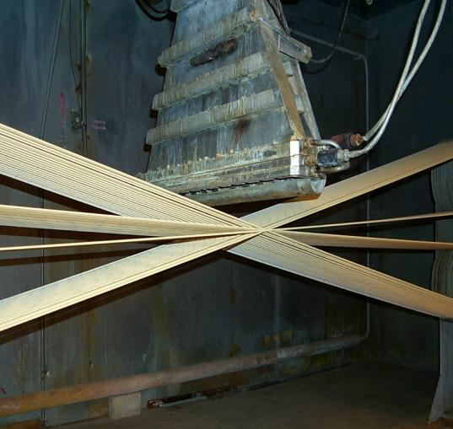
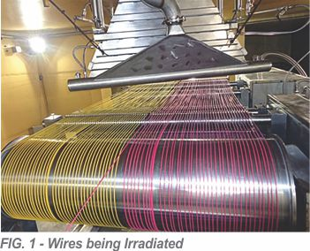
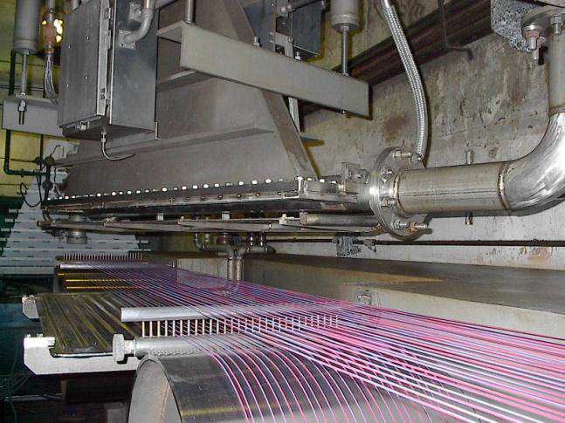
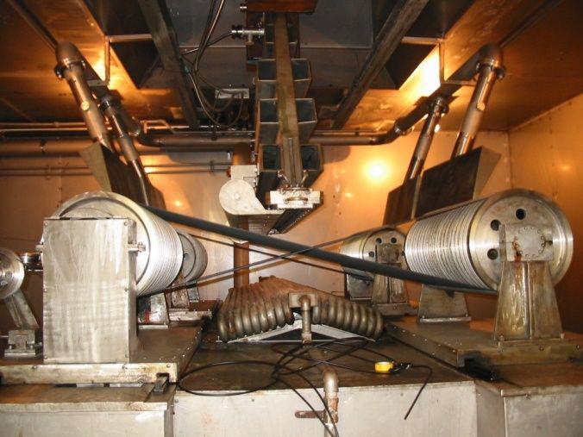
Polymer Cross-linking

Slide 10
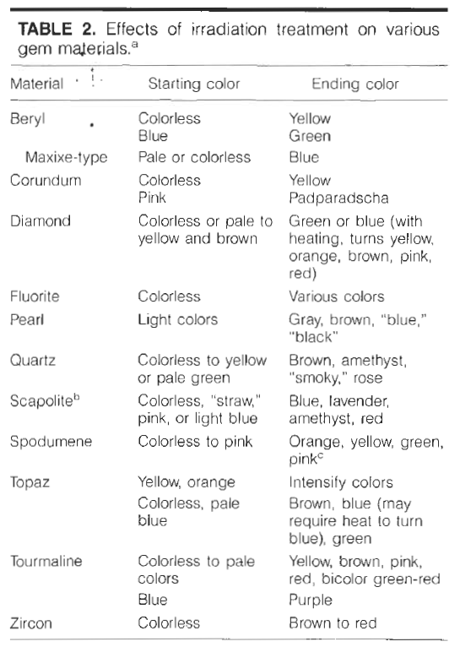
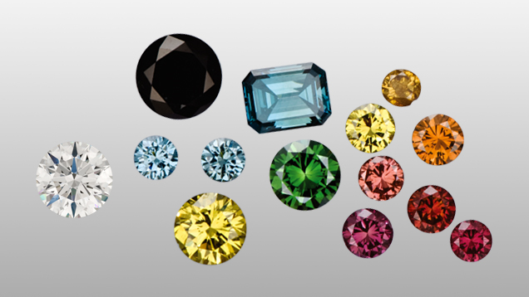
Gemstone enhancement

Slide 11
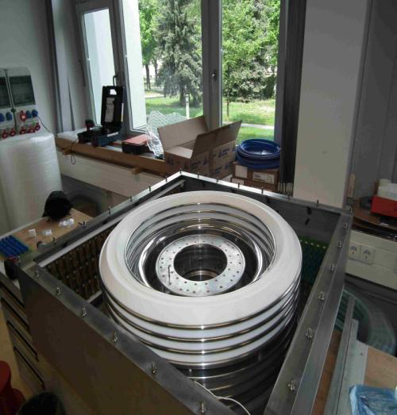
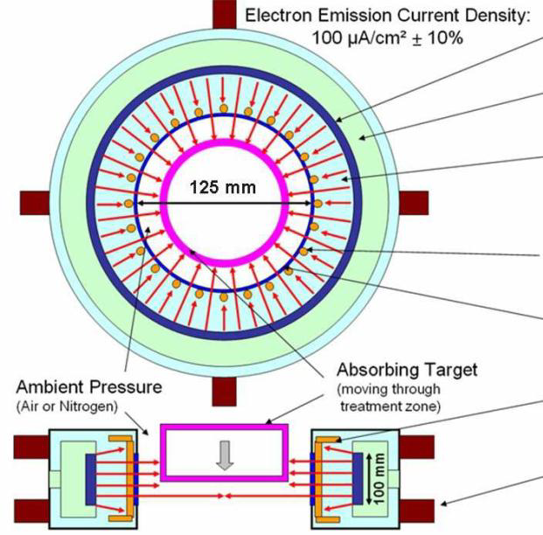
Some Activities – Task 3.2
First thoughts on use of RI technology: - SRF linac - high power, long-life RF magnetron - e-beam FFAG (Carol Johnstone) - toroidal accelerator (FH Roegner)

Slide 12
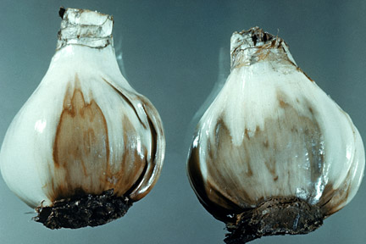
Some Activities – Task 3.3
New applications being studied:
  Marine diesel engine exhaust gases
  Sewage sludge and AMR
  Production of biodegradable polymers for medical applications, e.g.
    microspheres and microcapsules
    nanospheres and nanofibers for controlled release drug delivery systems
    bone implants
    scaffolds for tissue engineering
    resorbable surgical sutures
  Elimination of plant pathogens from bulbs
  Preservation of water-damaged documents
  Treatment of waste water from the Solvay process (Na₂CO₃ production)
Fusarium oxysporum infested flower bulb

Slide 13
Some Activities – Task 3.3
New applications being studied:
  Treatment of biological cell substrates - sterilising biological tissues - vascular grafts - pericardial tissue
  Structuring of OLED pixel for display applications
  Crosslinking of Carbon Nanomembranes
  Medium energy x-ray sterilization
  Inactivation of biohazards
  Microplastic treatment in wastewater

Slide 14

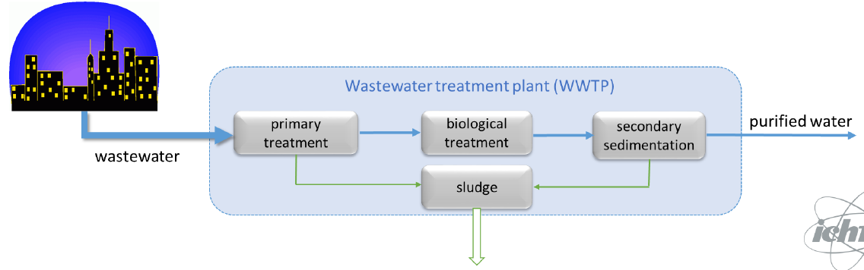
Sewage Sludge Treatment
Municipal water treatment plant
Biological sludge: highly contaminated – bacteria, viruses, parasite eggs, etc
Developed world: difficult to dispose of
Developing world: major source of ill-health and death

Slide 15
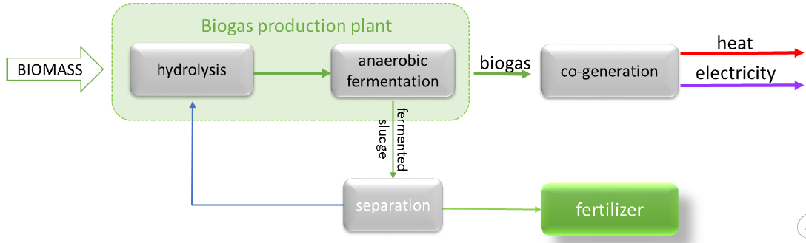
Anaerobic Digestion
Anaerobic digestion: micro-organisms break down organic matter
Typically runs at 35-39ºC, takes around 20 days
Outputs - biogas - cleanish fertilizer - 50% less organic material

Slide 16
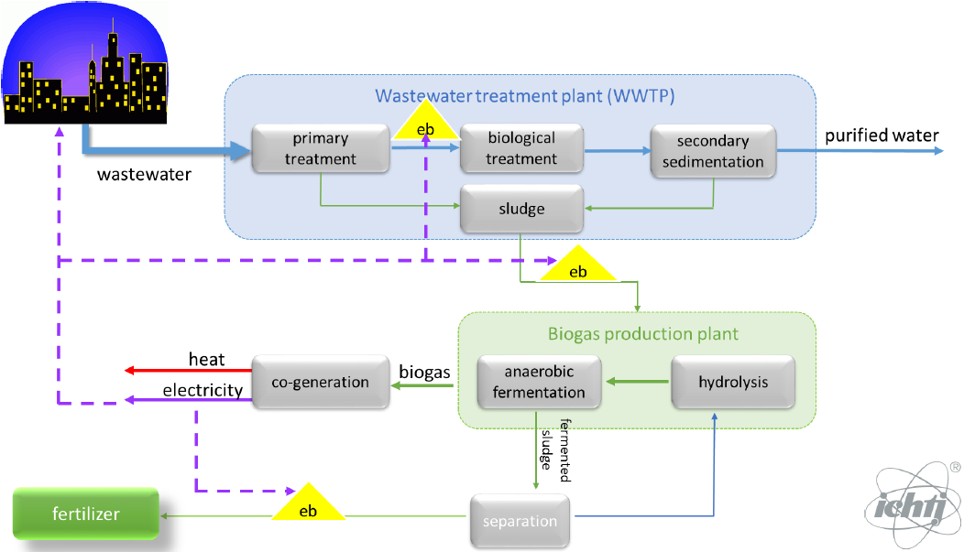
Biological Sludge Treatment

Slide 17
Some Activities – Task 3.4
Two main objectives:
  Applications of electron beams up to 140 MeV in the medical and other areas
  Study of the construction of high performance electron linear accelerator up to 140 MeV
Two workshops held:
  The use of Very-High Energy Electrons (VHEE) Radiation Therapy (RT) https://www.cockcroft.ac.uk/events/VHEE17/
  Special session in the CLIC 2018 workshop dedicated to CLEAR apps - beam instrumentation developments - irradiation of material and components - plasma lens acceleration - THz radiation developments - VHEE RT https://indico.cern.ch/event/656356/overview
PRAE (Platform for Research and Application of Electrons)

Slide 18
Some Activities – Task 3.4

Slide 19
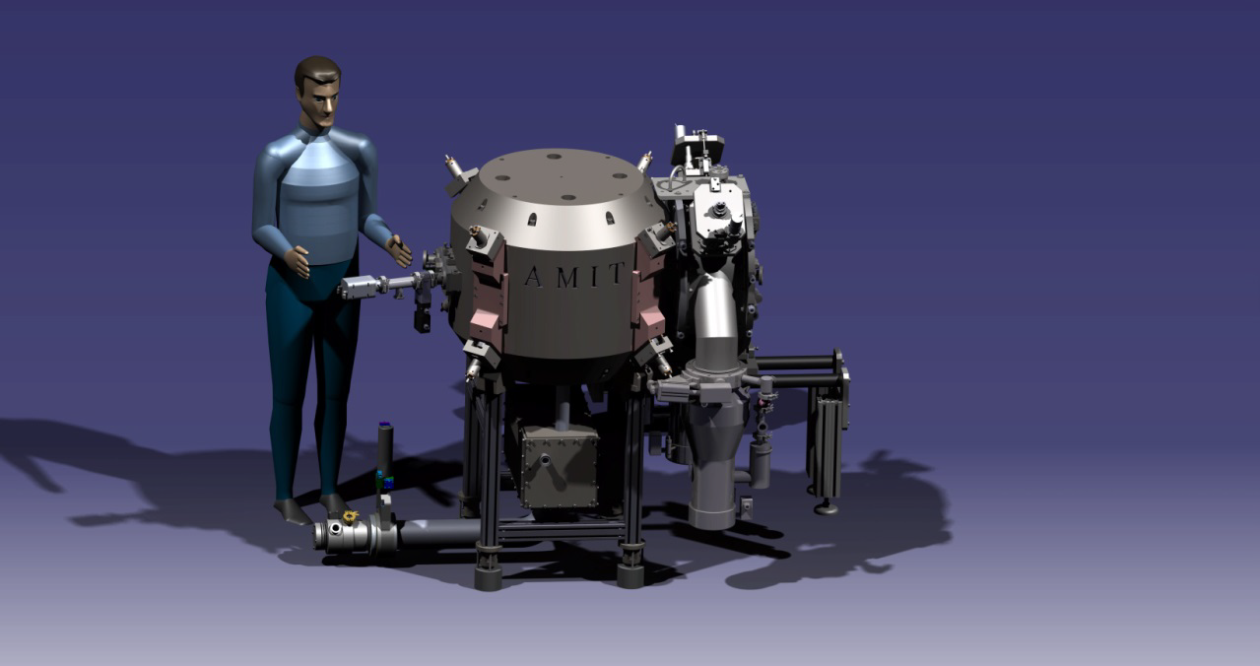
Some Activities – Task 3.5
Main activities:
  Optimisation of the AMIT compact cyclotron for PET isotope production (CIEMAT)

Slide 20
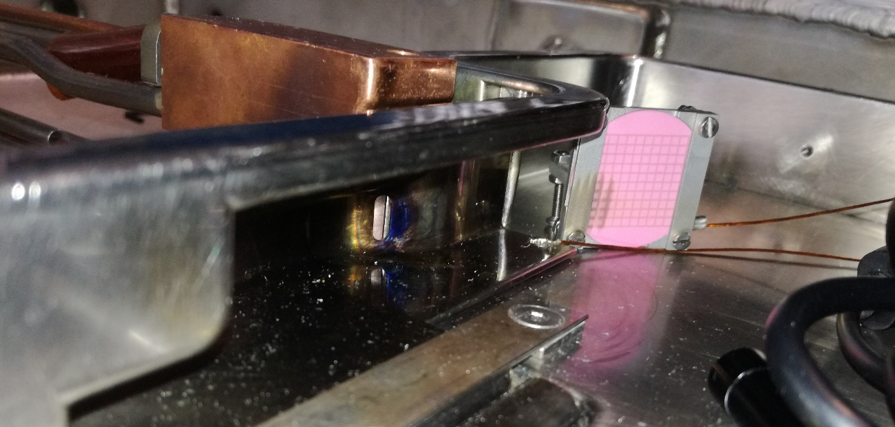
Some Activities – Task 3.5
450 µA measured

Slide 21
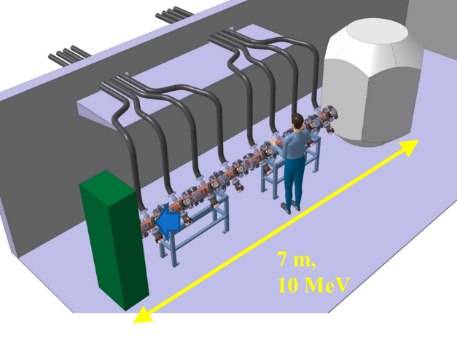
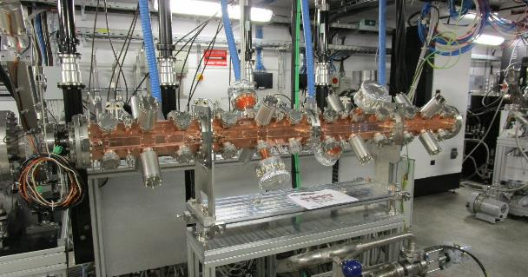
Some Activities – Task 3.5
Optics design of high current FFAG complete and thesis being written
Use of electrons for ⁹⁹Mo
Progress being made on CERN RFQ: - injector for proton therapy - PET production - PIXE of artwork - acceleration of q/m=1/2 for various apps - radiobiology of cells

Slide 22
Conclusions
Lots of progress being made!
No concerns over any future deliverables or milestones
Possibilities of additional funding:
  PoC
  H2020
  Country programmes (e.g. UK: Industrial Strategy; GCRF)
Trying to interest new industry:
  Webinar
  FEP visit to Brazil and MOU with IPEN
  Working with iiA
  Collaborative projects
  More countries through IAEA

