Slide 1

Proposal for the South East Europe International Institute for Sustainable Technologies
(SEEIIST)
Dr Ing Nicholas J. Sammut
ARIES Annual Meeting, 22-25 May 2018, Riga, Latvia

Slide 2
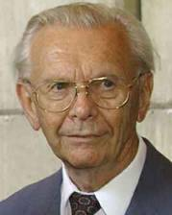







SEEIIST
Joint South-East European International Institute for Sustainable Technologies (SEEIIST)
in the spirit of ‘Science for Peace’
Autumn 2016 - meeting of the World Academy of Art and Science in Dubrovnik Croatia
Initiative first proposed by Prof. Herwig Schopper, former Director General of CERN
positive reception by a number of organizations and institutions

Slide 3
SEEIIST
The main objectives of the Project
To promote collaboration between science, technology and industry
To provide platforms for the education of young scientists and engineers based on knowledge and technology transfer from European laboratories like CERN and others
To mitigate tensions between countries in the region
To form a research nucleus in the region of South-East Europe by bringing people from different countries to work together – not only scientists and engineers, but also industry and the public sector
The combination of all these tasks would imply another case of the ‘CERN model’ of ‘Science for Peace’
The goals can only be achieved with a Large Scale Facility based on the latest technologies to enable ‘first class research’ and thereby strongly revert brain drain and assure high competitiveness

Slide 4
SEEIIST
Importance of the Project for the Region
The project would be unique in the whole region
Real international cooperation, bringing people together in the spirit
of ’Science for Peace’ could contribute to
develop the economic situation
improve the standard of living
reduce unemployment (in particular for young people)
reverse the brain drain
aim at excellence throughout
this would imply a certain ‘industrialization’ of the region based on sustainable technologies
- These types of projects represent an important pillar of the ‘knowledge-based economy’

Slide 5
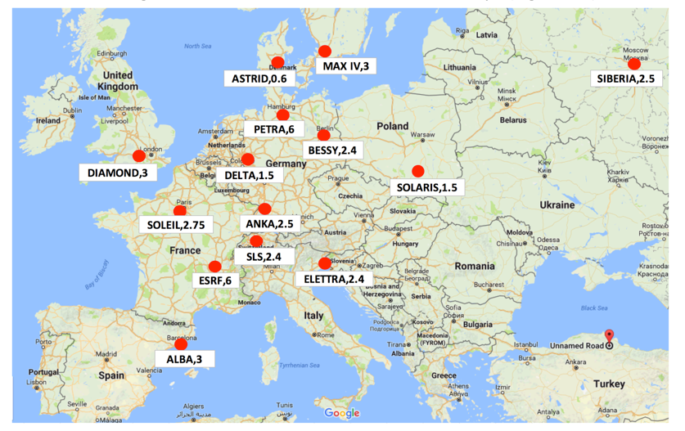
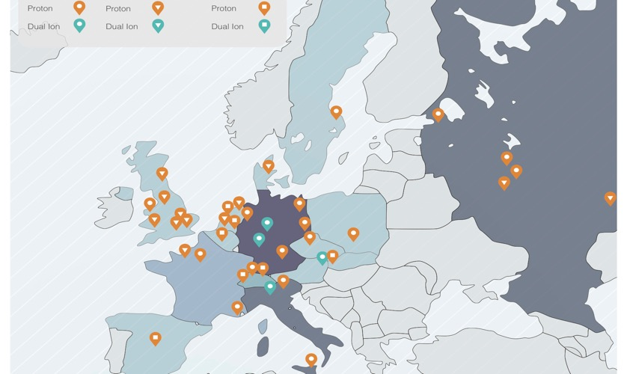
Distribution of Light Sources in Europe
More than 60 light sources in the world, 14 in Europe
Big Empty Space in the SEE Region
12 dual ion machines in the world, 4 in Europe
Particle therapy centers in Europe

Slide 6
SEEIIST
Summary of the main mission of the SEE Project
Science for Peace
Scientific Excellence
International Collaboration
Sustainable development of society
Education
Technology Transfer and Boost of Innovation
Development of powerful digital network

Slide 7
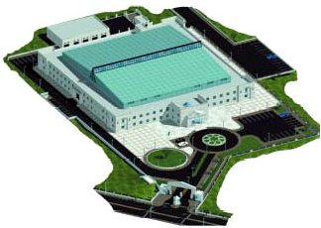
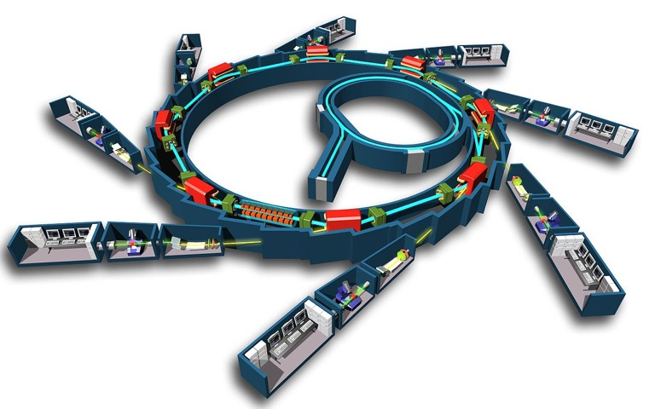

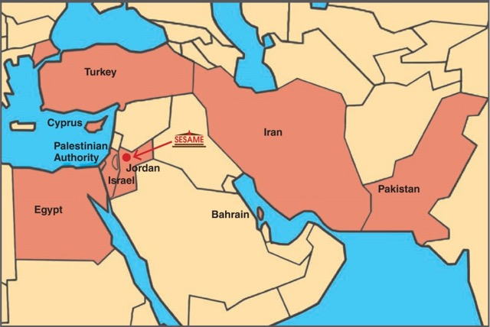
SESAME: ‘Synchrotron Light for Experimental Science and
Applications in the Middle East’
Jordan
The success of such an initiative is being demonstrated by the SESAME project:
built in Jordan, unifies 9 member states of different political systems and religions in the Middle East: Bahrain, Cyprus, Egypt, Israel, Iran, Jordan, Pakistan, Palestinian Authority, Turkey; has achieved all of them to peacefully work together
The first President of Council of SESAME:
Prof. Herwig Schopper

Slide 8
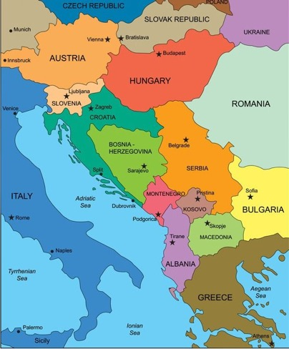
Members for the South-East European
International Institute for Sustainable Technologies
Republic of Albania
Signed a Declaration of Intent
Agreed ‘ad referendum’
Bosnia and Herzegovina
Observer
Republic of Bulgaria
Republic of Croatia
Hellenic Republic
Kosovo*
FYR of Macedonia
Montenegro
Republic of Serbia
Republic of Slovenia

Slide 9
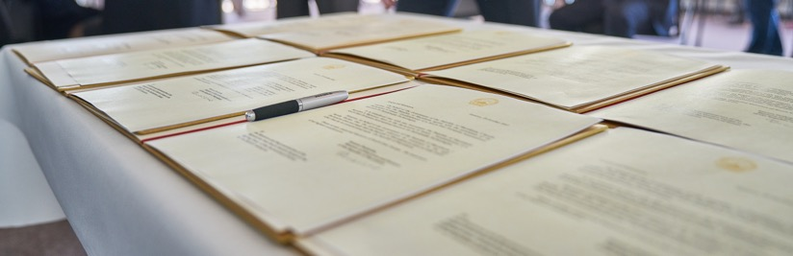
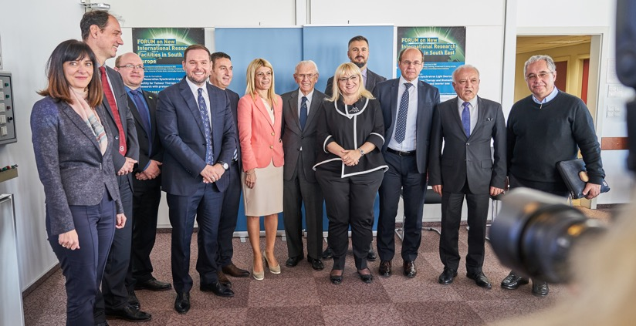
Declaration of Intent signed at CERN on October 25, 2017
Signed by eight parties:
Albania, Bosnian and Herzegovina, Bulgaria, Kosovo*, The FYR of Macedonia, Montenegro, Serbia and Slovenia.
Croatia agreed ‘ad referendum’, Greece is presently an observer
SEE Initiative now transformed into a Project with regional character
Intergovernmental Steering Committee formed for the further steps
SEE Ministers of Science/Corresponding Ministers or their representatives at CERN

Slide 10
SEEIIST
How the common central facility would look like?
Two complementary options were proposed,
both based on most advanced technologies

Slide 11
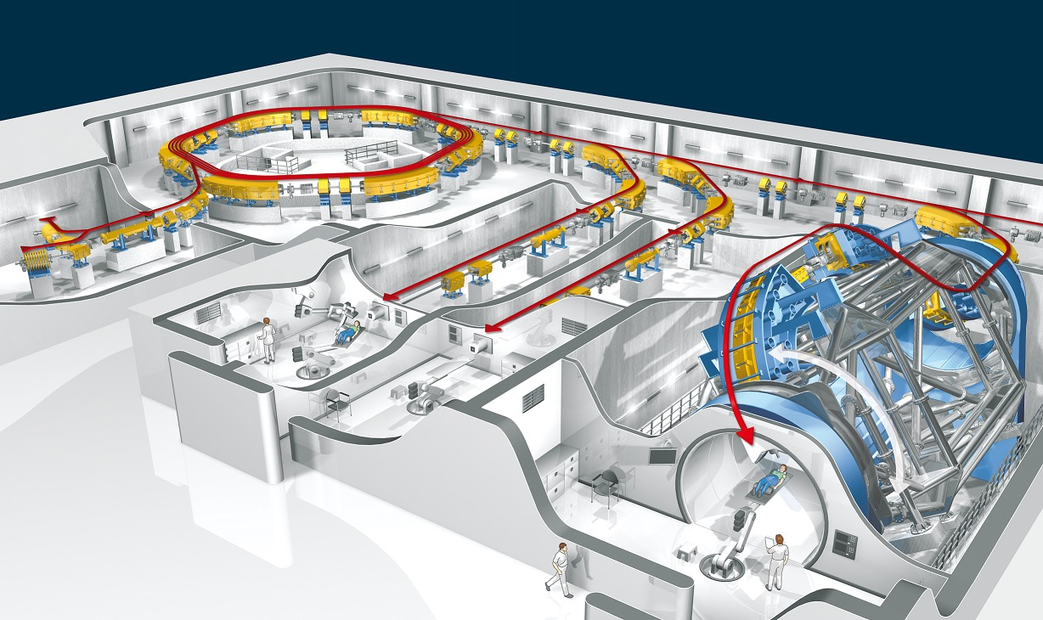
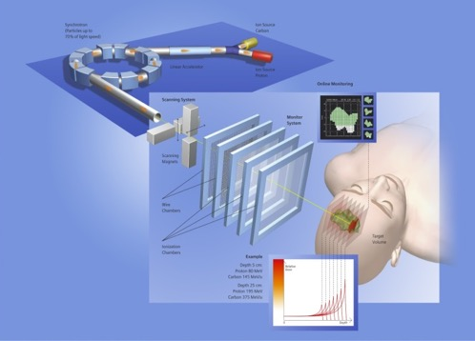

Option I: Facility for Tumour Therapy and Biomedical Research with protons and heavier ions
About 500 patients per year to be treated as needed for a population of 20M. In parallel, 50% of the beam time dedicated to biomedical research. About 1000 researchers, including a major number from outside the SEE region. Unique.
HIT Heidelberg
Med. Director: Prof. J. Debus
Tech. Director: Prof. T. Haberer

Slide 12
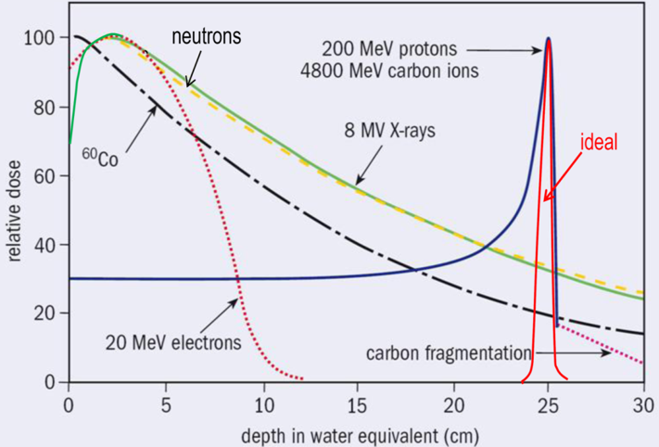
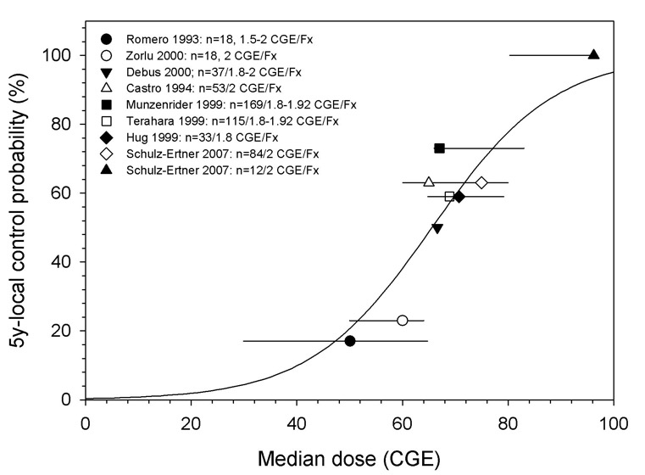
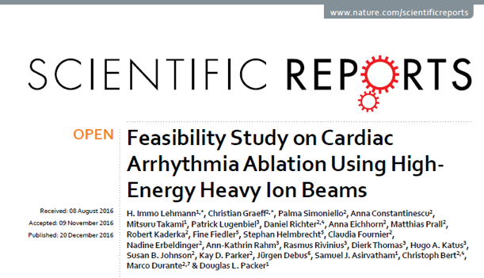
Hadron Cancer Radiation Therapy with protons and heavier ions - the most successful instrument for the treatment of many tumours
Results of therapy:
Chordomas of the Skull Base
Tumour region
Survival probability 5 years after treatment
Deposited dose along the tissue depth
¹²C Ions
Other use of ion beams: treatments of Heart Arrhythmia
Protons
Conventional Therapy

Slide 13
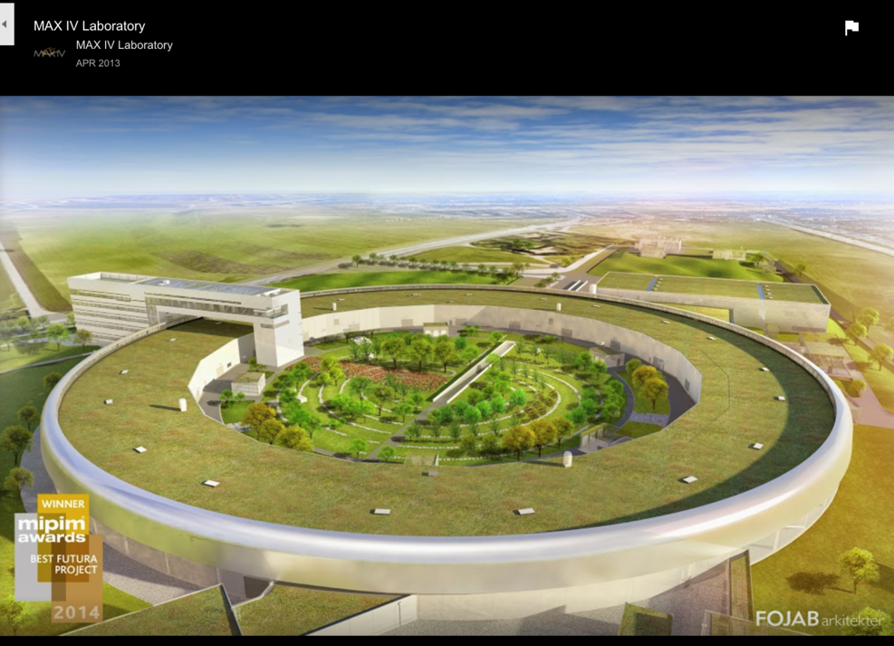
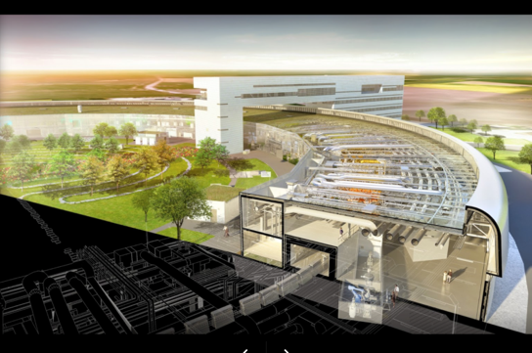
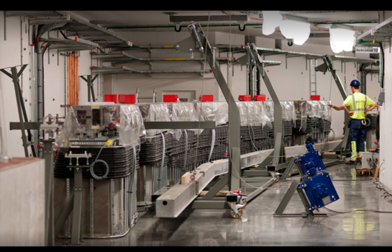
Option II: 4th Generation Synchrotron Light Source with a
new technique used for the first time in Lund, Sweden
Science community of South-East Europe would be unified, more than 1000 Users, a broad spectrum of research and applications in biology, chemistry, engineering, nanotechnology, archaeology and other industrial aspects
Max IV Lund
Director Dr. Christoph Quitmann

Slide 14
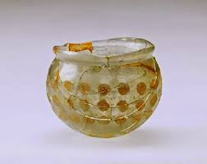
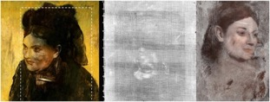
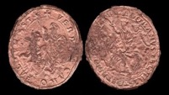
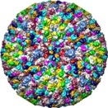
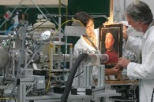
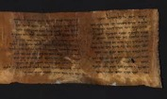


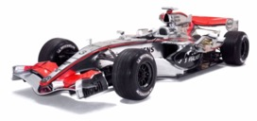
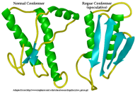

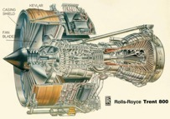
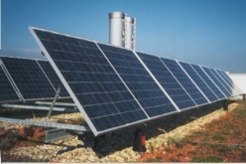
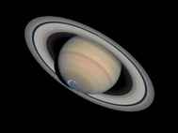

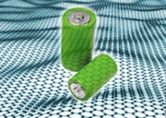
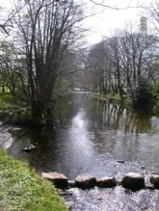
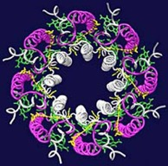
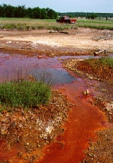
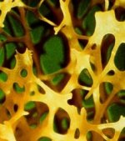

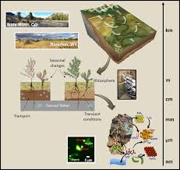

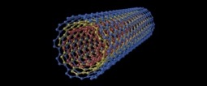
Applications of Synchrotron Light
Archaeology
Arts
Medicine
Engineering
Examples of possible research domains which are relevant for the region
SR: wide community
Energy
Physics
Environment
Chemistry&Materials

Slide 15
The first preparatory steps during 2017 towards the
realization of a SEE Project
2016
November
2017
March | April | May | June | July | August | September | October
WAAS meeting, Dubrovnik,
proposal
H. Schopper
for a joint SEE International
Institute
Official support by
the Government of Montenegro
Visit of all Science/Corresp. Ministers of the region
First joint discussion,
Budva
Ministerial meeting at CERN – Signature of Declaration
of Intent
Initiative presented
to the EC, incl. Commissioner C. Moedas
Initiative presented to the IAEA, incl. DG Y. Amano
Political steps
2017 |  |  |  |  |  |  |  | 2018
Jun |  |  | August | Septemb. | October | November | Decemb. | January | February | March
July
Two international committees
of experts
for each of the two project options formed
Editor committees work on Concept Studies
Scientific Forum
ICTP, Trieste
Editor committee meeting at CERN
Editor committee meeting in Budva
Editor committee meeting at CERN
1st Intergovernmental Steering Committee meeting, Sofia
2nd SC meeting, Tirana
Scientific steps
Executive Summary
of the results prepared

Slide 16
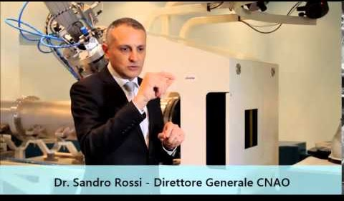
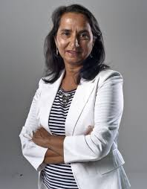
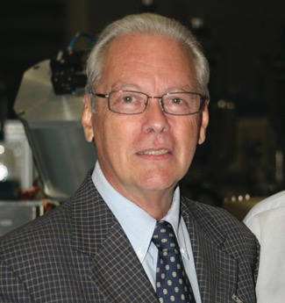
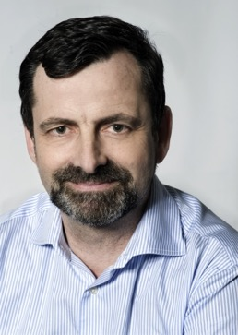
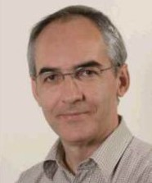
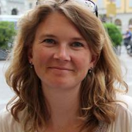
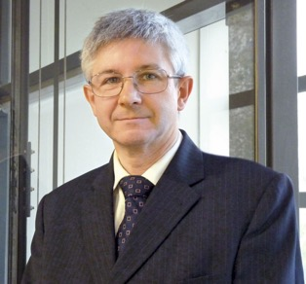
Members of the Editor Committee for Option I – Facility for Tumour Therapy and Biomedical Research with p and heavier ions
Chairman
Dr Sandro Rossi, Director
of CNAO in Pavia, Italy
Prof. Ugo Amaldi, President
of TERA, Novara, Italy
Prof. Manjit Dosanjh, Staff at CERN
Prof. Philippe Lambin,
Head of Radiation Oncology, University of Maastricht, Maastricht, Netherlands
Prof. Brita Singers Sorensen, Depar. of Clinical Medicine, Denmark
Dr. Michael Scholz,
Scientific Head of Biophysics
Departm. GSI, Darmstadt, D
Prof. Dr. Jacques Balosso,
CHU Grenoble Alpes, FR

Slide 17
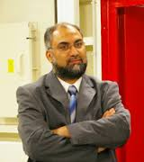
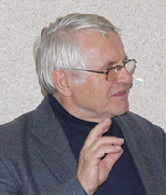
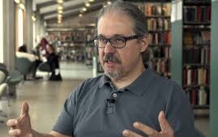
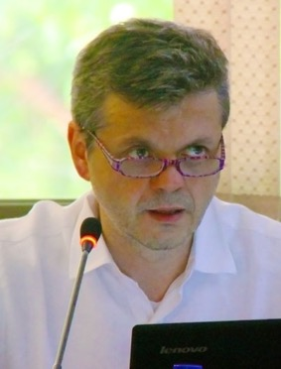
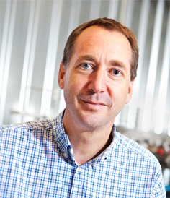
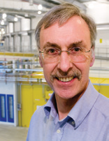
Members of the Editor Committee for Option II – 4th Generation
Synchrotron Light Source
Chairman
Dr Amor Nadji, Director of
Sources and Accelerator Division of SOLEIL, France
Dr. Pedro Fernandez-Tavarez, Machine-Director of MAX IV Lund, Sweden
Dr Dieter Einfeld, former Technical Director of
SESAME and ALBA
Prof. Riccardo Bartolini,
University Oxford and Diamond, UK
Dr. Trevor Rayment,
University of Birmingham, UK
Dr. Christoph Quitmann, Director of MAX IV, Sweden

Slide 18
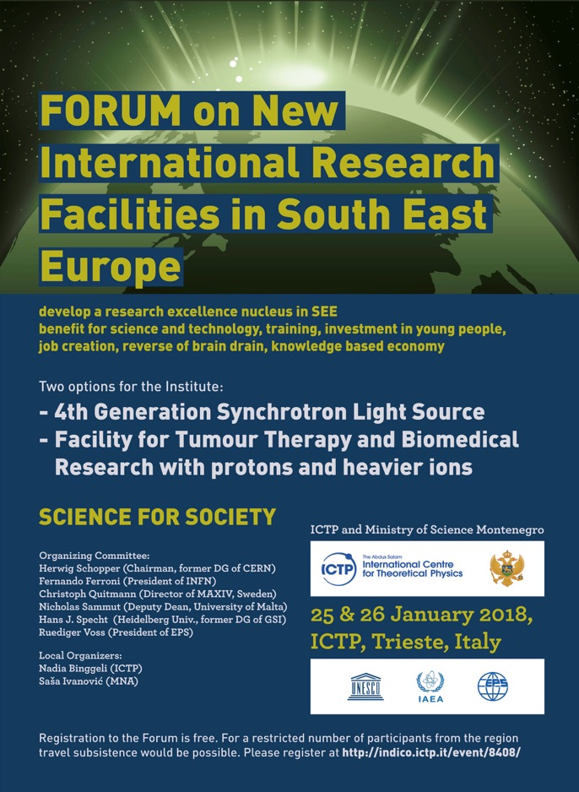
Culmination of the large effort invested over the year 2017
- ICTP/Trieste on January 25-26, 2018
- > 100 participants
- DG for Research and Innovation (Robert Jan Smits)
- Chair of the ESFRI (Giorgio Rossi)
- representatives of the IAEA
- Secretary General of the EPS
- representatives of the SEE Steering Committee
- representatives from the scientific community
- Medical and Technical Directors of HIT Heidelberg
- Director of CNAO
- Administrative Director of SESAME
- representatives from CERN including the Director of Accelerator and Technology
- the deputy Director of DESY
- the Research Director of GSI-FAIR.
Thanks to the financial help of the IAEA and some help from the EPS, more than 40 Users from the Region could participate in the Forum.

Slide 19
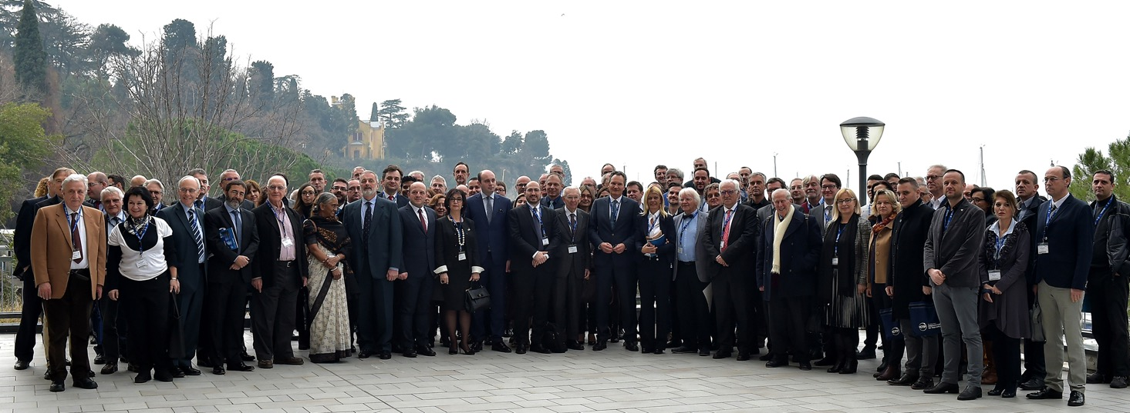


Forum on New International Research Facilities in South East Europe, ICTP, Trieste 25-26 January 2018

Slide 20

Central goal of the Forum: Concept Studies for the two options of the Institute created by the Editor Committees and presented for the first time to the public
Main elements of
a Business Plan:
Executive Summary of the Concept Studies prepared
for the Forum
- technical parameters
of the facilities
- time schedule
- investment costs
- operation costs

Slide 21
SEEIIST
Outcome of the Forum
The Forum was a great success in confirming the interest both
in the science-policy and the scientist communities
An important basis for the next steps was provided:
- Support from the IAEA for Capacity Building declared – 0.5 MEUR
offered to start the Training Program
- EC representatives looked favourably at the project –
potentially providing resources to support the next step, the
preparation of the Technical Design Report
However, the EC informed us that before any further steps were taken, one of the two options had to be selected

Slide 22
SEEIIST
The next political and scientific-technical steps
Develop Intergovernmental Steering Committee to a leadership role in all future science-policy steps
Prepare proposals for funding requests
Form an Executive (future Directors)
Start training programs for young people in 2018
for technical operation crew
for future users community
Technical Design Report (TDR)
Establish Procedure of selection of sites

Slide 23
SEEIIST
Sources of funding
Politically widely accepted that the SEE region
needs economic help and further stabilization.
Europe needs SEE, and SEE needs Europe.
Hence main investment from EU programs
(EU members and Non-members)
EUR 150 - 200 million required per project
guaranteeing competitivity in Europe

Slide 24

SEEIIST
A few days after the Forum – First SEE Intergovernmental Steering Committee Meeting in Sofia, Bulgaria
Reception by the President of the Republic of Bulgaria, Mr. Rumen Radev
Chairperson elected: Dr. Sanja Damjanovic, Minister of Science of Montenegro

Slide 25


SEEIIST
ESFRI meeting followed by the conference on Research Infrastructures beyond 2020
Subtitle: Sustainable and effective ecosystem for science and society
22 and 23 March 2018 Sofia, Bulgaria

Slide 26


SEEIIST
The 2nd Steering Committee Meeting held on 30 March, 2018, in Tirana, Albania
Unanimous decision to establish, as the core of the SEEIIST, a Regional Institute for Tumour Therapy and Biomedical Research with Protons and Heavier Ions
Meeting at the Ministry of Education, Sports and Youth, Tirana, Albania

Slide 27
SEEIIST
The next steps:
- Form an International Association as a legal entity
- Officially ask CERN to be the headquarters for the SEEIIST
Association until the site for the Project is selected
- Prepare application for EU financial support for the
Preparatory phase (work on Technical Design Report,
Business plan, Conditions for the site)
- Prepare further applications for MC RISE and COST
projects for capacity building

