Slide 1
Report from
Science Advisory Committee (SAC)
Akira Yamamoto
On behalf of SAC Members
The 1st ARIES Annual Meeting, Riga, 23-25 May, 2018

Slide 2
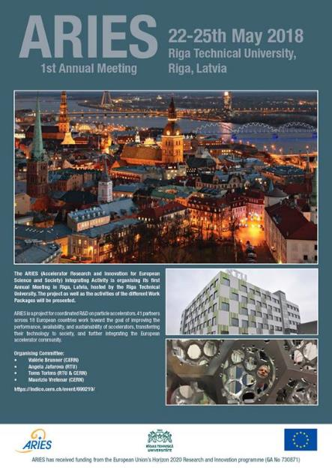
Executive Summary
The committee congratulate the very successful progress in the ARIES collaboration activities accomplished in the 1st year.
We have been very much impressed with all the progress report well prepared and excellently presented.
We recognize every work package well organized and started to meet the ARIES scientific pillars/goals:
  Excellence: develop key Accelerator Technology and improve European Accelerator Infrastructures
  Access: Trans national access opening 14 accelerator test facilities, and enlarging consortium with new partners and countries
  Innovation: enhance industrial participations with new co-innovation programs and develop social application programs
  Sustainability: develop a model for sustainable accelerator science , and train new generation in accelerator science and technology
We note that the EUCARD-II progress and spirit is extended with the ARIES collaboration.
We hope that ARIES collaboration proceeds activities in the 2nd year, with well established work-packages, and encourage the activities to support possible new alternative ideas going in the direction of smaller footprint and lower cost, or of a better use of existing infrastructures,
It should be emphasized to encourage further bi-beneficial cooperation between laboratories and industry to encourage the social application programs.

Slide 3
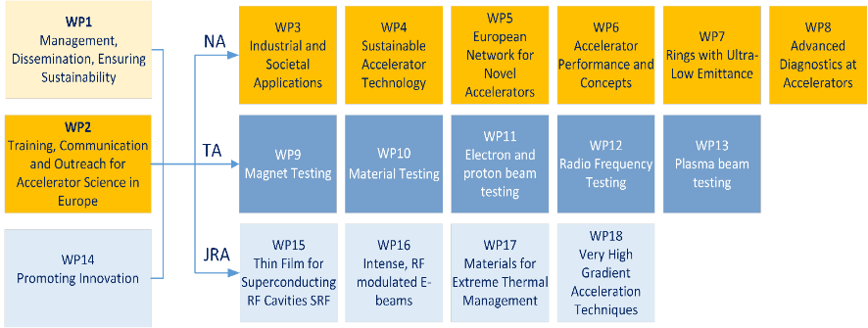
ARIES Structure
18 Workpackages:
8 Networks 5 Transnational Access, 5 Joint Research Activities.

Slide 4
Comments and Advices
Communication and outreach activities, in particular,
  e-learning on accelerator science is very interesting and unique activities matched with the ARIES spirit,
Innovative works material research and test facility
  The networking in Europe best fit to the ARIES motivation,
Advanced accelerator science and technologies of
  High-performance beam, diagnostics, e-gun,
  Superconducting magnet with HTS,
  High-gradient NRF, and SRF with thin-film should be very adeautely focused,
Further advanced accelerator concepts studies:
  gamma-factory, muon colliders, Linear Colliders are much encouraged.

Slide 5
Plenary Presentations: 23 May (p.m.) with my personal impression

Slide 6
Plenary Presentations: 24 May (a.m.)

Slide 7
Plenary Presentations: 24 May (p.m.)

Slide 8
Plenary Presentations: 25 May (a.m.)

Slide 9
Advances expected in the 2nd Year
The 1st annual meeting is for SAC to learn the starting of the real activities in each WG, and to prepare for observation and advances in the 2nd annual meeting.
We anticipate to hear excellent year-2 advances with enhanced members of SAC, and to enable useful advices in the next annual meeting 2019, and in the middle of the ARIES activities.

