Slide 1
Inner Tracking Detector Upgrade
ABC130 Chip Irradiation and SEU Testing
Silas K Grossberndt, Columbia University
Dr. Richard Teuscher, University of Toronto
Thanks to the Generous Support of the Lounsbery Foundation.

Slide 2
Overview
Introduction
ABC130 Chips
  Post Irradiation Measurements
  Pre-and-during Irradiation Measurements
  Re-irradiation
TFileMerger
Future Work

Slide 3
Background

Slide 4
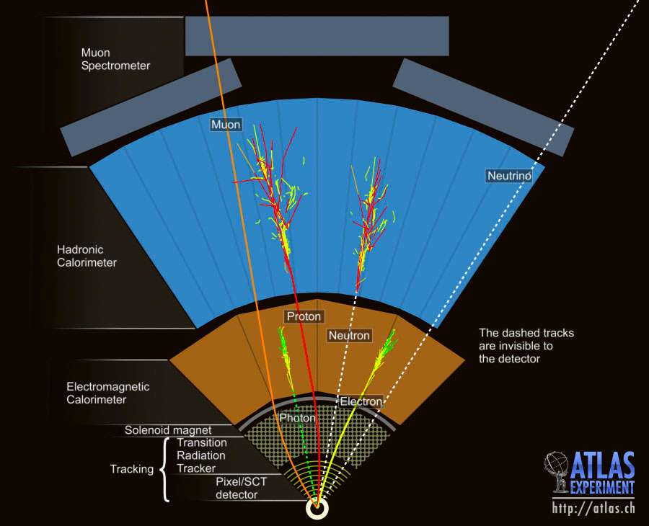
The ATLAS detector
The detector is divided into a number of subdetectors which can be grouped as follows
  Tracker
    This is the area just outside of the beam pipe, it does not destroy any particles, but it can track charged particles
  Calorimeters (Electromagnetic and Hadronic)
    Identification to get Energy of particles
  Spectrometer
    Finds muons

Slide 5
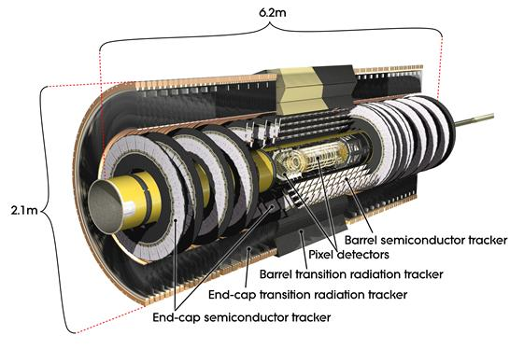
The Inner Detector
The Inner detector is made of three components: the pixel detector, the transition radiation tracker and the Semi-Conductor Tracker.
Pixel Detector (55-150 mm)
Silicon pixels –each is 50 x 400 microns (1x8 human hairs)
1750 modules (~50, 000 pixels/module + 16 readout boards)
Total: ~80 million channels of readout
Semi-Conductor Tracker (299-506 mm)
SiPM micro-strip detector made of two sections
  Barrel—Long staves—2112 modules total
  End Cap—Composed of Petals each containing slices of Rings of detectors—2 endcaps with 988 modules each
~6 million channels of readout
Gives 8 measurements per particle for spatial positioning
Both of these work by detection of charged particles, measuring the small ionization caused by the particles passing through the strip
Transition Radiation Tracker (563-1066 mm)
Drift Tube + Radiatiors in 1 barrel & 2 endcaps
  Barrel—3 layers of 32 modiules
  Endcaps- 1 per side 18 modules total
Particles ionize gas which then drift towards the wire for 30 position points
Source: https://cds.cern.ch/images/CERN-GE-0803014-01/file?size=medium

Slide 6
ITK Design
The ITK will be the all silicon detector replacing the whole Inner Detector for High Luminosity LHC
Similar system to current SCT
This “strip” detector will be replacing the pixel detector to increase pile up efficiency and jet identification

Slide 7
ABC130 Chip

Slide 8
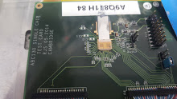
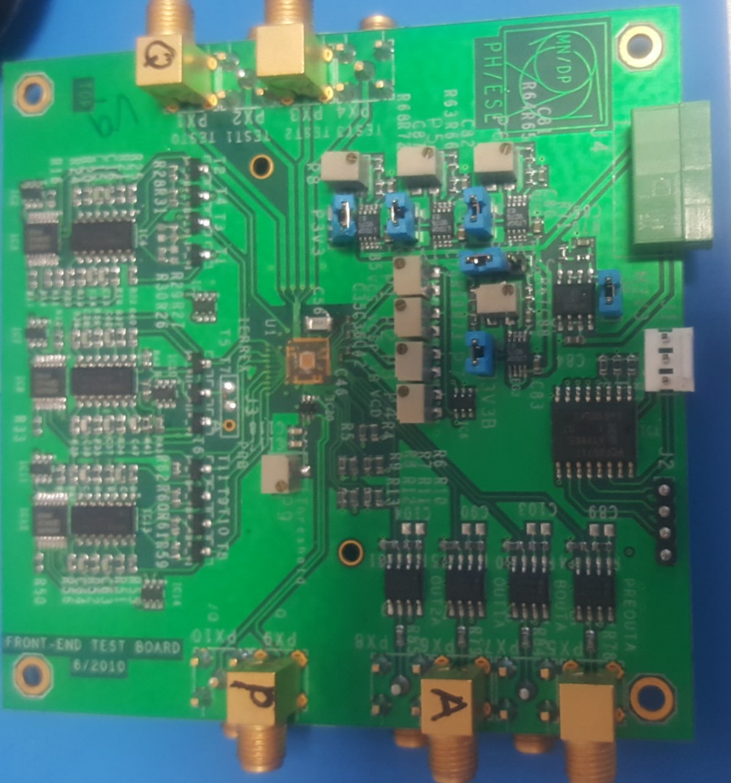
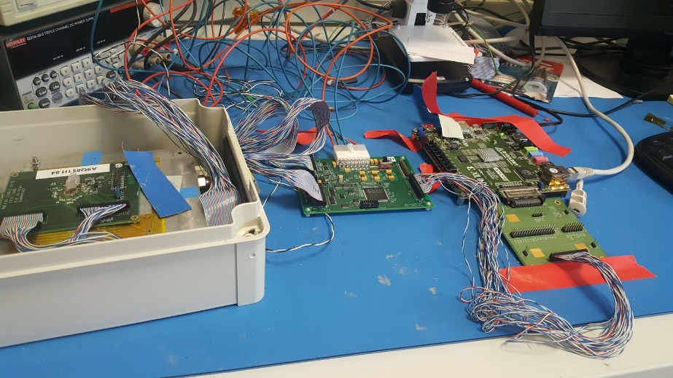
ITK operations
driver board (FPGA)
Hybrid Controller
Readout chip
DC-DC converter
  Regulates Voltage down to 1.5 V

Slide 9
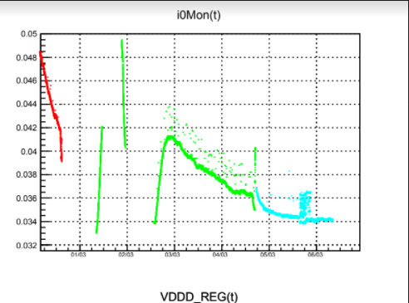
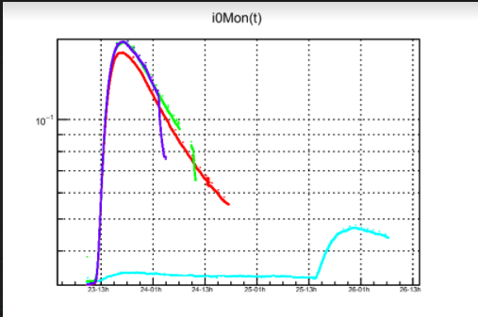
Total Ionizing Dose Bump and Annealing
There is an increase in current consumption when the chip is exposed to ionizing radiation
This effect is thought to be caused by damages to the chip
These damages cause leakage current and significant temperature increases (few °C per chip)

Slide 10
Post-Irradiation (Batch 2) & Pre-Irradiation (Batch 3)

Slide 11
During Irradiation

Slide 12
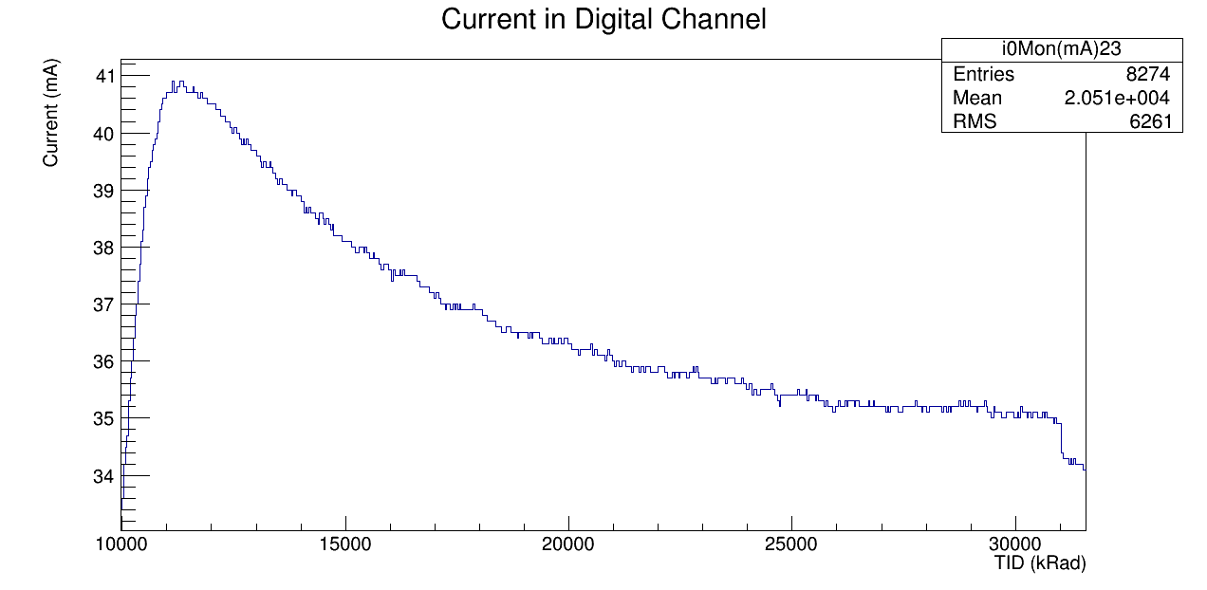
Re-Irradiation

Slide 13
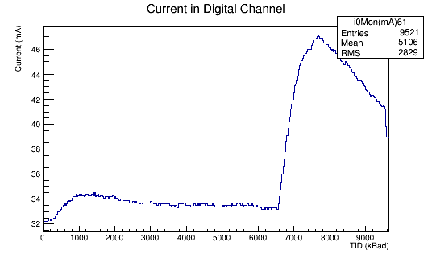
Power Off Irradiation

Slide 14
Temperature Rise

Slide 15
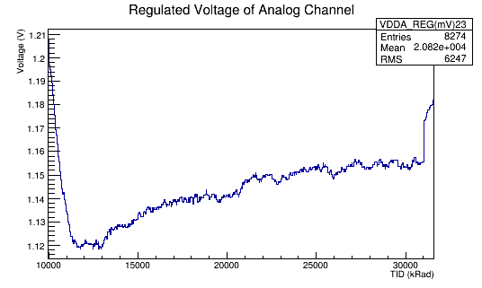
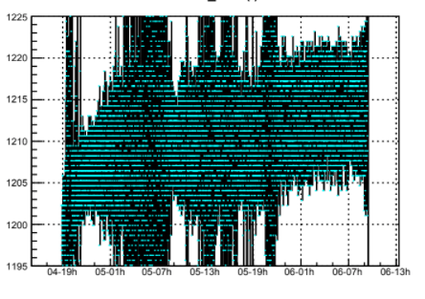
Regulated Voltage Failures

Slide 16
Batch 3 Chip Issues

Slide 17
Other Work

Slide 18
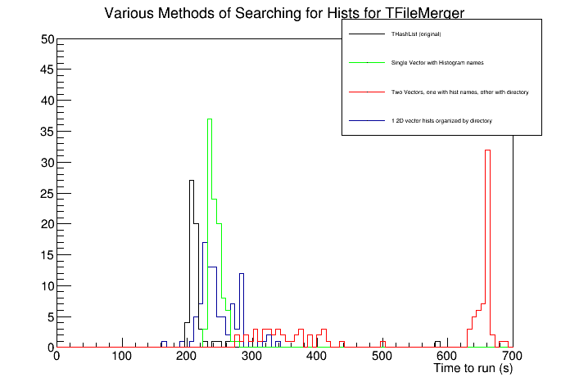
TFileMerger and SEU
SEU package: Identifies Single Event Upsets—ionization caused readout errors—wrote a README file for proper use
TFileMerger: main macro of “hadd” in ROOT.
new Verison was running slowly/incorrectly, so I tried to implement a few potential fixes

Slide 19
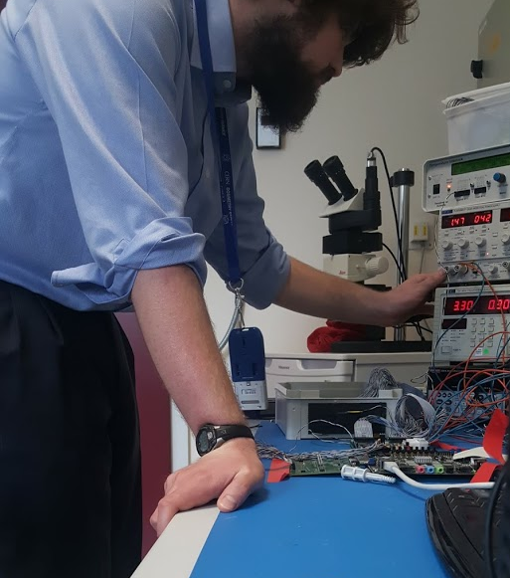

Miscellaneous

Slide 20
Acknowledgements
This project and experience was funded by the generous support of the Lounsbery Foundation
Thanks to Steve Goldfarb and Jean Kirsch for their support and advice
Thanks as well to Dr. Olivier Arnez and Kyle Cormier for their mentorship and help on this project

