Slide 1



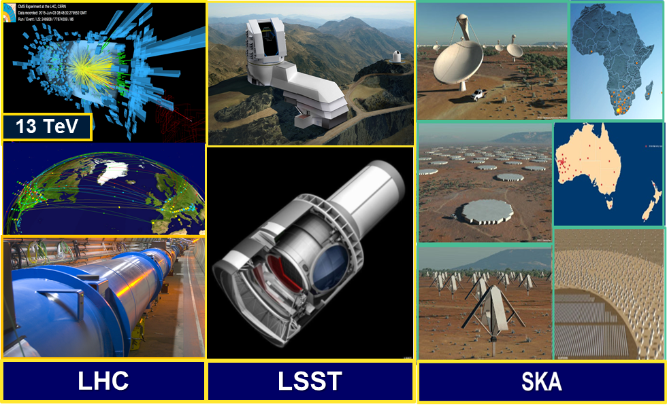
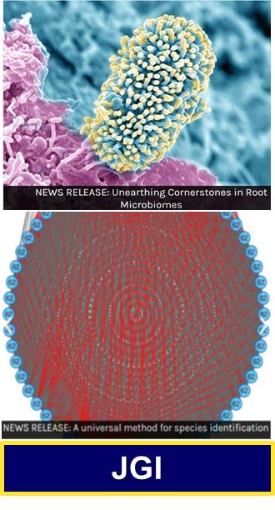

NGenIA: Next Generation SDN Integrated
Architecture for LHC and Exascale Science
LHC Beyond
the Higgs Boson
LSST SKA
BioInformatics
Earth Observation
Gateways
to a New Era
Joint Genome Institute
Harvey Newman, Caltech
INDIS Panel on Data Intensive Sciences
Denver, November 12 2017

Slide 2

A New Era of Challenges: Global Exabyte Data Distribution, Processing, Access and Analysis
Exascale Data
  0.5 EB now, 1 EB by end of LHC Run2
  To ~100 EB during HL LHC Era
Network Total Flow of >1 EB this Year
  850 Pbytes flowed over WLCG in 2016
Projected Shortfalls by HL LHC
  CPU ~4-12X, Storage ~3X, Networks
Network Dilemma:
Per technology generation (~8 years)
  Capacity at same unit cost: 4X
  Bandwidth growth: 30X (Internet2); 50X (GEANT), 70X (ESnet)
During LHC Run3 (~2022)
we will likely reach a network limit
This is unlike the past
  Optical, switch advances are evolutionary; physics barriers ahead
New Levels of Challenge
Global data distribution, processing, access and analysis
Coordinated use of massive but
still limited diverse compute, storage and network resources
Coordinated operation and collaboration within and among scientific enterprises
HEP will experience increasing Competition from other data intensive programs
  Sky Surveys: LSST, SKA
  Next Gen Light Sources
  Earth Observation
  Genomics

Slide 3
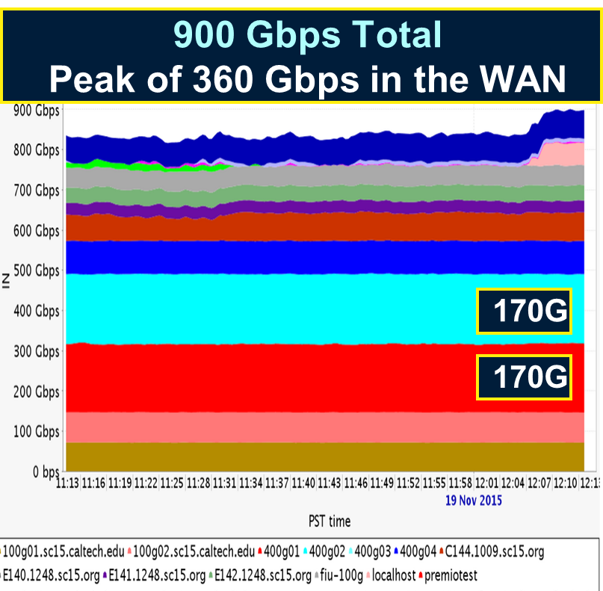
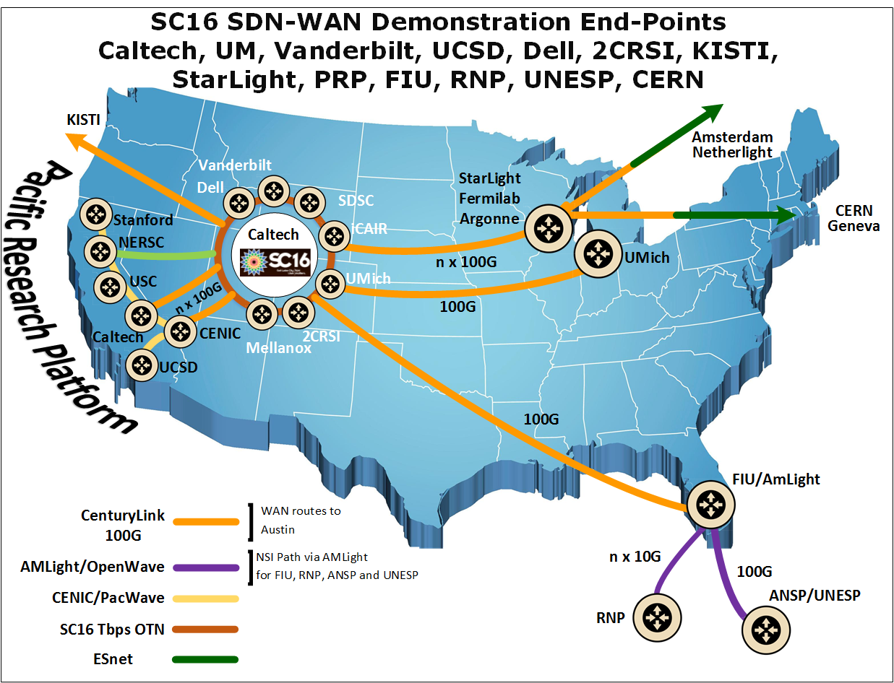
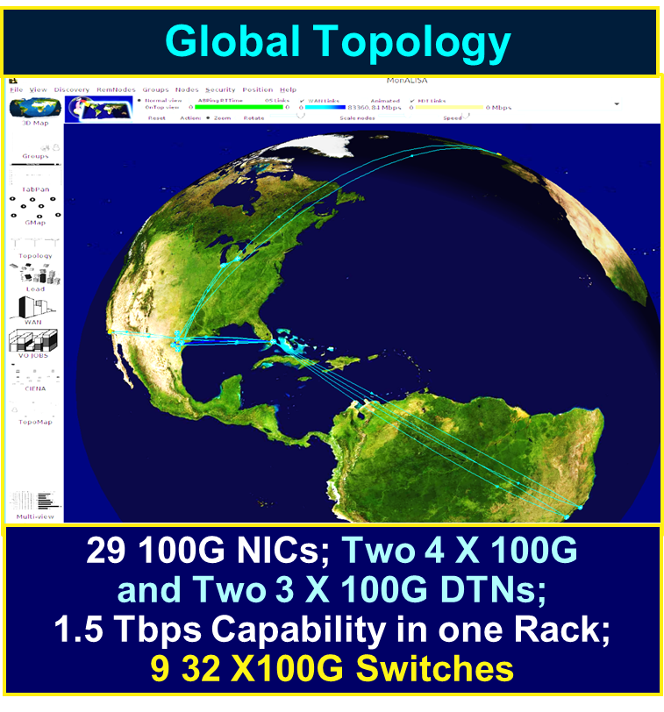
SC15-17: SDN Next Generation
Terabit/sec Ecosystem for Exascale Science
supercomputing.caltech.edu
SDN-driven flow steering, load balancing, site and net orchestration
Over Terabit/sec
Global Networks
SC17 Consistent Operations with Agile Feedback
Major Science Flow Classes
Up to High Water Marks
Preview PetaByte Transfers to/
from Site Edges of Exascale Facilities With
100G -1000G DTNs
LHC at SC15: Asynchronous Stageout (ASO) with Caltech’s SDN Controller
Tbps Ring at SC17: Caltech, Ciena, Scinet, OCC/
StarLight + Many HEP, Network, Industry Partners
45

Slide 4
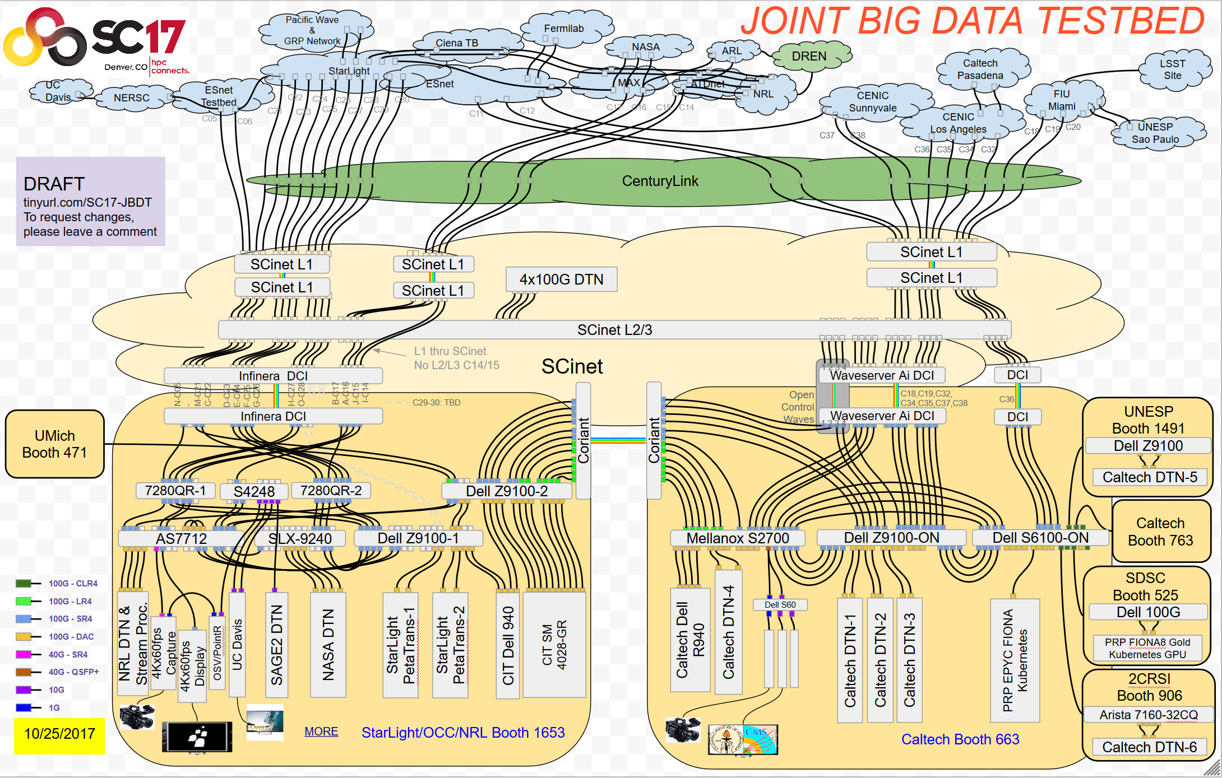
Caltech and Partners at SC17
A Global Collaborative Scientific Enterprise
~3 Tbps each at the Caltech
and Starlight/OCC booths
1.8 Tbps between the Booths
and ~3Tbps out to the WAN
Connections to the 2CRSI,
SDSC, UNESP booths
Caltech Booth: 200G dedicated
to the Caltech campus;
300G to PRP (UCSD, Stanford, UCSC, et al); 200G to Brazil + Chile via Miami; 200G to ESnet
Waveserver Ai + Coriant DCIs
in the booths: N X 100GE
to 400G, 200G, 100G waves
Intel State of the Art SSDs
(P4608, P4500, P4800X)
at the heart of it
Microcosm: Creating the Future SCinet
and the Future of Networks for Science
★

Slide 5
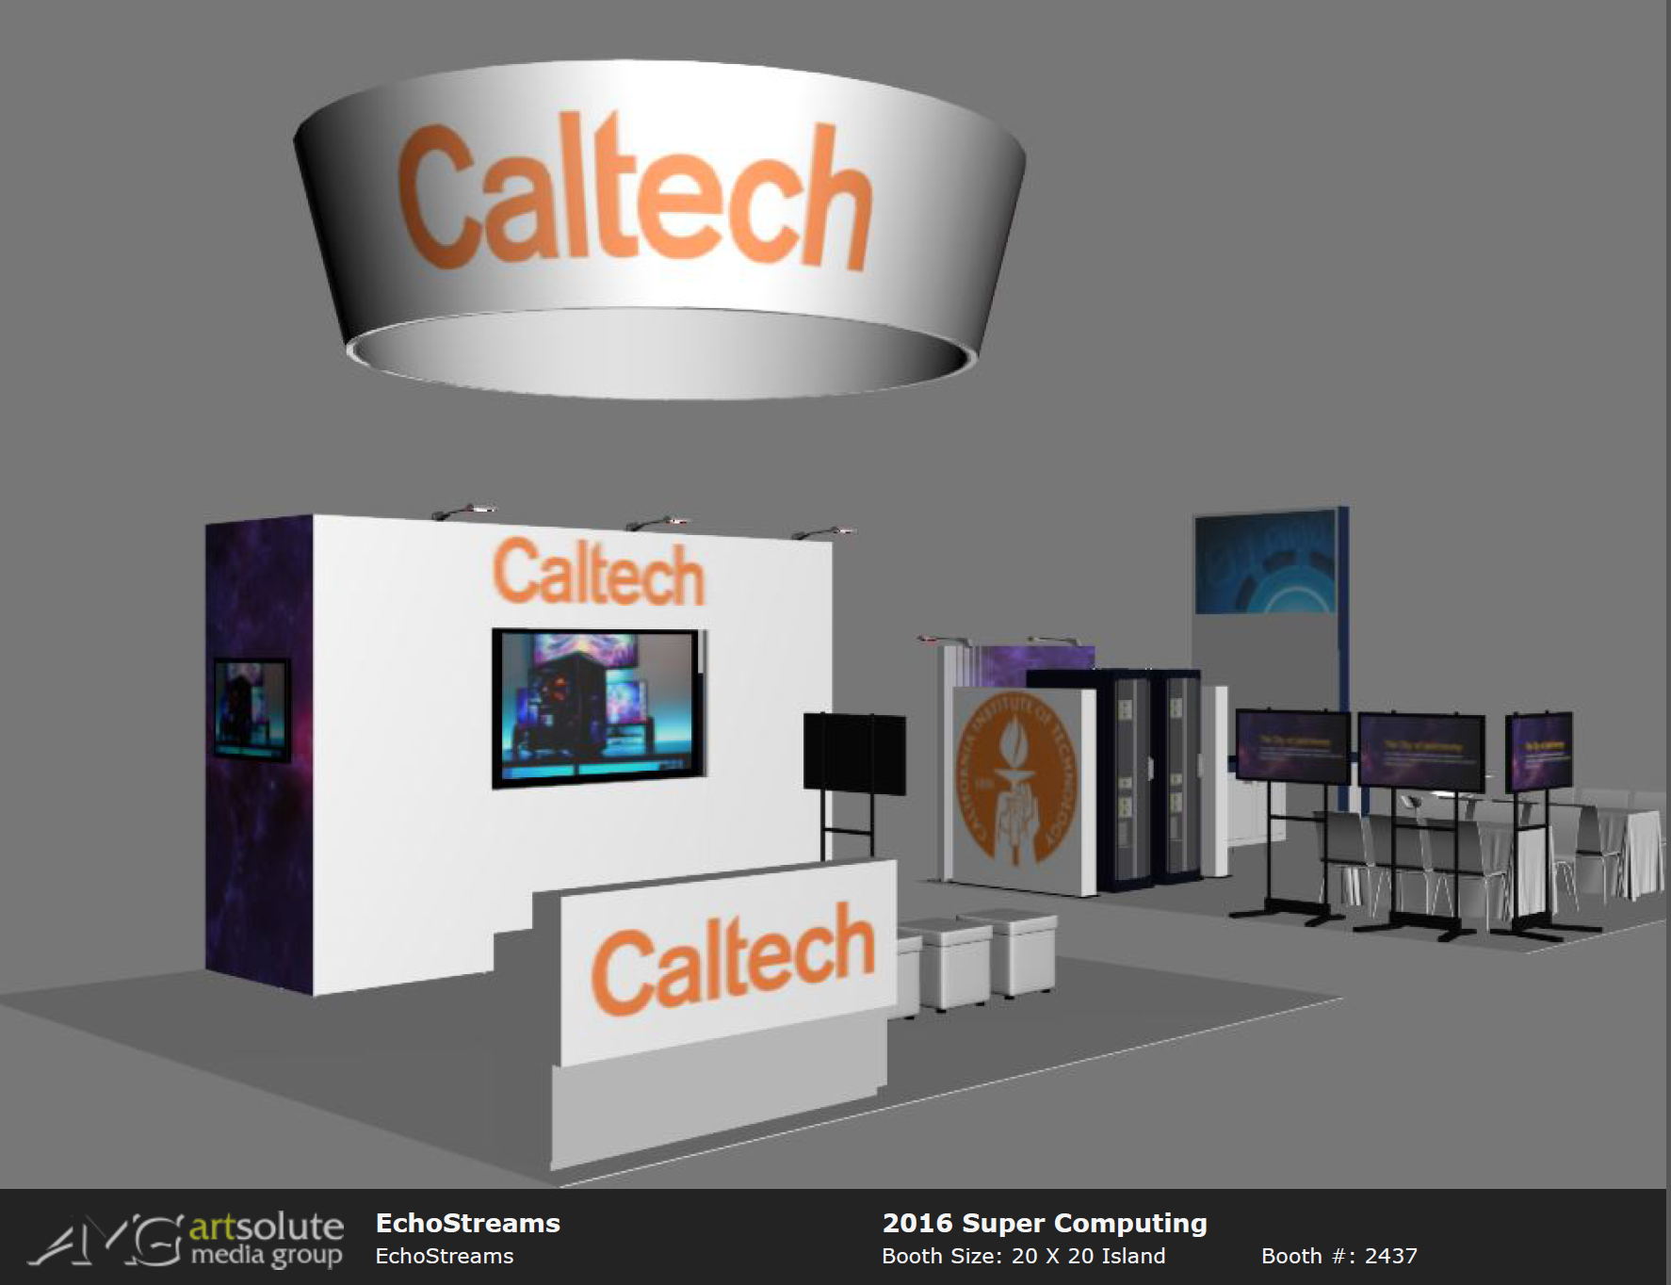
New Paradigms
for Exascale Science
Tbps SDN Intercontinental Steered Flows for LHC and LSST
  Kytos Controller: LSST
  Multicontroller
  Multi-Domain SDN
SDN NGenIA and SENSE
  LHC And Network Orchestrators
HEPCloud with Caching;
Dynamic Paths
Steering with Real-time Analytics + Machine Learning
Immersive VR with Ai Guide for HEP
Partners: Fermilab, PRP, USCD, Argonne, StarLight, NRL, FIU, UNESP, NERSC/LBL, CERN, ATT; SCinet, Ciena, ESnet, Internet2, CENIC, AmLight, RNP, ANSP; Dell, 2CRSI, Arista, Supermicro
Visit Caltech Booths 663, 763

