Slide 1
CMB Constraints for Millicharged Dark Matter
Daniel Pfeffer (Johns Hopkins University)
with Kimberly Boddy and Vivian Poulin
IDM 7/24/2018

Slide 2
Overview
Why Millicharged Dark Matter?
Millicharged Basics
Millicharged Constraints

Slide 3
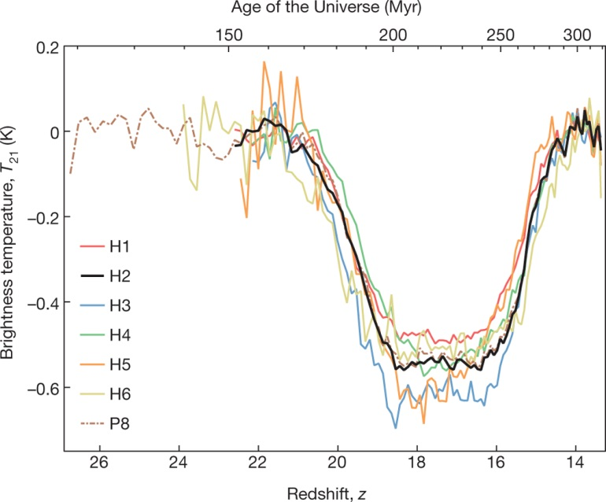
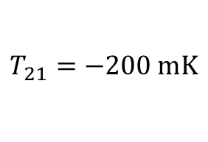
EDGES
21-cm Detection
Less then expected brightness temperature
Need a way to cool baryons
$$T_{21}=−200 \text{mK}$$
Bowman et al 2018
Notes:
Expect \Delta T_21 = -300, not -500 mK
Cool with dark matter

Slide 4
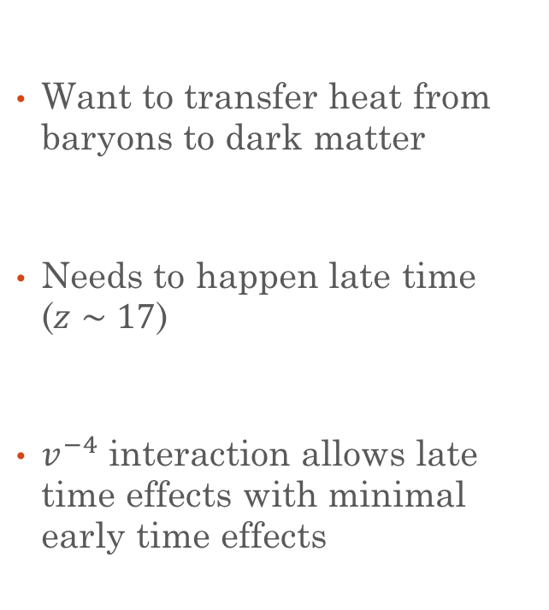

Cool Baryons with Dark Matter
Want to transfer heat from baryons to dark matter
Needs to happen late time ($z∼17$)
$v^{−4}$ interaction allows late time effects with minimal early time effects
$$σ∝v^{n}$$
Notes:
Need to interact at late times to avoid CMB constraints
n=-4 is coulomb scatter, n=-2 is dipole, who knows about others
$v^{−4}$ interaction allows stronger late time effects
Easiest way to get n=-4 is coulomb

Slide 5
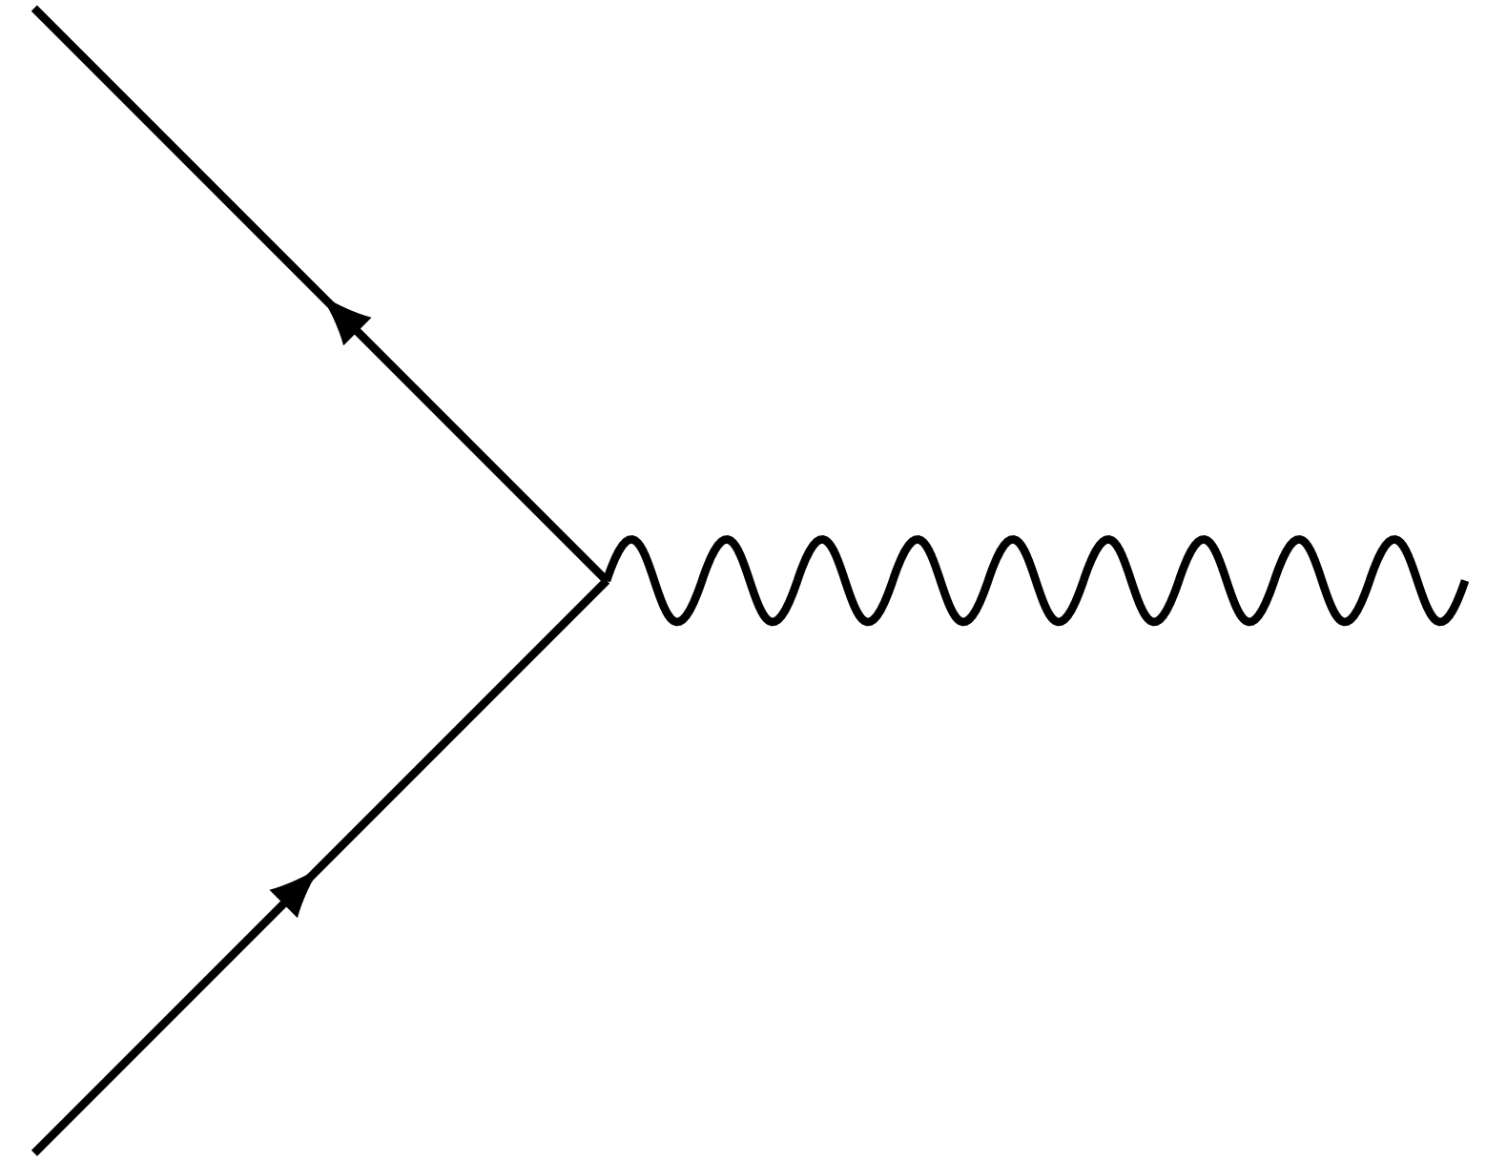





Millicharged Basics
Dark matter with charge $εe$
Not one “millicharged” dark matter model
Allows $v^{−4}$interaction
Has increased late time interactions with baryons
$$χ$$
$$eϵ$$
$$γ$$
$$χ$$
Notes:
add U1, freeze-in, freeze-out, higher energy model
Just dark matter, not forcused on extra componants
//Focus on just low fraction of dark matter being millicharged
More then just scattering with baryons

Slide 6





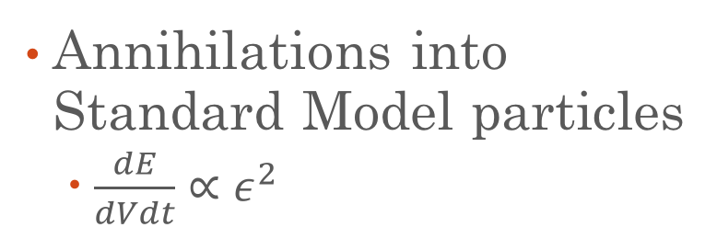
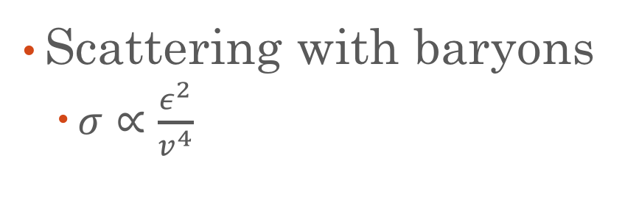




Non-gravitational Interactions
Annihilations into Standard Model particles
  $\frac{dE}{dVdt}∝ε^{2}$
Scattering with baryons
  $σ∝\frac{ε^{2}}{v^{4}}$
$$χ$$
$$χ$$
$$χ$$
SM
$$eε$$
$$eϵ$$
$$e$$
$γ$
$$χ$$
$$e$$
SM
b
b
Notes:
Acts like any charged particle
Annihilations depend on mass
Photon scattering is weakest
Annihilations second
Baryon scattering strongest (v dependent)

Slide 7
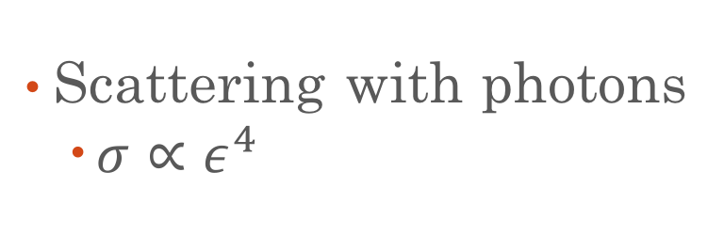






Non-gravitational Interactions II
Scattering with photons
  $σ∝ε^{4}$
$$χ$$
$$γ$$
$$eε$$
$$χ$$
$$eε$$
$$γ$$
$$χ$$
Notes:
Acts like any charged particle
Annihilations depend on mass
Photon scattering is weakest
Annihilations second
Baryon scattering strongest (v dependent)

Slide 8
Impacts on CMB
Baryon scattering usually dominates
Annihilations are mostly subdominant to baryon scattering
Photon scattering is extremely subdominant
Notes:
Include all effects
B scattering dominates due to eps^2 and v^-4
At low fraction and high eps, dark matter behaves like baryons
Annihilations never saturate

Slide 9
Fraction Independent Constraints
Notes:
SLAC was an accelerator experiment that look for them directly
Stellar cooling says that if mdm exists that it should be produced in stellar objects and escape the object cooling it down
Red giant, helium burning and white dwarf
Sn1987A says the same thing as stellar cooling. There would be lost energy

Slide 10
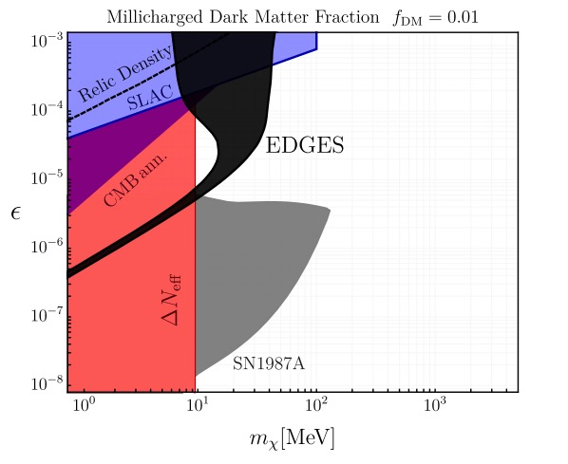
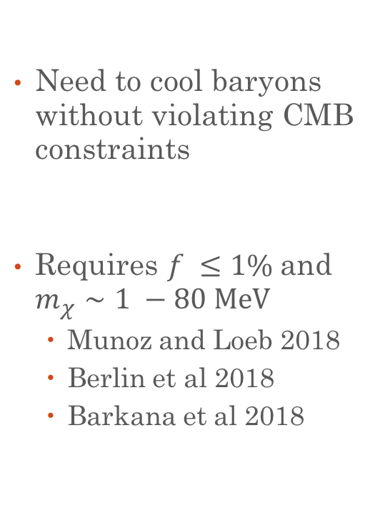
Edges Constraints
Need to cool baryons without violating CMB constraints
Requires $f ≤1\%$and $m_{χ}∼1 −80 \text{MeV}$
  Munoz and Loeb 2018
  Berlin et al 2018
  Barkana et al 2018
Berlin et al 2018
Notes:
Direct edges constraints, galaxy constraints
CMB Constraints only focus on baryon scattering
All found roughly the same thing right after edges
Red \Delta Neff is light element abundances BBN
Purple is DM annihilations
Black region is allowed region

Slide 11



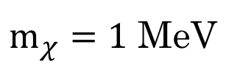
Cross Section v.s. Fraction
$$ε=1.3×{10}^{−4}$$
$m_{χ}=1$ MeV
$$ε=4.0×{10}^{−5}$$
$$ε=1.2×{10}^{−5}$$
Boddy, Gluscevic, Poulin, Kovetz, Kamionkowski and Barkana (in prep)
Notes:
Figure out what epsilons these correspond to
A 1 meV
\eps = 1 e-3 => \sigma = 5.7e-33
\eps = 1.3e-4 => \sigma = 1e-34
\eps = 4e-5 => \sigma = 1e-35
\eps = 1.25e-5 => \sigma = 1e-36
\eps = 1e-5 => \sigma = 6.7e-37

Slide 12
Baryon Scattering Constraints
Kovetz, Poulin, Gluscevic, Boddy, Barkana and Kamionkowski (in prep)
Notes:
Just baryon scattering constraints
Kovetz et all 2018 show …
de Putter et all 2018 1805.11616: shows how tightly coupled dm can leave an impact on the CMB through a changed helium fraction
Dan Green paper
Both require f < 0.5%
BBN is model dependent
Most optimistic scenario, no astrophysics heating baryons

Slide 13
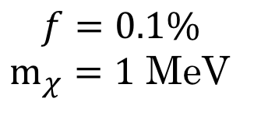
Baryon Scattering Saturation
$$f=0.1\%$$
$m_{χ}=1$ MeV
Notes:
PLOT WITHOUT ANNIHILATIONS
F = 10^-3, m=1 MeV
Scattering with baryons saturates for low fractions
MDM acts like baryons in this case
Allows annihilations to become dominate
de Putter et all 2018 1805.11616: shows how tightly coupled dm can leave an impact on the CMB through a changed helium fraction

Slide 14
Weak Annihilations
$$f=0.1\%$$
$m_{χ}=1$ MeV
Notes:
Add in some annihilations
Scattering with baryons saturates for low fractions
MDM acts like baryons in this case
Allows annihilations to become dominate

Slide 15
Weak Annihilations
$$f=0.1\%$$
$m_{χ}=1$ MeV
Notes:
Add in some annihilations
Scattering with baryons saturates for low fractions
MDM acts like baryons in this case
Allows annihilations to become dominate

Slide 16
Strong Annihilations
$$f=0.1\%$$
$m_{χ}=1$ MeV
Notes:
Add in some annihilations
Scattering with baryons saturates for low fractions
MDM acts like baryons in this case
Allows annihilations to become dominate

Slide 17
Over Annihilation
$$f=0.1\%$$
$m_{χ}=1$ MeV
Notes:
Super ruled out
Scattering with baryons saturates for low fractions
MDM acts like baryons in this case
Allows annihilations to become dominate

Slide 18
Over Annihilation
$$f=0.1\%$$
$m_{χ}=1$ MeV
Notes:
Super ruled out
Scattering with baryons saturates for low fractions
MDM acts like baryons in this case
Allows annihilations to become dominate

Slide 19
Strong Annihilations
$$f=0.1\%$$
$m_{χ}=1$ MeV
Notes:
Add in some annihilations
Scattering with baryons saturates for low fractions
MDM acts like baryons in this case
Allows annihilations to become dominate

Slide 20
Cross Section v.s. Fraction
$$ε=1.3×{10}^{−4}$$
$$ε=4.0×{10}^{−5}$$
$$ε=1.2×{10}^{−5}$$
Boddy, Gluscevic, Poulin, Kovetz, Kamionkowski and Barkana (in prep)
Notes:
A 1 meV
\eps = 1 e-3 => \sigma = 5.7e-33
\eps = 1.3e-4 => \sigma = 1e-34
\eps = 4e-5 => \sigma = 1e-35
\eps = 2e-5 => \sigma = 2.6e-36
\eps = 1.25e-5 => \sigma = 1e-36
\eps = 1e-5 => \sigma = 6.7e-37

Slide 21

Cross Section v.s. Fraction with Annihilations
Preliminary
$$ε=1.3×{10}^{−4}$$
$$ε=4.0×{10}^{−5}$$
$$ε=1.2×{10}^{−5}$$
Modified from Boddy, Gluscevic, Poulin, Kovetz, Kamionkowski and Barkana (in prep)
Notes:
A 1 meV
\eps = 1 e-3 => \sigma = 5.7e-33
\eps = 1.3e-4 => \sigma = 1e-34
\eps = 4e-5 => \sigma = 1e-35
\eps = 2e-5 => \sigma = 2.6e-36 --------------------
\eps = 1.25e-5 => \sigma = 1e-36
\eps = 1e-5 => \sigma = 6.7e-37

Slide 22
Baryon Scattering Constraints
Kovetz, Poulin, Gluscevic, Boddy, Barkana and Kamionkowski (in prep)
Notes:
Just baryon scattering constraints
BBN is model dependent this is freeze in
Most optimistic scenario, no astrophysics heating baryons

Slide 23
Baryon Scattering Constraints
Preliminary
0.1%
0.4%
Modified from Kovetz, Poulin, Gluscevic, Boddy, Barkana and Kamionkowski (in prep)
Notes:
Just baryon scattering constraints
Dan Green paper
Both require f < 0.05%
BBN is model dependent
Most optimistic scenario, no astrophysics heating baryons

Slide 24
Summary
Constraints weaken for baryon scattering for f < 0.3%
But annihilations still give constraining power for f < 0.3%.
Future Work
More realistic millicharged model
Effects of dark photons (N_eff, freeze-out constraints)

