Slide 1

Searching for Decaying and Annihilating Dark Matter with Line Intensity Mapping
Cyril Creque-Sarbinowski, JHU
IDM 2018
arXiv: 1806.11119 authors: Cyril Creque-Sarbinowski, Marc Kamionkowski

Slide 2
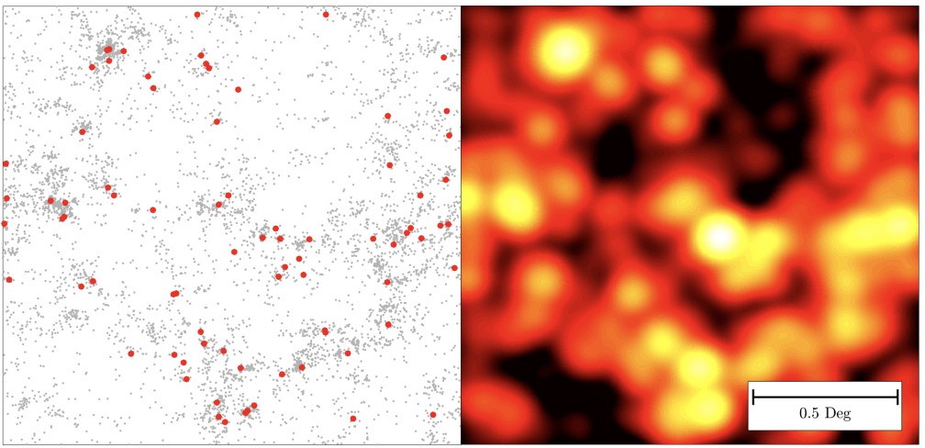
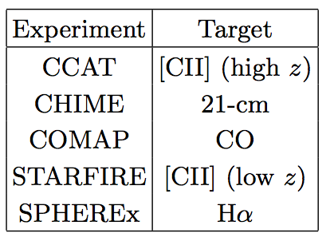
What is Line Intensity Mapping (IM)?
Measures integrated emission from spectral lines in galaxies + diffuse IGM
Image Source: Kovetz, et. al 1709.09066
arXiv: 1806.11119 authors: Cyril Creque-Sarbinowski, Marc Kamionkowski

Slide 3
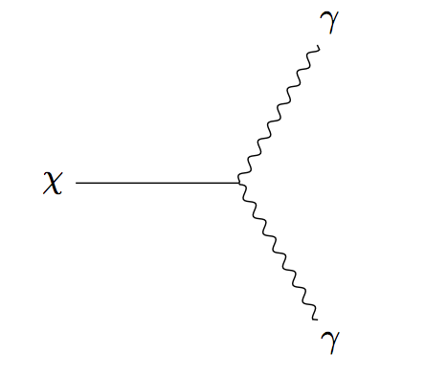
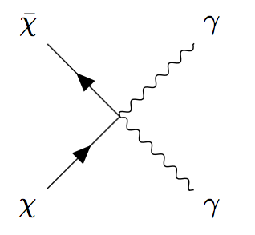
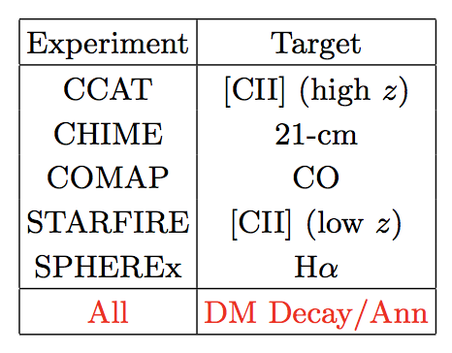
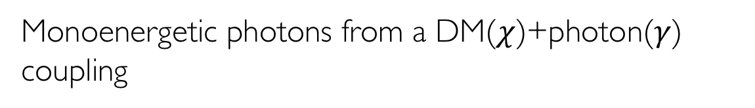
What photons are we trying to observe?
Monoenergetic photons from a DM($χ$)+photon($γ$) coupling
arXiv: 1806.11119 authors: Cyril Creque-Sarbinowski, Marc Kamionkowski

Slide 4
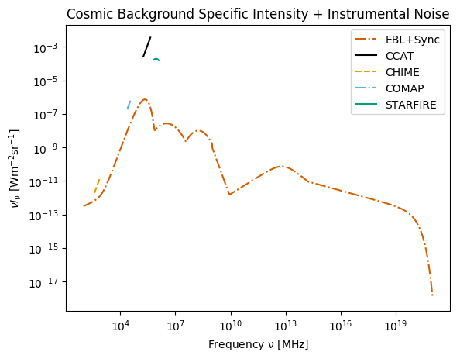
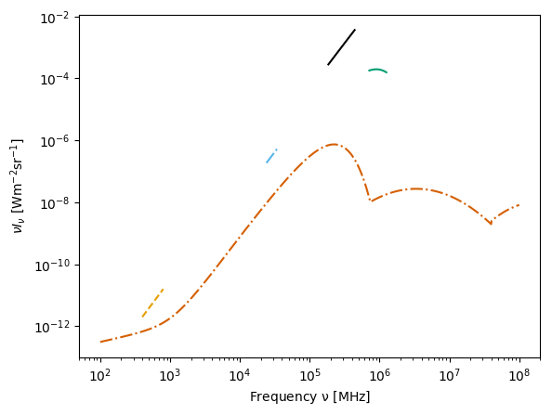
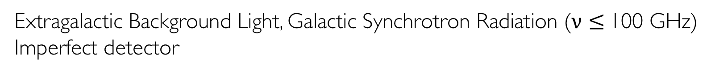
What contaminants are there?
Extragalactic Background Light, Galactic Synchrotron Radiation ($\text{ν} \text{≤ }\text{100 }\text{GHz}\text{)}$
Imperfect detector
arXiv: 1806.11119 authors: Cyril Creque-Sarbinowski, Marc Kamionkowski

Slide 5

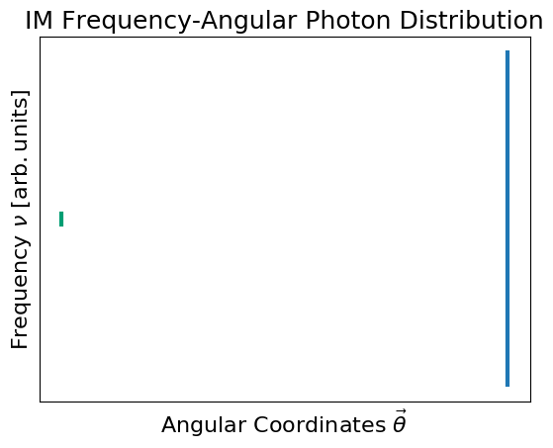
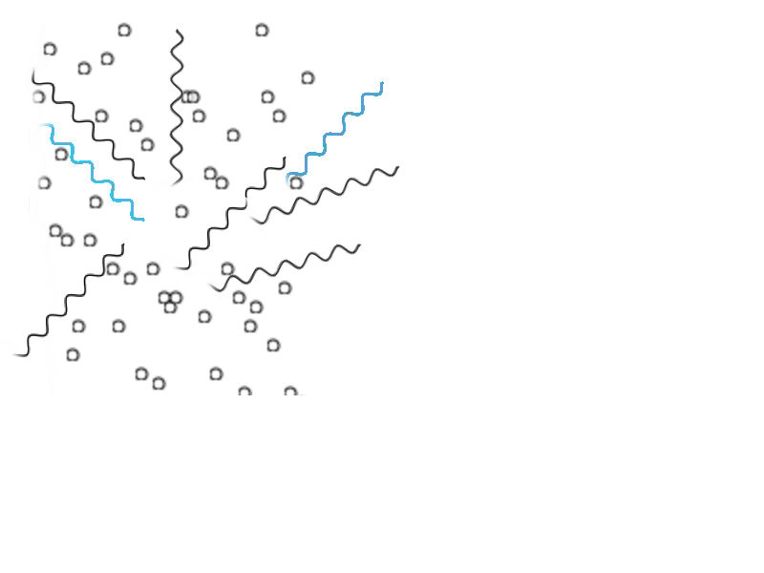
How to distinguish these photons?
Cross correlating with a tracer (e.g. galaxies)
DM Decay
Background
arXiv: 1806.11119 authors: Cyril Creque-Sarbinowski, Marc Kamionkowski

Slide 6

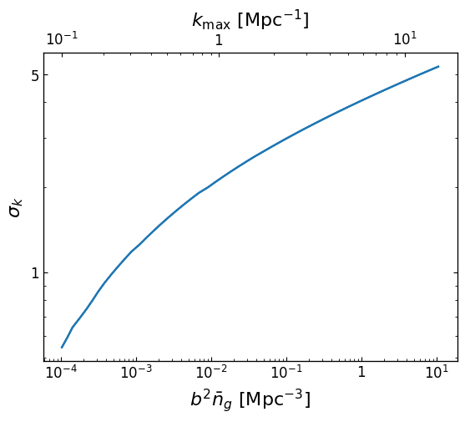
How do I know I have detected DM?
Count enough photons
arXiv: 1806.11119 authors: Cyril Creque-Sarbinowski, Marc Kamionkowski

Slide 7
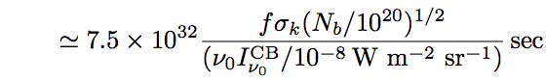

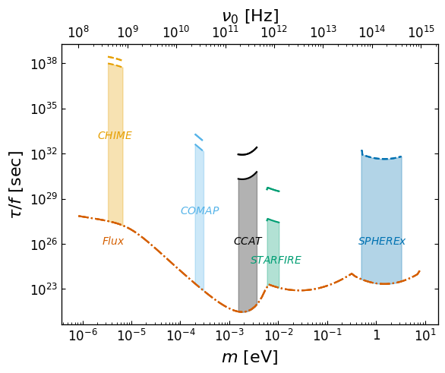
What constraints can I put if no detection?
Pretty good ones
arXiv: 1806.11119 authors: Cyril Creque-Sarbinowski, Marc Kamionkowski

Slide 8
Summary
IM can detect DM decays and annihilation
Negligible background contributions
Not cosmic-variance limited
Noise doesn’t ruin measurements
10^9 constraining improvement
arXiv: 1806.11119 authors: Cyril Creque-Sarbinowski, Marc Kamionkowski

