Slide 1
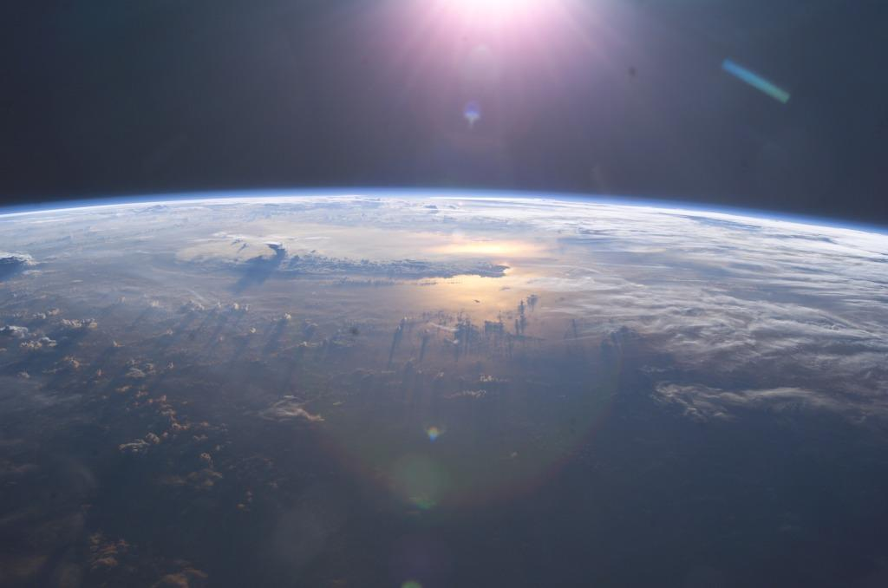
The CLOUD experiment
Cosmics Leaving Outdoor Droplets
Studies the influence of
galactic cosmic rays on aerosols and clouds,
and their implications for climate
Photo: NASA ISS007E10807

Slide 2
Agenda
Background: Earth’s climate, cosmic rays, aerosols and clouds
CLOUD Experiment: Concept, methods, results
Visit to CLOUD

Slide 3
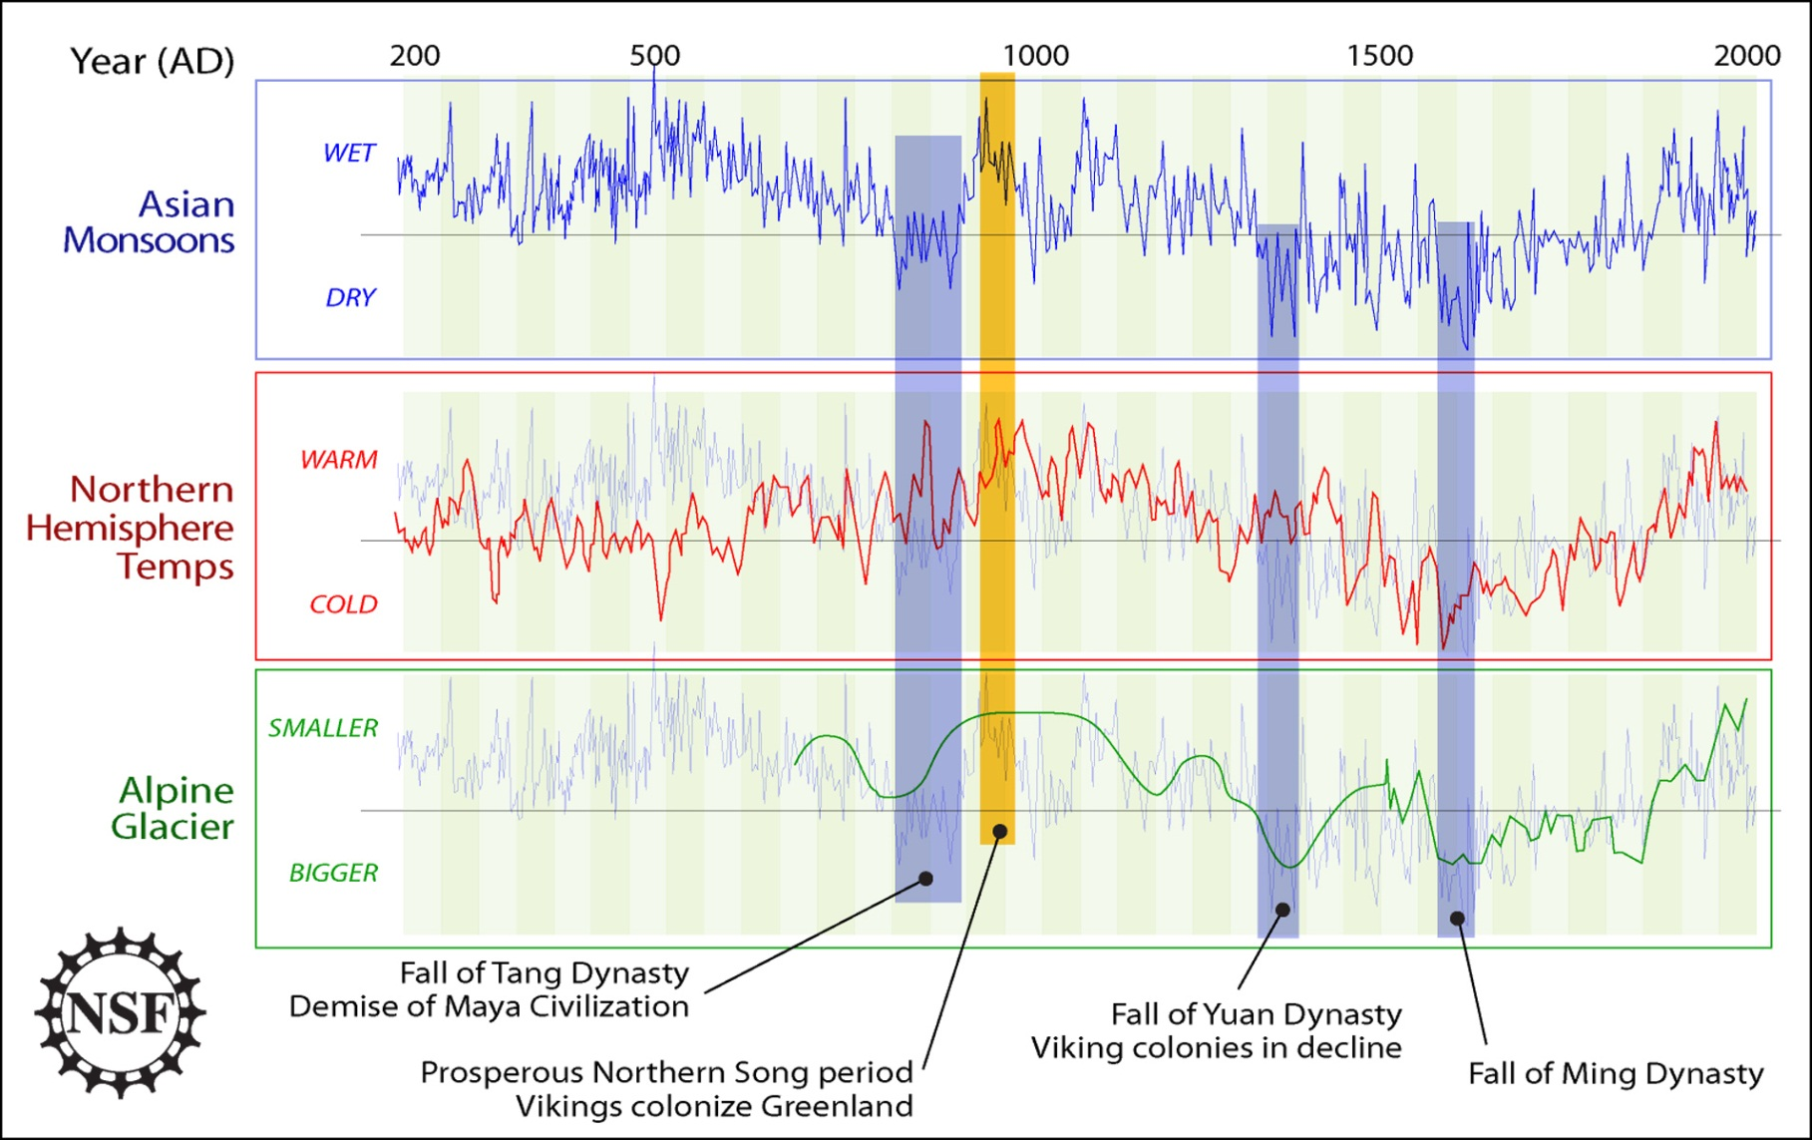
Earth’s climate
Source: U.S. National Science Foundation, 2008

Slide 4
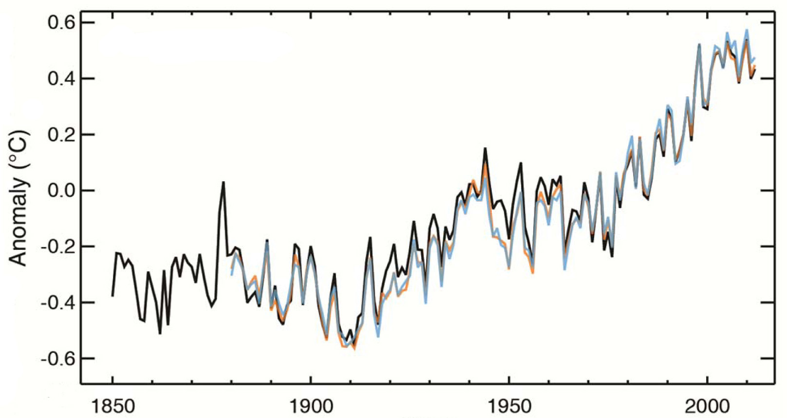
Global surface temperature
ΔT = 0.8ºC
Year
Source: IPCC, Summary for Policymakers, 2013

Slide 5
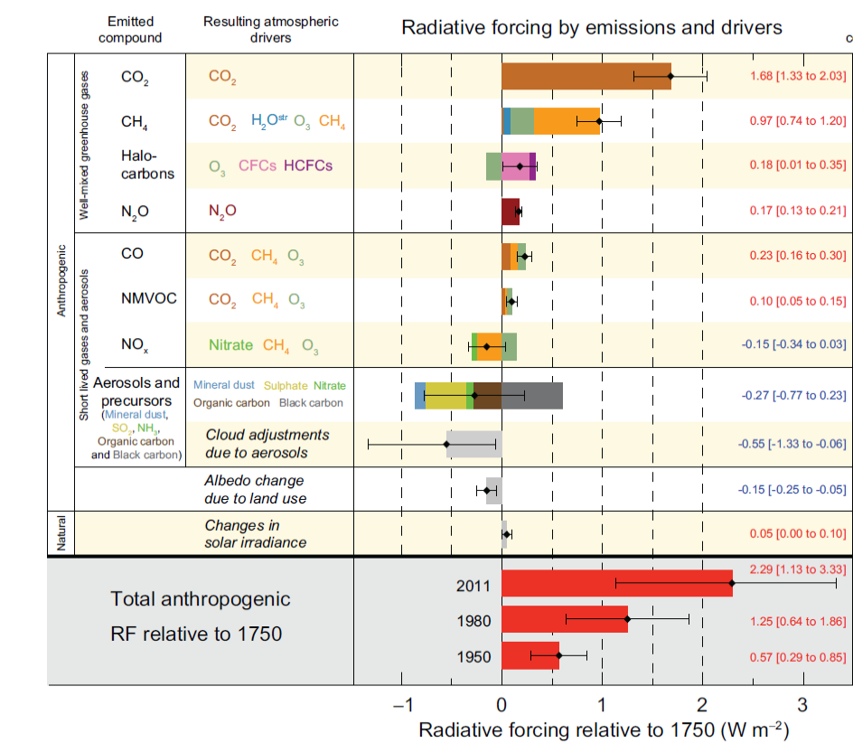
Climate radiative forcings in Industrial Age
A. Anthropogenic aerosol forcings are poorly understood.
B. Natural part is very small.
Is there a missing natural forcing?
Is that from varying cosmic ray flux, modulated by sun?
Source: IPCC, Summary for Policymakers, 2013
A + B → The CLOUD experiment

Slide 6
Link between Cosmic rays and Climate ?
Numerous correlations suggest GCR-climate connection.
But no established mechanism to explain this.
Several recent
observations,
e.g. by
Eichler et al.,
ACP, 2009:
Correlation
between
GCRs and
temperature
in Siberia
from glacial
ice core data.

Slide 7
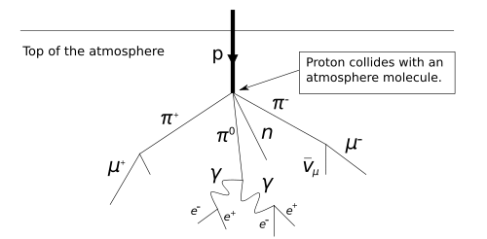
Cosmic rays
High energy particles from outer space
Mostly protons; ~90%
Helium nuclei (alpha particles); ~9%
Others: Electrons, heavy nuclei; 1%
Earth atmosphere protects from the cosmic rays
Lacking protection against cosmic rays is a major problem for long space travels.

Slide 8
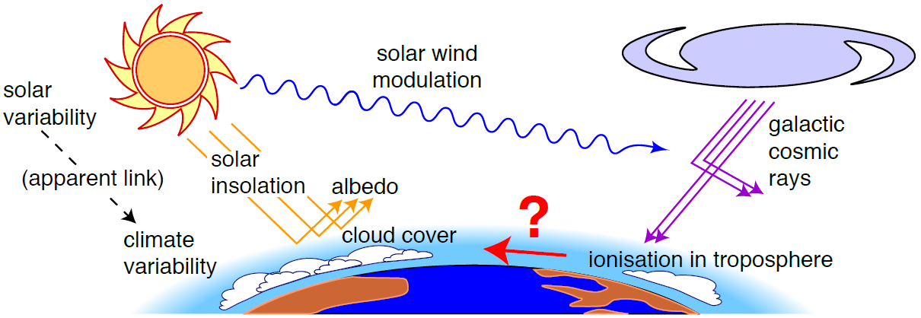
Solar → Cosmic ray → Climate mechanism?
?
Higher solar activity → reduced GCRs → reduced cloud cover → warmer climate
Satellite observations not yet settled:
Significant GCR-cloud correlations reported by some (Svensmark, Laken...) and weak or excluded by others (Kristjansson, Wolfendale...)

Slide 9
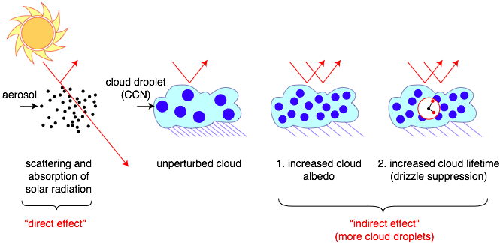
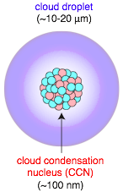
Role of aerosols on sun’s radiative forcing
All cloud droplets form on aerosol “seeds” known as cloud condensation nuclei - CCN
Cloud properties are sensitive to number of droplets
More aerosols/CCN:
  Brighter clouds, with longer lifetimes
Sources of atmospheric aerosols:
  Primary (dust, sea salt, fires)
  Secondary (gas-to-particle conversion)
See youtube: “No particles no fog” https://www.youtube.com/watch?v=EneDwu0HrVg

Slide 10
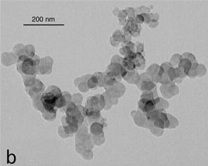
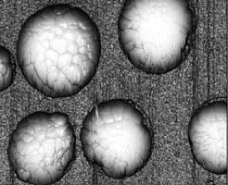
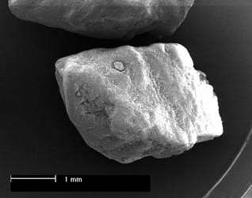
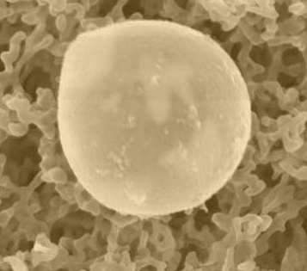
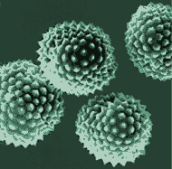
What is an aerosol?
Definition: Suspension of small (liquid or solid) particles in a gas
Diesel soot: ca. 0.1 μm
Ammonium sulfate: ca. 0.1 μm
Sea salt: 0.2 - 10 μm
Mineral dust: 0.2 - 10 μm
Pollen: 10 - 100 μm

Slide 11
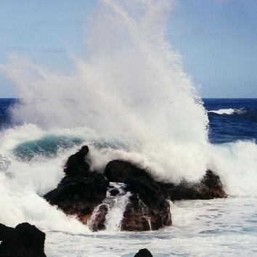
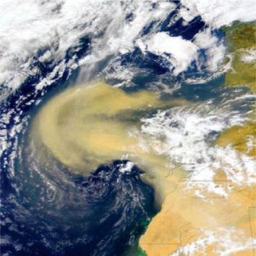
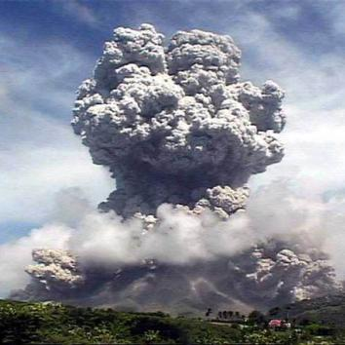
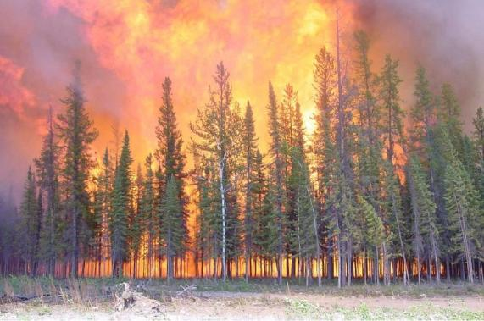
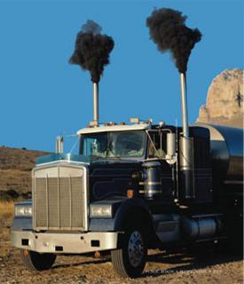
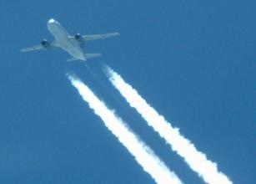
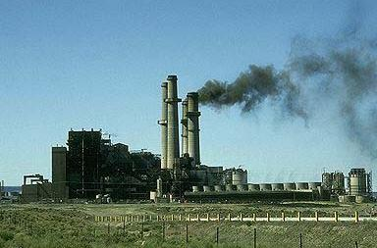
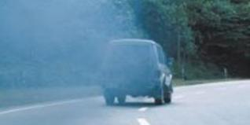
Primary Aerosol Sources
Sea spray
Mineral dust
Volcano ► Sulfates,
dust
Biomass burning ► Organics
Traffic emissions ► Soot
Industrial Emissions
Notes:
Primary Aerosol sources, meaning particles are directly emmitted into the atmosphere either from biogenic sources
Click
Or antrophogenic sources…
Actually there is a small misstake on the slide Volcanos don‘t emmit Sulfates, They emmit large amounts of SO2 emmitted as a gas which gets oxidized in the atmosphere to sulfuric acid which then forms particles.
Next slide

Slide 12
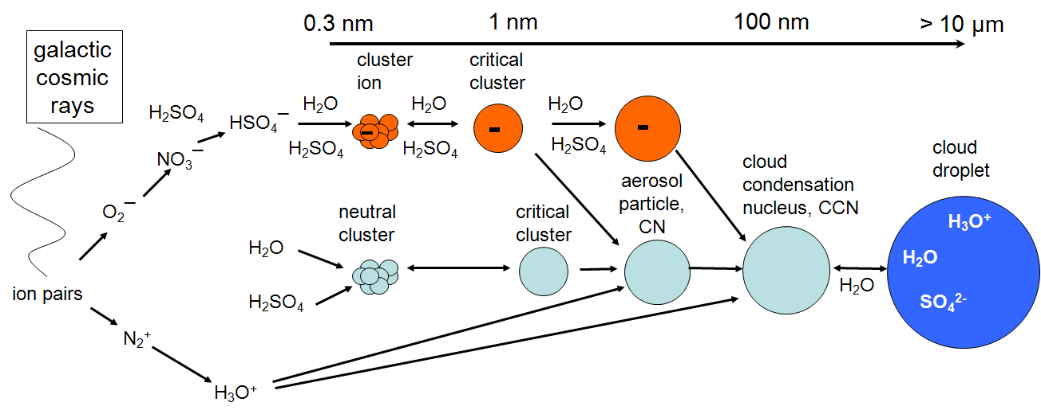
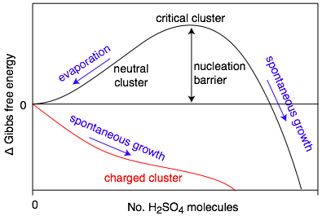
Secondary aerosol production:
Gas-to-particle conversion
Solar wind modulates
Trace condensable vapour → CN → CCN
But contributing vapours and nucleation rates poorly known
H2SO4 is thought to be the primary condensable vapour in atmosphere (sub ppt)
Ion-induced nucleation pathway is energetically favoured but limited by the ion production rate and ion lifetime
Candidate mechanism for solar-climate variability
  This secondary aerosol formation is the key object of study in CLOUD

Slide 13
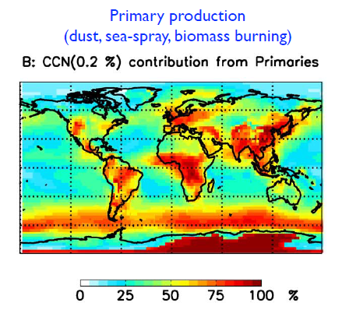
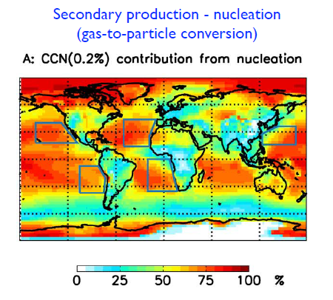
Primary vs. secondary aerosols
Origin of global cloud condensation nuclei, CCN, 500-1000 m above ground level
Merikanto et al., ACP, 2009
  About 50% of all cloud drops are formed on secondary aerosols
  Secondary aerosol formation – nucleation is poorly understood and
  is the key object of study in CLOUD

Slide 14
CLOUD experiment concept
1. Fill chamber with
clean air
+ water vapour
7. Carefully flush the chamber and clean the chamber walls between experiments
2. Set temperature and pressure
Chamber
Controlled experimental ‘sample’ of Earth’s atmosphere
6. Repeat experiment (typically some hours), possibly with varying parameters
3. Add trace gases,
condensable species
in atmospheric, extremely low concentrations
~1 molecule in 10¹² air molecules
5. Observe
Particle growth size distribution
Electrical charge distribution
Cloud droplet/ice particle concentrations,
etc.
4. Expose to ionizing beam,
and possibly to UV-light

Slide 15
CLOUD
Unique capabilities:
temperature stability: <0.1°C
temperature range: -90°C to +30°C; cleaning at +100°C
surface cleanliness: <10 pptv^{*)} organics contamination,
stainless steel (and gold), no teflon, no O-rings
ultrapure gas supplies
UV system: negligible heat load by use of fibre optics.
field cage 30 kV/m
Highly advanced aerosol chamber already as such!
*) pptv = part per trillion, 1 / 10¹²

Slide 16
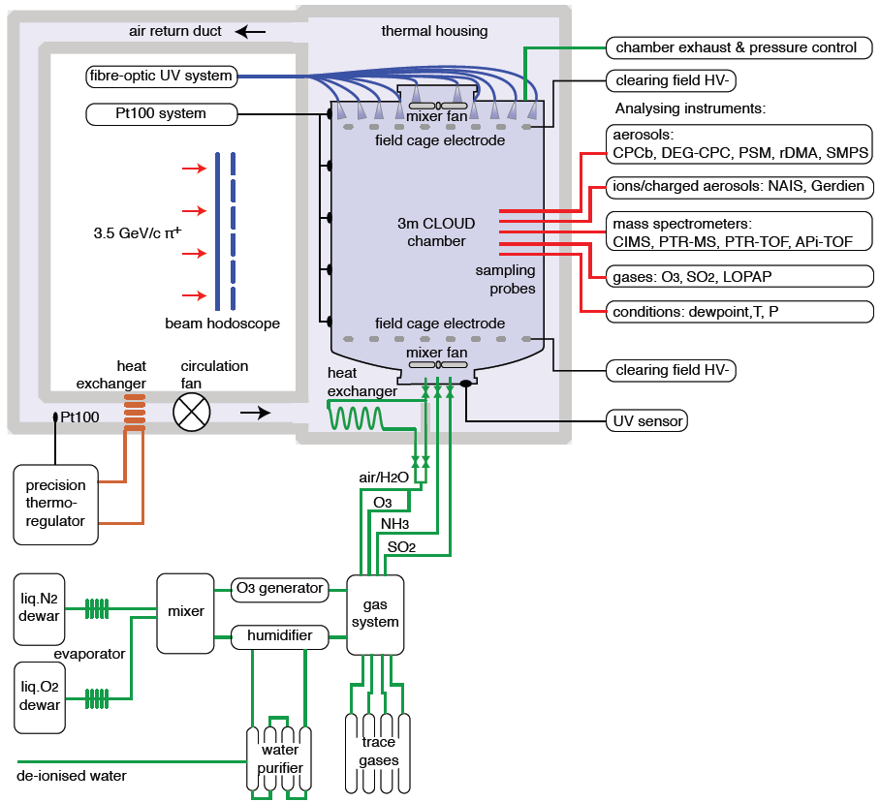
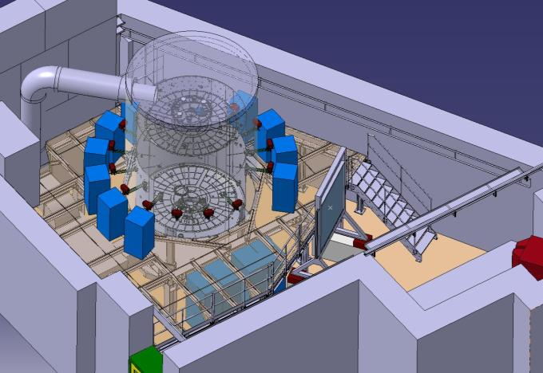
CLOUD

Slide 17
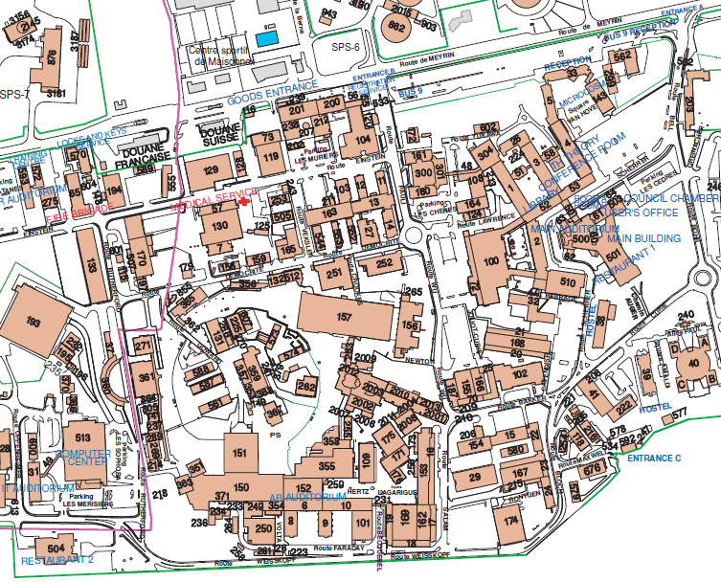
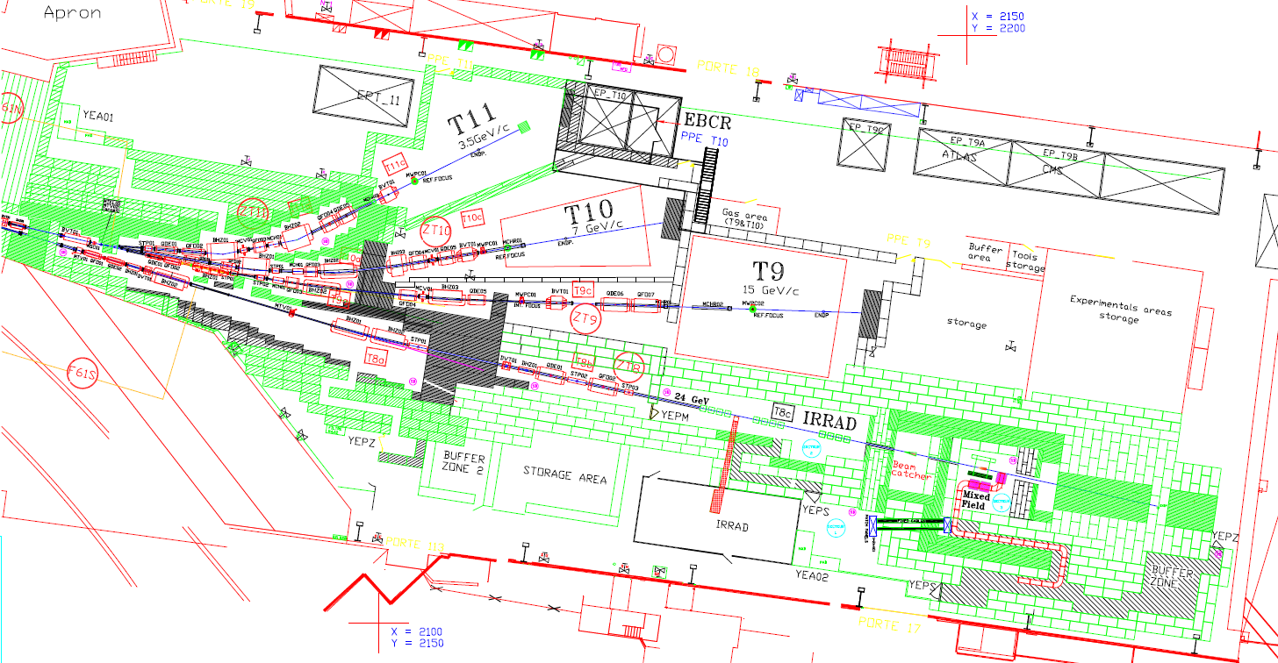
CLOUD in CERN PS-T11 beam
PS East Hall
T11 beam area
(3.5 GeV/c)
Proton Synchrotron (PS) accelerator,
first operation in 1959

Slide 18
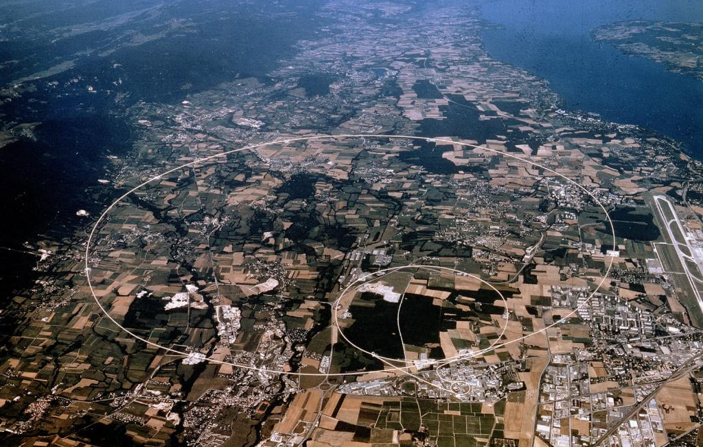
CLOUD in CERN PS-T11 beam
Here!

Slide 19
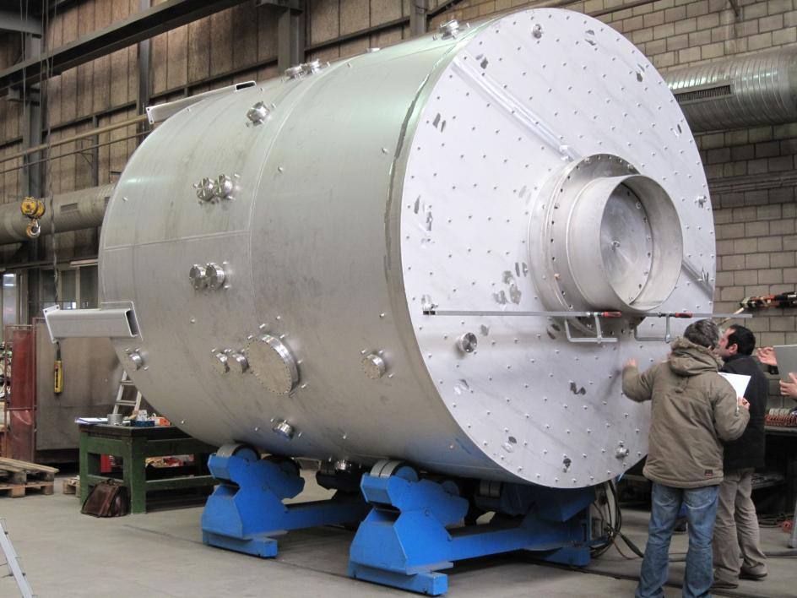
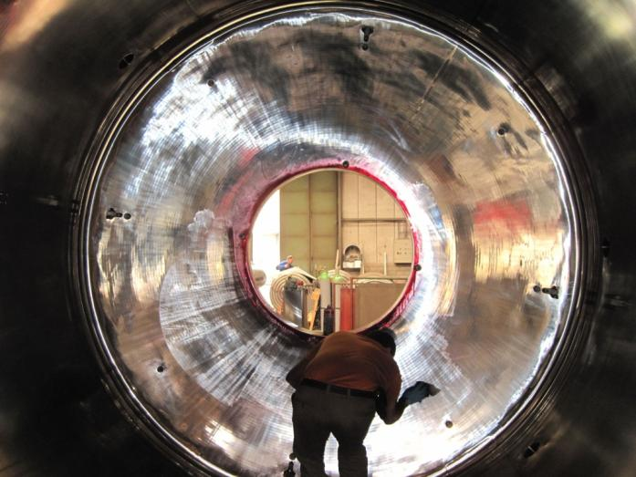
CLOUD Aerosol chamber
27 m³
Pressure: Atmospheric ± 0.3 bar
Only metallic seals
Electropolished inner surfaces

Slide 20
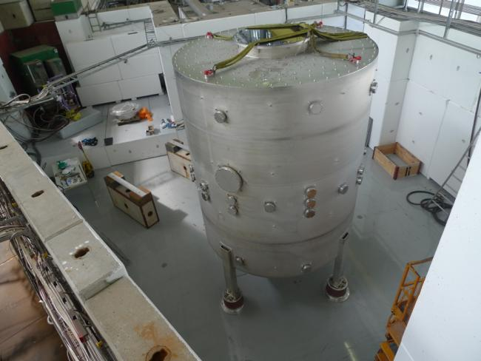
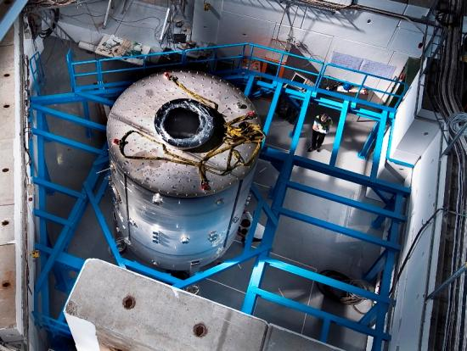
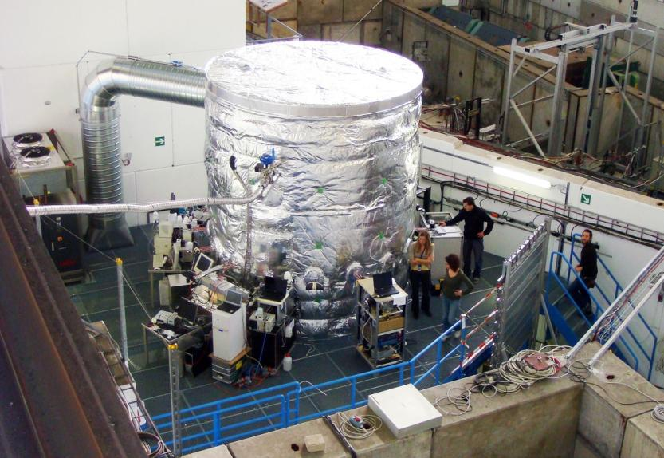
Aerosol chamber in T11
September 2009
July 2009
November 2009

Slide 21
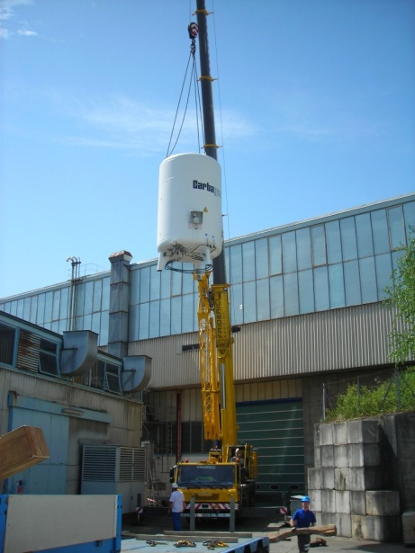
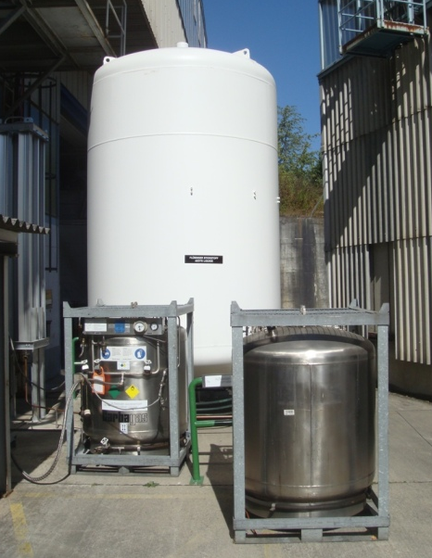
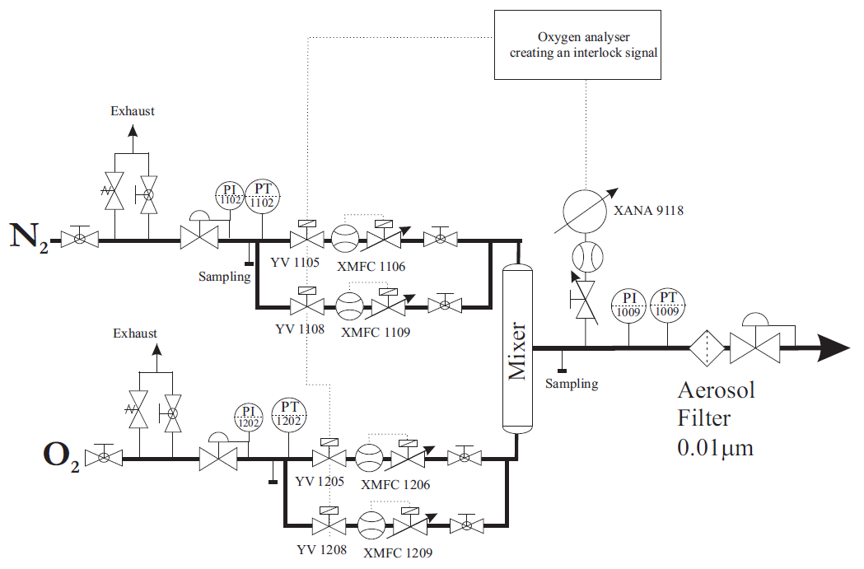
Ultra-pure air

Slide 22
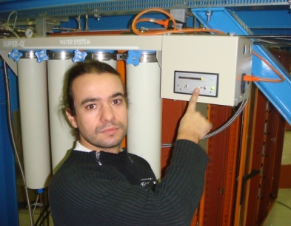
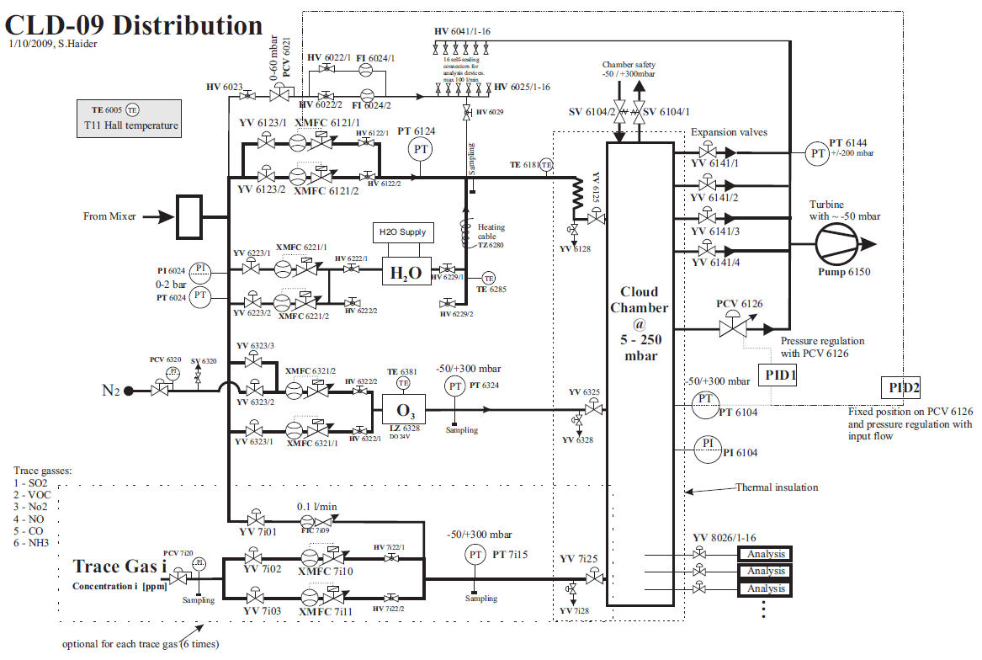
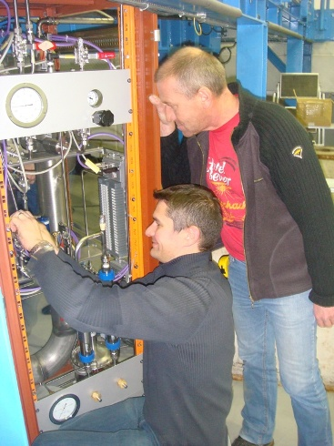
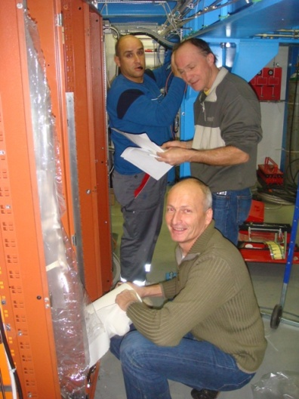
Gas system

Slide 23
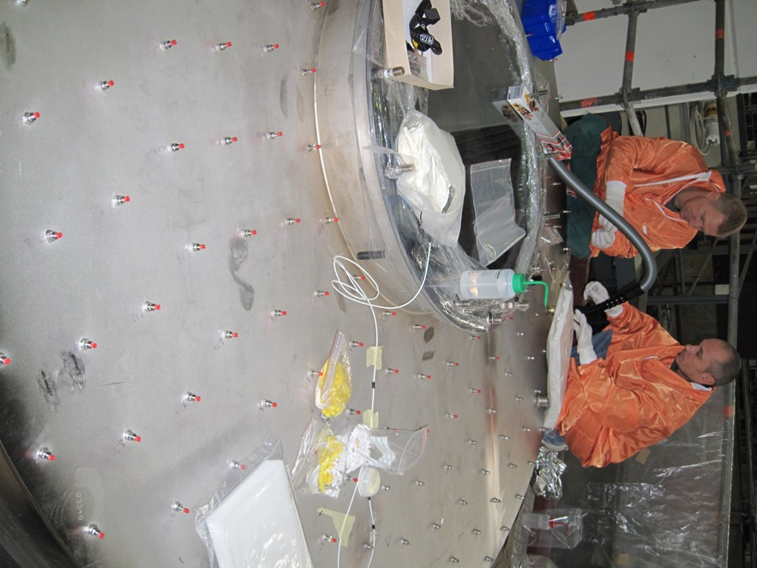
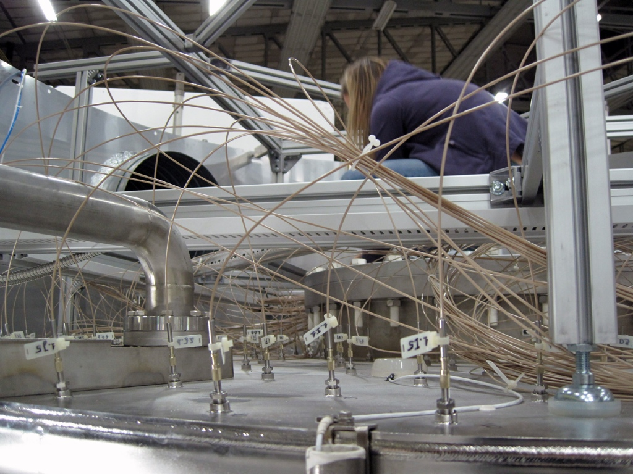
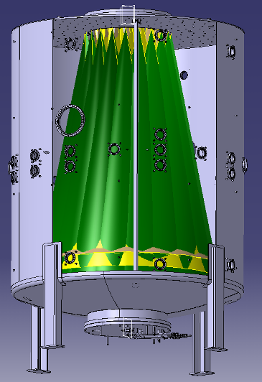
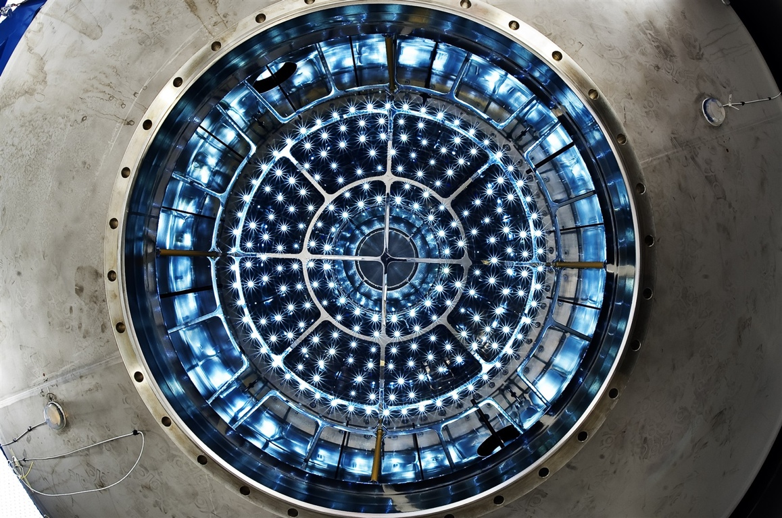
UV system

Slide 24
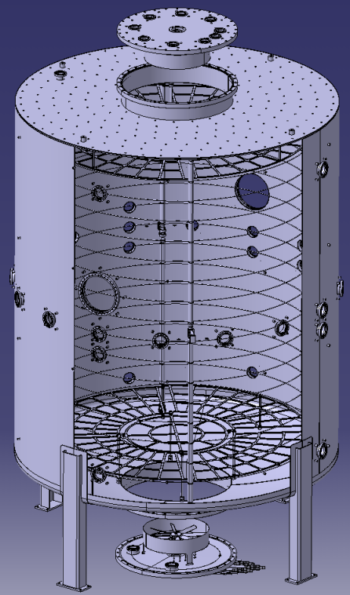
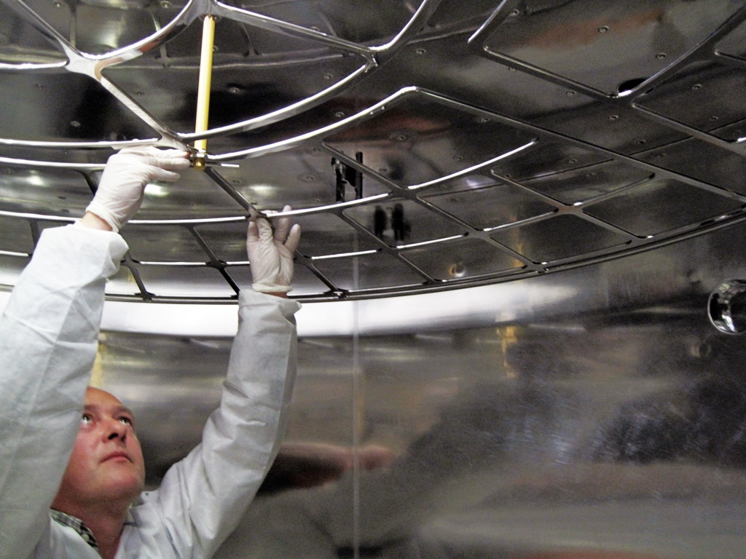
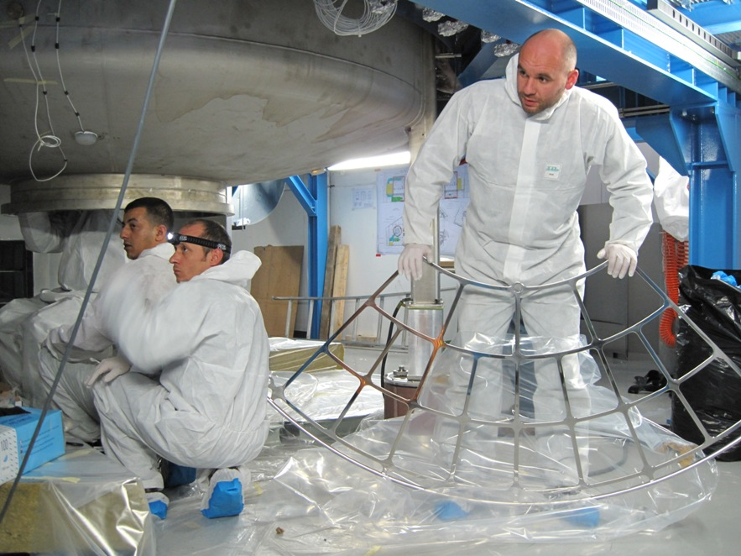
HV field cage

Slide 25
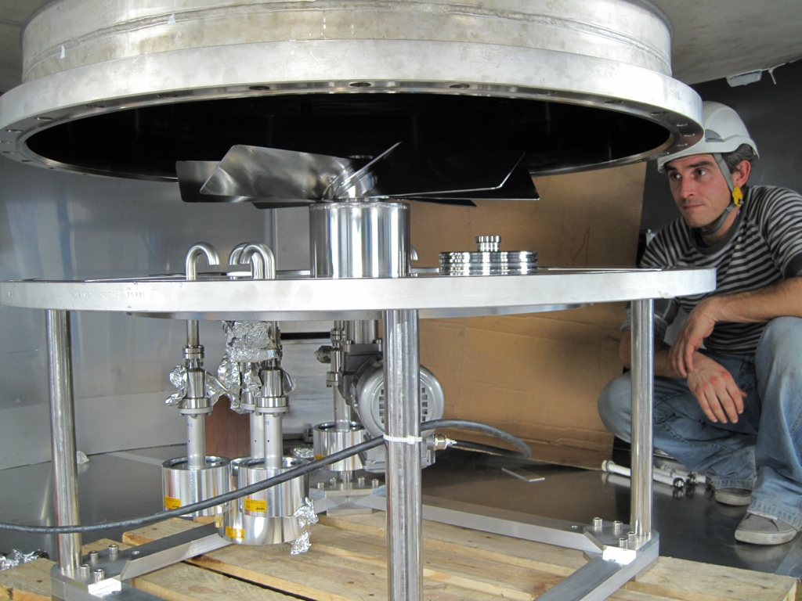
Mixing fan

Slide 26


Thermal system

Slide 27
CLOUD with the measurement instruments

Slide 28
Aerosols from gas-to-particle conversion / Cosmic rays
PS Beam,
Hodoscope
NAIS, Gerdien
API-tof-MS, PTRMS (VOC)
CIMS
DewPoint
CPC, SMPS, Snapper, AMS
CCNC, HTDMA
Slide courtesy of J.Kirkby

Slide 29

Example of a typical measurement “run”
Further results available in:
Role of sulphuric acid, ammonia and galactic cosmic rays in atmospheric aerosol nucleation,
nature, 24 August 2011,
doi:10.1038/nature10343

Slide 30

Results from CLOUD
First major publication
5 years after CLOUD approved in CERN programme,
2 years after first run
CLOUD now “in production”. Examples of the produced results:
J. Almeida et al., Molecular understanding of amine-sulphuric acid particle nucleation in the atmosphere, Nature, 2013
H. Keskinen et al., Evolution of particle composition in CLOUD nucleation experiments, Atmospheric Chemistry and Physics, 2013
S. Schobesberger et al., Molecular understanding of atmospheric particle formation from sulfuric acid and large oxidized organic molecules, PNAS, 2013
F. Riccobono et al., Oxidation Products of Biogenic Emissions Contribute to Nucleation of Atmospheric Particles, Science, 2014
F. Bianchi et al., Insight into acid-base nucleation experiments by comparison of the chemical composition of positive, negative and neutral clusters, PNAS, 2014
J. Kirkby et al., Ion-induced nucleation of pure biogenic particles, Nature, 2016
J. Tröstl et al., The role of low-volatility organic compounds in initial particle growth in the atmosphere, Nature, 2016
E. Dunne et al., Global particle formation from CERN CLOUD measurements, Science, 2016

Slide 31


Example of on-going CLOUD measurements
Recreating of boreal forest conditions, to understand the observed aerosol particle nucleation and growth.
Hyytiälä, Finland

Slide 32

Further information on the CLOUD experiment:
https://home.cern/about/experiments/cloud
Thank you for your attention!

Slide 33
Back-up slides

Slide 34

History of CO₂
+100%
+50%

