Slide 1
CI update
Hao Zhang

Slide 2
Previously questions
The scale of current gas jet density
Progress of the system
Next steps and timeline.

Slide 3

Density scan
3.18e14
2.88 mm
8.4 mm
1.59e14
11 mm
0
21 mm

Slide 4
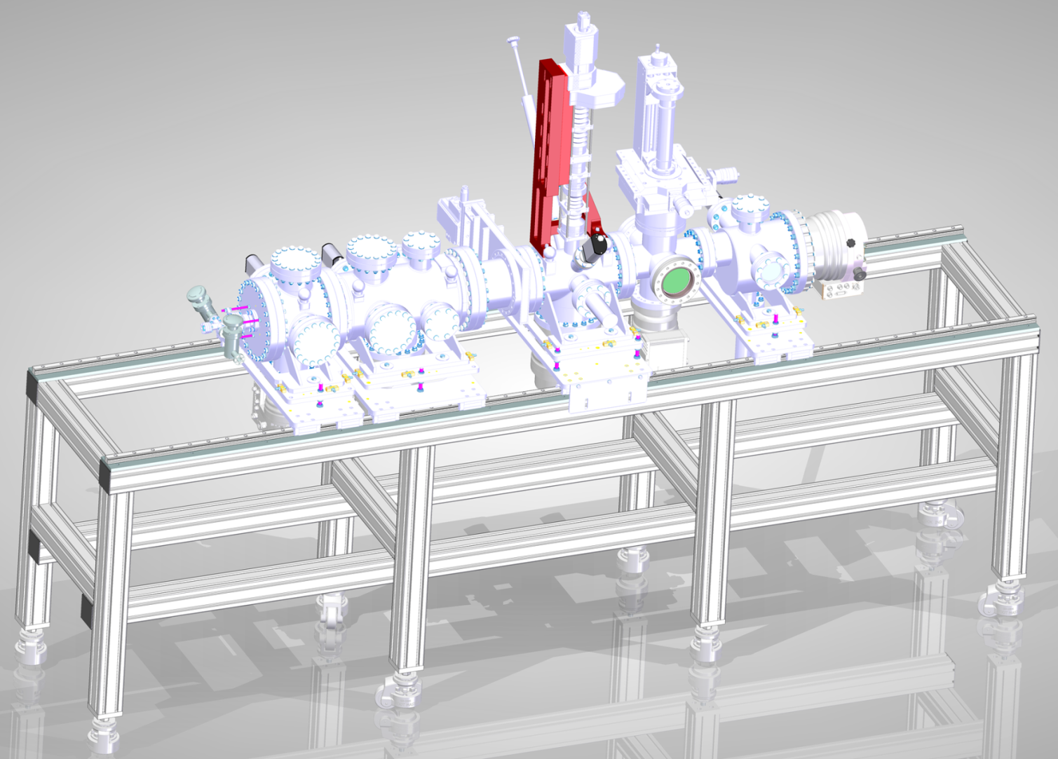
Setup in drawing

Slide 5
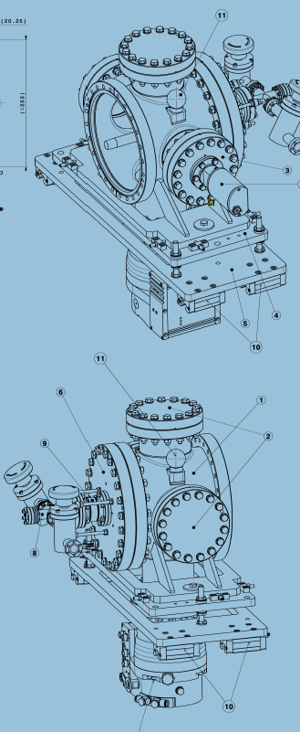
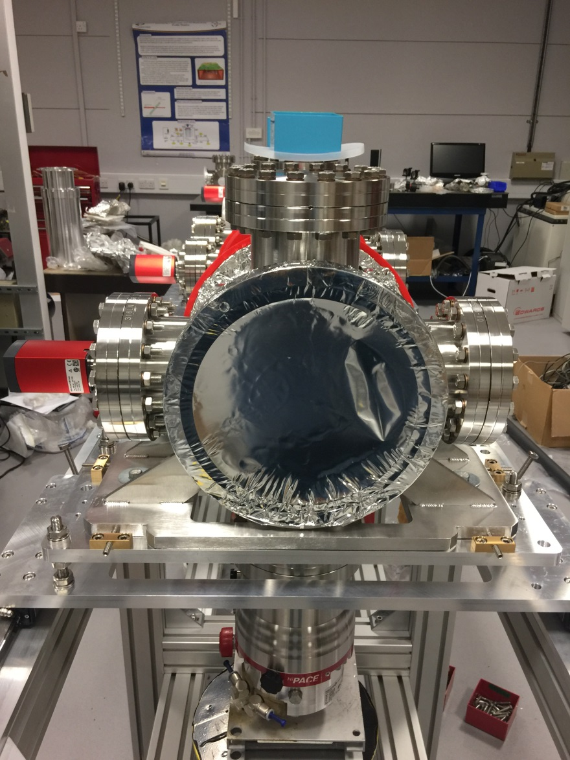
Nozzle chamber

Slide 6
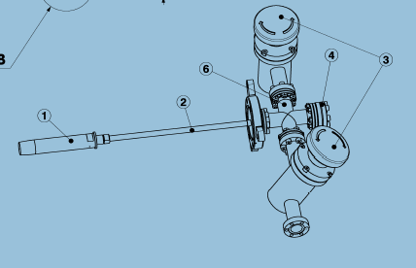
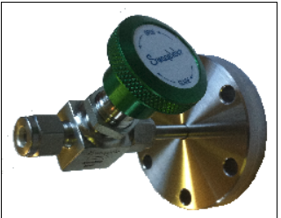
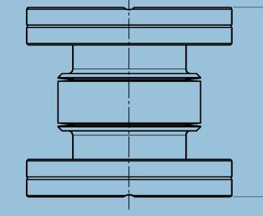
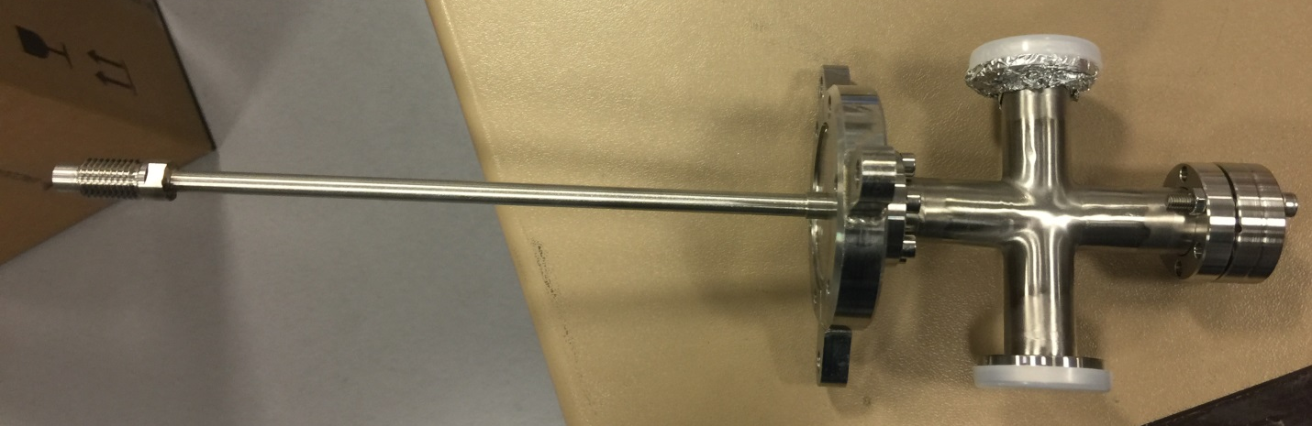
Nozzle assembly
Inline valve will be changed to DN16 flange connected to a Swagelok valve.
Bellow order from Lesker last year, will be delayed to 19/02.
Nozzle??

Slide 7
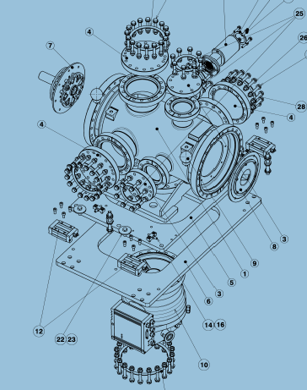
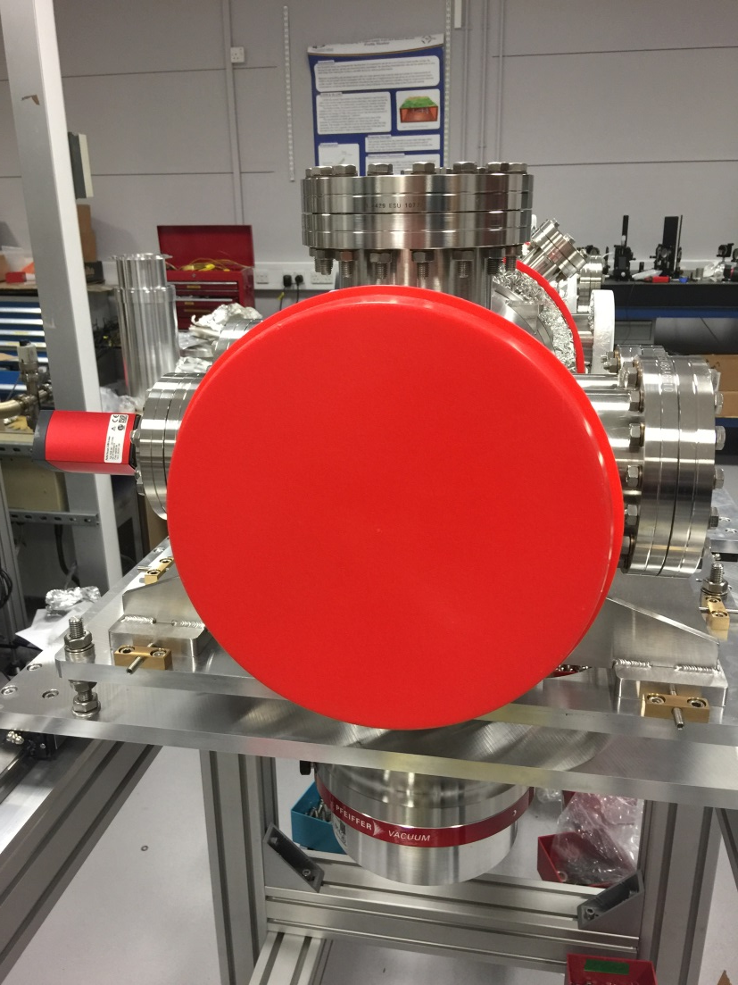
Skimmer chamber

Slide 8
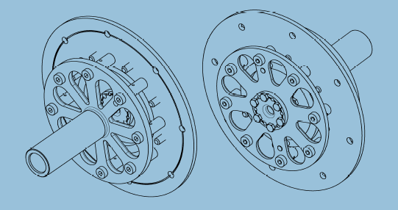
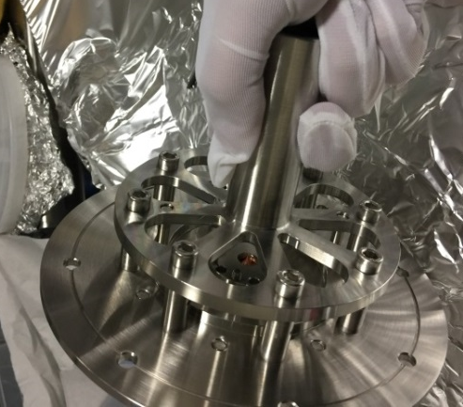
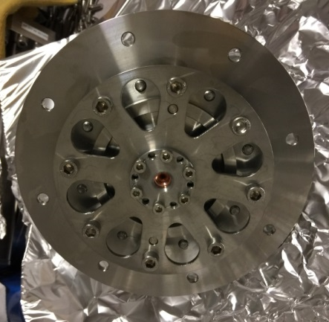
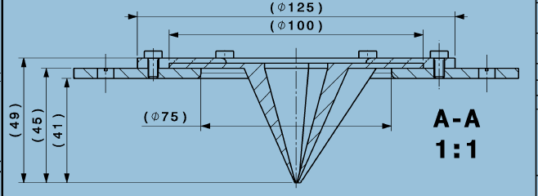
Skimmer assemblies
One of the design errors not found. The diameter of the plate of the third skimmer is actually 75 mm. The two piece was remade and will be ready next week.

Slide 9
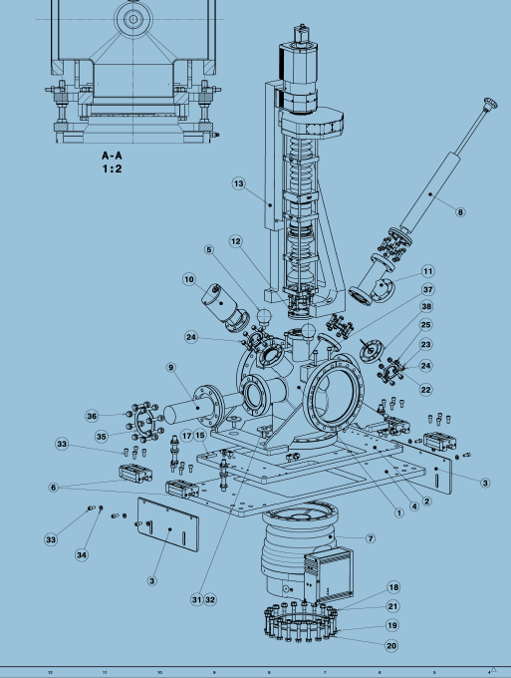
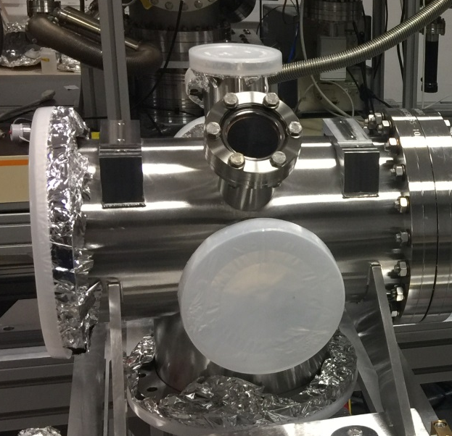
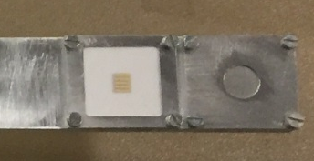
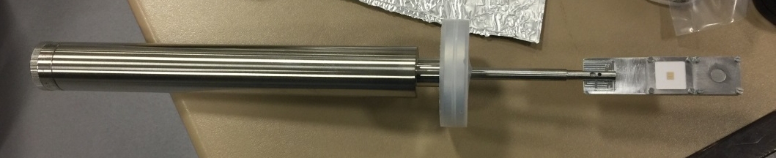
Experimental Chamber
Coating: Currently we could apply a graphite coating pretty quick. Need to make a decision!!!

Slide 10
Optical holder and E-gun
E-gun will be ready in May.
  COMPLETE EGG-3103/EGPS-3103 System, Standard length, ac 230V (UK standard)
  option: Electrostatic Deflection capability
  option: Port Aligner±2 degrees
  option: Pulsing, Dual-Grid
  spare parts: FRA-EGG-3103 Spare Field Replaceable Assembly 10 mA
  Rear Interface Panel Options: standard RS-232 connectors
Optical holder sent out for quotation. Wait for your approved drawings

Slide 11
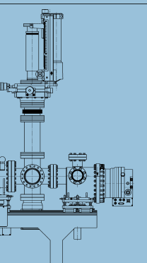
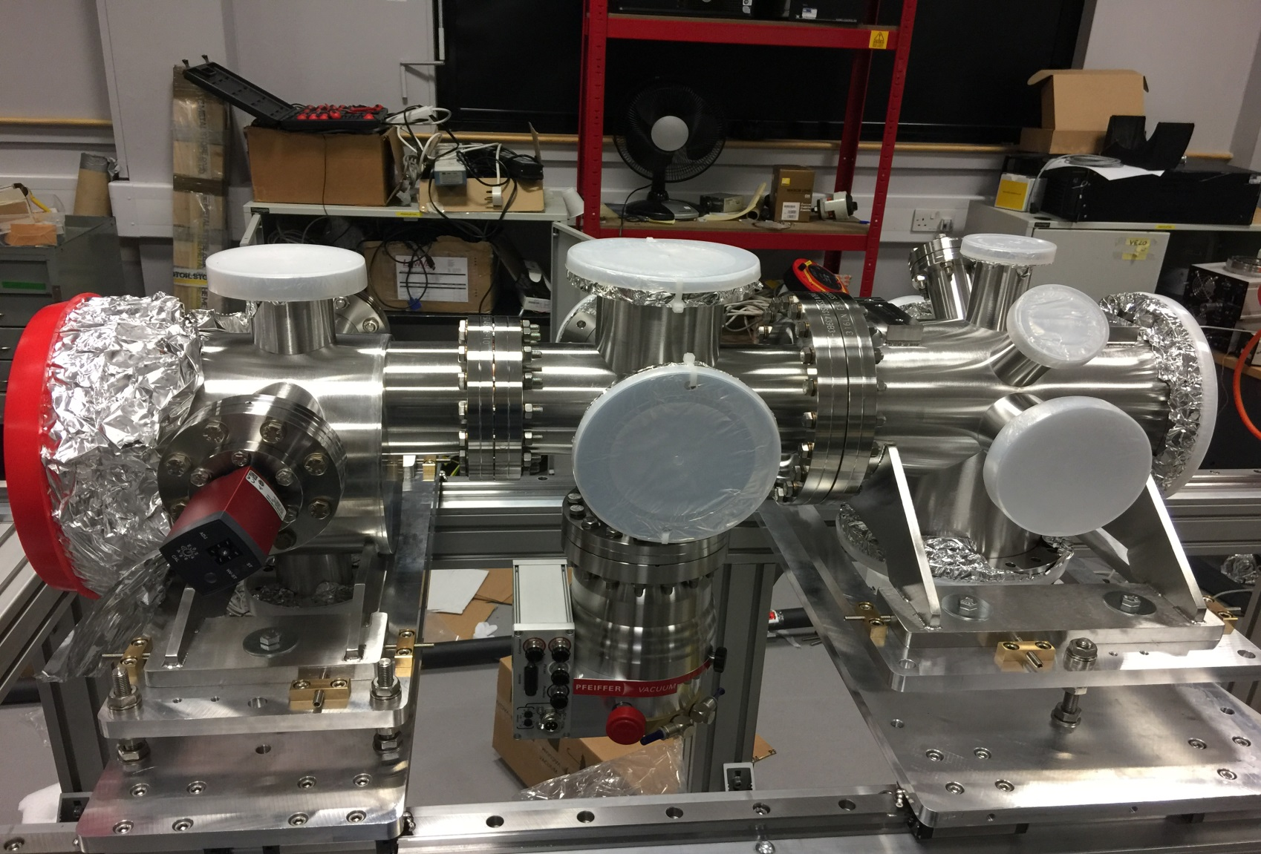
Other chamber
The gas jet density scanner will be from the old system.
Amir will made a mirror holder for laser alignment. (linear bellow drive is ready)

Slide 12
Summary of things not ready
Bellow flange(Connect nozzle and gas injection, delayed from Lesker, will be 19/02)
Nozzle (CERN? we have spare nozzles, but need to design and manufacture the clip holder fitted to current design)
Third skimmer holder (redesigned and manufactured will be ready 09/02)
Coating for experimental chamber? Shall I continue with Graphite coating?
Optics holder quoted (3 weeks)
E-gun? Will use one of the old gun for test.
Laser alignment system.

Slide 13
What is the next
Contact electrician to have power connection or move the whole system to the wall.
Assemble laser alignment system. (Component ready in our optics lab).
Mount the skimmer assemblies.
Graphite coating.
Gas pipe connection.
Begin to pump down by next meeting

