Slide 2
LHC BIF test setup - update
S. Mazzoni, 20/12/2017

Slide 3
Status
Equipment:
  PMT
  PMT cooling box
  HV power supply
  Discriminator
  PC
  USB to fibre converter
  Filter wheel
  Filter wheel driver
  ND filters
  Color filters
Cooling: solution proposed by EN-CV. ECR update probably needed. Gerhard following up
Mechanical design: unclear (to me) the fixation of the optical X95: ground or girder?

Slide 4
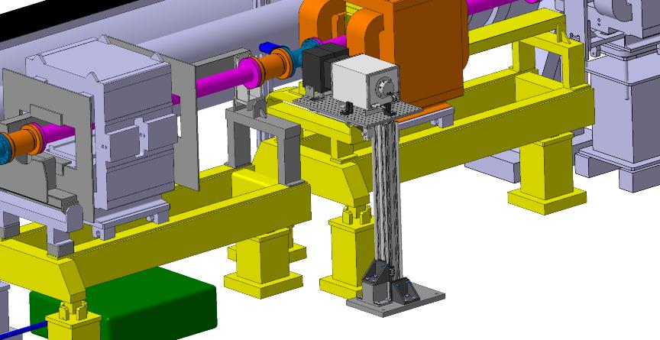
Layout

Slide 5
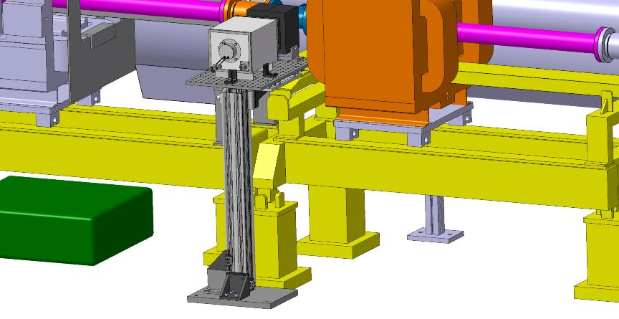
Layout

