Slide 1
BGC CERN Update
Tom Dodington, BE-BI-ML
02.02.2017

Slide 2
Optical Holder
Drawings complete
Can be taken to manufacture by Cockcroft
Final CERN signatures not present yet.
Available now:
  Optical Support
  Optical Gantry A
  Optical Gantry B
  Optical Gantry C
ST0916376_01

Slide 3
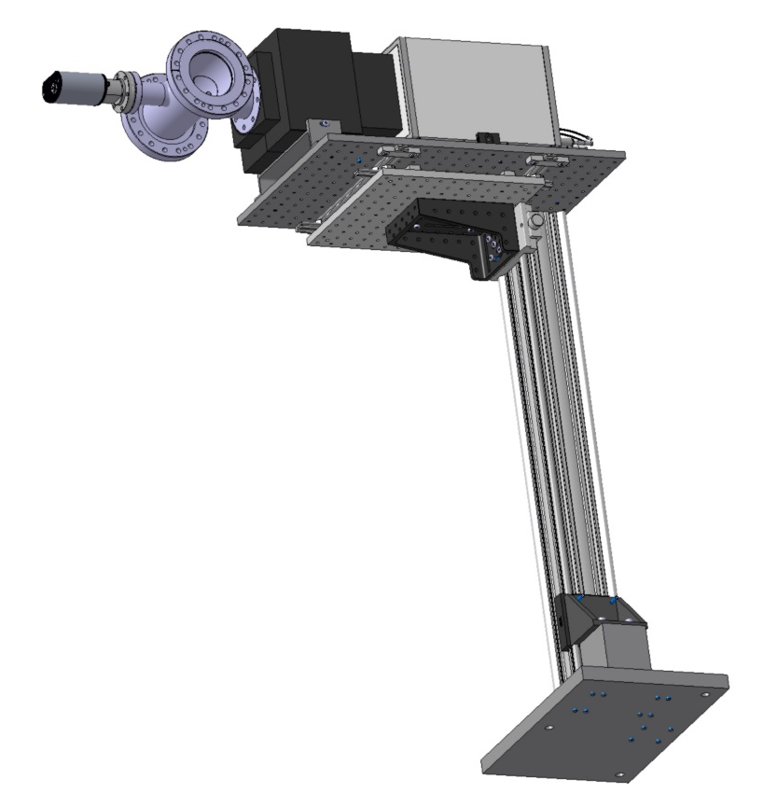
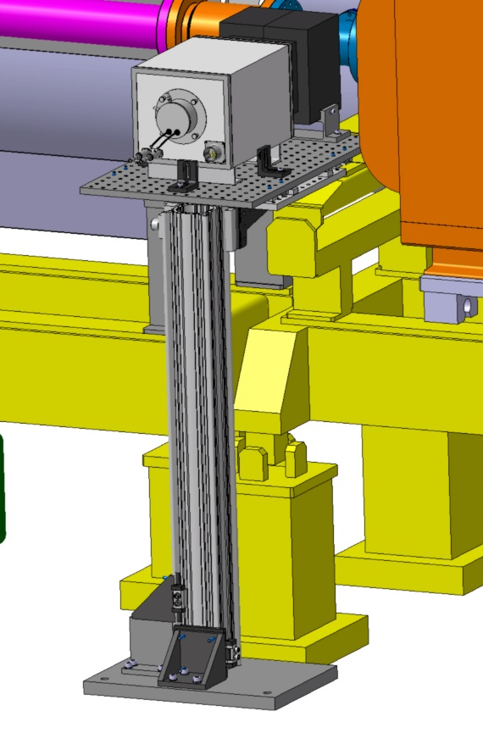
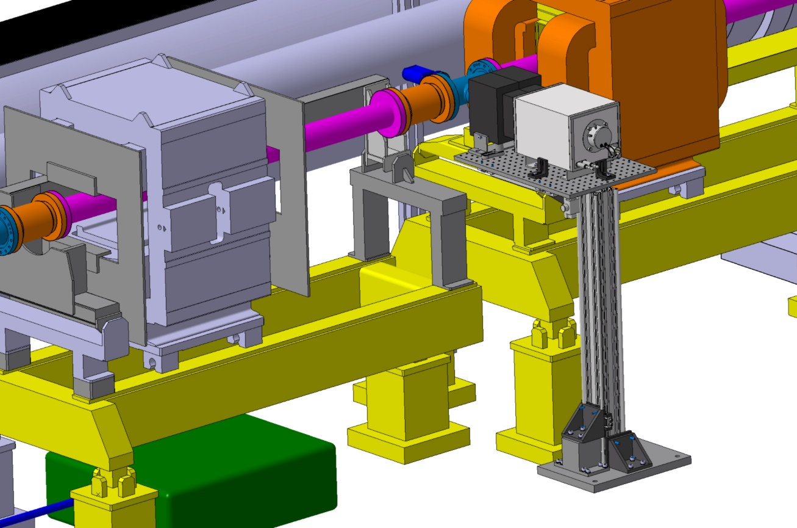
Fluorescence Monitor Optics
Alexandre Mariet, BE-BI-ML
Mechanical support for Photon Counter installation.
  Light shield production now.
  Finalising design of support components, ensure no floor drilling.

Slide 4

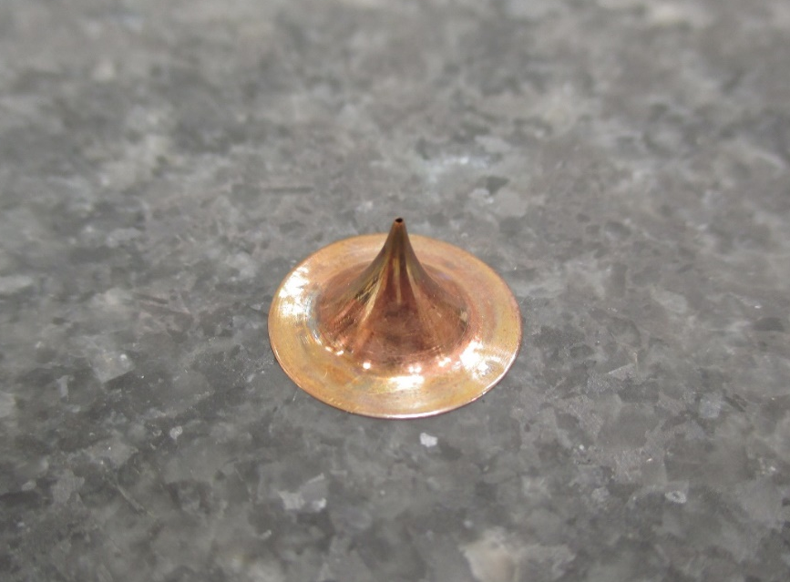
Skimmers Analysis
Two skimmers analysed with CERN Metrology
  Controlled by Didier Glaude
  Profil projector (Baty) with 100X magnification
      Used for side view and angle of hole
  CMM Zeiss O-Inspect
      Used for pictures of the holes
EDMS 1898684 v.1
"Skimmers beam molecular“
by Didier GLAUDE
Status: In Work
https://edms.cern.ch/document/1898684/1/approvalAndComments

Slide 5
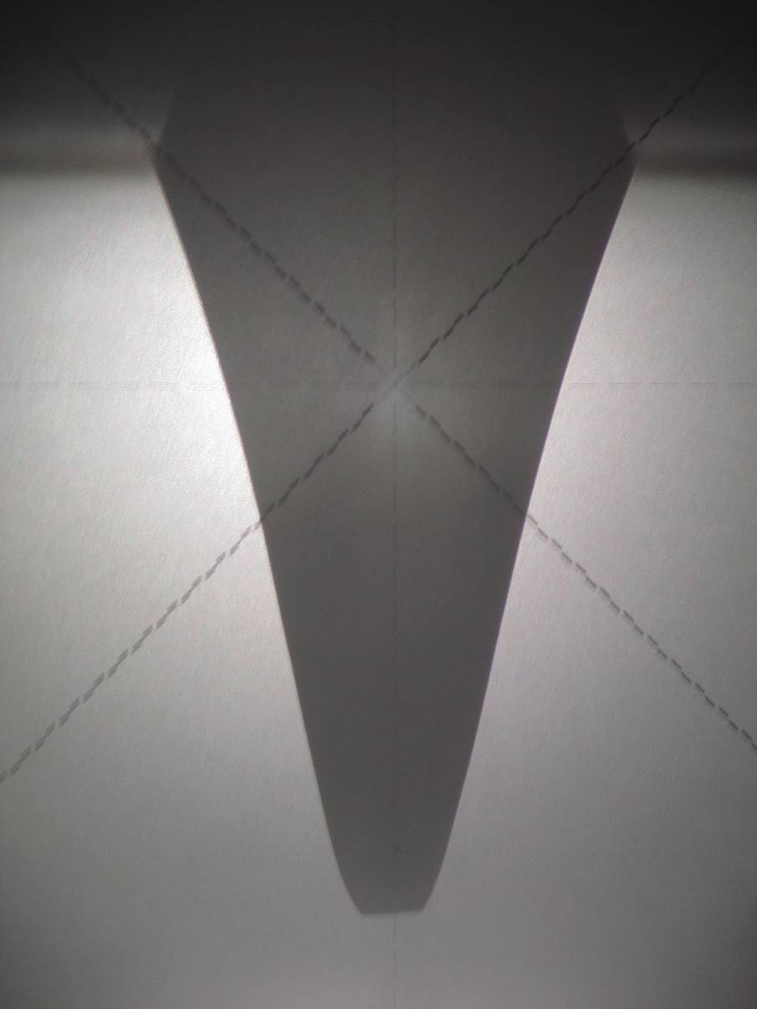
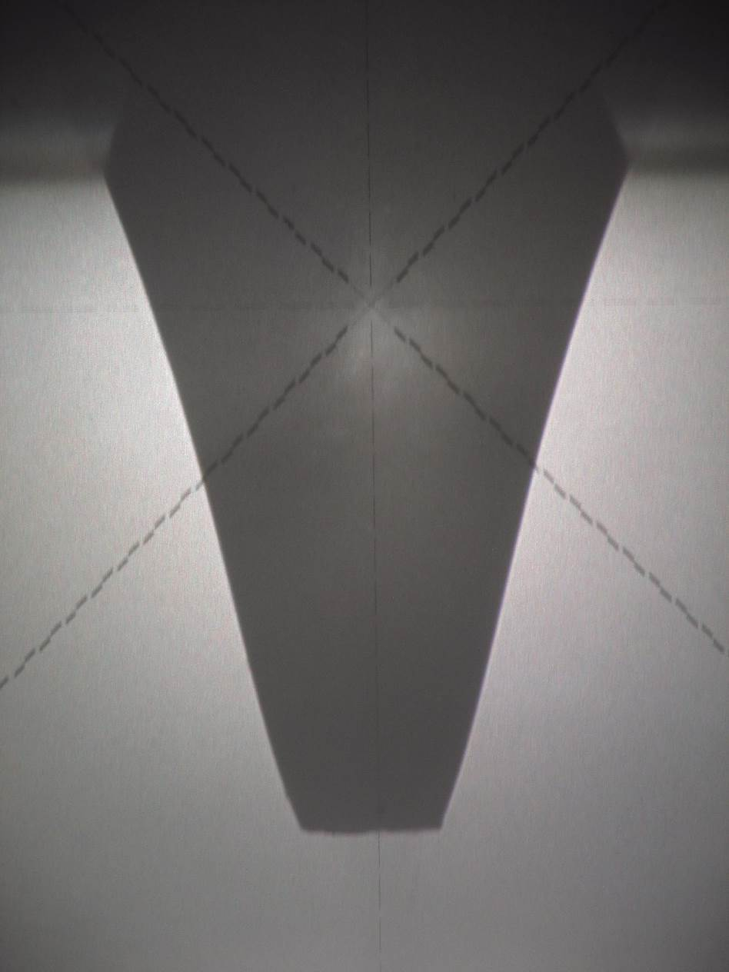
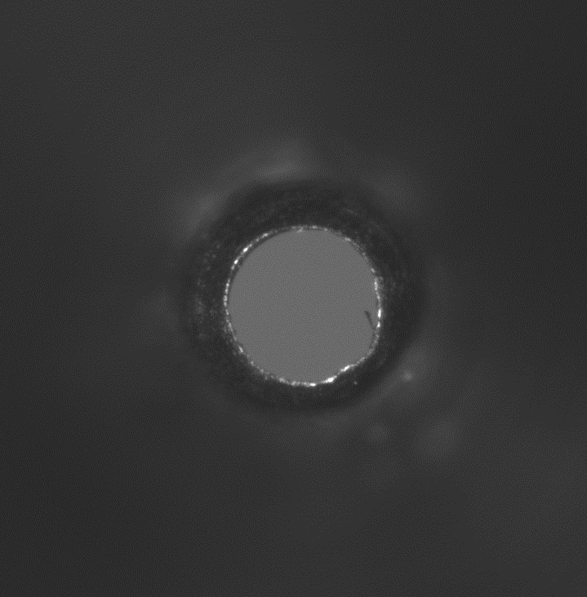
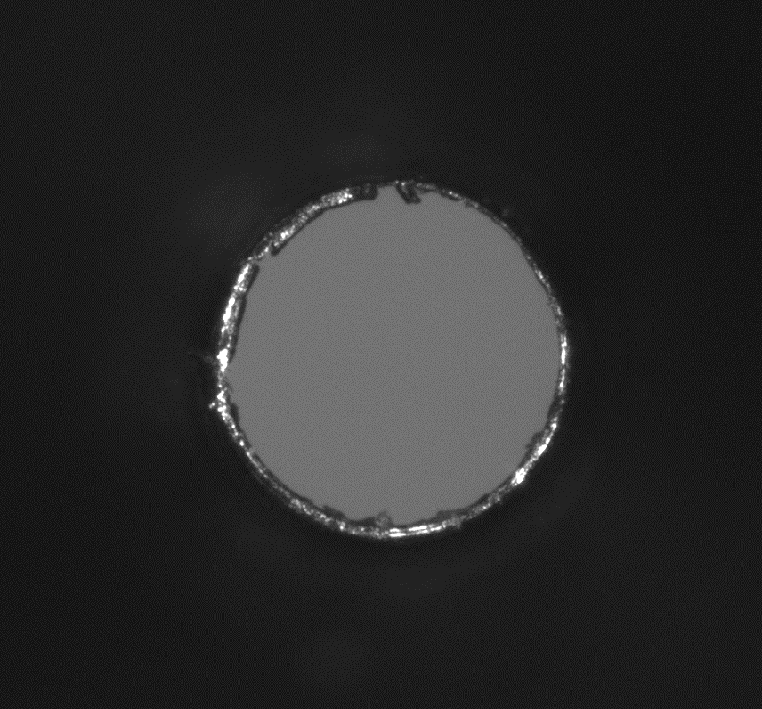
Skimmers Analysis
Didier Glaude, CERN Metrology
Model 7 size 0.18mm
Model 7 size 0.18mm
Model 7 size 0.41mm
12µm
10µm

Slide 6
home.cern

Slide 7
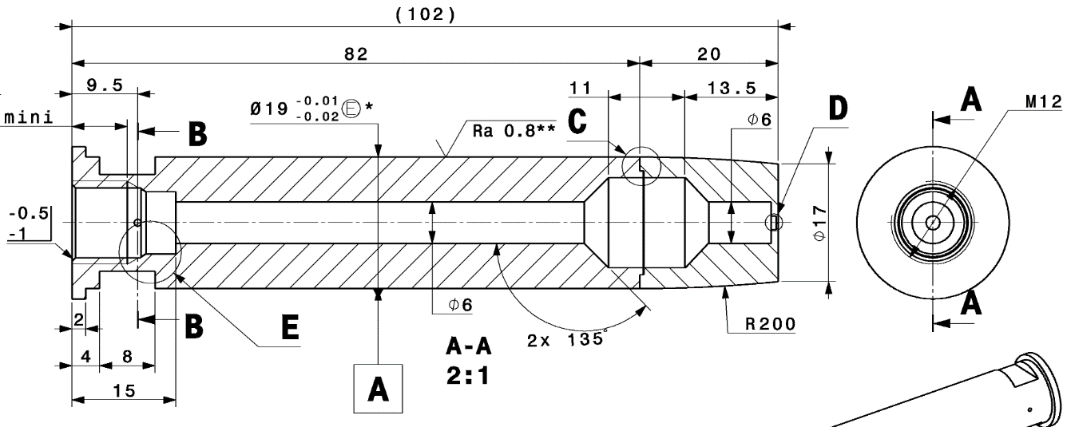
Nozzle Manufacture
All parts manufactured at Scitech, Rutherford Appleton Labs, UK
Now the welding and drilling remain.
Test welds taking place this week
Based on hole drilling we will use mechanical drill for 30um holes.
Hope to receive by end of January

Slide 8
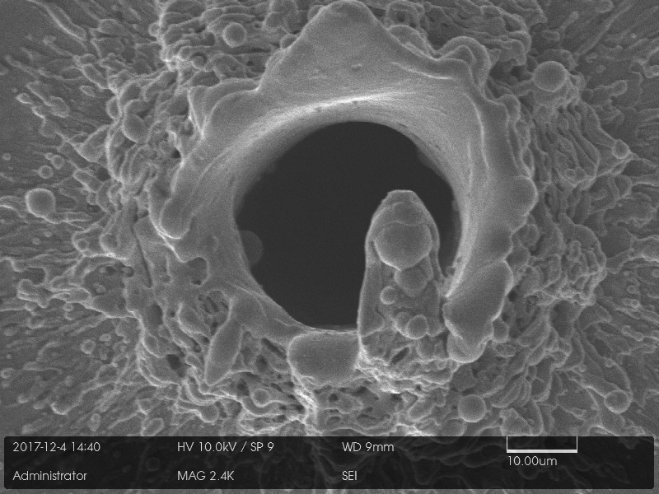
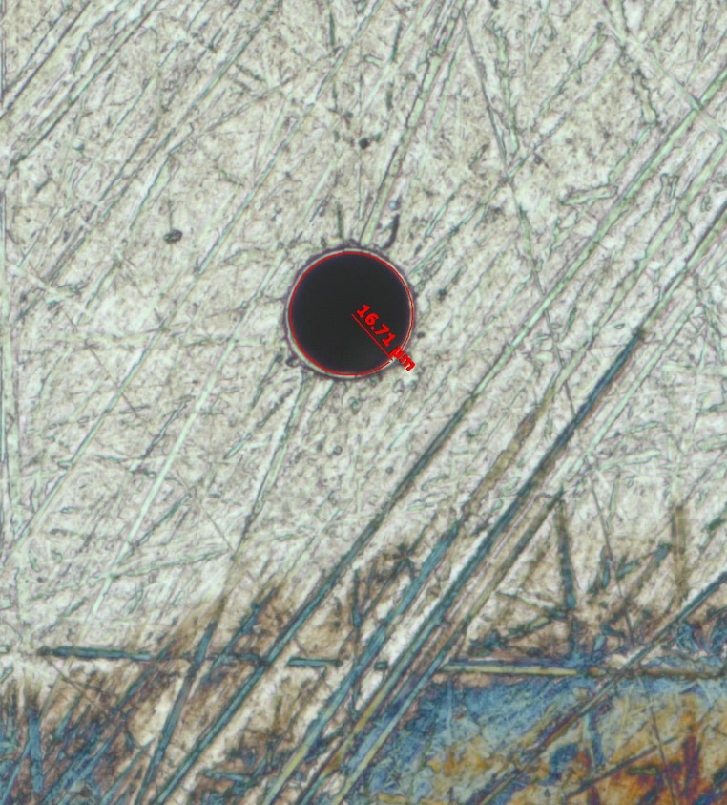
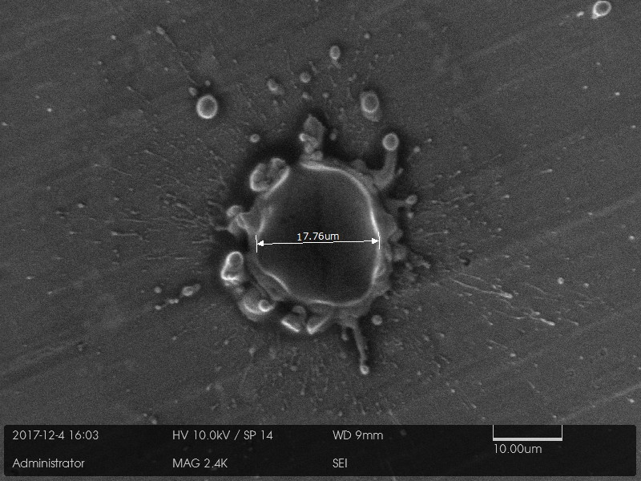
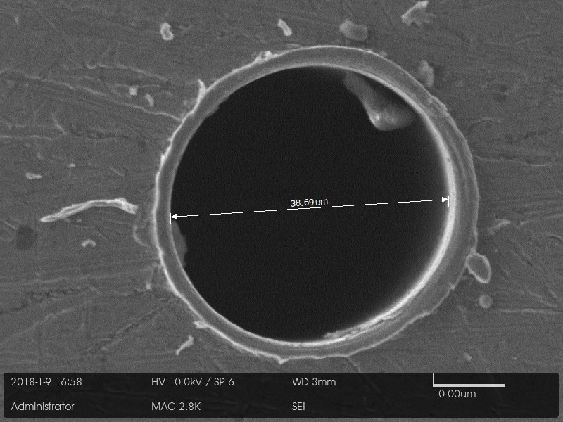
Hole Manufacture
20um laser drilled hole completed
30um machined hole drill bits being manufactured
Both 250&350 um drill lengths
No breakages!
Propose to use this for nozzle manufacture
30um hole, mechanically drilled
20um hole, laser machined
Scitech, Rutherford Appleton Laboratories, UK

Slide 9
Gas Volume Partition
Idea to separate pumping between skimmer 1 & 2
Secondary design now complete by CERN Design Office
ST0923983_01
Candy Capelli, EN-MME

Slide 10
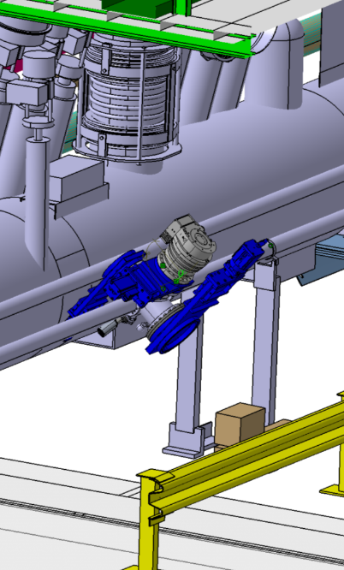
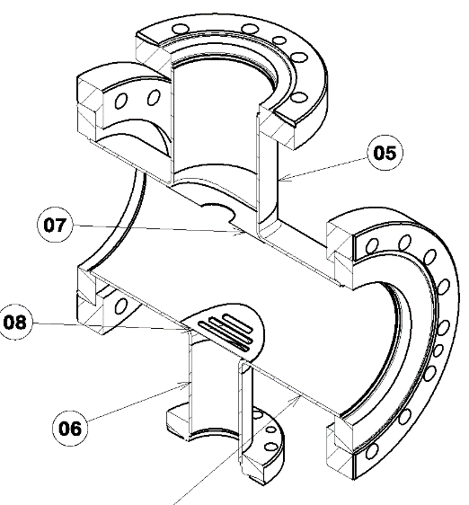
New LHC BGC Integration Chamber
ECR for new Integration chamber due in March 2018 for HiLumi technical review and LS2 integration
Some collaboration with EN-MME integration and design office.
Discussion with BE-APB for impedance analysis
Shielding with holes / slits to reduce effect of larger DN200 flanges

Slide 11
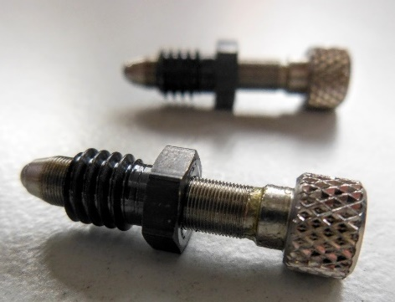
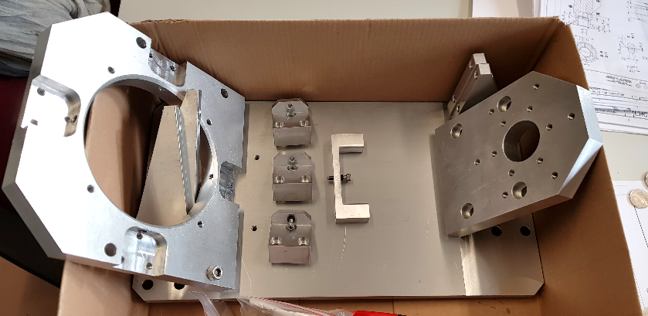
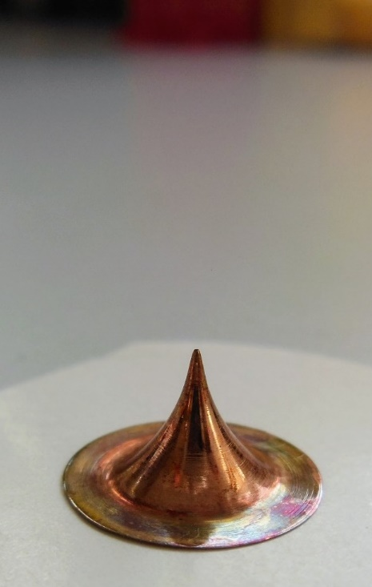
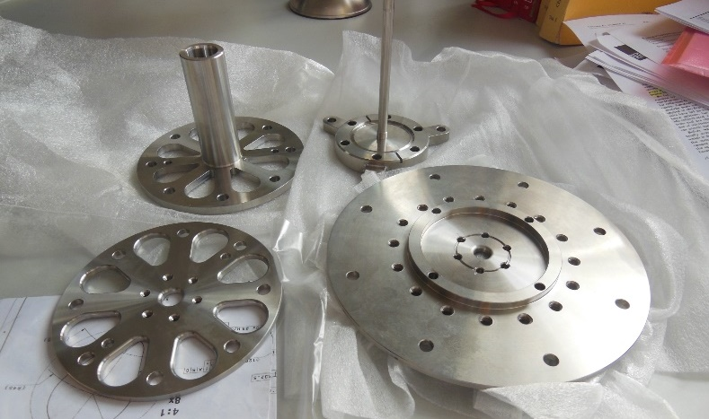
Alignment Progress
Stainless steel parts ✔
Skimmers ✔
Alignment Table ✔
Alignment laser & components ✔
Nozzle - ongoing
Next steps:
Assemble everything
Verify skimmer hole size with metrology
Align skimmers as best as possible
with current setup

