Slide 1
Low-pressure simulation update
Marton Ady
BGC meeting 02/02/2018

Slide 2
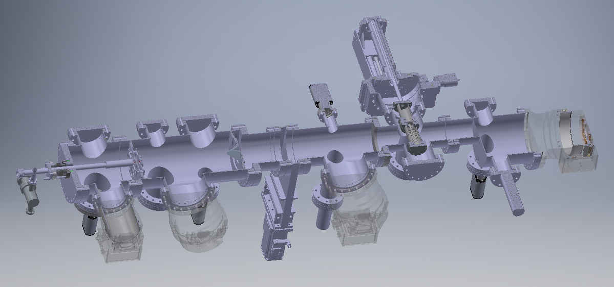

Slide 3
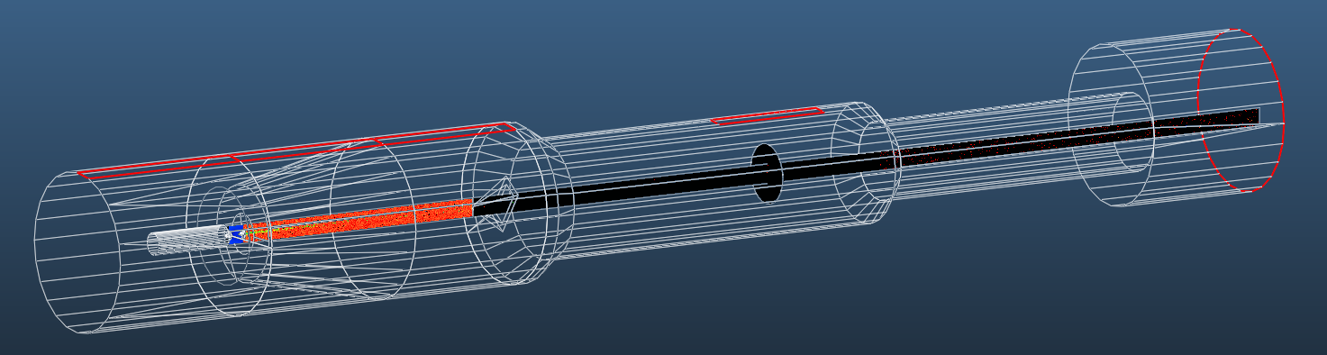

Slide 4
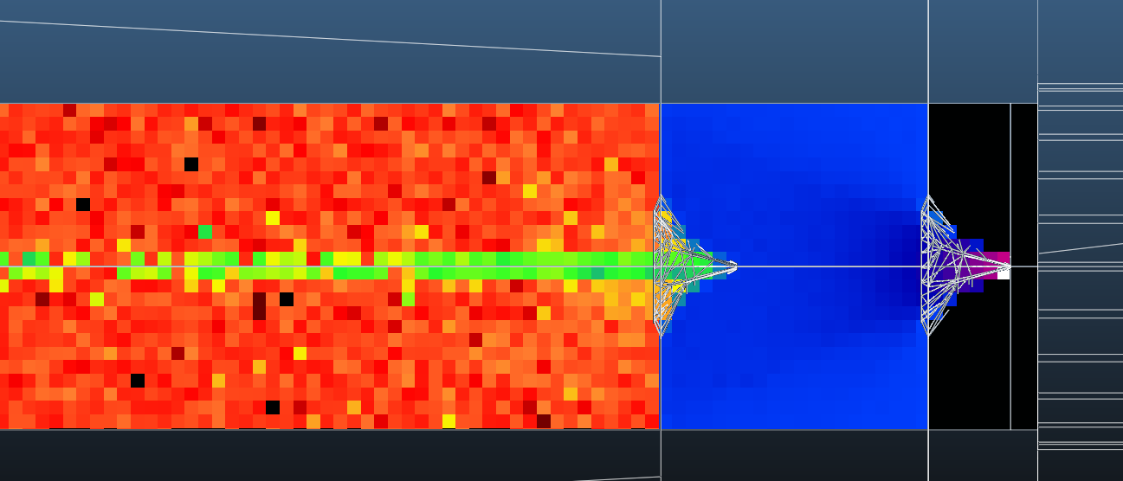
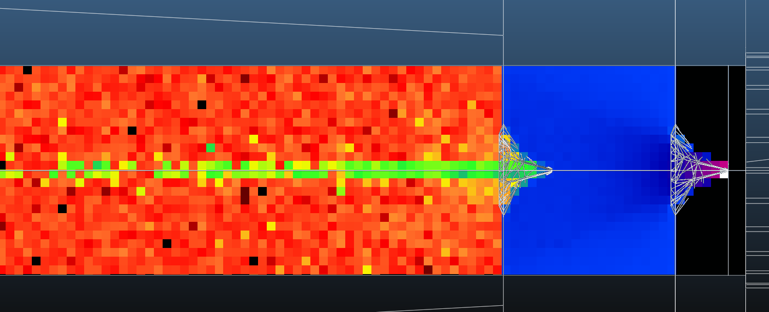
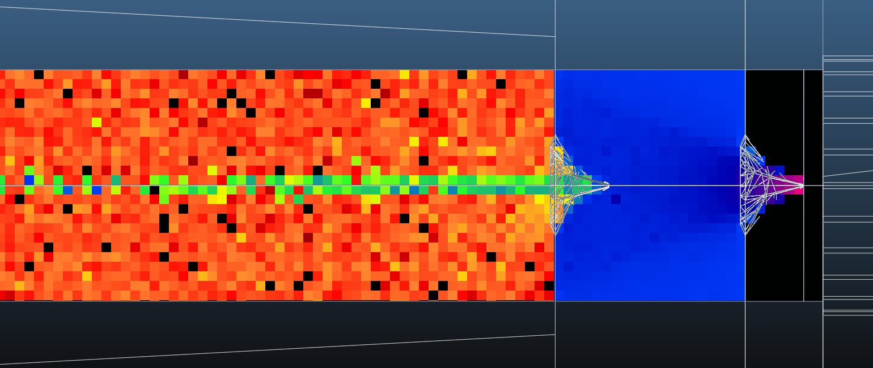
Uniform
(divergent)
Cosine
(medium)
Cosine^5
(collimated)

Slide 5
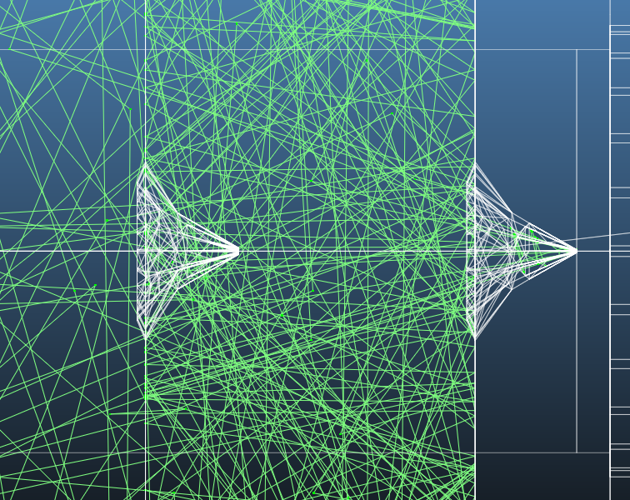
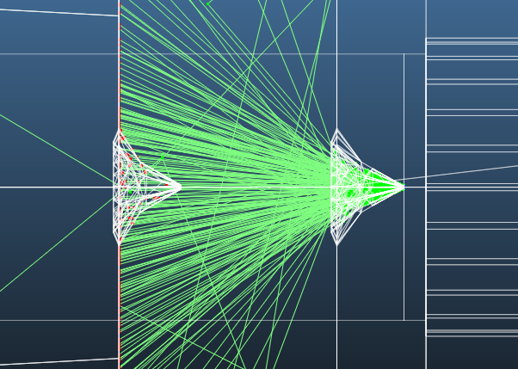
Normal simulation
“Sticking” simulation

Slide 6
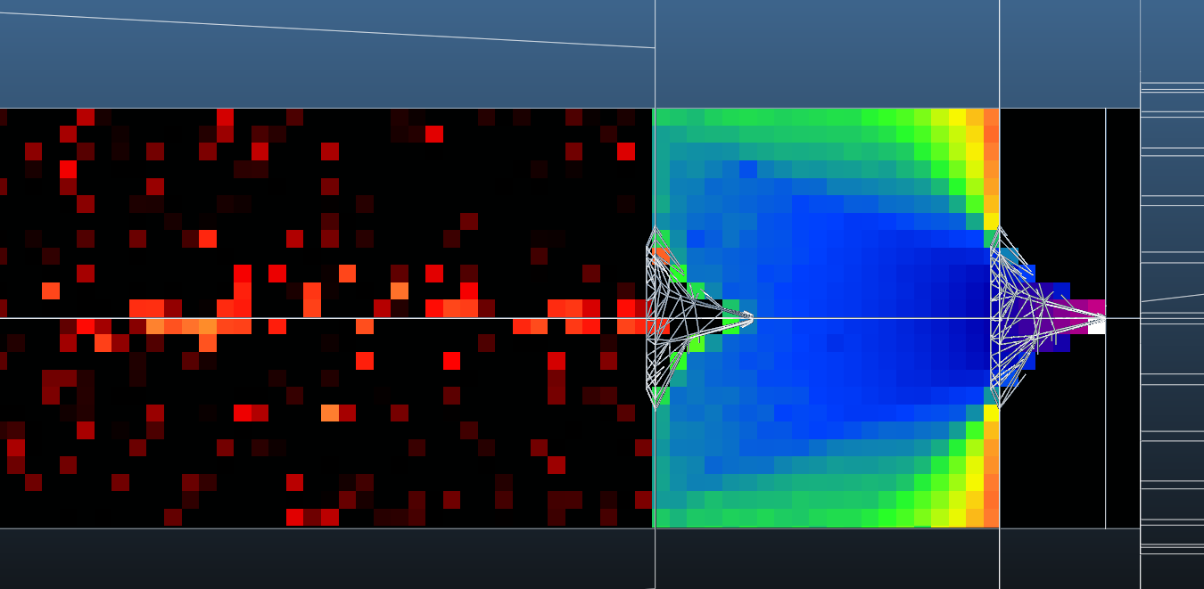
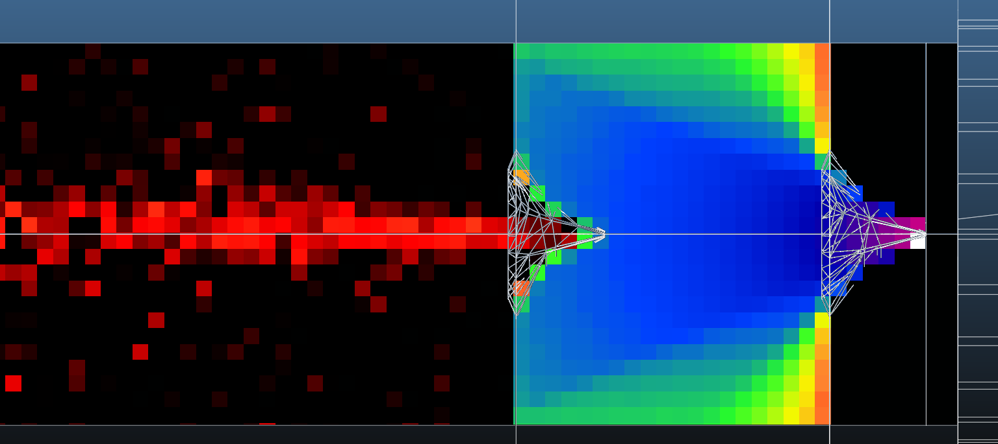
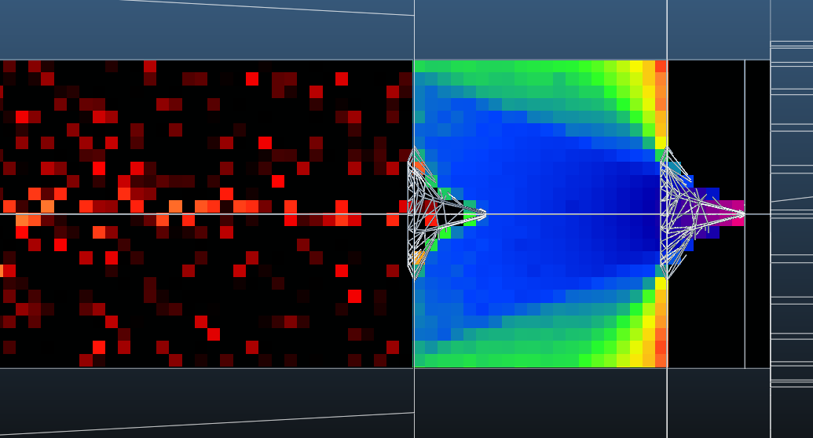
Uniform
(divergent)
Cosine
(medium)
Cosine^5
(collimated)

Slide 7
prependicular
grazing
prependicular
grazing
prependicular
grazing
prependicular
grazing

Slide 9
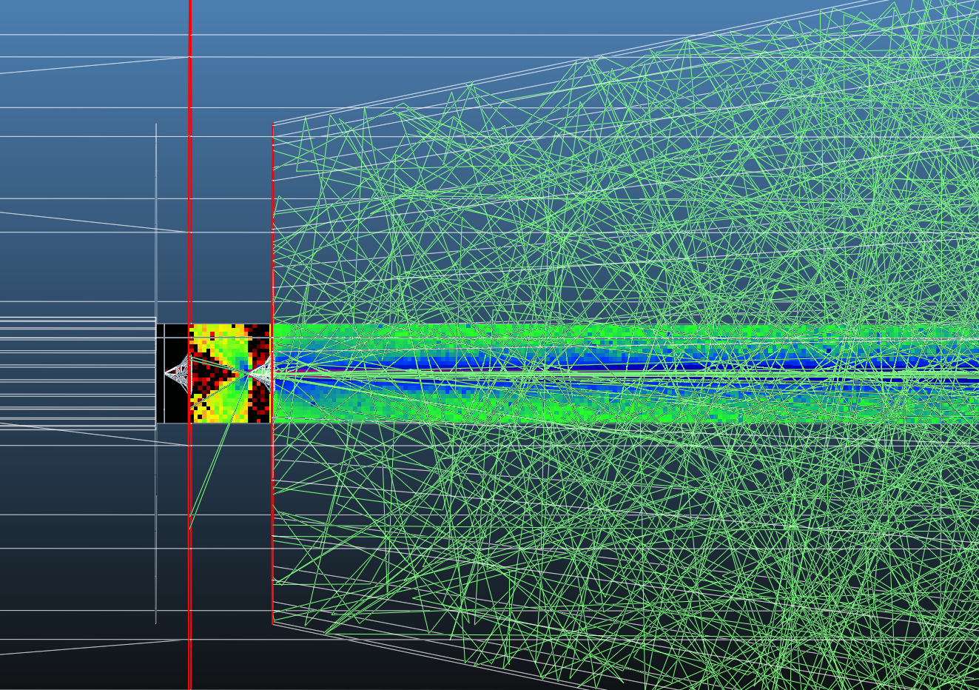

Slide 10
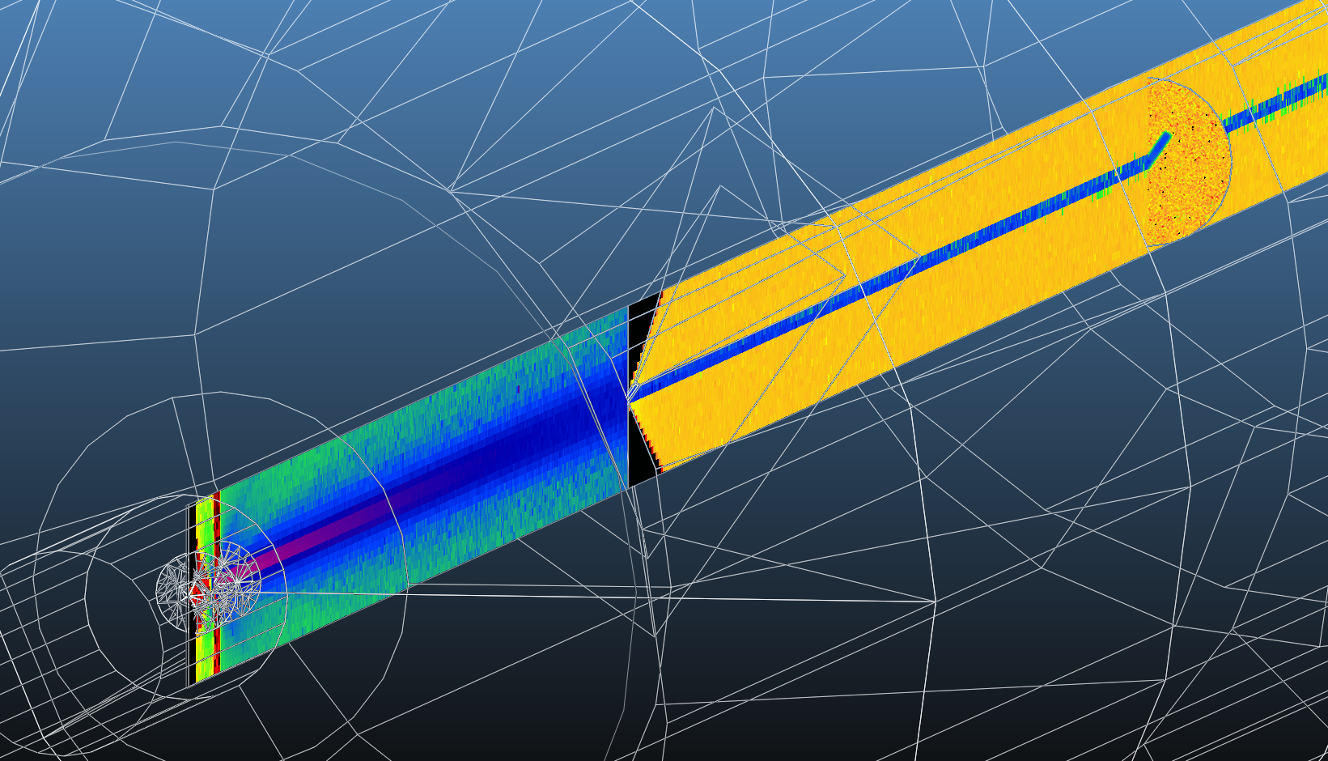

Slide 11
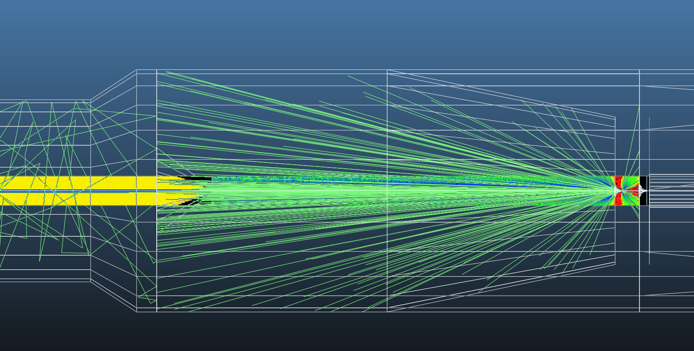

Slide 12
Normal simulation
“Sticking” simulation

Slide 13
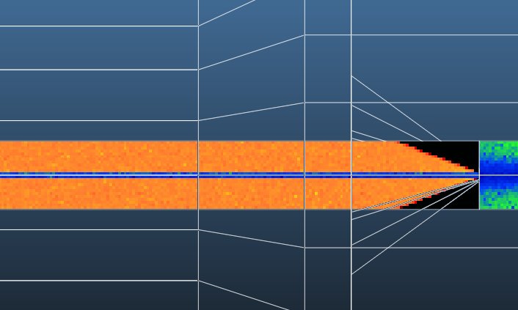
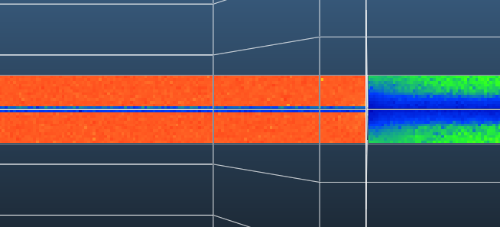
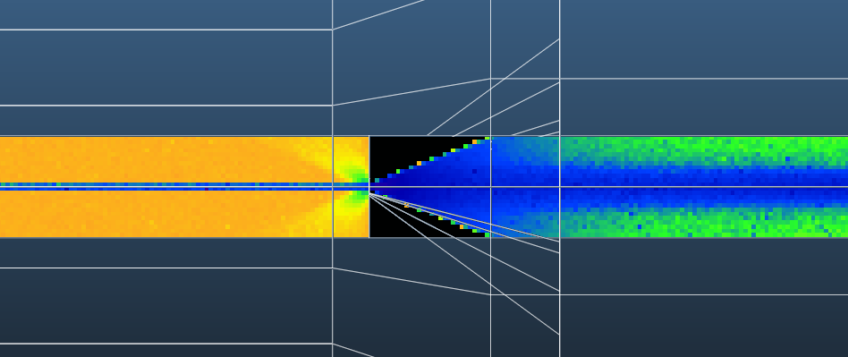
JET
JET
JET

Slide 14
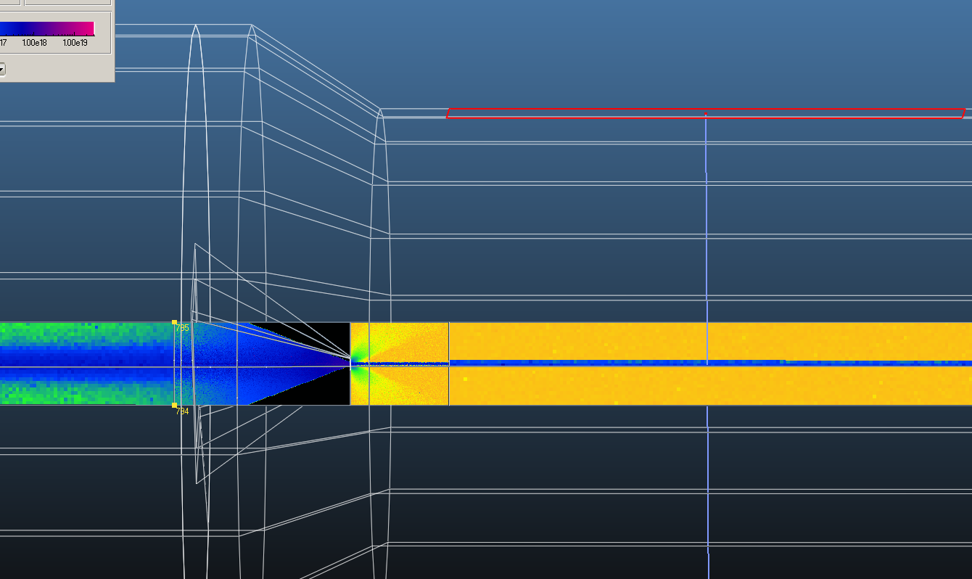
Aligned pump
normal |  | 6.79E-12 | 1.71E-09 | 6.63E-09
skim3 target |  | 6.75E-12 | 1.73E-09 | 6.60E-09
flat |  | 5.41E-12 | 1.72E-09 | 6.66E-09
inv ver1 |  | 1.69E-11 | 1.77E-09 | 6.66E-09
inv pump align |  | 1.69E-11 | 1.78E-09 | 6.63E-09

Slide 15
 | Background | Jet
Normal skimmer 3 | 6.79E-12 | 1.71E-09
Normal skimmer 3 + sticking | 6.75E-12 | 1.73E-09
Flat skimmer | 5.41E-12 | 1.72E-09
Inverse skimmer | 1.69E-11 | 1.77E-09
Inverse + pump aligned | 1.69E-11 | 1.78E-09

Slide 16
Conclusion
(If sufficiently divergent) simulation not very sensitive to skimmer 1 divergence
Optimal simulation method found (2 iterations)
Flat skimmer 3 is the simplest -> recommended

