Slide 1
QCD at the Large Hadron Collider
Jon Butterworth
SLAC Summer Institute
SLAC
August 2018
Notes:
Ideas:
Quote from Bj & Drell
The Drell-Yan plot (resonances etc) in pp

Slide 2
10² Atomic binding energy
10¹¹ Electroweak symmetry breaking
W, Z, H, top mass
10⁷ Nuclear binding energy
Planck
0 − γ, g
10¹³ LHC CM energy
10⁶ Electron
10²⁵ Grand Unification?
10⁰
10¹⁴
10²⁸
electronVolts
10⁹ Quark confinement, proton mass, Λ _{QCD}
Neutrinos

Slide 3
10² Atomic binding energy
10¹¹ Electroweak symmetry breaking
W, Z, H, top mass
10⁷ Nuclear binding energy
Planck
0 − γ, g
10¹³ LHC CM energy
10⁶ Electron
10²⁵ Grand Unification?
10⁰
10¹⁴
10²⁸
electronVolts
10⁹ Quark confinement, proton mass, Λ _{QCD}
Neutrinos

Slide 4
Outline
Total cross section and parton densities
The soft stuff
Jet production
Jet substructure
Heavy Flavour production
Measuring the coupling
Quark and gluon matter
Future prospects

Slide 5
Outline
Total cross section and parton densities
The soft stuff
Jet production
Jet substructure
Heavy Flavour production
Measuring the coupling
Quark and gluon matter
Future prospects

Slide 6
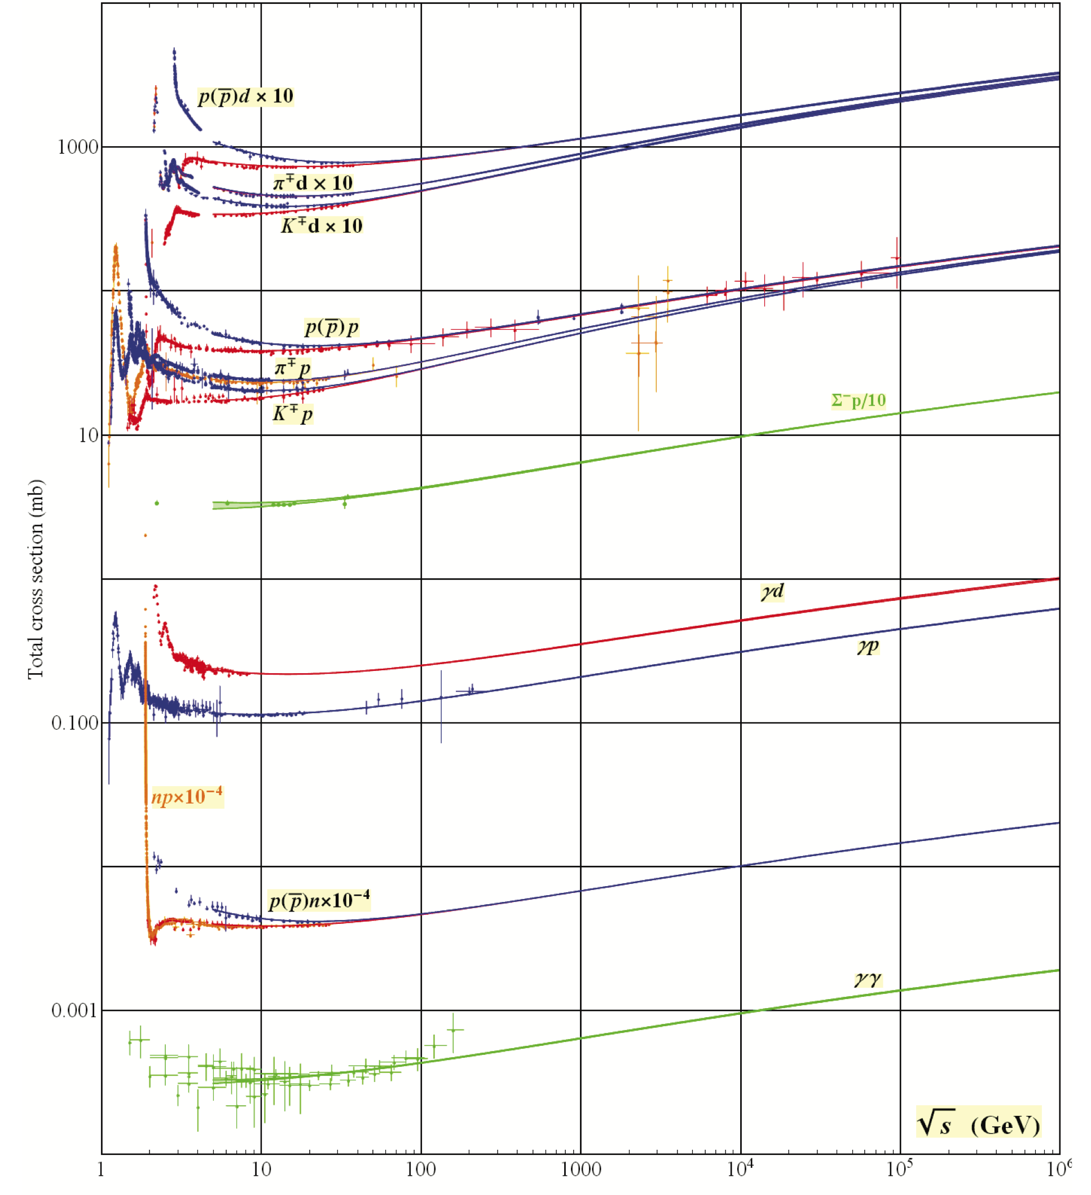
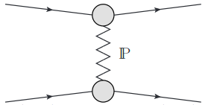
Total cross sections
PDG 2018
Notes:
Discuss common rise: exchange of quantum numbers of vacuum (Regge). Pomeron.

Slide 7
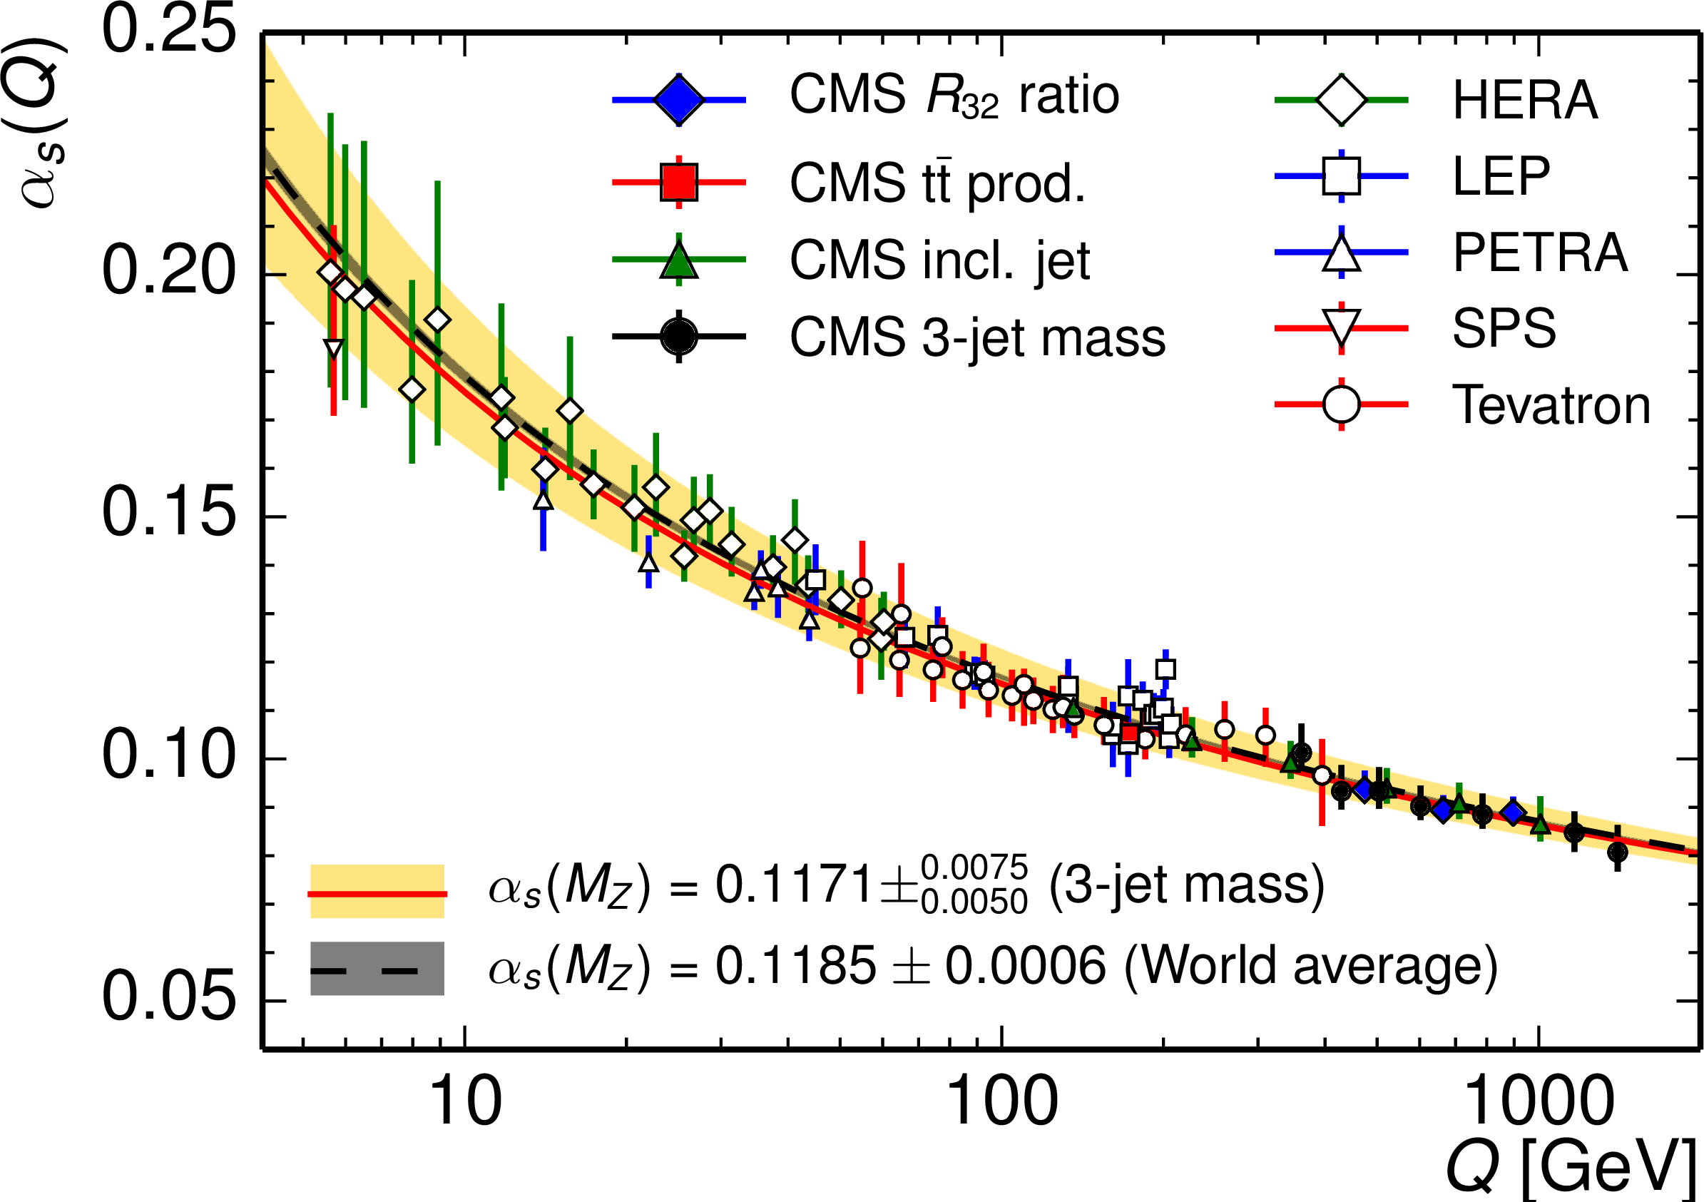
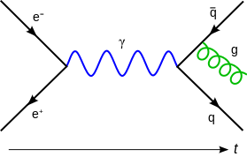
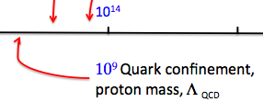
Asymptotic freedom ←→ infrared confinement

Slide 8
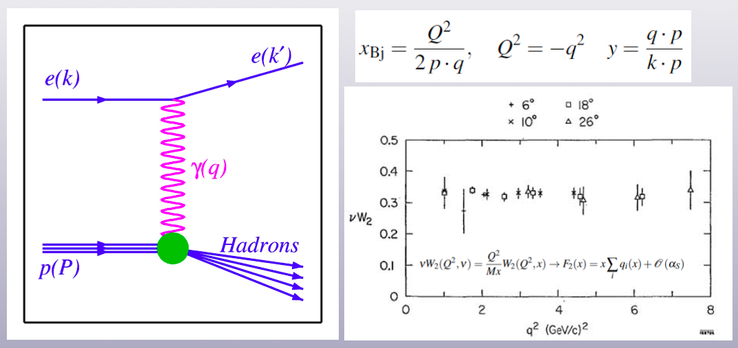

Deep Inelastic Scattering
Part of Slide from Juan Rojo
Notes:
Lepton probe is cleaner, though DY also works.

Slide 9
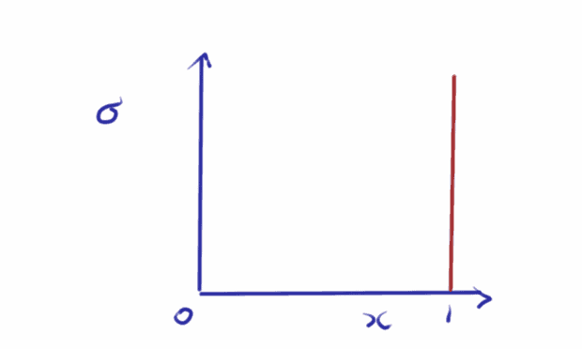
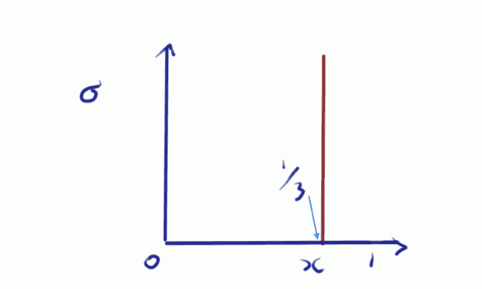
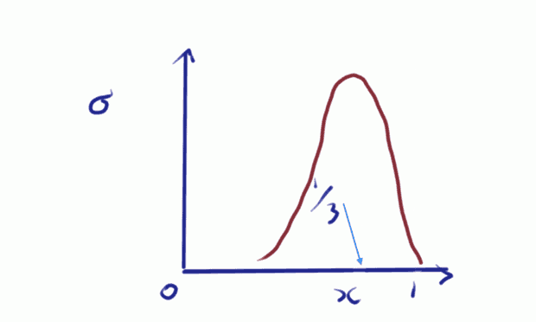
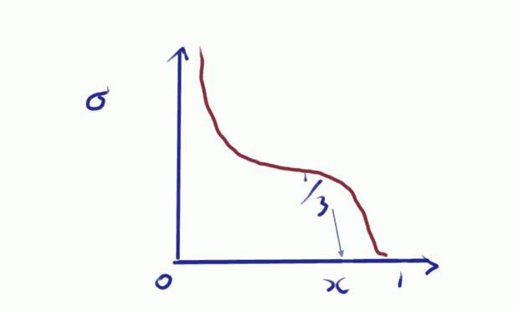
From Proton to PDF
= F₂
Notes:
From proton to PDF: draw the delta function in x, 1, 1/3, smeared, QCD.

Slide 10
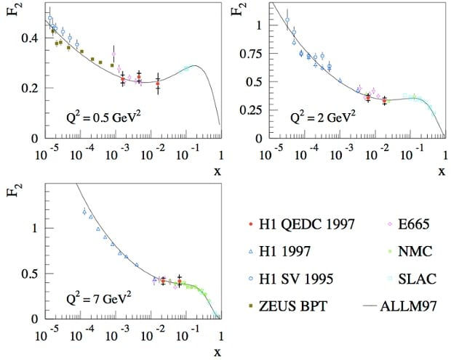
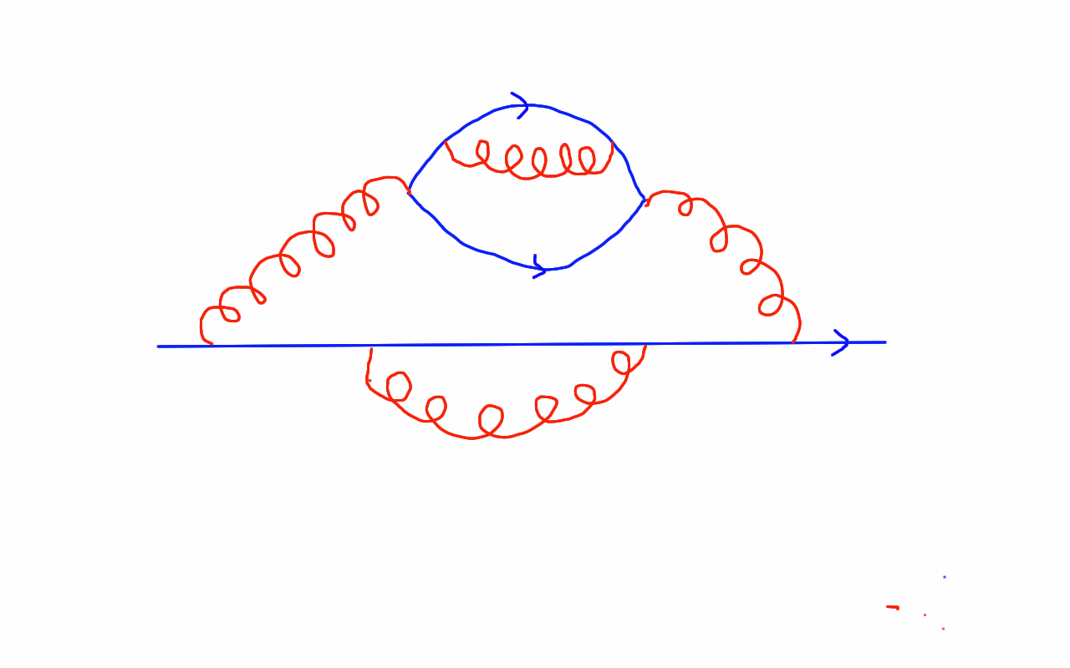
From Proton to PDF
Notes:
From proton to PDF: draw the delta function in x, 1, 1/3, smeared, QCD.

Slide 11
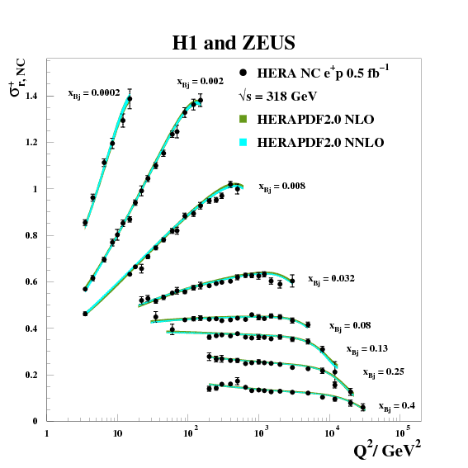
Scaling and Scaling Violations
arXiv:1607.00790

Slide 12
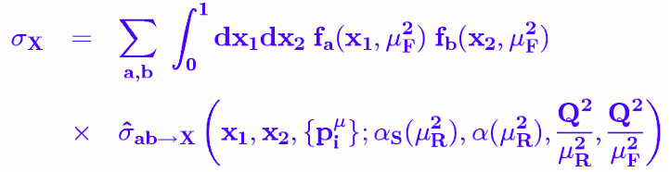
At the LHC?
Don’t/can’t measure F₂
  it is only defined for DIS
Structure functions can be expressed in terms of parton densities
Factorisation allows these to be used to calculate proton-proton cross sections

Slide 13
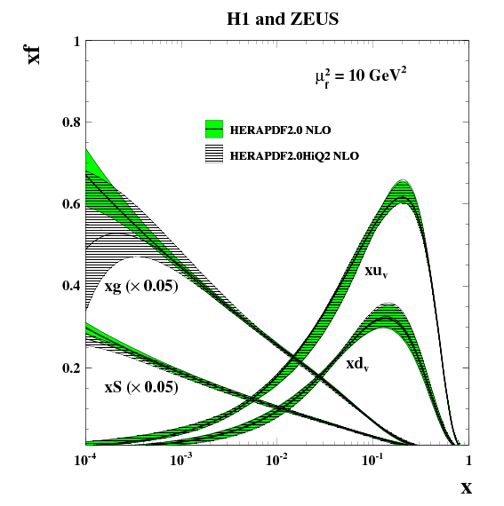
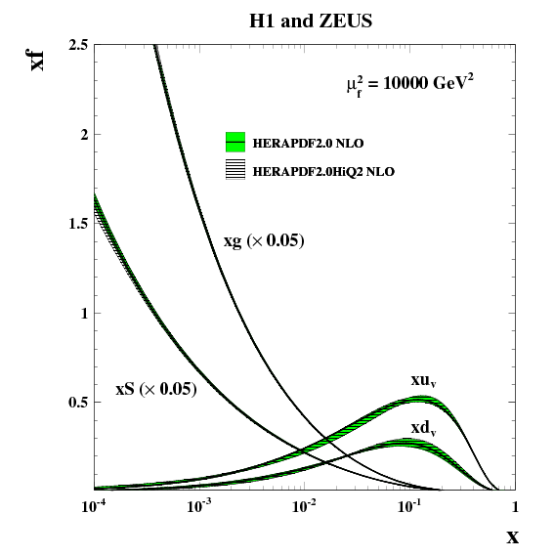
From Proton to PDF
arXiv:1607.00790
Notes:
Can’t measure

Slide 14
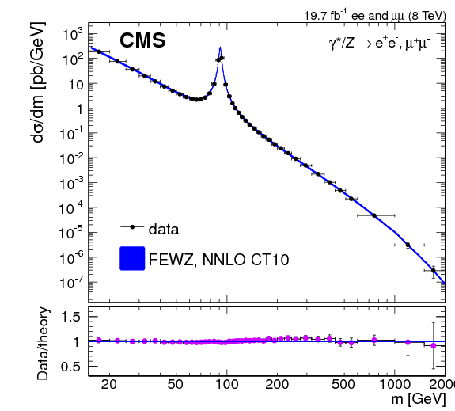
Drell-Yan

Slide 15
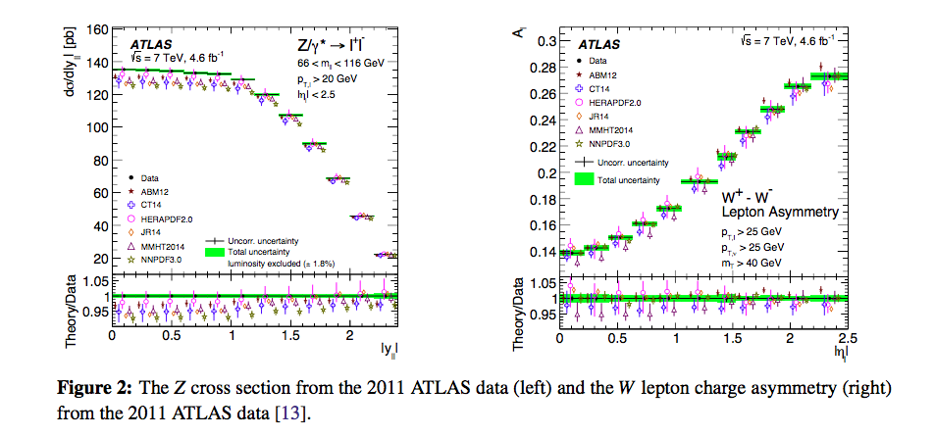
PDFs from LHC Data
From Mark Sutton, DOI: 10.22323/1.314.0411

Slide 16
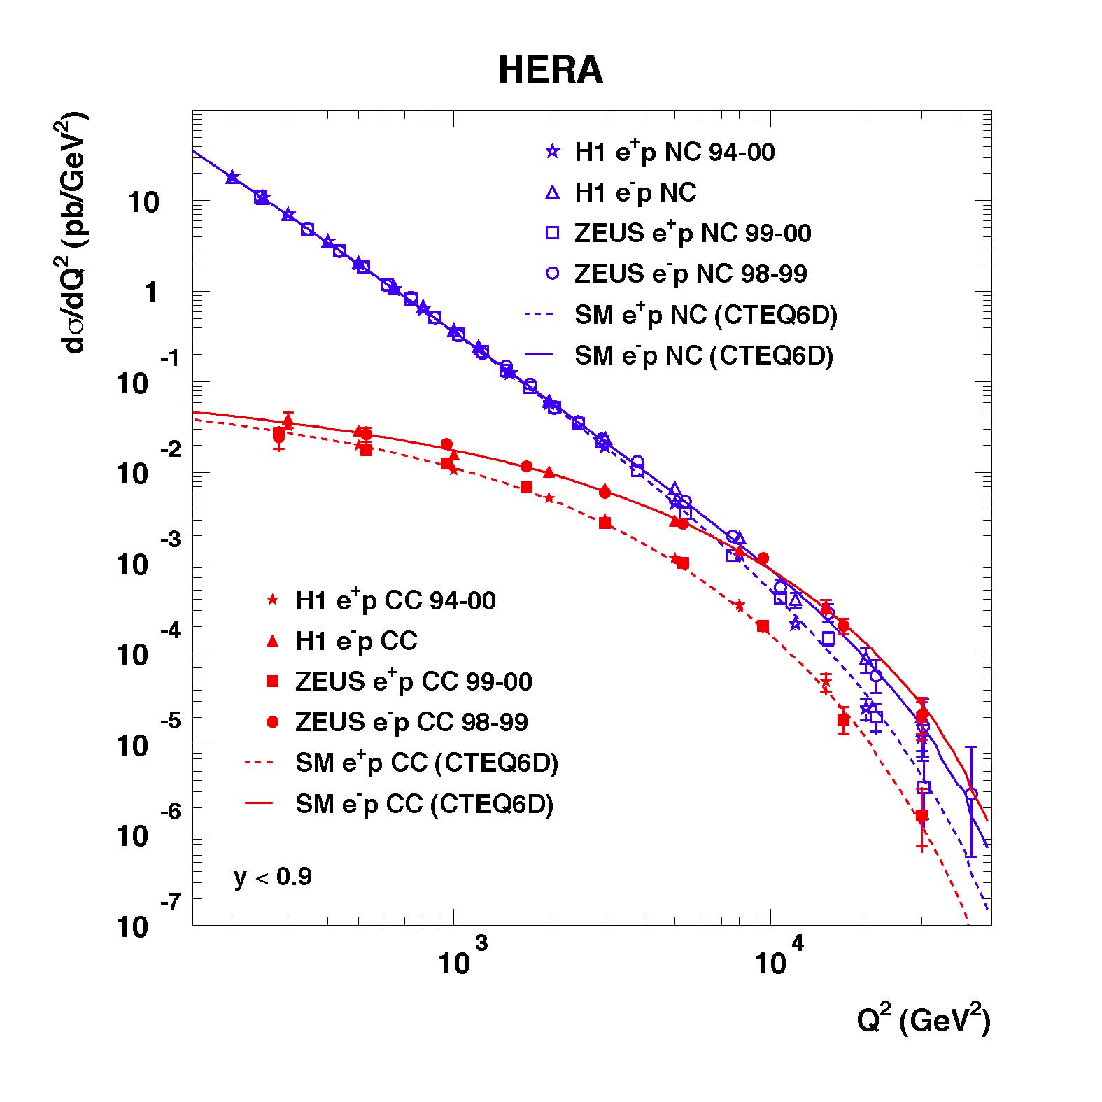
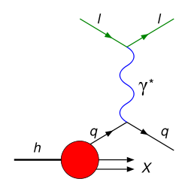
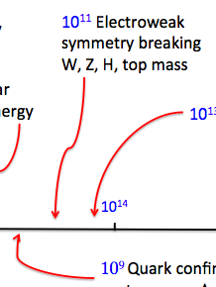
Deep Inelastic Scattering
Notes:
The weak force (isn’t). Reminder of the short-distance physics.

Slide 17
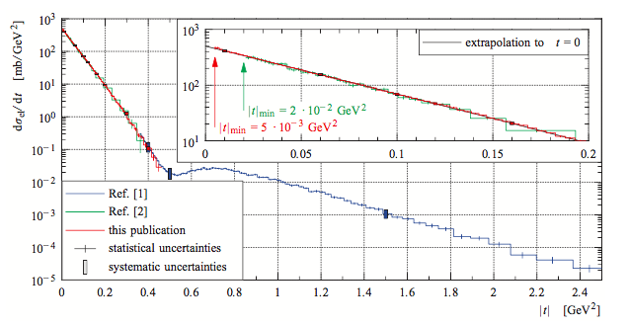
The soft stuff: Diffraction
TOTEM, EPL 101 (2013) no.2, 21002
Notes:
Pomeron exchange: Diffractive peaks

Slide 18
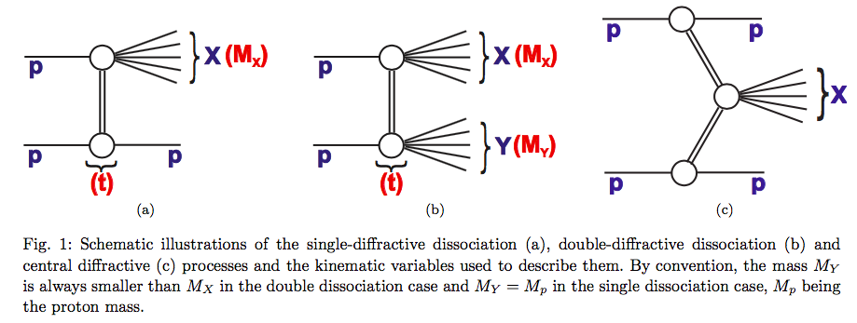
The soft stuff: Diffraction
Notes:
Pomeron exchange: Diffractive peaks

Slide 19
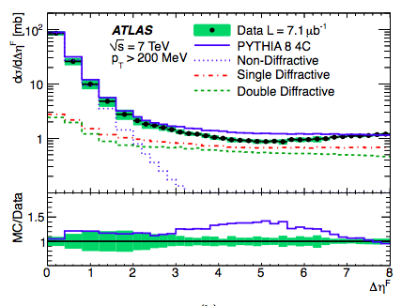
The soft stuff: Diffraction
QCD predicts less radiation when there is color single exchange
  Can we see diffraction emerge from pQCD?
  Hard diffraction, rapidity gaps? More later
Notes:
Pomeron exchange: Diffractive peaks

Slide 20
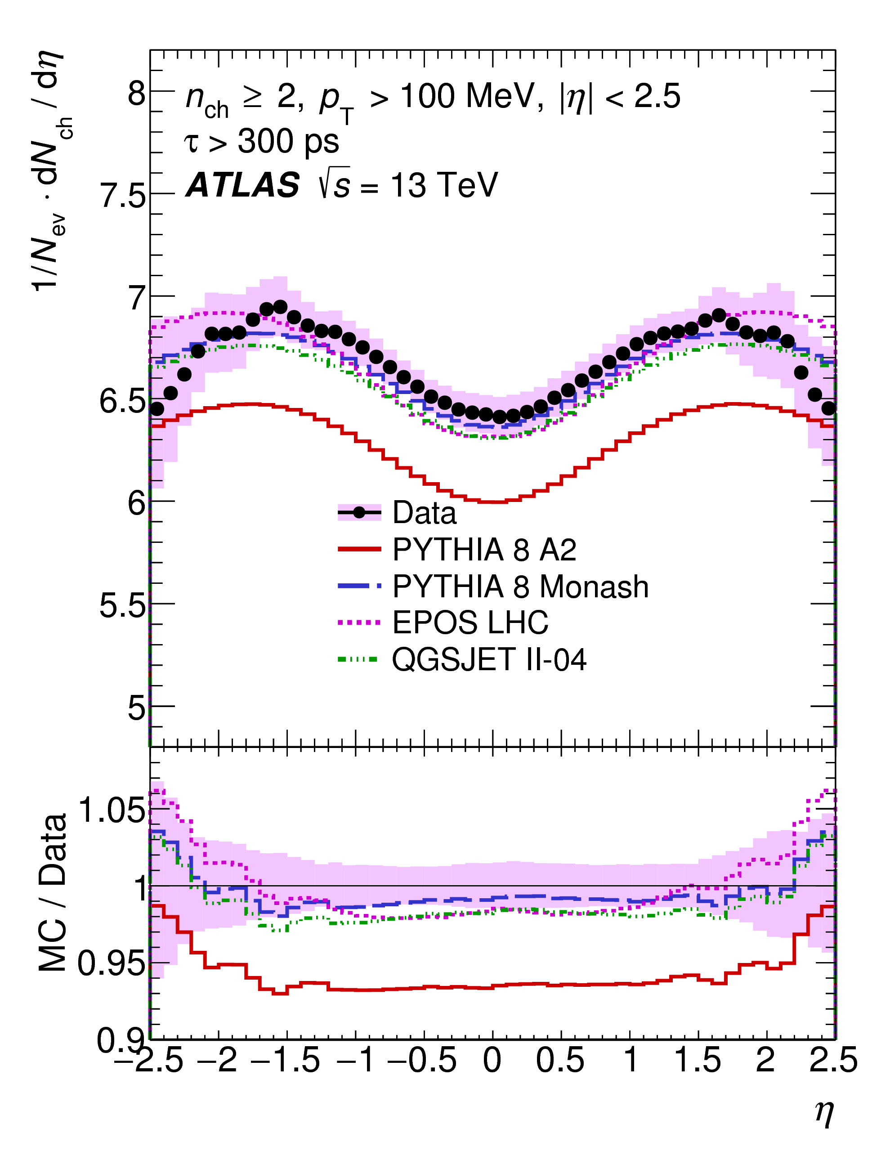
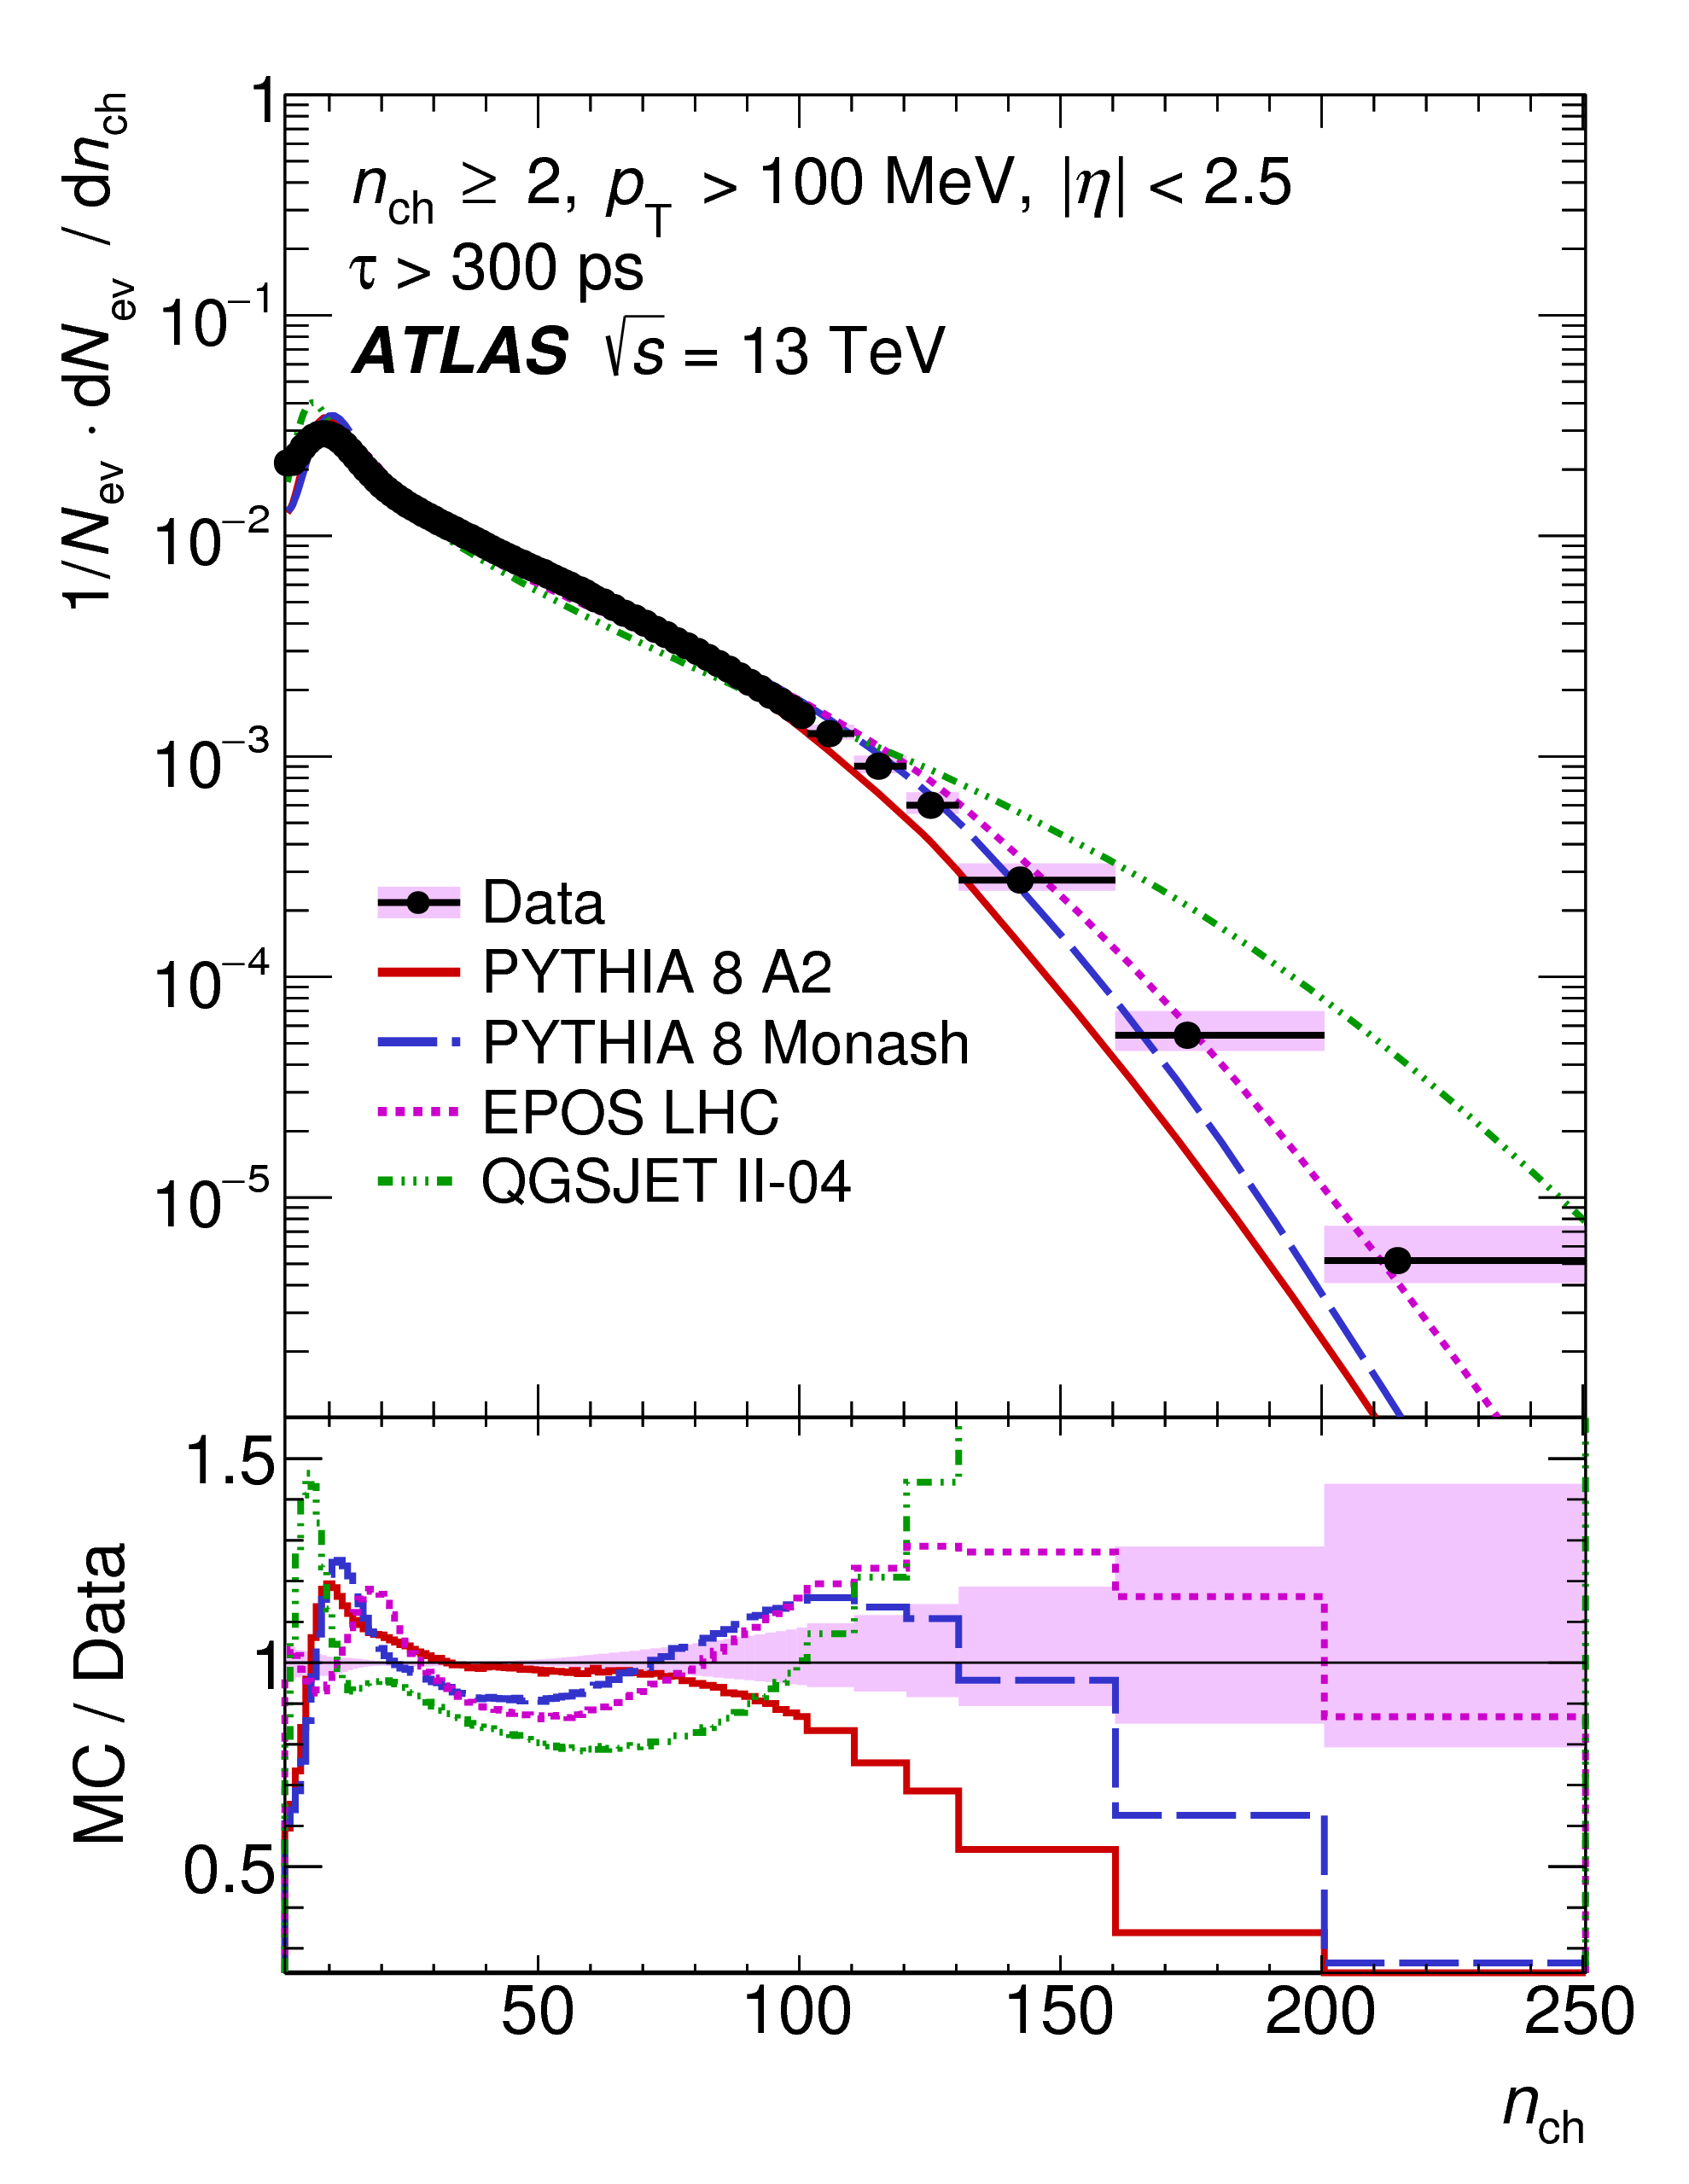
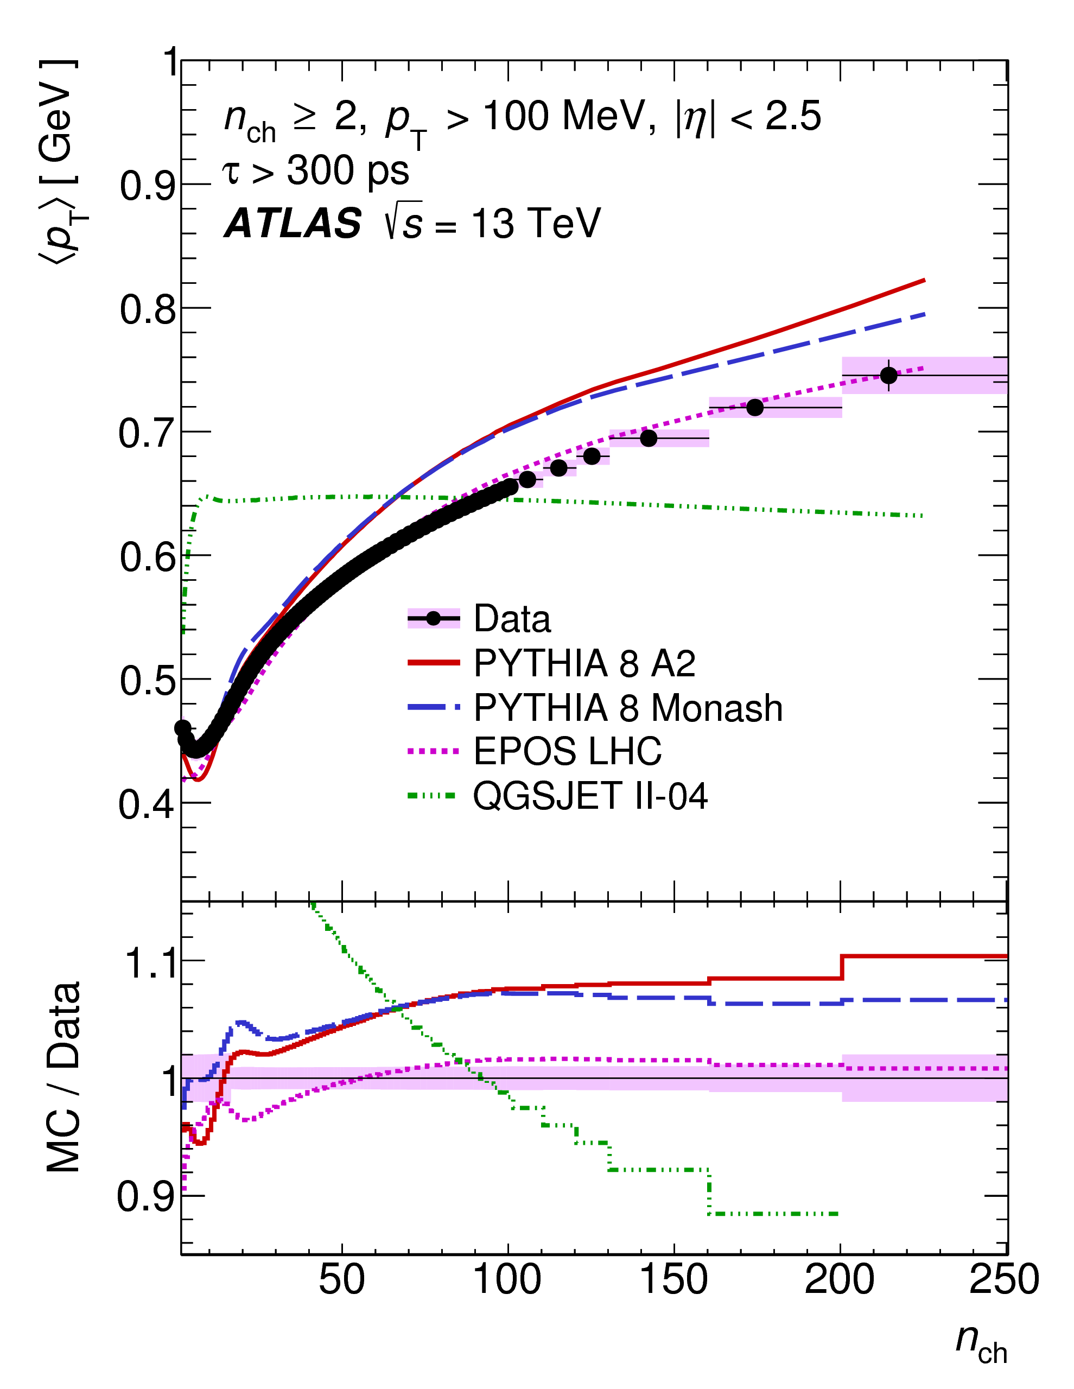
Minimum Bias
arXiv:1606.01133
Notes:
Concept of a fiducial cross section
Needed for pile up

Slide 21
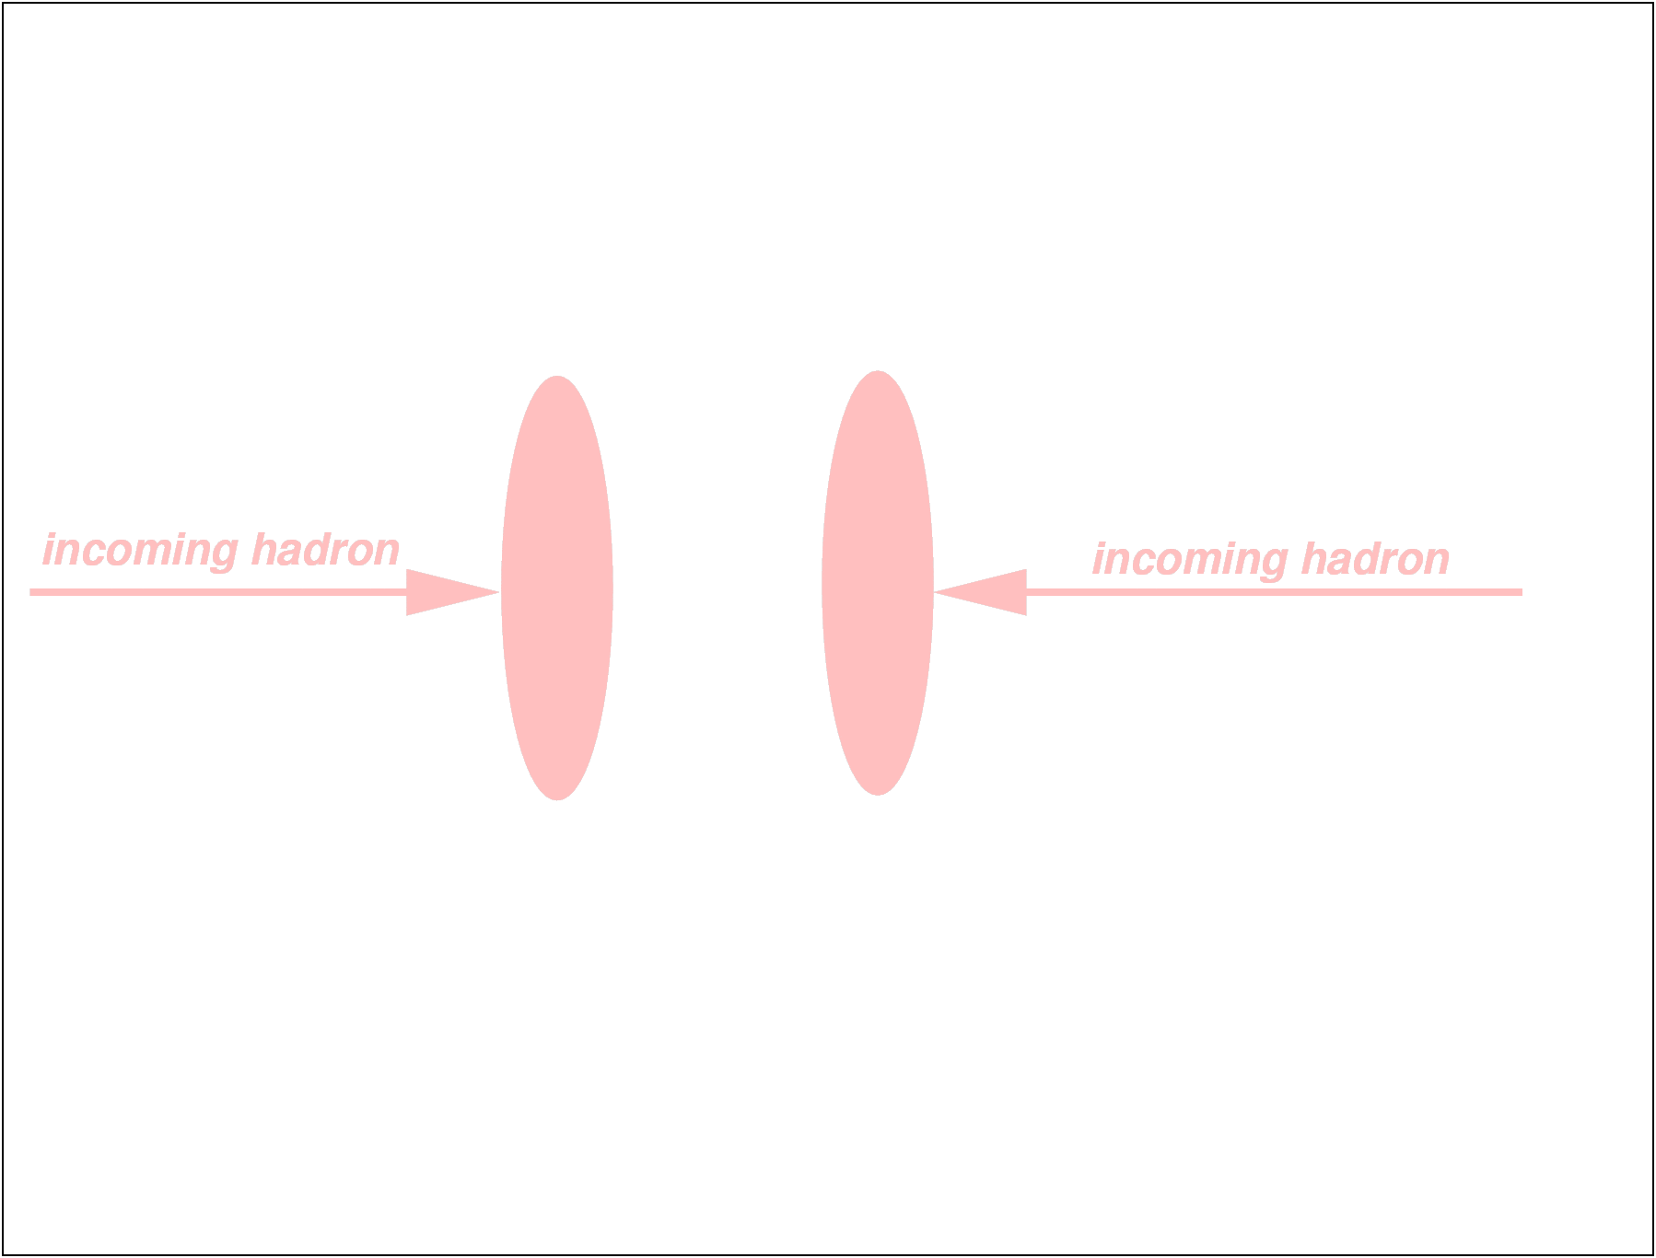
Underlying event
Even in a given observed collision there will be several physical processes taking place in addition to the “interesting” process.

Slide 22
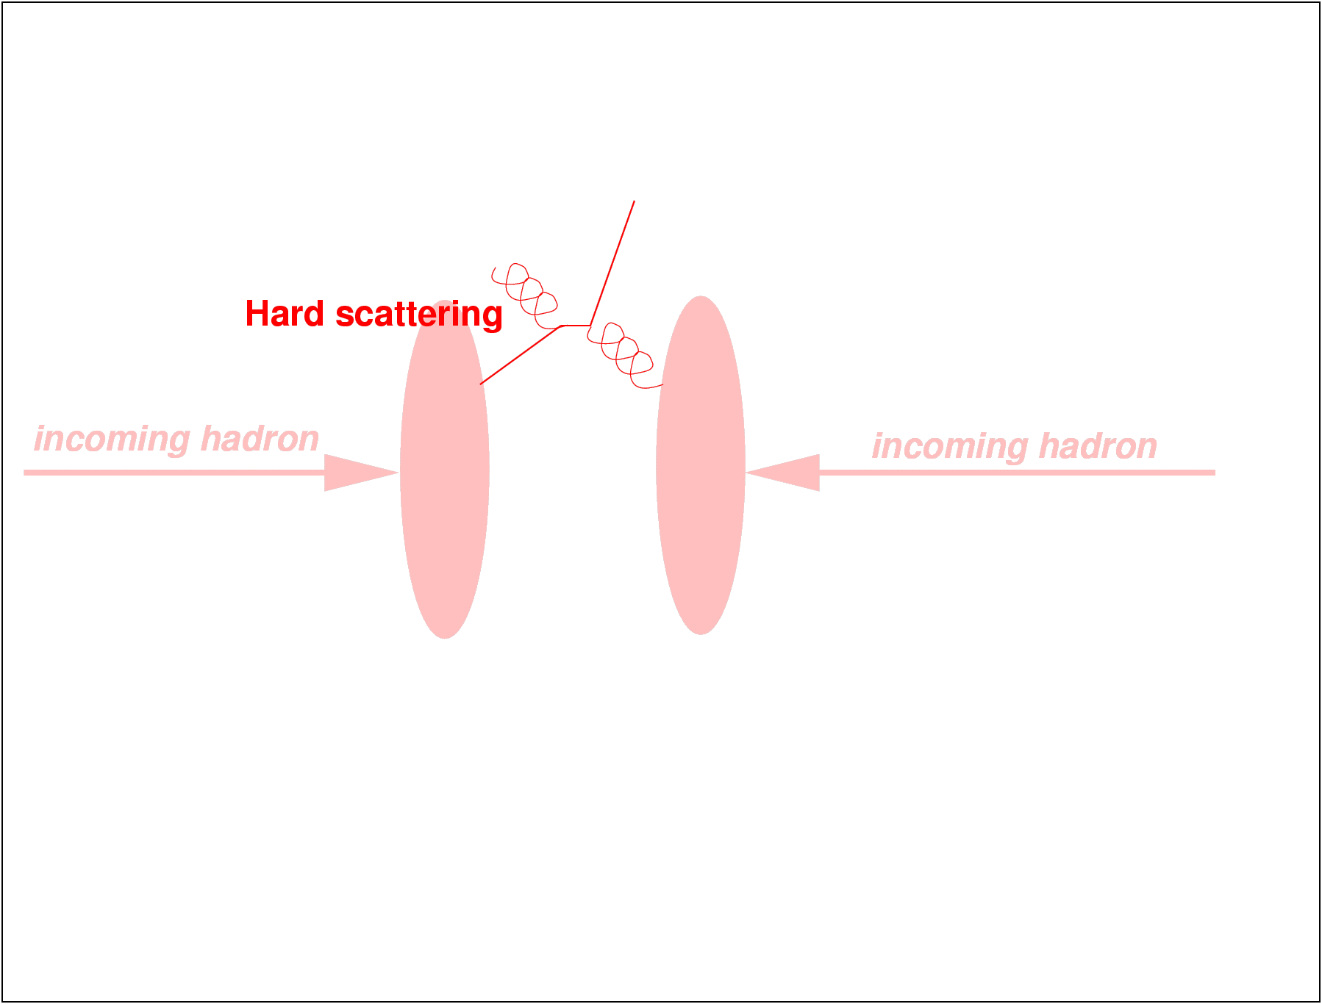
Underlying event

Slide 23
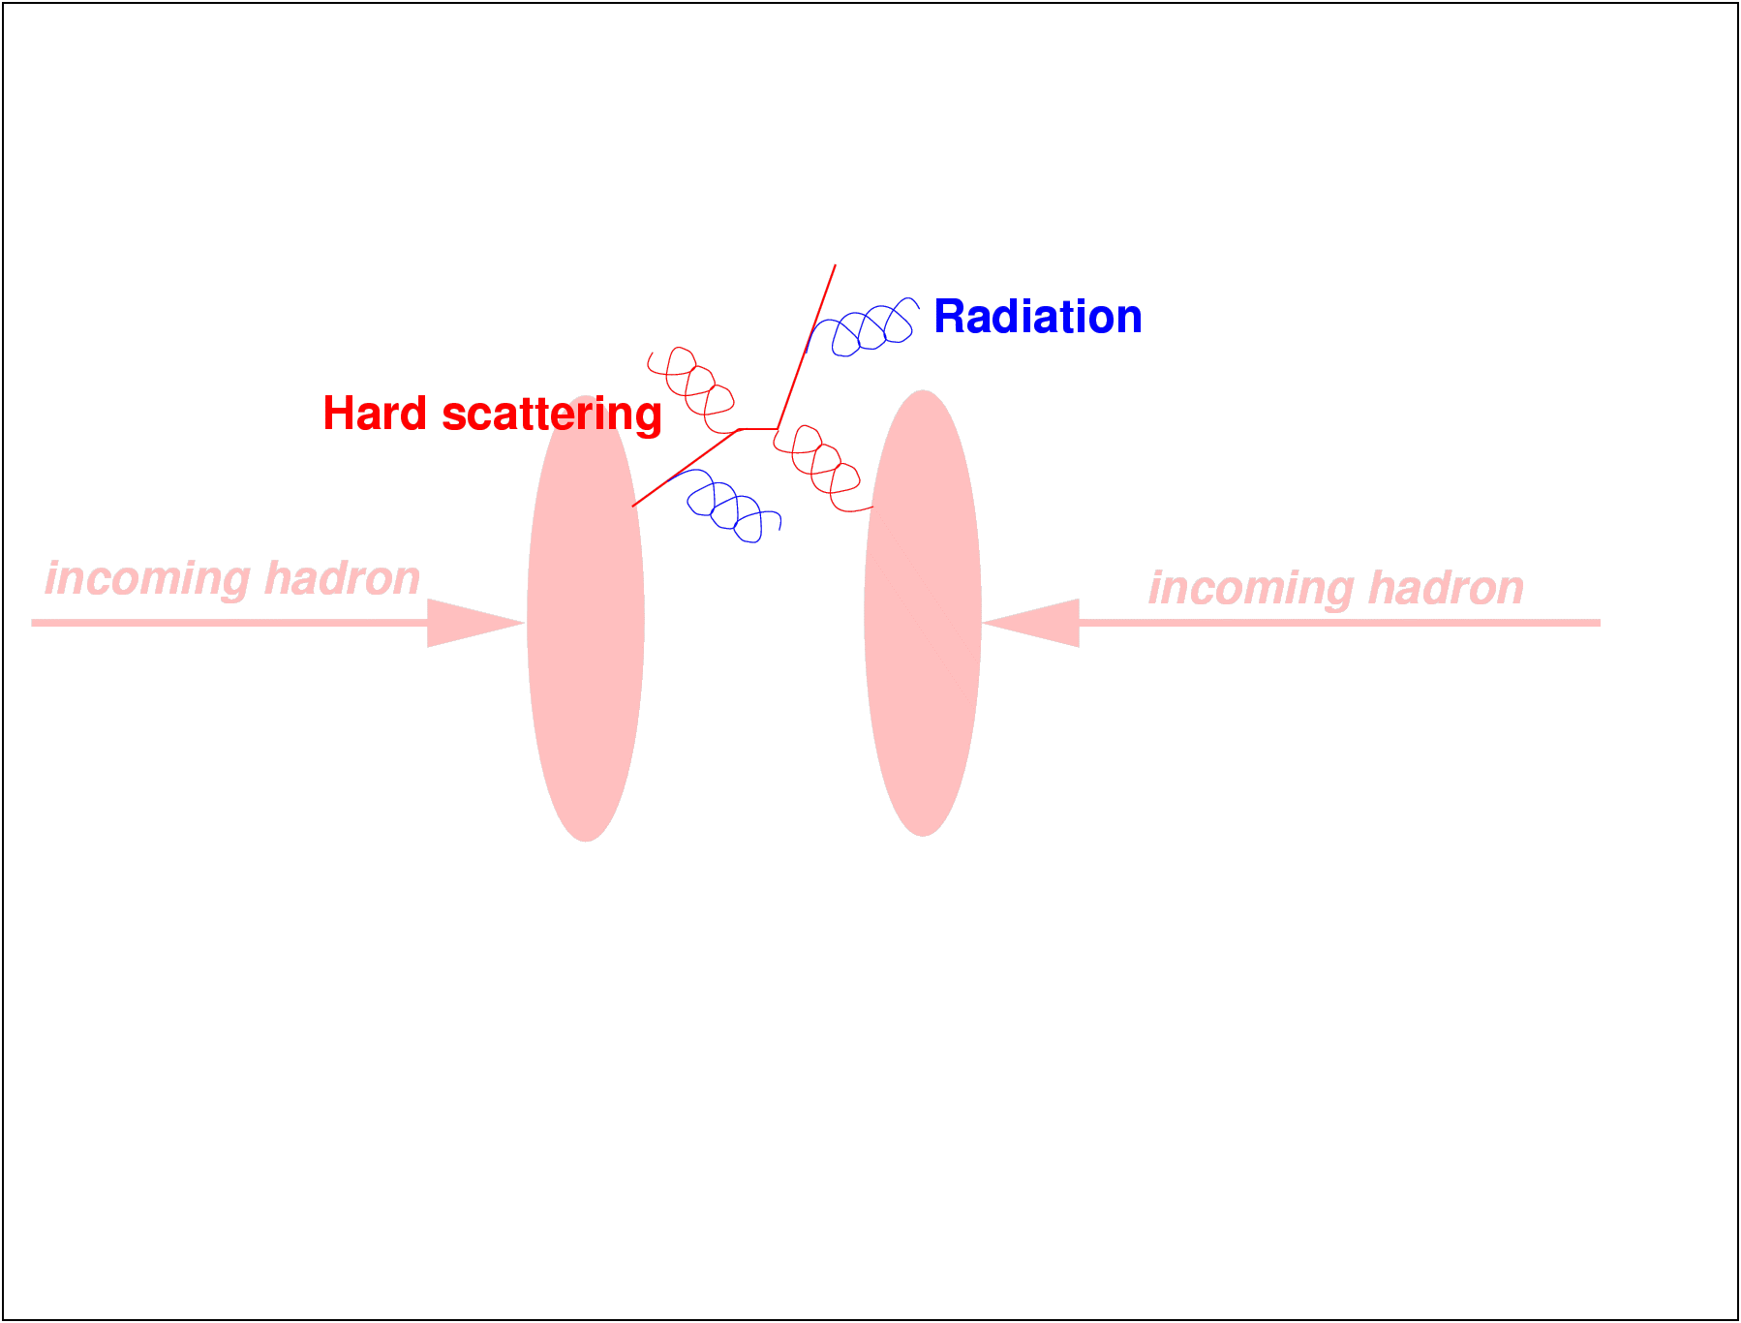
Underlying event

Slide 24

Underlying event

Slide 25
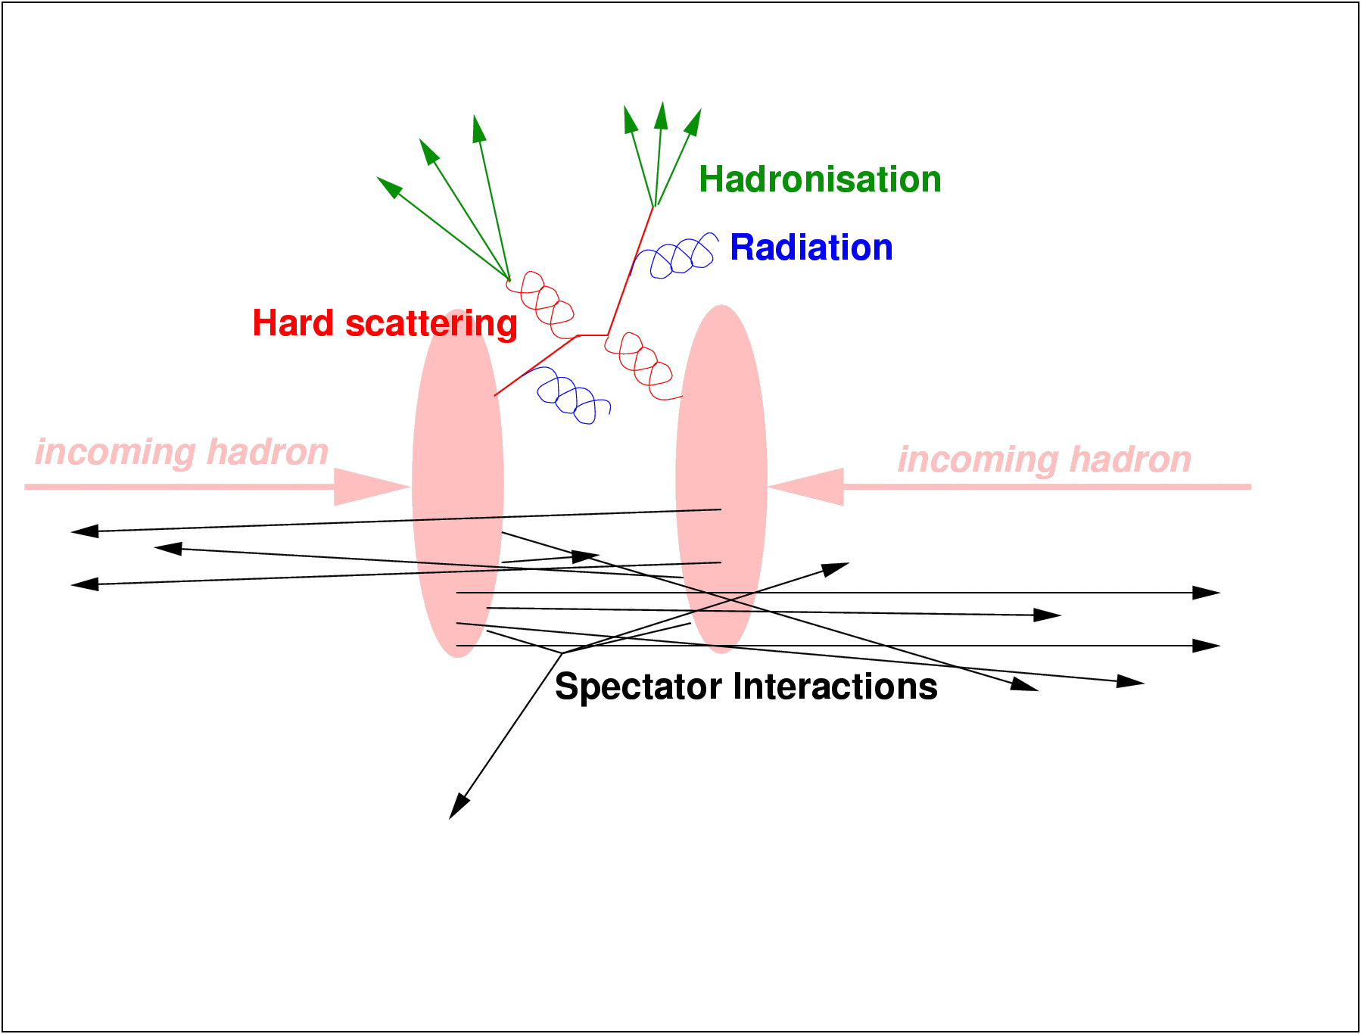
Underlying event

Slide 26
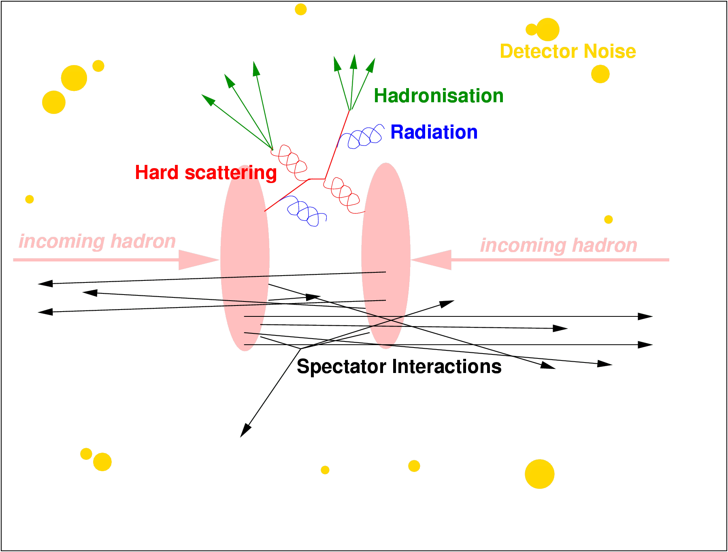
Other activity

Slide 27
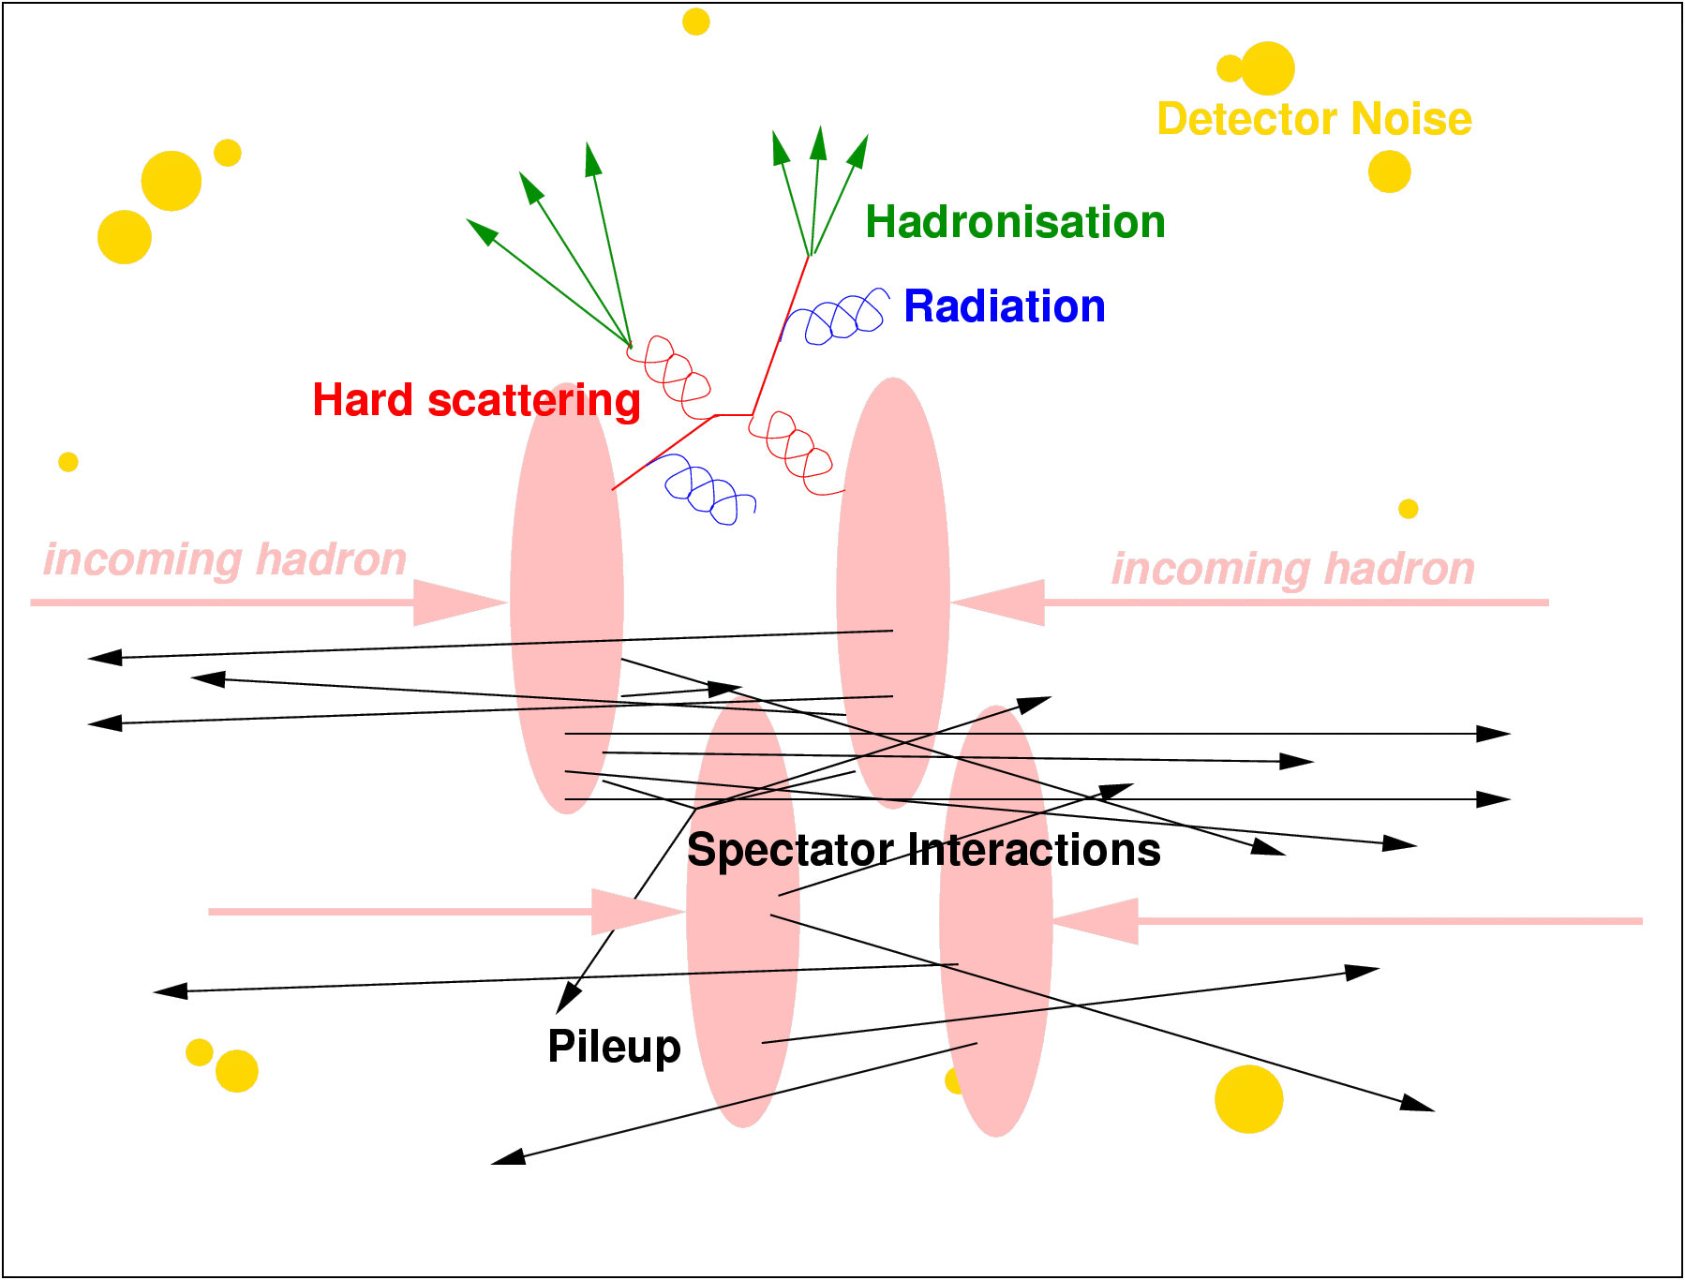
Pile up

Slide 28
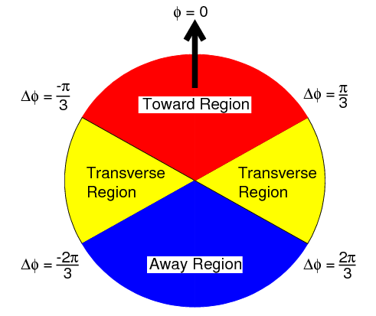
Underlying event measurements
Identify/trigger/selection on a hard process
  Lepton pairs, lepton + missing energy, jets…
Try to identify all products of that hard process
Study the additional activity
arXiv:1711.04299

Slide 29
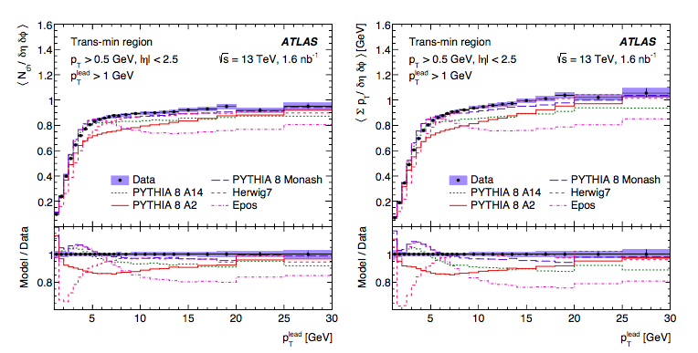
Underlying event measurements
Example: ATLAS charged particle jets
  arXiv:1701.05390

Slide 30
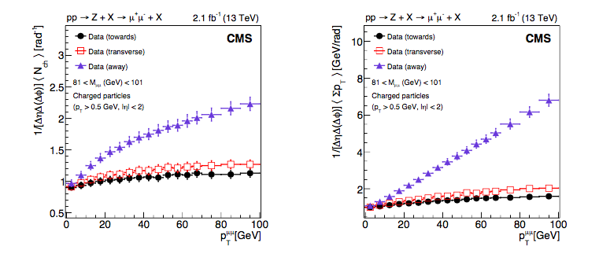
Underlying event measurements
Example: CMS Z → dileptons
  arXiv:1711.04299

Slide 31
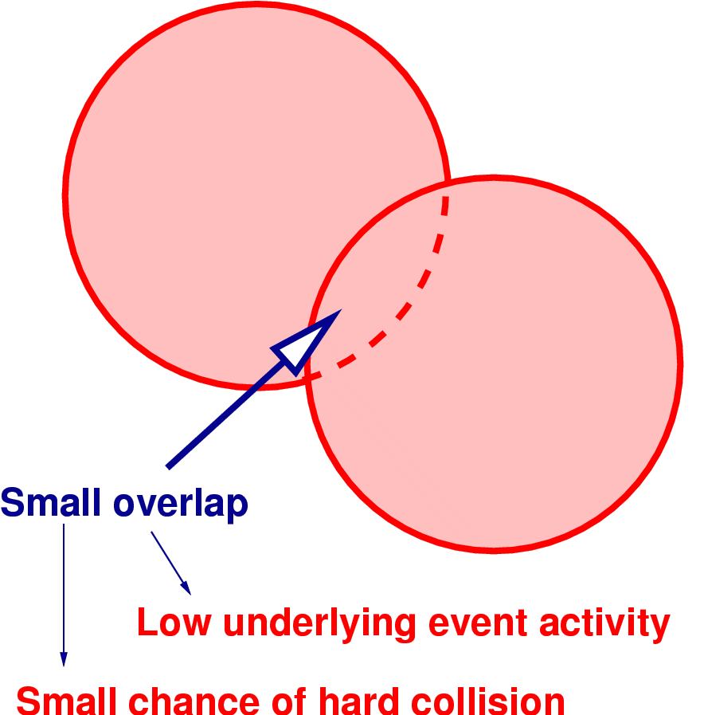
Modelling the Underlying Event

Slide 32
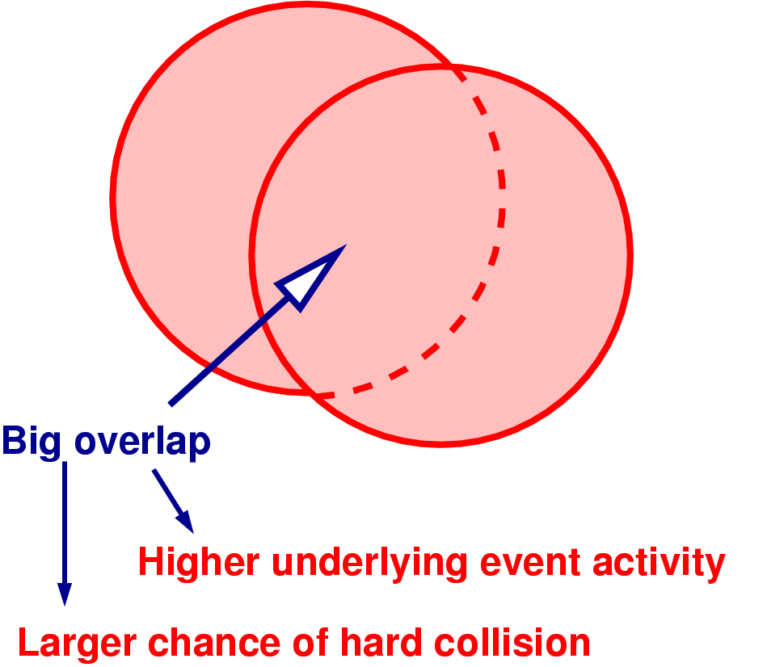
Modelling the Underlying Event

Slide 33
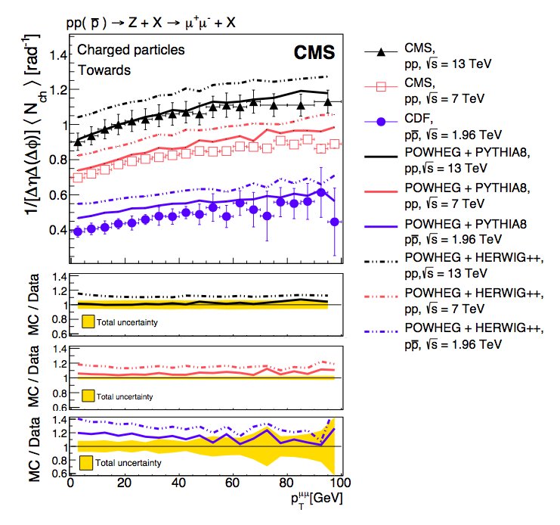
Underlying event measurements
  arXiv:1711.04299

Slide 34
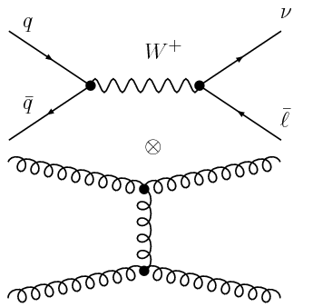
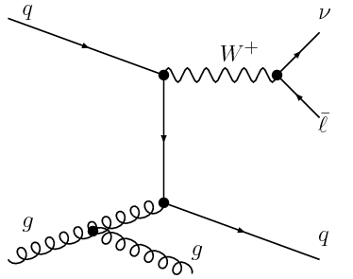

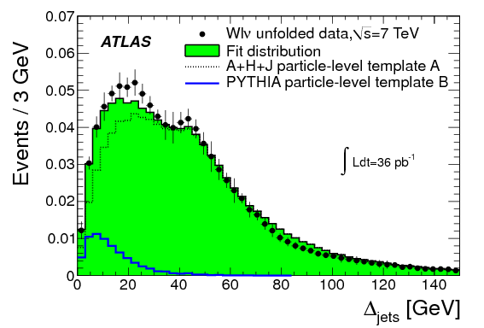
Measuring multiparton scattering
ATLAS: arXiv:1301.6872

Slide 35
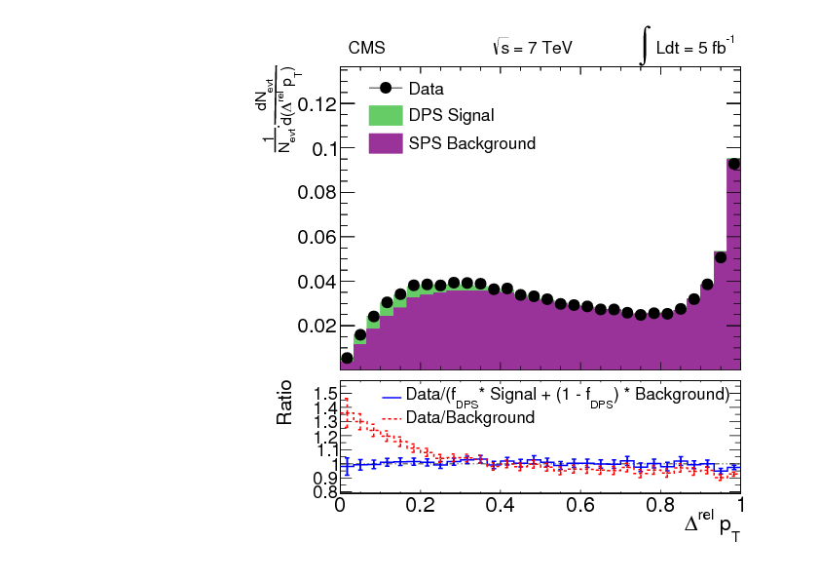
Measuring multiparton scattering
CMS: arXiv:1312.5729

Slide 36
Probably end of first lecture
Some overflow slide follow just in case

Slide 37
Outline
Total cross section and parton densities
The soft stuff
Jet production
Jet substructure
Heavy Flavour production
Measuring the coupling
Quark and gluon matter
Future prospects

Slide 38
So what about jets then?

Slide 39
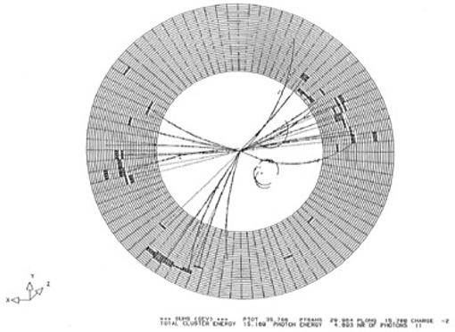
‘Hard’ QCD
When quarks and gluons make a break for it… Jets!

Slide 40
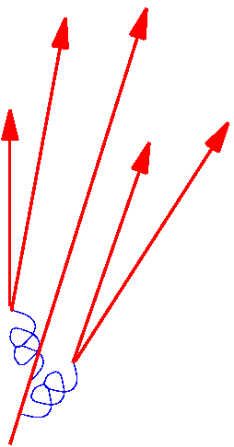
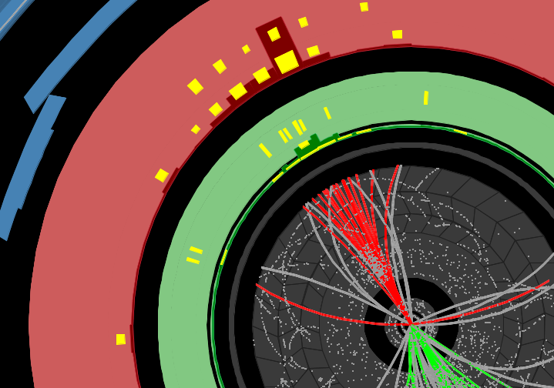
‘Hard’ QCD
When quarks and gluons make a break for it… Jets!

Slide 41
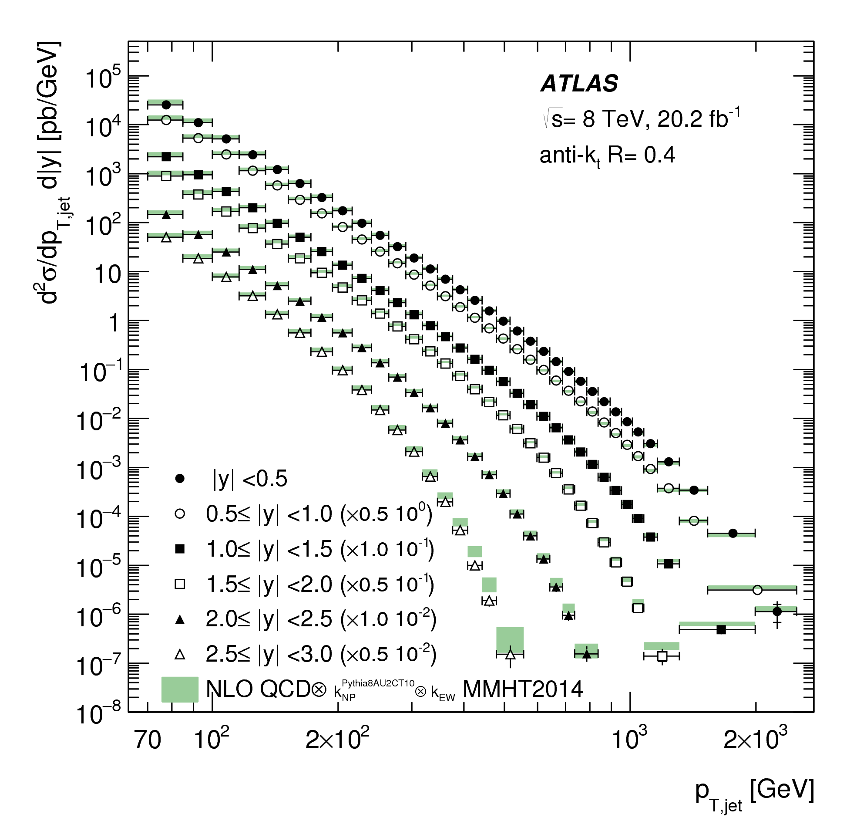
‘Hard’ QCD
When quarks and gluons make a break for it… Jets!
1706.03192

Slide 42
What is a Jet?
Protons are made up of quarks and gluons.
Quarks and gluons are coloured and confined – we only ever see hadrons.
A jet of hadrons is the signature of a quark or gluon in the final state.
The gross properties (energy, momentum) reflect the properties of the quark or gluon, and stand out above the rest of the event.
Jets are defined by an algorithm which can be applied to data and theory so we compare like-with-like.

