Slide 4
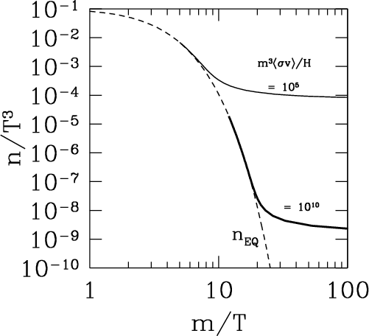
Standard Model of Cosmology: Implications for Particle Physics
Determine the identity of the dark matter
Weakly Interacting Massive Particles (WIMPs) led to a well-defined 3-pronged program.

