Slide 1
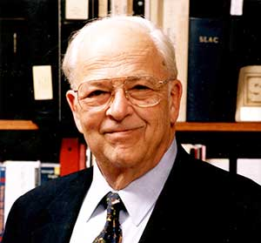
The View Ahead
The Standard Model @ 50: Successes and Challenges
2018 SLAC Summer Institute, dedicated to
Burt Richter (March 22, 1931 – July 18, 2018)
Young-Kee Kim
The University of Chicago

Slide 2

The Standard Model of Particle Physics
Most of us have grown up with the Standard Model’s orderly account of
the fundamental particles and interactions

Slide 3
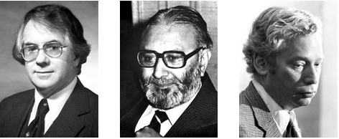
Now is the 50th birthday of the Standard Model
“Glashow-Weinberg-Salam Model”, “Weinberg-Salam Model”
(Core of the Standard Model)
Glashow Salam Weinberg
(paper 1968) (paper 1967)
1979 Nobel Prize in Physics
"for their contributions to the theory of the unified weak and electromagnetic interaction between elementary particles, including, inter alia, the prediction of the weak neutral current".

Slide 4
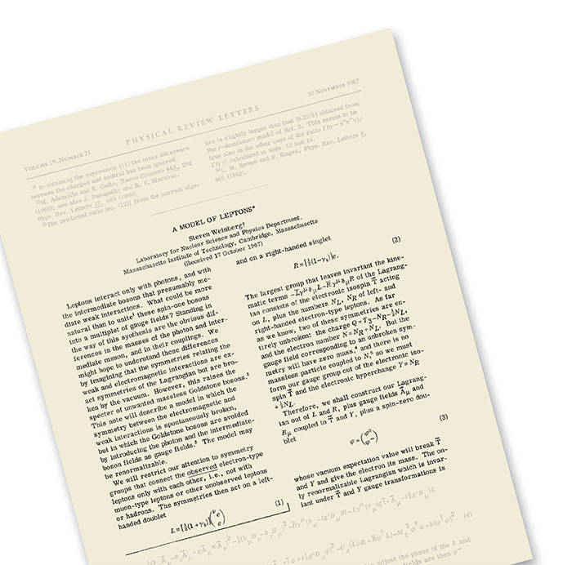
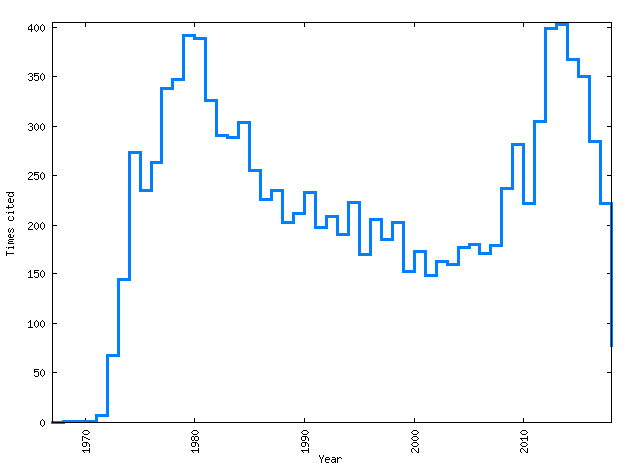
“A Model of Leptons”
# of citations per year !!
1967 2018
Nov. 1967 Weinberg’s iconic paper
“A Model of Leptons”
Notes:
This paper determined the direction for particle physics research from then on. This paper lies at the core of the Standard Model, our most complete theory of how particles interact in our universe. Just 2 pages long. Weinberg’s elegant and simply written theory was revolutionary at the time.

Slide 5
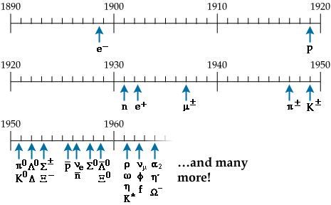
Experimental Preludes
Particles discovered:
Cosmic rays
Produced by accelerators
.
Parity (P) violation (1957)
CP-violation in Kaon (1964)

Slide 6
Experimental Preludes

Slide 7

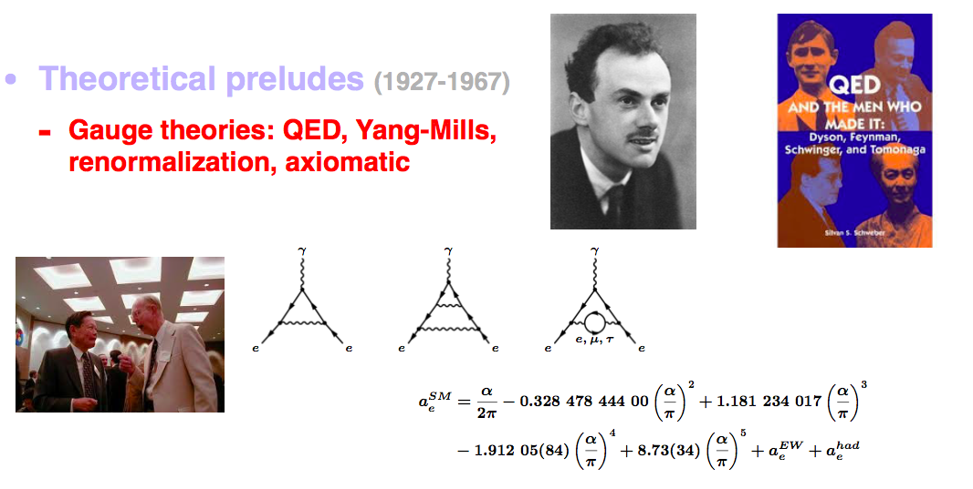
Theoretical Preludes
Quantum electrodynamics (QED) well established
Yang-Mills theory
extension of QED to provide an explanation of strong interactions

Slide 8
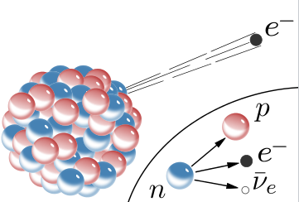
Theoretical Preludes
No mature theories of the strong and weak interactions
Weak force:
Fermi Theory
V-A Theory
Cabbibo angle

Slide 9
Theoretical Preludes
No mature theories of the strong and weak interactions
The weak force exhibits some common features with QED.
It might be mediated by a vector boson (W) analogous to the photon (γ).
The W boson would have to be very massive empirically
The mathematical symmetry of the theory required massless W like γ.

Slide 10
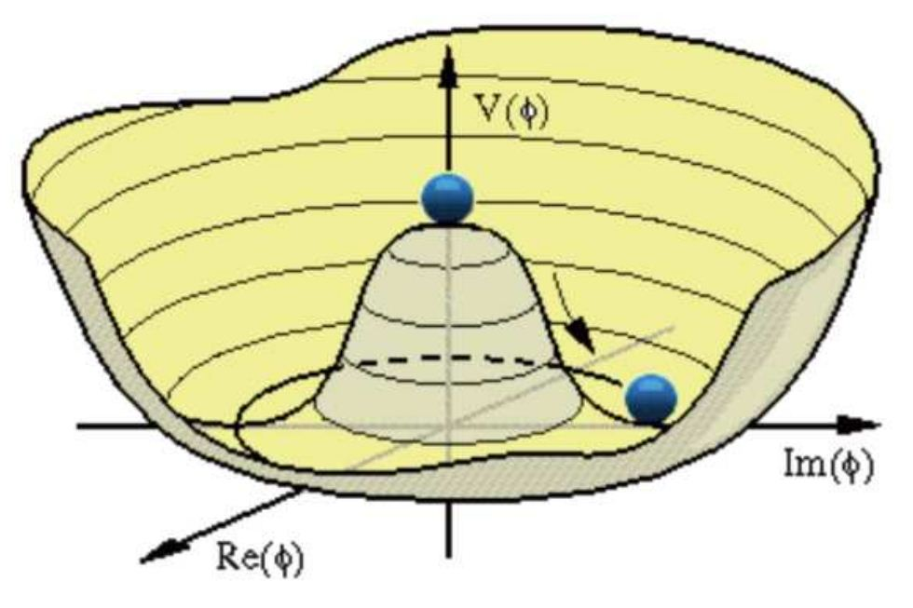
Theoretical Preludes
Idea of spontaneously broken symmetry (1960)
(Higgs mechanism)
Demonstration of vector bosons becoming massive without spoiling the fundamental gauge symmetry (1964)
Strong interactions in mind
(protons, neutrons, pions and ρ-mesons)
Notes:
(1960) Goldstone and Nambu
Superficially these rho-mesons had the hallmarks of being the gauge bosons of the strong interactions, but they also have mass.
Higgs mechanism: Brout, Englert, Higgs, Kibble, Guralnik, and Hagen

Slide 11
Weinberg and Salam
Applying the idea to leptons (electron and neutrino)
Massless photon (electromagnetic interactions)
Hypothetical massive W boson (weak interactions)

Slide 12
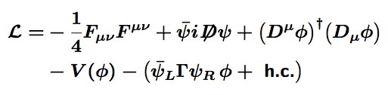
Glashow-Weinberg-Salam Model
Unified electromagnetic and weak interactions

Slide 13
Glashow-Weinberg-Salam Model
Despite their present fame,
at the time of their publication the papers went largely unnoticed
until 1971 when it was proven to be renormalizable
Weinberg’s paper: # of citations per year
1967 2018
1971
Neutral Current (1973) )
Higgs Discovery (2012)
Weak – EM Interference (1978)
Notes:
Charlie Prescott in 1978
direct demonstration of interference between the weak and electromagnetic interaction by the observation of a small parity violation in inelastic scattering of polarized electrons on deuterons. This result confirmed convincingly the unification of the weak and electro-magnetic interactions as embodied in the new standard electroweak theory.

Slide 14
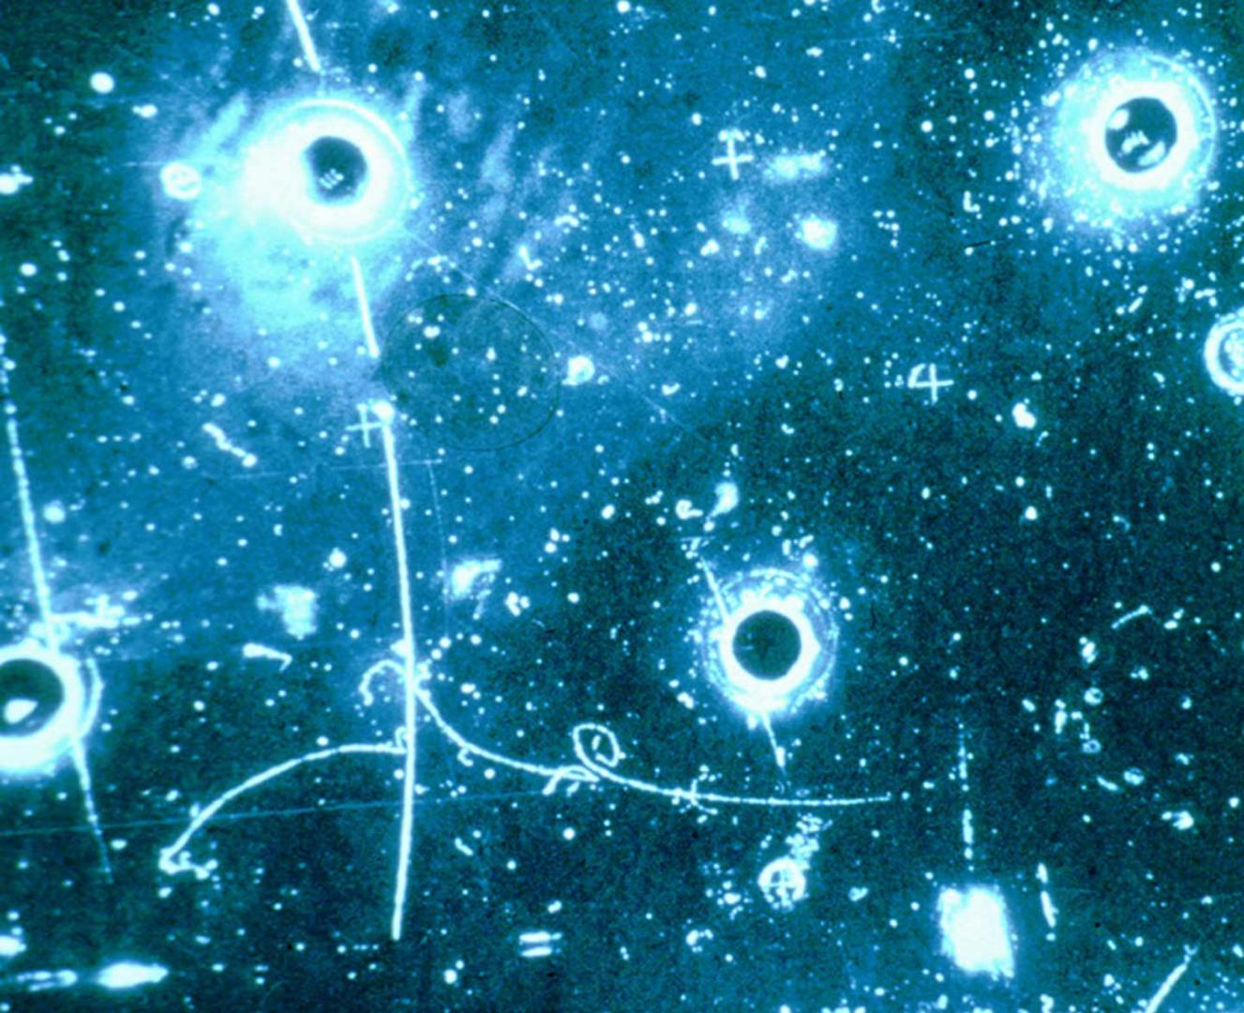

Standard Model @ 50: Successes
Late 1960s: Solar neutrino deficit
1968: Direct proof of the quark model (ep scattering experiments revealed the structure of the proton as a bound state of quarks)
1973: Discovery of neutral currents (weak interactions). The first example of a single-electron neutral current
ν_{μ}
2001: Discovery of neutrino oscillation :1998
2000: Discovery of CP violation in B
1973: 3 generation quark mixing matrix and CP violation in SM (theory)

Slide 15
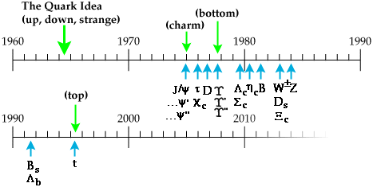
Standard Model @ 50: Successes
b
c
q
g
ν_{τ}
H
Quantum chromodynamics (QCD) was established
as the theory of the strong interactions

Slide 16
Standard Model @ 50: Successes
Top quark
Higgs boson
hydrogen atom mass
Z
Spin 0 Boson
W
gluons
b
.
τ
ν_{τ}
.
c
c
Spin ½ Fermions
Spin 1 Bosons

Slide 17
The Standard Model
Combines strong and unified electroweak interactions

Slide 18
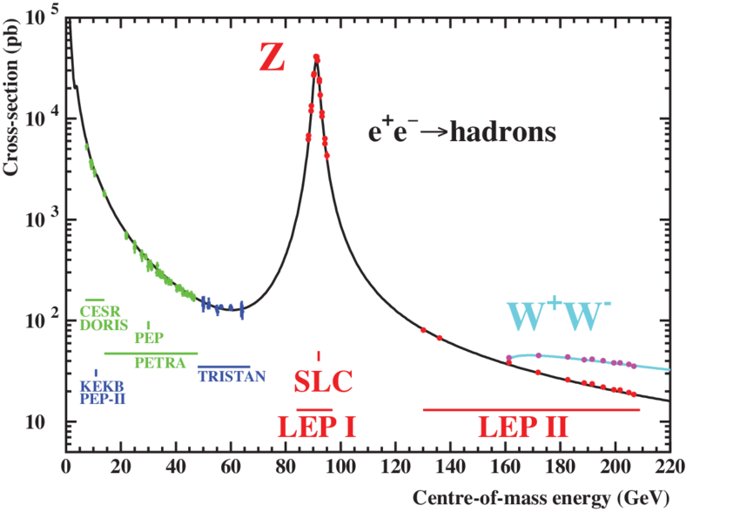
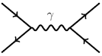
Standard Model @ 50: Successes
Electroweak measurements & theoretical calculations (e⁺e⁻ colliders)
(1974 – 2000)
γ
e
e
q
q
γ
e⁺e⁻ cross section (pb)
γ + Z
Interference
+
e
e
q
q
Z
e⁺e⁻ center-of-mass energy (GeV)

Slide 19
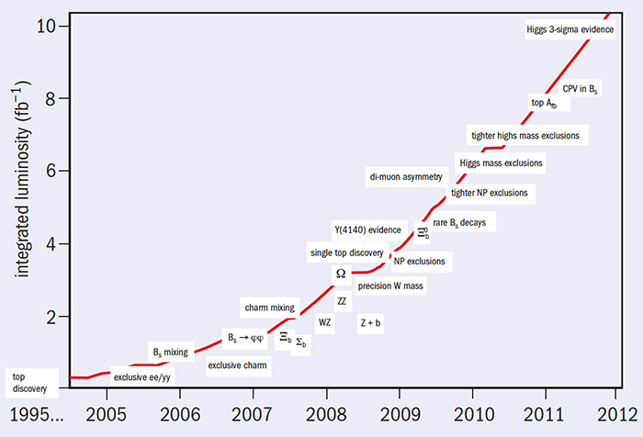
Standard Model @ 50: Successes
_
Tevatron pp collider at 2 TeV LHC pp collider at 13 TeV
A wide range of measurements: SM predictions have been essentially spot on.
A tribute to a large amount of work done by experimentalists and theorists.

Slide 20
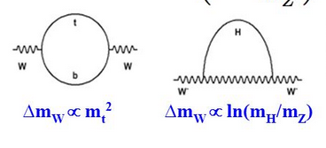
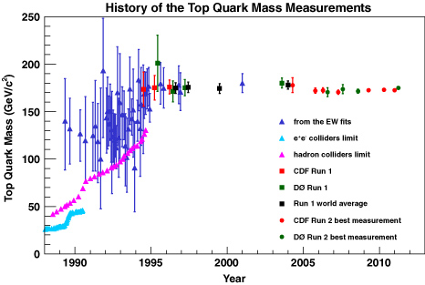
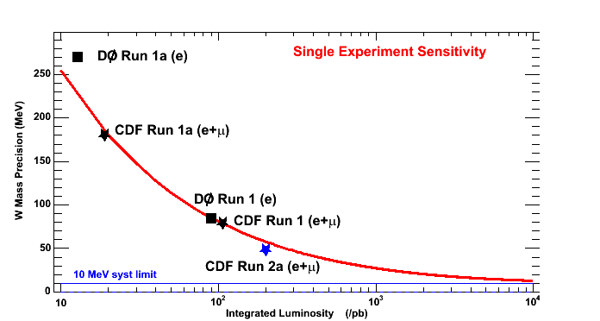
Standard Model @ 50: Successes
Prediction of top mass in the Standard Model
EWK precision measurements (Tevatron, LEP, SLC ..) + radiative corrections (theory)
SM
New physics
Top
X
W
W
W
W
Top mass predictions (SM)
Top mass meas.s (0.3%)
CDF/Dzero
at Tevatron
Progress in Δm_{W}
W mass precision (MeV)
Integrated luminosity (pb⁻¹)
Δm_{W} /m_{W} = 0.02%
Discovery of top quark

Slide 21
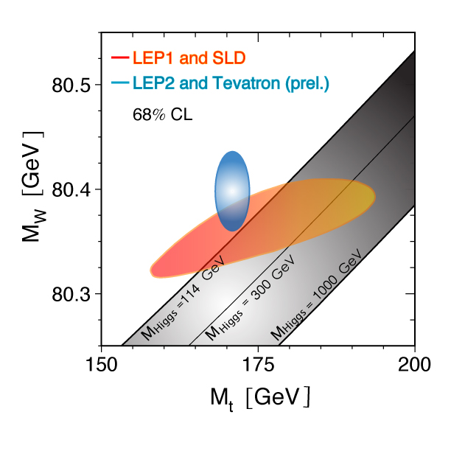
Standard Model @ 50: Successes
Prediction of Higgs mass in the SM
M_{W} and M_{top} precision measurements
Radiative corrections
SM
New physics
X

Slide 22
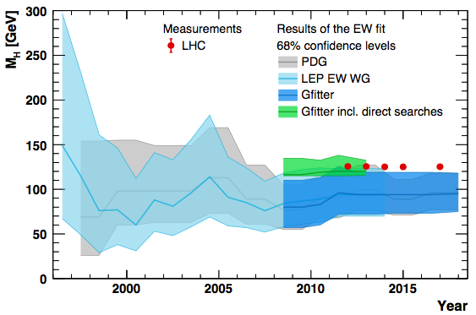
Standard Model @ 50: Successes
arXiv: 1803.01853
Direct Higgs mass meas.s (0.2%)
Prediction of Higgs mass
m_{W} and m_{top}
Discovery of Higgs boson

Slide 23
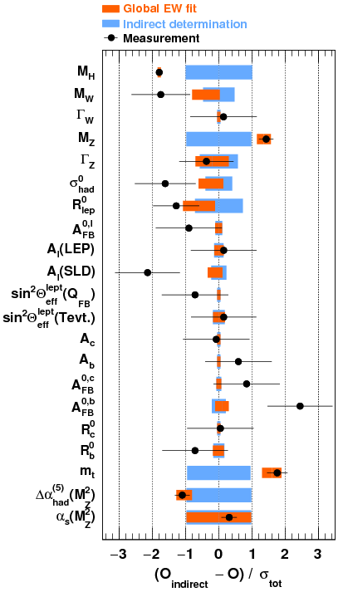
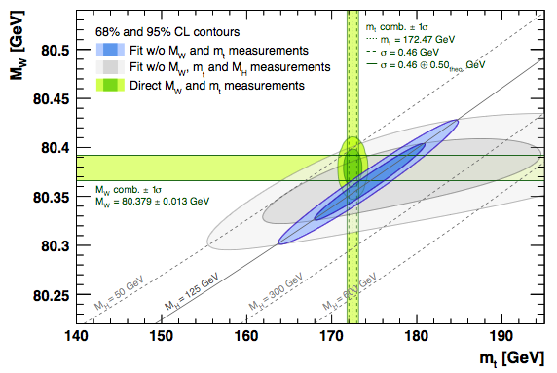
Standard Model @ 50: Successes
arXiv:1803.01853
arXiv:1803.01853
~20 years of precision measurements: quantitatively test the consistency of SM radiative corrections
Higgs redefines needs and precision targets (e.g. m_{W})

Slide 24
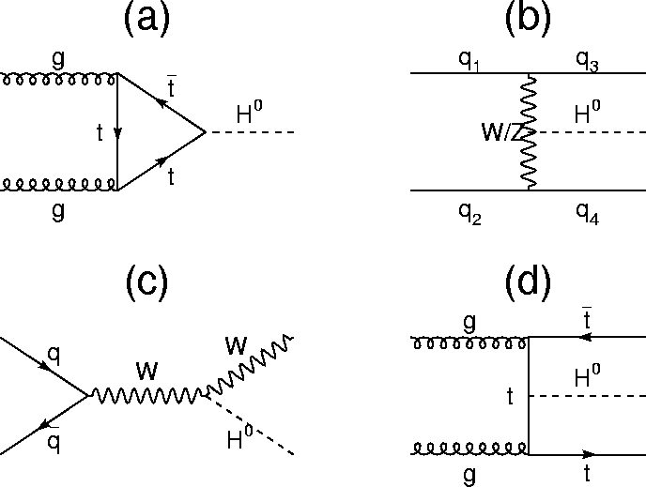
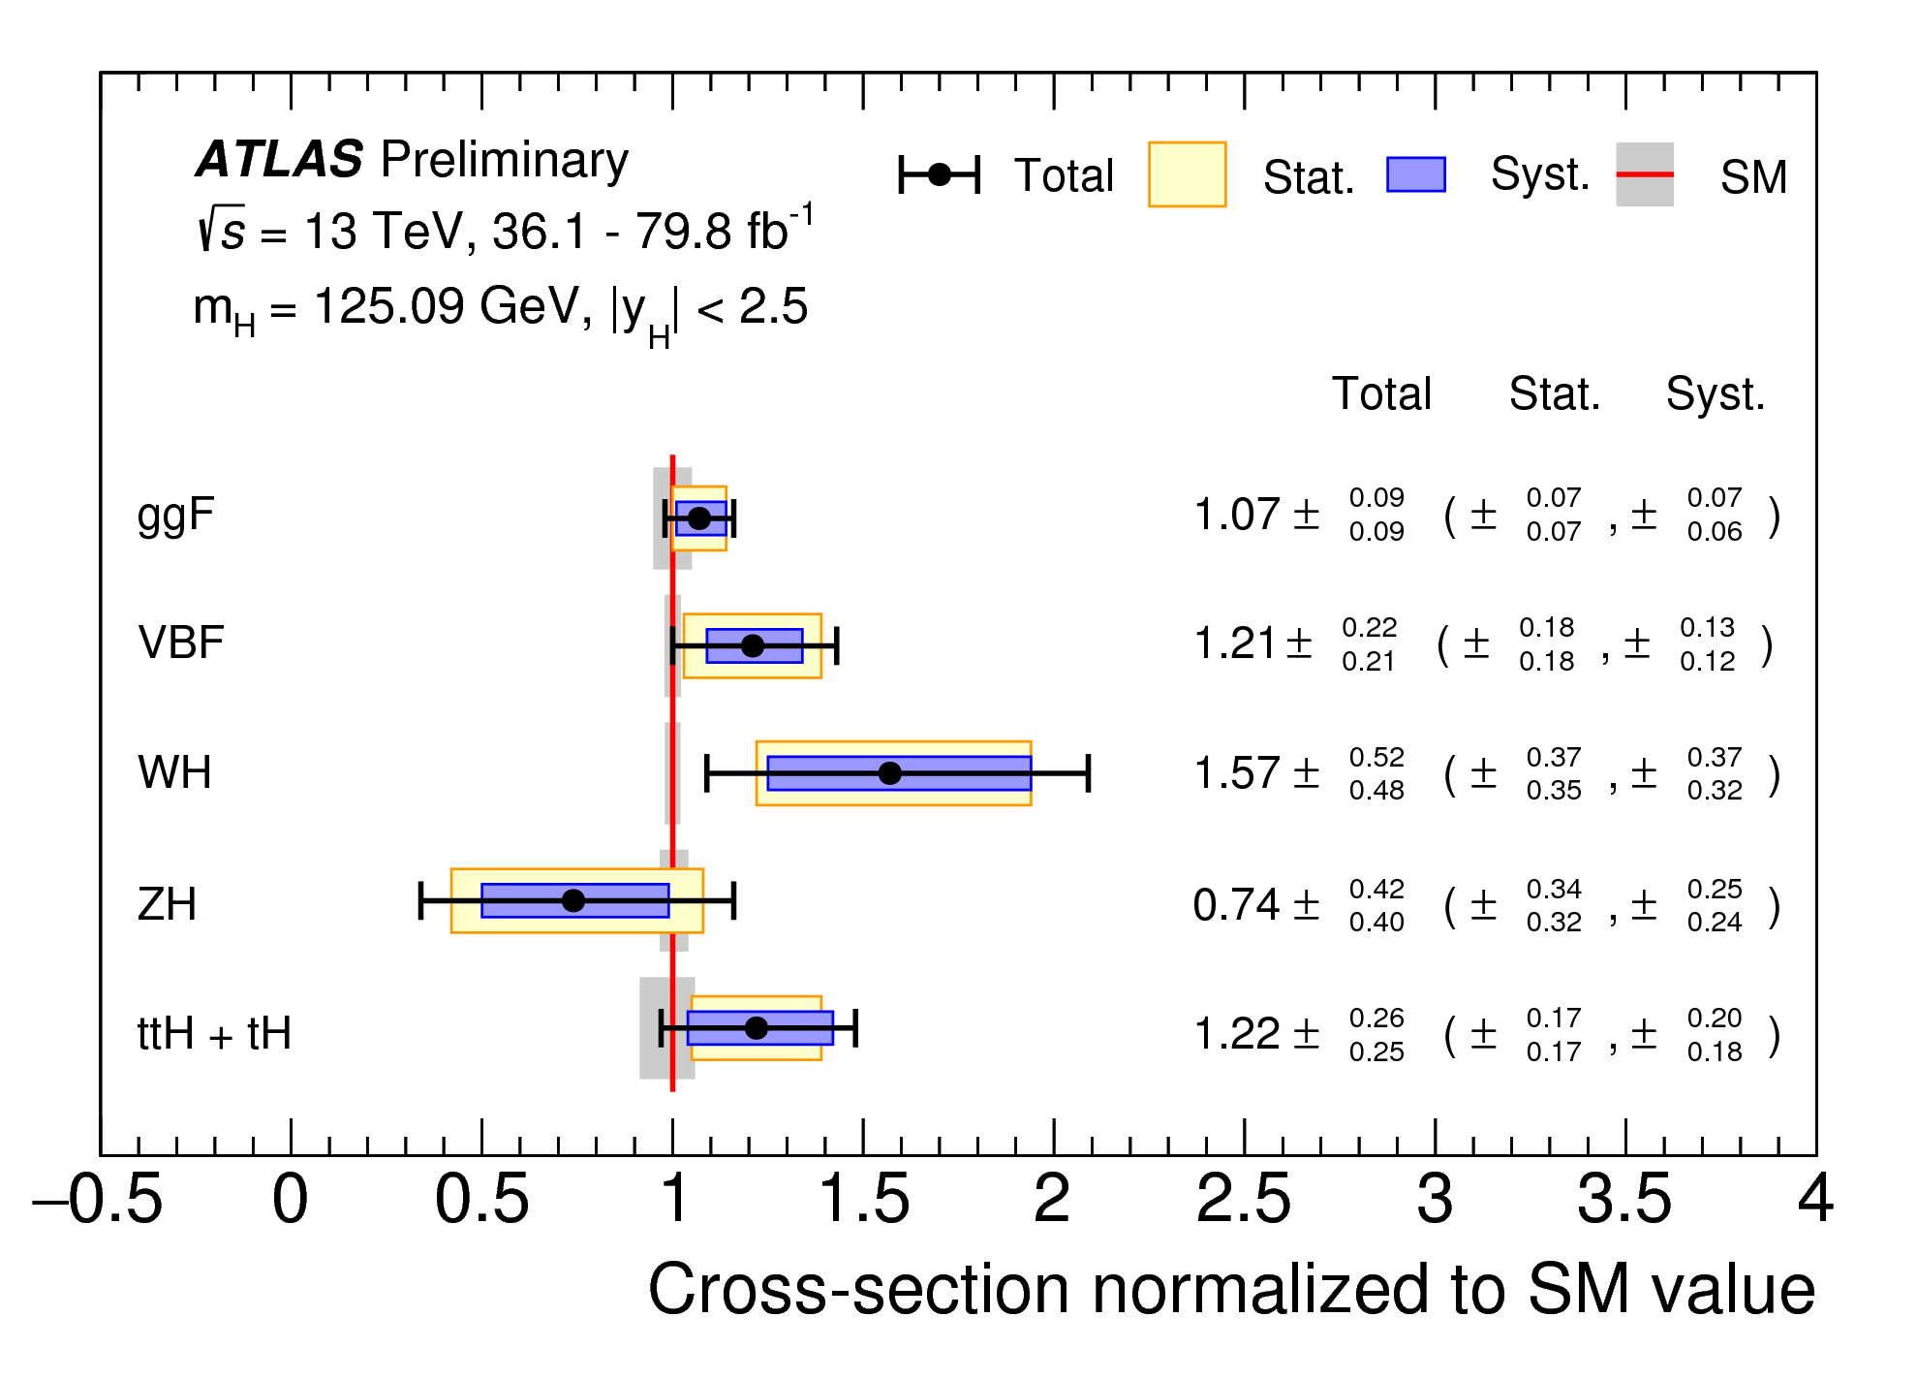
Standard Model @ 50: Successes
Higgs production: any deviation from the Standard Model → new physics models
SM prediction
Observed all major Higgs production modes! Consistent with SM.

Slide 25
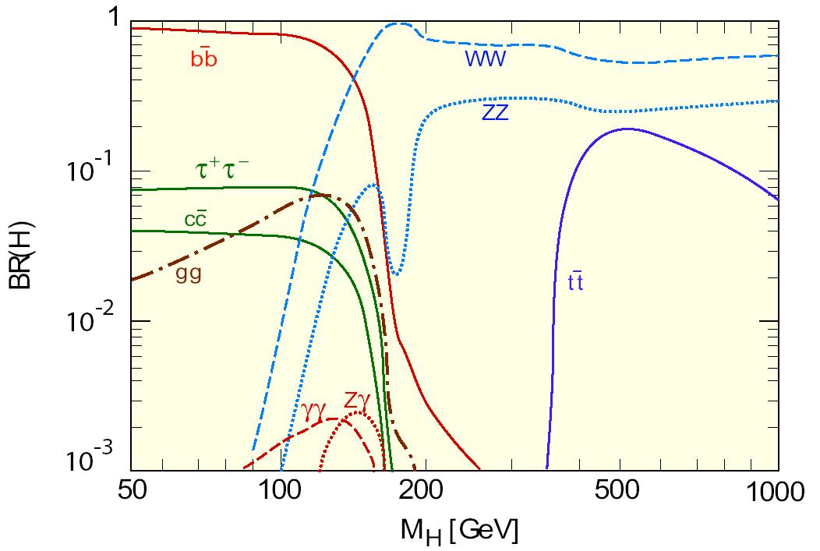
Standard Model @ 50: Successes
Higgs decays: any deviation from the Standard Model → new physics models
SM Branching ratios
μ τ b W Z t
M_{Higgs} = 125 GeV
All couplings to high mass particles measured. Next challenge: muon, charm, ...

Slide 26
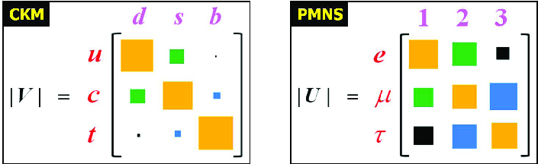
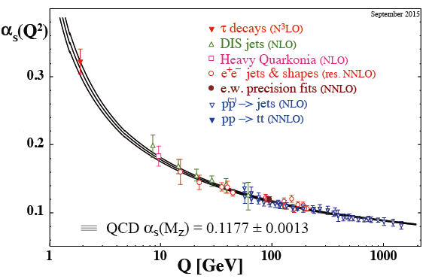
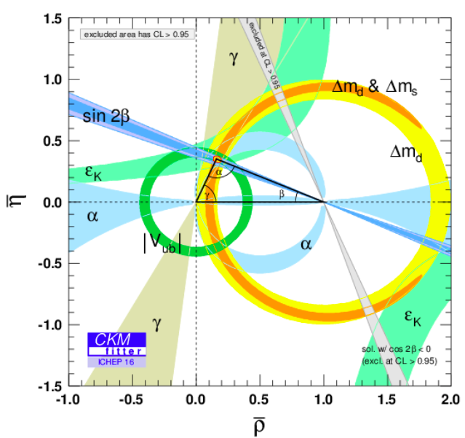
Standard Model @ 50: Successes
d s b
Strong interactions
Running α_{s}(Q)
Flavor mixing of quarks

Slide 27
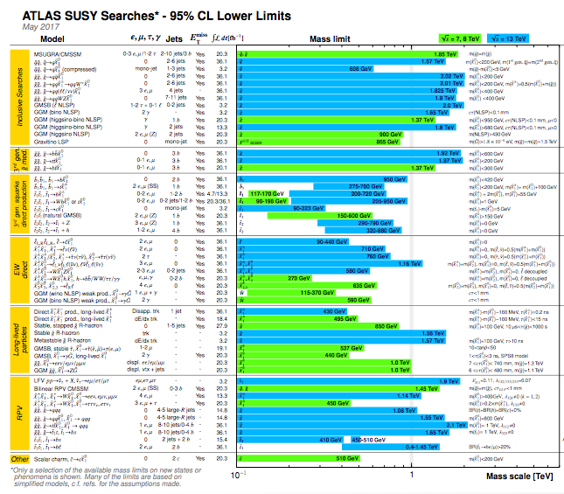
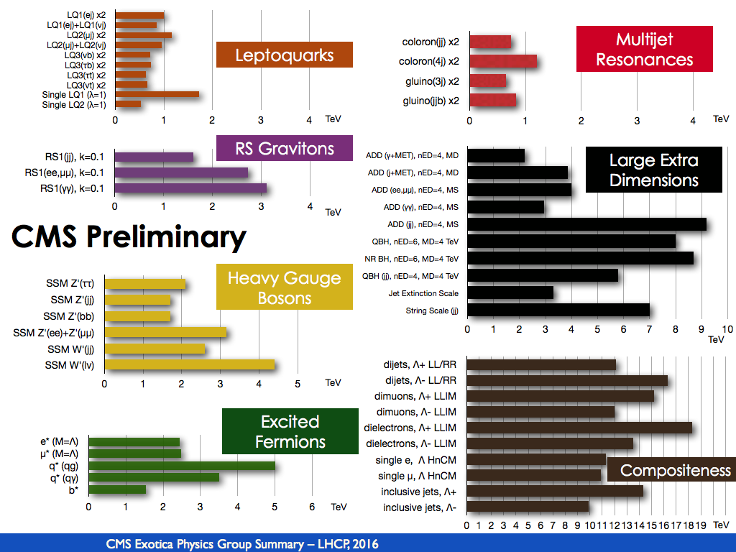
Standard Model @ 50: Successes
Direct searches at LHC: No new physics found anywhere looked
Simplified signatures covered to high masses, but unexplored models at low mass

Slide 28
Standard Model @ 50: Successes
Completion of the Standard Model
Passing every experimental test
How about non-zero neutrino masses (via oscillations)?
In a sense it is beyond the SM, but
Weinberg says that treating the SM as an effective field theory,
it could be beyond the leading terms (renormalizable/unsuppressed part) of SM.

Slide 29
The Standard Model – Epilog
Mass
6 quarks
3 families
Forces
Anti-matter
Neutrinos
…
WHY ?

Slide 30
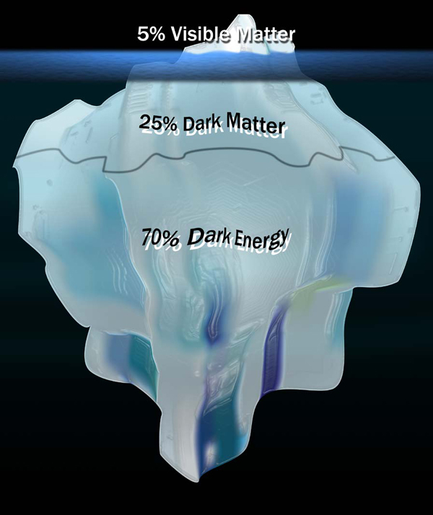
The Standard Model – Epilog
Visible Universe
Invisible Universe
(Dark Universe)
?

Slide 31
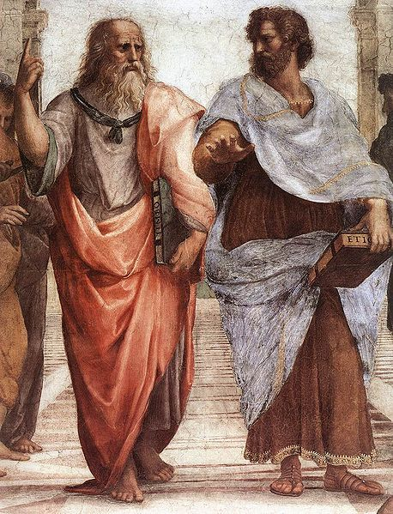
The Standard Model – Epilog
“The more you know, the more you know you don't know.”
Aristotle (Greek philosopher and scientist, 384 – 322 BC)
Continue to search for a more complete and elegant theory

Slide 32
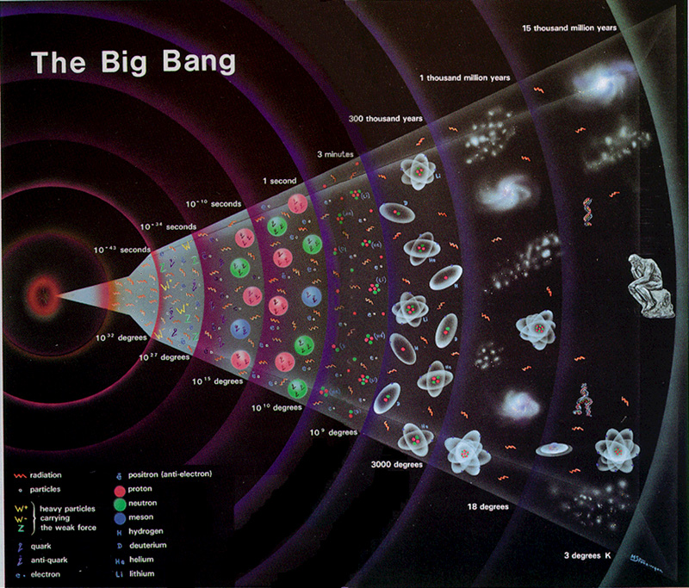

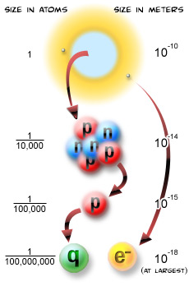
History of the Universe
Searching for an elegant and complete theory
peeling backward in time
peeling inward

Slide 33
History of the Universe
Searching for an elegant and complete theory
peeling backward in time
peeling inward

Slide 34
History of the Universe
Searching for an elegant and complete theory
peeling backward in time
peeling inward
Elegant Theory

Slide 35
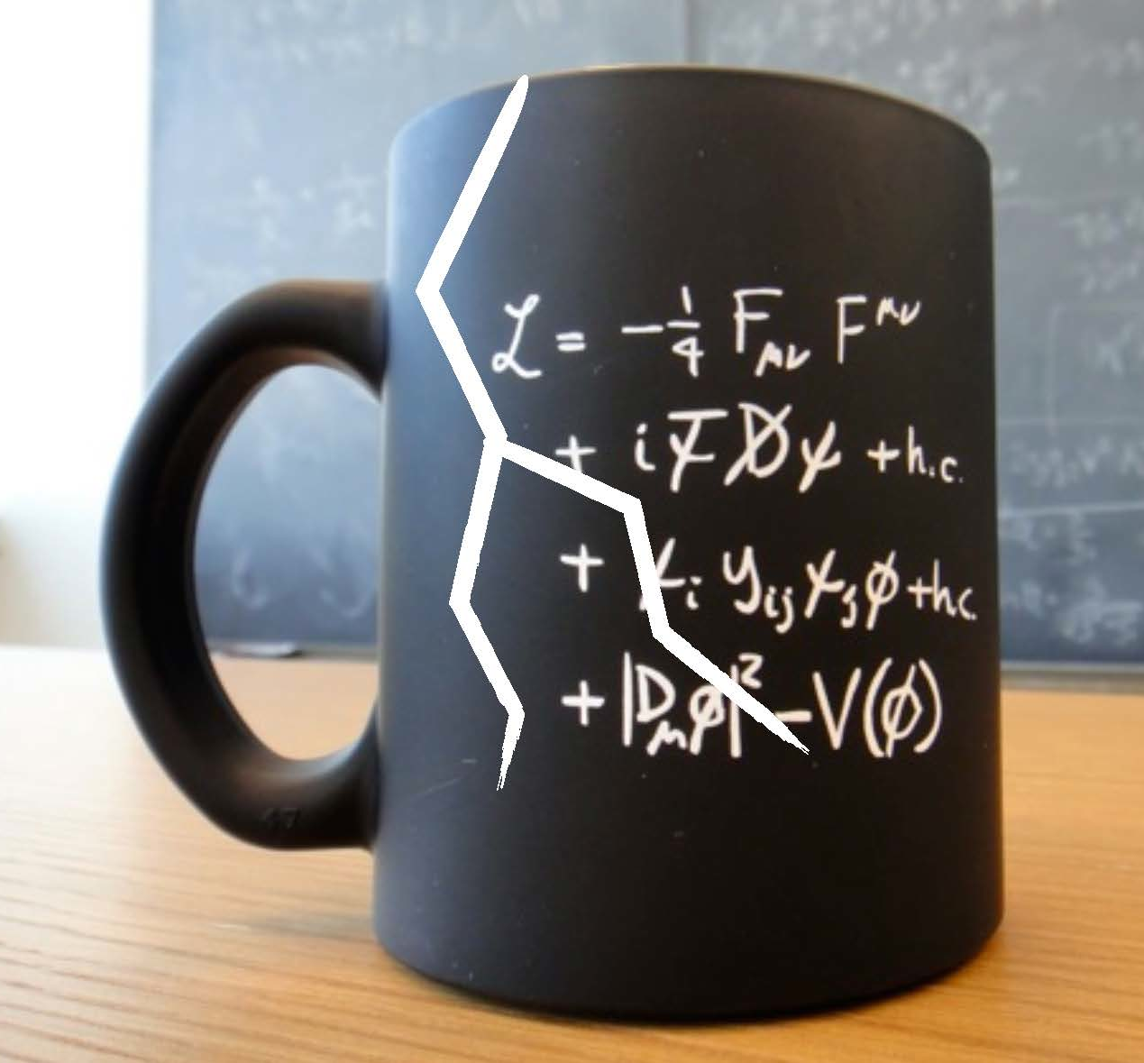
Find cracks in the Standard Model
Intense scrutiny → Identify discrepancies
Precision Electroweak and QCD
Higgs coupling to bosons and fermions
Flavor CKM matrix and CP violation
Higgs self interaction / Higgs potential
+ New
Wide open eye: new phenomena and new areas
Look EVERYWHERE!!
Challenges and Opportunities

Slide 36
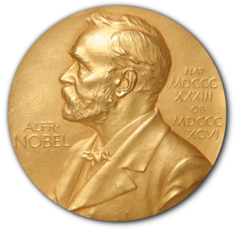
Science Drivers
U.S. Strategic Plan (Snowmass + P5, June 2014)
2013
2002
2015
2011
2008
2004

Slide 37
Higgs
from the discovery of a Higgs-like particle
to measurements and a new tool for discovery

Slide 38
Higgs as a tool for discovery
Questions
  What is the origin of the Higgs potential?
  What is the nature of Higgs interactions?
  Where does it come from?
Measurements
  Higgs couplings to EWK gauge bosons
  Higgs couplings to fermions
  Higgs self couplings (Higgs potential)

Slide 39
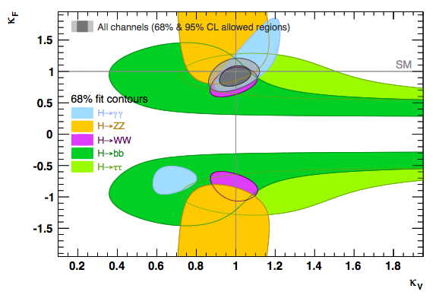
Higgs couplings to gauge bosons and fermions
κ_{F}
ATLAS/CMS
arXiv: 1803.01853
Sensitivity to new physics demands
smaller uncertainties
κ_{V}
arXiv:1310.836
New physics model | κ_{V} | κ_{b} | κ_{γ}
Singlet Mixing | ~ +6% | ~ +6% | ~ +6%
2HDM | ~ +1% | ~ +10% | ~ +1%
Decoupling MSSM | ~ -0.0013% | ~ +1.6% | ~ -0.4%
Composite | ~ -3% | ~ -(3 – 9)% | ~ -9%
Top Partner | ~ -2% | ~ -2% | ~ +1%

Slide 40
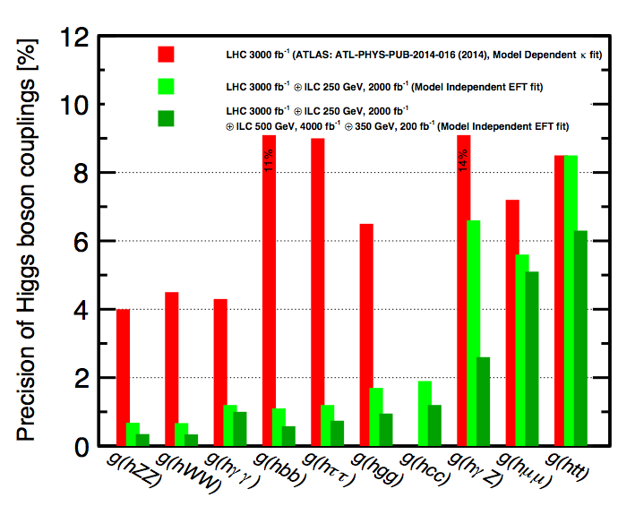
Precision Higgs couplings
LHC (2009 – 2023)→ HL LHC (2026 – 2038)
Future e⁺e⁻ collider options: Linear (ILC, CLIC), Circular (CEPC, FCC-ee)
HL LHC
HL LHC + ILC

Slide 41
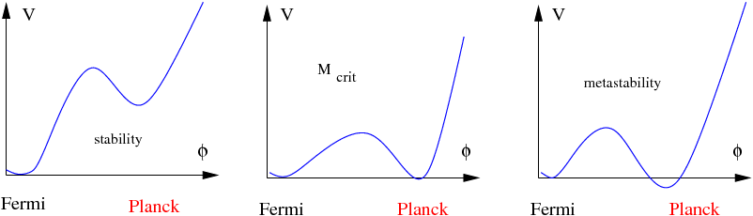
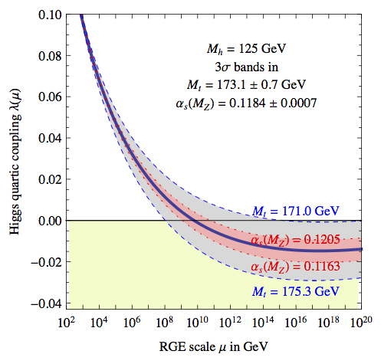
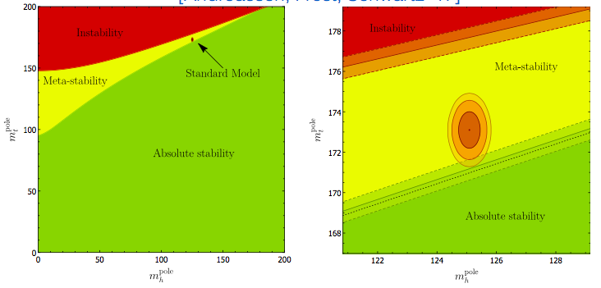
Fate of the vacuum
Roles of top and Higgs masses
on the Higgs potential
our vacuum
our vacuum
meta-stability
stability
0 Higgs field
0 Higgs field
0 at M_{planck} if m_{top} = 171 GeV
Needs Δm_{top} < ~250 MeV
m_{top}
m_{top}
…
…
m_{Higgs}
m_{Higgs}
…
…

Slide 42
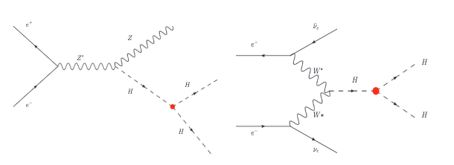
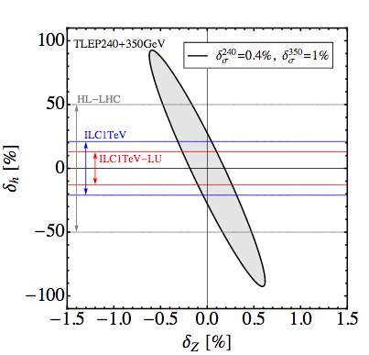
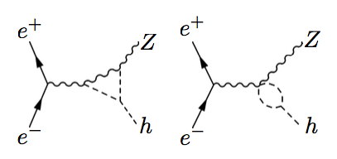
Higgs self-coupling
HL LHC → Future e⁺e⁻ collider (ILC upgrade, CLIC, FCC-ee)
Direct probe
e⁺
e⁻
arXiv:1312.3322
e⁺
e⁻
h
h
h
h
h
h
h
h
h
Indirect probe via radiative corrections

Slide 43
Neutrinos

Slide 44
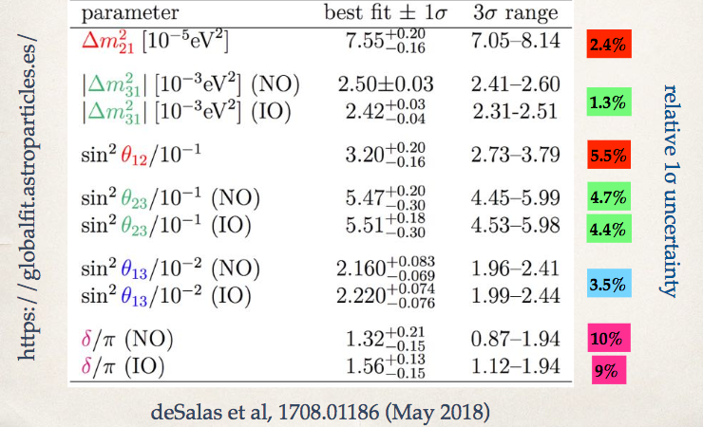
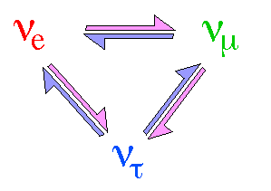
Neutrinos
Propelled by surprising discoveries from a series of pioneering experiments,
neutrino physics has progressed dramatically over the past two decades.
Precision measurements !!

Slide 45
Neutrinos are everywhere!
Many neutrinos over many different energies!
Oscillations over broad range of distances and energies..
Tell us about neutrinos and about the universe…

Slide 46
Neutrinos are related to everything.
Supersymmetry
LHC
Astrophysics
Cosmic rays,
Supernovae,
BBN,
….
Cosmology
Dark matter,
Baryon asymmetry,
….
Neutrinos
Flavor physics
Quark mixing
….
GUT
SO(10),
See-saw,
Proton decay,
….

Slide 47
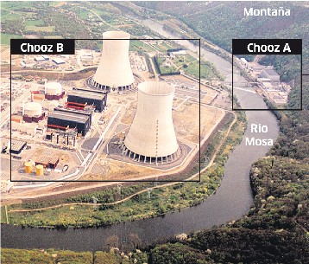
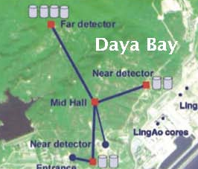
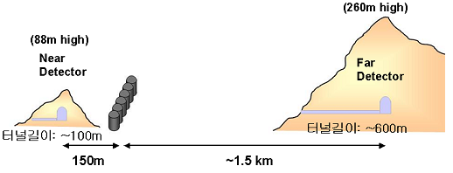
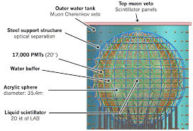
Reactor-based neutrinos
Double Chooz
RENO
Daya Bay
Double Chooz in France Daya Bay in China RENO in South Korea
Next gen. JUNO
Data taking 2021

Slide 48
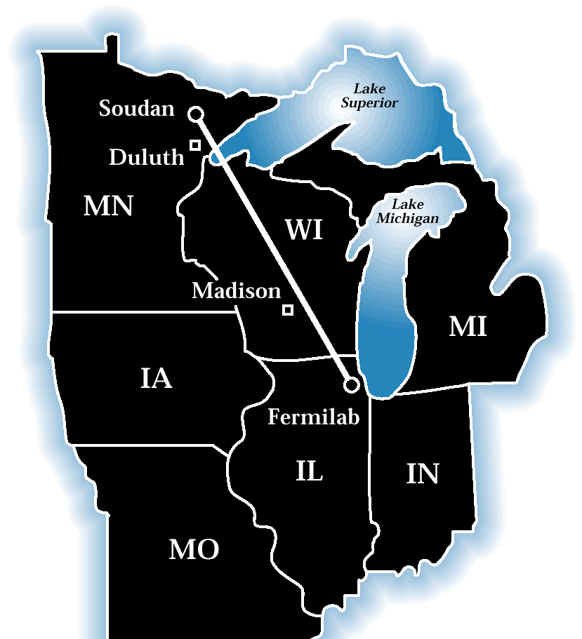


Accelerator-based neutrinos
Fermilab
CERN
KEK
Long baseline
Fermilab → NOvA (810km) CERN → OPERA (732km) J-PARC → T2K (295km)
MINOS (735km)
Short baseline
MiniBooNE, MicroBooNE, … (< ~1 km)
Fermilab
CERN

Slide 49

Many aspects of neutrino physics are puzzling
What are the origin of neutrino mass?
What are the masses?
Are ν’s their own antiparticles?
How are the masses ordered (hierarchy)?
Do ν and anti-ν oscillate differently? (CP)
Are there additional ν types or interactions?
cosmology
2νββ
0νββ
Long baseline ν
Short baseline ν

Slide 50

Many aspects of neutrino physics are puzzling
What are the origin of neutrino mass?
What are the masses?
Are ν’s their own antiparticles?
How are the masses ordered (hierarchy)?
Do ν and anti-ν oscillate differently? (CP)
Are there additional ν types or interactions?
cosmology
2νββ
0νββ
Long baseline ν
Short baseline ν
Normal
hierarchy
Inverted
hierarchy
quarks neutrinos
d s b
1 2 3

Slide 51




Neutrino Mass
2006: Transport of spectrometer to Karlsruhe
KATRINA
May 18, 2018: First tritium injection
Goal: m_{β} < 0.2 eV (90% CL)

Slide 52



Are ν’s are their own particles? (Majorana vs Dirac)
Impressive progress due to dedication, ingenuity, and diversity of the field
Nuclear physics
insight required
0νββ
0νββ
Detector technologies !!
Future experiments
<m_{ββ}> (eV)
Require novel ideas
KATRIA / Cosmology

Slide 53




Additional neutrinos or interactions?
Reactor antineutrino anomaly
ν and anti-ν data from MiniBooNE
now consistent with LSND anomaly
Reactor
fluxes
Δm₄₁² (eV²)
LSND
Sin²2θ_{μe} = 4|U_{e4}U_{μ4}|²

Slide 54


Mass hierarchy and CP violation
Normal
Hierachy
Inverted
Hierachy
Normal Hierachy
Normal Hierachy
Prefer Normal Hierachy
First hint of CP in the lepton sector

Slide 55


Mass hierarchy and CP violation (next 2-3 decades)
DUNE Experiment
Currently under construction
Data taking next decade

Slide 56


Mass hierarchy and CP violation (next 2-3 decades)
Detector in Kamioka: decision by ~end 2018
Hyper K
(Proposed)
2nd detector in Korea

Slide 57
Dark Matter

Slide 58

Dark Matter: Experimental Approaches
(collider)
Collider
(underground)
(space)
Complementary to each other

Slide 59


Dark Matter: Indirect Detection
(Blue: Future experiments)

Slide 60

Dark Matter: Direct Detection
Moore’s Law in WIMP dark matter search
Last 20 years: detector sensitivities improved ~5 orders of magnitude

Slide 61

Dark Matter: Direct Detection
Particle Data Group (2018)
Collider
LHC
Direct
Direct

Slide 62

Many other candidates (opportunities)!
WIMP

Slide 63
Dark Energy and Inflation

Slide 64

Two periods during which the expansion of the Universe accelerated
2nd (Dark Energy)
began recently, continues today
1st (Inflation)
primordial epoch of acceleration

Slide 65






Probing Dark Energy and Inflation
DES (now)
LSST
Euclid
Today

Slide 66
Explore the unknowns:
new particles, interactions, physical principles

Slide 67


m_{LSP}
[GeV]
LHC:
:
8 TeV
20 fb⁻¹
1000
Direct squark
ATLAS-CONF-2013-037
Example of “difficult” SUSY channels!
Assume ATLAS and CMS detector performance remains the same
Direct slepton
ATLAS-CONF-2013-049
Direct
CMS-PAS-SUS-13-006
500
BR=100%
all limits are
observed nominal
95% CLs limits
RP conserved
250
LHC
(2009 – 2012)
m_{SUSY}
[GeV]
0
0
1250
1500
250
500
750
1000

Slide 68
m_{LSP}
[GeV]
LHC:
:
LHC:
20 fb⁻¹
300 fb⁻¹
8 TeV
14 TeV
1000
Direct squark
ATLAS-CONF-2013-037
Direct slepton
ATLAS-CONF-2013-049
Direct
CMS-PAS-SUS-13-006
500
LHC
(2015 – 2023)
BR=100%
all limits are
observed nominal
95% CLs limits
RP conserved
250
LHC
(2009 – 2012)
m_{SUSY}
[GeV]
0
0
1250
1500
250
500
750
1000

Slide 69
m_{LSP}
[GeV]
LHC:
:
LHC:
HL-LHC:
8 TeV
14 TeV
14 TeV
20 fb⁻¹
300 fb⁻¹
3000 fb⁻¹
1000
Direct squark
ATLAS-CONF-2013-037
Direct slepton
ATLAS-CONF-2013-049
LH-LHC
(2026 – 2038)
Direct
CMS-PAS-SUS-13-006
500
LHC
(2015 – 2023)
BR=100%
all limits are
observed nominal
95% CLs limits
RP conserved
250
LHC
(2009 – 2012)
m_{SUSY}
[GeV]
0
0
1250
1500
250
500
750
1000

Slide 70






Flavor Anomalies
Tree Level
Penguins
Need more data from LHCb at LHC/HL LHC & Belle II at SuperKEKB

Slide 71

SuperKEKB and Belle II
Luminosity: 2 x 10³⁴ cm⁻²s⁻¹ (KEKB) → 8 x 10³⁵ cm⁻²s⁻¹ (SuperKEKB)

Slide 72

Daruma Doll
Japanese wishing dolls
  The process of using a Daruma doll
    Have a goal, wish, or promise to fulfill.
    Paint in one eye.
    Work for it everyday.
    When the dream is achieved, paint in the other eye.

Slide 73


Celebrating the first SuperKEKB collisions
June 26, 2018
Makoto Kobayashi
2008 Nobel Prize in Physics
(for broken symmetry)
Masanori Yamauchi
Director of KEK
Daruma doll
Start of the SuperKEKB construction
End of the SuperKEKB construction

Slide 74


Physics Reach of SuperKEKB/Belle II and HL LHC/LHCb

Slide 75



Charged Leptons
Charged lepton flavor violation searches
Muon magnetic moment anomaly
10⁻¹⁸

Slide 76


Rare Kaon Decays
NA62
(2017 – )
KOTO

Slide 77

Various facilities prepared
Planned and Executing
Rich and Diverse Program
in the next couple of decades
Check “EVERYWHERE” (new areas / new theories)
Physics sensitivities driven by technologies (novel ideas)
/ DUNE
In addition, ν: JUNO, Hyper K; Super B factory: SuperKEKB / Belle II; Kaon: NA62 and KOTO; Muon: MEG II, Mu3e, COMET

Slide 78


What should be the next energy frontier collider?
Fermilab
CERN
Tevatron (1985-2011)
pp: 2 TeV
_
LHC (2009-2038)
pp: 7,8 TeV → 14 TeV
(decision)
Future collider

Slide 79



What should be the next energy frontier collider?
China
Global projects
~100 km circular collider
e⁺e⁻ CEPC (250 GeV Higgs factory) → pp SppC (~100 TeV)
Japan
27 km LHC
Europe
30 – 50 km
International linear collider (ILC)
250 GeV Higgs factory → higher energy
~100 km FCC-pp (~100 TeV)
FCC-ee, FCC-ep
50 km CLIC (ee)

Slide 80


What should be the next energy frontier collider?
The world may not be able to afford to build multiple “global” projects at once: limited by human and financial resources
the world community’s effort
Science strategy
Technology development
Technically limited timeline
YKK’s personal view

Slide 81


What if?
1 TeV e+e- accelerator ~50 km
1 TeV e+e- accelerator ~1 km

Slide 82



What if?
Superconducting RF refrigeration systems, for one cavity.
2K (Today) Cost: ~$1M
4.2K Cost: $50k
CBB
4.2K operation will make Superconducting RF vastly more accessible, enabling widespread use of high power beams in science and industry.

Slide 83



Breakthrough technologies
Tevatron at Fermilab
Fermi’s Globatron
40,000 km in 1954
1 TeV accelerator
with then technologies
6 km in 1985
Achieved!

Slide 84


Breakthrough technologies
Detectors
Accelerators
Moore’s law
Moore’s law
Today
Increasing sensitivity

Slide 85



Breakthrough technologies
Challenges and Opportunities
# of particle physics Ph.D. students >> # of accelerator Ph.D. students
Personal note
Accelerator group at U.Chicago

Slide 86






Breakthroughs
Theory, Accelerators, Instrumentation, Computing
Standard Model @ 50: Successes
Standard Model @ 50: Challenges
Next 50 years’ Opportunities
Accelerators (1930s)
Today’s accelerators
(2010s)
Tomorrow’s accelerators
(2060s)
1930
Identified by Google
Ernest Lawrence
(1901-1958)

Slide 87

New particle physics through astrophysical observations
Remember observing the cosmos has provided strong evidence for physics not contained in the SM
  non-zero neutrino masses
  dark matter
  dark energy
  primordial inflation – likely tied to the unification of 4 forces near the Planck scale.
The necessary, and yet puzzling, connections between the inner space of quantum reality and outer space of cosmic reality may enable the discovery of new particle physics through astrophysical observations.

Slide 88




Accomplishment
of the 19th Century
Periodic Table of Elements
Accomplishment
of the 20th Century
The Standard Model
Accomplishment
of the 21th Century
XXX
Daruma doll
Daruma doll

