Slide 1
Difficulties of positron acceleration known from theory
Konstantin Lotov
This is a brief reminder of known facts that were earlier clarified and published

Slide 2



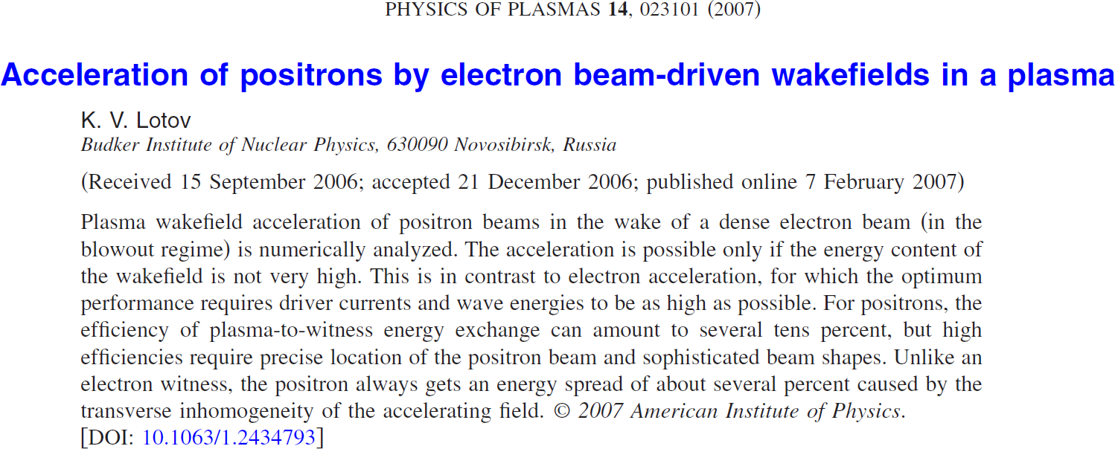
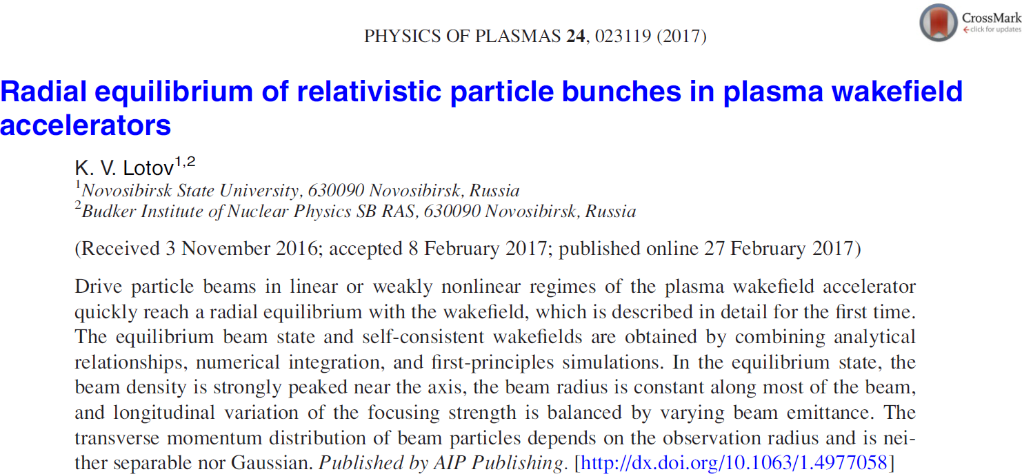
slide 2 of 14
K.Lotov, ALEGRO Positron Acceleration in Plasma
Mini-Workshop, CERN, 9.02.2018
My report is based on two papers:

Slide 3
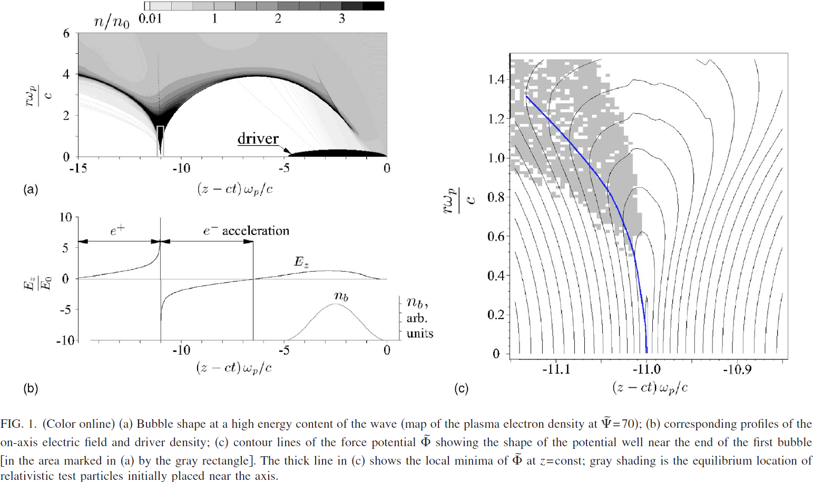
slide 3 of 14
K.Lotov, ALEGRO Positron Acceleration in Plasma
Mini-Workshop, CERN, 9.02.2018
Problem 1: Narrow area of acceleration + focusing
(Not a problem for linear wakes, but those have lower fields and lower efficiencies)

Slide 4
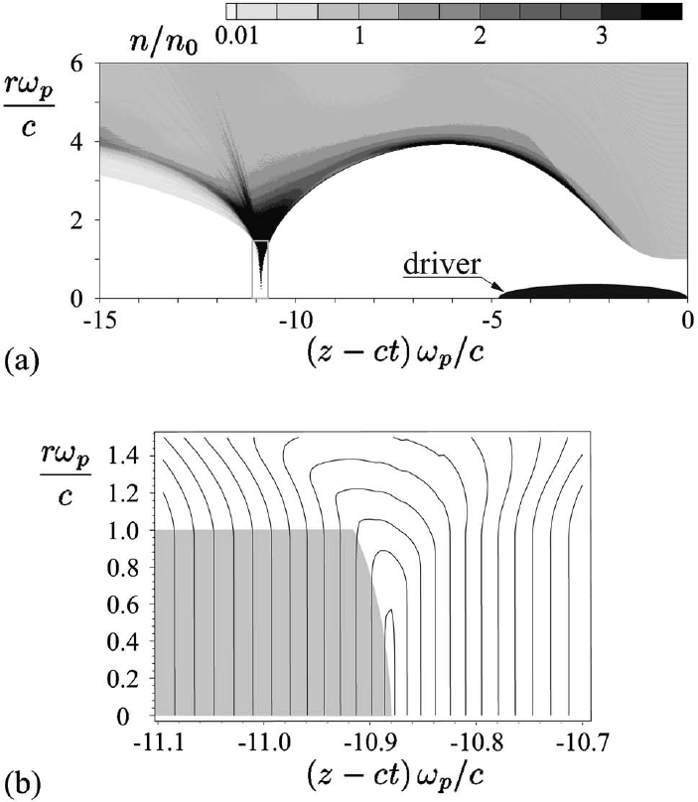
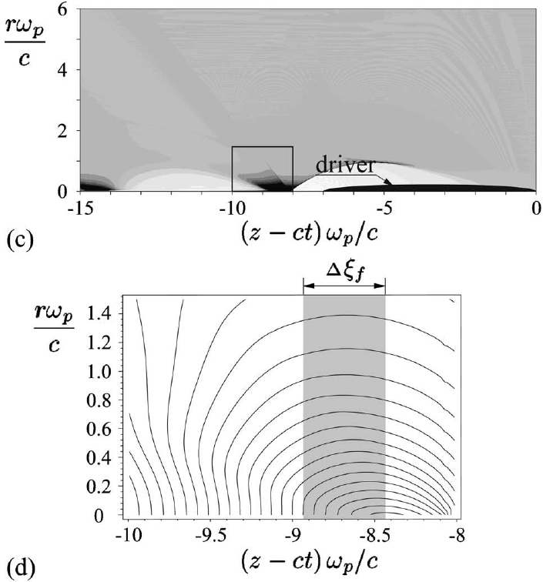
slide 4 of 14
K.Lotov, ALEGRO Positron Acceleration in Plasma
Mini-Workshop, CERN, 9.02.2018
Possible solutions to Problem 1
Hollow channel (no ions inside that defocus e+)
Narrow bubble (quasi-nonlinear regime)

Slide 5
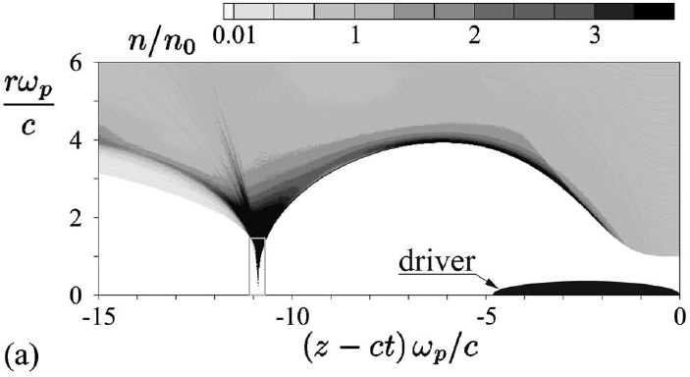
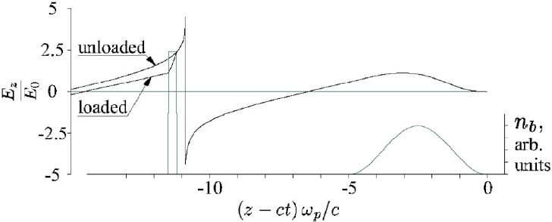
slide 5 of 14
K.Lotov, ALEGRO Positron Acceleration in Plasma
Mini-Workshop, CERN, 9.02.2018
Problem 2: Unfavorable slope of E_{z}(z-ct)
Even if defocusing problem is solved with a hollow channel,
the beam loading increases the energy spread

Slide 6
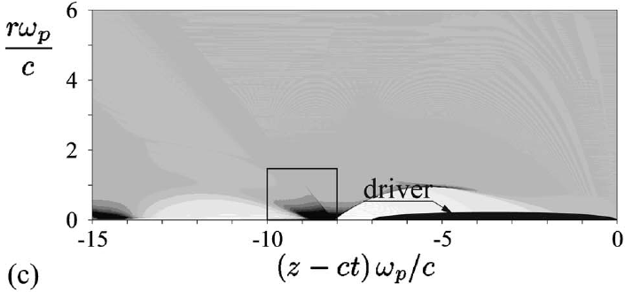
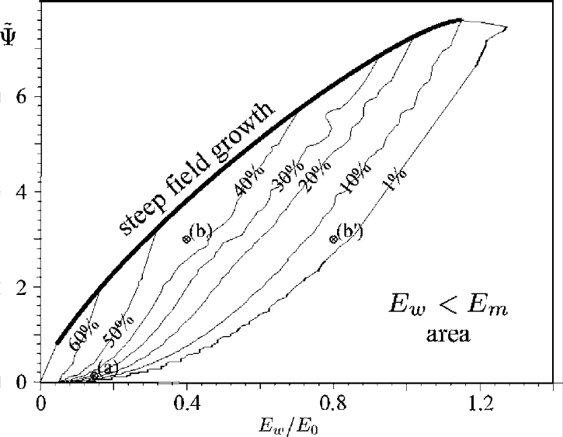
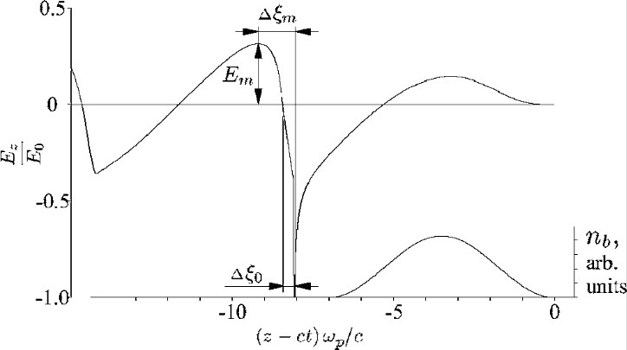
slide 6 of 14
K.Lotov, ALEGRO Positron Acceleration in Plasma
Mini-Workshop, CERN, 9.02.2018
Problem 3: Efficiency needs fantastic precision
In the case of quasi-nonlinear regime, the efficiency is low (too much energy left in the plasma).
High efficiency needs very precise positioning of the witness bunch and a complicated witness shape.
How to preserve this match along the whole interaction distance is an open question.
witness-to-wave positioning 0.01c/w_{p}
p-w efficiency
energy content of the plasma wave
see the next slide
accelerating field (for a matched witness shape)

Slide 7
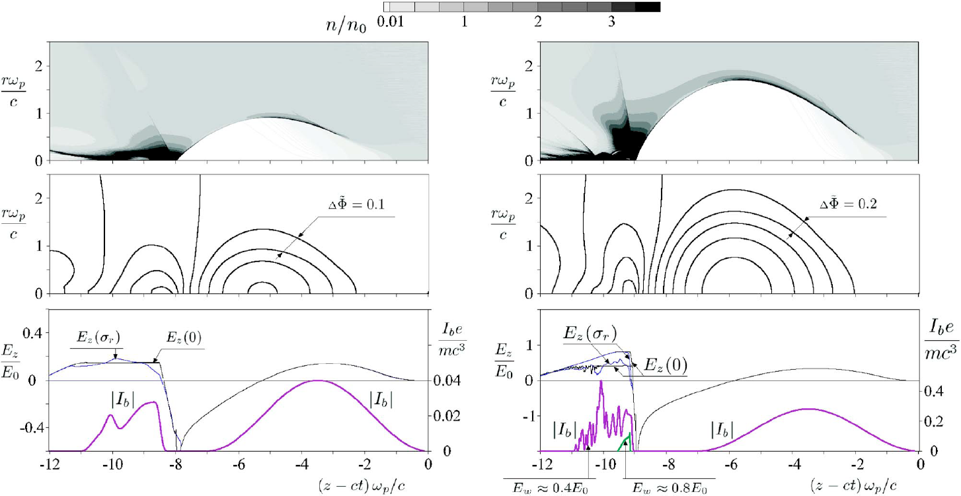
slide 7 of 14
K.Lotov, ALEGRO Positron Acceleration in Plasma
Mini-Workshop, CERN, 9.02.2018
Problem 3: Efficiency needs fantastic precision
The witness shape that provides a constant accelerating field on the axis is rather exotic.

Slide 8
slide 8 of 14
K.Lotov, ALEGRO Positron Acceleration in Plasma
Mini-Workshop, CERN, 9.02.2018
Problem 4: Accelerating field is not constant across the witness

Slide 9
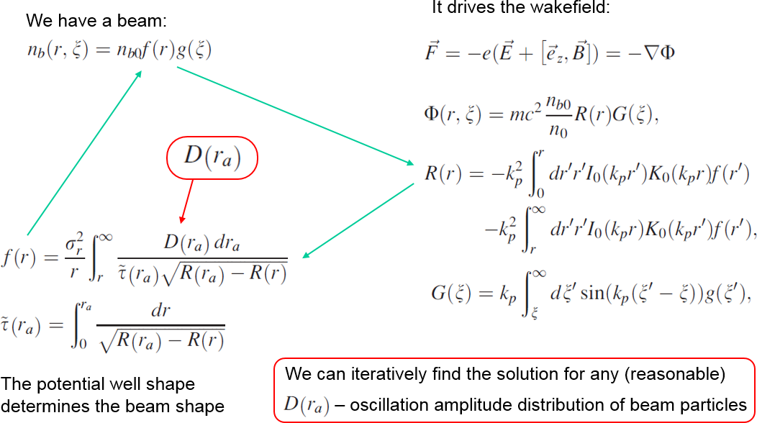
slide 9 of 14
K.Lotov, ALEGRO Positron Acceleration in Plasma
Mini-Workshop, CERN, 9.02.2018
Problem 4: Accelerating field is not constant across the witness
The problem is of a fundamental nature, as indicated (but not proven) by the theory of beam equilibria.
This theory is good for the radial equilibrium of drive bunches in a linearly responding plasma
Results for witnesses will probably be even worse (as follows from derivation)
Results will be quantitatively different,
but probably qualitatively the same
Here we discuss witness beams in nonlinear waves

Slide 10
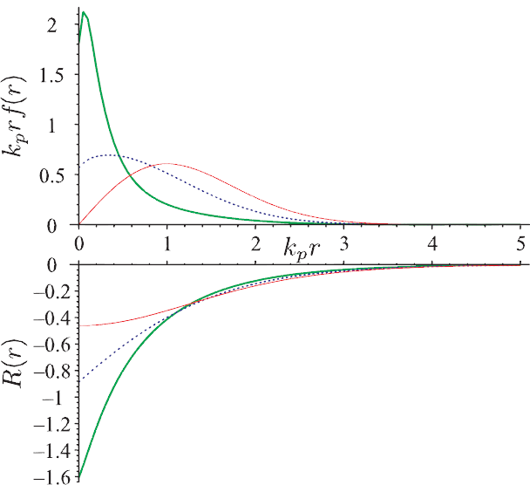
slide 10 of 14
K.Lotov, ALEGRO Positron Acceleration in Plasma
Mini-Workshop, CERN, 9.02.2018
For drive bunches there is a universal solution
(difference is in scales only)
Beam shape:
strongly peaked near the axis
singular behaviour (1/r)
  (the smaller the initial emittance, the higher on-axis density)
not Gaussian
equilibrium
equilibrium with initial amplitude distribution
initial Gaussian
initial Gaussian
Potential well:
funnel-shaped
  (not usual parabolic)
E_{r} = const up to the axis
  (no usual linear decrease)
  (may be important for ionization by the beam field)
several times deeper than for a Gaussian beam
equilibrium

Slide 11
slide 11 of 14
K.Lotov, ALEGRO Positron Acceleration in Plasma
Mini-Workshop, CERN, 9.02.2018
For drive bunches there is a universal solution
(difference is in scales only)
equilibrium
We may expect similar features (density peaking near the axis, deep potential well) for nonlinearly responding plasma as well.
equilibrium with initial amplitude distribution
initial Gaussian
initial Gaussian
Variation of the potential well depth on the beam radius scale
Unavoidable energy spread, E_{z} ∝ R(r)
equilibrium

Slide 12
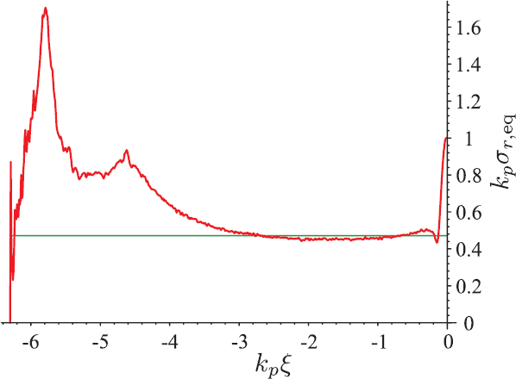
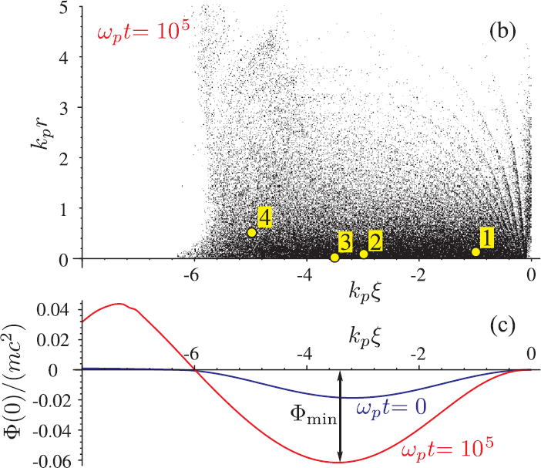
slide 12 of 14
K.Lotov, ALEGRO Positron Acceleration in Plasma
Mini-Workshop, CERN, 9.02.2018
Why the theory is good for drivers only?
We learned this from simulations: excellent agreement only for the leading half of the bunch
What is wrong with the trailing (accelerated) part?
It approaches to equilibrium in a different way.
Times: well deepening VS particle oscillation
(the deeper the well, the faster the oscillations;
time of well change is that of preceding particles)
beam rms radius
simulations
theory
(½ of initial value)
bunch propagation
fast well change
slow oscillations
slow well change
fast oscillations
beam emittance
(60% of rough estimate)

Slide 13
slide 13 of 14
K.Lotov, ALEGRO Positron Acceleration in Plasma
Mini-Workshop, CERN, 9.02.2018
Why the theory is good for drivers only?
We learned this from simulations: excellent agreement only for the leading half of the bunch
What is wrong with the trailing (accelerated) part?
It approaches to equilibrium in a different way.
Times: well deepening VS particle oscillation
(the deeper the well, the faster the oscillations;
time of well change is that of preceding particles)
beam rms radius
simulations
theory
We may expect even worse case for witnesses:
emittance blow-up during equilibration,
wider equilibrium radius,
stronger field change across the bunch
(½ of initial value)
bunch propagation
fast well change
slow oscillations
slow well change
fast oscillations
beam emittance
(60% of rough estimate)

Slide 14
slide 14 of 14
K.Lotov, ALEGRO Positron Acceleration in Plasma
Mini-Workshop, CERN, 9.02.2018
Summary: all methods have problems
Linear wave: Low field amplitudes and efficiencies,
Large energy spread (narrow focusing does not reduce the spread)
Quasi-nonlinear wave: Low field amplitudes and efficiencies,
Large energy spread (narrow focusing does not reduce the spread)
Weird bunch shape
Blowout regime: Weird bunch shape, strict requirements for tolerances
Positron driver (nonlinear regime):
Large energy spread (narrow focusing does not reduce the spread)
(Maybe) weird bunch shape
Hollow channel with electron driver:
Large energy spread (wrong slope of Ez)
Stability issue
Channel production
Hollow channel with positive-charge driver:
Stability issue
Channel production

