Slide 1

Possible production and acceleration/focusing of secondary particles at AWAKE
A. Petrenko
ALEGRO Positron Acceleration in Plasma Mini-Workshop, Feb. 9, 2018, CERN
Hadronic shower:
e⁺
EM shower
e ‒
γ
Decays in 10⁻¹⁶ s
γ
400 GeV proton
π⁰
π⁺
e ‒
Compton e ‒
Neutrons,
Antineutrons,
Antiprotons, Kaons
π ‒

Slide 2
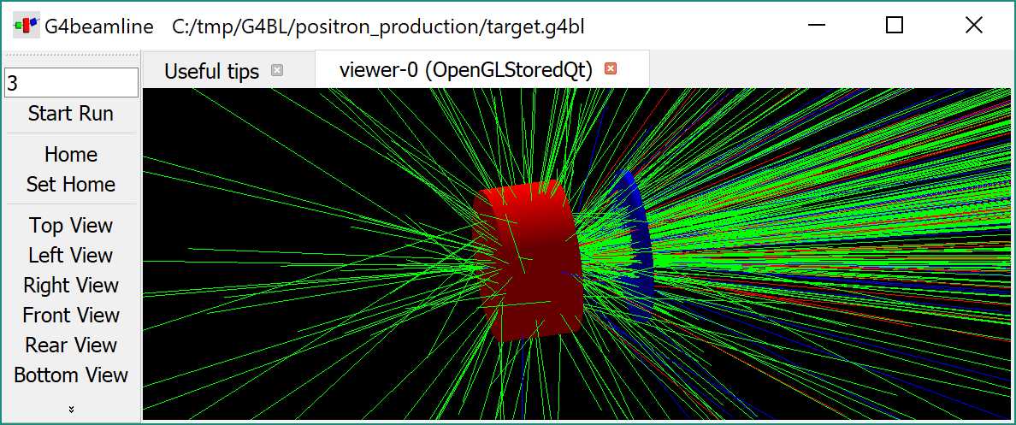
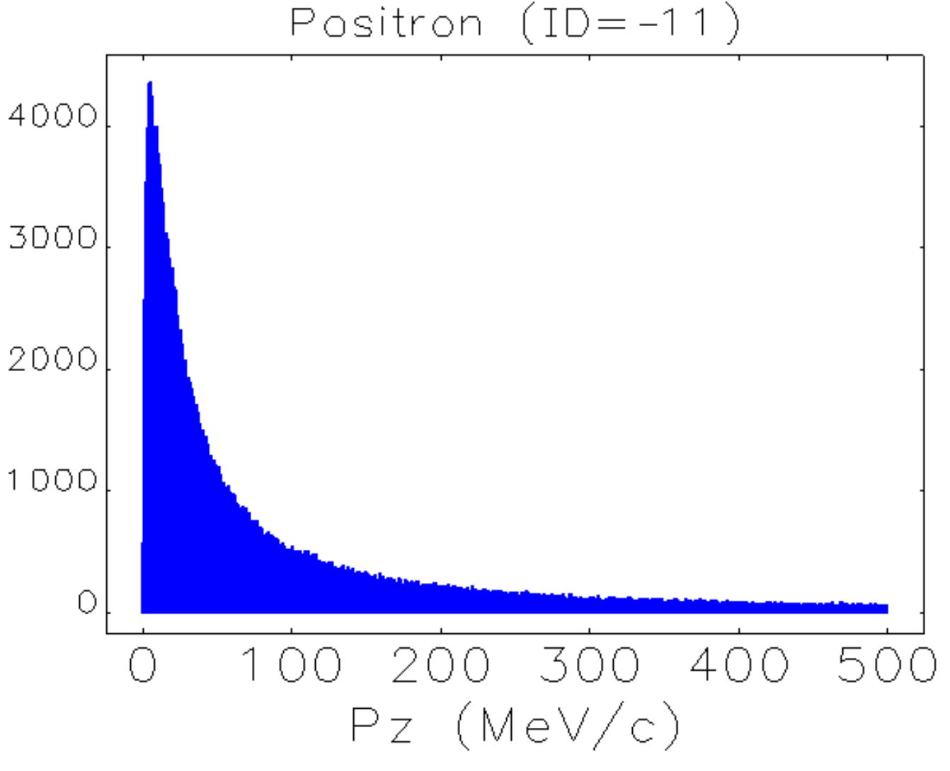
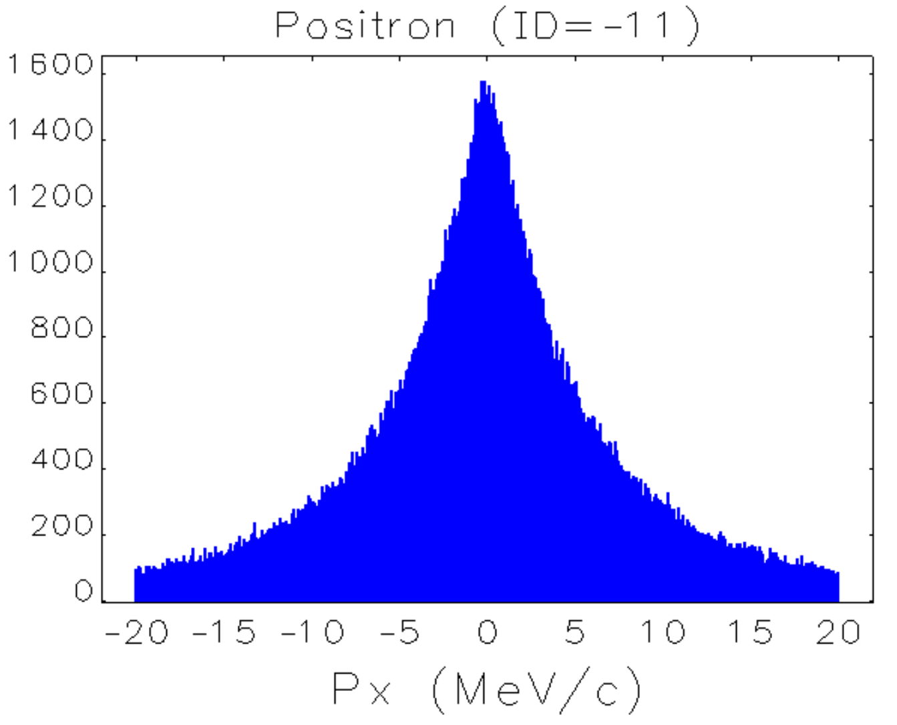
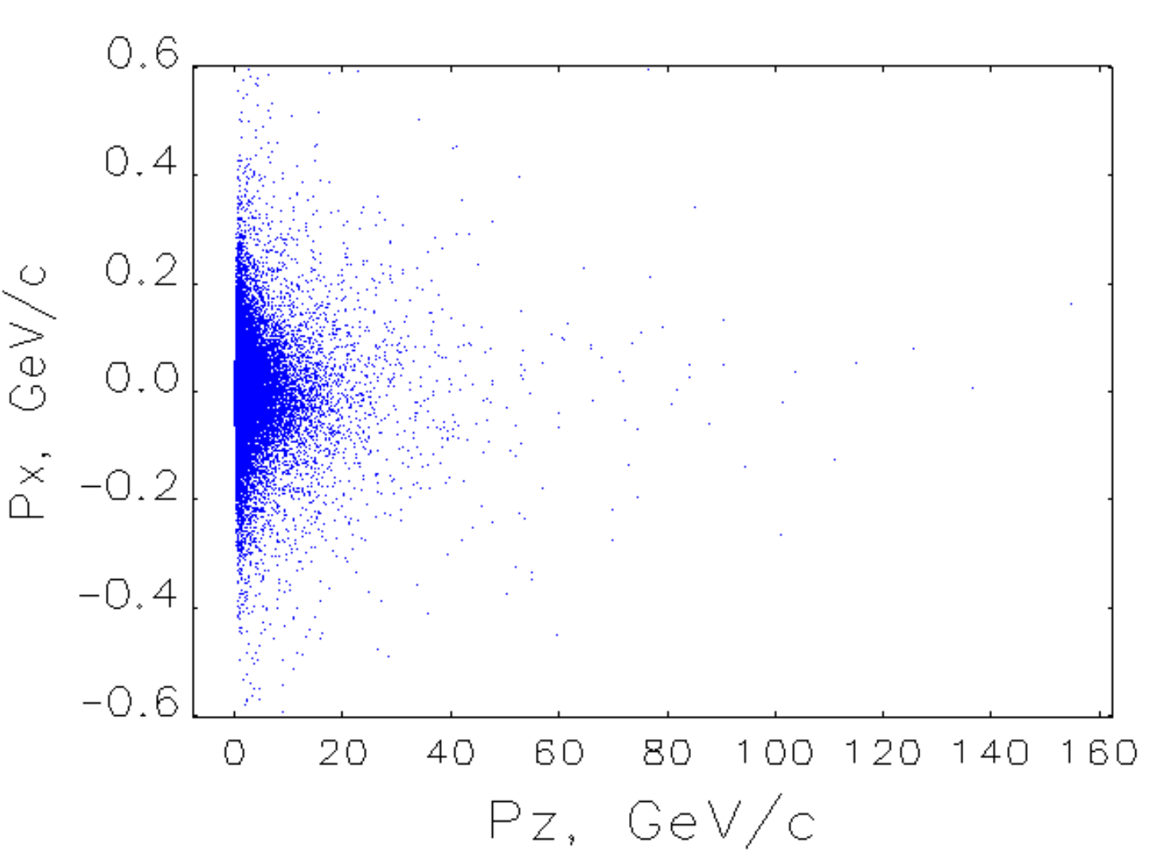
G4beamline simulation of 400 GeV p-beam hitting 1 cm long W target:
Mainly
gamma-photons
2

Slide 3
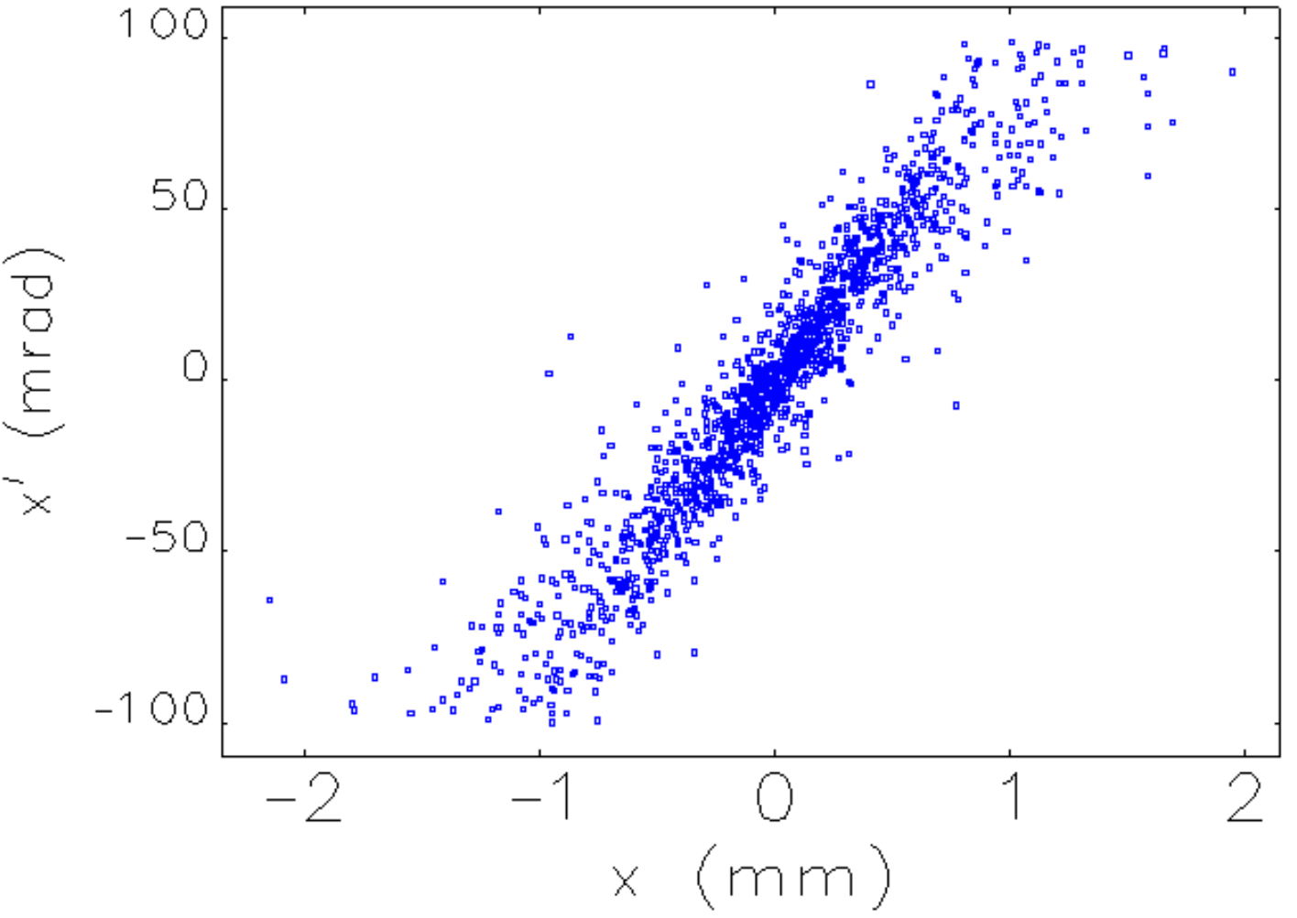
G4beamline simulation of 400 GeV p-beam hitting 1 cm long W target:
Mainly
gamma-photons
Typical energy acceptance of a damping ring = 5%
Typical x-x’ acceptance of a damping ring =
100 mm*mrad
100000 protons on target in this simulation
With 3e11 protons we can capture 4e9 200-210 MeV e+
3

Slide 4
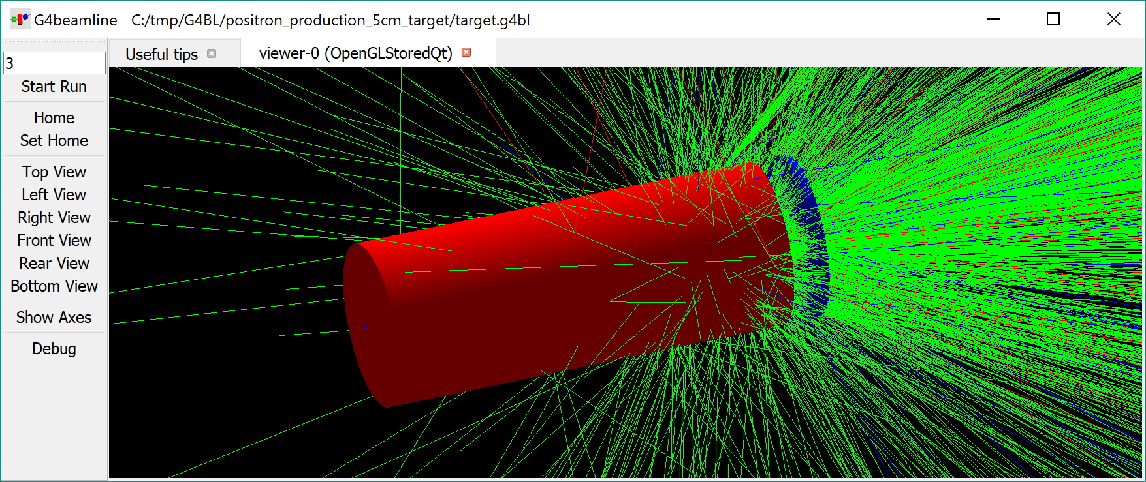
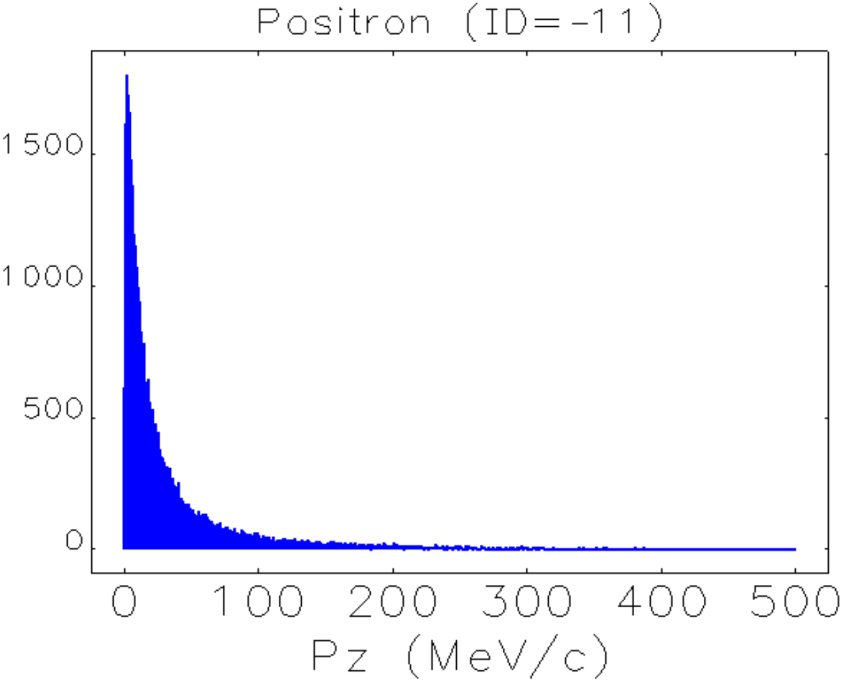
G4beamline simulation of 400 GeV p-beam hitting 5 cm long W target:
Mainly
gamma-photons
Typical energy acceptance of a damping ring = 5%
With 3e11 protons on 1 cm long W target a damping ring can capture 4e9 e+, while with 5 cm long target – 3e10 e+.
It’s not clear if a 1 cm target is any better from the RP point of view.
More low-energy e+ produced
Only 1000 protons on target in this simulation. Number of e+ at 200-210 MeV is actually higher.
4

Slide 5
Examples of small damping rings:
(from FACET-II proposal)
TDR: https://doi.org/10.2172/1340171
500 MeV Damping Ring in Novosibirsk:
Can be also used as a replacement for AWAKE Run-II injector.
5

Slide 6
Possible locations for the target and the DR in AWAKE:
Target (somewhere before DR)
6

Slide 7
Possible locations for the target and the DR in AWAKE:
Target
7

Slide 8
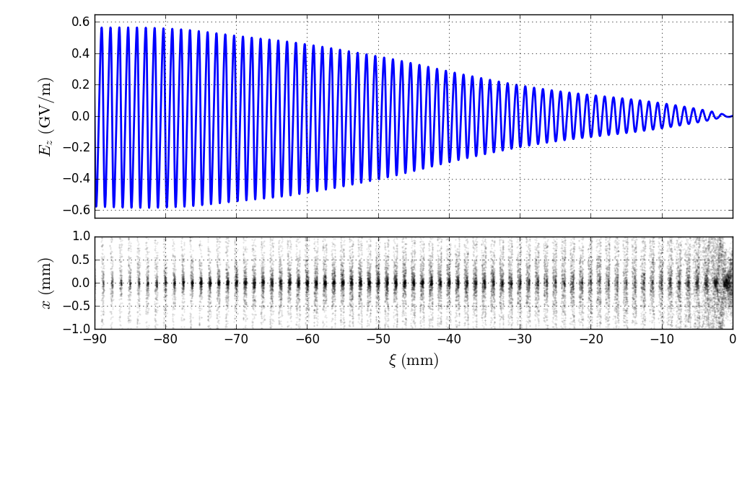
What if we place a narrow target right into plasma?
Needle or tape-like target
It might be possible to detect the effect of positrons staying focused by imaging the plasma exit with quadrupoles at spectrometer or Marlene’s BTV.
Any possible use for narrowly-focused secondaries?
Pions-muons?
Neutrinos?
Some positive-charge secondaries with high-enough gamma will be trapped inside the wakefield together with protons. They can stay focused for kilometers!
(this may happen naturally in dense enough plasma)
8

Slide 9
Conclusions
~1e9…1e10 e+/shot can be captured into a typical damping ring from 3e11 protons at 400 GeV hitting cm-long high-Z target.
Any interesting use for the capture of other ~100 MeV secondaries in such DR?
It might be interesting to consider production of secondaries right inside the plasma wakefield.
9

